Slide 1
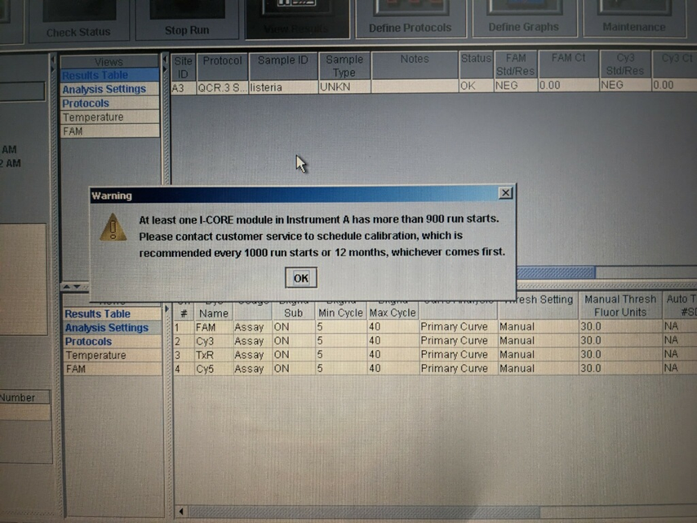
Vignette 7-
Calibration Alert for the
Cepheid SmartCycler Block
Whenever the Cepheid Block run count is more than 900 runs, this message will appear.

Slide 2
Vignette 7-
Calibration Alert for the
Cepheid SmartCycler Block
The Cepheid Software Maintenance Screen will report the “Run Stats” for each I-CORE Module.
If the modules are above 900 runs, contact AME Certified PCR Laboratories for Recalibration.

Slide 3
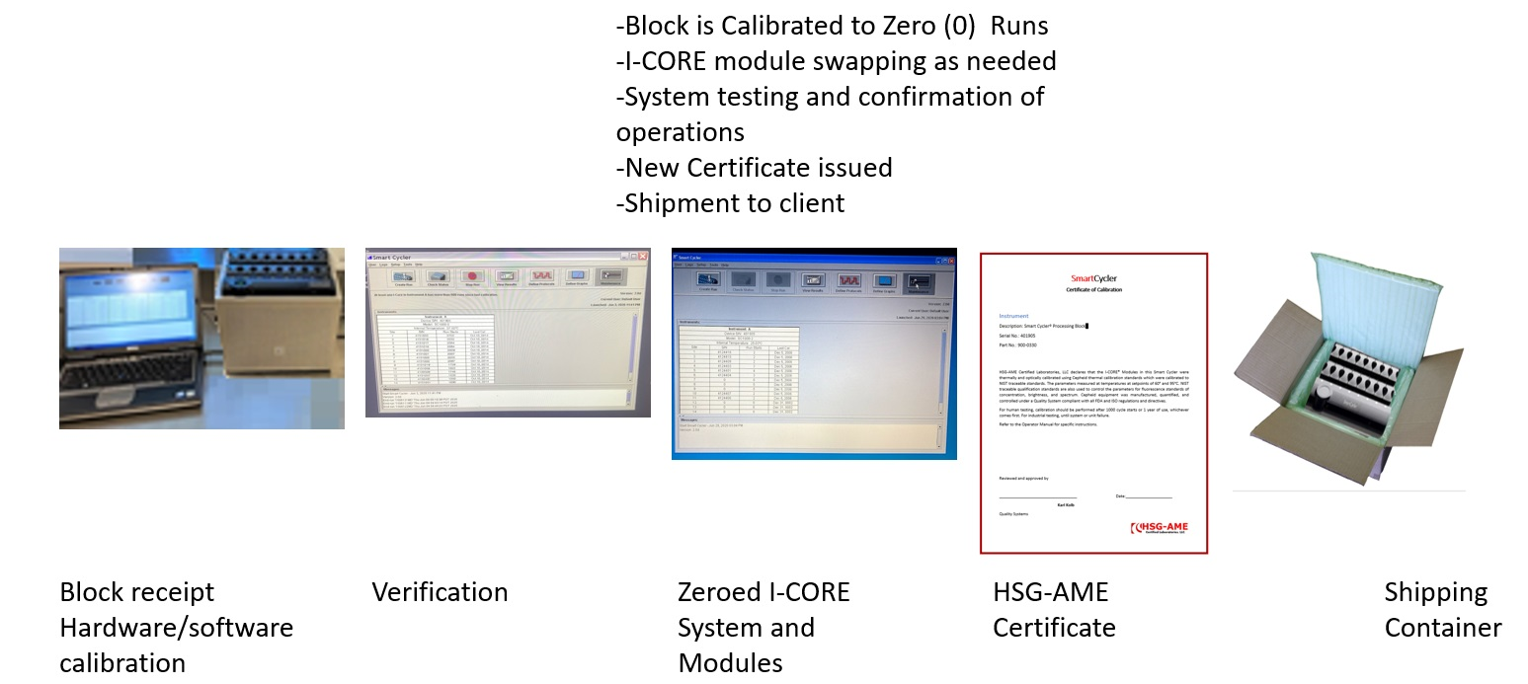
Vignette 7-
Calibration Alert for the
Cepheid SmartCycler Block
AME’s Wisconsin Supply Center will send out a replacement block.

Slide 4
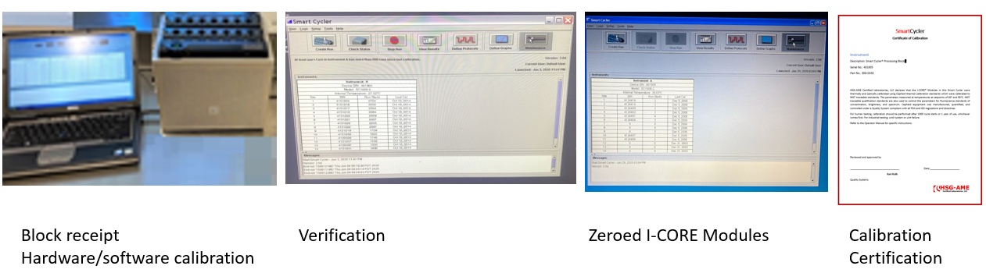
Vignette 7-
Calibration Alert for the
Cepheid SmartCycler Block
The replacement block will include a Calibration Certificate.

