Slide 1
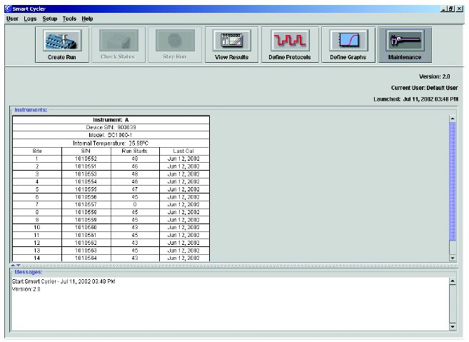
Vignette 9
Error Code Reset Steps
Whenever the Cepheid Maintenance Screen displays warning messages and error codes, follow these steps
Warning messages and error codes will display here

Slide 2
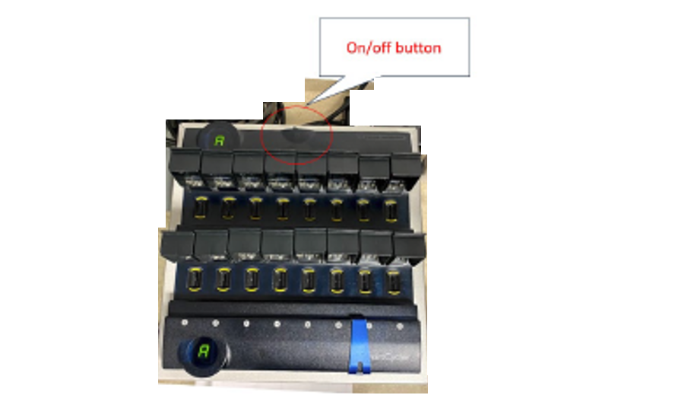
Vignette 9
Error Code Reset Steps
Turn off the SmartCycler Block(s)

Slide 3
Vignette 9
Error Code Reset Steps
Turn off the SmartCycler Block(s)

Slide 4
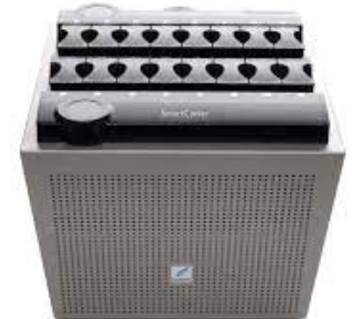
Vignette 9
Error Code Reset Steps
All electronic lights “off”
All electronic lights “off”
Wait for all the lights to turn off (5 minutes)

Slide 5
Vignette 9
Error Code Reset Steps
Restart the Computer software: Windows Restart

Slide 6
Vignette 9
Error Code Reset Steps
Turn “on” the Cepheid Block

Slide 7
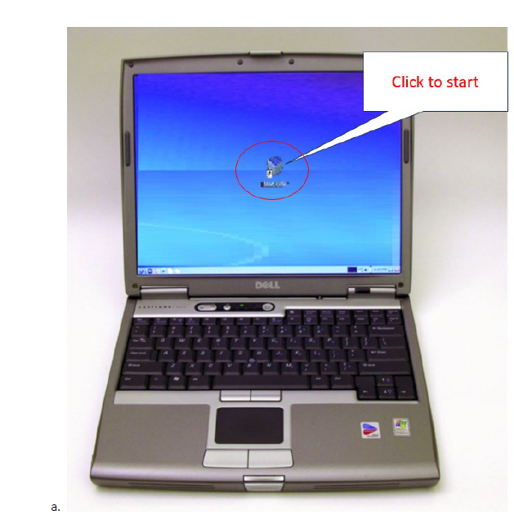
Vignette 9
Error Code Reset Steps
Double-Click the Cepheid Software Icon

Slide 8
Vignette 9
Error Code Reset Steps
The warning messages and error codes should be clear.
Double-Click the Cepheid Software Icon

