Slide 1
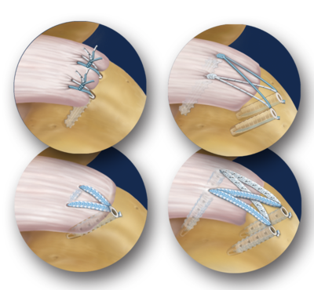
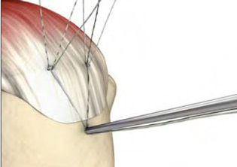
Arthroscopic Rotator Cuff Repair
Levy Shoulder to Hand Center
Jonathan Levy, MD
Casey Beleckas, MD
Paley Orthopedic and Spine Institute
Boca Raton, Florida USA
LEVYREHAB.COM

Slide 2
What we know…
Rotator cuff tears are common
Partial Tears vs. Full Thickness Tears
By age of 60 -- ~50% have at least a partial tear Milgrom, JSES 1999
By age 70 – ~30% have full thickness tears Tempelhof JSES 1999
Most tears (80%) are degenerative
Some are traumatic (20%)
Larger tears have greater loss of shoulder function
Notes:
Which do we want to keep for first bullet point

Slide 3
What we know…
Rotator cuff tears do not heal on their own
Rotator cuff tears get larger over time
Many patients with rotator cuff tears do not have pain
Many patients will eventually have pain
(Yamagucci, JSES 2001)

Slide 4
Non-operative Treatment
Vast Majority (60-91%) of degenerative tears will improve without surgery
Rotator cuff will not heal
Anti-inflammatory medications
Physical therapy
Poff et al (J Clin Med 2023), Zhu et al (J Rehab Med, 2022), Kukkonen et al (JBJS 2015), MOON Shoulder Group (JSES 2013), Traven et al (Arthroscopy 2019), Bartolozzi et al (CORR 1994), Hawkins & Dunlop (CORR 1995)

Slide 5
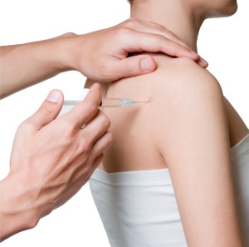
Injections
Cortisone
Increased risk of repair failure if performed within 6 months of surgery
May lead to tear progression
PRP (platelet rich plasma)
Improvement in pain and function for partial thickness rotator cuff tears
Poff et al (J Clin Med 2023), Zhu et al (J Rehab Med, 2022), Kukkonen et al (JBJS 2015), MOON Shoulder Group (JSES 2013), Traven et al (Arthroscopy 2019), Bartolozzi et al (CORR 1994), Hawkins & Dunlop (CORR 1995)

Slide 6
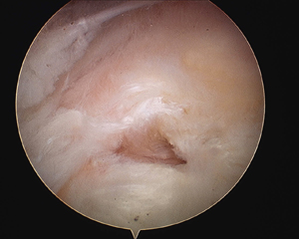
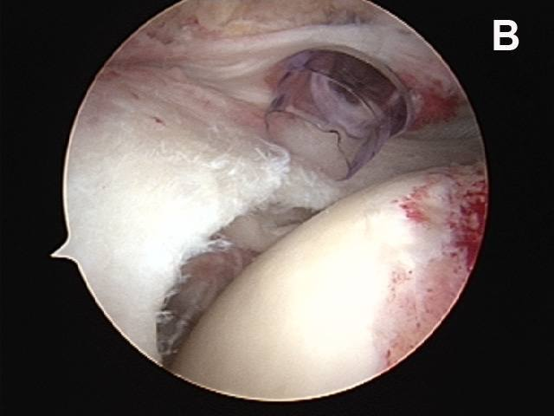
Surgical Treatment
Options
Surgical treatment – rotator cuff repair
Opportunity to heal tendon
Arthroscopic surgery
Outpatient
Well-tolerated
Small-medium size tears have 90-95% chance of improvement
Small Tear
Massive Tear
(Wolf, Arthroscopy 2004) (Gartzman, JBJS, 1998) (Tauro, Arthroscopy, 1998)

Slide 7
Challenges
Smoking
2.5x risk of requiring additional surgery (Traven et al Arthroscopy 2019)
Increased age (Diebold et al, JBJS 2017; Khazzam et al, JSES Int 2020)
Diabetes
Large/massive rotator cuff tears
88-95% improvement in symptoms (Savoie, Arthroscopy 2003; Burkhart et al, Arthroscopy 2001)
36% re-tear (Haleem et al, Knee Surg, Sports Traum 2021)
Recurrent tear after previous repair
Rotator cuff muscle atrophy
Multiple cortisone injections (Watson JBJS 1985)
Notes:
Retear rate…

Slide 8
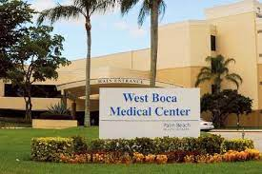
Surgery
West Boca Outpatient Surgical Center
Outpatient Surgery
General Anesthesia with nerve block
Multimodal Pain Management
Nerve Block
Cold Therapy
Anti-Inflammatory
Steroids
Tylenol
Opioids

Slide 9
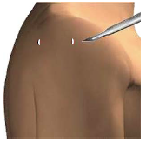
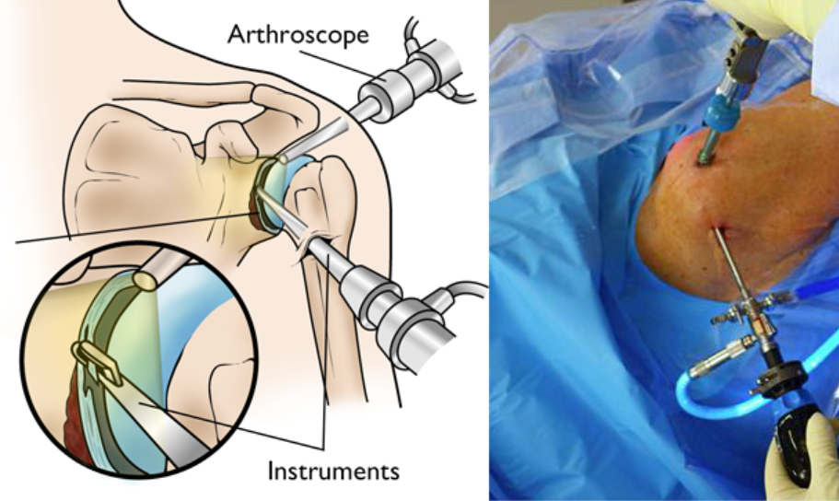
Arthroscopic Rotator Cuff Repair
Small incisions
Arthroscope
“Under Water”

Slide 10
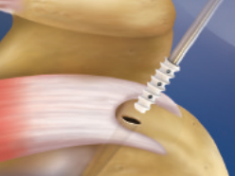
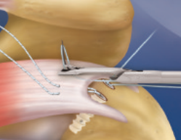
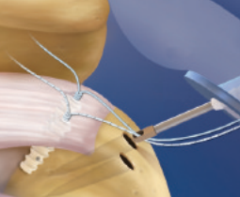
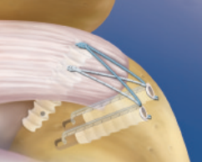
Arthroscopic Repair
https://www.arthrex.com/resources/LT1-0515-EN/suturebridge-double-row-rotator-cuff-repair?referringteam=shoulder

Slide 11
Rehabilitation
Individualized rehabilitation protocol
Tear size
Rotator cuff quality
Types of Therapy
Home based therapy
Formal physical therapy at outpatient facility

Slide 12
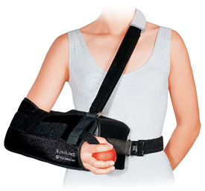
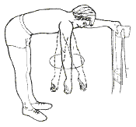
Post-operative Rehabilitation
Phase 1 -- Healing (0-6 weeks)
Ultra-Sling
6 weeks
Pendulum exercises only
3 Times per day
25 Clockwise
25 Counterclockwise
May use hand for activities immediately in front of you
Eating, drinking, shaving, brushing teeth, etc.
Ultra-Sling
Pendulum exercises

Slide 13
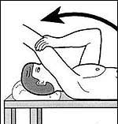
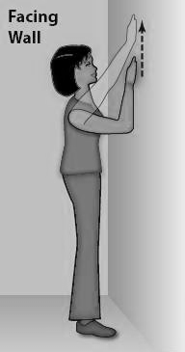
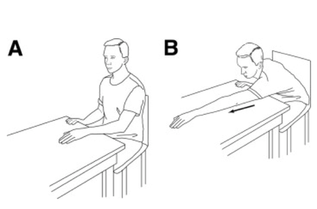
Post-operative Rehabilitation
Phase 2 – Stretching (6-12 weeks)
Discontinue brace
Stretching 3x per day
Begin to use arm
No lifting >2 lb

Slide 14
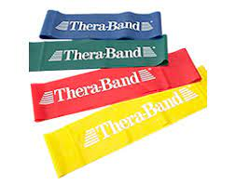
Post-operative Rehabilitation
Phase 3 – Return to Activity (3 months+)
Rotator cuff and periscapular strengthening
Gradual return to activities

Slide 15
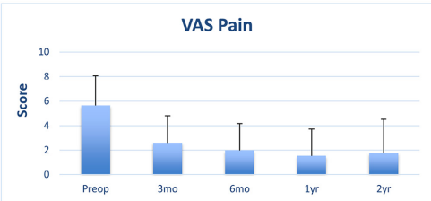
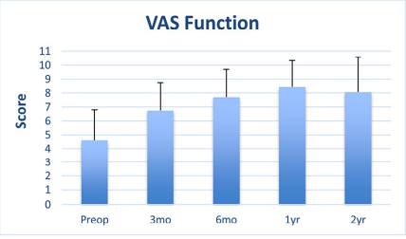
Recovery Expectations
Pain Relief
Quick
Most patients off pain medication within 1-2 weeks
Functional Recovery
3 months- ~50% improvement
6 months- ~80% improvement
3-6 Month Recovery

Slide 16
Appointments
Surgical Discussion (with Sara Blum, PA-C)
Review medical clearance
Review individualized post-operative therapy protocol
Baseline outcome scores
7 Day Post-operative Visit (with Sara Blum, PA-C)
Remove sutures
Review intra-operative imaging
6 Weeks – Advance to stretching exercises (with Sara Blum, PA-C)
12 weeks – Advance to strengthening, outcome scores obtained
6 months – Follow-up on return to activity, outcome scores obtained

Slide 17
Complications
Rotator cuff re-tear
Up to 5-30% for small tears (Boileau et al JBJS 2005)
Up to 94% for massive tears (Galatz et al JBJS 2004)(Galatz et all JBJS 2004)
Dependent on co-morbidities (ie smoking, diabetes, etc.)
Stiffness
Infection
Arthritis/chondrolysis
Nerve injury
Suture or anchor related complications
Anesthesia risks

