Slide 1
THE Li3 GROUP
CMX™ & BMX™ EXCHANGES
Trading & Tokenization of Commodities
and Mining with Real-World Assets
via our Proprietary Exchange Platforms

Slide 2
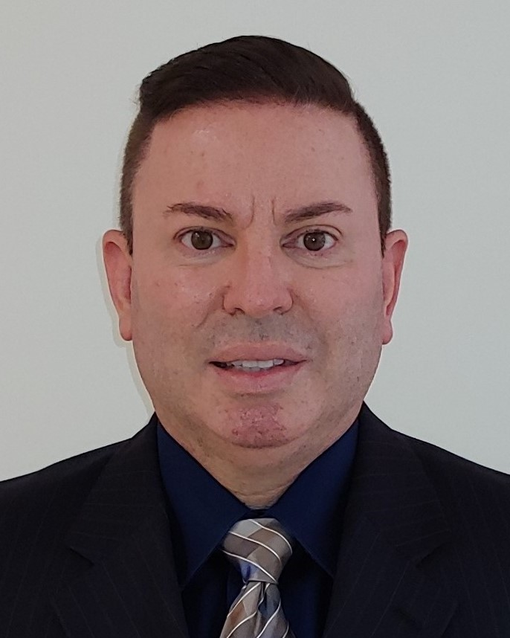
Management Team
CEO/Chairman
PRESIDENT/Vice-Chairman
DAVID MACIAS
JORGE AIZCORBE
A 23-year Veteran in the Physical Trade & Sourcing at Sunshine Energy and Commodities, participating in Physical Bulk Cargos of Commodities like Crude Oil, Coal, Iron Ore, and others. Mr. Macias’ negotiations capabilities, combined with knowledge of Shipping and Logistics of these Raw Materials in Institutional size, give access to the Supply Chain end-user participants in various Refineries, Steel Mills, and Power Plants Globally.
Previously served as Chairman and CEO of Upower, Inc., where he developed and funded with The World Bank, Latin America's largest photovoltaic solar power plant in Honduras for $232mm in 2015, eventually was sold to FinnFund (The sovereign wealth fund of Finland).
Brings 37+ years of Wall Street financial experience, serving as a Senior Vice President of several different FINRA broker-dealer firms where he managed $400,000,000+ in assets for over 3,500 Clients. Instrumental in the initial launch in underwriting SPAC’s as financial instruments in 1992.
David has raised $50 million dollars in private capital raises, and participated in over 154 publicly traded companies since 1987.
Mr. Aizcorbe, is a proven leader with 30 years as a Pioneer in the Solar Energy industry. Having worked as a Strategic Consultant, Investment Banker, and Investor, his divested set of experiences have provided the ability to fuse operational strategy and corporate finance to maximize value creation .
Managing Director at RedRock Energy Ventures, Inc..
Jorge has deployed several hundred Megawatts of successful utility scale projects to date, in addition to being Founder of Principal Solar, Inc.. Mr. Aizcorbe was former President of Upower, a renewable energy developer of Solar Projects Internationally focused on Utility-Scale Solar Plants.
Recently raised capital for the largest lithium brine project in the USA.
Mr. Aizcorbe is an Investment Banker for over 30 years. Worked at W.R. Grace & Co., one of the first true conglomerate corporations in the USA in Corporate Development and Merger & Acquisitions. Mr. Aizcorbe has structured numerous successful transactions for clients such as Madison Dearborn Partners, Bechtel Corporation, Chase Capital Partners, Scott’s Miracle Grow, Hunt Corporation.
Assisted family in the Real Estate development of communities, including Wellington (WPB) and Palm Beach Point.
2

Slide 3
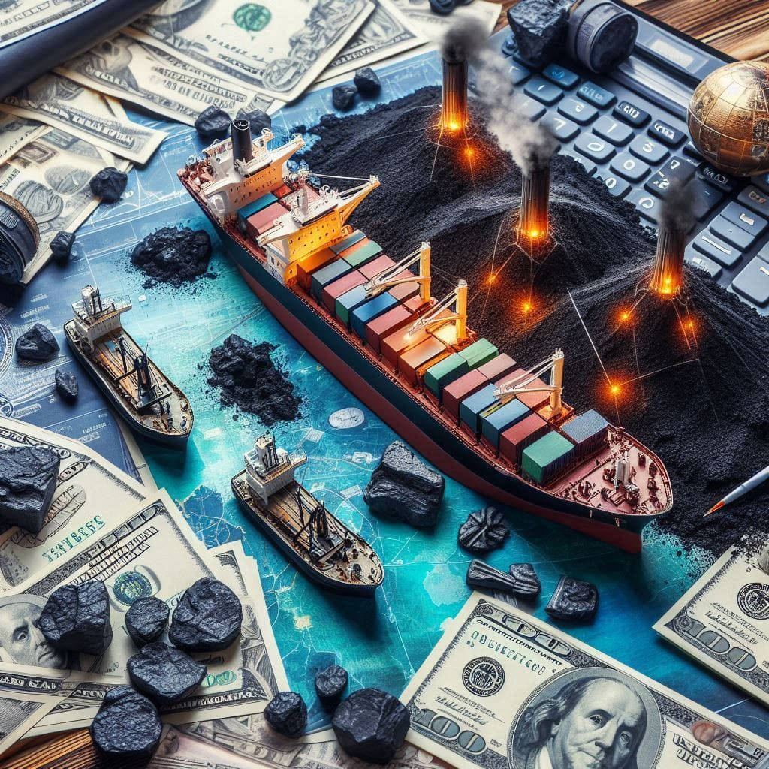
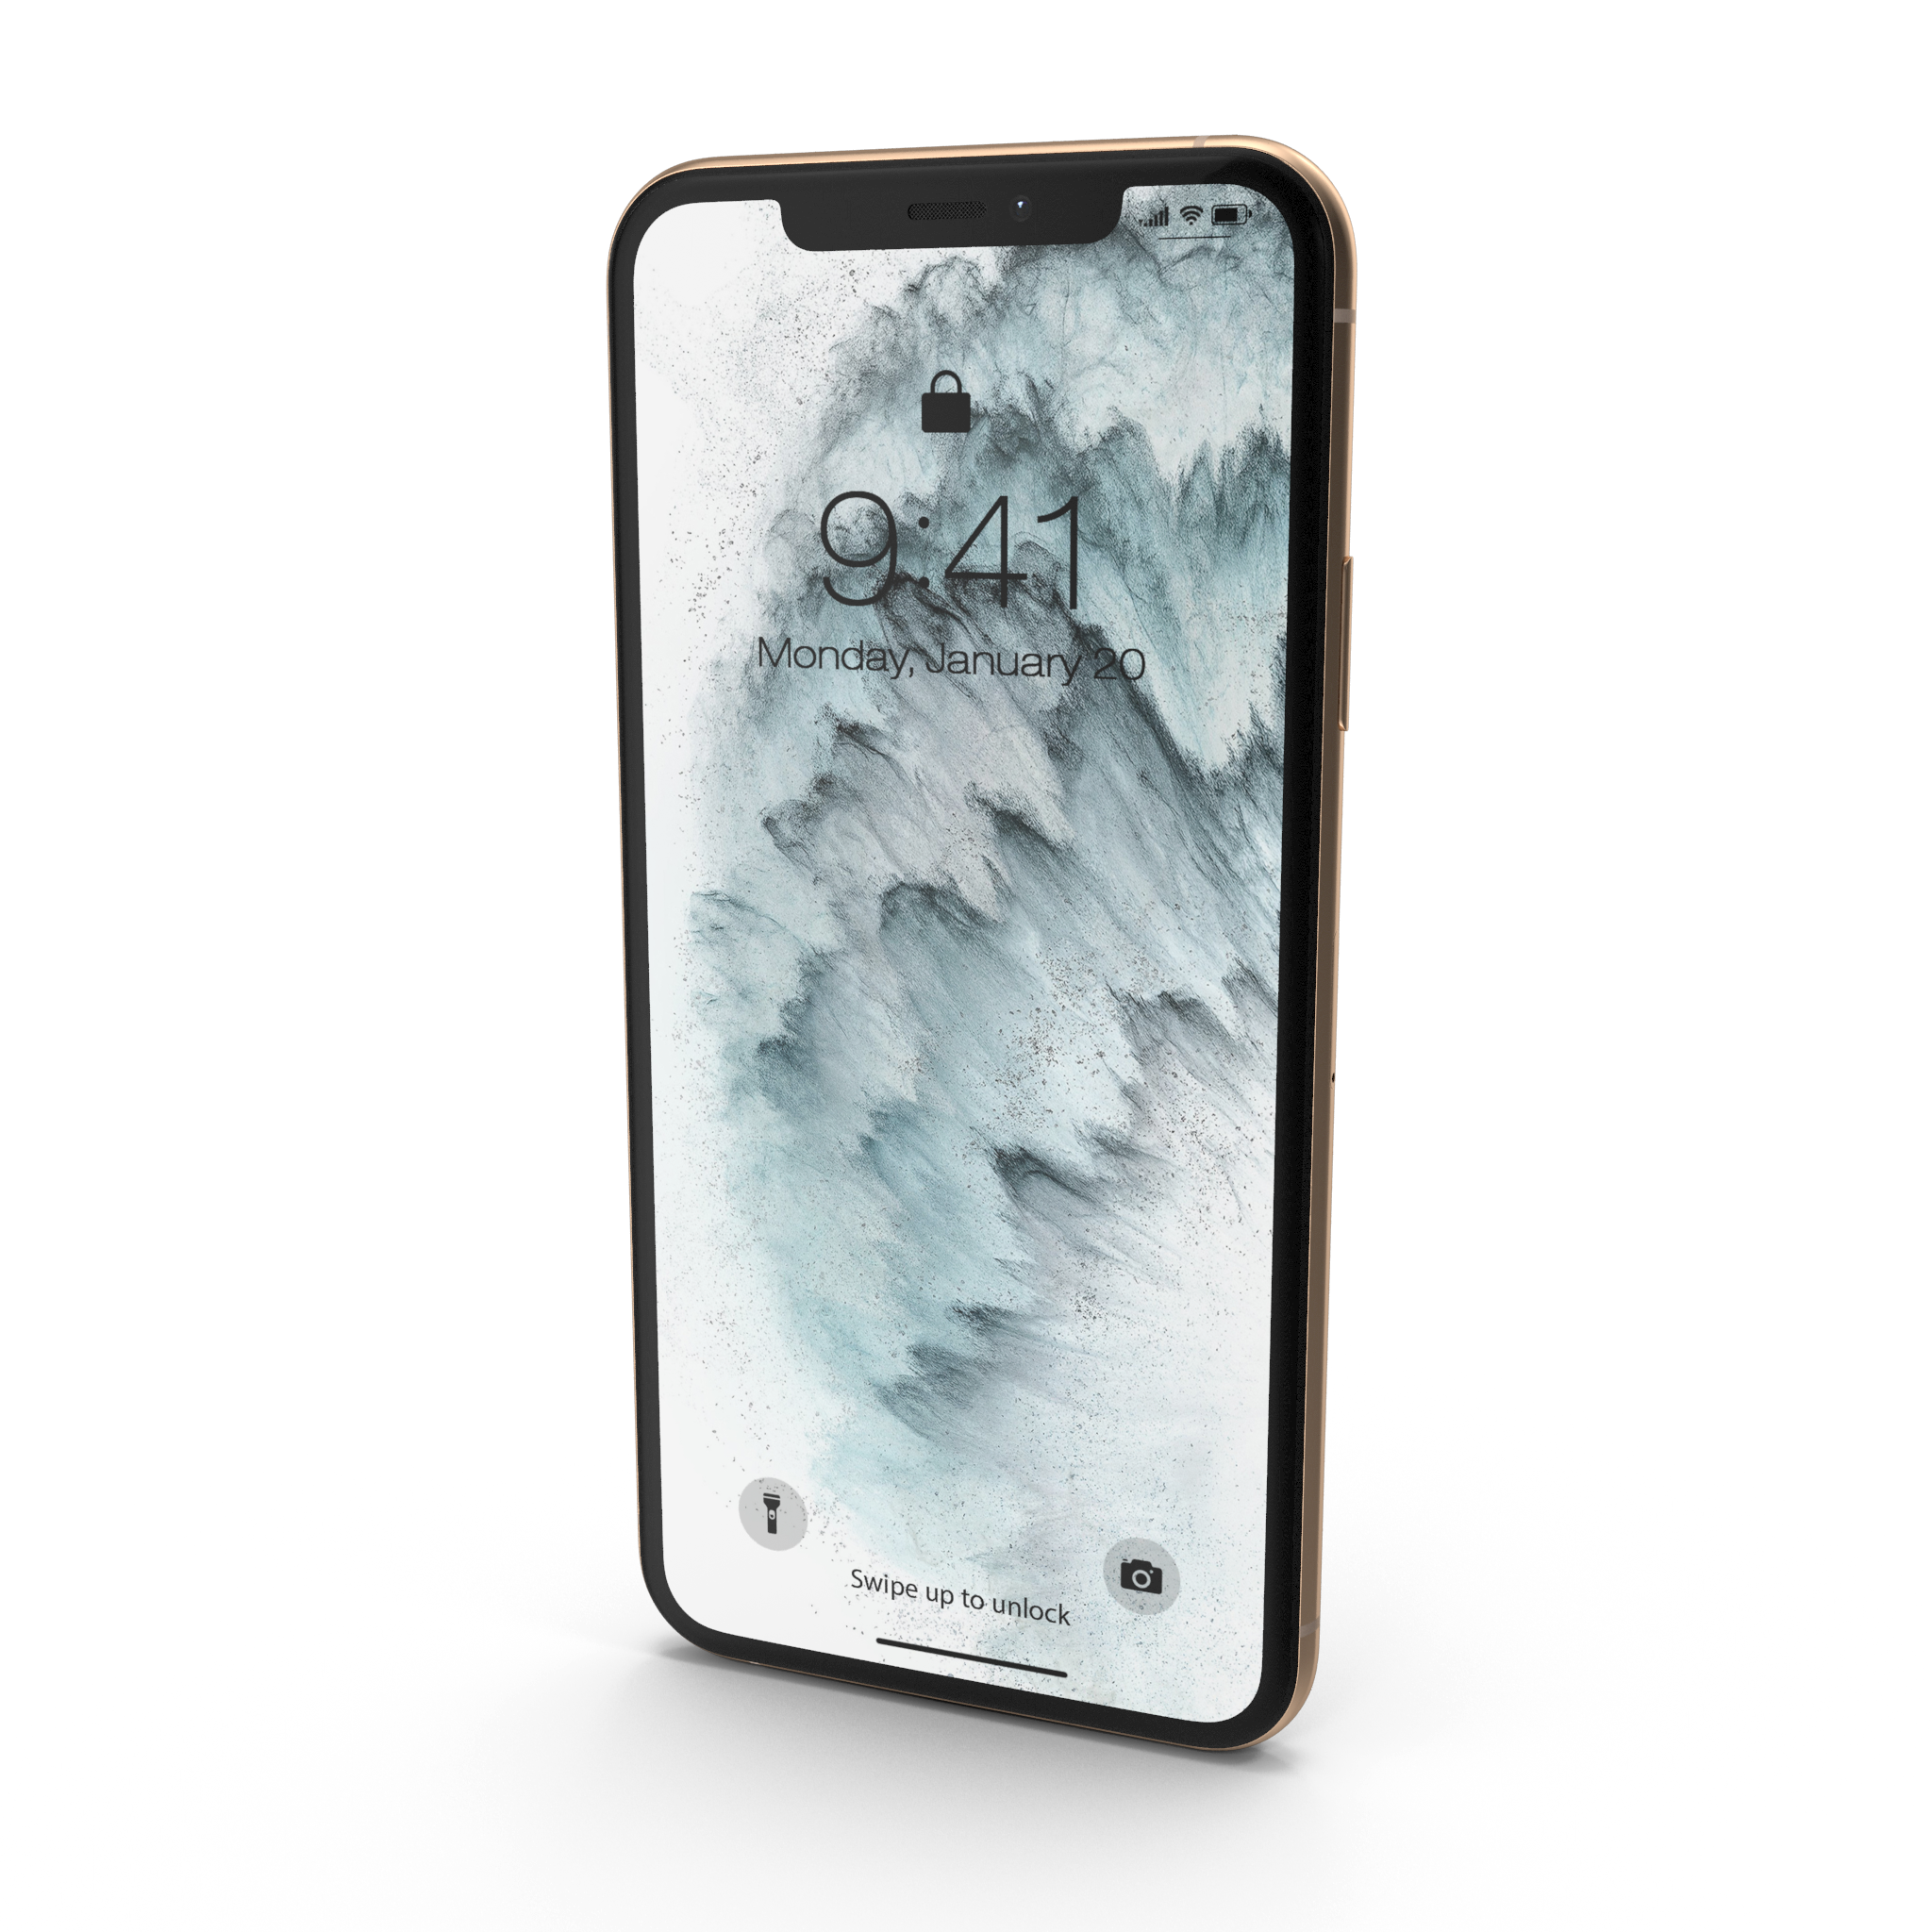
Opportunity
Proprietary Trading
The Commodities Mining Exchange (CMX™) to Global Clean Energy Initiatives
Physical Commodities Trade Financing & Digital Platform CMX™ The Commodities Mining Exchange (CMX™), our Proprietary Platform provides a unique Trade Finance Hub for Investors, Mining Companies, Energy Providers, Manufacturers and Technology alike, with Significant Arbitrage Opportunities and Solutions for both Short-Term and Long-Term Off-Take Agreements.
3

Slide 4
Prop Trading …Continued
Commodity Trading
Li3 Group has a Physical Trading Platform for:
Physical Commodities
Energy
Battery Metals
Other Raw Materials
4

Slide 5
Supply Chain Hub
A Physical Commodities Trading
and Investing Ecosystem
Mining Companies
Investors
Energy Industry
The Commodities Mining Exchange (CMX™) via our Proprietary Platform, identifies specific lucrative Physical Commodities Transactions available for funding, with the ability to share in part of the Arbitrage Spread, when Buying and Re-Selling the Cargos . For the first time, Investors and Shareholders alike participate in the business that "Makes the World Go Round".
CMX
Trade Finance
Opportunities
Royalty Agreements
Streaming Agreements
Trading Physical Commodities
Trade Arbitrage
5

Slide 6
Ongoing FinTech Growth
The Battery Metal Exchange (BMX™)
“The energy transition is going to be expensive, and the mining and metals industry will need to invest US $1.7 trillion over the next 15 years for enough supply of copper, cobalt, nickel, & other critical metals.” ⁴
$800
Billion¹
Projected non-conventional mine project financing options over the next 10 years.
$200
Billion²
Projected Size of the Battery & Rare Earth Metals markets by 2030.
Number of new Battery Metal mines that need to be built by 2035 to meet the growing demand for EV’s, Energy Storage, & other Clean Tech technologies.
384³
1. McKinsey, Feb 2021 Article
2. PSI Market Research, Jul 2022
3. Benchmark Minerals, Sept 2022 Article
4. EY Americas, 2022 Analysis
6

Slide 7
Digitizing Real-World Assets
The Battery Metal Exchange (BMX™) is a Disruptive Digital Platform Connecting Battery Metal Mining Projects to Viable Funding Sources.
The BMX™ uses Blockchain and Smart Contracts to meet the growing demand for Battery Metals, including Lithium, Copper, Cobalt, Nickel, and Graphite, a new funding mechanism through Tokenization, to support the entire Mining Ecosystem for Electric Vehicle, Smartphone, and Power Storage Markets.
7

Slide 8
Our Traction
MILESTONES
Li3 Group has Seasoned Executive Management Team, Traders, and Existing Relationships with Trade Partners.
Li3 Group has Collaborated with the Government of Colombia’s Mining Agency (800+ mines @ ANM).
Li3 Group has Collaborated with Indonesia’s Ministry of Energy & Mineral Resources.
Li3 Group has signed a Joint Venture with Mulcore Mineral of Indonesia, with over a Dozen Nickel & Coal Mines to sell exclusively several monthly cargos of 50k MT each and a willingness to digitize the Mining Assets themselves through our Proprietary Platforms.
Li3 Group brings Game-Changing Solutions with our Proprietary Physical Commodities Trade Financing Platform, the Commodities Mining Exchange ( CMX™ ) and our innovative solution to Conventional Project Financing via our Proprietary Mining Project Financing Platform, that Tokenizes or Digitizes Real-World Assets (RWA), the Battery Metals Mining Exchange ( BMX™ ).
Li3 Group has signed Strategic Partnership with Blockchain leaders Fireblocks & Tokeny.
BMX ™ ’s “Readiness” is planned for early/mid 2025.
Li3 Group’s Corporate Lawyer – Brown Rudnick, has extensive Compliance/Regulatory Reports and Market Analysis completed with us through the Chairperson of the Digital Assets Division in NYC.
Li3 Group is one of the First Movers to Market.
Li3 Group has Existing Relationships with Trade Partners
Li3 Group has Capital Raises via a SEC Filed Reg D 506b and Reg CF at $2.00 per share.
8

Slide 9
Revenue Model
1. Traditional & Digitizing Offtake Agreements
Physical Commodities Trade Financing & Digital Platform, The Commodities Mining Exchange ( CMX ™ ), our Proprietary Platform provides a unique Trade Finance Hub for Investors, Mining Companies, Energy Providers, Manufacturers and Technology alike, with Significant Arbitrage Opportunities and Solutions for both Short-Term and Long-Term Off-Take Agreements.
2. Brokerage Fees
Transaction Fees for a Suite of Services including:
Supporting Commodity Auctions
Project Tenders and RFP’s
Market Intelligence
Sourcing Supplies and End Users
.
3. Digital Securities Tokens (STO’s)
Percentage Benefit of each project investment via Asset-Backed Digital Tokens created onLi3 Group’s Proprietary Platform via a Peer-to-Peer Marketplace (Anticipated Exchange & Licenses in Early 2025).
9

Slide 10
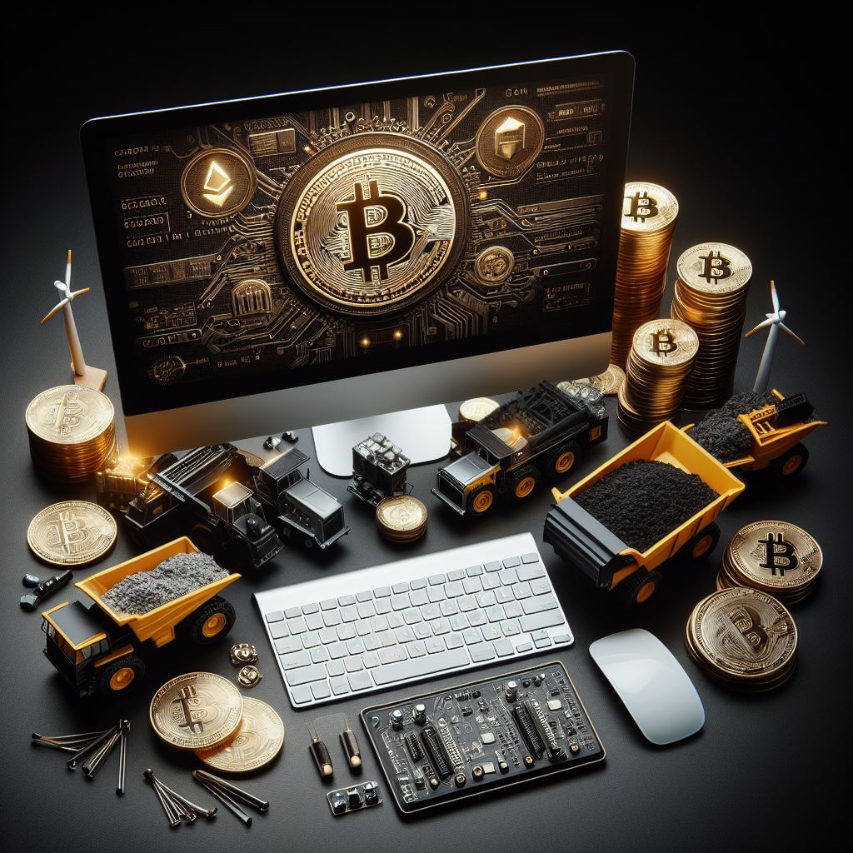
CAPITAL RAISE
$4 Million-$80 Million*
* -Variable for Each Monthly Supply of Physical Cargos on Yearly Contracts (Over $1.5mm+ already raised in Friends and Family Round)
10

Slide 11
Future Markets
Tokenization of Real-World Assets (DigitizeRWA™)
ENERGY & MINING
Petroleum-Based, PetCoke, Coal, Iron Ore, Battery Metals, Rare Earths
GHG
Track & Report the Carbon Footprint and Carbon Intensity of Mining Operations, Manufacturing and the complete product Supply Chain
Track & Trace
Track and Trace the Provenance of Metals and Minerals (non-conflict, child and forced labor, environmental impact, etc)
Real Estate
Clone our Proprietary digital Platform for funding commercial Real Estate projects via Asset-Backed Tokens .
Gaming
Create a digital online Gaming system using Blockchain Technology, Smart Contracts and Tokens.
11

Slide 12
CMX™ & BMX™ Platforms
THANK YOU!
David Macias, CEO/Chairman
Investor-relations@li3group.com | (561) 774–3300
www.li3group.com
Learn more about Li3 Group by Clicking here
and watch all three videos on our YouTube Channel: https://www.youtube.com/@Li3Group
12

