Slide 1
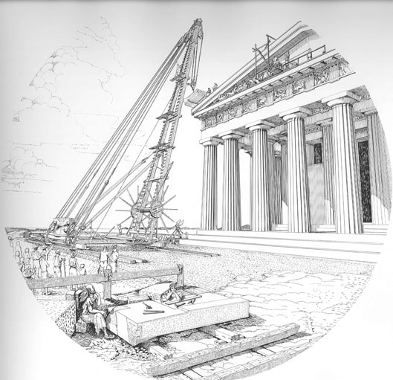
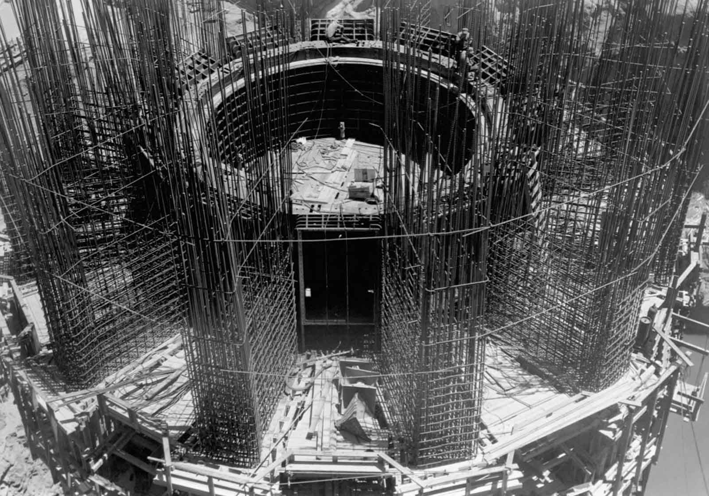
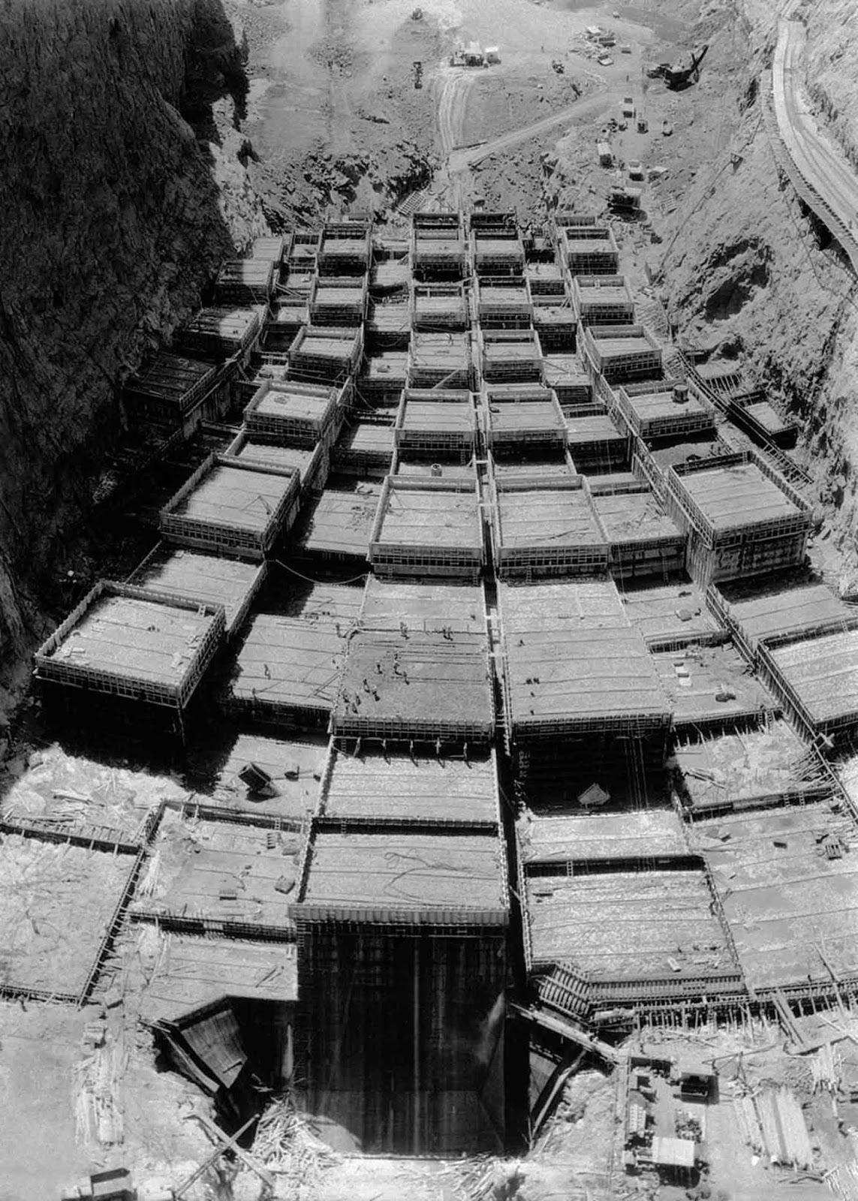

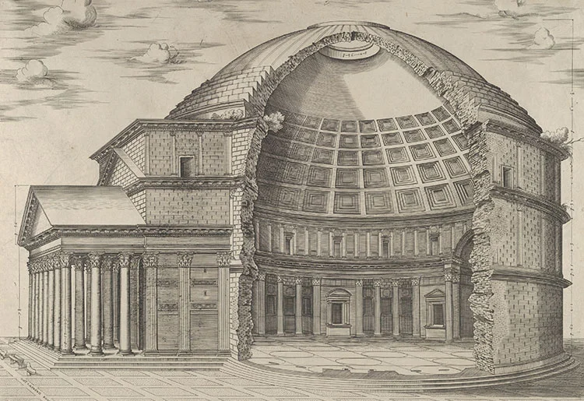

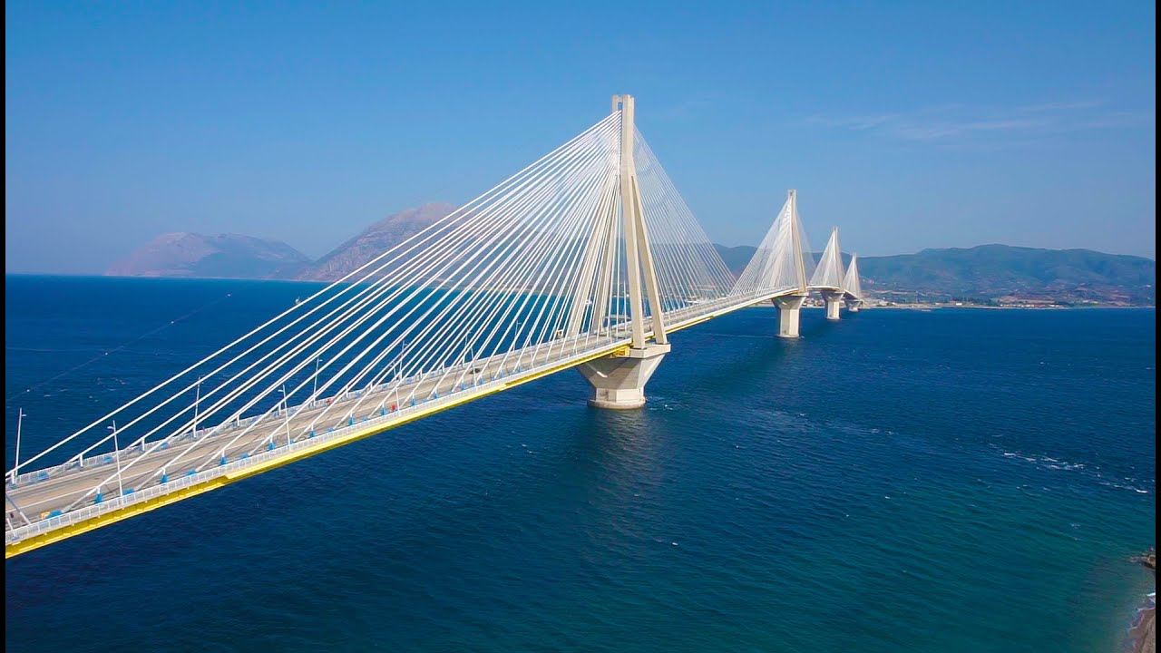
A Brief History of Project Scheduling

Slide 2
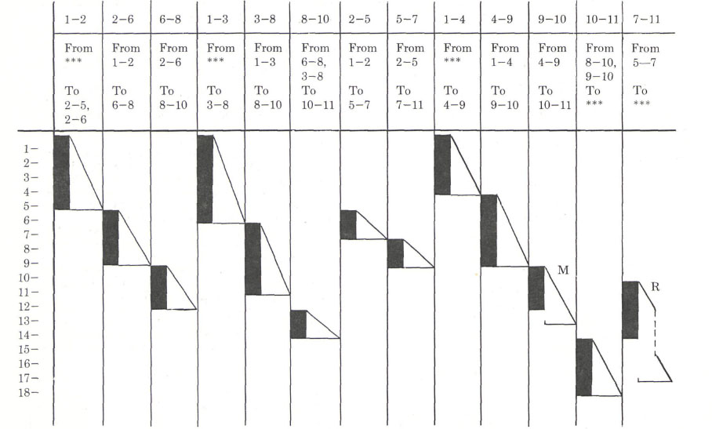
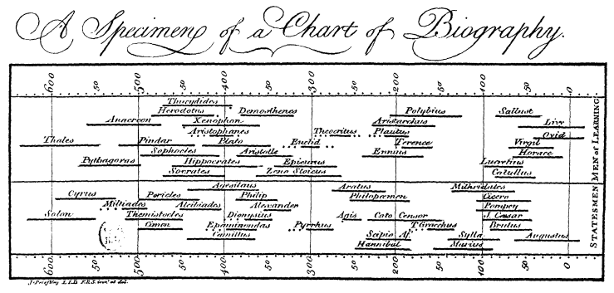
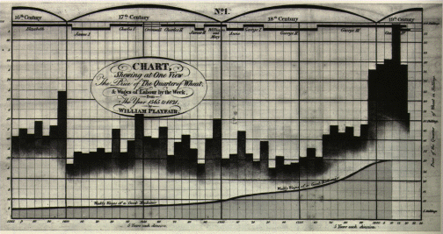
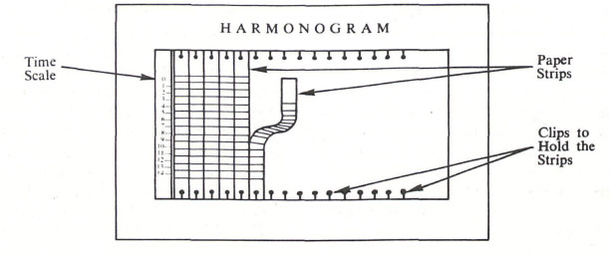
A Brief History of Project Scheduling
1765 – Chart of Biography by Joseph Priestly (Creator of the first Bar Chart)
1786 – Commercial & Political Atlas by William Playfair (Creator of Histogram)
1896 – The Harmonogram by Karol Adamiecki

Slide 3
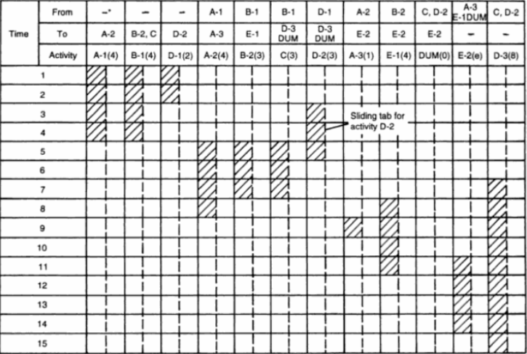
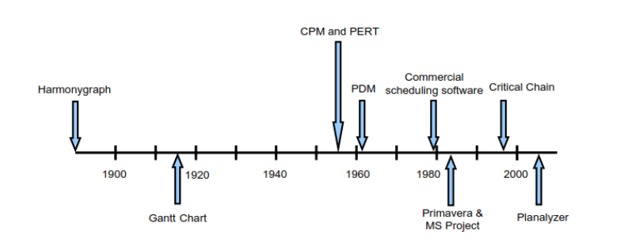
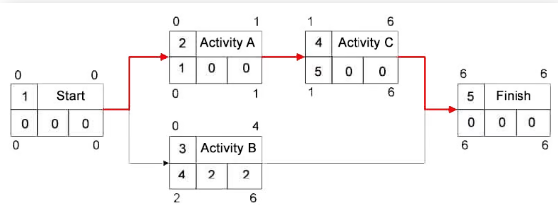
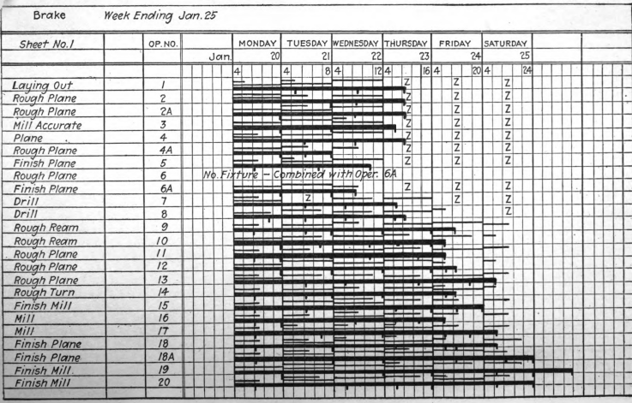
A Brief History of Project Scheduling
1917 – The Gantt Chart by Henry Gantt *(used in the Hoover Dam construction)
1955 – Parkinson’s Law by Cyril Northcote Parkinson
1956 – Critical Path Method (CPM) by DuPont & Remington
1957 – Program Evaluation and Review Technique (PERT) by US Navy (SPO)
1961 – Precedence Diagram Method by Dr. John Fondahl

Slide 4
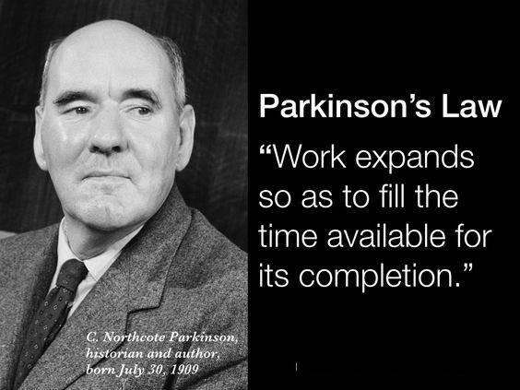
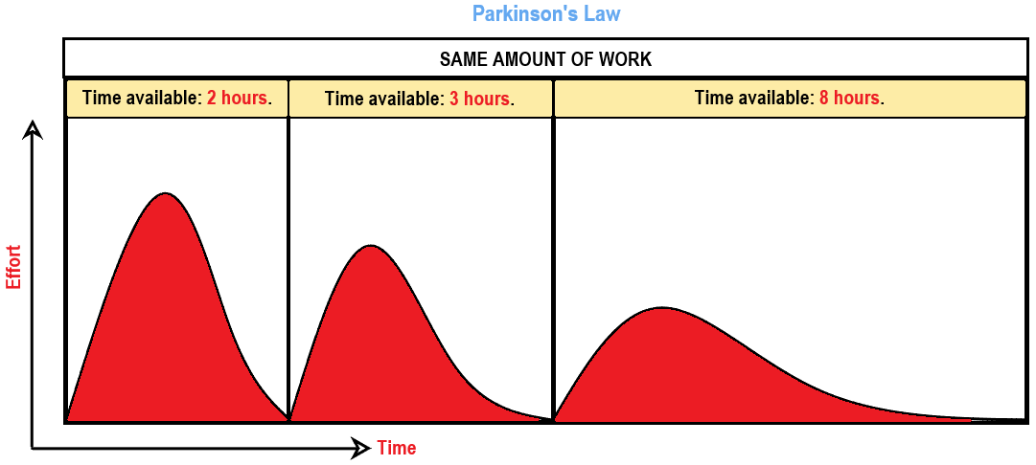
A Brief History of Project Scheduling
“To achieve the most efficient use of resources and time, the time allocated for each task in a project needs to correspond with the time to completion using maximum effort.”

Slide 5
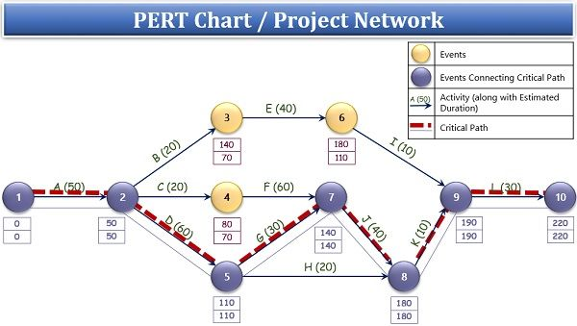
The Importance of Project Scheduling
“Project scheduling is the application of skills, techniques, and intuition acquired through knowledge and experience to develop effective schedule models.
The schedule model integrates and logically organizes various project components, such as activities, resources, and logical relationships, to enhance the likelihood of successful project completion within the baseline duration.” PMI – Practice Standard for Scheduling
• Time phasing of required activities
• Resource Management
• Coordination of events within the project and between other projects and other Contractors
• Early detection of risks or problems (Risk Management)
• Performing “what-if” and PERT analysis
• Forecasting of estimate at complete
• Liability Protection (As-Built Schedules)
• Assist in Machine Learning for A.I. utilization (Historical Data)

