Slide 1
Yoga Therapy in Intensive Cardiac Rehabilitation
With Applications to Pulmonary Rehab
Presented By: Jennifer Lenders, C-IAYT Yoga Therapist

Slide 2
Yoga and ICR
How does yoga therapy heal?
What do patients find beneficial about yoga in ICR?
What health imbalances are addressed by yoga therapy in ICR?
What techniques are used with ICR patients?
Research on Yoga in Health Care

Slide 3
Benefits of Yoga
Reduce stress (or imbalance) in Body-Mind-Emotions
Improve energy
Fight or Flight (stress) Response
Better cardiovascular function
Healthy lifestyle & self-care choices
rest and digest response
Improvement of psychological aspects of disease

Slide 4
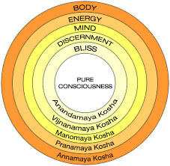
The Layers of Healing in Yoga Therapy
Perfect Health-Balance

Slide 5
The Physical Layer
Potential Imbalances in Cardiac Rehab
Posture
Muscle Tension/Chronic Pain
Joint Stiffness
Cardiovascular System Healing
Nervous System Balance
Respiratory System Weakness
Yoga Therapy Tools
Physical Postures/Poses
Joint Freeing Series
Guided Body Awareness
“I didn’t understand that my difficulty breathing was due to the tension and discomfort of my upper back.”
“I had no idea that I could feel so relaxed.”
“I figured I had to work harder and harder to get better, but I could no longer run because my joints hurt.”
“My blood pressure was 15 points lower after the yoga class.”

Slide 6
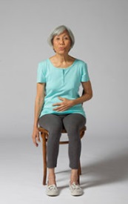
The Energetic Layer
Potential Imbalances in Cardiac Rehab
Shallow breathing
Lack of full exhalation
Lack of awareness of sensation throughout the body
Fatigue
Yoga Therapy Tools
Breath awareness practice deep abdominal breathing
”ha” breath w/ shoulder release
Alternate nostril breathing
“After the yoga class I feel a whole new energy. Like I’m ready to continue the day without fatigue.”
“I used deep breathing when going into an MRI, which I am terribly afraid of small spaces. It relaxed me completely.”

Slide 7
The Mental-Emotional Layer
Potential Imbalances in Cardiac Rehab
Depression/anxiety
Isolation
Fear
Lack of motivation
Negative self- talk
Yoga Therapy Tools
Guided body/breath awareness of positive sensation
Mindfulness meditation for thought/emotion awareness
Classroom language and environment
Healing affirmations
“So this class is teaching us permission to take care of ourselves? That it’s ok to take time for our health? I’ve never taken time to care for my mental-emotional well being and I’m ready!”
“The affirmations are beautiful and shift my thinking.”

Slide 8
The Wisdom Layer
Potential Imbalances in Cardiac Rehab
Unaware of the patterns of behavior that do not support healthy lifestyle
Possible Type A personality structure with intense characteristics and lack of time for self-care
Unaware of body sensation and identifying body messages such as hunger, fatigue, stress
Yoga Therapy Tools
Guided Body Awareness of Tension/Stress
Mindfulness Meditation
Guided Deep Relaxation (Yoga Nidra)
Guided Visualization of the Cardiovascular System
Stress Education Workshops
“My natural state of being is stress and intensity. I’m understanding how to recognize sensations of stress, and that I need to say ‘no’ sometimes.”
“I realized that the relationships I’ve had with strong demanding personalities caused me great stress and lack of confidence.”
“I realized how much stress I was feeling about pain around my surgical site. After the visualization of the cardiovascular system, I was clear that these sensations were just healing bones, not anything more. This was a great relief.”

Slide 9
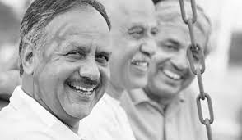
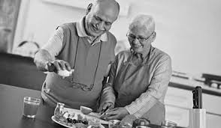
A Full Life Perspective: The Layer of Life Bliss and Peace
What does your space of peace and whole health look like?
Do you experience joy?
“I visualized myself swimming when I was a child, and remembered the lovely feeling of floating. I think I’ll try an aqua class for exercise since I cannot walk without pain.”

Slide 10
Yoga Therapy Adapted for Pulmonary Rehabilitation
Coordination of muscles, bones, and joints for optimum breathing (strengthening muscular system)
Deep breathing can reduce sympathetic activity and dyspnea
Visualization of the respiratory system (effective tool for stress management of disease)
Mindfulness meditation and yoga nidra can reduce psychological factors such as stress, depression, and anxiety

Slide 11
Research on Yoga and Cardiovascular Disease
Adding a psychosocial intervention in cardiac rehabilitation program improves the quality of life and decreases mortality (Linden, Stossel, & Maurice, 1996). Yoga practices support well-being, better sleep and appetite, improved physical fitness, stress reduction, and lifestyle change, hence being suitable in this respect. (Telles & Naveen, 1997)
Tulpule & Tulpule (1980) reported more patients were able to resume work within 6 months in the yoga group than in the control group. Also, they observed decreased mortality in the yoga group during the study period.
A significant decrease in perceived stress, anxiety, depression, and negative affect was observed in the yoga group compared to increase anxiety in the control group. (Raghuram et al., 2014) Also observed was a reduction in BMI, blood glucose, and LDL as compared to the controls.
Silberman et al. (2010) found a decrease in BMI, triglycerides, LDL, HbA1c, blood pressure, depression, and hostility and also an increase in exercise and functional capacity.

Slide 12
Liu et al. (2014) found that yoga training significantly improved FEV1 and 6 minute walking test, concluding that,” Yoga training has a positive effect on improving lung function and exercise capacity and could be used as an adjunct pulmonary rehabilitation program in COPD patients.” Experimental studies indicate a large number of potential benefits for the use of yoga practices in respiratory diseases, particularly in COPD, and also in the crucial respiratory involvement of other relevant diseases such as congestive heart failure. (Khalsa et al. 2016) Deep Breathing has been shown not only to improve gas exchange but also to improve exercise capacity and dyspnea. (Bernardi et al., 1998)
Research on Yoga and Respiratory Disorders

