Slide 1
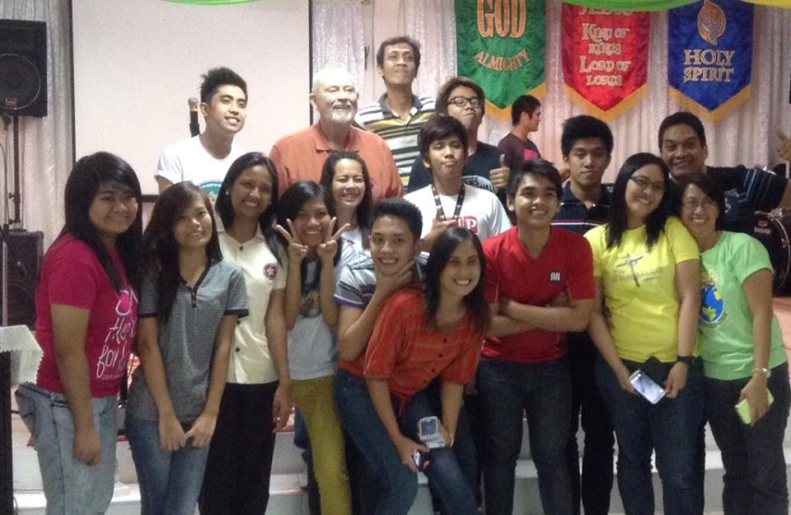
Equipping Students (ES)
To Change The World

Slide 2
Failure to Fulfill One’s God-Given Purpose Can Lead to a Life of Idleness, Self Gratification, Incompleteness, Worldly Addictions, and despair!
We Are

Slide 3
Vision
Without Vision, the people Perish
Proverbs 29:18
Intention
I can do all things through Christ who strengthens Me
Philippians 4:13
Powered by the Holy Spirit, Become Witnesses locally and to the uttermost
Acts 1:8
Means
Go, Make Disciples, Teach them to Obey, I’m with you
Matthew 28:18-20

Slide 4
Our Vision is to Change the World
Our Intention is to Equip Students to Change the World
Our Means is to use Jesus’ Plan to Reveal Their Purpose in Life

Slide 6
Knowing Their God-Given Purpose,
Students will Become Responsive to Jesus and take the Gospel onto their Campuses, into their Cities, and to the Uttermost Parts of the World!
(Acts 1:8, Matthew 28:18-20)

Slide 7
Five Reasons For Focusing on Students:
1. They Represent the Future of Christianity.
2. They Are The Largest Group Leaving the Church.
3. They Have the Greatest Influence on their Peers.
4. They Are Energetic, Idealistic, and Teachable.
5. They Will Soon Marry, and Introduce A New Generation.

Slide 8
Envision Drug and Alcohol Free Campuses
Envision Motivated, Disciplined Students
Envision Students with Solid Spiritual / Moral Foundations
Envision Students Eager to Prepare themselves to Change the World!

Slide 9
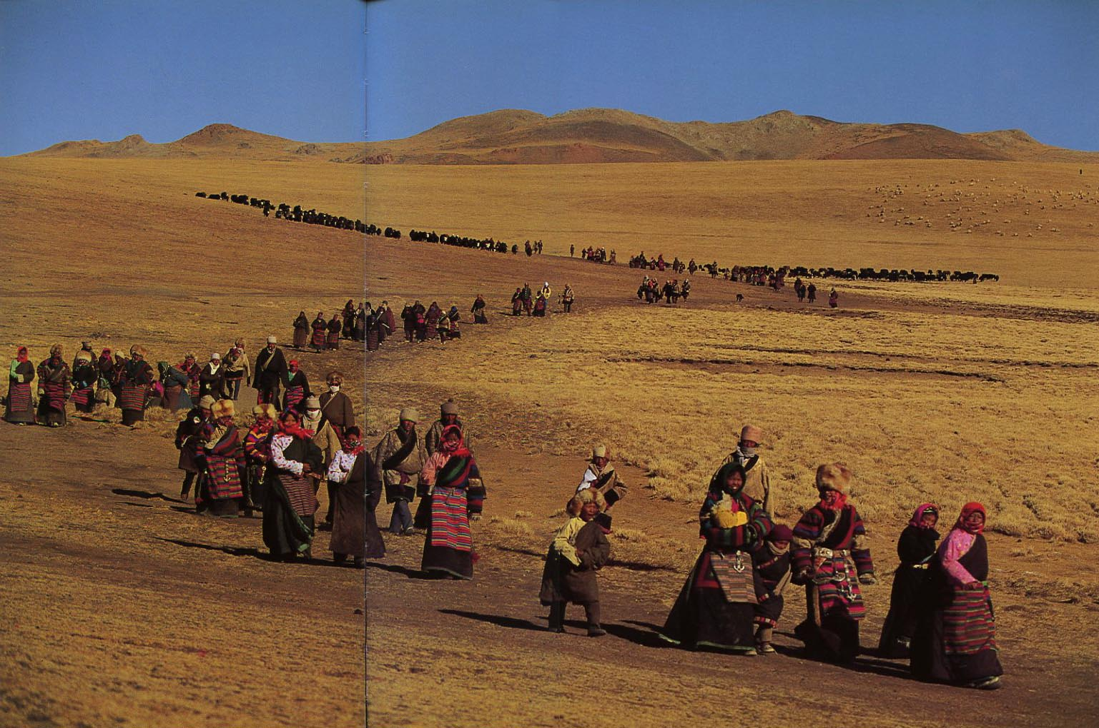
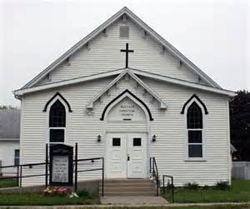
Our Current Context
People of all ages are leaving the Church and many are leaving Christianity in Search of Purpose

Slide 10
Post Christian Rate (per Barna Research)
Elders: Born Before 1945 (Over 70 years old)
Best Resource Age
28% of Post Christians are Elders
Boomers: 1946 – 1964
(51 to 69 years old)
Preparing to take the Mantle
35% of Post Christians are Boomers
Busters: 1965 – 1983 (32 to 50)
Most Influence on next Generation
40% of Post Christians are Busters
Mosaics: 1984 – 2000
(13 to 29 years old)
The Future of Christianity
48% of Post Christians are Mosaics!

Slide 11
During the 1960s Polls showed the three most influential factors in a Student’s life to be:
1. Parents
2. Teachers
3. Spiritual Leaders
Today the three most influential factors in a Student’s life are:
1.Friends
2. Media
3. Parents
Spiritual Leaders Dropped to 17th!

Slide 12
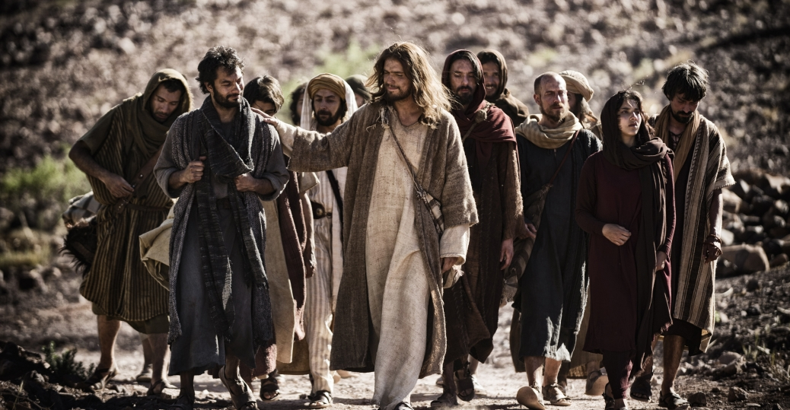
Jesus Chose Common People to be His Disciples:
They Were Common People but Learned Their Purpose in life and Became Great
They Were Willing to Obey His Teachings
They Were Willing to Forsake Worldly Pleasures and Entertainments to Follow Him
They Understood and Choose to Practice the Great Commandment and Great Commission
And THEY CHANGED THE WORLD
They Agreed to Practice What They Shared With Others

Slide 13
Today, Jesus Is Calling Students to Be His World-Changing Disciples
Understanding Their Purpose in Life, They Will CHANGE THE WORLD

Slide 14
Adult Christian Managers are required to start an ES Movement.
This couple will become Regional Managers for ES
They will manage ES in their area and report Regional Results to Equipping Central.
They will seek ES Coordinators to help before equipping students.
ES Managers will Disciple a group of 4 to 6 Students:
by Teaching eight 1 to 1 ½ hour ES Discipleship Sessions

Slide 15
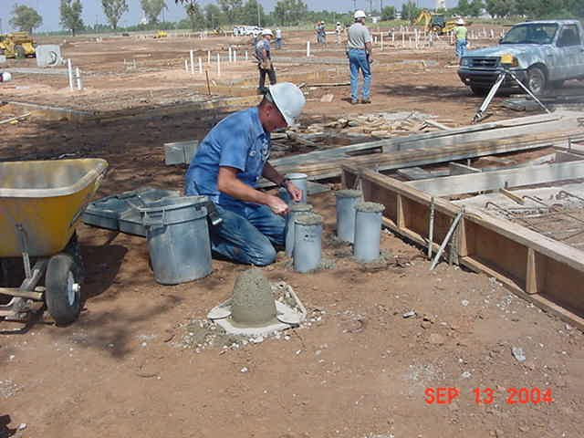
Jesus said, “I will show you what someone is like that comes to me, hears my words and acts on them“
“He is like a man building a house, who dug deeply, and laid the foundation on Rock “ (Luke 6:47-48)
ES establishes solid Christian foundations for students that will come to Jesus, hear His words, and build their life upon them.

Slide 16
The Students to be Discipled Will:
1. Make a List of Students they know that are Away from God
2. Briefly write their Relationship with Jesus
(their story)
3. Write a Brief Bridge to the Gospel
4. Recite John 3:16
(The Gospel)
Select A Secret Place

Slide 17
ES will cast 8 Biblical Visions to Assure the Students that they CAN Change the World
ES Provides 8 Discipleship Lessons to Equip the Students
Students will Agree to Weekly Goals and Be Accountable for Accomplishing them.

Slide 18
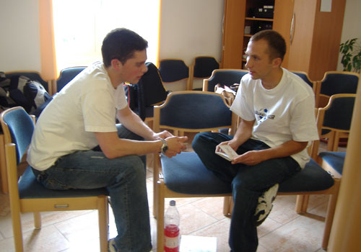
ES students will practice sharing their faith in the classroom, and commit to sharing on their campuses.

Slide 19
We must have a radical paradigm shift back to Christian basics as outlined in the book of Acts
Our commission is to build the Kingdom: Start locally (our schools) and move out to the uttermost parts of the world

Slide 20
Let’s Do it!!

Slide 21
Discussions and Questions Regarding ES
Will You Become an ES Manager?

Slide 22
ES 8 -- Request to become an ES Manager
My Name: ___________________________ Date: ____________
Phone: _____________________ email: ____________________________________
Mailing Address: ________________________________________________________
______________________________________________________________________
Attending a Church? ( ) No, Yes at: _________________________________________
We are a married Christian couple making this request ( Y), ( N)
We are abiding Disciples of Christ practicing daily disciplines of prayer, and Bible study.
( Y), ( N)
I request to be certified as an ES Manager for the following: ( City), ( USA State), ( Country)
____________________________________________________________
If selected, I agree to study the ES materials (including each Student class), perform weekly goals, and be accountable to the group by reporting how I fulfilled my weekly goals.
_______________________________
Signature
Comments about why I (we) should be selected:
Keep in touch with Equipping Central at www.equippingstudents.com, email: dotnjohn@comcast.net

