Slide 1
E
S
Equipping
Students
To Change The World
One Day Adult Promotion

Slide 2
One Day Adult Promotion OUTLINE:
LUNCH
Afternoon
Morning
8 Student Visions Cast
8 Student Discipleship Themes
Typical 6 Part Student Session
1. Example Opening
2. Example Spiritual Check
3. Example Vision Cast
4. Example Discipleship Lesson
5. Example Goal Setting
6. Example Accountability Time
Scope ES Organization
Questions / Discussions
The ES Vision and Purpose
Our Current Context
Why Focus on Students
Demonstrate ES Materials
ES Strategy
Who Can Change the World
Foundations
Student Tasks

Slide 3
Failure to Fulfill One’s God-Given Purpose Can Lead to a Life of Idleness, Self Gratification, Incompleteness, and despair!
We Are

Slide 4
Vision
Without Vision, the people Perish
Proverbs 29:18
Intention
I can do all things through Christ who strengthens Me
Philippians 4:13
Powered by the Holy Spirit, Become Witnesses locally and to the uttermost
Acts 1:8
Means
Go, Make Disciples, Teach them to Obey, I’m with you
Matthew 28:18-20

Slide 5
Our Vision is to Change the World
Our Intention is to Equip Students to Change the World
Our Means is to use Jesus’ Plan to Reveal Student’s Purpose in Life

Slide 7
Knowing Their God-Given Purpose,
Students will Become Responsive to Jesus and take the Gospel onto their Campuses, into their City, and to the Uttermost Parts of the World!
(Acts 1:8, Matthew 28:18-20)

Slide 8
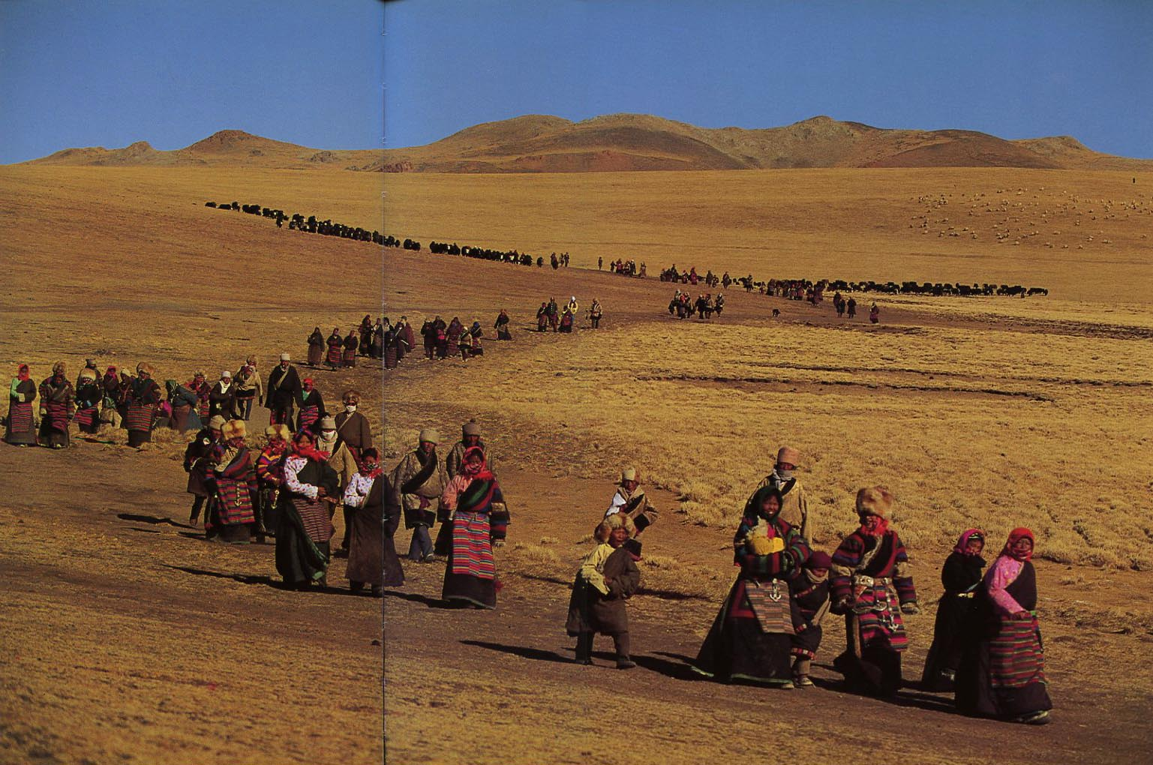
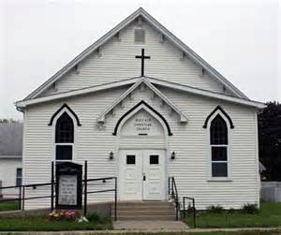
Our Current Context
People of all ages are leaving the Church and many are leaving Christianity in Search of Purpose

Slide 9
Worldly Entertainment and Self Gratification is Influencing Christians
Culture is Changing Rapidly (for the worse)
Luring Christians Away from Church and Christianity!

Slide 10
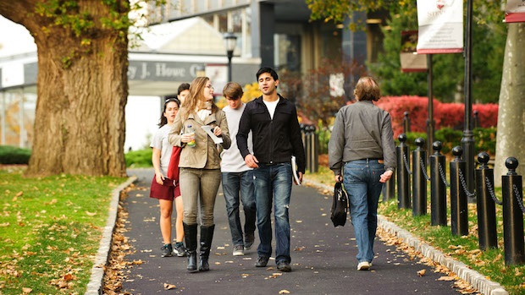
Church Dropout Rate (per Barna Research)
Elders: Born Before 1945 (Over 70 years old)
Best Resource Age
28% of Elders are Dropouts
Boomers: 1946 – 1964
(51 to 69 years old)
Preparing to take the Mantle
35% of Boomers are Dropouts
Busters: 1965 – 1983 (32 to 50)
Most Influence on next Generation
40% of Busters are Dropouts
Mosaics: 1984 – 2000
(13 to 29 years old)
The Future of the Church
48% of Mosaics are Dropouts!

Slide 11
During the 1960s Polls showed the three most influential factors in a Student’s life to be:
1. Parents
2. Teachers
3. Spiritual Leaders
Today the three most influential factors in a Student’s life are:
1.Friends
2. Media
Spiritual Leaders Dropped to 17th!
3. Parents

Slide 12
Why Focus on Students?:
1. They Represent the Future of Christianity.
2. They Are The Largest Group Leaving the Church.
3. They Have the Greatest Influence on their Peers.
4. They are Energetic, Idealistic, and Teachable.
5. They Will Soon Marry, Form Families, and Introduce Another Generation.

Slide 13
Adult Christian Managers are required to start an ES Movement.
This couple will take a 3 day training class and agree to be Disciples of Christ to become Regional Managers for ES
They will manage ES in their Region and report Results to ES Central.
They will seek ES Coordinators to help equip students.
ES Managers will Disciple a group of 4 to 6 Students:
by Teaching eight 1 to 1 ½ hour ES Discipleship Sessions

Slide 14
ES Central Will:
Maintain and Provide Information and Training Materials needed by Regional Managers & Coordinators.
Write and Distribute ES Newsletters
Training materials include Power point slides, Videos, student manuals, student forms, etc.
Maintain a Web Site / BLOG

Slide 15
Demonstrate ES Materials
Manager Manuals
Student Presentations
Student ES Binder
Student Manuals
Student Forms

Slide 16
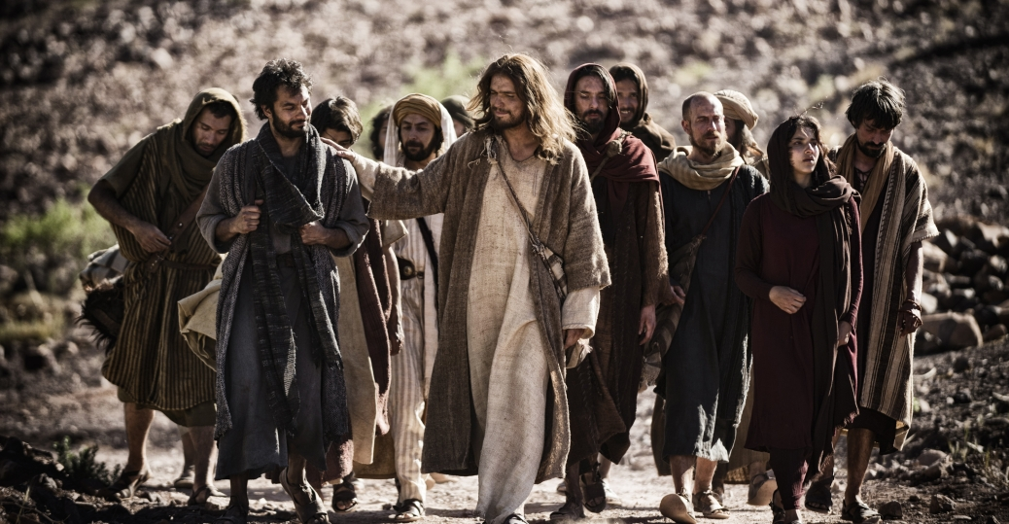
Jesus Chose Common People to be His Disciples:
They Were Common People but Learned Their Purpose in life and Became Great
They Were Willing to Obey His Teachings
They Were Willing to Forsake Worldly Pleasures and Entertainments to Follow Him
They Understood and Choose to Practice the Great Commandment and Great Commission
And THEY CHANGED THE WORLD
They Agreed to Practice What They Shared With Others

Slide 17
Today, Jesus Is Calling Students to Be His World-Changing Disciples
Understanding Their Purpose in Life, They Will CHANGE THE WORLD

Slide 18
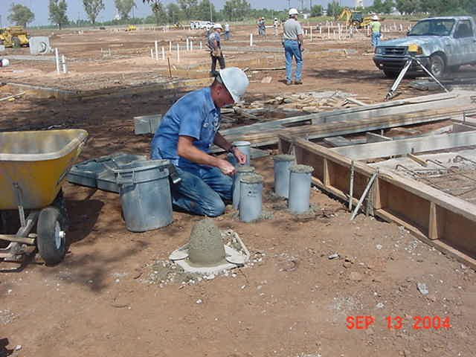
Jesus said, “I will show you what someone is like that comes to me, hears my words and acts on them“
“He is like a man building a house, who dug deeply, and laid the foundation on Rock “ (Luke 6:47-48)
ES establishes solid foundations for students that come to Jesus, hear His words, and acts upon them.

Slide 19
If a Student Does Not Clearly Know his/her Purpose in Life, ES will guide them.
If the Student is A Christian, They May Become A World-Changing Disciple of Christ

Slide 20
Spiritual Foundations - Disciplines
Select a Secret Place:
Come to Jesus: Pray
Hear His Words: Study the Bible
Determine Life’s Purpose
Acts On Jesus’ Words: Go and Make Disciples

Slide 21
During An 8 Week Period Adult Managers will Disciple a group of 4 to 6 Students:
Teach Eight ES Sessions
(one to 1 ½ hour classes)
Students will Complete Some Forms:

Slide 22
The Students to be Discipled Will:
1. Make a List of Students they know that are Away from God
2. Briefly write their Relationship with Jesus (their story)
3. Write a Brief Bridge to the Gospel
4. Recite John 3:16 (The Gospel)
Select A Secret Place

Slide 23
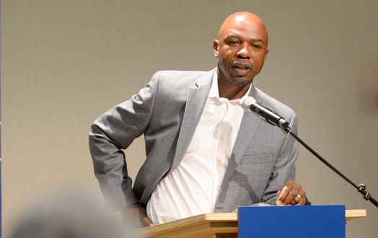
They Will Lead in Prayer
They Will Receive A Scripture-Based Vision
They will be Taught a Brief Discipleship Lesson
They will set Goals for the Following Week
They will Give An Account for How They Accomplished last Week’s Goals

Slide 24
We must have a radical paradigm shift back to Christian basics as outlined in the book of Acts
Our commission is to build the Kingdom: Start locally (our schools) and move out to the uttermost parts of the world

Slide 25
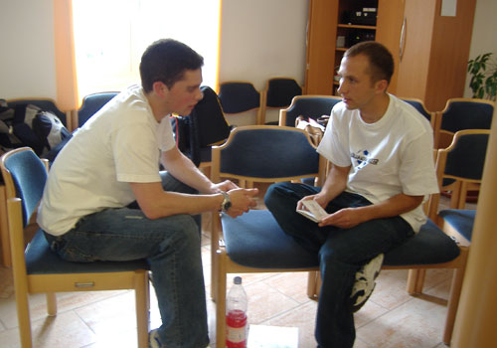
Have students Practice Sharing their Story in the Classroom.
Then Move Them to Share their Story in their Schools.

Slide 26
Let’s Do it!!

Slide 27
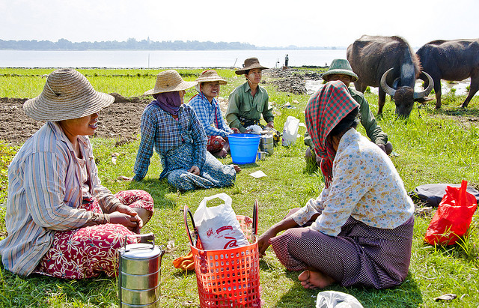
Let’s Take A Lunch Break
This Afternoon, We will Cover the content of Eight Student Discipleship Sessions Included in the Kit

Slide 28
An Adult will Teach each Session with Assistance from a Student for some of the parts
A Typical ES Meeting will include six parts:
1. Opening Prayer (Student Assist)
2. How are you doing Spiritually? (Student Assist)
3. Loving Accountability (Student Assist)
4. Vision Casting (Adult Led)
Following Week
5. Brief Discipleship Lesson (Adult Led)
6. Goal Setting (Student Assist)

Slide 29
The Eight ES Sessions:
1. Know Your Purpose (Christian and know my life-purpose)
2. Spiritual Disciplines (Daily applications)
3. Moral Boundaries (Where’s the line?)
4. Moral Boundaries Con’t (How Far Should I Go?)
5. Healthy Friendships (In the world but not of it!)
6. Wise Choices (Right for me? Will It Support My Purpose?)
7. Ultimate Authority (Parents, teachers, law, God)
8. Others First (Servanthood)

Slide 30
The Eight Visions Cast in ES:
Don’t Depend on Your Understanding: Depend on Jesus
(Proverbs 3:5-6)
2. Power: You Will Receive Power When the Holy Spirit Comes on You and You Will be My Witnesses to the Ends of the Earth. (Acts 1:8)
3. Attitude: I Can Do This in Christ!. (Philippians 4:13)
4. Self-Control: Take Up Your Cross Daily. (Luke 9:23)
5. Follow Me: I will make you Fishers of Men. (Matthew 4:19)
6. Vision: We Perish for lack of Vision. (Proverbs 29:18)
7. Commissioned: Go, Make Disciples…….. (Matthew 28:18-20)
8. He Loves You: He Commended His Love while we were Sinners. (Romans 5:8)

Slide 31
Sample Slides from the 8 Student ES Sessions

Slide 32
Adult Leads First Session Prayer for Their Schools
Pray For:
Example of First Student Session (Authentic Faith) Opening Prayer
Students
Teachers
Parents
Administrators
Cooks
Janitors

Slide 33
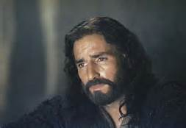
Authintic Faith is in a Person or an Object!
Authentic Christian Faith is in the Person of Jesus

Slide 34
Session # 1 Students: Think of people you know that are away from God
Fellow Students.
Pause for a few minutes to write these names on a form. Keep in your ES Binder

Slide 35
Do not use ‘Churchy’ words like “when I was young, I always went to church” or “I accepted Christ when I was 12 years old but got away from Him when I grew older.”
Use a few minutes
to discuss Your Relationship with Jesus. This will be Your Story.
Use a form to write out Your Story. Make it very brief. Keep in your ES Binder

Slide 36
Session # 1 Example of Your Story:
“Since I have Jesus in my life I have come into a relationship with Him: He has changed me, given me purpose and eternal life.”
Keep Your Story Very Short and easy for others to understand

Slide 37
Example of Second Student Session (Disciplines) “How Are You Doing Spiritually?”
Start by Briefly Sharing Your Relationship with Jesus
Each Student Briefly tells the group about their Relationship with Jesus. (They can read from their Notes)
This may be awkward for some: Encourage them to be honest and brief
Avoid using too much time with one student

Slide 38
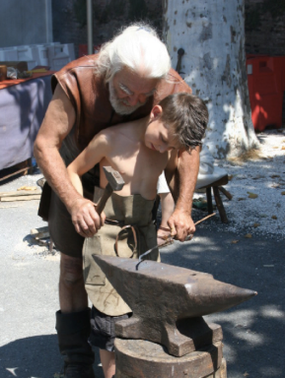
Spiritual Disciplines:
Discipline refers to the process by which one learns a way of life.
A disciple is like an apprentice who is learning a trade or craft from a master.
Such learning requires a relationship between the master who knows the way of life (discipline) and a learner (a disciple).
Within this relationship, the master leads a learner through a process (the discipline) until the learner can imitate or live like the master

Slide 39
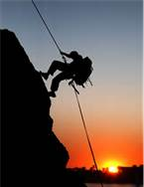
Vision Casting:
Can-Do Attitude
Example of Third Student Session (Moral Boundaries) Vision Casting by Adult

Slide 40
Discipleship - Moral Boundaries
How Far is Too Far?
Example of Fourth Student Session Discipleship Lesson by Adult
Where Will You Draw the Line?

Slide 41
Example Session #4 (Moral Boundaries Cont.) Discipleship Lesson:
True Christianity is Relationships
Proper Relationship with Jesus
Proper Relationship with Students of the Other Sex
Proper Relationship with
Parents

Slide 42
Moral Boundaries Continued: Choices are up to You.
Quality Life is on this Side.

Slide 43
Example Session #5 (Healthy Friendships) Goal Setting
Boys Perform a Good Deed for a Girl Student
Girls Perform a Good Deed for a Boy Student
Continue Daily Bible Study, Prayers and Meditation in Your Secret Place.
Pray for the Names on your List
Pray for your classmates
Tell Your Story to a student on your list
Memorize Philippines 4:13

Slide 44
Healthy Friendships
Friends will have a direct impact on the decisions made and standards chosen.
Healthy friendships builds a person up and draws them closer to Jesus; unhealthy friendships brings a person down and causes them to compromise what they know is right.
Your friends will determine the direction and quality of your life.
Matthew 4:19

Slide 45
Example Session #6 (Wise Choices) Accountability
Share the Good Deed you Did this Past Week
Tell Where You spend time Studying the Bible, Journaling, and Praying each day in Your Secret Place.
How Did the Student you Shared Your Story With Respond?
Tell Your Story and Your Bridge to the Gospel.
Recite Philippines 4:13
Q: Why should you do a good deed for someone of the opposite sex?
A: To learn to socialize properly with the opposite sex.

Slide 46
Wise Choices
Good decision making is more than simply choosing between right and wrong.
What is the wise thing to do in any situation?
In light of past experiences and my Life’s Purpose, what is the wise thing for me to do?
Proverbs 29:18

Slide 47
Example Session # 7 (Ultimate Authority)
When Someone with Authority has to be Away, He or She may Delegate their Authority to Someone Else
Jesus Has Delegated His Authority to Us in Matthew 28:18-20

Slide 48
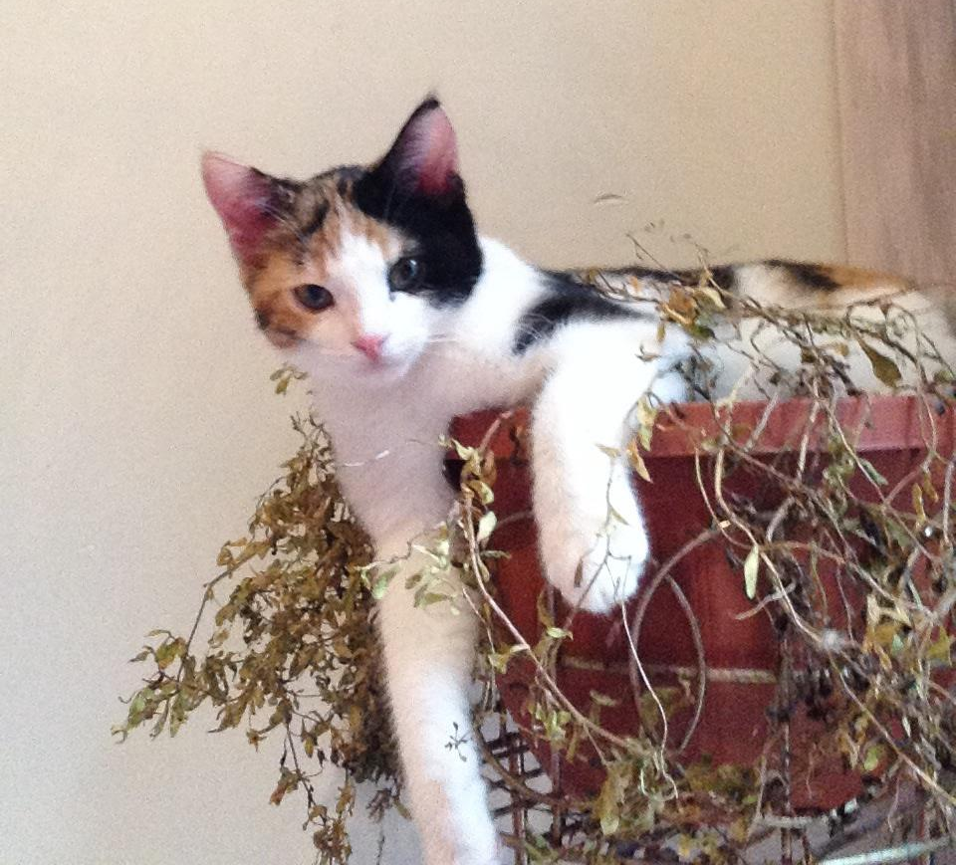
Example Session #8 (Others First)
How to Start making Others First:
Listen
Remember
Ask
Pray
Q: Why did Jesus instruct us to put others first?
A: Because He knows that we will be blessed the most.
Proverbs 11:25

Slide 49
Asking students to know their Purpose in Life and become Disciples/Equippers raises the bar of expectation radically.
Jesus was a Radical!
These students are making final preparations for their future.
They will soon marry and become parents.
They will influence our culture economically, morally, and spiritually,
This field is, indeed, ripe for harvest. Now is our only chance to help them Identify their Life Purpose.

Slide 50
There is a big difference between a Disciple and an Equipper.
Our churches have emphasized transfer of knowledge through preaching, Sunday school, special classes, etc.
Teaching transfers knowledge but Equipping changes behavior.
A Disciple is a student or a learner.
An Equipper is a Disciple that makes Disciples that will make Disciples (2 Timothy 2:2)

Slide 51
Remember
Let’s Do it!!

Slide 52
ES Scope & Organization
Equipping Central (Texas, USA)
State Managers
Nicaragua
Manager
Philippine
Manager
Nigeria
Manager
Brazil
Manager
Pacific
Manager
Atlantic
Manager
The UTTERMOST

Slide 53
Discussions and Questions Regarding ES
Do You Know Someone Who Will Help You?
Will You Become an ES Manager?

