Slide 1
E
S
Equipping
Students
To Change The World
3 Day Manager / Coordinator Training Kit

Slide 2
3 Day Adult Training OUTLINE:
Evening 1st Day
Overview of ES: Context & Why Students
3rd Day
Field Training
Breakfast
Example Opening
Example Spiritual Check
Example Vision Cast
Example Discipleship Lesson
Example Goal Setting
Example Accountability
Adult Application
2nd Day
ES Strategy
Purpose of ES; Discipleship, Equipping, Change the World
The Process; Student Sessions
Lunch
Eight ES Sessions
Opening & Spiritual Check
Vision Casting & Discipleship
Goal Setting & Accountability
Tomorrow Field Training & Commissioning
Evening 3rd Day
Commissioning

Slide 3
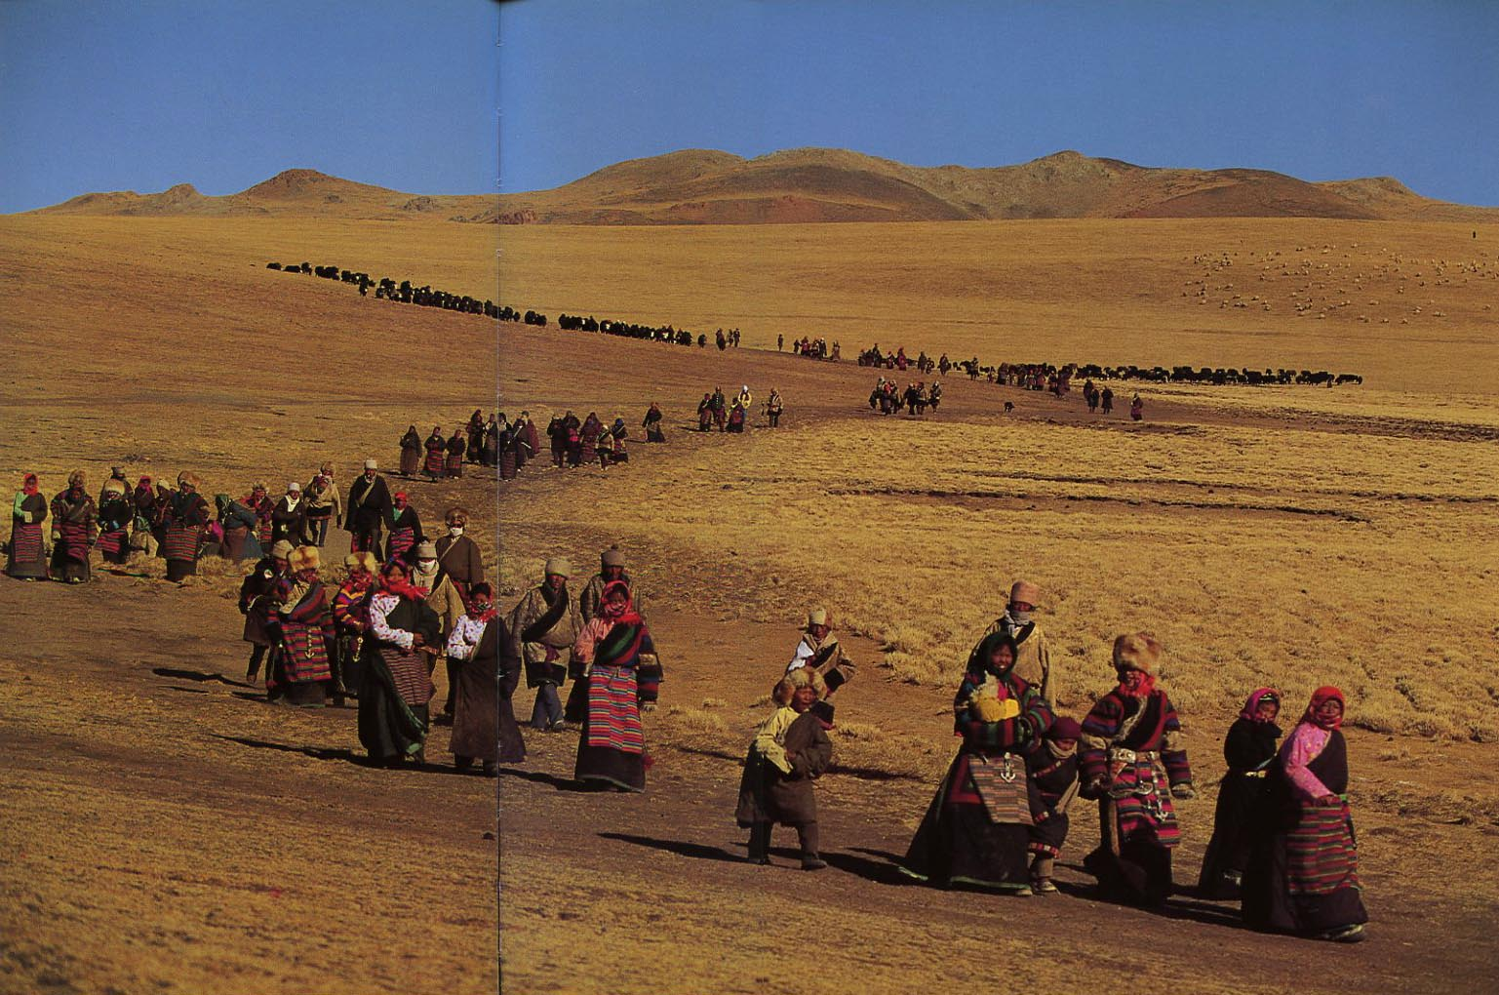
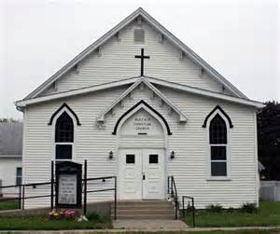
The Context for ES
People of all ages are leaving the Church and many are leaving Christianity in search of their Purpose

Slide 4
Post Christian Rate (per Barna Research)
Elders: Born Before 1945 (Over 70 years old)
Best Resource Age
28% of Post Christians are Elders
Boomers: 1946 – 1964
(51 to 69 years old)
Preparing to take the Mantle
35% of Post Christians are Boomers
Busters: 1965 – 1983 (32 to 50)
Most Influence on next Generation
40% of Post Christians are Busters
Mosaics: 1984 – 2000
(13 to 29 years old)
The Future of the Church
48% of Post Christians are Mosaics!

Slide 5
During the 1960s Polls showed the three most influential factors in a Student’s life to be:
1. Parents
2. Teachers
Today the three most influential factors in a Student’s life are:
3. Spiritual Leaders
1.Friends
2. Media
3. Parents
Spiritual Leaders has Dropped to 17th!

Slide 6
Why Focus on Students?:
1. They Represent the Future of Christianity.
2. They Are The Largest Group Leaving the Church.
3. They Have the Greatest Influence on their Peers.
4. They are Energetic, Idealistic, and Teachable.
5. They Will Soon Marry, Form Families, and Introduce Another Generation.

Slide 7
Three Day ES Manager/ Coordinator Training:
Day 1 (Evening) : Overview of ES
Day 2: Classroom Training about ES Strategy
Day 3: ES Field Training
Day 3 (Evening): Commissioning Service

Slide 8
Overview of ES
(Evening of DAY ONE)

Slide 10
Adult ES Network
ES is designed to be a Sustained, Multiplying, Discipleship Ministry (Matt. 28:18-20)
Step 1. – Appoint and Train Adult Managers
ES Success Depends Upon Adult Managers
Step 2. – Select and Train Adult Coordinators
Step 3. – Select Group of Students
Step 4. – Equip 1st Student Group
Step 6 Equip
Step 5. – Select 2nd Student Group
ES Coordinators
ES Coordinators
1st Group Selects 2nd Student Group
ES Regional Managers

Slide 11
Regional Christian Adult Managers & Coordinators are required to start an ES Movement.
They will manage ES in their area and report Results to Equipping Central.
This couple will become the Regional Managers for ES
NOTE: The Managers will not be expected to perform all of the arrangements for ES courses
They will seek ES Coordinators to help before equipping students.

Slide 12
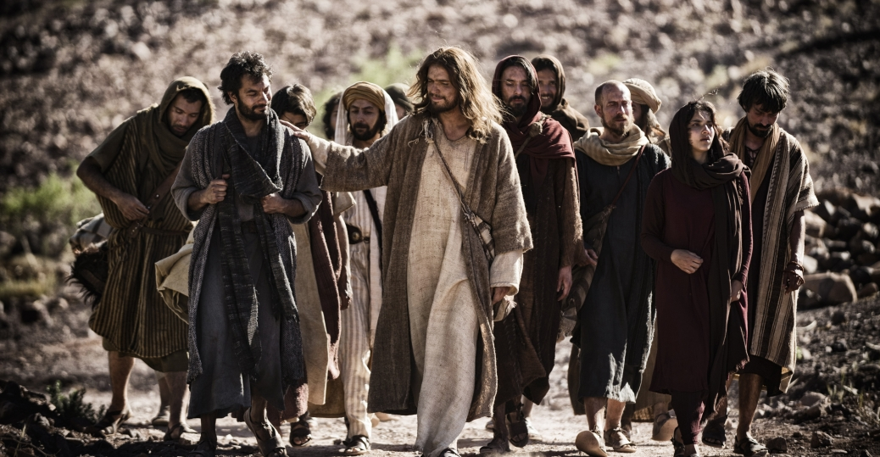
Jesus Chose Common People to be His Disciples:
They Were Willing to Obey His Teachings
They Were Common People but Became Great
They Were Willing to Forsake Worldly Pleasures and Entertainments to Follow Him
They Understood and Choose to Practice the Great Commandment and Great Commission
They Agreed to Practice All that They Shared With Others
And THEY CHANGED THE WORLD

Slide 13
Today, Jesus Is Calling Students to Be His World Changing Disciples
Properly Discipled, THEY WILL CHANGE THE WORLD

Slide 14
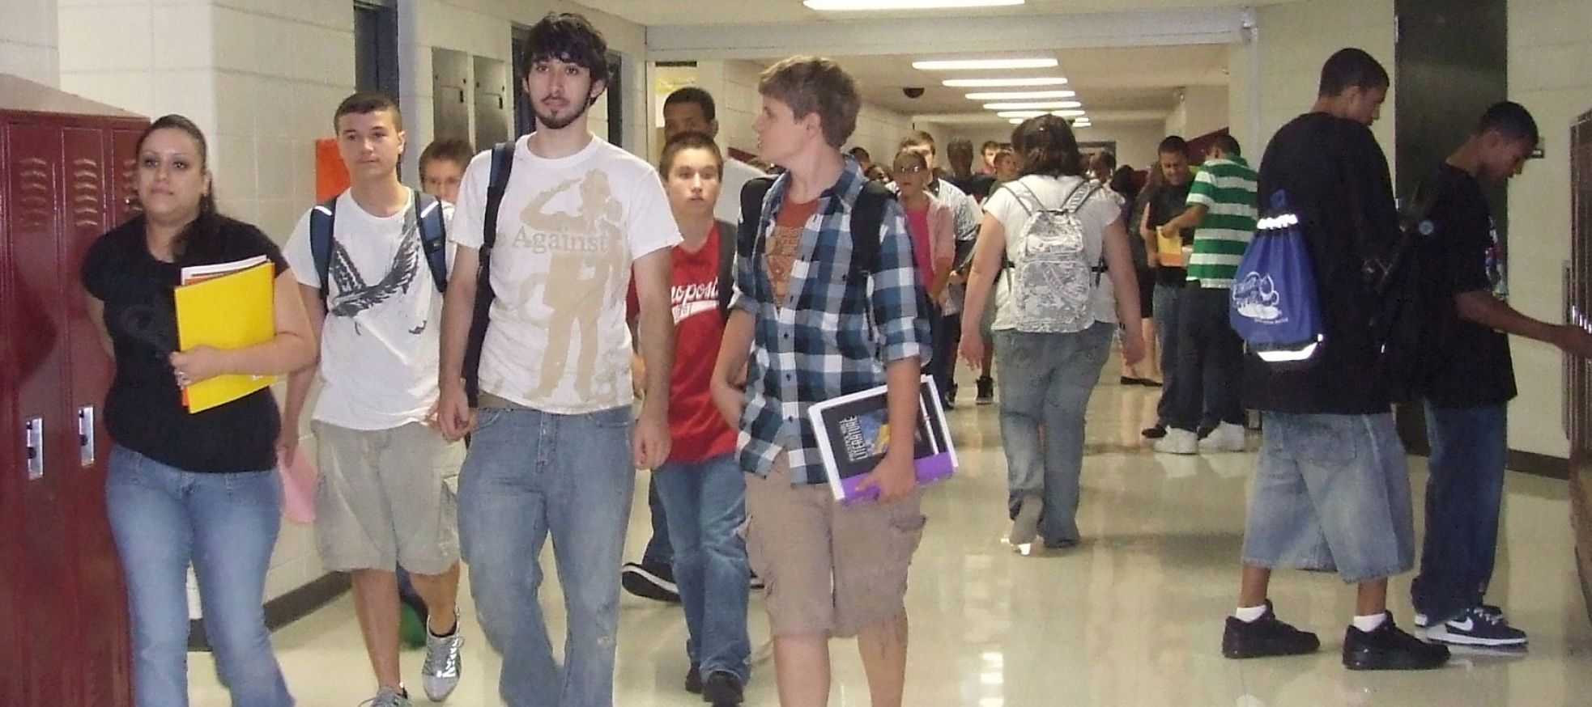
Manager Tasks Prior to initial Student Training:
2. Recruit a small group of Christian Jr. High, High School/College Students (4 to 6) to be equipped to take the Gospel onto their campuses
1. Select a few adults to observe and help with the first Student Equipping Cycle
3. Select a suitable off-campus location for ES Training Sessions with:
a. AC electrical power. Extension cord with two outlets
b. Tables for students to write on.
c. Individual Chairs.
d. Screen or suitable wall for projecting training slides
e. Rest Room.
g. Copy Machine (if available)
f. Good lighting

Slide 15
Each student must be Provided:
A Student Study Bible
A binder containing:
ES Student Manuals
A Journal
Scriptures and ES Forms
Writing Pen

Slide 16
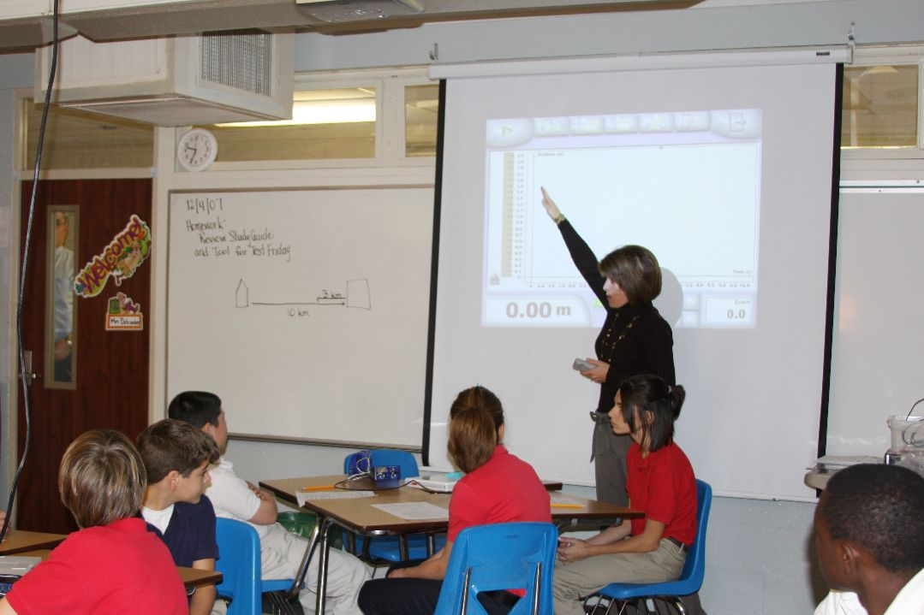
Schedule and conduct the initial Eight ES Classes
Adult Coordinators sit in as Observers

Slide 17
Students Will:
1. Make a List of Students they know that are Away from God
2. Briefly write about their Relationship with Jesus (their Story)
3. Write a Brief Bridge to the Gospel
4. Recite John 3:16 (The Gospel)
Select a Secret Place

Slide 18
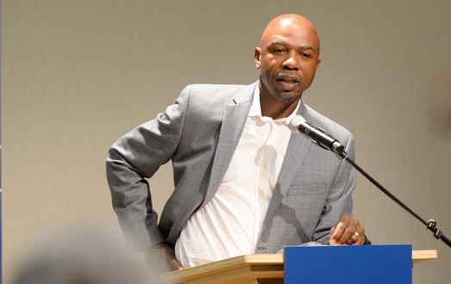
They Will Lead in Prayer
A Scripture Based Vision will be Cast
They will be Taught a Brief Discipleship Lesson
They will set Goals for the Following Week
They will Give An Account for How They Accomplished last Week’s Goals

Slide 19
Equipping Central Will:
Maintain Information and Training Materials needed by Regional Managers & Coordinators.
Write and Distribute ES Newsletters
Training materials include Power point slides, Videos, student manuals, student forms, etc.
Maintain a Web Site / BLOG

Slide 20
ES Scope & Organization
Equipping Central (Texas, USA)
State Managers
Nicaragua
Manager
Philippine
Manager
Nigeria
Manager
Brazil
Manager
Pacific
Manager
Atlantic
Manager
The UTTERMOST

Slide 21
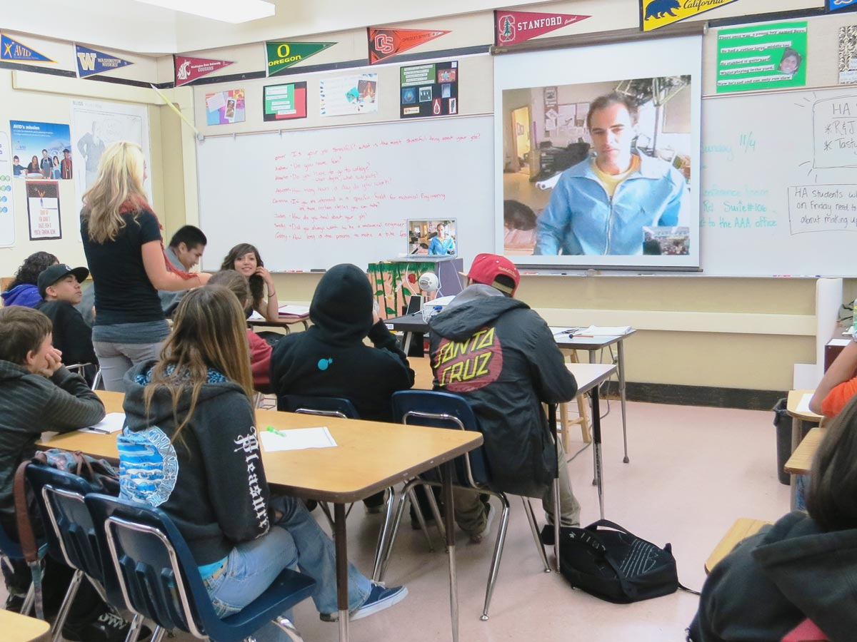
Sustained ES:
The Managers will schedule and conduct 8 weekly (1 to 1 ½ hour) Student training sessions and follow up with the students
Adult Coordinators will monitor all classes
This Process will continue By Selecting additional Adult Coordinators and Student Groups
1st Student Group will Recommend a 2nd Group of Students upon completion of their training.
Adult Coordinators will Equip the 2nd Student Group
Managers will Recruit Additional Adult Coordinators who will Monitor Subsequent Student classes

Slide 22
Tomorrow We will spend the day going over the BASIC STRATEGY OF ES
Time and Location ?
Questions and Discussions about Equipping Students (ES)
Conclude the Evening with Prayer

Slide 23
BASIC STRATEGY OF ES
(DAY TWO)

Slide 26
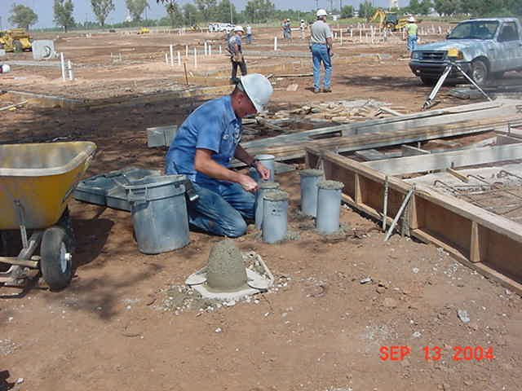
Jesus said, “I will show you what someone is like that comes to me, hears my words and acts on them“
“He is like a man building a house, who dug deeply, and laid the foundation on Rock “ (Luke 6:47-48)
ES establishes solid foundations for students that will come to Jesus, hear His words, and acts upon them.

Slide 28
We must have a radical paradigm shift back to Christian basics as outlined in the book of Acts
Our commission is to build the Kingdom: Start locally (our schools) and move out to the uttermost parts of the world

Slide 29
Appoint and Train Adult Managers and Coordinators
How
Recruit a Small Group of Christian Students (4 to 6)
Adults and Students must be Committed to Faithfully Obey Selected New Testament Commandments and Commissions
They must be taught to Absolutely Depend upon the Holy Spirit to Accomplish the Objectives of ES

Slide 30
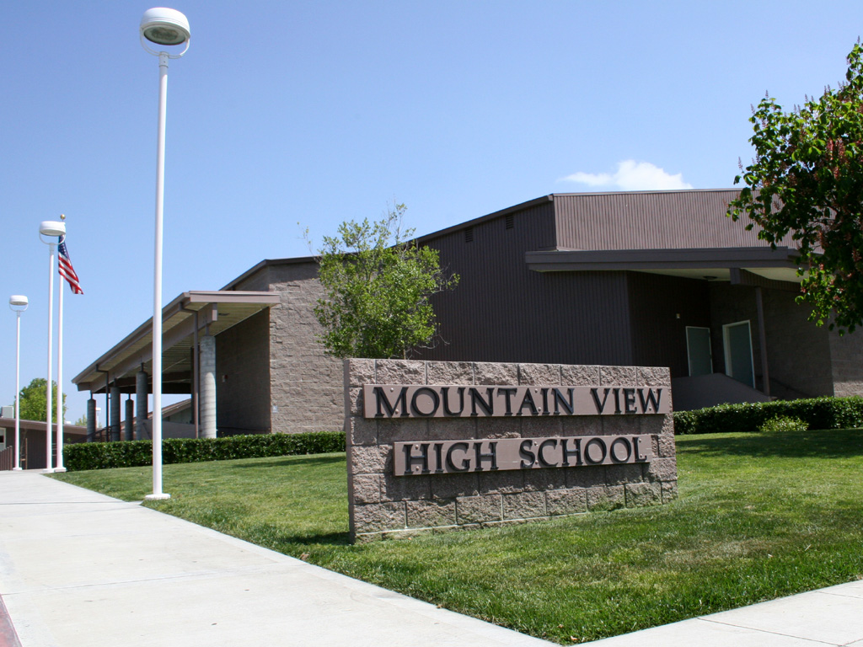
The ES Process
ES Manager Training
(3 days)
Select Managers & Coordinators
Manager /Coordinators
Students
1st Generation Story
1st List
1st Bridge
1st Witness
8 Weeks
2nd Bridge
2nd List
2nd Story
2nd Generation Disciples
2nd Generation
3rd Generation Disciples
4th Generation Disciples
SCHOOL
2nd Witness

Slide 31
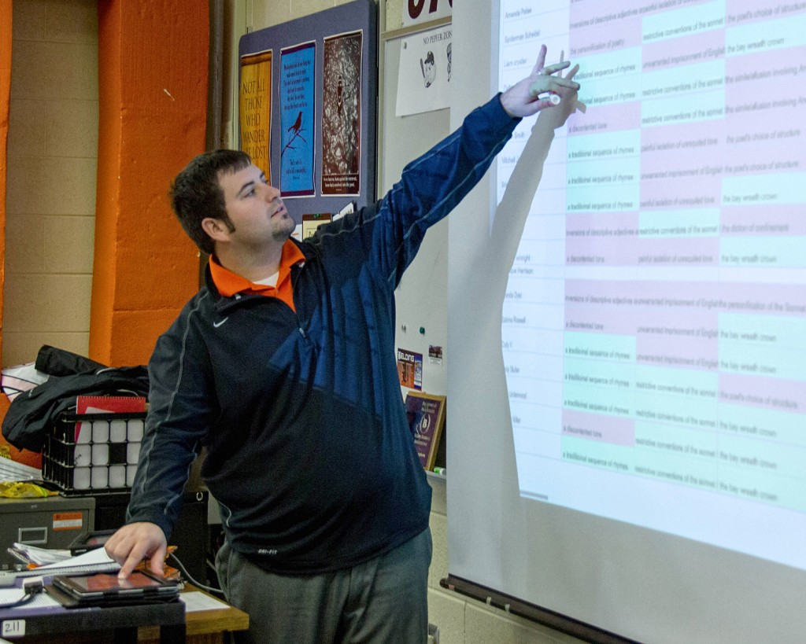
Equip the Students with a Solid Relationship with Jesus as their Foundation

Slide 32
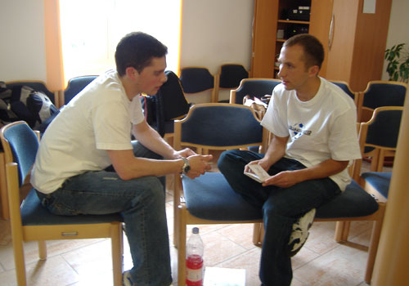
Have Students Practice sharing their story in class and then take it to their schools.

Slide 33
An Adult will Teach each Session with Assistance from a Student for some of the parts
A Typical ES Meeting will include six parts:
1. Opening Prayer (Student Assist)
2. How are you doing Spiritually? (Student Assist)
3. Loving Accountability (Student Assist)
4. Vision Casting (Adult Led)
Following Week
5. Brief Discipleship Lesson (Adult Led)
6. Goal Setting (Student Assist)

Slide 34
The Eight Visions Cast in ES:
Don’t Depend on Your Understanding: Lean on Him
(Proverbs 3:5-6)
2. Power: You Will Receive Power When the Holy Spirit Comes on You and You Will be My Witnesses to the Ends of the Earth. (Acts 1:8)
3. Attitude: I Can Do This in Christ!. (Philippians 4:13)
4. Self-Control: Take Up Your Cross Daily. (Luke 9:23)
5. Follow Me: I will make you Fishers of Men. (Matthew 4:19)
6. Vision: We Perish for lack of Vision. (Proverbs 29:18)
7. Commissioned: Go, Make Disciples. (Matthew 28:18-20)
8. He Loves You: He Commended His Love while we were Sinners. (Romans 5:8)

Slide 35
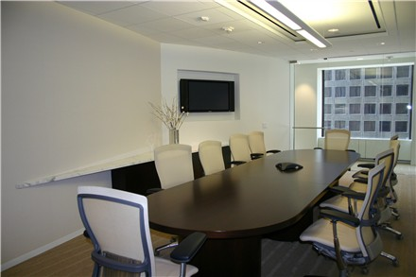
The Manager / Coordinator must set up the equipping room and test the projection equipment before the Students arrive.
Students should bring their Binder and Pen to each Session
Never ask a question for which a single word can be the answer.
Insist that Students answer with sentences rather than with one word.

Slide 36
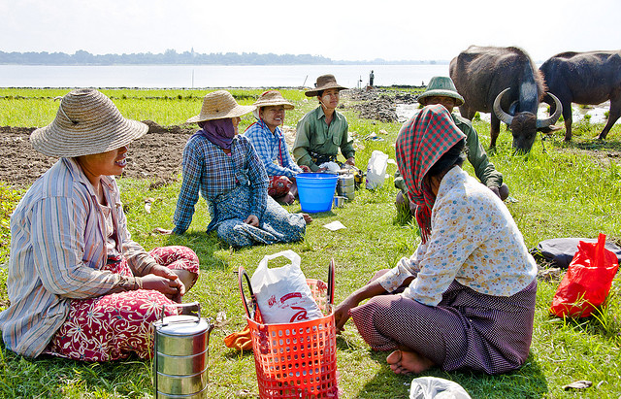
Let’s Take A Lunch Break
This Afternoon, We will Cover the content of Eight Student Discipleship Sessions

Slide 37
The Eight Brief Discipleship Lessons in ES:
1. Know Your Purpose (Make sure they are saved)
2. Spiritual Disciplines (Daily applications)
3. Moral Boundaries (How Far is to Far?)
4. Moral Boundaries Con’t. (Where’s the line?).
5. Healthy Friendships (In the world but not of it!)
6. Wise Choices (Is this right for me?)
7. Ultimate Authority (Parents, teachers, law, God)
8. Others First (Servanthood)

Slide 38
Following are Examples of the six parts of each Student Session

Slide 39
Adult Leads First Session Prayer for Their Schools
Pray For:
Students
Example of First Student Session Opening Prayer
Teachers
Parents
Administrators
Cooks
Janitors

Slide 40
Students: Think of people you know that are away from God
Fellow Students.
Pause for a few minutes to write these names on form ES2. Keep in your Binder

Slide 41
Do not use ‘Churchy’ words like “when I was young, I always went to church” or “I accepted Christ when I was 12 years old but got away from Him when I grew older.”
Use a few minutes
to discuss Your Relationship with Jesus. This will be Your Story.
Use form ES1 to write out Your Story. Make it very brief. Keep in your Binder

Slide 42
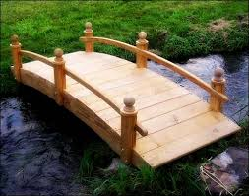
Your Story
BRIDGE: I can tell you how to have eternal life?
The Gospel (John 3:16)
Do you want eternal life?

Slide 43
Example of Your Story:
“Since I have a Relationship with Jesus, He has changed me, revealed my Purpose, and given me eternal life.”
Keep Your Story Very Short and easy for others to understand

Slide 44
The Gospel:
“God so loves YOU that He gave His only begotten Son so that if YOU believe in Him (Authentic Faith) YOU will not perish but have everlasting life.” John 3:16

Slide 45
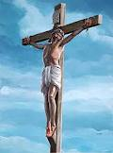
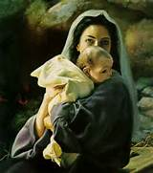
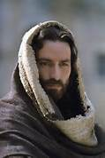
GOD
A Holy and Sinless Place
The Gospel
John 3:16
Father
Son
Holy Spirit
GRACE
Grace
Cloud of Sin Separates
Authentic Faith

Slide 46
It is very important that you only use ONE Story, Bridge, and Gospel. Practice it often – Be able to use it under all circumstances

Slide 47
Your Story Might Be :
My Life Before Christ Was Without Purpose
My Life Before Christ Was One of Depression
My Life Before Christ Was Filled with Loneliness
My Life Before Christ Was Held Hostage by Addictions
Bridge: But Now I Am Free from my past! You can be too! Can I tell you how?

Slide 48
True Christianity is a Relationship with Jesus.
It is not membership in an organization, study group, or social program.
Establishing and maintaining a Relationship with Jesus takes daily Discipline.

Slide 49
Ask, “How are You Doing Spiritually ?”
Example of Second Student Session Spiritual Check “How Are You Doing Spiritually?”
Start by Briefly Sharing Your Relationship with Jesus
Each Student Briefly tells the group about their Relationship with Jesus
This may be awkward for some: Encourage them to be honest and brief
Avoid using too much time with one student

Slide 50
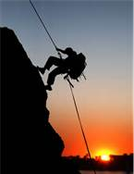
Vision Casting:
Can-Do Attitude
Example of Third Student Session Vision Casting by Adult

Slide 51
Discipleship - Moral Boundaries
How Far is Too Far?
Example of Fourth Student Session Discipleship Lesson by Adult
Where Will You Draw the Line?

Slide 52
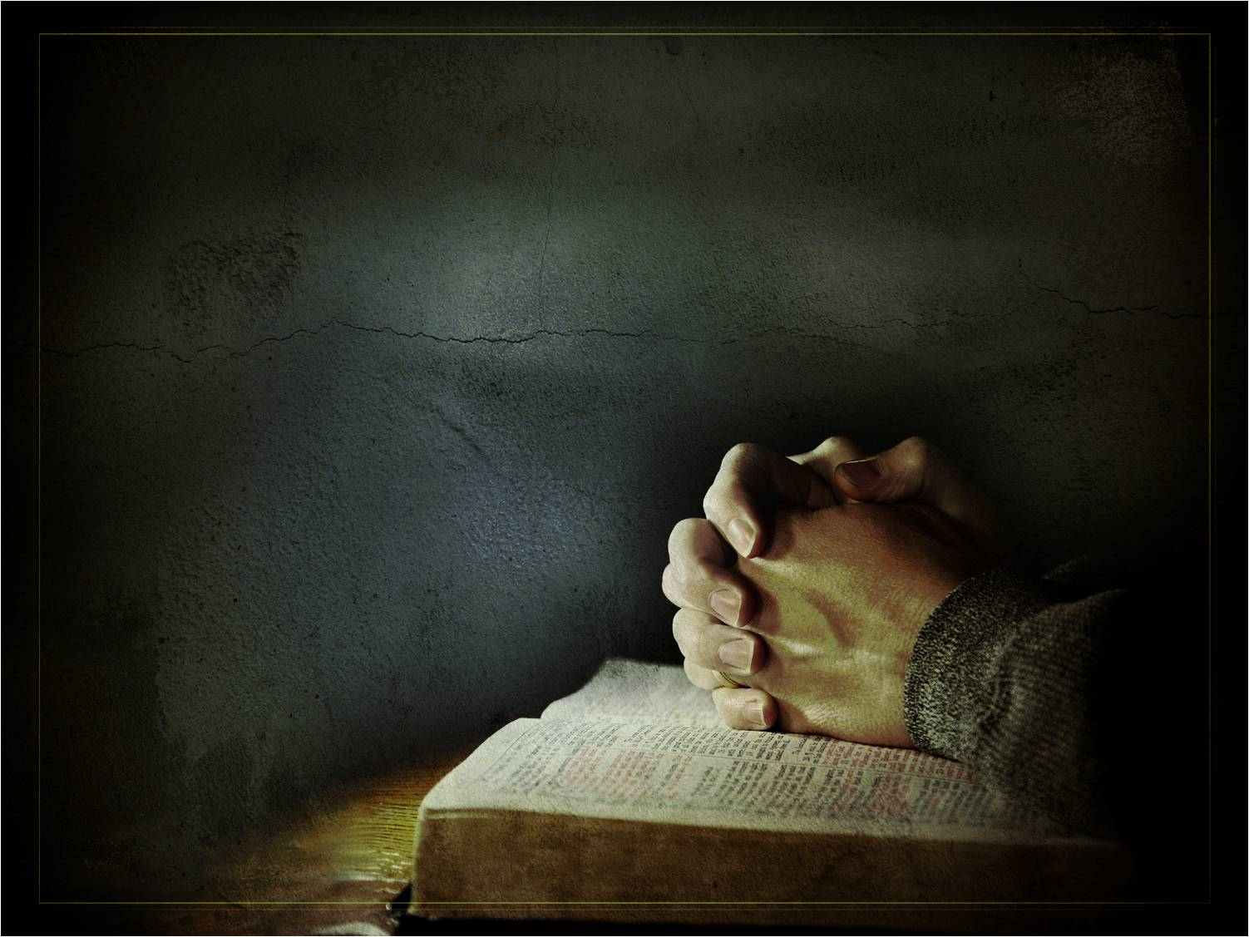
Goal Setting for Session #1
Starting tomorrow, rise early each morning (for the rest of your life),
Locate a secret place, and do the following:
Read at least a chapter of the Bible (Suggest starting with the Book of John)
Example of First Student Session Goal Setting
Journal your impressions about what you read
Pray: Confess any known sins.
Thank Jesus for what He has done to set you free from the penalty of your sins and from the power of sin.
Review Your Story, Revise it but keep it brief
Write Your Bridge to the Gospel
Add to Your List of Students that you Know are away from God.
Memorize Acts 1:8

Slide 53
Keep Your Bible, ES Binder, and Pen in Your Secret Place

Slide 54
Accountability for Session #2
Ask each Student to:
Tell what you learned from the chapter of John read this morning?
Example of Second Student Session Accountability
Select and read your Journal entry for one morning this past week. How many days have you made entries in your Journal?
Tell how you identified students on Your List of People Away from God?
Tell Your Story
Repeat Proverbs 3: 5-6

Slide 55
The Seven ES Discipleship Topics

Slide 56
1. Know Your Purpose
Authentic Faith focuses on a correct understanding of faith.
The Object of Authentic Faith is the Person, Jesus, the Christ
Authentic faith is confidence that Jesus is who He says He is --- and confidence that He will do everything He has promised to do.
Jesus can be trusted. He will do all He has promised to do.
Proverbs 3:5-6.

Slide 57
Trust Jesus with all your heart and Depend not on your own understanding,
In all your ways Acknowledge Him, and He will direct your life.

Slide 58
2. Spiritual Disciplines
Spiritual Disciplines focuses on the devotional life. Actions you need to take
True transformation comes from a renewed mind.
When you see as Jesus sees, you will do as Jesus says.
A Disciple of Christ practices a consistent devotional life (Prayer, Bible study, Journaling, Sharing).
Acts 1:8.

Slide 59
You will receive power when the Holy Spirit comes upon you and you will be My witnesses in your school, other schools, your town, and to the ends of the earth.

Slide 60
3. Moral Boundaries
Clear moral limits must be established and practiced
Protect our bodies and emotions by honoring God’s plan for morality
Purity paves the way to intimacy.
Philippines 4:13

Slide 61
Where Should You Draw the Boundary Beyond Which You will Not Cross?

Slide 63
Rather than let Peers pressure you, Love them.

Slide 64
Philippians 4:13

Slide 65
4. Healthy Friendships
Friends will have a direct impact on the decisions made and standards chosen.
Healthy friendships builds a person up and draws them closer to Jesus; unhealthy friendships brings a person down and causes them to compromise what they know is right.
Your friends will determine the direction and quality of your life.
Matthew 4:19

Slide 66
Follow Me and I’ll make you fishers of men.
Matthew 4:19

Slide 67
5. Wise Choices
Good decision making is more than simply choosing between right and wrong.
What is the wise thing to do in any situation?
In light of past experiences and my purpose in life, what is the wise thing for me to do?
Proverbs 29:18

Slide 68
Proverbs 29:18

Slide 69
6. Ultimate Authority
Authority and Freedom are not opposing concepts!
True freedom comes from God’s ultimate authority and respect for earthly authorities He has placed over us.
Maximum freedom is found under God’s authority

Slide 70
I will Be With You
Matthew 28:18

Slide 71
7. Others First
Selfishness comes naturally.
Selflessness must be learned.
Consider others over self.
Others First focuses on the true nature of humility and service.
Romans 5:8

Slide 72
God commended His love toward us in that while we were still sinners, Christ died for us.

Slide 73
Asking students to become Disciple/Equippers raises the bar of expectation radically.
Jesus was a Radical!
In a few years, these students will be making final preparations for their future.
They will marry and become parents.
They will influence our culture economically, morally, and spiritually,
This field is, indeed, ripe for harvest. Now is our only chance to guide them.

Slide 74
There is a big difference between a Disciple and an Equipper.
Our churches have emphasized transfer of knowledge through preaching, Sunday school, special classes, etc.
Teaching transfers knowledge but Equipping changes behavior.
A Disciple is a student or a learner.
An Equipper is a Disciple that makes Disciples that will make Disciples (2 Timothy 2:2)

Slide 75
Let’s Do it!!

Slide 76
Tomorrow We will Meet for Breakfast and Complete our Training.
Where ?
Time?
Conclude today’s training with Prayer

Slide 77
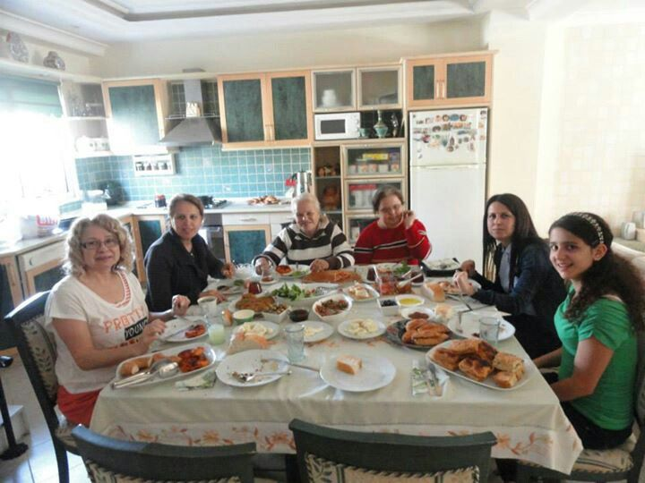
DAY THREE
Managers/Coordinators Meet in the morning for breakfast
Write Your Story
(Be Brief)
Write your Bridge to the Gospel (Also Brief)
List people you know that are away from God that can be contacted today
Share John 3:16 with each other
After Breakfast, Make contact with one of the people on your list.
Share Your Story with each other

Slide 78
REMEMBER:
As their teacher, You must Do what you will ask them to do.

Slide 79
Invite the person you contacted to a cup of coffee (or tea).
During your conversations, tell Your Story.
Bridge Your Story to the Gospel
(John 3:16).
Recite John 3:16 (the Gospel)
Ask if he/she would like to be sure they can have eternal life.
Be Prepared to Give him/her a Christian tract and a Bible if one is needed.
Ask to follow-up with him/her. Thank them for the visit

Slide 80
Example of Your Story, Bridge, Gospel
Your Story:
Since I have a Relationship with Jesus, He has changed me, removed my sins, revealed my purpose in life, and given me eternal life.
I Am Free from my past! You can be too! Can I tell you how?
Bridge:
Gospel:
“God so loves YOU that He gave His only begotten Son so that if YOU believe in Him YOU will not perish but have everlasting life.” John 3:16

Slide 81
DAY THREE (Evening)
Managers / Coordinators meet to discuss ES, share questions they have, and problems they foresee.
Pray for students, parents, teachers, and their school campuses
Pray that ES will be anointed to start a sustained Spiritual Awakening among Students

Slide 82
REMEMBER:

Slide 83
Commissioning
Each ES Manager / Coordinator completing three days of training will be Commissioned to start and sustain an ES movement locally.

Slide 84
ES Commission
Congratulation!
You have been prepared to Equip Students (ES) to:
Be accountable for exercising:
Authentic Faith in Jesus, the Christ,
Daily Spiritual Disciplines,
Moral Boundaries,
Healthy Friendships,
Wise Choices,
Ultimate Authority, and
Preferring Others First
Reynard Venturina
Date: May 17, 2016
Place: Santa Rosa, Philippines
____________________________________
Witnessed By:
“Equipping Disciples to make Disciples” II Timothy 2:2

