Slide 1
E
S
Equipping
Students
Session 1
To Change The World
Know Your Purpose

Slide 3
REMEMBER:
Proverbs 3:6

Slide 4
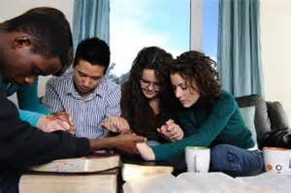
Opening Prayer for Your School
Students
Teachers
Parents
Administrators
Cooks
Janitors

Slide 5
How are You Doing Spiritually?
Q: Why do you think students new to ES should reveal how they are doing spiritually?
A: To gain experience in verbalizing their faith.
A: So the group will know how to pray for each other.

Slide 6
Let’s Share our Relationship with Jesus Story:
What is Your Story?
Here’s Mine
Since I have come into a relationship with Jesus, He has made me His brother/sister, Shown me my Purpose in Life,
and given me eternal life.
My Life Before Christ Was One of Depression
My Life Before Christ Was Without Purpose
OR
My Life Before Christ Was Held Hostage by Addictions
My Life Before Christ Was Filled with Loneliness
BRIDGE: But Now I Am Free from my past! You can be also! Can I tell you how?

Slide 7
Use the Blank ES1 Form in your ES Binder to write Your Story. Keep it very Brief.
Use ES2 form to write the names of Students You Know that Are Away from God.

Slide 8
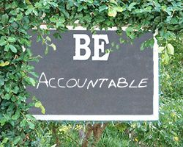
Accountability
At the Close of each meeting, we will set Goals for the following week.
Starting at our next meeting, You will Share How You Accomplished Your Goals?
Q: Why is it important to be accountable for accomplishing and reporting goals?
A: Life after graduation demands it.
Q: What are some goals you will be expected to accomplish after graduation

Slide 9
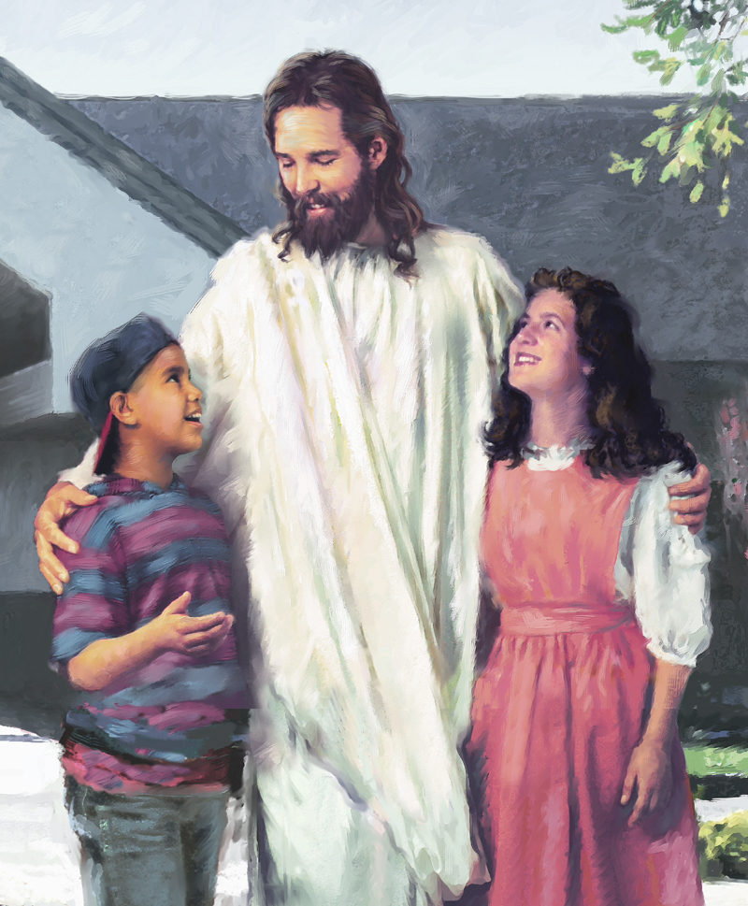
Vision Casting
Apart From Me (Jesus), You Can Do Nothing!
(John 15:5)
We Christians are able to accomplish amazing things in God’s Kingdom.
BUT
We MUST, however, not attempt ministry in our flesh (self), we MUST draw upon the Power and Wisdom of His Spirit.
I Can Do All Things Through Christ who Strengthens Me.
(Philippians 4:13)

Slide 10
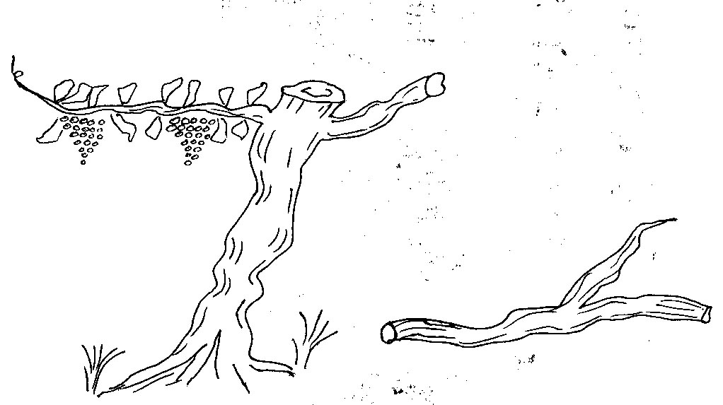
Q: What did Jesus mean when He told us to take up our cross daily and follow Him ? -- Luke 9:23
John 15: 5
I am the Vine; you are the branches. If a man remains in me and I in him, he will bear much fruit, apart from me you can do nothing.
A: We are to live as if our Self has been crucified (dead to our selfishness). (Galatians 2:20)
A: We are to follow Jesus daily. Our relationship with Jesus reveals our purpose, and equips us to live free, quality lives. (Matthew 4:19)
You can know your purpose and be a productive Christian by remaining in Christ
Jesus is the source of Power – The Vine
Or you can do the best you can without Christ – Nothing (Dead Works)

Slide 11
Brief Discipleship Lesson
Know Your Purpose
We Are

Slide 12
Do You Know What Your Life Purpose is ?
If not, Would you Like to Know?
You Should Be Preparing to Fulfill Your Purpose Now While you Have the Opportunity
The Bible Tells Us that We Can and Should Know!

Slide 13
Do You want to find your true vocation in this world?
Do You want to find the true Purpose for which God created you?
And God Does Want to Do Something With You!
Do You want to find your true purpose for which Christ died for you?
Do You want to know what God wants to do with you?

Slide 14
As long as you hold on to your life for yourself, you will never know!
Jesus says, “He that loses his life shall find it;” that is, whoever will give up his own life for Jesus’ sake shall find the purpose of his life.

Slide 15
Failure to Fulfill One’s God-Given Purpose Can Lead to a Life of Idleness, Self Gratification, Incompleteness, Worldly Additions, and despair!

Slide 16
We will Know our Life’s Purpose by Abiding in Christ
Jesus Calls each of us to become one of His Students (Disciples) and promises to Always be with us.
Jesus can be trusted. He will do all He has promised to do.
The foundational cornerstone of our faith is Jesus.
Proverbs 3:5-6.

Slide 17
Trust the Lord with All your heart and lean not upon Your Understanding.
Acknowledge Him in All that you do and He will direct your life! Proverbs 3: 5-6

Slide 18
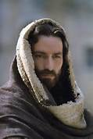
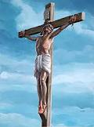
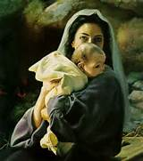
GOD
Holy and Sinless Heaven
God the Word Came Down to Earth
Father
John 3:16
Word
Holy Spirit
GRACE
Grace
Cloud of Sin Separates
Authentic Faith
He was named Jesus.

Slide 19
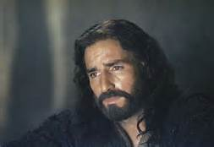
All Faith is in a Person or an Object!
Authentic Christian Faith is in the Person of Jesus
Only Jesus Reveals Our Purpose for Being Created!

Slide 20
Do You Know Jesus?
More Important
Does Jesus Know You?
If You are not Sure, We need to settle Your Relationship with Him
We Can Help You to be Sure.

Slide 21
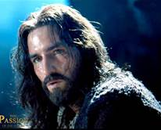
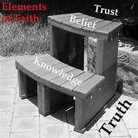
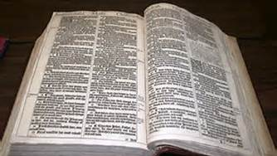
Q: Why do you think that God insists that we faithfully trust Jesus?
A: Because He knows the purpose for which He created us and the best way to fulfill that purpose is to follow Jesus’ example.

Slide 22
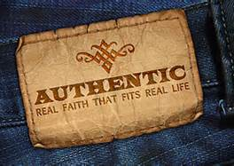
Now He Is

Slide 24
Goal Setting for Session 1
Select a Secret Place
Start a Daily Journal:
Date each Entry
Start reading a chapter of the Book of John each day and journal what the verses mean to you.
Add to your list of students that you know are away from God.
Rewrite Your Story
(very brief)
Memorize Proverbs 3:5-6

Slide 25
Q: Why do you think it is important to set spiritual goals?
A: To build a spiritual foundation upon which to Know and Fulfill Your Purpose

Slide 26
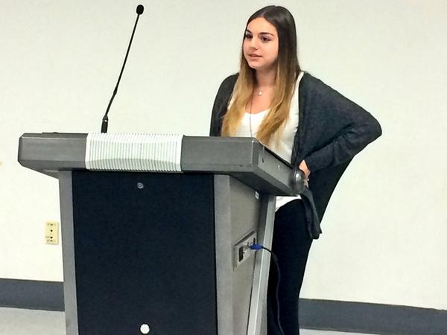
You Will Be Called Upon to Report How You Accomplished Your Goals Next Week.

