Slide 1
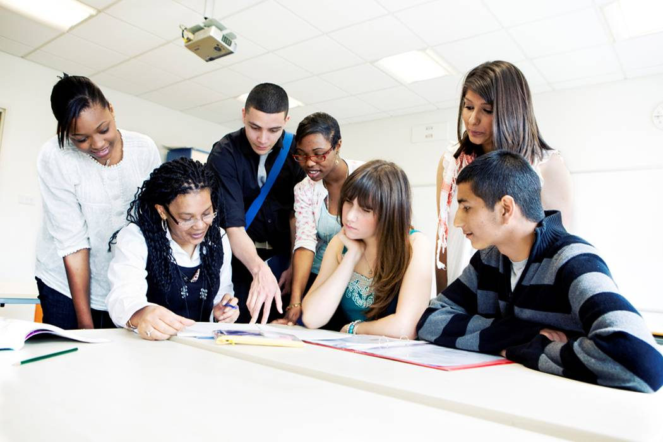
E
S
Equipping
Students
Session 2
To Change The World
Spiritual Disciplines

Slide 3
REMEMBER:
Proverbs 3:6

Slide 4
Student Led Prayer
Ask for additional names of students away from God
Ask to strengthen Your Relationship with Jesus

Slide 5
How are You Doing Spiritually?
Describe Your Relationship With Jesus
Q: Why should you care about the time used during this sharing time?
A: To avoid using too much time with one student
A: To tactfully keep the group on the subject

Slide 6
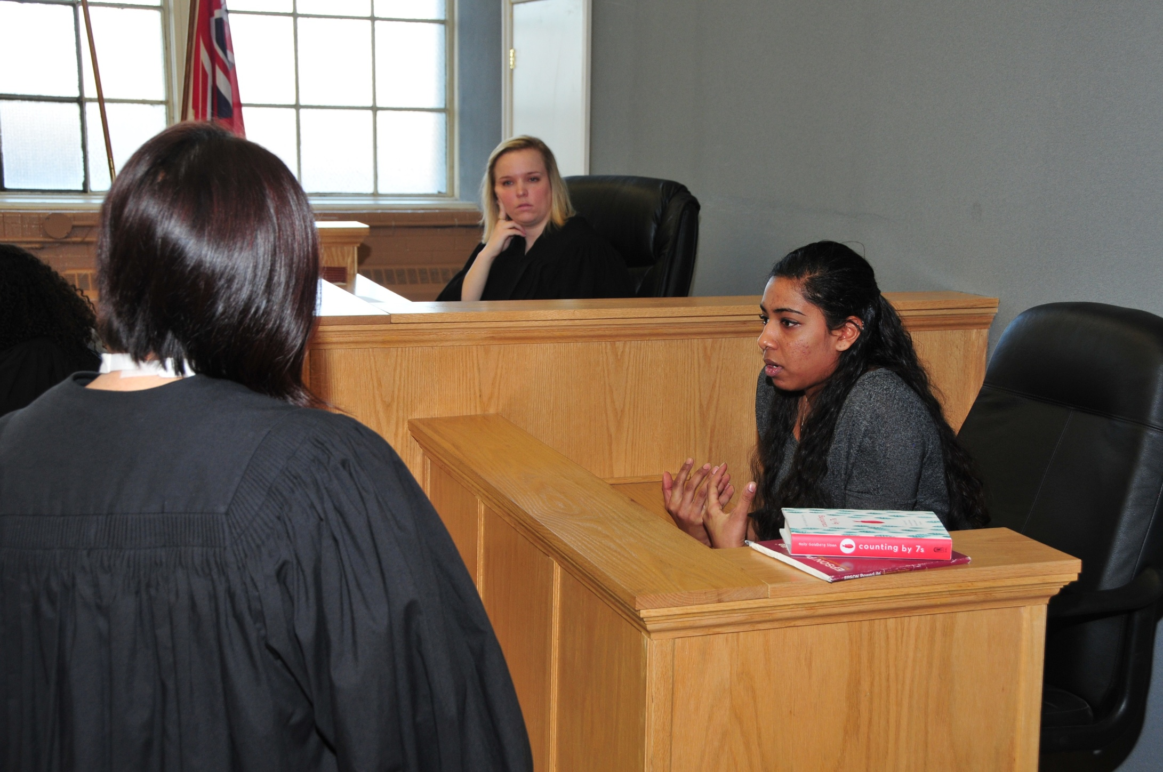
Accountability for Session #2
Ask Student to:
Describe Their Secret Place
Select and read your Journal entry for one morning this past week. Read what you learned from the chapter of John read this morning.
Tell how you identified students on your List of Students Away from God?
Tell Your story
Repeat Proverbs 3: 5-6

Slide 7
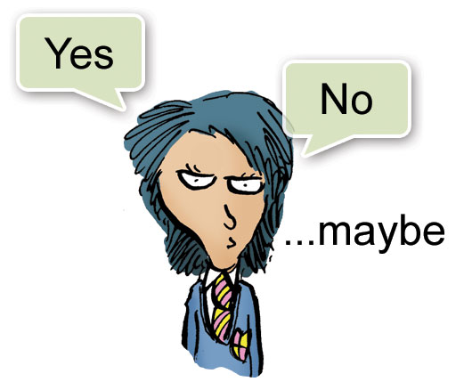
Q: Why should the students answer with sentences rather than a single word?
A: To get out of the shy box and learn to express him/herself more clearly

Slide 8
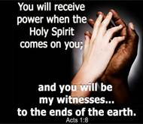
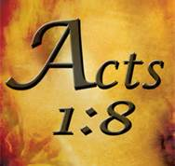
Vision Casting:

Slide 9
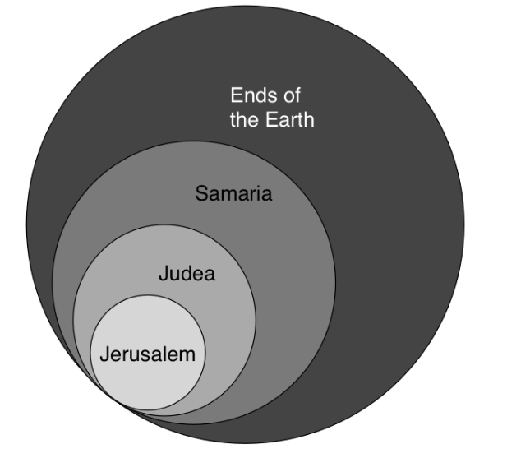
You are Promised Power to Share Your Story With
Schools
In Other Countries
Other Schools in Your Country
Other Schools in Your Town.
Acts 1:8
Your School

Slide 10
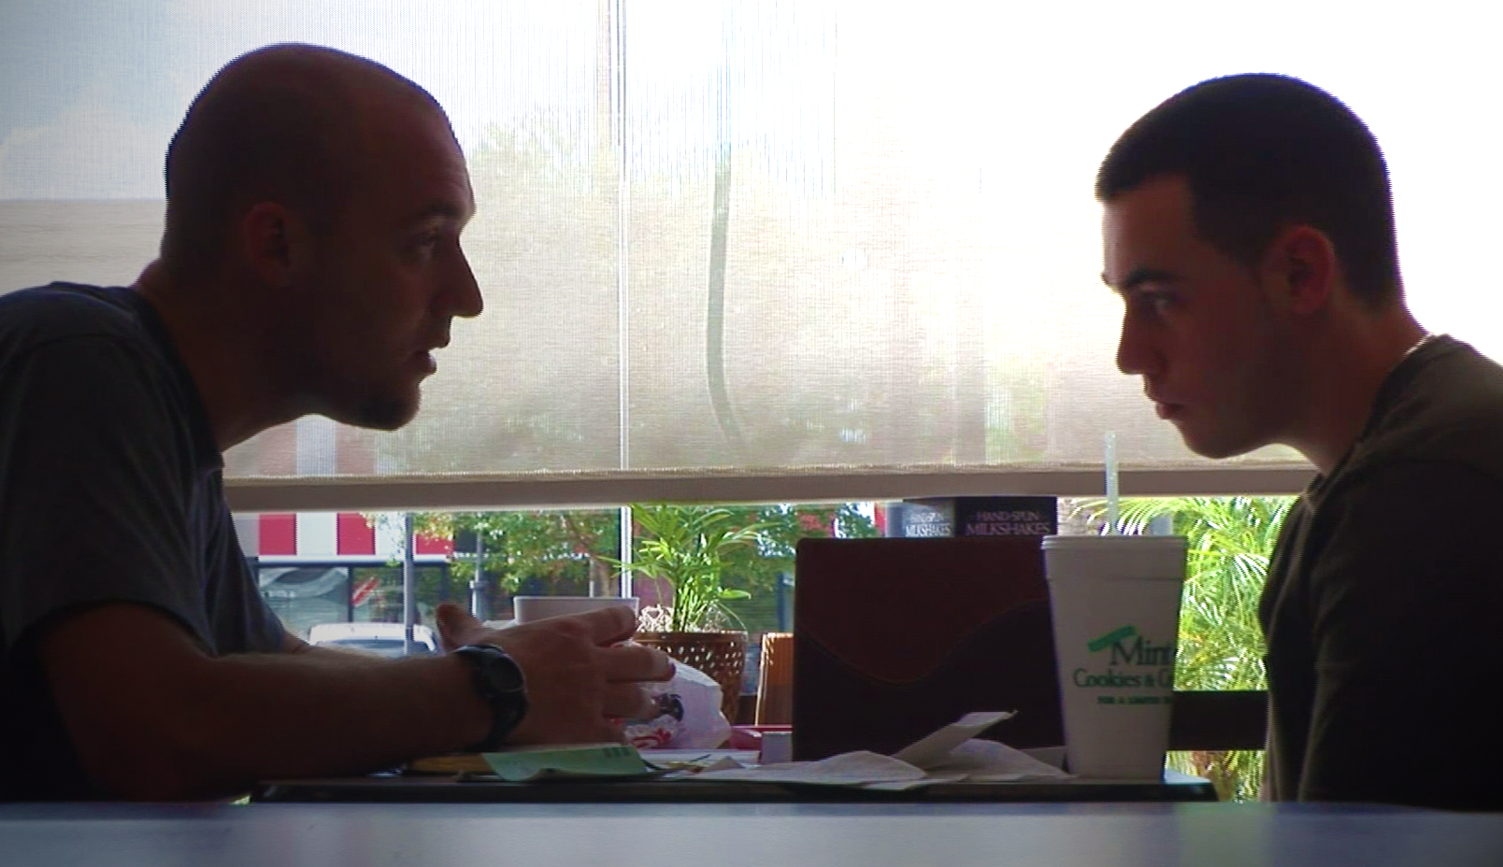
Too Often, we get discouraged and fail to tell other Students Our Story
That will happen if you do not wait and depend upon being Empowered by the Holy Spirit!
This is why it is necessary to practice the disciplines of daily Bible Study, Prayer, and Journaling in Your Secret Place.

Slide 11
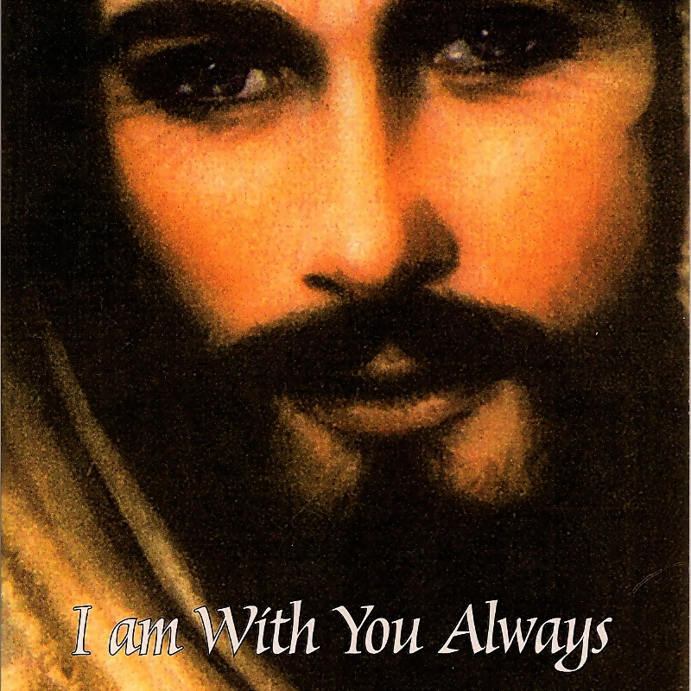
You Can’t make Disciples of Christ by yourself!
But You are not by yourself!

Slide 12
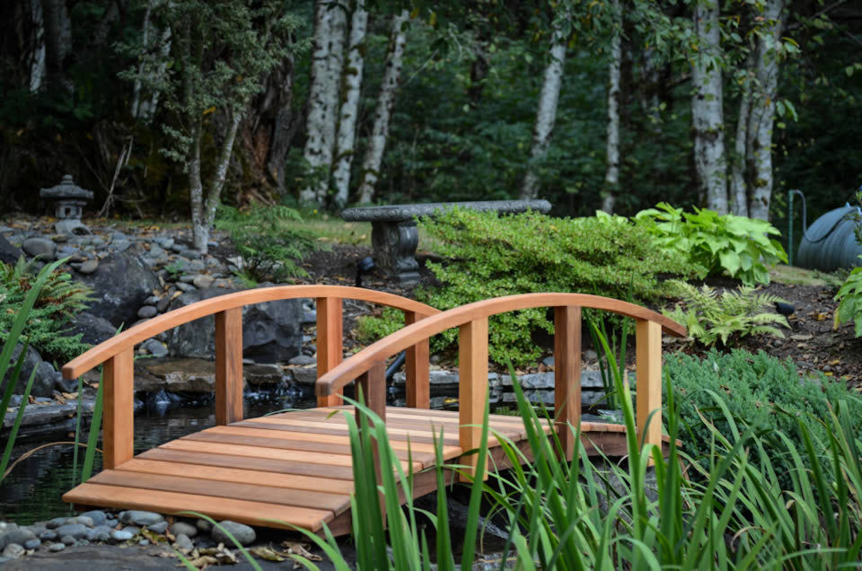
Bridging Between Your Story and the Gospel

Slide 13
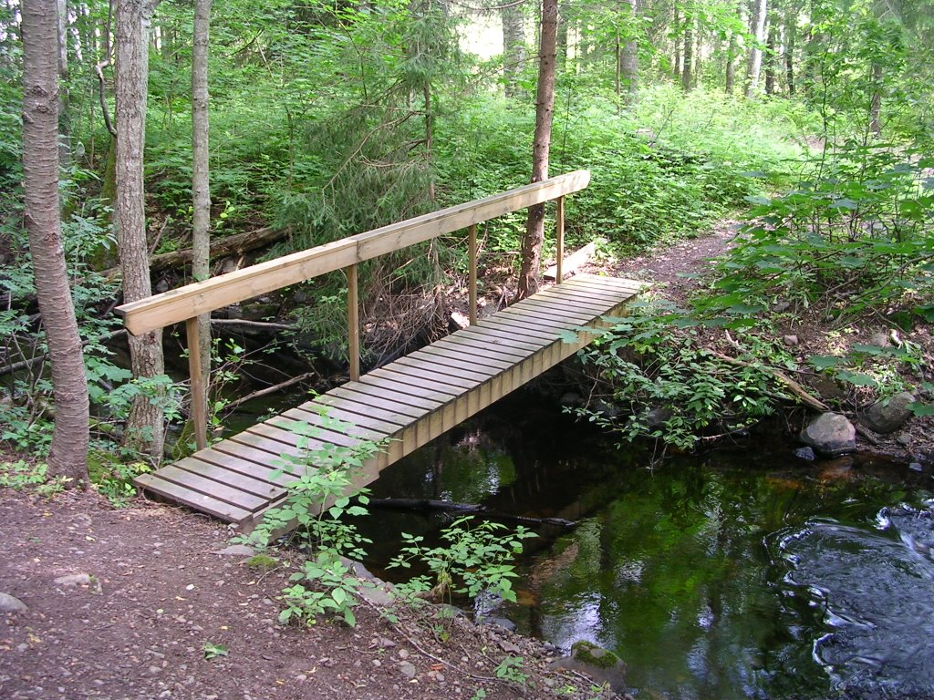
Example of a Story and Bridge:
Since I have come into a relationship with Jesus, He has shown me my purpose in life, made me His brother/sister, and given me eternal life.
Your brief Story
I can show you how to Know Your Purpose and have Eternal Life!
Your brief bridge to the Gospel

Slide 14
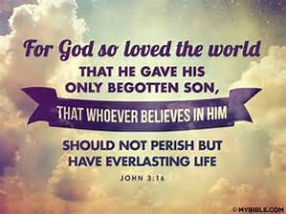
The Good News: The Gospel
John 3:16

Slide 15
Pair the students and have them practice 1) Telling Their Story, 2) Bridge to the Gospel, and 3) Repeat John 3:16.
Rearrange the students and have them repeat 1) Telling Their Story, 2) Bridge to the Gospel, and 3) Repeat John 3:16.

Slide 16
Brief Discipleship Lesson

Slide 17
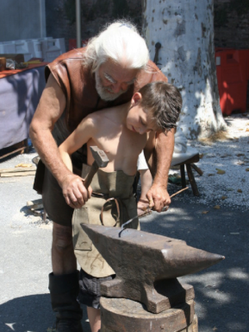
Discipline refers to the process by which one learns a way of life.
A Disciple is like an apprentice who is learning a trade from a Master Craftsman.
Such learning requires a relationship between the Master who knows the way of life (discipline) and a learner (a disciple).
Within this relationship, the Master leads a learner through a process (the discipline) until the learner can imitate or live like the Master

Slide 18
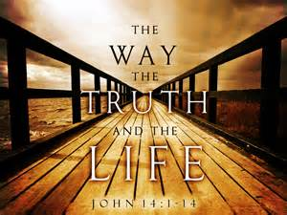
This is how you will learn Your Purpose in life – Discipline your life to learn from Jesus, the Master of Life.
Jesus said, “I Am the Way, the Truth, and the Life.” (John 14:6)

Slide 19
Examples of Christian Disciplines:
Daily Prayer
Daily Bible Study
Journaling
Stewardship
Solitude
Fasting
Sharing Your Story

Slide 20
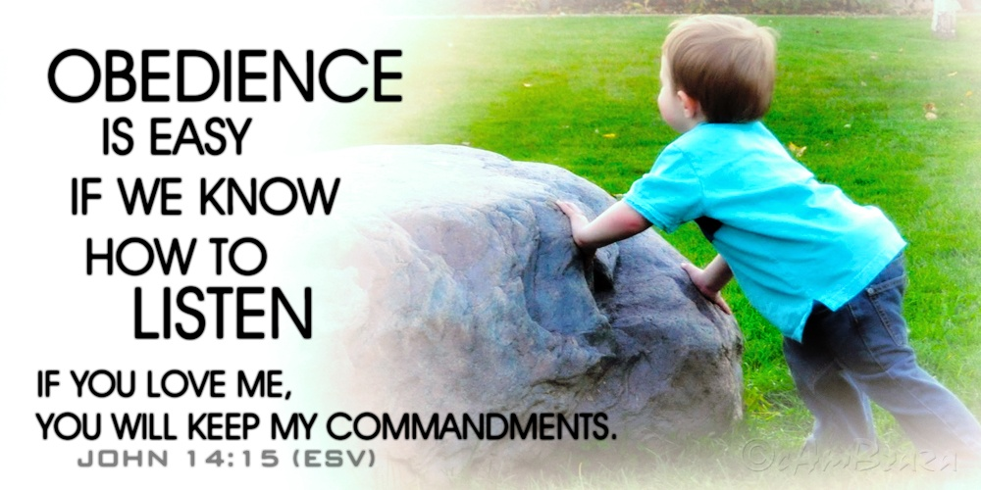
Discipline is the important part of Christian Life that You can do.
Jesus said, “If you Love Me, You will Keep My Commandments”
John 14:15
Discipline is Obedience.

Slide 21
Q: What is the big advantage of studying the Bible for you?
A: To know what God has promised.
II Timothy 2:15
A: To tell other students about God with confidence.

Slide 22
Daily Prayer
Daily Bible Study
Journaling
This Week we will Emphasize these Three Disciplines

Slide 23
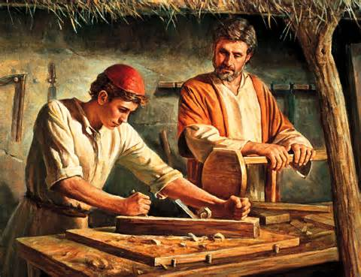
Q: In your own words, what is a Disciple?
A: A person that is a learner or apprentice under the instruction of a Master Teacher

Slide 24
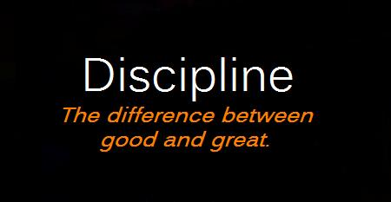
Q: What does Discipline mean?
A: Discipline is a regular practice expected to improve one’s life
Q: What do you have to do to become a Disciple of Christ?
A: Follow Him, Obey Him, Live like He Lived

Slide 25
Goal Setting for Session 2
Starting tomorrow, rise early each morning (for the rest of your life), use your secret place to do the following:
Read at least a chapter of the Bible (Suggest starting with John)
Journal your impressions about what you read
Pray: Confess any known sins.
Thank Jesus for what He has done to set you free from the penalty of your sins and from the power of sin.
Review Your Story, Revise it but keep it brief
Write Your Bridge to the Gospel
Add to your List of Students that you Know are away from God.
Memorize Acts 1:8

Slide 26
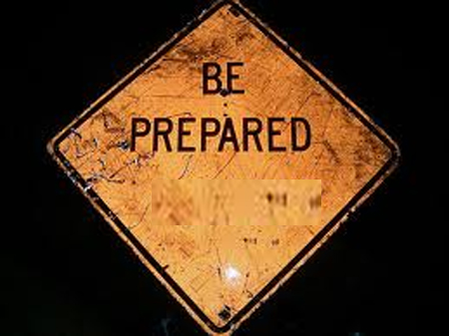
To Give An Account of How You Accomplished Your Goals At Our Next Meeting

