Slide 1
E
S
Equipping
Students
Session 3
To Change The World
Moral Boundaries

Slide 2
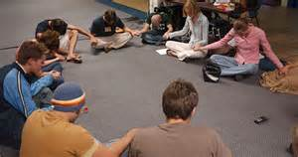
Student Led Prayer
Pray for the Members of the Group and Classmates

Slide 3
How are You Doing Spiritually?
Each Student Briefly Share:
How are your times in your secret place?

Slide 4
Accountability for Session #3
Share some things you journaled this week in your Secret Place
Which Chapters of the Bible are you now studying ? Tell how you truly feel about spending time reading the Bible.
Share how you met the new names you added.
How has confessing known sins affected your time of prayer?
Tell Your Story, Your Bridge to the Gospel, and recite John 3:16.
Recite Acts 1:8
Q: What are some things you have given up to make time to study your Bible, pray, and journal daily?

Slide 5
Vision Casting:
Can-Do Attitude

Slide 6
Jesus’ Commission provides us with a Can-Do Attitude.
Our Attitudes Determine our Effectiveness;
“I Can” or “I Can’t” – Which is Yours?
The Greatest Barrier to success is the Fear of Failure!

Slide 7
Discipleship Lesson
An example of a moral code is the Golden Rule which states that, "One should treat others as one would like others to treat oneself."

Slide 8
To Accomplish Your Purpose in Life, You must Have Proper Relationships:
Your Relationship with Jesus
Your Relationship with Other Students
Your Relationship with
Your Parents

Slide 9
Examples of Morals:
Patience
Integrity
Serve Others
Promise Keeper
Treat others as You want to be Treated
Do not Cheat
Generous
Humility
Loyal
Do not Gossip
Seek Justice
Tolerant of Differences
Do not have Sex Before Marriage
Self Control
Respect Yourself
Do not Vandalize Property
Accountable and Responsible
Forgiving
Courage
Dependable
Respect Others
Truthful
Trustworthy
Do not Judge

Slide 10
Girls follow the Adult Lady Teacher into another room for the rest of Discipleship Lesson #3.
Boys remain here for the rest of Discipleship Lesson #3.

Slide 11
God Created the Universe, He owns it, and He established the rules for its proper operation, Including your purpose for life.
Satan is your Spiritual Enemy and he perverts God’s Holy rules
God’s Rule for a Fulfilled Life is to know your purpose and prefer Others over Self
Satan Perverts God’s Rule by tempting You to Enjoy Instant, Selfish, Gratification
For Example: Sex before marriage

Slide 12
What occupies most of our lives, is simple distraction.
Too often we get distracted from the really important things of life.
We tend to depend upon SELF more than on our Savior.
We are instructed to seek first the Kingdom and all necessary things of life will be provided (Matthew 6:33)

Slide 13
Our Spiritual Enemy, Satan, perverts good things to distract us
We live in a Culture of Lies:
1. Everyone is having sex.
2. You can’t live without sex.
3. Sex is a natural part of a loving relationship.
4. Sex is a natural part of growing up.
5. Sex outside of marriage would cease to be a problem if teens would just wear condoms.
6. Sex makes life better.

Slide 14
How Far is Too Far?
Where Should You Draw the Line?
1. The further you go, the faster you go!
2. The further you go, the further you want to go!
3. The further you go, the harder it is to go back!
4. Where you draw the line determines a lot.

Slide 15
God Created Males and Females for Intimate Marriage.
Satan’s Perversion is, “Why Wait Till Marriage?”
Christians are Instructed to Establish Boundaries Beyond Which they will not go.

Slide 16
Satan’s Greatest Tool to Ruin a Person’s Christian Witness is:
Perverted Sex!
God Designed Boys and Girls to go through a maturing phase called:
God’s purpose for this physical characteristic is to cause a mutual attraction between males and females for marriage.

Slide 17
Men focus on the physical aspect of their relationship with women
For Young Men:
Sexual experience now does not translate into sexual fulfillment later.
The very opposite is true.
The best thing a young man can do now to ensure a good relationship with his future wife is learn how to honor and respect the women God has already put in his life:
His Mom, Sister, Classmates

Slide 18
Women focus on the relational side of things even when there is only a fragile, temporary relationship in place.
For Young Women:
A teenage girl looks for assurance of commitment once things start to heat up physically
As the physical involvement increases, she wants more and more reassurance from her boyfriend that he really cares for her.

Slide 19
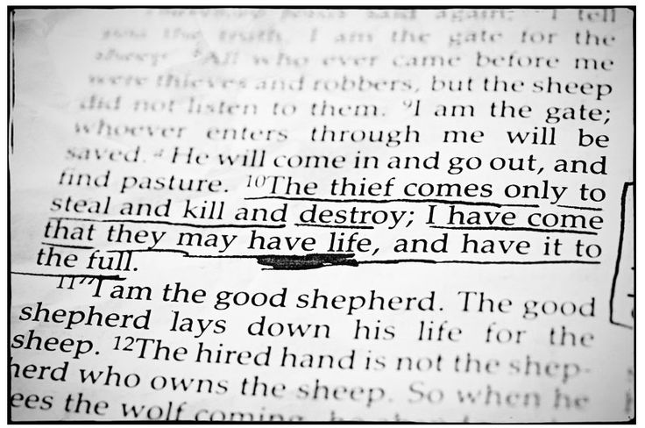
Whereas God’s plan is to prepare males and females for genuine intimacy in Marriage,
Satan’s plan is to steal, kill and destroy the beautiful life God has in store for them by tempting them with instant gratification
(John 10:10).

Slide 20
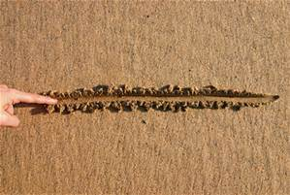
Where You Draw the Line Establishes Where Satan’s Temptation Starts!
God is not against their having Sex. But they must wait for marriage.
God is not against Sex. He Created it. God is not against Students. He Created them.
Sex is not for mature people. Sex is not for ready people. Sex is not for in-love people. Sex is for Married people.
Why? Because Sex is not physical; it is relational. It is to be reserved for the unique, committed, multifaceted relationship of marriage.
Only between man and wife can sex be the wonderful and intimate experience that God always intended.

Slide 21
Holding Hands?

Slide 22
Arm Around Shoulder?

Slide 23
First Kiss?

Slide 24
This Concludes our First Discipleship Class on Moral Boundaries
We will continue Next Week
Girls Join the Boys for Goal Setting

Slide 25
6. Goal Setting and Prayer for Session 3
Boys Perform a Good Deed for a Girl Student
Girls Perform a Good Deed for a Boy Student
Continue Daily Bible Study, Prayers and Meditation.
Pray for the Names on your List
Pray for your classmates
Tell Your Story to a student on your list
Meditate on your Bridge to the Gospel.
Memorize Philippines 4:13

Slide 26
You will be asked to share the results of Your goals at next week’s meeting.
Our Next ES Session will Continue our teaching on Moral Boundaries

