Slide 1
E
S
Equipping
Students
Session 4
To Change The World
More On Moral Boundaries

Slide 3
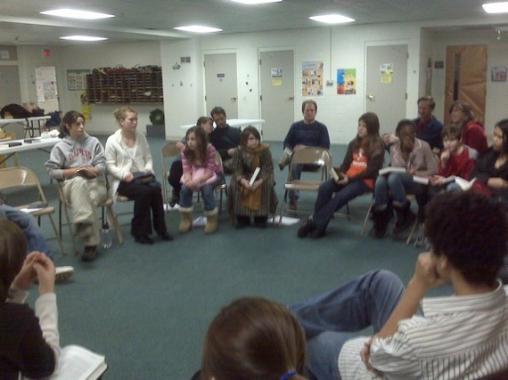
Student Led Prayer
Pray for Holy Spirit led boldness to Draw Moral lines across which you will not cross.

Slide 4
How are You Doing Spiritually?
How is your times in your Secret Place equipping you for the day?
Tell How You Are Beginning to Understand Your Life’s Purpose.

Slide 5
Accountability for Session #4
Share the Good Deed you Did this Past Week
Tell Where (Secret Place) You spend time Studying the Bible, Journaling, and Praying each day.
How Did the Student you Shared Your Story With Respond?
Tell Your Story and Your Bridge to the Gospel.
Recite Philippines 4:13
Q: Why should you do a good deed for someone of the opposite sex?
A: To learn to socialize properly with the opposite sex.

Slide 6
Vision Casting
Self Control
Left Alone, Self Will dominate you!
Radical Jesus told us to Execute Self!
Luke 9:23

Slide 7
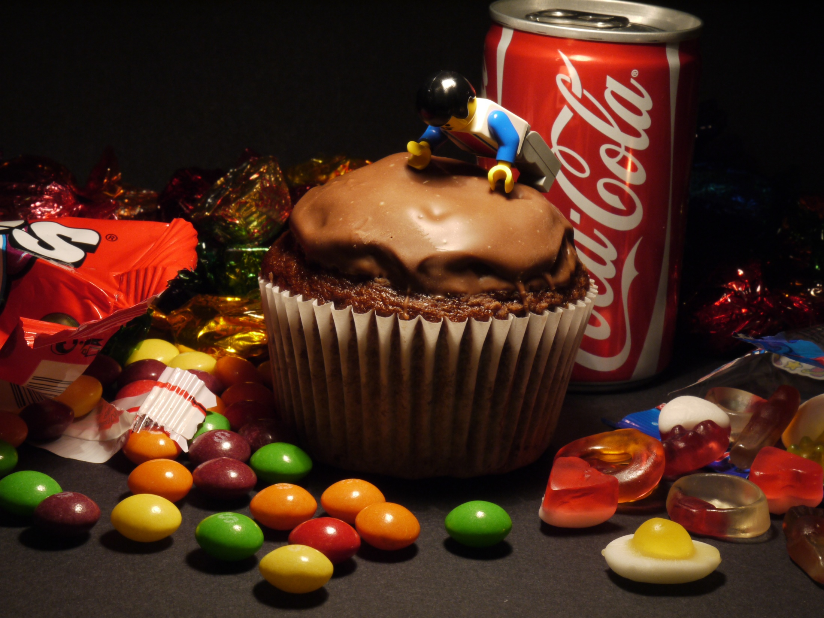
Self has an Unquenchable Appetite
Self Will Lead You Into All Sorts of Addictions!
Self Will Control You Through Addictions!
Control Self By Killing it!

Slide 8
The Characteristics of the Holy Spirit in you:
2. JOY
1. LOVE
3. PEACE
4. PATIENCE
5. KINDNESS
6. GOODNESS
7. FAITHFULLNESS
8. GENTLENESS
9. SELF CONTROL
Galatians 5:22

Slide 9
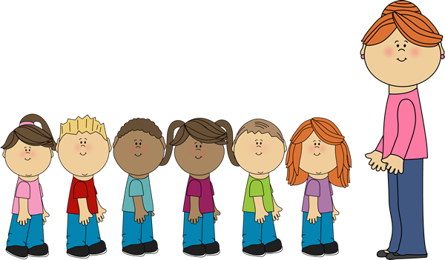
Girls Follow Lady Teacher into Another Room
Boys Remain in this Room

Slide 10
Discipleship - More On Moral Boundaries
How Far is Too Far?
Where Will You Draw the Line?

Slide 11
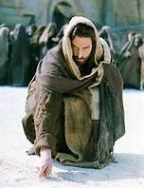
Where Should You Draw the Boundary Beyond which You will Not Cross?

Slide 12
Moral Boundary Choices are up to You.
Quality Life is on this Side.

Slide 13
6. Goal Setting and Prayer for Session 4
Boys Perform another Good Deed for a Girl Student
Girls Perform another Good Deed for a Boy Student
Continue Daily Bible Study, Prayers and Meditation.
Pray for the Names on your List
Pray for your classmates
Tell Your Story to a student on your list and Bridge to the Gospel
Memorize Luke 9:23

Slide 14
This Concludes our ES Sessions on Moral Boundaries
Girls Join the Boys for Schedule Announcements

Slide 15
Next Week We Will Study
Healthy Friendships

