Slide 1
E
S
Equipping
Students
Session 5
To Change The World
Healthy Friendships

Slide 3
REMEMBER:
Proverbs 3:6

Slide 4
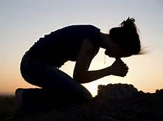
Prayer Time
Let’s Worship Him with Prayer

Slide 5
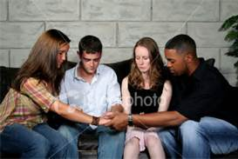
Each member of the ES Group take turns praying
Be Silent before the Lord for a few moments
Ask the Holy Spirit to energize this meeting.
Pray, by name, for those on your list.
Ask Him to remind the Group of New names that are away from God
Adult Teacher Close the Prayer Time

Slide 6
How are You Doing Spiritually?
Share how you are personally changing spiritually.

Slide 7
Accountability for Session #5
What Good Deed did you Do for a Student this past week? How did they respond?
Share today’s time in Prayer and Bible Study in your secret place.
How have some students responded favorably to Your Story?
Q: What Does It Mean to take up one’s cross?
A: To live as though SELF were dead!
Recite Luke 9:23
Q: How often are we to deny ourselves?
A: Every Day!
Q: Why Daily?

Slide 8
Vision Casting
Are you aware that you are seen by our Heavenly Father as being holy, blameless, and beyond reproach?
Colossians 1: 22
Yet He (Christ) has now reconciled you in His fleshly body through death, in order to present you before Him (God) holy and blameless and beyond reproach.
Colossians 3:23

Slide 9
Our Sin (Faith)

Slide 10
His Righteousness (Grace)

Slide 11
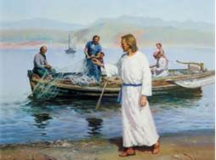
Jesus wants us to share with others what He has done for us.
He wants You to become Fishers of men (Students)! Matthew 4:18-23

Slide 12
During the 1960s Polls showed the three most influential factors in a Student’s life to be:
1. Parents
2. Teachers
3. Spiritual Leaders
Today the three most influential factors in a Student’s life are:
1.Friends
2. Media
3. Parents
Spiritual Leaders Dropped to 17th!

Slide 13
Friends Often Have More Influence on Students than:
Personal Convictions
Parents
God
Solomon wrote in Proverbs 13:20:
Walk with the wise and become wise, for a companion of fools suffers harm.
A Wise Friend Knows Right from Wrong and Chooses Right
A Foolish Friend Knows Right from Wrong and Chooses Wrong!

Slide 14
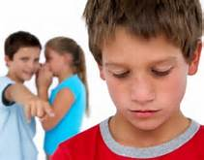
The Two Most Influential Consequences of Friends
Rejection
And
Acceptance

Slide 15
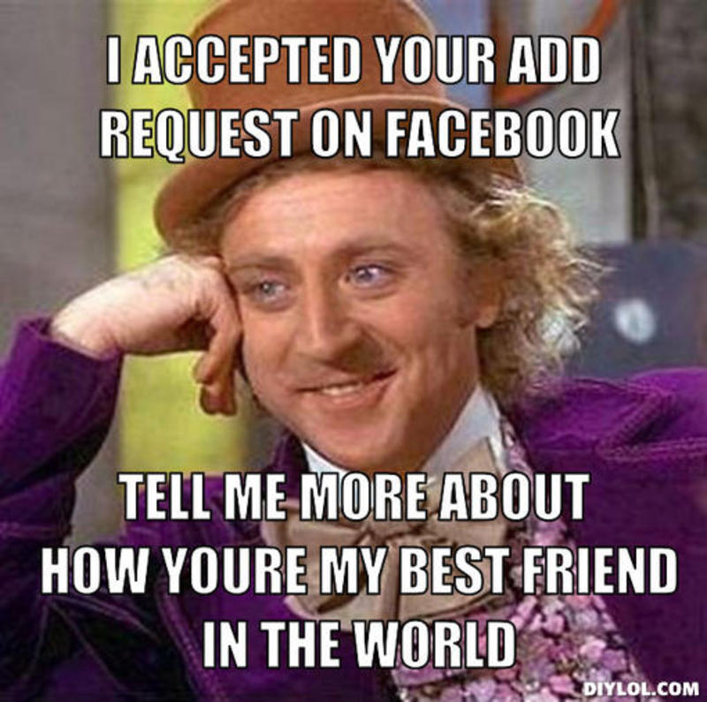
Acceptance Paves the Way to Influence.
Students Resist the Influence of those that They Feel Do Not Accept Them.
When they Feel Accepted, However, They Drop Their Guard.

Slide 16
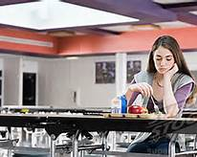
Goal Setting for Session 5
Eat Lunch with a Student that is Sitting Alone
Prayerfully review your list of Students and Add new names as prompted by the Holy Spirit
Share Your Story With a Student that Does not Appear to have a Friend.
Tell them about ES and ask if they would be interested in joining an ES group.
Select an entry in Your Journal to Share with the Group
Memorize Matthew 4:19

Slide 17
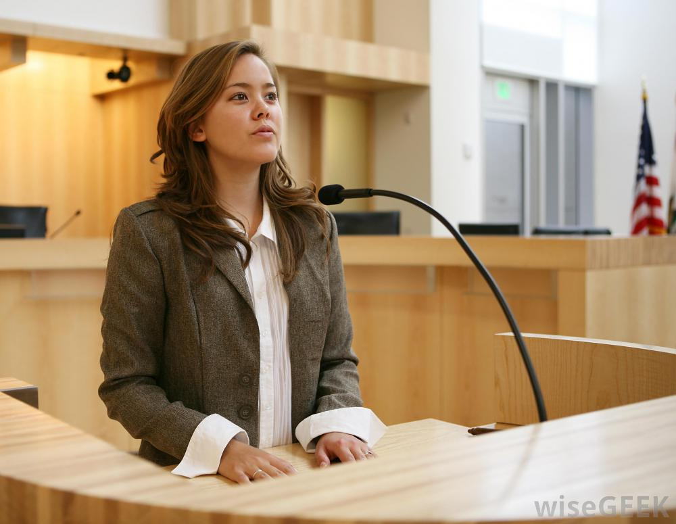
Remember: You will be asked to share the results of Your goals at next week’s meeting.
Our Next ES Session will be on
Wise Choices

