Slide 1
E
S
Equipping
Students
Session 6
To Change The World
Wise Choices

Slide 3
REMEMBER:
Proverbs 3:6

Slide 4
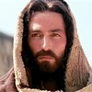
Opening Prayer
Be silent for a few moments and think about what Christ has endured to provide you freedom from the penalty of your sins and the power of sin.
Being Abandoned
Being Disappointed
Being Rejected
Being Falsely Accused
Being Abused
Being Executed as a common criminal
Having the sins of the World (including all of yours) put on Him
Being Tortured
Having the Father Forsake Him

Slide 5
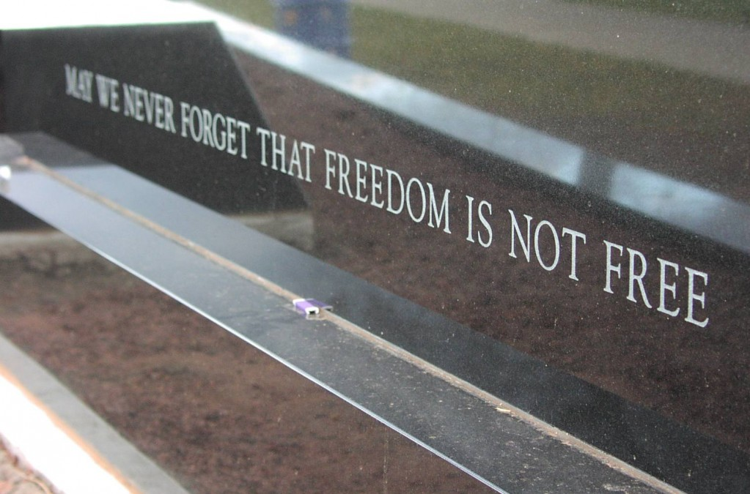
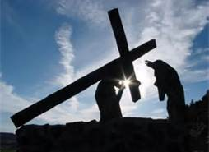
Freedom is not Free: Someone Pays the Price

Slide 6
How are You Doing Spiritually?

Slide 7
More Important than you Knowing Jesus is Assurance that He Knows You!
Matthew 7:23
It is Urgent that You Spend Time with Him Daily in Your Secret Place.

Slide 8
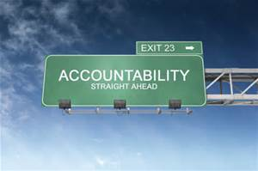
Accountability for Session #6
Ask Each:
Who Did You Have Lunch with that was Sitting Alone? What was their response?
Tell the group some specific ways you pray for those on Your list. How Many Students Do you Now Have on Your List?
Briefly share one of your Journal Entries
How Have You Adjusted Your Attitude to become More Attractive to Students Needing a Friend?
Recite Matthew 4:19
Q: What does it mean to be a fisher of men?
A: To be used to draw students into God’s Kingdom

Slide 9
Where there is no vision, the people perish. Proverbs 29:18
Vision without action is a daydream. Action without vision is a nightmare.

Slide 11
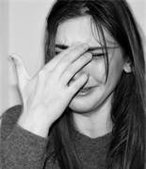
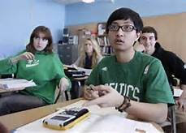
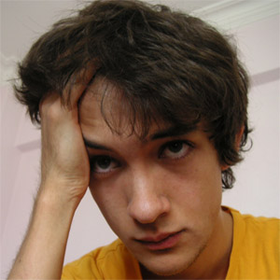
These Students May Perish for lack of our Vision!

Slide 12
Wise Choices
Brief Discipleship Lesson
Do You Want to Be Wise or Foolish?

Slide 13
We Choose how we spend each day. Though others may try to persuade us to follow them, we will choose who we will follow.
Jesus said, “Follow Me and I’ll make you Fishers of Men!”

Slide 14
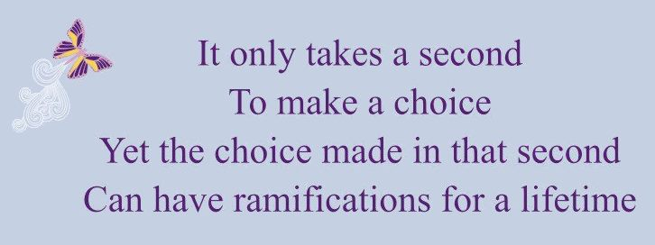

Slide 15
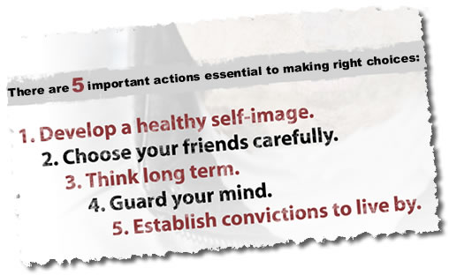
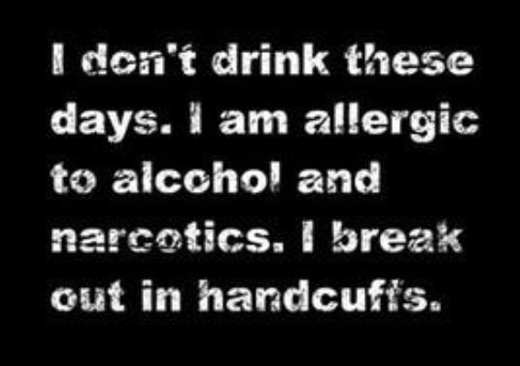

Slide 17
Goal Setting for Session 6
Assume a role of leadership with your school mates.
Circle names on your list that you will share your story this next week.
Make Some Changes From Foolish to Wise Choices This Week
Journal Situations You Face In Which It Was Tempting to Make a Foolish Choice
Pray for the ES Group’s Vision this week
Start a list of Students interested in joining an ES Discipleship Class
Memorize Proverbs 29:18

Slide 18
Remember, You will be asked to share the results of Your goals at next week’s meeting.
Our Next ES Session will be on
Ultimate Authority

