Slide 1
E
S
Equipping
Students
Session 7
To Change The World
Ultimate Authority

Slide 3
REMEMBER:
Proverbs 3:6

Slide 4
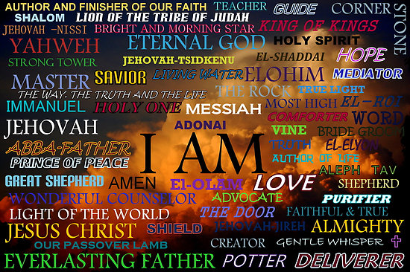
Let’s Pray
Our God is everything we need
Be Silent Before Him and Reflect on His Names

Slide 5
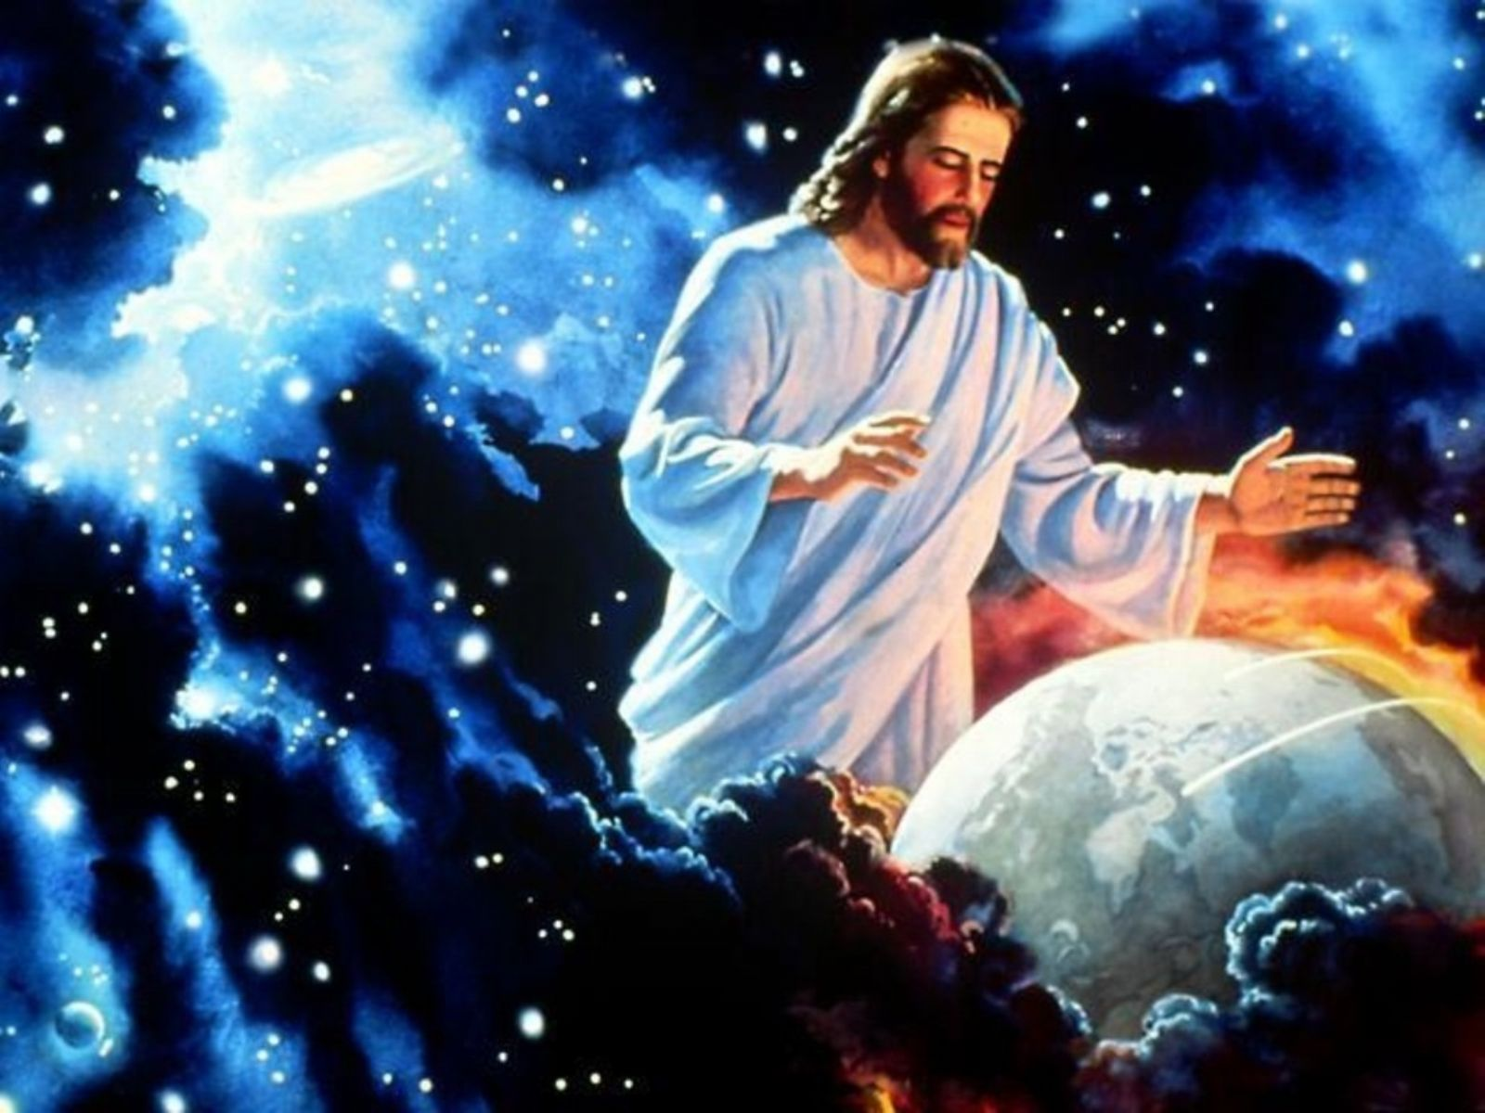
We must trust and depend upon Him.
And not trust and depend upon Self!

Slide 6
Session 7:
Share with the Group if you believe You are growing Spiritually.
Discuss how You believe You Can Grow More Relationally with Jesus.
How are You Doing

Slide 7
Accountability for Session #7
Share the Wise Choice You Made Rather than A Foolish One this past week.
Read or Recall From Your Journal about A Situation Where you Were Tempted to Make a Foolish Decision
Share How some of the Students on Your List have responded to Your Story
How Have You Chosen to Take Leadership with Your Fellow Students?
Recite Proverbs 29:18
Q. How will anyone perish if we fail to be visionary?
A. They may never hear the Gospel!

Slide 8
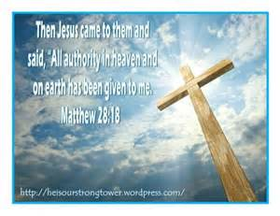
Vision Casting:
Student Leadership is Taking Responsibility when You Are Sure you have the Authority to do so.
Matthew 28: 18-20 Commissions us Under Jesus’ Authority
Jesus came to them and said, “All Authority in Heaven and Earth Has Been Given to Me”

Slide 9
When Someone with Authority has to be Away, He or She may Delegate their Authority to Someone Else
Jesus Has Delegated His Authority to Us in Matthew 28:18-20

Slide 10
Brief Discipleship Lesson
We Are under Authority From Multiple Sources

Slide 11
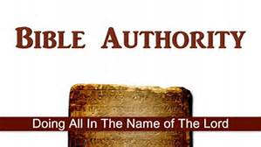
Let everyone be subject to the governing authorities, for there is no authority except that which God has established. The authorities that exist have been established by God. Romans 13:1
The Bible Instructs Us About Being Under Authority:
Therefore, it is necessary to submit to the authorities, not only because of possible punishment but also as a matter of conscience. Romans 13:5
Show proper respect to everyone, love the family of believers, fear God, honor the emperor. 1 Peter 2:17
Submit yourselves for the Lord’s sake to every Human Institution, whether to a king as the one in authority - 1 Peter 2:13

Slide 12
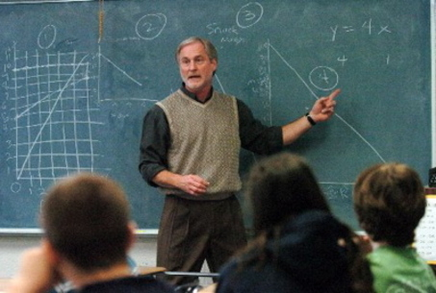
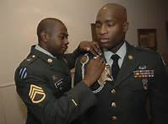
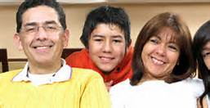
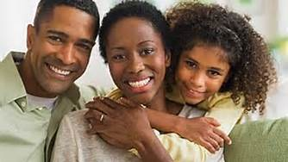
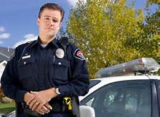
Authority Figures
Q: Why do we resist authority?
A: Pride, Self, the Flesh!!

Slide 13
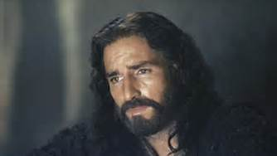
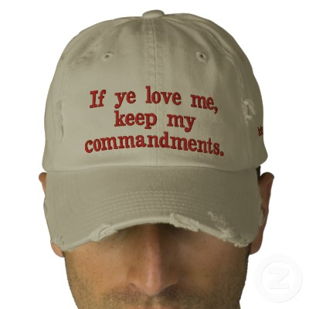
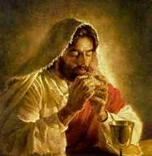
Our Ultimate Authority
Jesus Remained Under the Authority of His Father

Slide 14
Goal Setting for Session 7
Tell a Teacher that You Appreciate Him/ Her
Speak to your Parent or Guardian about how you are grateful for them.
Ask your parent or Guardian to go with you to deliver some cookies at the local Police Station.
If you attend church, let your Pastor, Youth Leader, Spiritual Teacher know that you love them.
As part of your prayers this week, Thank God that You Can Trust His Authority Over You
Memorize Matthew 28:18

Slide 15
Example of ES
My Story: Since I have become a Christian, my poor choices (sins) have been forgiven, I have become a child of God, and I have eternal life.
Bridge to the Gospel: I can show you how you can have eternal life.
The Gospel: God loves you so much that He will forgive you of your poor choices, make you a child of His, and give you eternal life if you will trust Him (faith.)
Will you trust Him?

Slide 16
Our Final ES Session will be on
Preferring Others

