Slide 1
E
S
Equipping
Students
Session 8
To Change The World
Others First

Slide 3
REMEMBER:
Proverbs 3:6

Slide 4
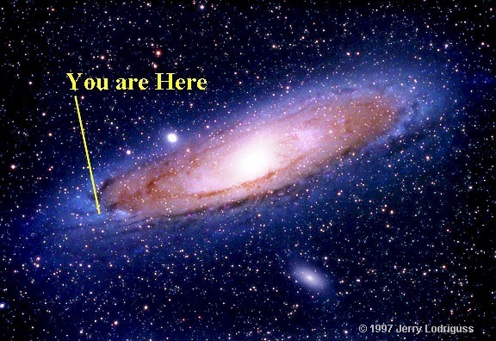
Let’s Worship
Be silent and think about the vastness and majesty of God.
He created and owns the Universe.
The Earth is like a speck of dust floating around in His Universe.
We are like a speck of dust on His Earth
Thus, we are like a speck of dust floating around on a speck of dust in His Universe.
Yet He loves us supremely!

Slide 5
Q: Why do you think that God loved us while we were still self-centered sinners?
A: From the beginning of time He has wanted us to love Him and spend eternity with Him.

Slide 6
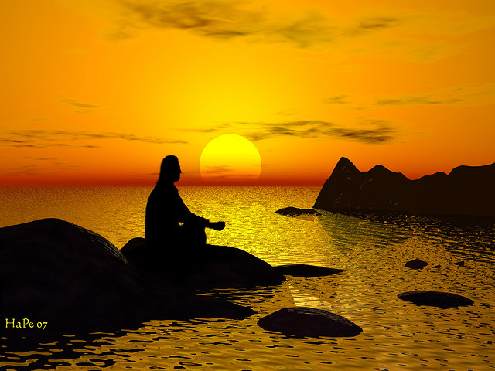
Session 8:
Considering God’s Majesty and our finiteness, share your attitude toward Him.
Discuss how you would like to see your school change.
How are You Doing Spiritually?

Slide 7
Accountability for Session #8
Ask Each to Share:
How did the Teacher respond to your expression of Appreciation?
Based Upon Your Parent’s or Guardian’s Reaction, How will You Continue Showing Your Gratitude to Them?
Now that you have told your Spiritual Leaders that you love them, how do you plan to please them by serving in your school?
If you recognize the Police Officers you met at the Station, How will you react in the future?
How do you feel now that you have thanked God for His Protective Authority over you?
Recite Matthew 28:18

Slide 8
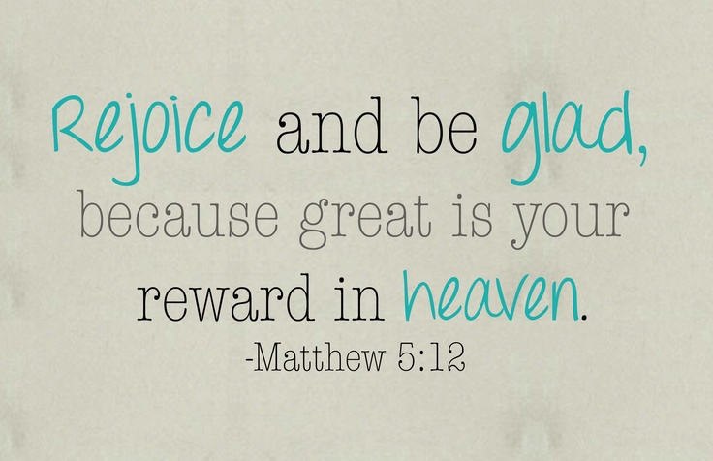
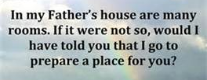
Vision Casting
Do you realize that you will receive rewards in Heaven to be enjoyed forever?
Behold, I am coming soon! My reward is with me, and I will give to everyone according to what he has done. I am the Alpha and the Omega, the First and the Last, the Beginning and the End. Revelation 22:12-13
John 14:4

Slide 9
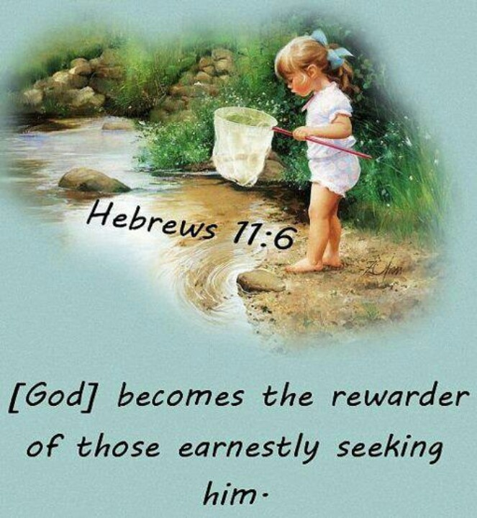

Slide 10
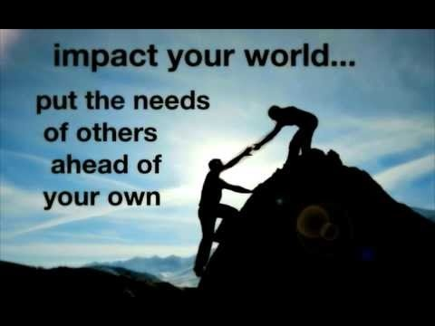
Others First
Discipleship Lesson

Slide 11
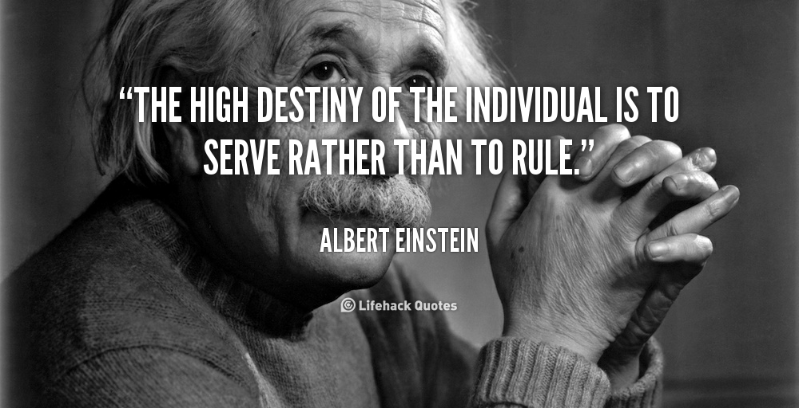
When you started attending ES did you ask yourself;
What is in ES for me?
Or
How Can I Serve?

Slide 12
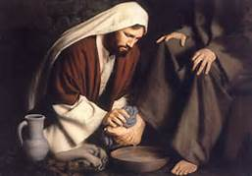
Don’t allow ambition or conceit drive your decisions
View others as more important than yourself.
Look out for the interests of others.
Follow Christ’s example of Humility.

Slide 13
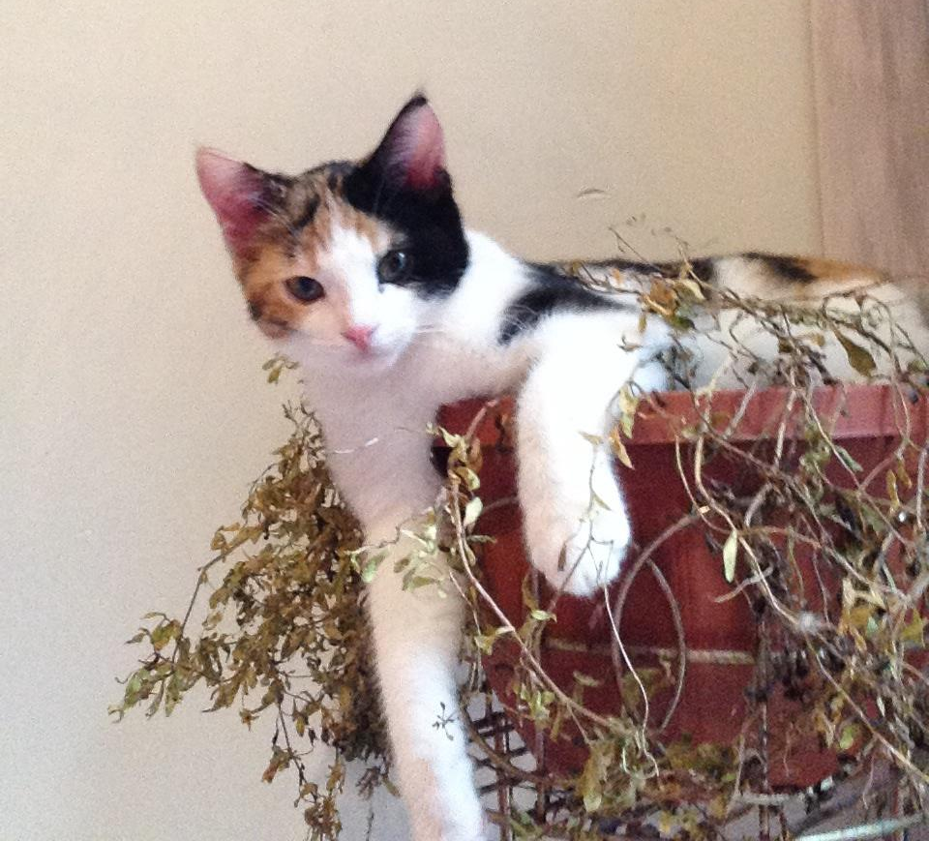
How to Start making Others First:
Listen
Remember
Ask
Pray
Q: Why did Jesus instruct us to put others first?
A: Because He knows that we will be blessed the most.
Proverbs 11:25

Slide 14
Goal Setting for Session 8
Let Others Go Ahead of you at Lunch
Offer to Help a Classmate with a tough assignment
Invite another Student to Sit with you at Lunch
Volunteer to help a Teacher
Pay Special Attention to Someone that is not an ES member. Listen to what they want to talk about. Pray for them.
Memorize Romans 5:8

Slide 15
Let’s review where we have been in ES:
Session 1: Know Your Purpose
Session 2: Spiritual Disciplines
Session 3: Moral Boundaries
Session 4: More on Moral Boundaries
Session 5: Healthy Friendships
Session 6: Wise Choices
Session 7: Ultimate Authority
Session 8: Others First

Slide 16
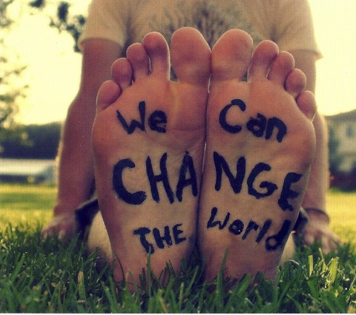
You are a Disciple of Christ and an Equipper of others: Let’s Go Change the World!

Slide 17
Pray a Prayer of Commissioning over each ES Graduate.
Present them with a Certificate of Completion.

