Slide 1

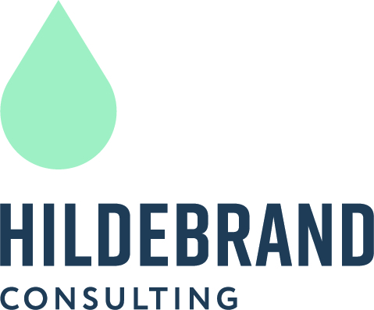
2025 Water & Sewer Rate
Public Hearing
August 14, 2025

Slide 2
Agenda
Rate Setting Process
Water Enterprise Financial Plan
Water Rate Survey
Wastewater Enterprise Financial Plan
Wastewater Rate Survey
Project Schedule
2

Slide 3
The Rate Setting Process
Revenue Requirements
Cost-of-Service
Rate Design
Compares the revenues of the utility to its expenses to determine the overall level of rate adjustment
Equitably allocates the revenue requirements between the various customer classes of service
Design rates for each class of service to meet the revenue needs of the utility, along with any other rate design goals and objectives
3

Slide 4
Legal Requirements for Setting Water Rates In California
Proposition 218 (Article XIIID, Section 6 of California Constitution)
  Revenues shall not exceed funds required to provide service; nor used for another purpose
  Amount shall not exceed the proportional cost of the service attributable to the parcel
  Service must be actually used or immediately available
  Approval process includes 45-day notice, public hearing, and written majority protest. Does not require a voting process (unlike taxes).
4

Slide 5
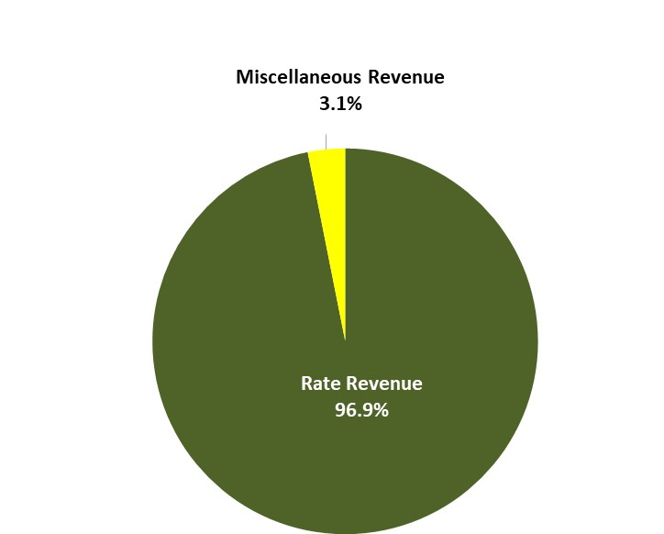
Water Revenue
FY2024/25 Budget
5

Slide 6
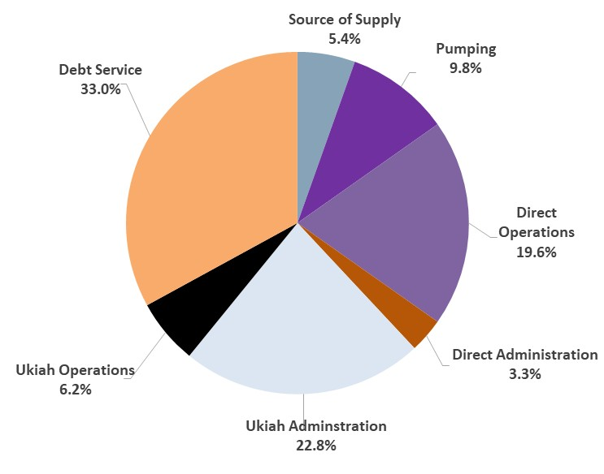
Water Operating Expenses
FY2024/25 Budget
6

Slide 7
Water Rate Increase Drivers
Deferred Rate Increases – Rates have not increased in over 10 years.
Inflation – Since 2014, costs have increased by 40% (CPI).
Capital Reinvestment - The District has been spending a minimal amount on capital repair and replacement, which has allowed it to defer rate increases. However, an increase in capital spending is necessary at this time.
7

Slide 8
Annual Inflation Assumptions
Ukiah Administrative Costs…………….…… 7.5% per year
Ukiah Operating Costs………………………… 7.5% per year
Insurance……………………………………………. 5% per year
CalPERS Unfunded Liability…………………. 5% per year
Utilities……………………………………………….. 5% per year
All other……………………………………………… 3% per year
8

Slide 9
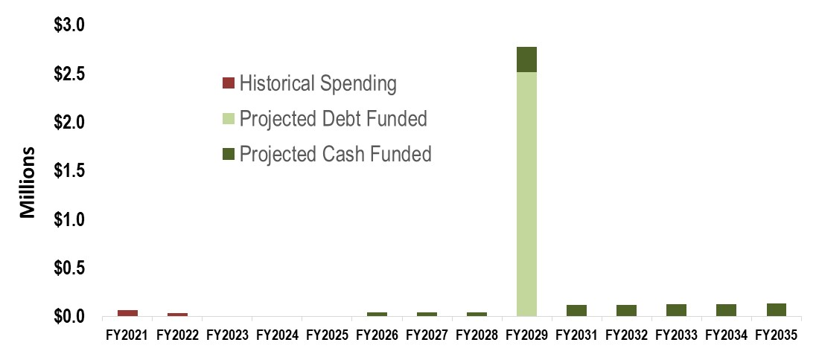
Water Capital Spending
$5M CalTrans relocation project (to be split with sewer) expected in 3 – 7 years. Proposing the cash finance $200K (8%) and debt finance* $2.3M (92%)
5-Year historical average is $20K
Propose to increase annual repair & rehabilitation to $40K in the near term and then $100K starting in 2031
9
* Assumes 5% interest and 30-year term

Slide 10

Water Financial Forecast & Proposed Rate Revenue Increases
Additional Rate Revenue
Existing Rate Revenue
Non Rate Revenue
Cash Capital
Debt Service
Debt Service
Operating Expenses
10

Slide 11
Current & Proposed Water Rates
11

Slide 12
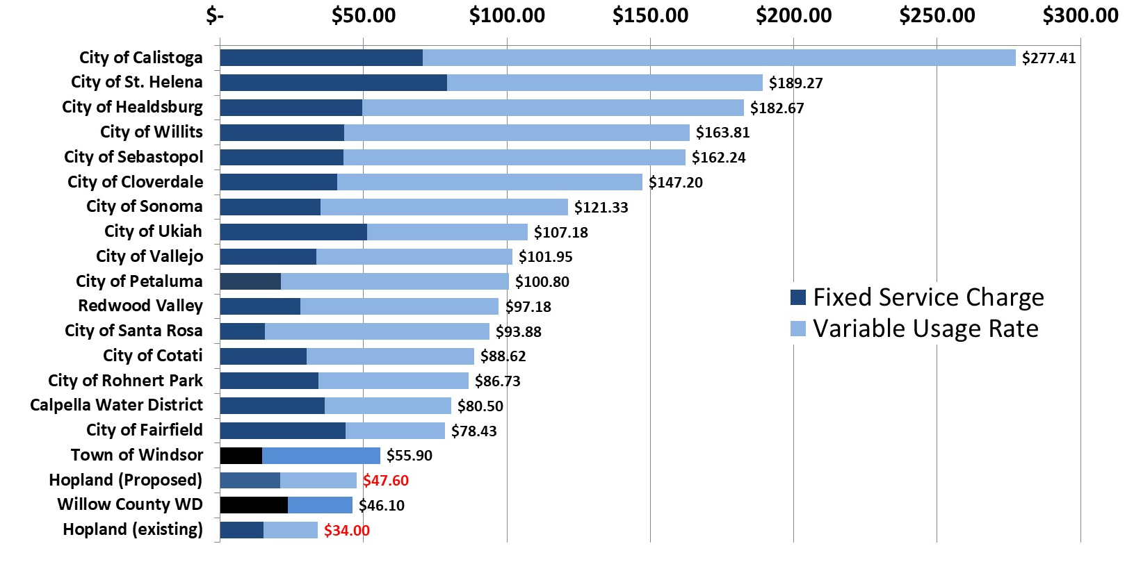
Monthly water bill comparisons among selected regional water agencies
Single Family Homes with ¾” meter using 10,000 gallons per month
12

Slide 13
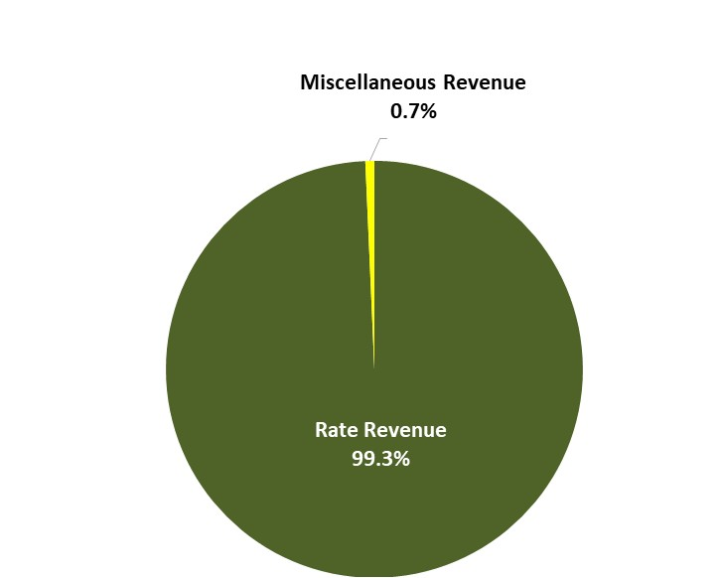
Wastewater Revenue
FY2024/25 Budget
13

Slide 14
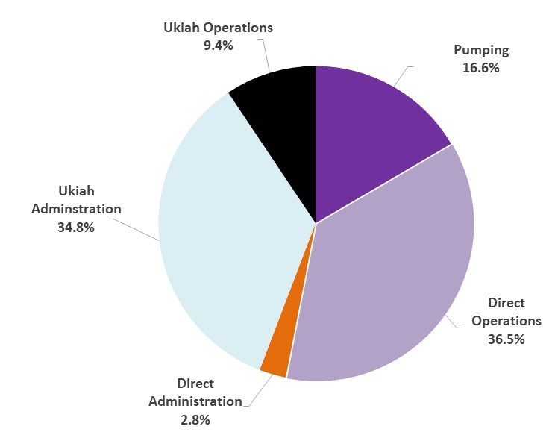
Wastewater Operating Expenses
FY2024/25 Budget
14

Slide 15
Wastewater Rate Increase Drivers
Deferred Rate Increases – Rates have not increased in over 10 years.
Inflation – Since 2014, costs have increased by 40% (CPI).
Capital Reinvestment - The District has been spending a minimal amount on capital repair and replacement, which has allowed it to defer rate increases. However, an increase in capital spending is necessary at this time.
15

Slide 16
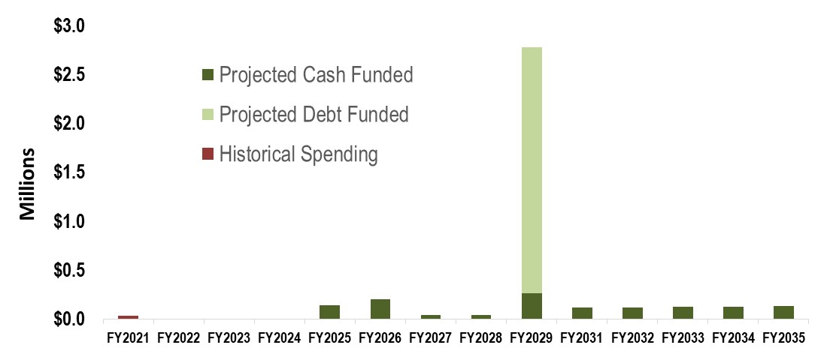
Wastewater Capital Spending
$5M CalTrans relocation project (to be split with sewer) expected in 3 – 7 years. Proposing the cash finance $200K (8%) and debt finance $2.3M (92%)
4-Year historical average is $10K
Pond Lining $100K
I&I Location & Repair $200K
Propose to increase annual R&R to $40K in the near term and then $100K starting in 2031
16

Slide 17
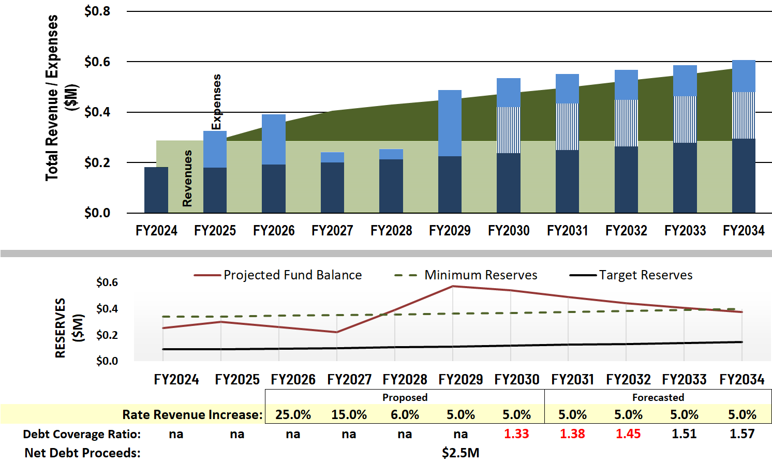
Wastewater Financial Forecast & Proposed Rate Revenue Increases
Additional Rate Revenue
Existing Rate Revenue
Non Rate Revenue
Cash Capital
Debt Service
Debt Service
Operating Expenses
17

Slide 18
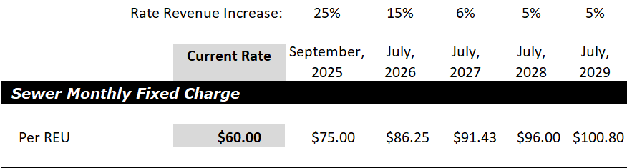
Current & Proposed Wastewater Rates
*
* REU = residential equivalent unit
18

Slide 19
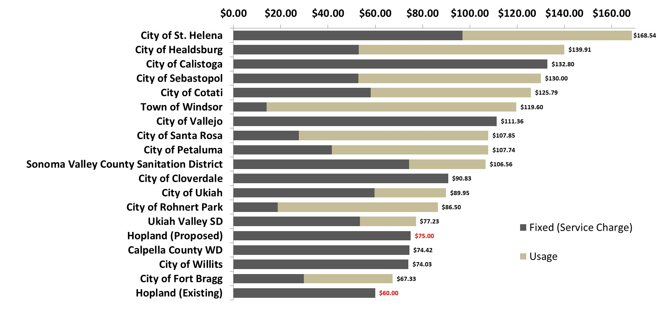
Monthly water bill comparisons among selected regional wastewater agencies
Single Family Homes with ¾” meter using 5,000 gallons per month
19

Slide 20
Public Hearing Next Steps
Public comments
Close Public Hearing
Tally protest votes
Board deliberation
Board vote on proposed rates (if majority protest does not exist)
First rate increases would occur on September 1, 2025
20

