Slide 1
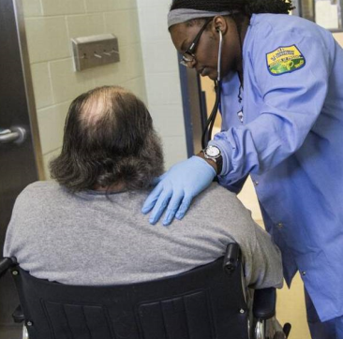
Providing Healthcare to a Vulnerable Population
Greater NC Association of
Rehabilitation Nurses
April 20-21, 2023
Ram Upadhyaya, RN | Nursing Resource Liaison

Slide 2
ANCC Accreditation Statement
The Greater North Carolina Chapter of the Association of Rehabilitation Nurses (GNCCARN) is accredited as a provider of nursing continuing professional development by the American Nurses Credentialing Center’s Commission on Accreditation via the NC Nurses Association.

Slide 3
Providing Healthcare to a Vulnerable Population
Learning Outcomes
Participants attending this session will be able to:
Define a vulnerable population
Describe healthcare delivery in a non-traditional setting
List 2-3 different areas of practice settings

Slide 4
What is a Vulnerable Population?
A vulnerable population includes those who
• Have no current healthcare, employment or shelter
• Have undiagnosed problems such as cancer, diabetes, PTSD
• Have uncontrolled chronic conditions
(Mahoney, 2015)
Notes:
Have uncontrolled chronic conditions
Hypertension, diabetes, morbid obesity, drug withdrawal, mental health issues

Slide 5
Where does one find the vulnerable?
Homeless
Long-term care facilities
Jails / Prisons
Other marginalized populations
Who cares for these people?
Notes:
Public health nursing is the practice of promoting and protecting the health of populations using knowledge from nursing, social and public health sciences.
Public health nursing is a systematic process by which: The health and healthcare needs of a population are assessed in order to identify subpopulations, families and individuals who would benefit from health promotion or who are at risk of illness, injury, disability or premature death.
A plan for intervention is developed with the community to meet identified needs that take into account available resources, the range of activities that contribute to health and the prevention of illness injury, disability, and premature death.
The plan is implemented effectively, efficiently and equitably.
Evaluations are conducted to determine the extent to which the intervention has an impact on the health status of individuals and the population.
The results of the process are used to influence and direct the current delivery of care, deployment of health resources and the development of local, regional, state and national health policy and research to promote health and prevent disease.
Nurses that cater to this population are PHN.

Slide 6
What is Public Health Nursing?
The health and healthcare needs of a population are assessed
A plan for intervention is developed
The plan is implemented
Evaluations are conducted
The results are used to direct the delivery of care
(Missouri Department of Health and Senior Services, 2021)
Notes:
Public health nursing is the practice of promoting and protecting the health of populations using knowledge from nursing, social and public health sciences.
Public health nursing is a systematic process by which: The health and healthcare needs of a population are assessed in order to identify subpopulations, families and individuals who would benefit from health promotion or who are at risk of illness, injury, disability or premature death.
A plan for intervention is developed with the community to meet identified needs that take into account available resources, the range of activities that contribute to health and the prevention of illness injury, disability, and premature death.
The plan is implemented effectively, efficiently and equitably.
Evaluations are conducted to determine the extent to which the intervention has an impact on the health status of individuals and the population.
The results of the process are used to influence and direct the current delivery of care, deployment of health resources and the development of local, regional, state and national health policy and research to promote health and prevent disease.
Nurses that cater to this population are PHN.

Slide 7
Public Health Nursing (continued)
This systematic process is based upon:
Community strengths, needs and expectations
Current scientific knowledge
Available resources
Accepted criteria and standards of nursing practice
Agency purpose, philosophy and objectives
The participation, cooperation and understanding of the population.
(Missouri Department of Health and Senior Services, 2021)
Notes:
This systematic process is based on and is consistent with:
Community strengths, needs and expectations;
Current scientific knowledge;
Available resources;
Accepted criteria and standards of nursing practice;
Agency purpose, philosophy and objectives; and
The participation, cooperation, and understanding of the population.
One of the most vulnerable and underserved populations is incarcerated persons that live in our nation’s correctional facilities.

Slide 8
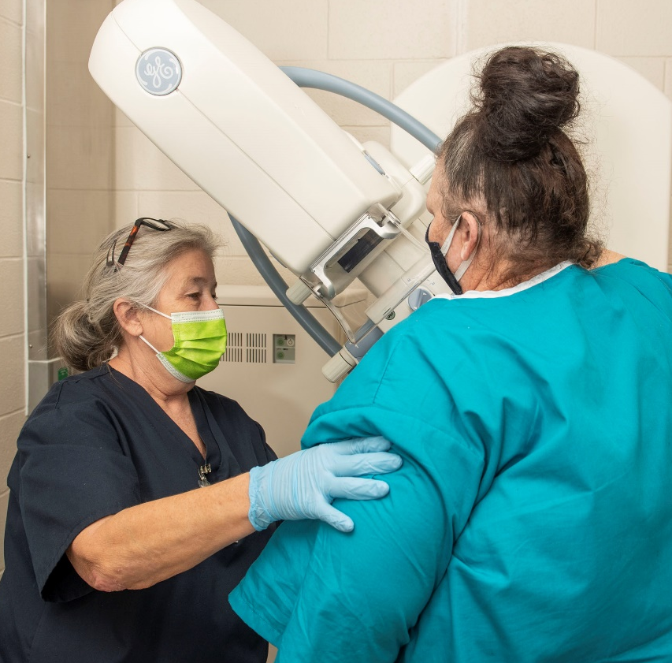
Correctional Healthcare Providers Work with Vulnerable Populations Everyday
Notes:
US Bureau of Justice Statistics 2016 Report
Found that incarcerated individuals were more likely than the general population to experience chronic conditions and infectious disease.
Of those surveyed, 40 percent reported having a current chronic medical condition, while 21 percent of individuals in prison and 14 percent of individuals in jail reported a history of tuberculosis, hepatitis B or C, or other STDs (excluding HIV or AIDS).
Many incarcerated people do not have consistent access to treatment, meaning they arrive with undiagnosed conditions.
Patients find out for the first time that they have an existing condition like hypertension or that they have contracted an infectious disease.
2017 BOJ Report found 14% federal inmates and 26% jail inmates met the threshold for serious psychological distress (SPD).
37% of federal prisoners and 44% of jail inmates had past mental health disorder.

Slide 9
Nursing’s Mission coincides with the Mission of Correctional Healthcare
Notes:
View correctional facilities as public health stations that significantly impact the health status of the larger community.

Slide 10
Who Works in Correctional Healthcare?
Custody staff
Administrators
Nursing staff [RN, LPN, Med. tech. NA’s]
Dental staff
Physicians
Psychological staff
Pharmacy staff
Support staff
Medical records staff
Dietary staff
Notes:
Not unlike other prominent healthcare providers in North Carolina, DPS offers an expansive network of healthcare facilities across the state to serve the needs of our vulnerable population. You will find that, healthcare professionals within a correctional environment provide many of the same services as private sector healthcare facilities. Due to life circumstances, many of our patients enter our care needing treatment for preexisting conditions. The diversity of our provider network allows our teams to diagnose and treat these conditions and elevate the overall health and well-being of our communities.
Hypothetical: Give an example of a condition that the vulnerable population may bring with them into our facilities (from the outside).

Slide 11
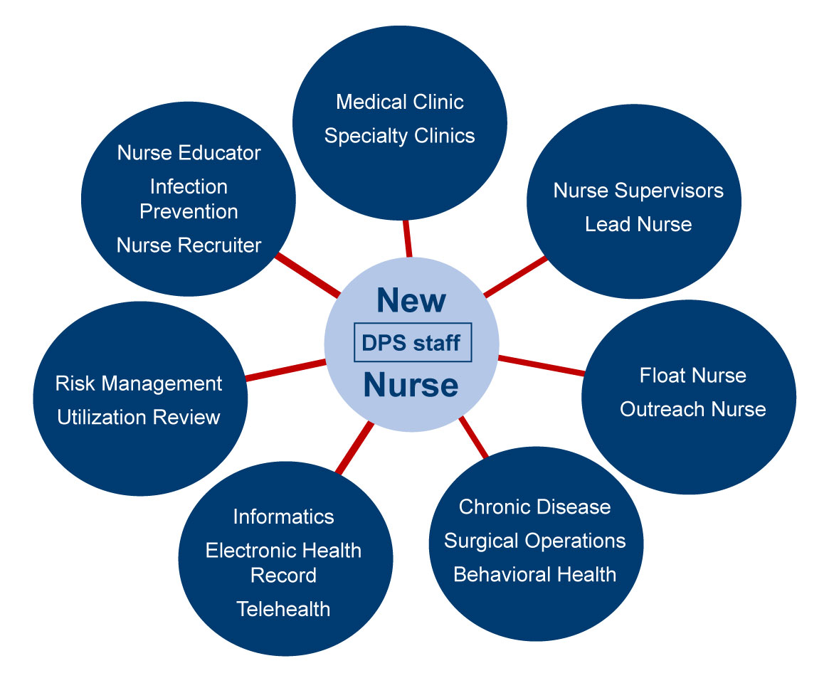
Variety of Roles Available in Corrections

Slide 12
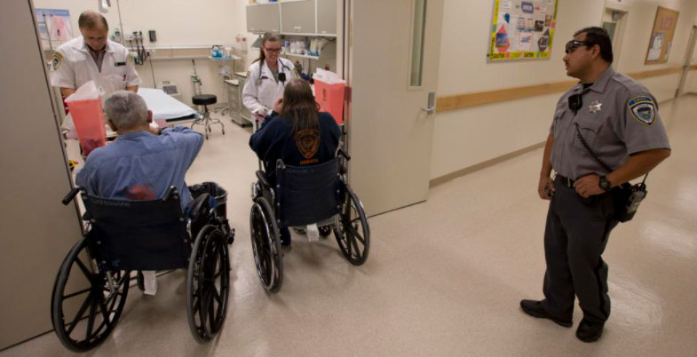
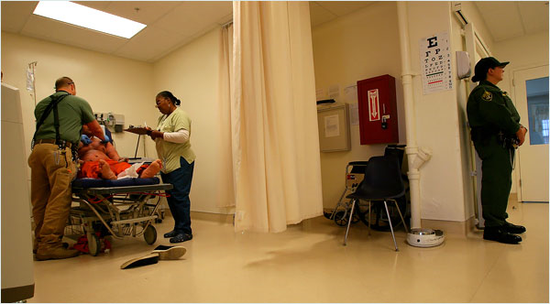
Healthcare in the Correctional Environment
Care for patients
Prioritize care
Advocate for patient
Provide patient education
(Nurse.org, 2017)
Notes:
Security and Safety
Working with a vulnerable population in a confinement scenario requires similar practices to private sector facilities, and the mission is the same: Patient care, advocacy and education are primary goals we serve. Again, due to the life circumstances that brought many patients to our facilities, they may not have a history of caring for their needs properly. Therefore, educating them about the importance of good health and nutrition is a critical part of the overall service that must be provided in vulnerable populations.
Generally speaking, the choice to work in healthcare places all of us in contact with work conditions that can adversely affect our own health. Being exposed to sickness and disease is really no different within a vulnerable population than you might experience in your current facility. If you are familiar with working in an emergency/triage setting, you may be exposed to violent outbursts from mental patients or substance abusers that are brought in for treatment. In serving vulnerable populations, we experience these conditions in our facilities as well, with the difference being we have a greater security presence and protocols to keep our staff secure and safe than might be present in a commercial health venue.

Slide 13
Healthcare Settings within Corrections
Urgent care outpatient services
Emergency services
Inpatient medical
Inpatient behavioral health
Surgery
“To provide care consistent with community standards.”

Slide 14
Central Prison in Raleigh, NC
Notes:
Central Prison Healthcare Complex (CPHC) – males
120 medical beds
Including (current and future) and not limited to – telemetry, dialysis, chemotherapy, surgery, outpatient specialty clinics, dental, radiology, laboratory, pharmacy, isolation, physical therapy, long-term care
216 mental health inpatient and RMH beds
Crisis and Intensive inpatient beds, and residential mental health beds
NCCIW Medical Complex – females
38 inpatient infirmary medical beds
Including (current and future) and not limited to – dialysis, chemotherapy, outpatient specialty clinics, dental, radiology, mammography, laboratory, pharmacy, isolation, physical therapy
42 assisted living beds
46 mental health inpatient beds – acute and chronic
24 residential mental health beds

Slide 15
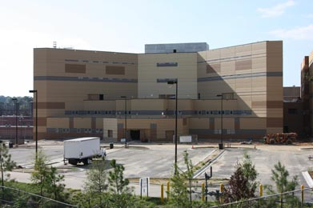
Central Prison Healthcare Complex
Notes:
Central Prison Healthcare Complex (CPHC) – males
120 medical beds
Including (current and future) and not limited to – telemetry, dialysis, chemotherapy, surgery, outpatient specialty clinics, dental, radiology, laboratory, pharmacy, isolation, physical therapy, long-term care
216 mental health inpatient and RMH beds
Crisis and Intensive inpatient beds, and residential mental health beds
NCCIW Medical Complex – females
38 inpatient infirmary medical beds
Including (current and future) and not limited to – dialysis, chemotherapy, outpatient specialty clinics, dental, radiology, mammography, laboratory, pharmacy, isolation, physical therapy
42 assisted living beds
46 mental health inpatient beds – acute and chronic
24 residential mental health beds

Slide 16
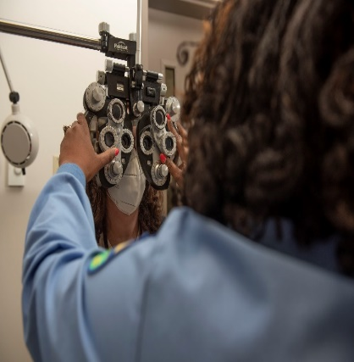
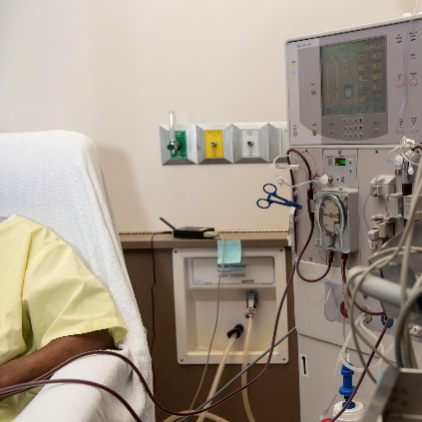
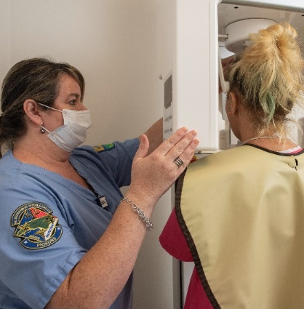
Services offered within Correctional Facilities
NEW PHOTOS FROM SHOOT. DIALYSIS, ETC
Provider clinics
Specialty clinics
Chronic disease clinics
Preventive care
X-Ray
CAT scan
MRI
Long-term care
Assisted living
Hospice, palliative care
Telemedicine
Notes:
Long-term Care; Assisted Living; Hospice
Telemedicine
Over 84 specialists
UNC Chapel Hill
Chronic Disease Clinics
Diabetes
Cardiovascular Disease
Pulmonary/Asthma
Hypertension
Seizures
TB/TB Prophylaxis
Hepatitis B & C & HIV
Cancer
Correctional healthcare serves the vulnerable population within your community

Slide 17
Attributes of Nurses Serving Vulnerable Populations
Remain calm under pressure
Detail-orientated
Strong assessment skills
Address problems before they arise
Crisis intervention skills
Fair, firm, consistent
Compassionate
Skilled communicators
Respectful
Accountable
Critical thinkers
Prepared

Slide 18
Advantages for Nurses working in Corrections
Nurse-driven environment
Nurses get to do what they were trained to do
Nurses have autonomy
Nurses get to work in a variety of healthcare areas
Nurses can work in different work locations
Nursing can work flexible schedules
Patient census does not affect staffing
Never the same day twice
Notes:
Because of our mission, serving a vulnerable population does take a slightly different approach to provide the best possible care for our patients.
The nurse-driven atmosphere means that the healthcare we provide is administered in an environment that is set by nurses. Vulnerable care nurses set the goals and interventions necessary for our patients to achieve health and nutritional standards/needs.
Nurses use the skill sets they were trained for and provide the care necessary.
There is a level of autonomy throughout the variety of healthcare areas and work locations that serve the DPS vulnerable population
We have a family liaison to answer questions.
Flexible schedules
Patient census in hospital dictates who works and who is called off – not in the correctional setting.

Slide 19
Delivering the “Best Care”
Communication is the key! Daily shift reports
Monthly department meetings
Continuous quality improvement monthly meeting of entire state with other disciplines
Partnerships with community and telehealth to provide specialized health care
50+ nursing protocols for handling a variety of situations
Notes:
Monthly Nurse Manager Quality Control Monitor (4 page tool) done at each facility to evaluate the functioning of the unit from adherence to training, licensure, equipment, number of clinic visits, TB, documentation, etc.
Nurse Managers hold monthly nurses meetings.
Quarterly Policy & Procedure Reviews done for each facility by outside regional nursing leadership.
CQI Continuous Quality Improvement monthly meeting of entire state facilities with other disciplines (nursing, medical, dental, behavioral health, medical records, education).
All facilities encouraged to do an annual CQI program.
Health Services is always working on ways to improve.

Slide 20
Aftercare Follow-up / Community Needs
• Just like in the hospital, discharge planning begins the day of admission
• Various patient needs:
• Medical
• Psychological
• Emotional
• Family support
• Community support
• Financial
• Employment
• Educational
• 90 days before release date, referral to social work department outlining medical needs

Slide 21
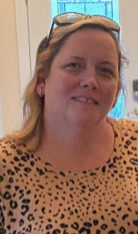
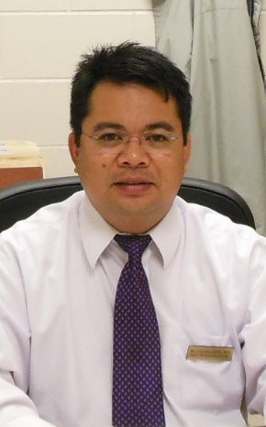
Bruce Nelson, RN Nurse Supervisor I
Christina Fox, BSN, RN Regional Nurse Educator
Marvin Casino, RN Nurse Supervisor II
Notes:
Bruce Nelson, RN “Appreciate the flexibility to move around in DPS and found a beautiful home by the beach”
Agency Nurse –2010
Maury
State Lead Nurse – 2012
Maury
Greene
Tabor
New Hanover
Nurse Supervisor I – 2020
Pender
Christina Fox, BSN, RN “If you are not willing to learn, no one can help you. If you are determined to learn, no one can stop you!”
Agency Nurse - 2012
Alexander Correctional
Lead Nurse - 2015
Nurse Supervisor I - 2017
Alexander
Regional Nurse Educator - 2020
at Western Region
Alexander and Piedmont
Marvin Casino, RN
I started my correctional career as a contract nurse at Eastern CI under Temp solutions on November 2004. I became full time state employee on May 15, 2005 at Eastern CI. I transferred to Maury on June 2006 as staff nurse then became a lead nurse on 2nd shift on Oct 2006. I was an interim nurse supervisor at Maury CI on Jan 2009 and then I was promoted to nurse supervisor II on October 2009. On October 2013, I was promoted to NSIII and still at Maury CI

Slide 22
What I like About This Specialty
“I like the autonomy of providing patient care”
“Everyday I learn something new”
“A balance of care with humanity”
Notes:
I like the autonomy of providing patient care.
While your work will always be performed in consultation with a physician, it is unlikely that a doctor will be on the facility’s grounds every day, advising you what to do in every scenario. Your patients are going to be relying on you to help them then and there. It is a terrific opportunity to use your nursing license to its fullest.
Everyday I learn something new
Correctional nursing expands your skill set from drawing labs, head to toe assessments, urgent care, chronic disease, pre-surgical EKGs, diabetic care, dental injury, etc.
Assessment skills grow in all areas.
It is nothing like what is seen on TV or the movies.
Balance Care with Humanity
Currently, there are more than 2.4 million men and women serving time in America’s jails and prisons.
Of these 2.4 million inmates, it is estimated that 40% are managing chronic medical conditions; 40% are coping with mental health disorders; and 65% meet the medical criteria for substance abuse and addiction.
Never has the need for qualified and capable healthcare providers that are willing to treat this vulnerable population been so evident.

Slide 23
Nursing at a
Correctional Facility
Correctional nursing is like nursing anywhere else
Take care of patients
Prioritize care
Advocate for patient
Provide patient education
More secure

Slide 24
Corrections as approved Clinical Training Site
Schools of nursing
PhD psychology
Nurse practitioner programs
Notes:
Schools of Nursing – traditional RN, LPN, BSN, and RN-BSN programs
PhD Psychology – from around the world
Nurse Practitioner Programs – 57 affiliations

Slide 25
Nursing Essential to New Healthcare Developments
TDU Therapeutic Diversion Units
RDU Rehabilitative Diversion Unit
CIT Crisis Intervention Team
HOPE Training
Long-term care facility
End of Life Care/Hospice Care
ICA Program
Notes:
TDU Therapeutic Diversion Units
RDU Rehabilitative Diversion Unit
CIT Crisis Intervention Team
HOPE Heightened Awareness; Observe & Listen; Provide Support & Reassurance, Encourage Compliance with Treatment & Self Help Strategies
Unit 7 Long Term Care Facility
End of Life Care/Hospice Care
ICA Program (inmate care assistant) program

Slide 26
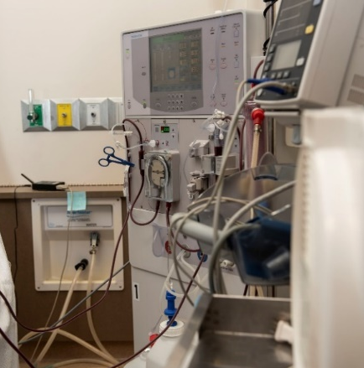
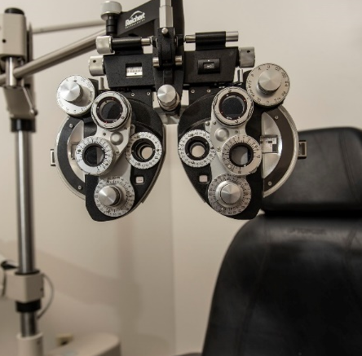
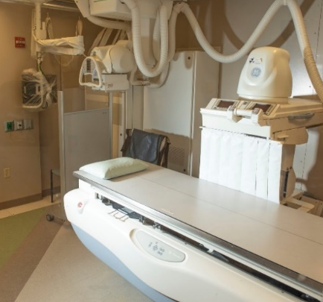
Services provided to promote the Health & Wellness of this vulnerable and underserved population
Physical therapy
Lab, X-Ray, mammogram
Dentistry
Dietary
Dialysis
Pharmacy
Surgery
Notes:
ServicesPhysical Therapy
Lab, X-Ray, Mammogram
Dentistry
36 clinics across the state
All offenders screened at admission intake
Dietary
Therapeutic Diets
Special needs diet
Religious Diets
Allergies
Dialysis
Pharmacy

Slide 27
DID YOU KNOW…?
Notes:
53 State Prisons in NC hire Nurses?
Over 1,000 nurses work in state prisons?
We serve 30,000 offenders of every age and all walks of life (low socio-economic level, etc)
We have regional nurse supervisors and regional directors of nursing?
Lots of support positions

Slide 28
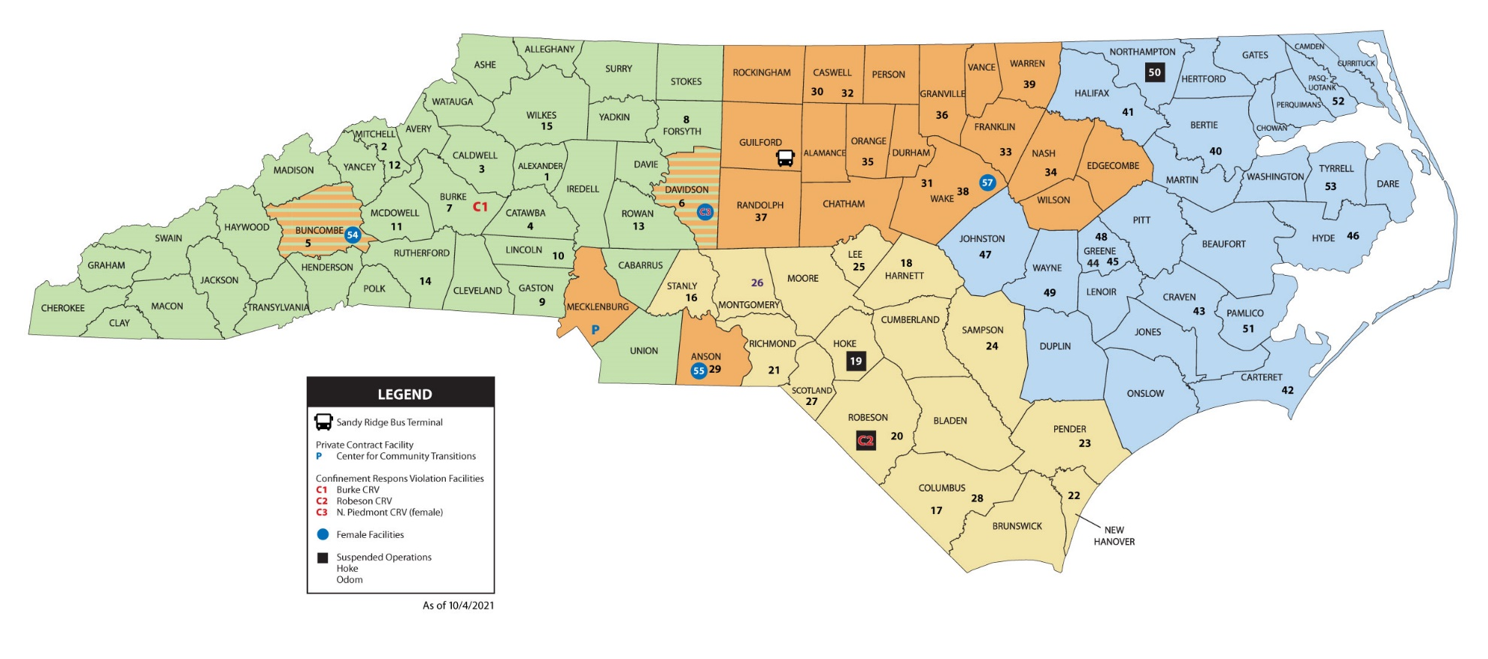
Correctional Facilities are Statewide

Slide 29
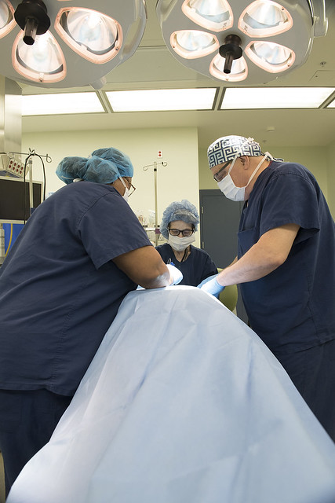
Growth Opportunities Within Corrections
Many nurses start as a staff nurse or agency nurse

Slide 30
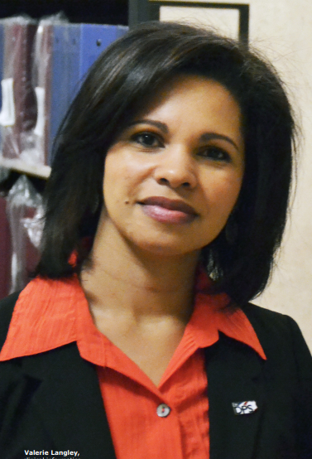
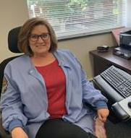
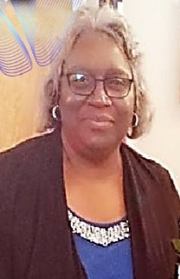
Health & Wellness Leadership
Valerie Langley, RN,CCHP Chief Nursing Officer
Letitia Owen, RN Nursing Services Operations Manager
Beverly Stubbs, RN Nurse Consultant
Notes:
Valerie Langley
Started as an Temporary Nurse August 1996
Went to state Staff Nurse October 1996
Lead Nurse 1998
Nursing Supervisor 2000
Eastern Regional Assistant Director of Nursing - 2008
Clinical Informatics Director - 2013
(Electronic Health Record Implementation)
Chief Nursing Officer – 2020
Letitia Owen, RN “Can do attitude”
Agency Nurse – September 2009 – McCain, Hoke, Maury, Scotland
State Staff Nurse – Scotland May 2011
State Lead Nurse – Lumberton December 2011
Nurse Supervisor I – Lumberton October 2012
Nurse Supervisor III – Scotland November 2016
Nursing Services Operations Manager at DPS Administration in Raleigh – August 2021
Beverly Stubbs, RN “Together We Can Dream, Believe, Lead, Achieve”
State Staff Nurse – 2005
Scotland Correctional
State Lead Nurse – 2006
Nurse Supervisor II – 2008
Nurse Consultant I – 2019
South Central Regional Office, Raeford

Slide 31
Resources and Organizations
American Correctional Nurses Association - ACNA
American Correctional Association - ACA
National Commission on Correctional Health Care - NCCHC
Academy of Correctional Health Professionals - ACHP
American College of Correctional Physicians - ACCP
Academic Consortium on Criminal Justice Health - ACCJH
International Association of Forensic Nurses – IAFN
NC Criminal Justice Association

Slide 32
References
Bronson, J. & Berzofsky, M. (2017). Indicators of mental health problems reported by prisoners and jail inmates. U.S. DOJ Bureau of Justice Statistics. Retrieved from: https://bjs.ojp.gov/content/pub/pdf/imhprpji1112.pdf
C1 Staff. (2015). Ten things I wish I knew before becoming a correctional nurse. Corrections1 by Lexipol. Retrieved from: https://www.corrections1.com/correctional-healthcare/articles/10-things-i-wish-i-knew-before-becoming-a-correctional-nurse-s20NUhy0aVBPWAGL/
Mahoney, S. (2015). The challenges of correctional nursing. Magnificat: A Journal of Undergraduate Nonfiction. Retrieved from: https://commons.marymount.edu/magnificat/the-challenges-of-correctional-nursing/
Missouri Department of Health and Senior Services. (2021). Definition of public health nursing. Council for Public Health Nursing. Retrieved from: https://health.mo.gov/living/lpha/phnursing/definition.php
Nurse.org. (2017). Five things I wish I knew before becoming a correctional nurse. Industry Featured Article. Retrieved from https://nurse.org/articles/correctional-nurse-tips/
Premier Medical Staffing Services (2020). Interview with Chris McMahon, RN, BSN. A Day in the Life of a Correctional Nurse. Retrieved from: https://premiermedstaffing.com/blog/a-day-in-the-life-of-a-correctional-nurse/

Slide 33
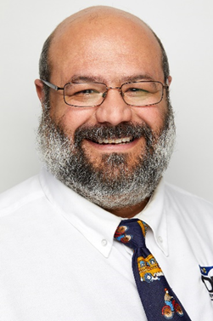
Questions? ramesh.upadhyaya@dac.nc.gov (984) 255 – 6078 (336) 259 – 0122
Ramesh C. Upadhyaya, MSN, MBA, RN, CCHP Nursing Resource Liaison

