Slide 1

Assessment of functional capacity in prisons: Challenges in rehabilitation of this vulnerable population
Ramesh C. Upadhyaya, MSN, MBA, RN, CRRN, CCHP
Notes:
Determining functional status of an incarcerated person is vital to determine their individual needs and to initiate a plan of care, particularly those with chronic or acute illnesses. The tool used by providers in the State of North Carolina has been in use for over 20 years. The problem is that there is little to no education provided about how to use the tool.
The aim of this quality improvement project was to develop, implement, and evaluate an educational program designed to assist the healthcare providers within the state of North Carolina Prison System in the administration of the PULHEAT assessment tool. A retrospective chart review will be used to collect pre-intervention data. The primary outcome of this DNP project aspires to provide the highest quality healthcare care to ensure that each patient seen in the North Carolina State Prison System achieves the maximum function possible, and that this function, measured objectively, improves over time.

Slide 2

Welcome to GNCCARN 2023
Life’s a beach…
The Greater NC Chapter of the Association of Rehabilitation Nurses (GNCCARN) is accredited as a provider of nursing continuing professional development by the American Nurses Credentialing Center’s Commission on Accreditation through the North Carolina Nurses Association.
2023
GNCCARN

Slide 3
Speaker Disclosure Statement
Ramesh C. Upadhyaya does not have relevant financial relationship(s) to disclose with ineligible companies whose primary business is producing, marketing, selling, re-selling, or distributing healthcare products used by or on patients.”
2023
GNCCARN

Slide 4
Learning Outcomes
Upon completion, the participant will be able to:
verbalize understanding and utility of the PULHEAT tool as a Functional Capacity Measure.
list three functional assessment tools used in rehabilitation nursing.
state how the tool used in one prison system compares to other functional assessment tools used in rehabilitation nursing.
verbalize the importance of an accurate functional assessment of an incarcerated person.
2023
GNCCARN

Slide 5
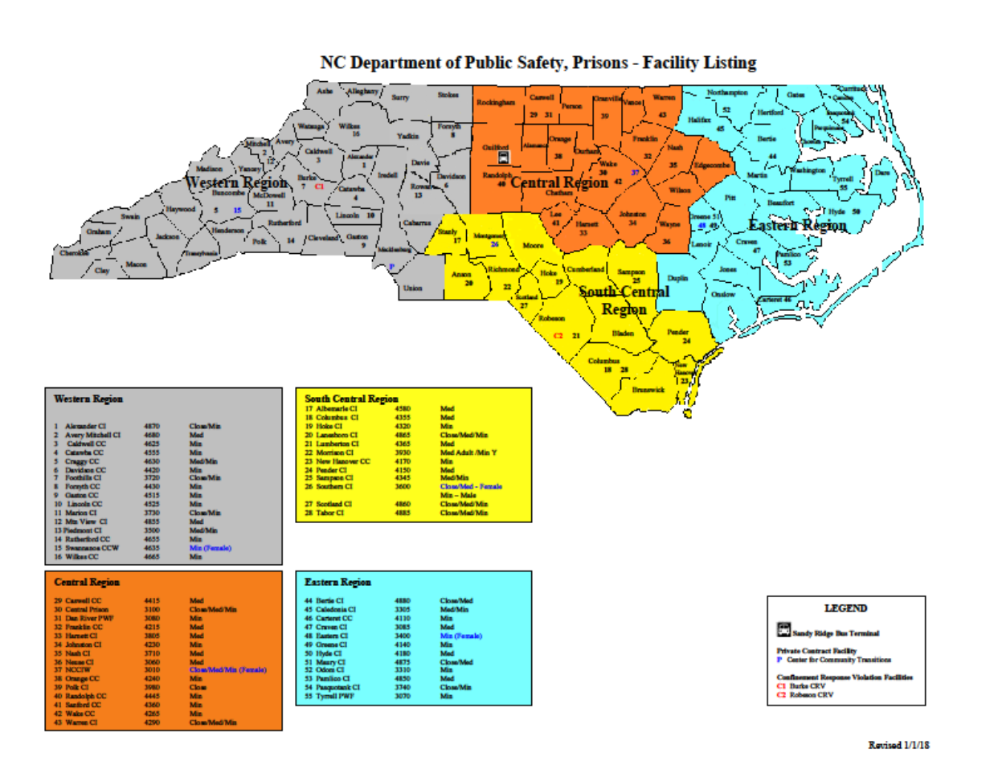
History
Estelle v. Gamble
North Carolina State Prison System
Functional capacity of offenders
2023
GNCCARN
Notes:
In the United States, freedom of speech, freedom of religion, and other rights are guaranteed by the Constitution. Healthcare, however, is not a right guaranteed to citizens, unless they are incarcerated. Although it may come as a surprise to many people, the right of the incarcerated to healthcare that is equal to or better than community standards is enshrined in the Bill of Rights (the first ten amendments of the U.S. Constitution). The eighth amendment of the Constitution includes the right of citizens to be free of cruel and unusual punishment. In a landmark case that came before the supreme court in 1976, Estelle v. Gamble, the Supreme Court interpreted the eighth amendment to mean that not providing healthcare to a person with a healthcare condition would constitute cruel and unusual punishment (Butler, 2019). In other words, denying treatment would be like adding a punishment on top of an incarcerated person’s sentence. Since 1976, therefore, correctional institutions are required, by the Constitution, to provide healthcare to their population.

Slide 6
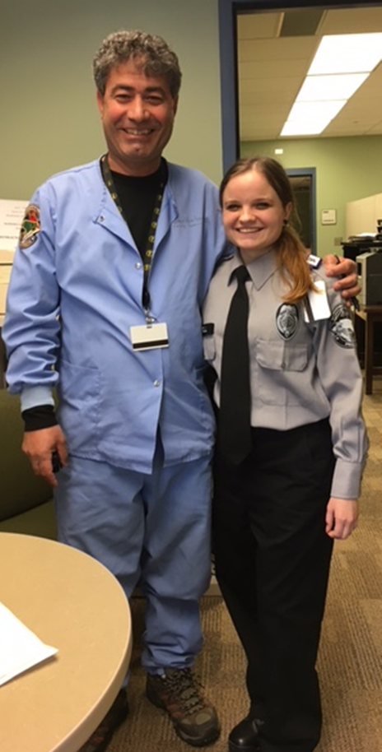
The problem
Population: Healthcare providers in the State Prison System of North Carolina that assess the functional capacity of incarcerated persons using the PULHEAT tool.
Intervention: An In-service program to enhance knowledge in the application of the tool
Comparison: Retrospective chart review to assess increased utilization of the tool
Outcome: The primary outcome will be the system wide improvement of the use of the tool. The secondary outcome will be better outcomes of incarcerated persons by increasing the consistent application of the tool.
Time: Temporal factors such as maturation
2023
GNCCARN
Notes:
In the United States, chronic disease management accounts for most healthcare expenditures. The prison system is no exception. During the admission process, the provider applies a tool known as PULHEAT to determine an incarcerated person’s overall functional capacity. This tool assists in determining which type of housing and which facility would be best to assign the incarcerated person. PULHEAT is an acronym that stands for: Physical stamina, Upper extremities, Lower extremities, Hearing (ears), Eyes (vision), Activity grade, and Transportation needs, Each category is assigned a number of one through five; a higher number indicates decreased function and/or increased needs in that functional area. Dental status, mental health status, and retardation [sic], added to PULHEAT, are the purview of Dentists and Licensed Mental Health Professionals, respectively (NCDPS, 2014). PULHEAT and MDS (healthcare Duty Status) may be two of the most important areas in the EHR because they determine where a patient is housed and what job assignment they are eligible for. The evaluation and recording of the individual's healthcare and physical status plays an important role in job assignment and patient welfare. Job assignment is important because it plays a part in a patient’s sentence. By working or going to school, patients are given “gain/earned” time which reduces their sentence. In addition, an accurate PULHEAT and MDS ensures that a patient is housed in an appropriate area and that they are allowed to have certain items in their property. (Woglom, 2021, p. 11)
In the prison system of North Carolina, there is little to no training for healthcare providers in the use of the assessment tool, PULHEAT. The current method of evaluation of the use of the tool is to ask the provider if he or she knows how to use the tool

Slide 7

Stakeholders
2023
GNCCARN
Notes:
The Department of Public Safety (DPS), the largest department in State government, employs over 27,000 employees. DPS encompasses a dozen divisions, including the North Carolina National Guard, the State Highway Patrol, the Division of Juvenile Justice, Alcohol Law Enforcement, the State Bureau of Investigation, the Governor’s Crime Commission, the Division of Criminal Investigation, the Division of Community Corrections (Probation and Parole), and the Division of Adult Correction. The State Prison System, headed by Commissioner Todd Ishee, is part of the Division of Adult Correction. Health and Wellness is one section within the Prison System and is headed by Dr. Gary Junker. Reporting directly to Dr. Junker are Dr. Arthur Campbell, the chief medical officer, Dr. James Clare, the chief of dentistry, Dr. Brian Sheitman, the chief of psychiatry, Dr. Karen Steinour, the chief of quality assurance, and my supervisor, Valerie Langley, the chief nursing officer. This detailed chain-of-command may seem superfluous to this discussion, but I wanted to highlight that despite the grand scope of my project, which encompasses the entire prison healthcare system, is but one section of one department of the State government. Still, if the project is successfully published, it may shape the way all incarcerated persons are assessed nationwide. Building a relationship, my DNP project will begin with the stakeholders in the organization. The top healthcare leader in my organization is the Director of Health & Wellness Section of the Prison System in North Carolina. This individual, Dr. Gary Junker, was previously the Director of Behavioral Health for the State Prison System. Dr. Junker’s direct reports are many of the C-level stakeholders to whom I plan to “sell” my project.

Slide 8

Literature Review and Description
PULHEATDMR = Physical stamina, Upper extremities, Lower extremities, Hearing (ears), Eyes (vision), Activity grade, Transportation needs, Dental, Mental health status, and Retardation
85% of men aged 60 and older
No standardized instruments found for prisons
CARE Item Set, FIM™ tool, MDS, CANFOR, and WHOQUOL-BREF
2023
GNCCARN
(Bedard, Metzger, & Williams, 2016)
Notes:
P - Physical capacity or stamina: This factor relates to general physical function. It is impacted by medical, dental, and mental health conditions that do not fall under other specific factors of the system. In arriving at the profile under this factor, it may be appropriate to consider strength, endurance, height-weight-body build relationship, agility, energy, and muscular coordination.
U - Upper extremities: This factor relates to the hands, arms, shoulder girdle, and upper back (cervical, thoracic and upper lumbar) concerning strength, range of motion, and general efficiency.
L - Lower extremities: This spine factor relates to the feet, legs, pelvic girdle, lower back musculature and lower back (lower lumbar and sacral spine) concerning strength, range of motion, and general efficiency.
H - Hearing and ears: This factor relates to auditory acuity, diseases, and defects of the ear.
E - Eyes: This factor relates to visual acuity, diseases, and defects of the eye.
A - Activity grade: This overall factor relates to institutional assignment and limitations affecting an offender’s ability to participate in jobs, programs, activities, and services.
T - Transportation: This factor relates to the designation as to whether special transportation requirements exist due to the offender's health condition.
A study cited by Bedard, Metzger, and Williams (2016) found that 85% of men aged 60 or older in prison reported at least one major chronic illness and over 60% had a diagnosed mental illness. A full assessment is necessary upon intake at correctional facilities to formulate a plan of care in order to meet the healthcare needs of these vulnerable individuals.
CARE stands for Continuity Assessment Record and Evaluation (CARE) Item Set. You can think of it as the replacement to FIM. I will be talking about inpatient rehab, but similar outcome measures are used in skilled nursing facilities (or MDS), long-term care facilities, and home health (or OASIS). The FIM™ is used widely across rehabilitation settings, and was developed by a joint task force appointed by the American Congress of Rehabilitation Medicine and the American Academy of Physical Medicine and Rehabilitation. It consists of 18 items: six are related to self-care, two are related to sphincter control, three are related mobility, two are related to locomotion, two are related to communication, and three are related to social cognition. Each item is scored by a clinician (nurse, therapist, or healthcare provider) on a seven-point scale, from one, which is complete dependence to seven, which is complete independence.
In the literature, assessment tools used in corrections are often specific to mental health needs, such as the Forensic Camberwell Assessment of Need (CANFOR) instrument. Other tools, such as the World Health Organization Quality of Life Instruments (WHOQOL-BREF) measures needs by perceived health status, rather than an objective assessment by a healthcare provider.
The World Health Organization Quality of Life Instruments (WHOQOL-BREF) measures on a five-point ordinal scale of 1 to 5 in the physical health domain including mobility, daily activities, functional capacity, energy, pain, and sleep, but these measures are perceived and answered by questionnaire, instead of an assessment by a provider, like the CANFOR instrument. For example, in a questionnaire administered by De Smet, De Donder, Ryan, Van Regenmortel, Brosens, and Vandevelde (2017), perceived health status was measured by the following question: “How would you assess your own health status in comparison with your contemporaries in prison?” (p. 1573). Physical frailty was measured on the questionnaire by using the Tilburg Frailty indicator, which is a validated instrument that assesses the extent of frailty of older people. The Tilburg Frailty indicator consists of eight yes or no questions about general physical well-being, loss of weight, mobility (walking), balance, vision, hearing, strength in the hands, and tiredness (α = 0.74) (p. 1574). In summary, the need for an objective functional measure instrument that is accurate, valid, and can be used consistently in correctional healthcare cannot be taken lightly. If the education program developed provides beneficial outcomes in the sample group, then it should be implemented system-wide for all the healthcare providers in the North Carolina Prison System.

Slide 9
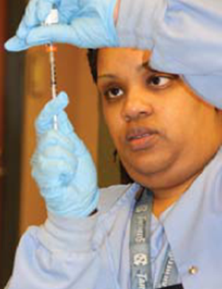
Qualitative Questions
What training is currently provided for using the tool?
Is the training currently provided sufficient?
What is the tool used for in practice?
Is the tool being used as an objective measure by providers?
Are providers applying the tool correctly?
Is there evidence that correct application of the tool brings about better patient outcomes?
2023
GNCCARN
Notes:
There are multiple objectives within this project; thus, lending itself to a mixed-methods design. The primary objective will be to increase healthcare providers’ knowledge of the functional assessment tool on incarcerated persons. The secondary objective is to educate healthcare providers on the importance of the tool as an objective measure of the incarcerated person’s functional ability. The third objective of the project is to assess the healthcare providers’ willingness to change their practice, given evidence that better outcomes will result.
Prior to the quantitative study of the change in healthcare providers’ knowledge, a qualitative study using focus groups aims to answer the following questions:
What training is currently provided for using the tool?
Is the training currently provided sufficient?
What is the tool used for in practice?
Is the tool being used as an objective measure by providers?
Are providers applying the tool correctly?
Is there evidence that correct application of the tool brings about better patient outcomes?

Slide 10
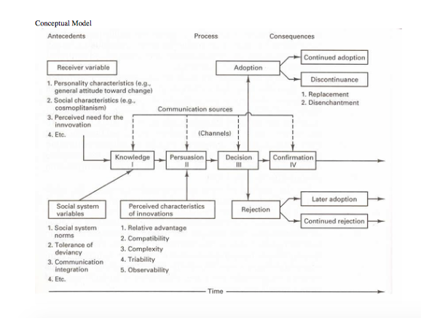
Rogers’ Diffusion of Innovation Theory
2023
GNCCARN
Notes:
Components of Rogers’ Diffusion of Innovation Theory will be incorporated in the implementation of the in-service to healthcare providers. Rogers’s theory employs a five-step process for knowledge translation and adoption:
Knowledge
Persuasion
Decision
Implementation
Confirmation (White, Dudley-Brown, & Terharr, 2021)
Rogers’ Diffusion of Innovation Theory describes a situation of how the implementation of the project will proceed. Rogers identifies five steps in the innovation-decision process and each step in the process is dependent on the individual’s “buy in” and belief that their practice needs improvement. If the healthcare provider does not “buy in” they will have an unfavorable attitude toward the educational program and not adopt the change – or attend the educational program at all (White, Dudley-Brown, & Terharr, 2021). Rogers Diffusion Model with constructs is depicted below:

Slide 11
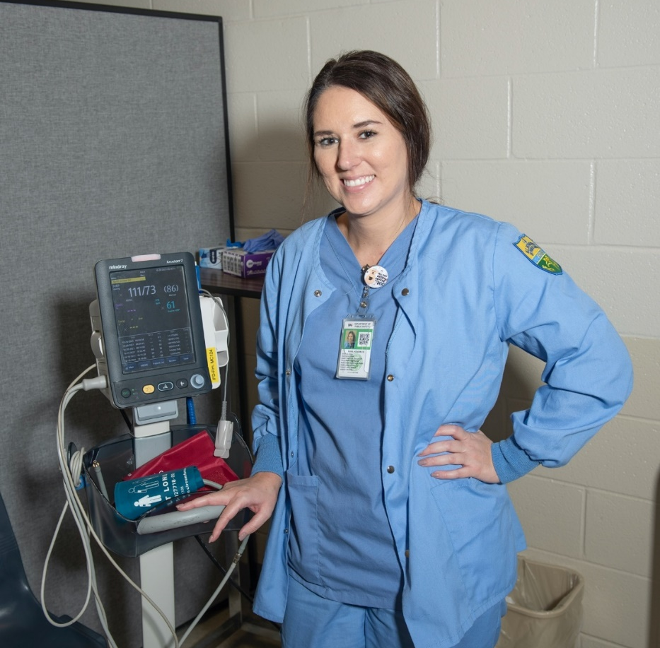
Rogers’ Diffusion of Innovation Theory
Knowledge
Persuasion
Decision
Implementation
Confirmation
(White, Dudley-Brown, & Terharr, 2021)
2023
GNCCARN
Notes:
Components of Rogers’ Diffusion of Innovation Theory will be incorporated in the implementation of the in-service to healthcare providers. Rogers’s theory employs a five-step process for knowledge translation and adoption:
Rogers’ Diffusion of Innovation Theory describes a situation of how the implementation of the project will proceed. Rogers identifies five steps in the innovation-decision process and each step in the process is dependent on the individual’s “buy in” and belief that their practice needs improvement. If the healthcare provider does not “buy in” they will have an unfavorable attitude toward the educational program and not adopt the change – or attend the educational program at all
The healthcare provider gains awareness of the functionality and utility of the assessment tool.
The healthcare provider, after receiving the education, determines that the assessment tool has merit.
The healthcare provider chooses to alter their practice in usage of the assessment tool.
The healthcare provider begins to use the assessment tool in practice per their training.
The healthcare provider decides to continue to use the assessment tool in the manner it was intended because they discover its worth.
The healthcare providers in the prison system are largely represented by what Rogers calls “the late majority.” They will not complete the training unless compelled to do so, despite their lack of knowledge of the assessment tool. Many providers eschew innovation and prefer to stick to traditional assessment models (White, Dudley-Brown, & Terharr, 2021). I expect that through dissemination, diffusion will occur by way of peer-support of the innovation. As a result of successful implementation, there will be more utility, consistency, and reliability of the PULHEAT assessment tool. A side-effect of the implementation will be better outcomes for patients, fewer requests for healthcare accommodations, and fewer requests for transfers to facilities with higher acuity.

Slide 12

Results
2023
GNCCARN
Notes:
The results of the qualitative study informed the formulation of the educational program used in the quantitative study aspect of the quality improvement project. In the qualitative study, it is projected that at least 50% of healthcare providers that currently work for NCDPS will attend the in-service, and the outcome of the paired t-test using a retrospective chart review for knowledge acquisition will reveal that there is a statistically difference between the results of the PULHEAT tool before and after the in-service is attended. Further, this difference is expected to be positive, meaning that the healthcare provider will demonstrate increased knowledge of the assessment tool as evidenced by an increased utilization of the tool following the educational program.
Following the qualitative focus groups, development of the education program tailoring to meet the needs of the healthcare providers will assist in providing motivation for taking part in the study. Part of the educational program delivered to the healthcare providers will allow the participants to see the value in the consistent administration of the assessment tool. Following the study, interviews with members of the diagnostic team will determine some of the benefits of the quality improvement project. Diagnostics, also known as population management, uses the PULHEAT DMR tool (along with other measures) to help determine where an offender is placed within the State Prison System. Placing offenders appropriately not only saves time and money for the State, but it also improves the quality of life for the offenders. Future studies can determine what level of improvement in the quality of life and outcomes of offenders are following the implementation of the project.

Slide 13
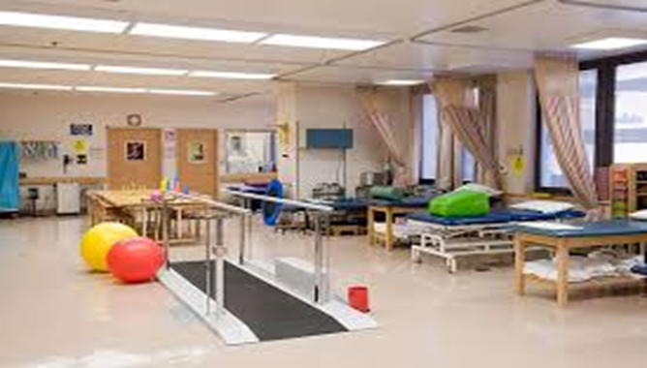
Discussion of Results
2023
GNCCARN
Notes:
The results that the quantitative study revealed were as expected. Given the nature of the healthcare providers’ attitude regarding in-service education, the motivation to complete the in-service, pre-test and post-test barely reaches above zero. The amount of training that the providers receive in the administration of the PULHEAT tool is negligible prior to the implementation of this quality improvement project. Following implementation, the important factor then becomes maintaining the “stickiness” of the project.
If an offender needs a wheelchair, it is logical to conclude that the offender either has something temporarily or permanently affecting their ability to walk. Regardless, one would imagine that any disease process which necessitates the use of a wheelchair would, by the current definitions in PULHEAT mean that the "L" should have either a designation of "3" or "4." However, only 31 of the 52 offenders at Maury who have been issued a wheelchair have a designation of either "3" or "4."
Conversely, in reviewing the list, I found multiple offenders who will routinely go to the basketball court in their wheelchair, play 30 minutes of basketball on the court with other offenders, and then return to their housing unit in their wheelchair. Nursing staff has pointed out this fact to Maury's healthcare providers only to be told, essentially, that it is easier to just let the offender have the wheelchair than it is to deal with the litany of complaints, grievances, phone calls from relatives, and threats of lawsuits (tort actions and Constitutional right violations) that occur if one takes the wheelchair away. Thus, the PULHEAT value may, in reality, be a "1," but for whatever good or mostly bad reason, the provider still wants the offender to have a wheelchair.
Thus, the preliminary data collection reveals that:
Most values that are entered aren't even made by healthcare providers but rather are made by mental health providers.
If one looks how often the PULHEAT values are updated, one quickly comes to realize that they are relatively static in nature (particularly from a healthcare provider perspective) and done initially in processing camps. They are also mandated each time an inmate gets an "annual physical." (Though the policy for getting an annual "physical" also varies according to age. For offenders over 50, it is actually mandated to be done "annually." For offenders under 50, it's done once every four years.) But simply because it's mandated doesn't mean it's done. Pulling up a number of "histories and physicals" completed at Maury, there have been no PULHEATs done for almost two years. This problem is not confined to Maury Correctional Institution; it is widespread across all correctional facilities. There simply aren't enough providers to keep up with annual history/physicals while simultaneously meeting the current demands of seeing offenders with current, chronic or acute problems. Thus history/physicals don't get done, and PULHEATS don't get updated.
Even a cursory review where one compares PULHEAT values to MDS values will reveal that PULHEAT values are not accurate, as the spreadsheet in appendix C aptly does for Maury Correctional (Rogers, 2022).

Slide 14
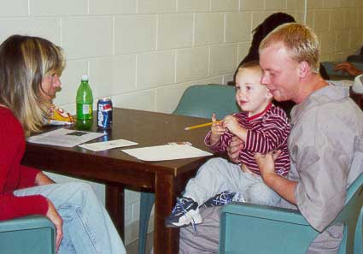
Limitations
2023
GNCCARN
Notes:
Even though the population of study includes all healthcare providers within the State prison system, this sample will represent only a small sample of the total population. This sample size likely does not have sufficient power to generalize to other prison systems outside the State of North Carolina. Many health interventions do not lend themselves to transferability, specifically transferring from one setting to another. The term, transferability, refers primarily to qualitative research design (Kellar & Kelvin, 2013). Generalizability, analogous to transferability, refers to a quantitative study design. Generalizability is the extent to which the results of a given study applies to a wider population, another setting, or another time (Kellar & Kelvin, 2013). Often administrators fall into a trap of assuming that works in one population or setting, will work in another. This highlights the threat to external validity. Again, when conducting an experiment under heavily controlled laboratory setting, attempting to translate the research outside the laboratory becomes a challenge. This represents a limitation in this quality improvement project.

Slide 15
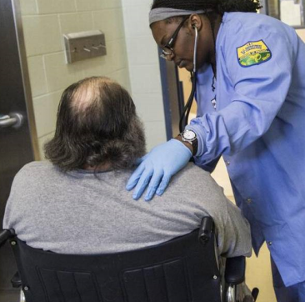
Conclusion and Future Research
Data Collection
  Qualitative
  Quantitative
Questions to answer:
  Is the tool reliable?
  Subjective in nature?
  Educational preparation?
  Training provided?
Continue or discontinue?
2023
GNCCARN

Slide 16
References
American Correctional Association (ACA) (2019). Performance-based standards and expected
practices for adult correctional institutions, 5th ed. American Correctional Association
Department of Performance-Based Standards and Accreditation: Alexandria, Virginia.
Barta, W. D., Shelton, D., Cepelak, C., & Gallagher, C. (2016). Promoting a sustainable academic-
correctional health partnership: Lessons for systemic action research. Systemic Practice and Action Research, 29(1), 27-50. doi:http://dx.doi.org/10.1007/s11213-
015-9351-6
Bedard, R., Metzger, L., & Williams, B. (2016). Ageing prisoners: An introduction to
geriatric health-care challenges in correctional facilities. International Review
of the Red Cross, 98(903), 917-939. doi:http://dx.doi.org/10.1017/S1816383117000364
Butler, B. (2019). Health information technology: Advancing care within corrections, improving
care within the community. Journal of Health and Human Services
Administration, 41(4), 85-116.
2023
GNCCARN

Slide 17
References Continued
Hartweg, D. L., & Fleck, L. M. (2020). Chapter 9: Dorothea Orem’s self-care deficit theory. In
Smith, M.C. (ed). (2020). Nursing Theories and Nursing Practice, 5th ed. (pp. 121-145). F.A. Davis: Philadelphia.
North Carolina Department of Public Safety (NCDPS). (2014). Health services policy & procedure
manual section: Assessment of patient, policy #A-2.
Reagan, L., Shelton, D., & Anderson, E. (2016). Rediscovery of self-care for incarcerated persons
with diabetes. Journal for Evidence-based Practice in Correctional Health, 1(5).
Shelton, D. (2019). Advancing Correctional Nursing: Correctional Nurse Roundtable Discussion.
Commission on Correctional Health Care Fall Conference on Correctional Healthcare.
National, October 12-16, 2019, Ft. Lauderdale, FL.
2023
GNCCARN

Slide 18
References Continued
Shelton, D. (2019). Advancing Correctional Nursing: Correctional Nurse Roundtable Discussion
Commission on Correctional Health Care Fall Conference on Correctional Healthcare.
National, October 12-16, 2019, Ft. Lauderdale, FL.
Shelton, D., Barta, B., Trestman, R., & Wakai, S. (2016). Biopsychosocial vulnerability-stress
modeling for an incarcerated population. Journal for Evidence-based Practice in Correctional Health, 1(1).
Shelton, D., Barta, B., & Anderson, E. (2016). The rediscovery of self-care: A model for persons
with incarceration experience. Journal for Evidence-based Practice in Correctional
Health,1(1).
Shelton, D., Muse, M. V., Blair, P., Bickford, C. J., Wright, R. M., et al. (2020). Correctional nursing:
Scope and standards of Practice,3rd ed. American Nurses Association Publishing:
Washington D.C.
White, K.M., Dudley-Brown, S., & Terhaar, M. F. (2021). Translation of evidence into
nursing and healthcare, 3rd edition. Springer Publishing Company: New York.
2023
GNCCARN

Slide 19

I want to hear from you!
Questions?
Ram Upadhyaya, MSN, MBA, RN, CRRN, CCHP
Nursing Resource Liaison
(984) 255-6078
(336) 259-0122
ramesh.upadhyaya@dac.nc.gov
ram.upadhyaya@gmail.com
2023
GNCCARN

