Slide 1
Please note that all videos have been removed from this power point slide deck. Presentation videos may be accessed by viewing the recorded session.

Slide 2
Module 1: Human Trafficking Basics
Health Care Professionals Training Program

Slide 3
NC Stop Human Trafficking
Vision: A state free of human trafficking
Mission: Creating communities actively working to abolish human trafficking

Slide 4
WHAT WE DO
EDUCATION:
Education and training is paramount in victim identification. NC Stop Human Trafficking trains professionals in health care, education, law enforcement, hospitality and social services about indicators of potential victimization and appropriate response.
COLLABORATION:
Human trafficking is a multi-faceted issue that requires every service provider, professional and community leader to come together to improve victim response, bolster services and raise collective awareness
LEGISLATION:
Change begins with sound policy decisions. NC Stop Human Trafficking advocates for stronger anti-human trafficking legislation on a state and federal level.
FAIR TRADING:
Increasing demand for fair trade products will reduce human trafficking globally. NC Stop Human Trafficking introduces fair trade products into the local markets

Slide 5
Full understanding of what human trafficking is, including definitions, terminology and prevalence
Full understanding of indicators of human trafficking in a health care setting
Learning objectives
Full understanding of vulnerable populations and the intersections between human trafficking and other health issues
Understanding of how trauma effects communication and patient response
Full understanding of how to use the PEARR Tool in health care practice to assist in intervention

Slide 6
What is human trafficking?
Definitions, terminology and prevalence

Slide 7
Legal Definition Under the Trafficking Victims Protection Act
The recruitment, harboring, transportation, provision, obtaining, advertising, maintaining, patronizing, or soliciting of a person for labor or services through the use of FORCE, FRAUD, or COERCION for the purpose of subjection to involuntary servitude, debt bondage or slavery.
Trafficking Victims Protection Act of 2000 (TVPA), as amended (22 U.S.C. § 7102)

Slide 8
Three elements of human trafficking
Action/Act
Means
Purpose of exploitation
Trafficker must:
Recruit
Transport
Harbor
Providing
Obtaining
Patronizing
Soliciting
Advertising
(sex trafficking only for advertising action/act)
Trafficker must use:
Force
(physical abuse, sexual abuse, confinement)
Fraud
(false promises about work, false promises about relationship, withholding wages)
&
Coercion
(threats of harm or deportation, debt bondage, confiscation of documentation, psychological abuse)
Commercial sexual exploitation
and/or
Forced labor
*If a person is under the age of 18 and performing a commercial sex act, force fraud or coercion need not be proven*
Trafficking Victims Protection Act of 2000 (TVPA), as amended (22 U.S.C. § 7102)

Slide 9
Force
Sexual Assault
Physical Assault
Confinement

Slide 10
Fraud
Selling A Dream
Romantic Dream
Prosperity Dream
Enticing a victim to work using a form of persuasion that would make the victim believe they will become financially better off.
Grooming to believe the perpetrator is a friend
Or a lover
Or a protector

Slide 11
Coercion
Seizure of documentation
Withholding or providing substances
Psychological threats – threats of harm to the victim or the victim’s loved ones
Debt bondage
Manipulation

Slide 12
Human Trafficking is NOT Human Smuggling
Human Trafficking
Force, fraud, coercion used to manipulate victim
Crime committed against a person
Human Smuggling
Individuals consent to being smuggled
Crime against a country
Trafficked person DOES NOT have to be moved or transported to be considered a victim of trafficking
Requires being transported across international borders
Transportation based
Exploitation based
- Department of Homeland Security/ICE

Slide 13
Labor trafficking
Using force, fraud or coercion to recruit, harbor, transport, obtain or employ a person for labor or services in involuntary servitude, peonage, debt bondage or slavery
Trafficking Victims Protection Act of 2000 (TVPA), as amended (22 U.S.C. § 7102)

Slide 14
Labor Trafficking
There are nearly 20 industries that are known for labor trafficking
- Polaris, “The Typology of Modern Slavery Defining Sex and Labor Trafficking in the United States

Slide 15
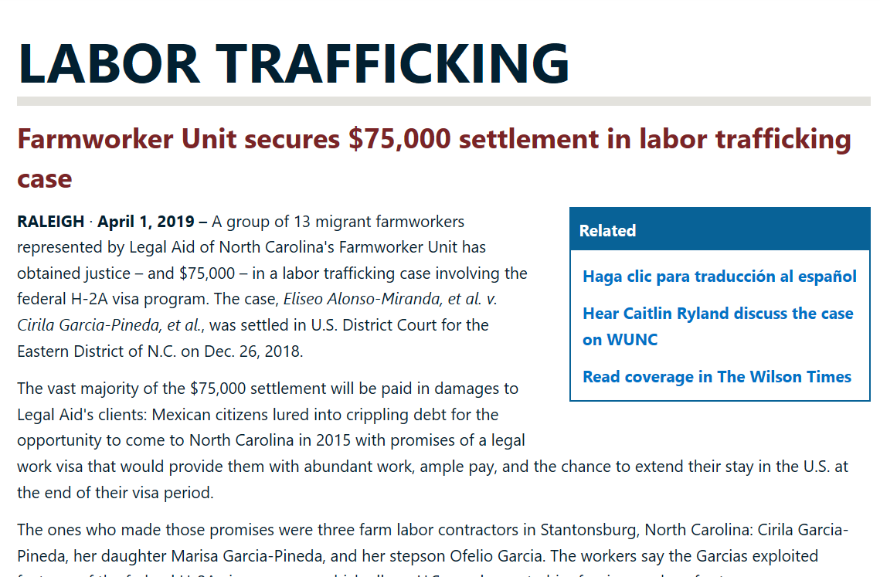
Labor Trafficking
Greene County
Charged unlawful recruitment fees
Workers did not get what they were promised.
Subjected to threats and coercive manipulation to keep working.
Confiscated their passports.
In U.S. lawfully under the H2A guest worker program.
"This is what labor trafficking looks like. Sex trafficking might be better known, but labor trafficking is just as pernicious and it's all too prevalent, especially in industries where labor contracting services are used.“
– Caitlin Ryland, lead attorney with Legal Aid of N.C.

Slide 16
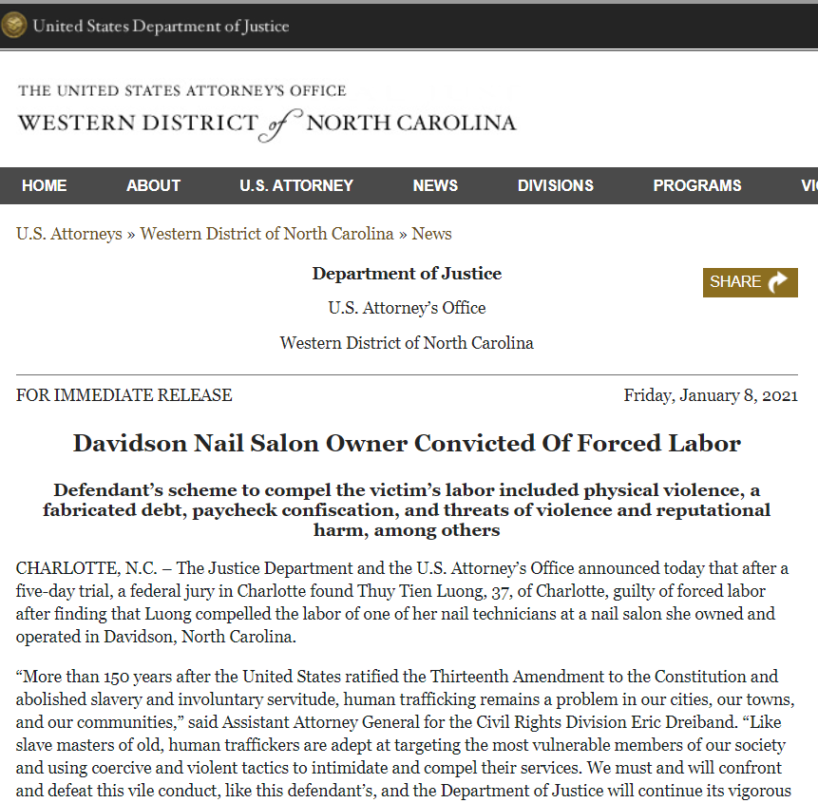
Labor Trafficking
Mecklenburg
County
Trafficker was a family member
Infliction of mental and physical abuse
Falsely claimed that the victim owed her a debt of $180,000
Worked 10 hours a day for 6 to 7 days a week
Falsely alleged victim’s poor work performance
Treated the victim in a humiliating and demeaning fashion
Luong’s coercive scheme caused the victim to fear Luong
“Through the infliction of mental and physical abuse, Luong despicably preyed upon the victim’s hardships and personal vulnerabilities for her own selfish financial gains. Forced labor schemes are an assault on human dignity and have no place in modern society.” - U.S. Attorney Andrew Murray

Slide 17
Activity
Listen to the next survivor story carefully.
What kind of medical conditions are related to his story?
How would he show up in a health care setting?

Slide 18
Activity
What kind of medical conditions are related to his story?
How would he show up in a health care setting?

Slide 19
Sex Trafficking
The recruitment, harboring, transportation, provision, or obtaining of a person for the purpose of a commercial sex act, induced by force, fraud or coercion, or in which person performing the act is under age 18.
Trafficking Victims Protection Act of 2000 (TVPA), as amended (22 U.S.C. § 7102)

Slide 20
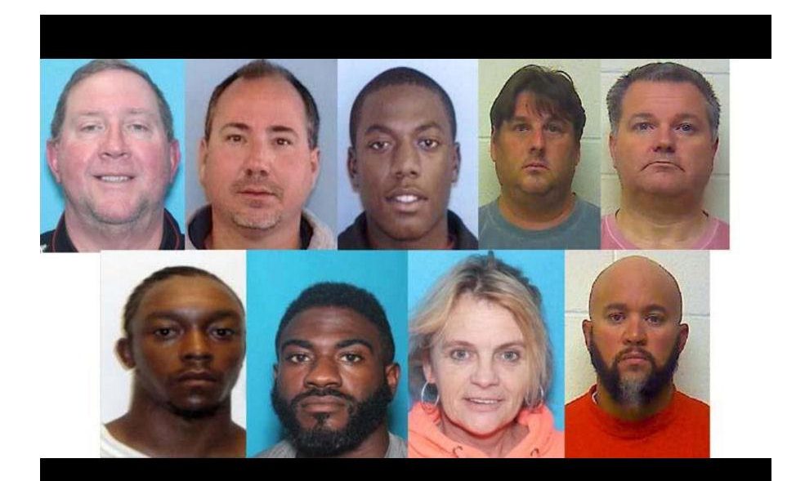
Sex Trafficking
Craven County
In a Craven County Sheriff’s Office sting, sex buyers and traffickers were arrested, amounting to 10 perpetrators. One of the suspects is a woman and another is a Pamlico County commissioner.
“Craven County Sheriff's Office nets 10 in human trafficking bust,” New Bern Sun Journal, Jan. 11, 2017

Slide 21
Activity
Listen to the next survivor story carefully.
What kind of medical conditions are related to her story?
How would she show up in a health care setting?

Slide 22
Activity
What kind of medical conditions are related to her story?
How would she show up in a health care setting?

Slide 23
Sex Trafficking: Where it Occurs
Massage parlors
Brothels
Strip Clubs
Cantinas
Escort Services
Military Bases
Truck Stops
Migrant/Seasonal Work Camps
Convention Centers
Sports Events
Tourist Destinations
Spas
Internet
Hotels/Motels
Residence
Street-Based
Pornography

Slide 24
Sex Trafficking
If a child is <18 years old and is being used for a commercial sex act, the child is considered a victim of trafficking; no further criteria must be met.
Trafficking Victims Protection Act of 2000 (TVPA), as amended (22 U.S.C. § 7102)
Safe Harbor Law; General Assembly of North Carolina; Session Law 2013-368

Slide 25
Domestic Minor Sex Trafficking/CSEC
Craven County
Havelock City commissioner Pete Van Vliet was arrested on 12 counts of second degree sexual exploitation of a minor by the SBI.
According to arrest warrants, the SBI says they found computer video files of children, some possibly as young as two years old, engaged in various sex acts with other children as well as adults.
He was sentenced to 25-90 months in prison, which was suspended to five years of probation.
He is listed on the sex offender registry for 30 years.
“Van Vliet sentenced; resignation accepted by Havelock board,” New Bern Sun Journal, Sept. 11, 2021

Slide 26
Domestic Minor Sex Trafficking/CSEC
NO ONE can consent to
human trafficking
MINORS CANNOT CONSENT TO PERFORMING COMMERCIAL SEX ACTS EVER
There is no such thing as a child prostitute

Slide 27
Traffickers: Who They are to the Victim/Survivor
Parents and family are oftentimes perpetrators of trafficking.

Slide 28
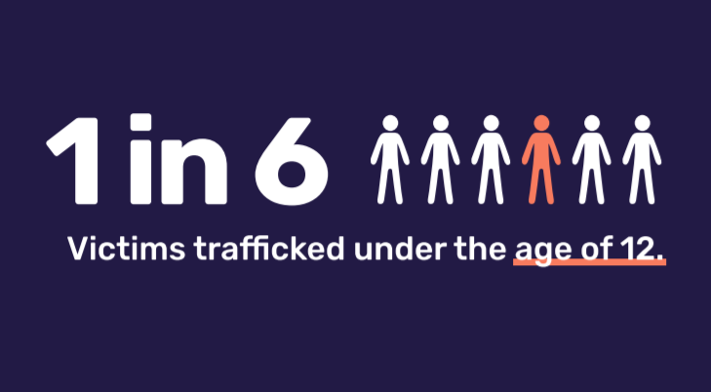
Traffickers: Who They are to the Victim/Survivor
“I could never escape. I never have anyone to turn to. I didn’t have a choice. I was born into this.”
- Survivor
“Survivor Insights The Role of Technology in Domestic Minor Sex Trafficking” from Thorn in collaboration with Dr. Vanessa Bouché, Assistant Professor, Department of Political Science, Texas Christian Universit

Slide 29
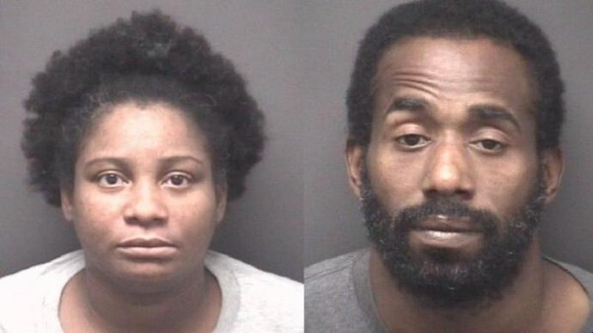
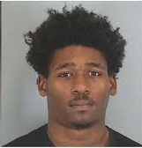
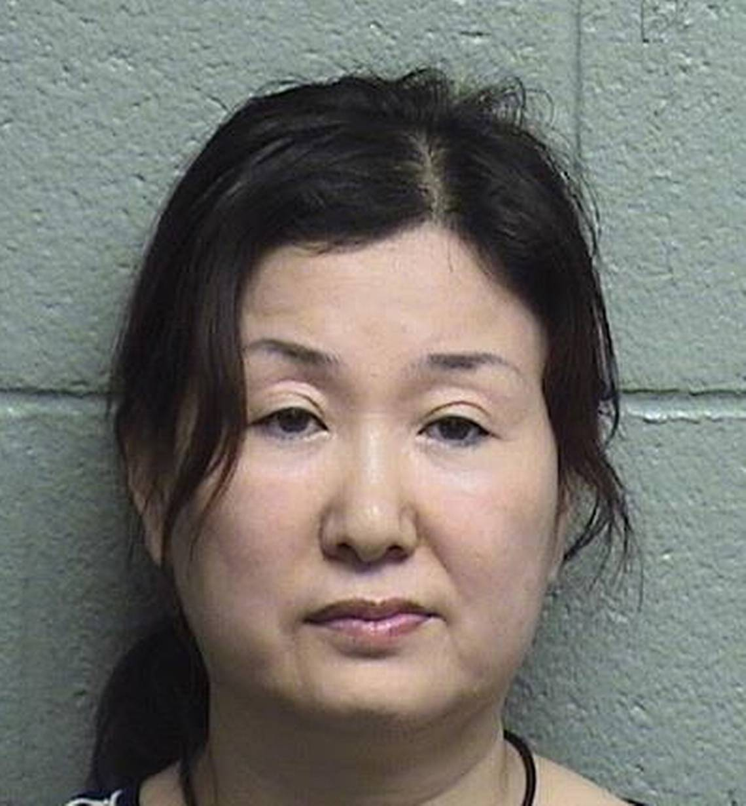
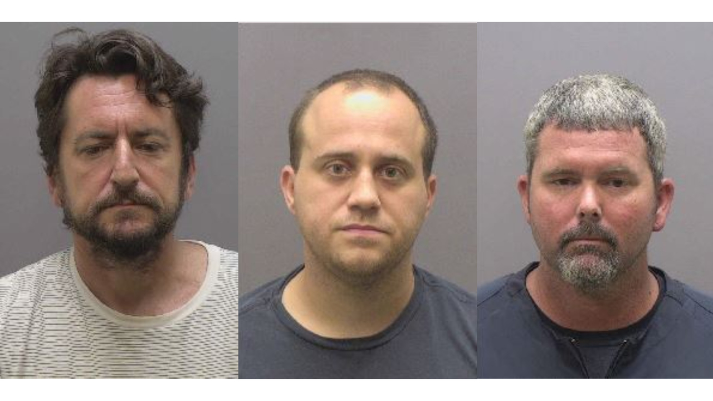
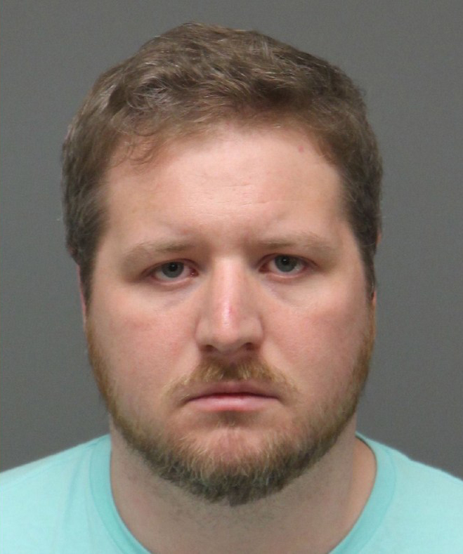
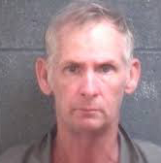
Traffickers: Who They are to the Victim/Survivor
Pimps, Madams, Brothel-Owners
“The main thing about putting a girl you just turned out to work is breaking her down mentally. Making sure she understands she no longer owns any part of her body or even a mind at this point. You own that body and she belongs to you.”
- “The 48 Laws of the Game: Pimpology,” Pimpin’ Ken

Slide 30
Prevalence
40,000,000 (estimated)
40 million people around the world are victims of human trafficking
71% of victims are women and girls
IMPORTANT: Men and boys are also trafficked across the world. In the U.S. there are few resources for men and boys who have been trafficked and few male victims come forward for help
- “Global Estimates on Modern Slavery,” International Labour Office, 2017

Slide 31
Prevalence
233
As of 2021,
North Carolina is ranked in the TOP 15 in the nation for human trafficking reports.
Confirmed
cases
340
Victims identified
National Human Trafficking Hotline
https://humantraffickinghotline.org/state/north-carolina

Slide 32
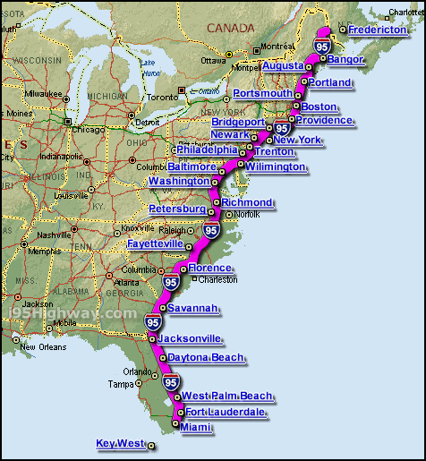
Prevalence
I-95 and I-85
Military Bases
Coastal state
High immigrant population
Large agricultural industry

Slide 33
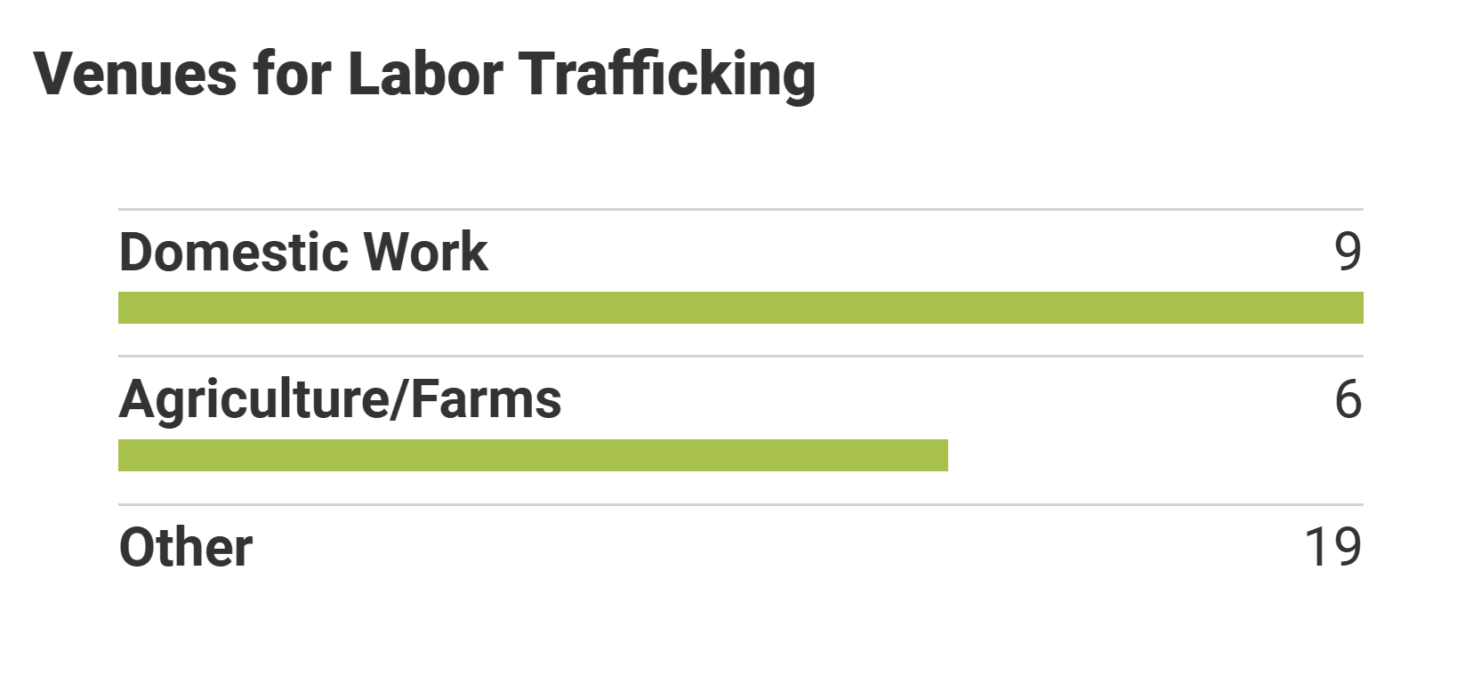
Prevalence
National Human Trafficking Hotline
https://humantraffickinghotline.org/state/north-carolina

Slide 34
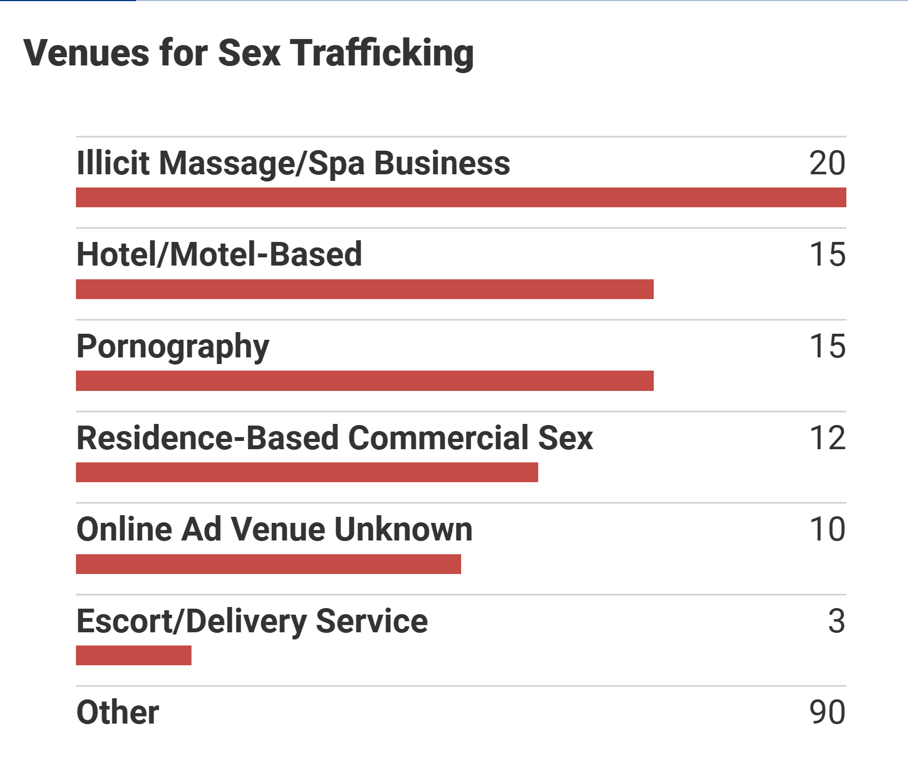
Prevalence
National Human Trafficking Hotline
https://humantraffickinghotline.org/state/north-carolina

Slide 35
Health Care Professional’s Role in Identification
Indicators of trafficking in health care setting

Slide 36
Health Care Providers Role
28%
of trafficked women saw a health care professional while under the control of a trafficker.
One study found that 28% of trafficked women saw a health care professional actively involved in the trafficking experience. This represents a serious missed opportunity for intervention.
Family Violence Prevention Fund. San Francisco, CA: Family Violence Prevention Fund; [January 3, 2010]. Turning pain into power: Trafficking survivors’ perspectives on early intervention strategies. Available from, www.childhood-usa.org/upl/files/4109.pdf; 2005.

Slide 37
Health Care Providers Role
30%
of human trafficking victims seek medical treatment while under the control of a trafficker.
“Healthcare providers are likely to encounter victims of Human Trafficking and may be in a position to offer assistance. According to Peters, 30% will seek medical treatment for illnesses or injuries while in captivity.³ This makes it especially important for providers to be able to recognize victims and offer assistance.”
Source: http://K. The growing business of human trafficking and the power of emergency nurses to stop it. J Emerg Nurs. 2013;39(3):280-288.)
nurse-practitioners-and-physician-assistants.advanceweb.com/Features/Articles/Sex-Trafficking-of-Women-in-the-US.aspx, Peters

Slide 38
Health Care Providers Role
“The Health Consequences of Sex Trafficking and Their Implication for Identifying Victims in Healthcare Facilities” Lederer, Wetzel, Published in Annals of Health Law, Vol 23, Issue 1 (Winter 2014)

Slide 39
Physical Presentations of Human Trafficking
“The Health Consequences of Sex Trafficking and Their Implication for Identifying Victims in Healthcare Facilities” Lederer, Wetzel, Published in Annals of Health Law, Vol 23, Issue 1 (Winter 2014)

Slide 40
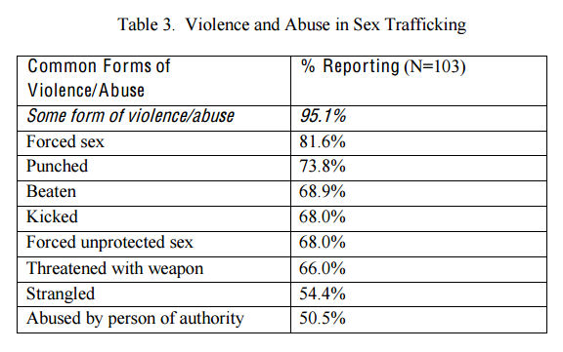
Physical Presentations of Human Trafficking
“The Health Consequences of Sex Trafficking and Their Implication for Identifying Victims in Healthcare Facilities” Lederer, Wetzel, Published in Annals of Health Law, Vol 23, Issue 1 (Winter 2014)

Slide 41
Physical Presentations of Human Trafficking
Common diagnoses for people involved in a labor trafficking experience:
Dehydration
Heat stress/stroke
Musculoskeletal and repetitive use injuries
Pesticide or chemical exposure
Water and sanitation related illnesses
Air quality and respiratory problems
Untreated skin irritations and infections
Sleep deprivation
Malnutrition
Work-related injuries (broken bones, eye injuries, lacerations)

Slide 42
Physical Presentations of Human Trafficking
Common diagnoses for people involved in a sex trafficking experience:
Genital trauma
Rape - vaginally or anally with foreign objects
Jaw and neck pain
STIs
Multiple pregnancies
Evidence of multiple abortions
Cigarette or other burns
Old injuries such as healed fractures, dislocations
Bruising, scars, cuts, especially those in non-apparent place

Slide 43
Physical Presentations of Human Trafficking
Common diagnoses for people involved in a sex trafficking experience:
Self-mutilation
Cuts with knife or razor
Gun shot wounds
Cotton, make up sponges in vagina
Dragged by hair, clumps of hair missing
Poor nutrition, dehydration
Poor hygiene
Exhaustion
Evidence of drug use
Tattoos of names
Missing teeth from trauma or poor dental health
Rashes, itching, skin sores

Slide 44
Physical Presentations of Human Trafficking
Common diagnoses for people involved in a sex trafficking experience:
Sexually Transmitted Infections
Pelvic Inflammatory Disease
Infertility
Urinary Tract Infections
HIV or AIDS
Tuberculosis
Frequent colds or sore throats
Untreated chronic diseases (asthma, GI)
Substance use-medical issues
Gastrointestinal disorders such as abdominal pain, diarrhea, vomiting

Slide 45
Psychological Presentations of Human Trafficking
PTSD
Depression
Anxiety
Panic attacks
Agoraphobia
Shame and guilt
Eating disorders
Fear for family members
Substance abuse
Suicide attempts or ideations
Dissociative reaction
Poor self-esteem, feelings of worthlessness

Slide 46
Psychological Presentations of Human Trafficking
“The Health Consequences of Sex Trafficking and Their Implication for Identifying Victims in Healthcare Facilities” Lederer, Wetzel, Published in Annals of Health Law, Vol 23, Issue 1 (Winter 2014)

Slide 47
Other indicators
Patient has repeatedly required reproductive health services, mental health services or ED services.
Patient defers to another person to speak for them.
Patient uses language associated with prostitution ( “ho” “the life” “daddy” “the game”)
Patient acts anxious, submissive, tense, nervous or combative.

Slide 48
How to think about identification
Health
Presents with physical ailments associated with human trafficking
Context
Accompanied by someone
Signs of trauma
Associated with industry known to have exploitation
Don’t know where they are or how they arrived

Slide 49
NOT Your Role as a Health Care Provider

Slide 50
Module 2: Addressing Vulnerable Populations
Health Care Professionals Training Program

Slide 51
Vulnerabilities
Substance Use Disorder
Developmental Delay
Mental Illness
Learning Disability

Slide 52
Vulnerabilities
Poverty
Family dysfunction
Isolation
Lack of personal safety

Slide 53
Vulnerable populations
Survivors of Child Sexual Abuse
LGBTQI+ Community
Runaway/Homeless Youth
History of multi-generational Exploitation

Slide 54
Vulnerable populations
Juvenile justice involvement
Children/adults with history child welfare involvement
Immigrant/Unaccompanied foreign national
Survivors of prior abuse or neglect
Marginalization

Slide 55
Substance Use Disorders
Cumberland County
Robin Applewhite was sentenced to 230 years in prison and ordered to pay $608,000 in restitution to his victims after coercing them to sell commercial sex acts to support their heroin and prescription pill addictions.
Story from Fayetteville Observer, March 5, 2019

Slide 56
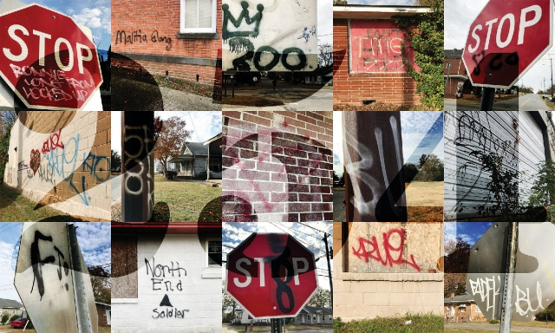
Gang Involvement
Goldsboro, N.C.
Gang tags
Courtesy
Goldsboro News-Argus
In Eastern North Carolina, there is a prevalence of gang activity, largely due to locations on the I-95 corridor and in larger eastern cities.
Gangs often make money by trafficking girls and women for sex
Gangs also use of form of labor trafficking to facilitate illegal activity.
- NC Gangnet

Slide 57
Module 3: Trauma and How it Impacts Communication
Health Care Professionals Training Program

Slide 58
What is Trauma?
An intense psychological response to a stressful situation
Causes lasting effects on the individual
Impacts functioning as stressful stimuli overwhelm the person’s ability to cope
Spinazzola, Joseph & Cook, Alexandra & Ford, Julian & Lanktree, Cheryl & Blaustein, Margaret & Cloitre, Marylene & DeRosa, Ruth & Hubbard, Rebecca & Kagan, Richard & Liautaud, Joan & Mallah, Karen & Olafson, Erna & van der Kolk, Bessel. (2005). Complex Trauma in Children and Adolescents. Psychiatric Annals. 35. 390-398. 10.3928/00485713-20050501-05.

Slide 59
What is Complex Trauma?
Traumatic events that occur repeatedly, over a prolonged period of time
Of an interpersonal nature
During important developmental stages or in instances of disability, disempowerment or dependency
Spinazzola, Joseph & Cook, Alexandra & Ford, Julian & Lanktree, Cheryl & Blaustein, Margaret & Cloitre, Marylene & DeRosa, Ruth & Hubbard, Rebecca & Kagan, Richard & Liautaud, Joan & Mallah, Karen & Olafson, Erna & van der Kolk, Bessel. (2005). Complex Trauma in Children and Adolescents. Psychiatric Annals. 35. 390-398. 10.3928/00485713-20050501-05.

Slide 60
Effects of Trauma
Trauma affects people differently
Depends on:
Characteristics of the individual
Their previous experiences
Their coping and life skills and those of immediate family
The type and characteristics of the event(s)
Developmental processes
The meaning of the trauma
Sociocultural factors (the responses of the larger community in which they live)
Trauma-Informed Care in Behavioral Health Services. Chapter 3 Understanding the Impact of Trauma, https://www.ncbi.nlm.nih.gov/books/NBK207191

Slide 61
Traumatic Response
Has gaps in memory, provides disjointed timeline, gives narrative with inconsistencies or changing details
Appears frozen, shut down, or disconnected from the moment
Appears overwhelmed by a sense of shame, guilt or helplessness
Has difficulty concentrating, thinking rationally, following schedules or making decisions
Demonstrates hostile or angry tendencies
Appears distrustful of others, overly reliant on others, shies away from others or repeatedly pursues unhealthy relationships
- National Human Trafficking Resource Center

Slide 62
Trauma-informed care
Focus-Do no harm
Delivered with an understanding of the vulnerabilities and experiences of trauma survivors, including the prevalence and physical, social, and emotional impact of trauma
Recognizes signs of trauma in staff, clients, and others
Respond by integrating knowledge about trauma into policies, procedures, practices, and settings.
Place priority on restoring the survivor’s feelings of safety
https://cclou.org/wp-content/uploads/2019/10/Guiding-Principles-for-Agencies-with-Self-Assessment.pdf
GUIDING PRINCIPLES For Agencies Serving Survivors of Human Trafficking The Southeast Regional Human Trafficking Advisory Group An Initiative of the Administration for Children and Families Region 4 Office

Slide 63
Communicating with possible victims
Because trauma affects the victim so profoundly, communication may be complicated and must be handled delicately
Difficulty with memories: Trauma affects how and what victims may remember. Understanding that is imperative to communicating and understanding the shifting story the victim may tell
Don’t try to get details: Victims trying to remember details may cause a trigger response to trauma. Keep that in mind when you are talking with a possible victim
Understand power dynamics: If the victim sees you as a person in power, then that could trigger the trauma response
Overcompliance: If a victim is over-compliant, be cautious of how you communicate with them. Their compliance may lead to you inadvertently retraumatizing them when you are asking for details about their stories or in seeking services for the possible victim.

Slide 64
PEARR Tool
P
rovide Privacy
Discuss sensitive topics alone and in safe private setting
If person with patient is reluctant to leave, it could indicate abuse, neglect or violence
Enlist a trusted interpreter. The person accompanying them is not appropriate. If patient approves, see your facility’s policy
Explain limits of confidentiality (mandated reporting requirements)
-- PEARR Tool, developed by Dignity Health, in partnership with HEAL Trafficking and Pacific Survivor Center

Slide 65
PEARR Tool
P
rovide Privacy (troubleshooting)
How to gain privacy if suspected trafficker does not want to leave patient alone
Explain there is a requirement for a private exam or need for patient to be alone for other tests (i.e. radiology, urine test)
Mandatory reporting laws for children exist in North Carolina and health care providers are NOT exempt from them
Do not discourage disclosure, patient should feel in control of those disclosures
-- PEARR Tool, developed by Dignity Health, in partnership with HEAL Trafficking and Pacific Survivor Center

Slide 66
PEARR Tool
E
ducate
Educate patient in a nonjudgmental way/normalize conversation
Offer brochures/resource/cards to patient
-- PEARR Tool, developed by Dignity Health, in partnership with HEAL Trafficking and Pacific Survivor Center

Slide 67
PEARR Tool
E
ducate
(troubleshooting)
To ensure the patient feels comfortable use phrasing such as:
“I educate all of my patients about [fill in the blank] because violence is so common in our society/community and it has a big impact on our health and safety”
When reviewing the resource card/list/brochure make sure there is more than one local service provider listed
“Here are some brochures to take with you in case this is ever an issue for you or someone you know”
If patient declines materials, accept and respect their decision.
-- PEARR Tool, developed by Dignity Health, in partnership with HEAL Trafficking and Pacific Survivor Center

Slide 68
PEARR Tool
A
sk
Allow time for discussion with patient
If there are indicators of victimization, ask about your concerns
All women of reproductive age should be screened intermittently for IPV
-- PEARR Tool, developed by Dignity Health, in partnership with HEAL Trafficking and Pacific Survivor Center

Slide 69
PEARR Tool
A
sk
(troubleshooting)
Questions to ask
“Is there anything you’d like to share with me? Do you feel like anyone is hurting your health, safety or well-being?
If there is suspicion of abuse
“I’ve noticed [indicator] and I’m concerned for your health, safety and well-being. You don’t have to share the details with me but I’d like to connect you with resources if you’re in need of assistance. Would you like to speak with [service provider/advocate]? If not, you can let me know anytime.”
-- PEARR Tool, developed by Dignity Health, in partnership with HEAL Trafficking and Pacific Survivor Center

Slide 70
PEARR Tool
R
R
espect &
espond
If patient declines assistance, then respect that decision
Offer hotline card or other information to assist in event of an emergency (i.e. crisis hotline/local shelter)
If patient accepts assistance, provide personal introduction to local victim advocate/service provider or arrange private setting for victim to call the National Human Trafficking Hotline, National Sexual Assault Hotline, National Domestic Violence Hotline
-- PEARR Tool, developed by Dignity Health, in partnership with HEAL Trafficking and Pacific Survivor Center

Slide 71
PEARR Tool
R
R
espect &
espond
Report safety concerns to appropriate staff/departments (e.g. nurse supervisor, security)
Report risk factors/indicators as required and permitted by law and continue trauma informed health services
Schedule a follow-up appointment to continue building rapport and to monitor patient’s safety and well-being
-- PEARR Tool, developed by Dignity Health, in partnership with HEAL Trafficking and Pacific Survivor Center

Slide 72
Communicating with possible victims
It may take several interactions to learn the story
Victim may not want help or resist cooperating
Keep in mind you may receive conflicting or misinformation

Slide 73
Communicating with possible victims
DO: Use the language they are using, i.e. boyfriend
DON’T: Say the boyfriend is a pimp or trafficker if they aren’t using that language
DO: Be mindful of underlying fear or mistrust
DON’T: Lose patience. It may take time to get information about suspected trafficking

Slide 74
Communicating with possible victims
DO: Be sure to speak privately
DON’T: Ask if he/she is a victim of trafficking.
DO: Offer hotline number or way to access help at a later time (offer resources that will be safe for the patient)
DON’T: Try to get all the details

Slide 75
Communicating with possible victims
DO: Communicate clearly what procedures you will be doing
DON’T: Force or push the patient to accept assistance
DO: Be aware and understand that some procedures will be triggering
DON’T: Use negative wording to chart the patient (i.e. frequent flyer, attention seeking, drug addict/abuser)

Slide 76
Communicating with possible victims
DON’T: Make promises

Slide 77
National Human Trafficking Hotline
National Trafficking Information and Referral Hotline:
1-888-3737-888

Slide 78
Organizational Protocols
Organizational protocols are vital in screening and serving victims of violence. Learn your facility’s protocols around reporting and responding to violence.
If there are none, encourage the creation of them.

