Slide 1
Legal Liability in Nursing
Emi Lawson, Corporate Risk Manager
Atrium Health

Slide 2
AGENDA
Recent Cases/Implications
Liability
Medical Malpractice
Documentation Tips
Practical Takeaways
Questions

Slide 3
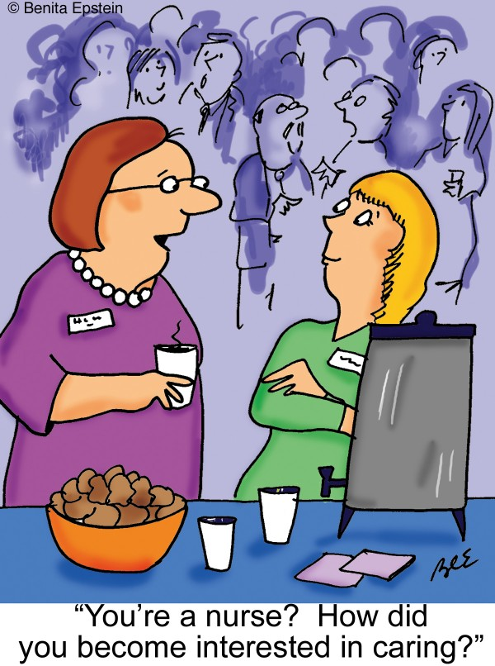

Slide 4
In The News
Radonda Vaught: guilty of criminally negligent homicide and gross neglect of an impaired adult.
NC Legislature: Byrd vs. Marion General Hospital- Protection of nurses who execute doctor’s orders. Advanced or specialized training & responsibilities.
WF Nurse accused of murder.
Nursing Home nurse amputates patient’s toe.

Slide 5
Types of Liability
Malpractice: Neglect to provide appropriate treatment, failure to take appropriate action, substandard treatment that causes harm.
Negligence: Act of omission that deviates from the standard of practice.
Intentional Acts: Abuse, assault, homicide.
4 elements of Malpractice/Negligence
Duty/Breach/Causation/Damages

Slide 6
Common Causes of Nursing Malpractice
Failure To: Assess Or Monitor A Patient Adequately. Document and/or Communicate Pertinent Information. Execute A Complete Nursing History. Formulate and/or Follow The Treatment Plan. Perform A Nursing Treatment or Procedure Properly. Provide A Safe Environment And To Protect The Patient From Avoidable Injury. Use Equipment Properly Make Prompt, Accurate Entries In A Patient’s Medical Record (E.G., Transcribing Orders Improperly Or Transcribing Improper Orders | Follow Hospital Policy and/or Procedure Document Prior Treatment Events Record Medications Have Been Administered Or Discontinued Use Of Known Defective Equipment Failure to prevent infection Failure to obtain help for a patient not receiving proper care form a physician. Altering A Medical Record

Slide 7
NC Medical Malpractice
Statute of limitations for medical malpractice. N.C.G.S. § 1-15(c):
3 years from the last act of the defendant.
If damage was not readily apparent and discovered, then must bring suit within 1 year from the date the discovery is made, but no more than 4 years since the last act of defendant.
§ 90-21.19. Liability limit for noneconomic damages
Cap is at $500,000 (is reset by Office of State Budget and Management) except if:
The plaintiff suffered disfigurement, loss of use of part of the body, permanent injury or death.
The defendant's acts or failures, which are the proximate cause of the plaintiff's injuries, were committed in reckless disregard of the rights of others, grossly negligent, fraudulent, intentional or with malice.
North Carolina law requires parties to mediate medical malpractice cases
Mediation with a neutral mediator to help determine if a voluntary settlement is possible
If the case is not resolved through mediation/settlement, a jury trial will determine any liability and damages
Most malpractice cases settle with recent settlements ranging from $850K to $5M
Of the cases that go to trial, plaintiff recoveries range from $0 to over $24M

Slide 8
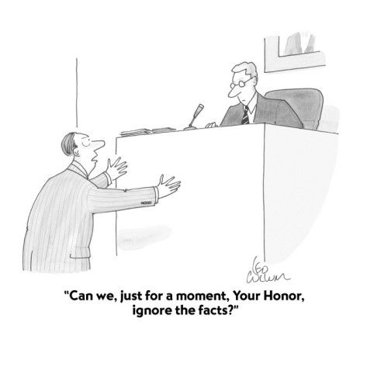

Slide 9
Practical Documentation Tips Never use the medical record to criticize another caregiver. Use quotations from the patient whenever appropriate. Assume that all your notes and reports are discoverable and will be read by the patient and an attorney. Document at appropriate times. Do not document something before it is accomplished, and do not document something much later without an explanation Make sure the timing of your entries would make sense weeks, months, years later Document all conversations with other providers and staff that are pertinent to the care of the patient. Never alter a record or rewrite a note after a legal action is commenced. Consult with leadership before accessing a medical record after a legal action has commenced Differentiate between progress notes or nursing entries (part of the medical record) and incident reports (not part of the medical record)

Slide 10
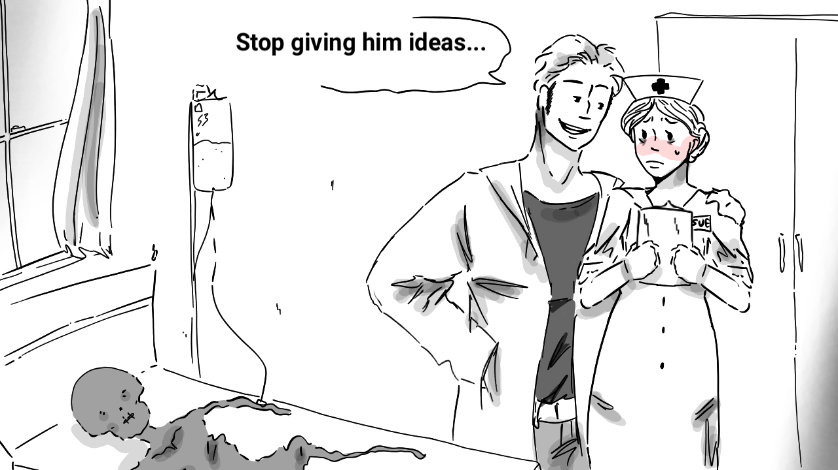

Slide 11
Risk Management Guidance
Nursing Vigilance can prevent adverse events.
Nursing empowerment is key to patient safety. Teamwork is essential.
Monitor shortcuts and workarounds. Speak Up.
Combat burnout and stress.
Recognize, address, ask for help.
Report and monitor medication errors.
1
2
3
4
5

Slide 12
CRIMINALIZATION OF MEDICAL ERRORS
To Err Is Human, we cannot punish our way to safer medical practices.
We must instead encourage nurses and physicians to report errors so we can
identify strategies to make sure they don’t happen again.
Criminal prosecutions for unintentional acts are the wrong approach.”*

Slide 13
PRACTICAL TAKEAWAYS
Scope of Practice
Insurance and License Protection
Apply documentation techniques consistently.
When in doubt, document.
Provide thorough and accurate entries. Document information that will foster appropriate coordination of care amongst all providers.
Create a record that you could go back to and explain days, weeks, or months after the fact. Malpractice cases can be won based on the quality of the medical record.
Speak Up, Teamwork, Become involved, Self Care.

Slide 14
Thank You
Questions, Comments, Complaints
Emilce.lawson@atriumhealth.org
704-512-3410

