Slide 1
Aspects of Mental Health Nursing-Guidelines, Applications to everyday rehab nursing practice
Don Kautz, RN, PhD
(CRRN 1988-2018)
Retired, Associate Professor Emeritus
UNCG School of Nursing
ddkautz@uncg.edu

Slide 2
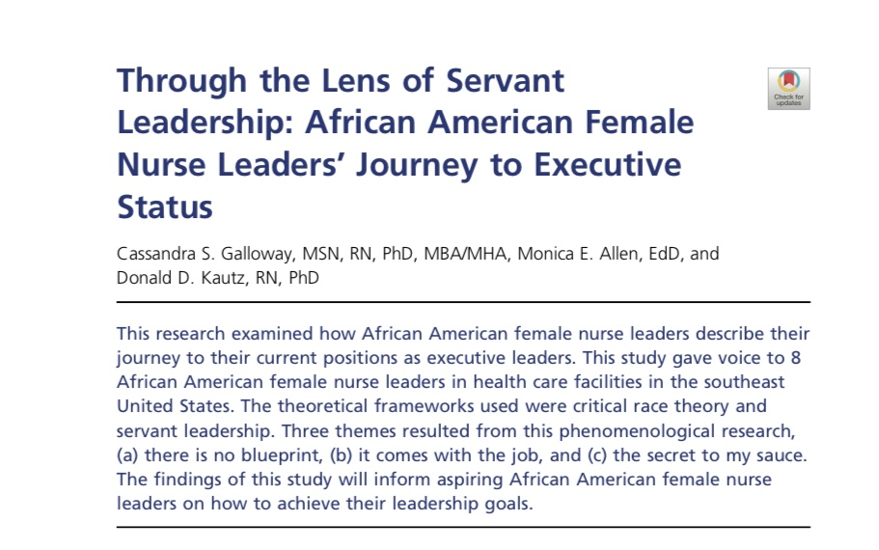

Slide 3
Introduction
Don’s use of PowerPoint
Feel free to use this PowerPoint anyway you want.
I began my work as a Rehabilitation Nurse in 1980 on a Spinal Cord Unit.

Slide 4
Some patient’s early in my career
Hazel, a 70-year-old widow who sold Avon makeup, became a paraplegic….
Shane, age 17, after a diving accident, whose family
Many young men who had been in crashes due to alcohol or drugs
Bill, age 68, recent quadriplegia, talking with Pete, age 17…
Lisa, who was divorced, and had a restraining order for her ex

Slide 5
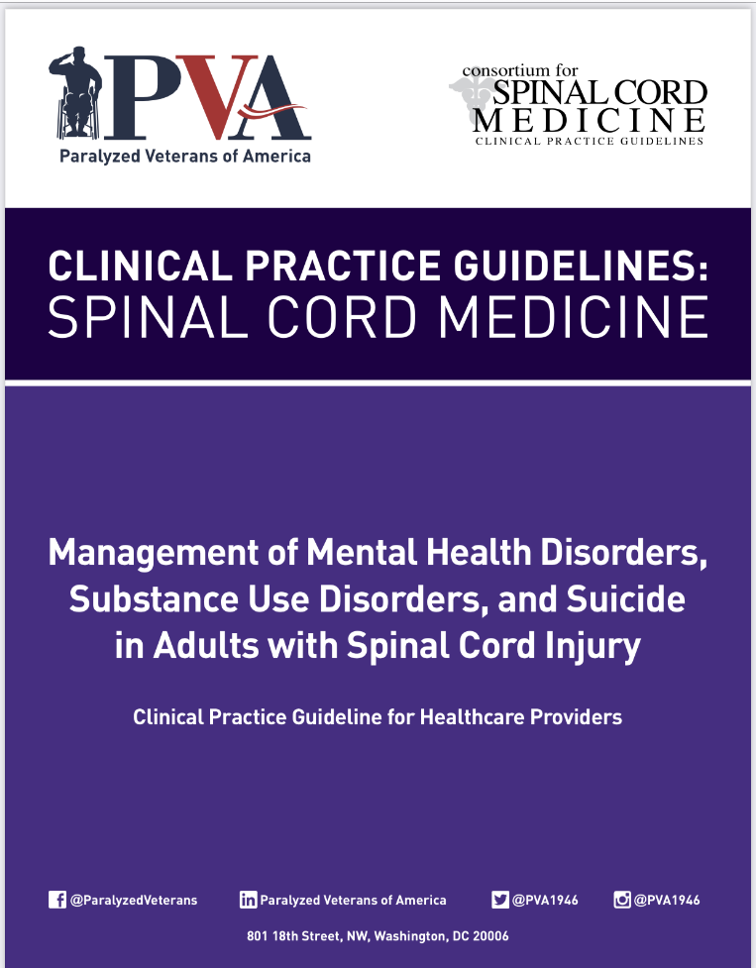

Slide 6
Donna Williams, MSN, RN, CRRN

Slide 7
Chuck Bombardier, PhD, Cheryl Vines, MS, Jesse Fann, MD, Casey Azuero, PhD, Scott Richards, PhD, Sunil Sabharwal, MD, and Rita Obi, MPH

Slide 8
Developing this (or any) guideline
127 studies were reviewed and rated
497 sources are cited in the guideline
27 Expert reviewers ensured accuracy
We started working together in 2016 – guideline was published 2020

Slide 9
Guideline addresses the following
Substance Use Disorders
PTSD
Depression
Anxiety
Suicide (prevention and care following a suicide attempt)

Slide 10
We recommend regular screening
On admission to a facility or home program
Every 6 months – year
Screening tools in the guideline include:
Substance use Disorder
Depression
Anxiety Disorder
Suicide Severity Screening Measures

Slide 11
We recommend referral for treatment
Refer to a psychologist, psychiatrist, other counselor for:
Counseling and therapy – tell patients and families that even a couple of sessions have been shown to be helpful. The guideline outlines appropriate and effective interventions for all these disorders. Don will NOT refer to therapies. PLEASE see the guideline.
Pharmacological interventions – the guideline contains EXCELLENT recommendations for medications for ALL the disorders. Don will NOT be referring to medications. PLEASE see the guideline.

Slide 12
Black Skimmers

Slide 13
Patients who are at risk for suicide
Newly disabled patients can be at an increased risk of suicide.
Don believes most nurses are adept at implementing suicide prevention measures and safety plans – and so will NOT address those today.
The guideline has EXCELLENT information on screening, warning signs, actions to intervene, treatment plans, and referrals. Please read the guideline for these updates.

Slide 14
Caring for a patient who attempted suicide
It’s OK to ask about the attempt, and how the patient is feeling now.
Asking about suicidal feelings does NOT increase risk.
What to say:
“I’m so glad you are here.”
“I know I can’t fix this for you, but I’m here to support you in any way I can.”

Slide 15
What NOT to say after a suicide attempt
“I need to know why you did this.”
“This was a failed/unsuccessful attempt.”
Don’t make it about you – i.e. “How could you do this to me?”

Slide 16
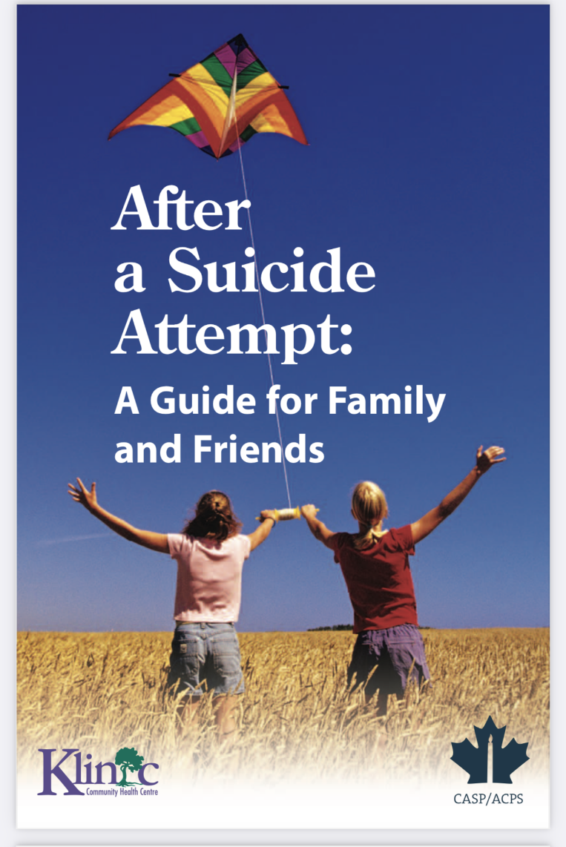
Resources for family – also good for nurses

Slide 17
Augmenting coping skills (good for everyone)
Replace maladaptive coping skills with more adaptive ones.
Encourage:
Anger management
Conflict resolution
Relationship building
Self-care
Mindfulness
See the article by Kautz & Vanhorn

Slide 19
A few interventions from the article
Encourage families to relieve stress with humor – which encourages relation, general wellness, positive and hopeful attitudes. Watch favorite TV shows or videos. “If family members can find the humor in their circumstances, the family can survive.
Sharing cherished memories helps develop a new vision of the future
Idealized images of a family’s togetherness need not be actualized.

Slide 20
Facilitating forgiveness
Teach patients and family members to say to themselves the thing that they did or failed to do, admit these actions were wrong, and then ask for forgiveness. Or:
Say, “I did wrong, and I forgive myself.”
Or:
“These people treated me wrong or made these mistakes, and I forgive them.”

Slide 21
A Zen parable for patients, families, & nurses (This parable is in the article)
A man is being chased by a tiger…
Sometimes there are NO solutions….
Yet, we can enjoy…

Slide 22
Wilson’s Plover

Slide 23
Posttraumatic Stress Disorder (PTSD)
PTSD can come from the injury/accident (i.e. Lisa)
PTSD may also occur due to the hospital stay/ICU
Bill, recent quadriplegia who had been a coal truck driver
PTSD may also come from childhood trauma – which then led to the crash/accident (See Williamson & Kautz, 2018).

Slide 25
Trauma Informed Care Concepts
Patients will likely have trouble trusting healthcare providers
When a patient is acting out, is difficult to care for, basic premise of trauma informed care is to ask “What happened to this person?” rather than, “What’s wrong with this person?”
Primary goals are to foster: safety, trustworthiness, choice, collaboration, and empowerment – ask before doing, listening, accepting the patient.

Slide 26
Other nursing interventions PTSD
Encourage journaling
Reorienting the patient during care
Engaging families in caregiving
Encouraging pharmacological interventions

Slide 27
American Oystercatcher

Slide 28
Substance Use Disorders (SUDs) – nursing interventions
Unfortunately, nurses…
On the other hand…
Avoid stigmatizing patients with unscientific beliefs about the cause, course, and treatment of SUDs.
SUDs are often, chronic, relapsing biopsychosocial conditions requiring episodic or continuous care, similar to diabetes

Slide 29
Interventions
Conceptualize readiness to change SUD in non-moralistic terms, using the transtheoretical stages of change of precontemplation, contemplation, determination, action, maintenance, and relapse.
Reframe relapse as a normal phase in the change process
Reinforce all abstinence, moderation, and harm reduction efforts
Incorporate intervention programs into rehabilitation settings

Slide 30
Interventions
Not only are substance abuse problems prevalent in rehabilitation settings, but trauma rehabilitation can also represent a window of opportunity within with individuals are more open to change and receptive to treatment.

Slide 31
Brown Pelicans

Slide 32
Anxiety and Panic
Individuals with anxiety may present with unrealistic fears, worries about the future, and avoid learning what they need to do to become independent
Anxiety does not necessarily remit over time.
It is often difficult for staff to work with anxious patients

Slide 33
Nursing and Team Interventions
Provide patients with enhanced informational control – which therapies, procedures, and medications are used and what they do.
Increase trust through predictability and maintenance of a stable routine. Let patients know ahead of time of anticipated changes
Provide regular positive feedback about gains made and accomplishments from rehabilitation.
Don believes…

Slide 34
Interventions
Stay with patients and maintain a calm demeanor during episodes of high anxiety. “Don’t just DO something, SIT there.”
Encourage patients to actively engage in decision-making where possible.
Provide community outings prior to discharge to ease discharge anxiety.

Slide 35
Interventions
Provide “warm handoffs” and co-treatment when transitions in treatment or discharge occur.
Give patients a way to contact staff who can answer questions or provide referrals.

Slide 36
Least Tern

Slide 37
Depression (Major Depressive Disorder MDD)
Feelings of sadness and depression are normal reactions to stress and loss – but when symptoms become severe, prolonged, and impair daily functioning, treatment is needed.
Depression often precedes disability and thus is a recurrent mental health condition rather than simply a reaction to disability.
Depression is associated with multiple poor health outcomes.

Slide 38
Remember…
Team members can contribute to depression if they believe that those with disability will have a low quality of life.
Research shows that people with disability have a much higher quality of life than health care providers anticipate.
Don remembers one study…

Slide 39
Promoting Self-efficacy and Hope
Engineering high success rates
Providing access to meaningful activities outside of therapies
Promoting ongoing access to meaningful relationships
Focusing on a future with meaning and purpose
Promoting a sense of “the possible”
Hope for the moment
See Kautz’ 2008 article.

Slide 41
These are two key concepts
A disability may be transformative for patients and their families. In health psychology research, positive change and transcendence from challenging life experiences and disability are referred to as posttraumatic growth, benefit finding, stress-related growth, and thriving, all of which have been found to be correlated with a high quality of life.
Assisting individuals with a disability and their families to experience transformation may also be transformative for the team.

Slide 42
Nurse Educator
Nurse Educator
Vol. 32, No. 4, pp. 223-226
Copyright © 2007 Wolteers Kluwer Health I
Lippincott Williams & Wilkins
Reading Children’s Books to Awe and Inspire Nursing Students
Donald D. Kautz, PhD, RN, CNRN, CRRN-A
Reading illustrated children’s books in the classroom to nursing students is 1 way to inspire students to be great nurses. After offering guidelines for the types of books to use and the courses books can be used in, the author describes the effects on student learning.

Slide 43
Why children’s books? Many books for 4-8 year olds
Have profound moral underpinnings
Take less than 5 minutes to read
Are based on characters who are torn about what action to take…
The characters all “seize the day”
Focus on today – here and now
Illustrate key principles of rehab nursing
Can provide spark to any presentation or lecture… illustrated by The Dark.

Slide 44
A wonderful illustration of our patient’s fears – their fears of the unknown – their fear of the dark

Slide 45
Think of Lazlo as if he was one of our patients
and we are with him on his journey

Slide 48
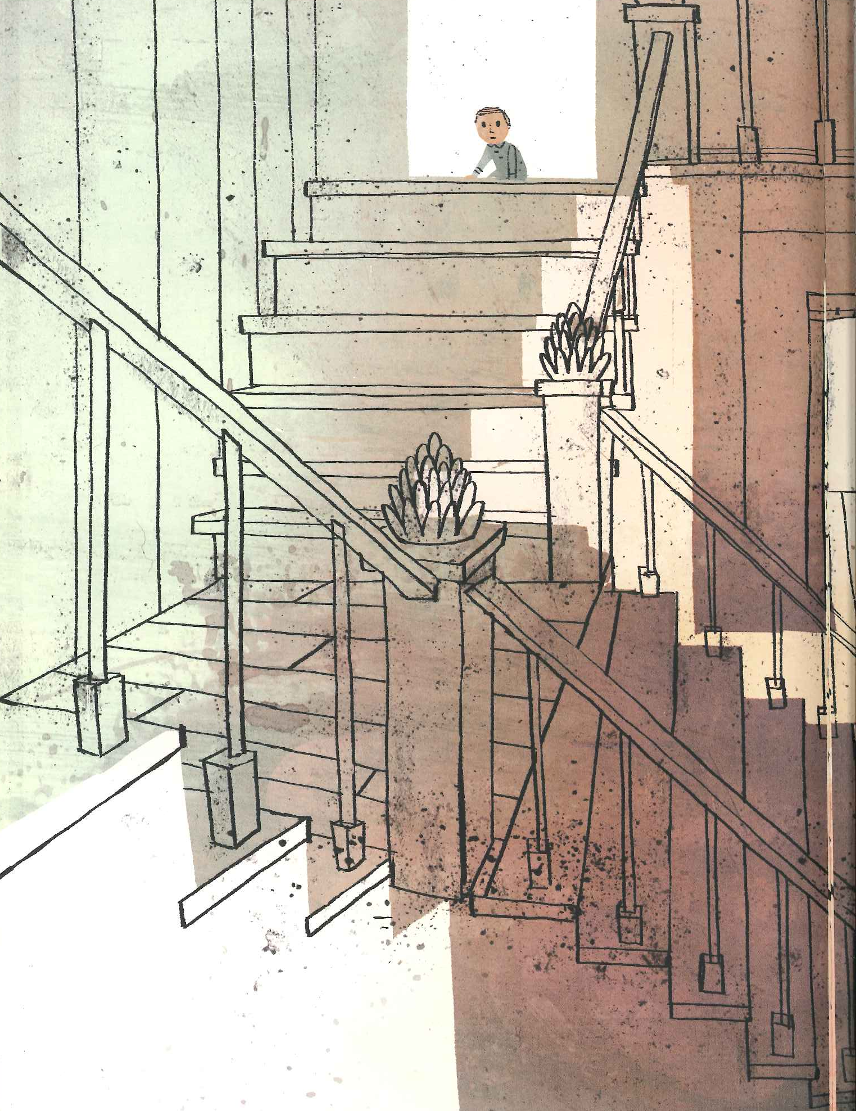
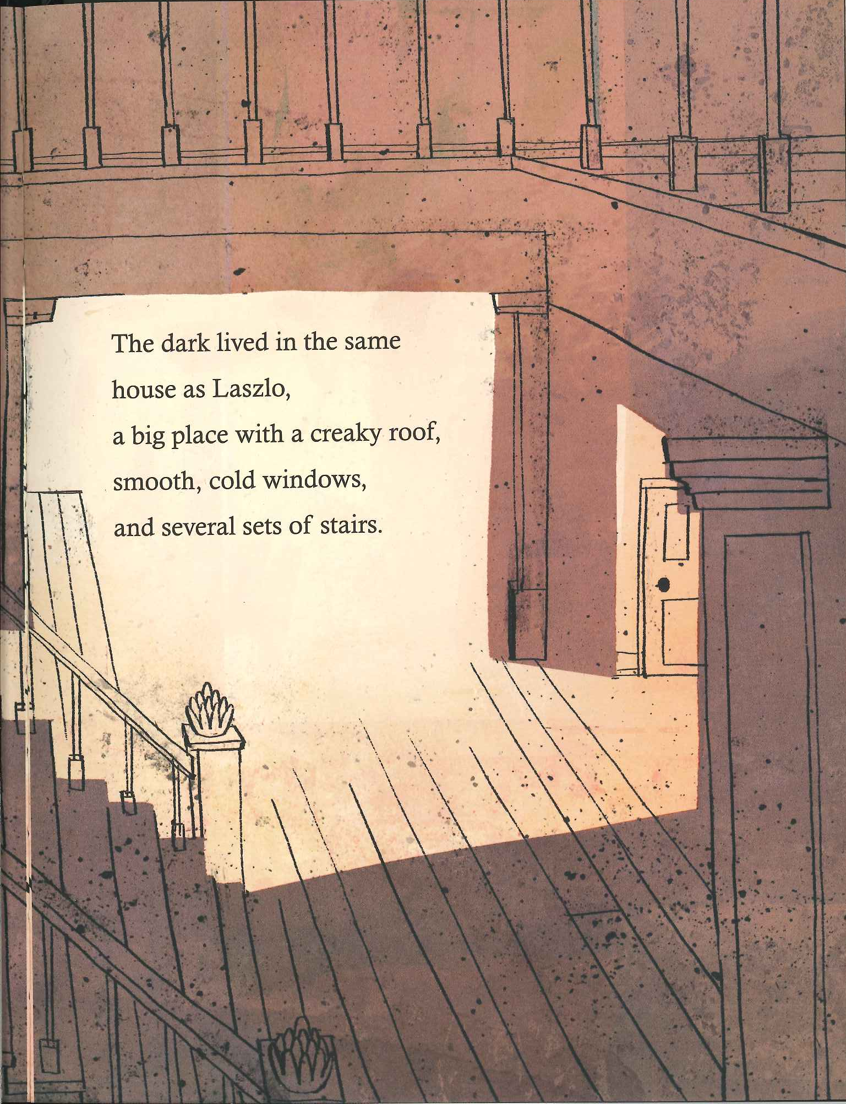

Slide 49
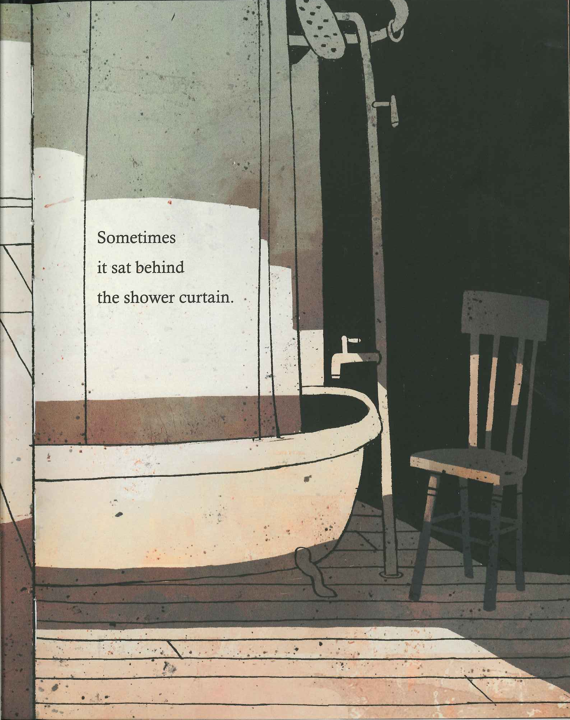
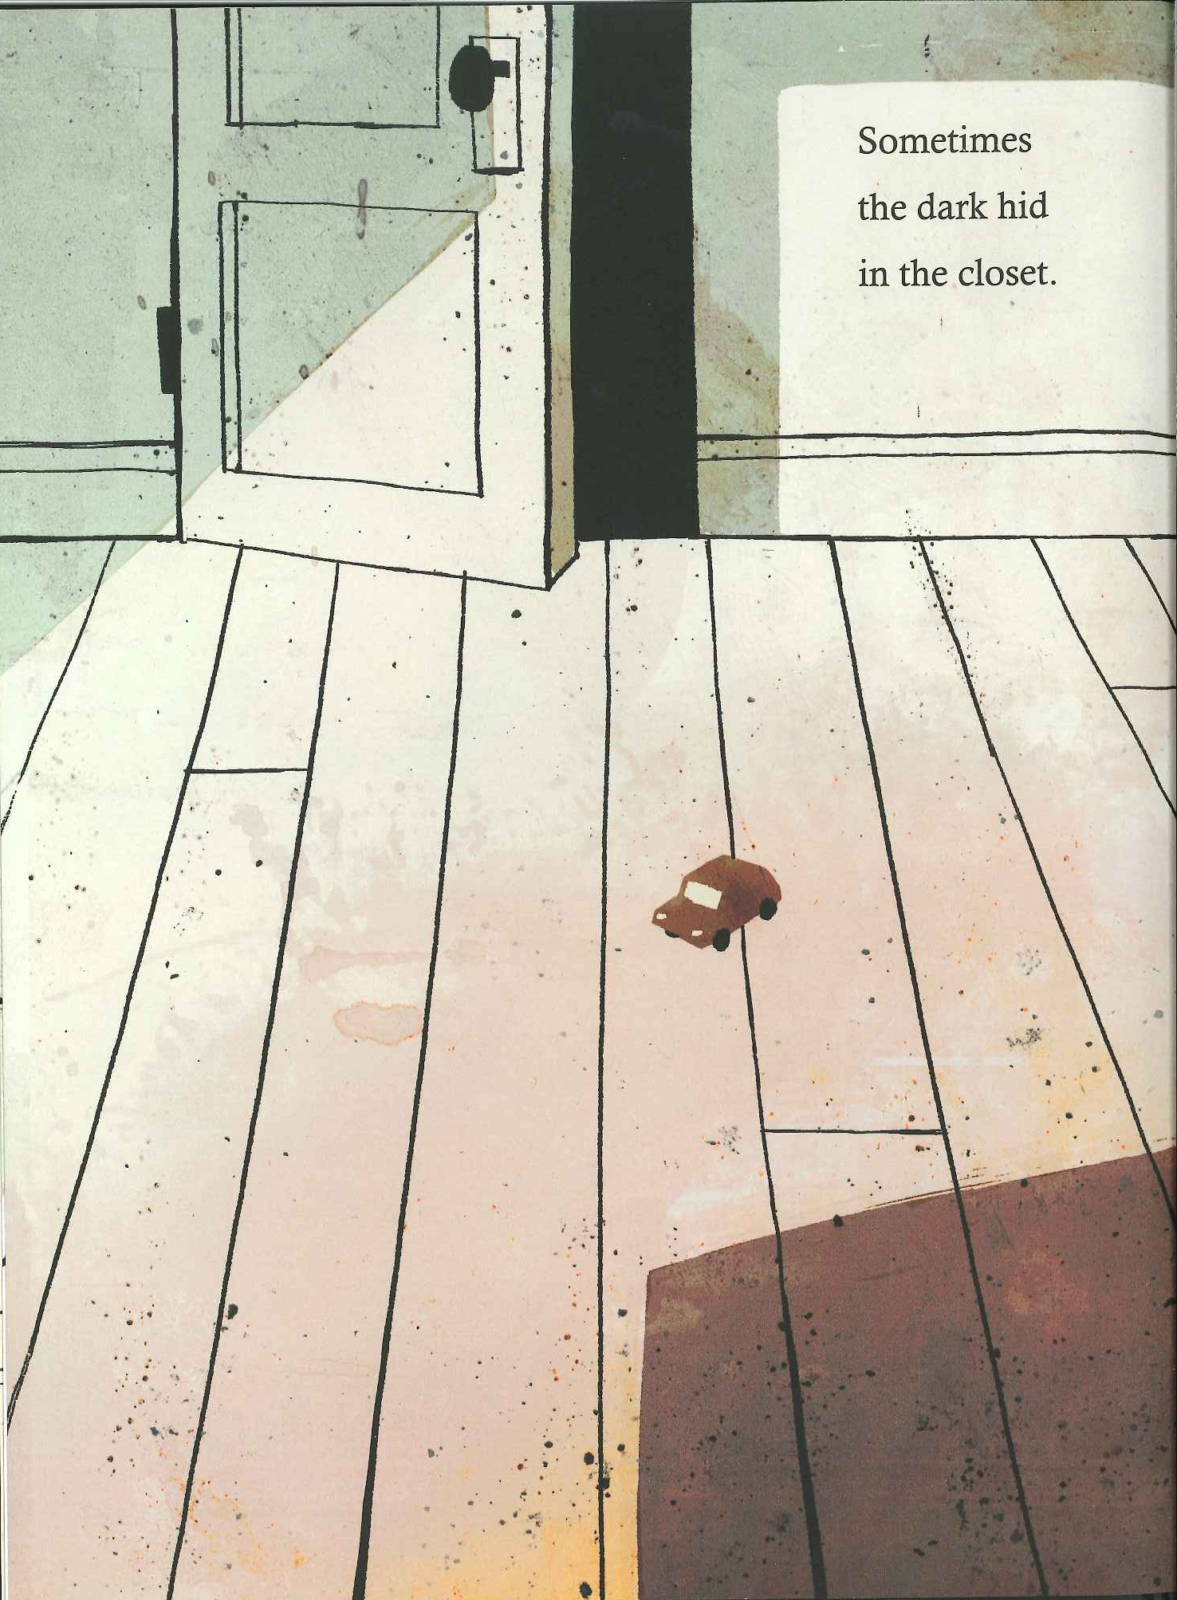

Slide 50
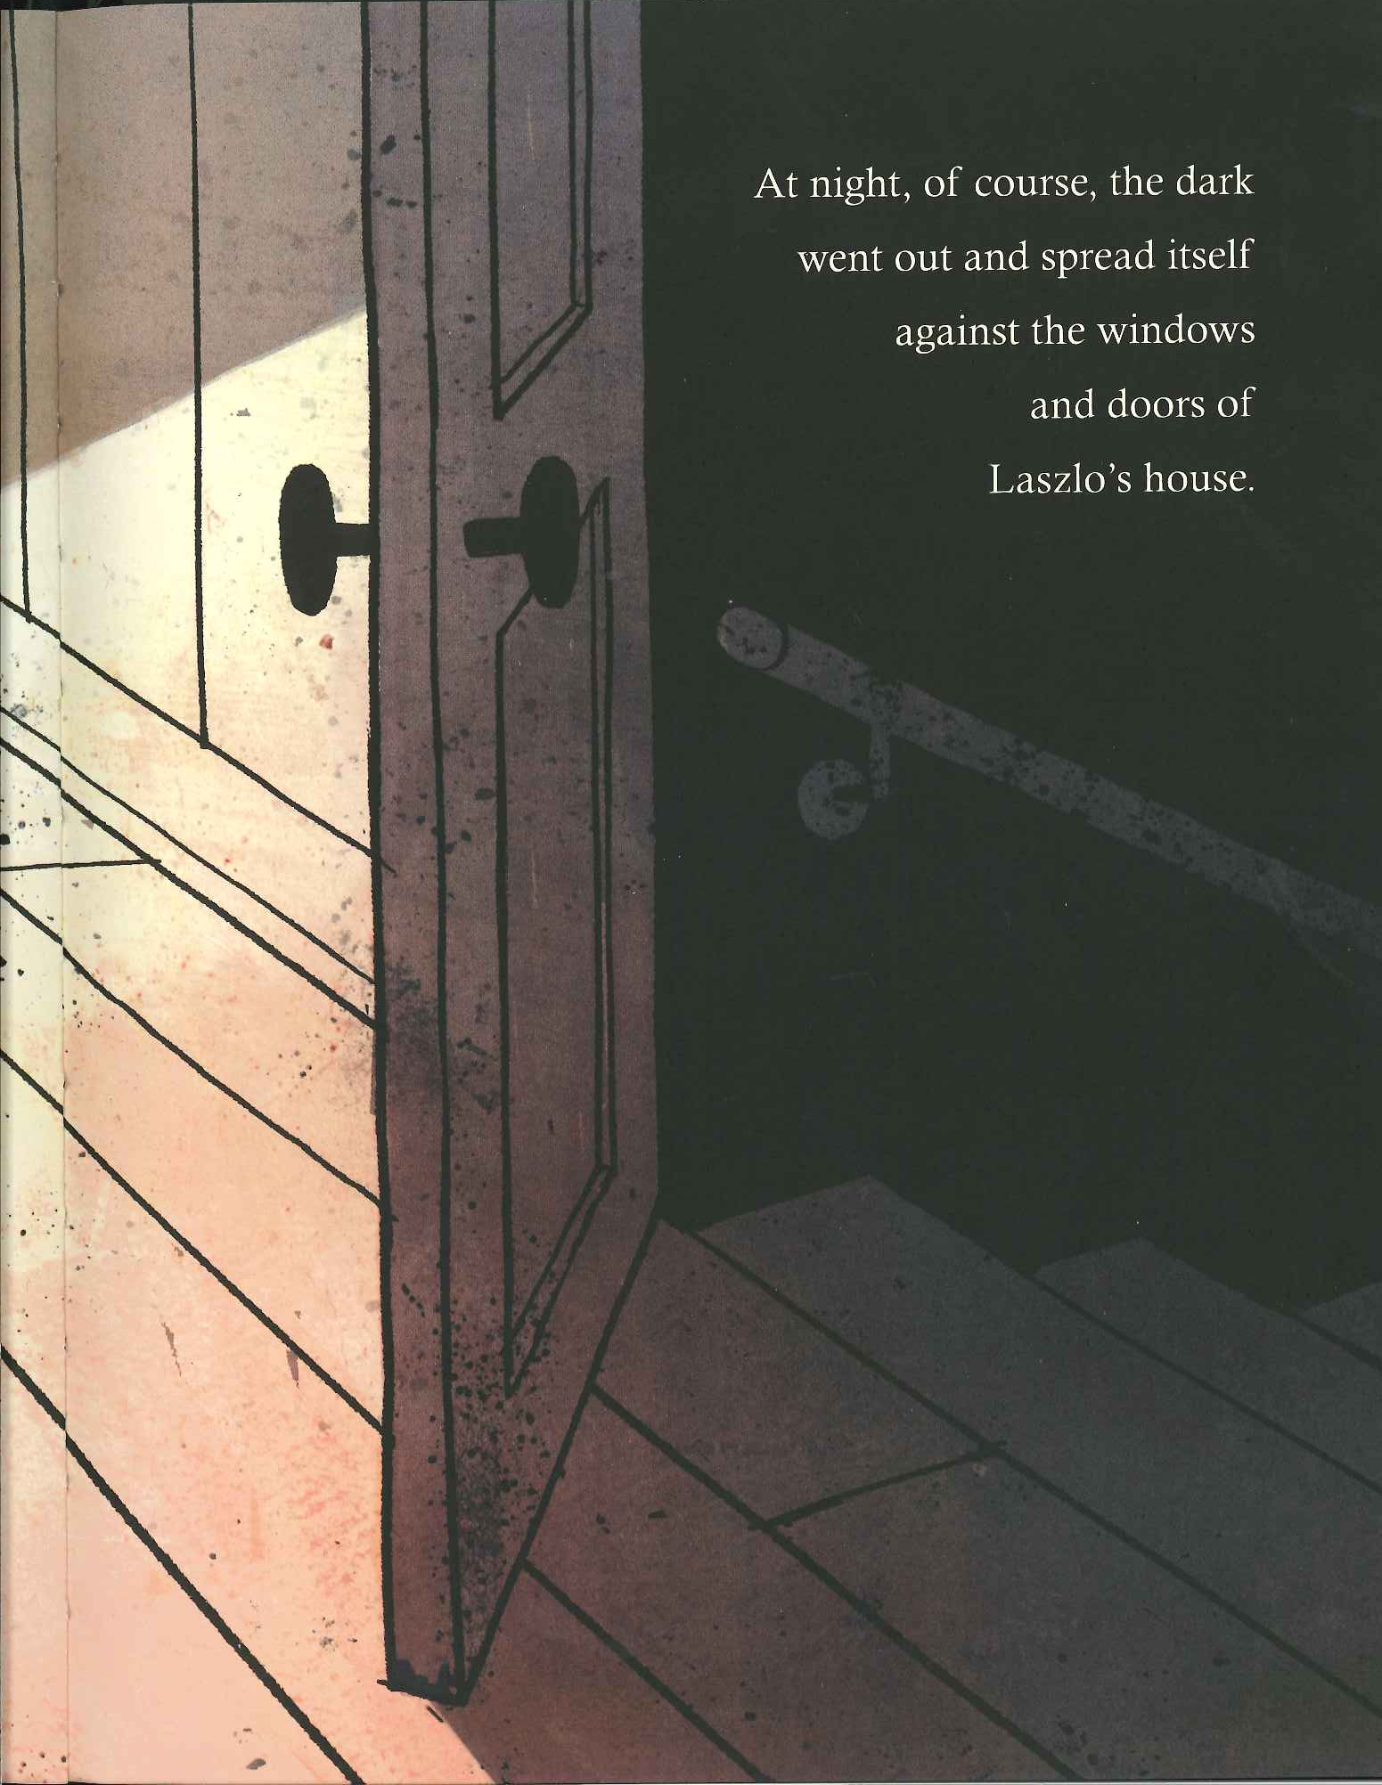

Slide 51
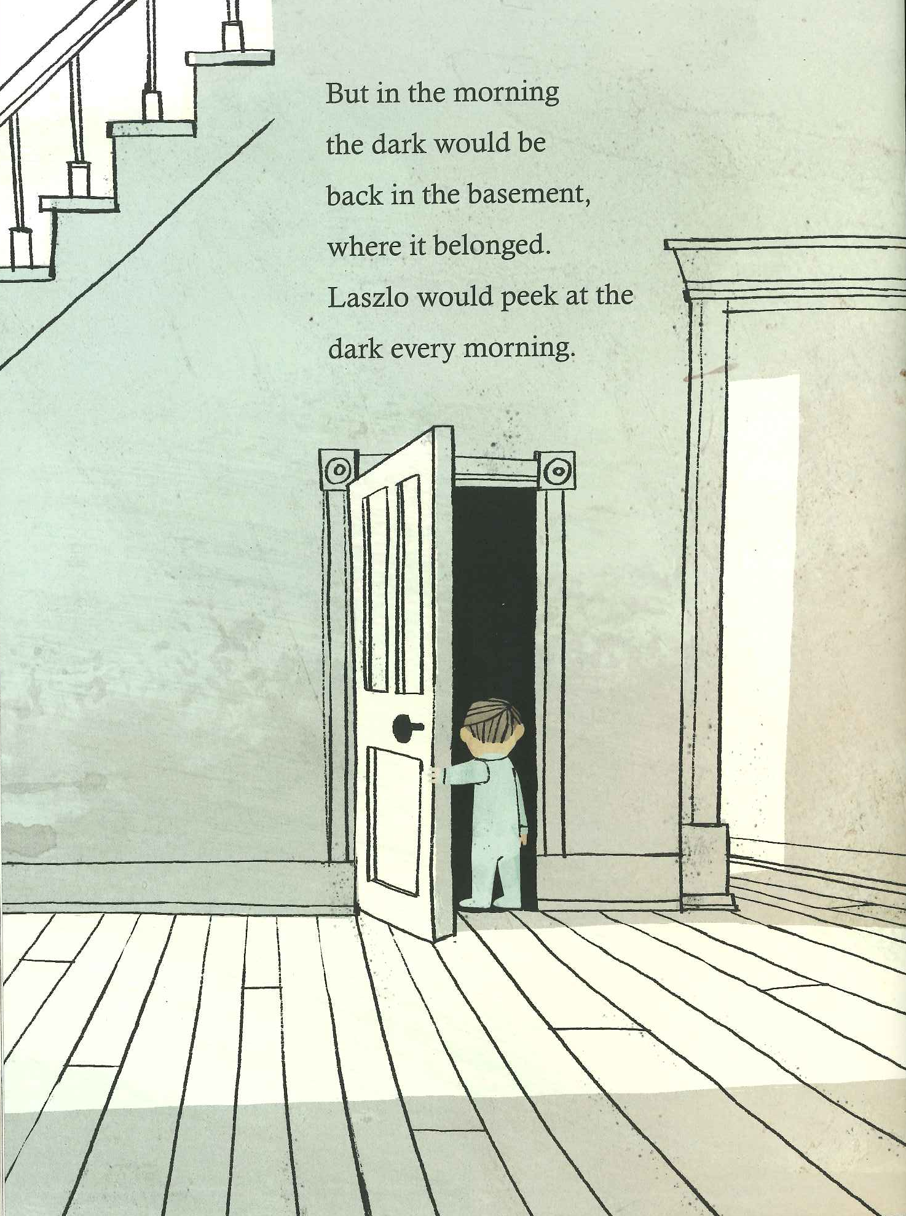

Slide 52
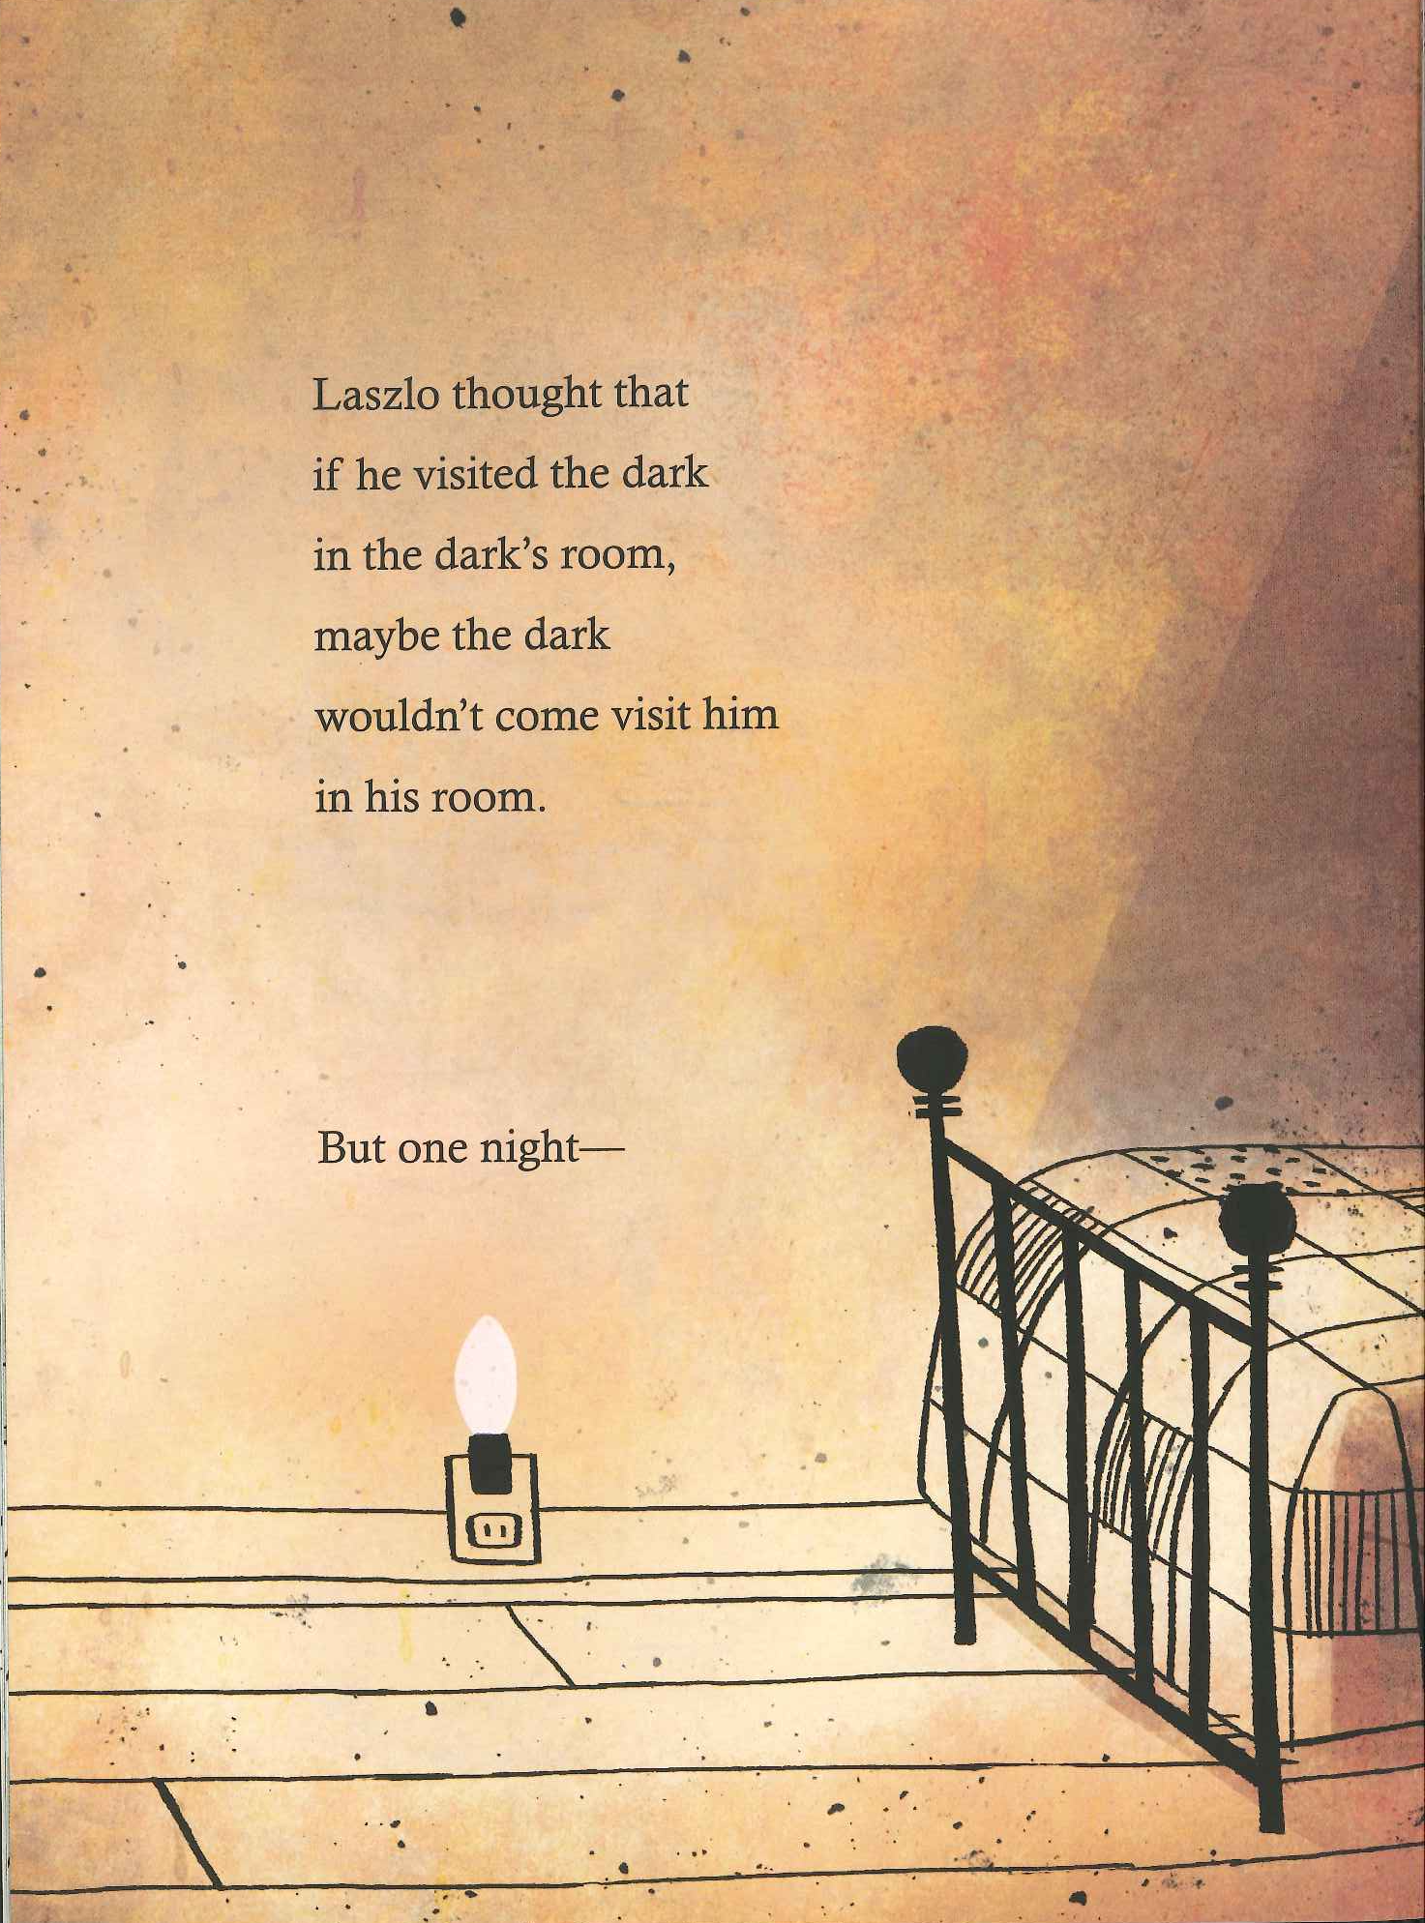
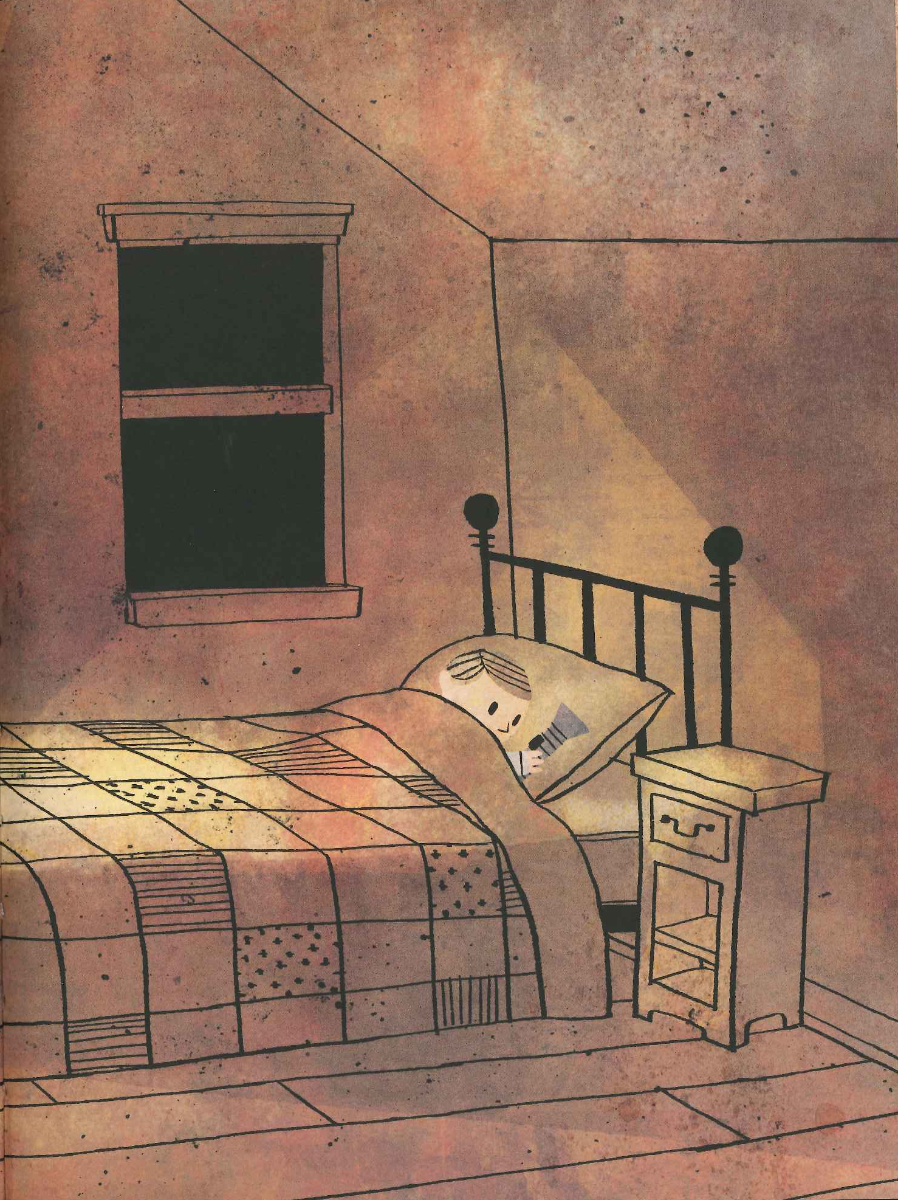

Slide 55
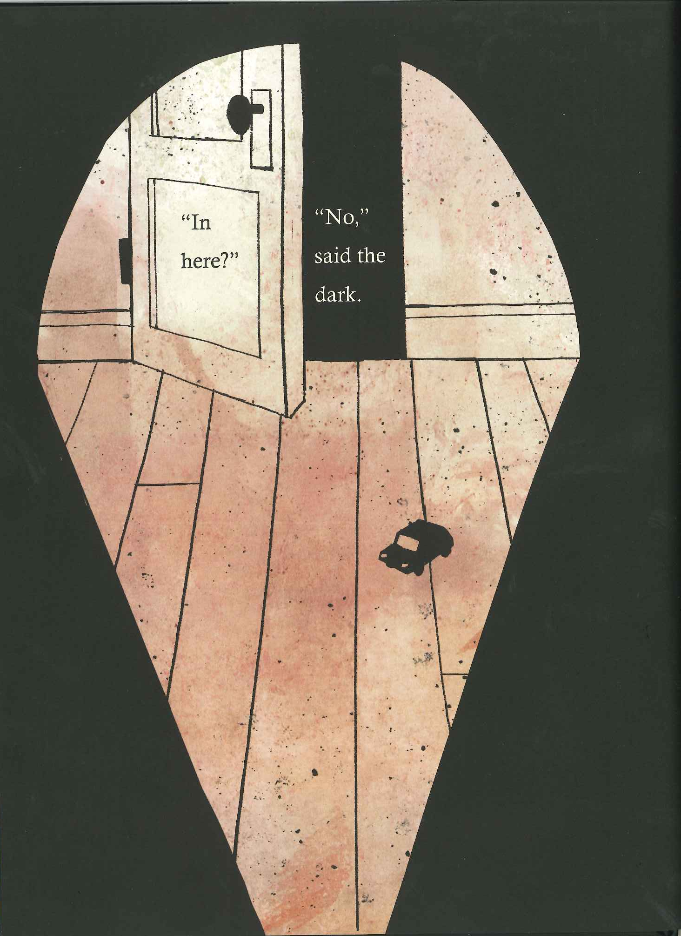

Slide 56
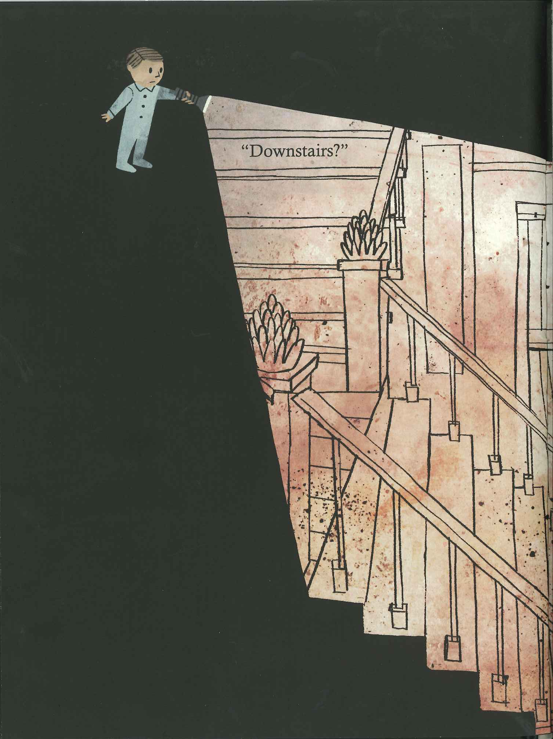

Slide 58
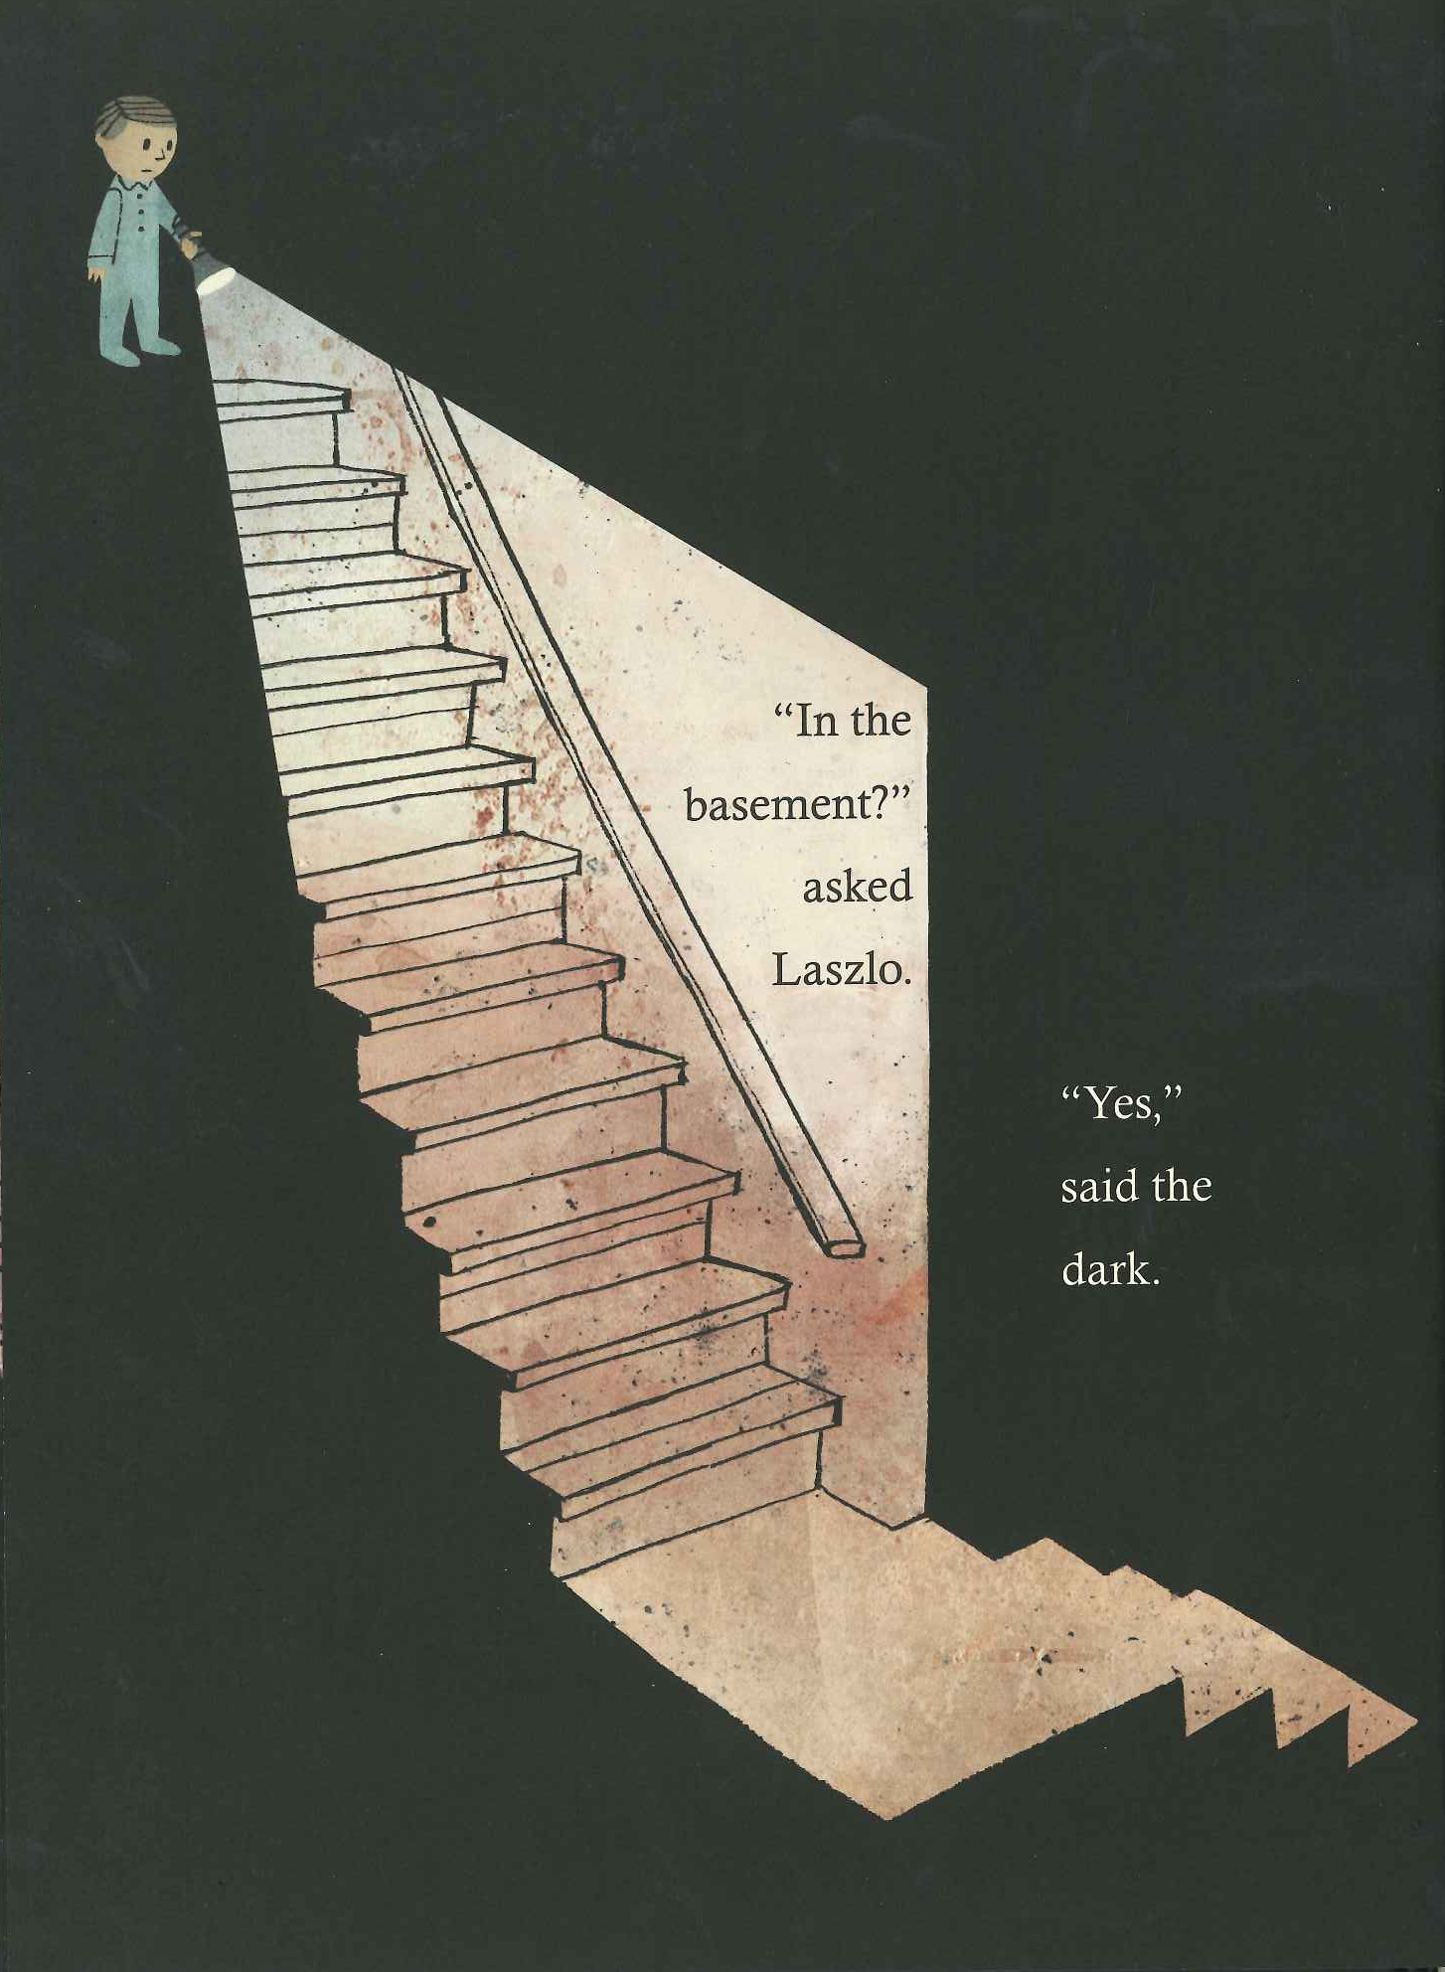

Slide 61
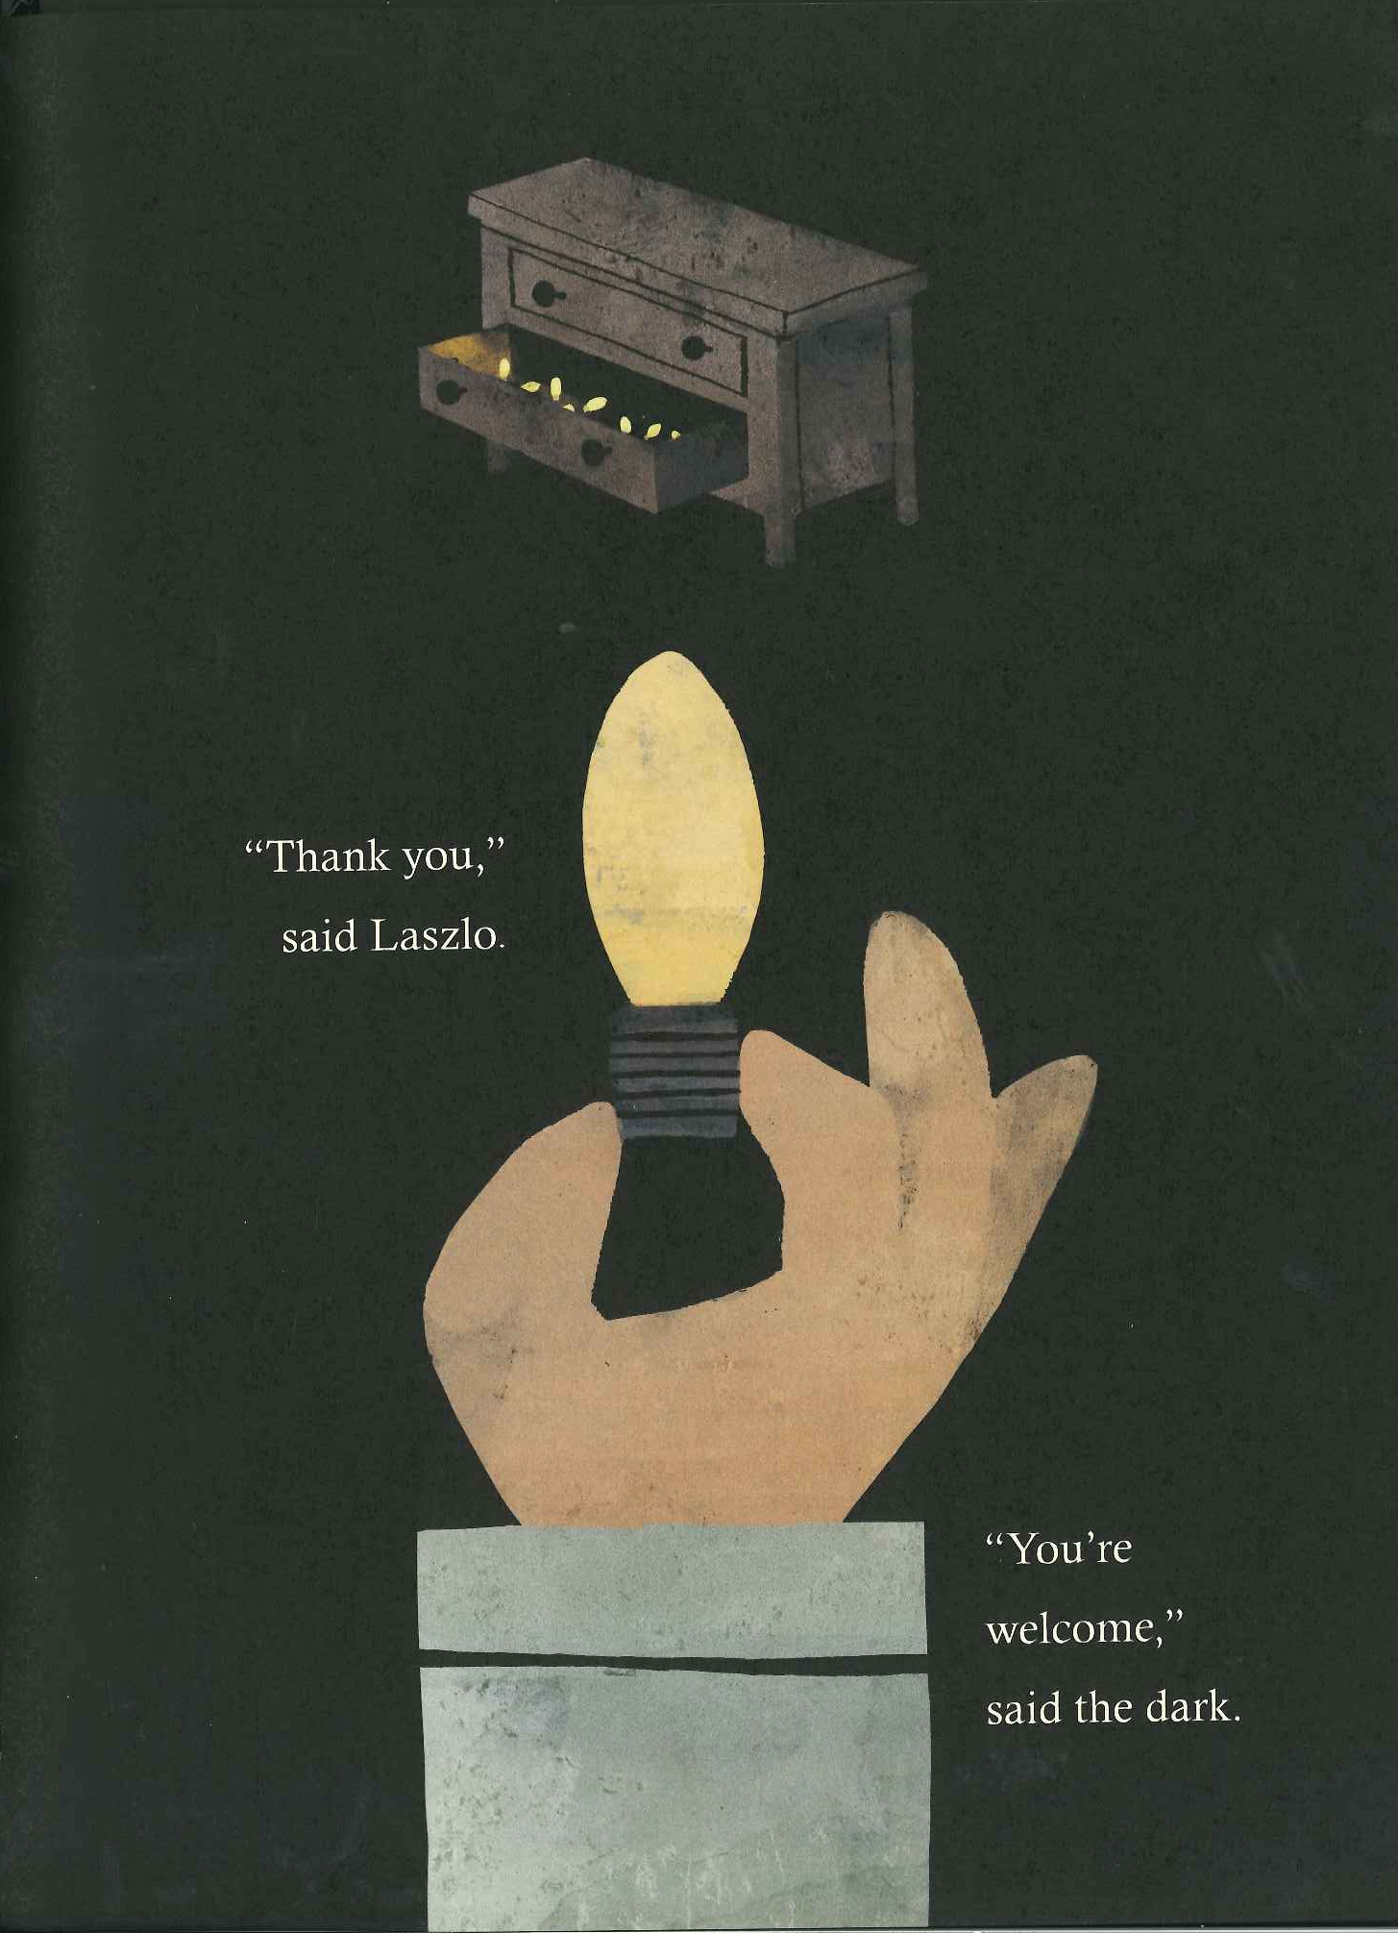

Slide 62
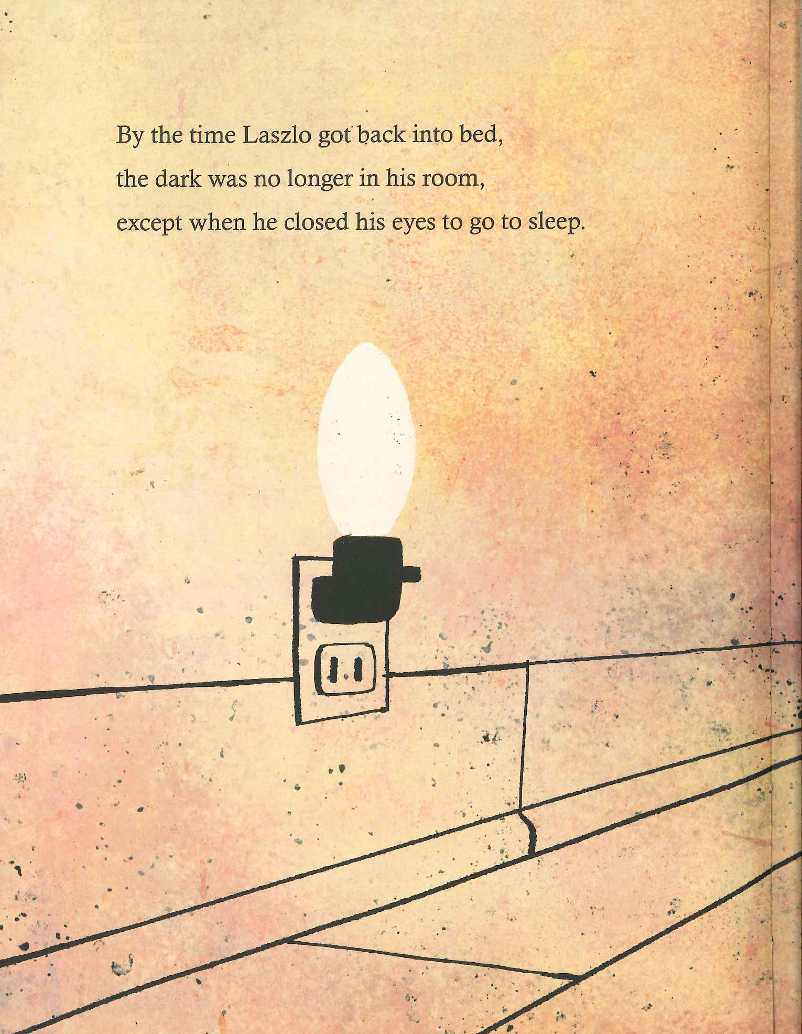

Slide 67
Lilly’s words
In a large house lives a boy. He is in the world on his own. The true cold and darkest of darkness lies within himself (in the darkness of the basement) and he is reluctant to make the journey to the darkest part of himself where he meets his darkest fears. The stairs that led to the basement, will stand for his return. This event, however, presents Lazlo with an opportunity to face the darkness. If a person makes the trip to the basement, spends time with darkness and becomes its visitor, while allowing the voice of darkness to be heard, the person may be blessed with the presence of the divine. He found the unexpected, inconceivable, awesome life within life: the life of the self.

Slide 68
Lessons from The Dark
Lazlo is transformed – by his own actions
Lazlo found the light… Some would say…
This is a key lesson for our patients. Unless they go into the dark – they will only see the darkness as Lazlo did…
This is a key lesson for us as nurses
And just like Lazlo, our patients on their trip…
As nurses, we can help…
Thriving… Some even say, “I have…
The Psychologists call it PSG…
AHA, ADA, ACS…
All feature people who say… “It is…”
Like Lazlo, we may find that the dark…

Slide 69
Books to illustrate the point
Kirk Douglas – My stroke of luck
Dr. Jill Bolte Taylor – My stroke of insight
Michael J. Fox – Lucky Man: A memoir
Art Buchwald – Too soon to say goodbye
Like Laszlo, these authors have confronted the dark, been comforted by its presence, seen the divine light within, and then shared essential truths and insights into the essence of life itself.

Slide 70
Notice the title of this article…

Slide 71
Inspiring hope

Slide 72
Managing upsetting feelings about an illness
Patient’s may feel:
Anxious and upset all the time
Angry and pessimistic
Feelings of worthlessness & powerlessness
“We should have died…”
Ralph (age 68) and Pete (age 17)
Notes:
Ralph, age 68, and Pete, age 17, were both new quadriplegics. Ralph had fallen off his roof. Pete had been in a car crash. One day in the cafeteria, Ralph turned to Pete and said, “Pete, we should have died. Especially YOU Pete. I’ve lived my life. But you are only 17. You have nothing to live for. Pete, you should die.”
The next slide shows how we can help both Pete and Ralph

Slide 73
Promote hope by
Listen…Then acknowledge…Then say “I can help you manage those feelings.”
Refer for counseling and therapy
Implement activity scheduling
Don at the Seattle VA and Joe with ALS
Don & Barb and Jim a new quad
Matt was hard to get up

Slide 74
Really involving a patient and their family in their care – let them run the show
Positioning – how does this feel?
Asking, “what’s the plan?” “What do you want?”
How do I………..?
What do you want the schedule to be today?
What is your timeline?
What is it going to take to get you…?

Slide 75
We help our patients envision the future by asking….
What are your goals for this week
Where are you going after you leave here?
What do you need to be able to do to go there?

Slide 76
Inspiring Hope - Believing in a miracle
Michael (15) - Wednesday – Bike vs truck collision
Severe TBI – after surgery – adm to Peds ICU
On vent, ICP, Mannitol, Pentobarb coma
Sherry called me – what else can I do?
The doctor, the family, Sherry & Pam
On Friday By the next Wednesday
Speech consult
Don went to see the family…
And so now, if a family tells me…

Slide 77
Sometimes a non-traditional approach
Casey was a 30-year-old C5-6 Quadriplegic
STILL in ICU – High anxiety
“Fighting the ventilator” – “clicking”
Cindy was the only nurse – during weaning
Don was the Clinical Nurse Specialist, we tried…
A colleague tells the story of her father…
Racist – sexist – But as life would have it
After a minor illness he decided – no amount
His wife called the doctor
Sometimes, when all else fails… “Caring” (and love) tells us….

Slide 78
Therapeutic Use of Humor
I hope each of you laughs out loud every day.
A closing speaker at a conference asked many years ago:
Is it fun where you work?
Do other staff like working with you?
When you leave your patients are they smiling?
If not…
I learned to incorporate humor into my care early as a nurse…

Slide 80
Lessons about humor from:
Jan Karon’s Midford series
I listen to the books when driving (On “Audible”)
In the first book we meet “Uncle Billy.”
Uncle Billy always has a joke to tell

Slide 81
Lessons for healthcare providers from Uncle Billy
Uncle Billy worked and worked at his jokes
He inspired others to find joy in their lives
Uncle Billy was married to and in love with Miss Rose Watson, a schizophrenic
His legacy was his love and his jokes
In the last book, Uncle Billy dies
At the graveside the minister reflected

Slide 82
Uncle Billy
“Uncle Billy spent his life modeling a better way to live, a healthier way, really, by inviting us to share in a continual feast of laughter.
When the tide seemed to turn against loving, he loved anyway. And when circumstances sought to prevail against laughter, he laughed anyway.
Uncle Billy loved us with his jokes. And oh, how he relished making us laugh, prayed to make us laugh. And we did.”
Jan Karon (2005) A light from heaven, 225-226

Slide 83
Favorite Jokes
One of Uncle Billy’s Favorites:
An ol’ man and a ol’ woman was settin on th’ porch, don’t you know…
One of Don’s favorites
A woman in her mid 40’s was just tired and fatigued all the time. She was married…
Lessons from the Holocaust about humor

Slide 84
Transcending Circumstance: Seeking Holism at Auschwitz (Freeman, 2002)
Freeman asks, “Is it our circumstances that define us?”
Living the unimaginable:
Cattle cars
Choosing lines
Naked, showered and shaved
Those who survived touched each other through art, music and humor to bring hope to their lives.

Slide 85
Certainly
Healthcare Organizations are NOT concentration camps
But patient’s often endure the unimaginable as part of their illnesses
Laughter by both the healthcare provider and the patient means we can see beyond our circumstances, our pain and our limitations.
Which leads us to…

Slide 86
Hope for the moment
Encompasses all the strategies I have mentioned
Just “being” with a patient promotes hope and “touches” him or her, right here, right now
It has been said, that if all there was to being a healthcare provider was caring, anyone could do it
The natural response to an illness

Slide 87
Care and Caring
Go hand in hand
When any of us say, “Hi, I’m going to care for you today.”
We are saying, “Come to us”
It doesn’t matter if you…

Slide 88
When a patient is incontinent of diarrhea in the bed…
The natural response is to say…
We say, “I see you’ve had an accident”
“Let me get you cleaned up, and then we will modify your bowel program”
We have: Increased the patient’s control
Made the unimaginable manageable
Sustained our relationship with them
Adopted a life promoting framework
Helped the patient see the future
And, touched the patient’s life forever

Slide 89
The power of the moment
In the moments we spend with our patients and families…
All any of us has…
We have all decided to…
The reality is, even though I have been providing healthcare for over 40 years…

