Slide 1
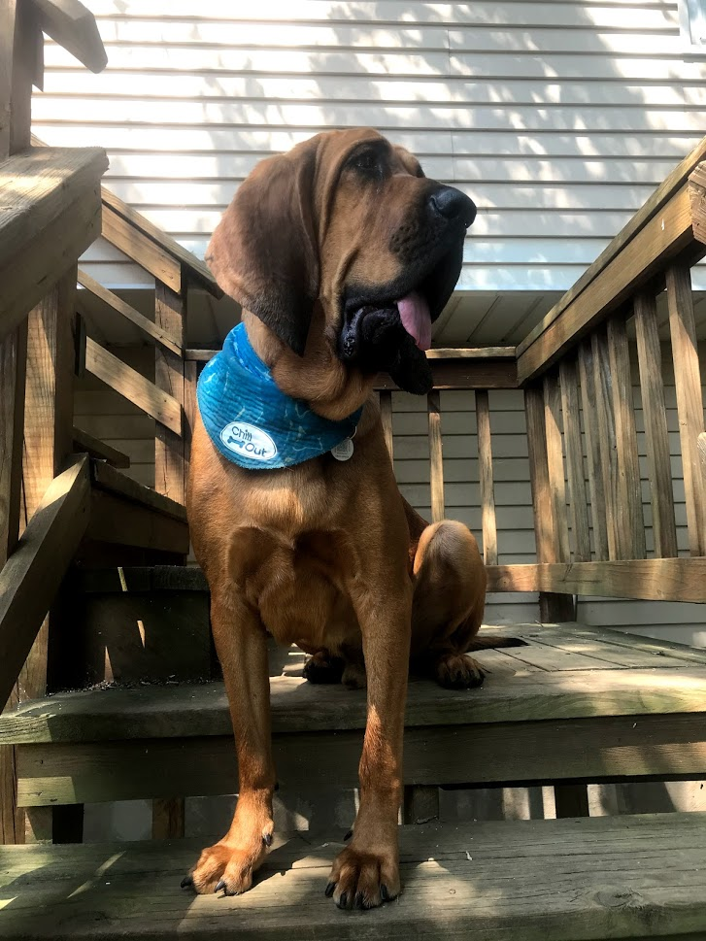
Redford-in-Training
Jan Evans Knight

Slide 2
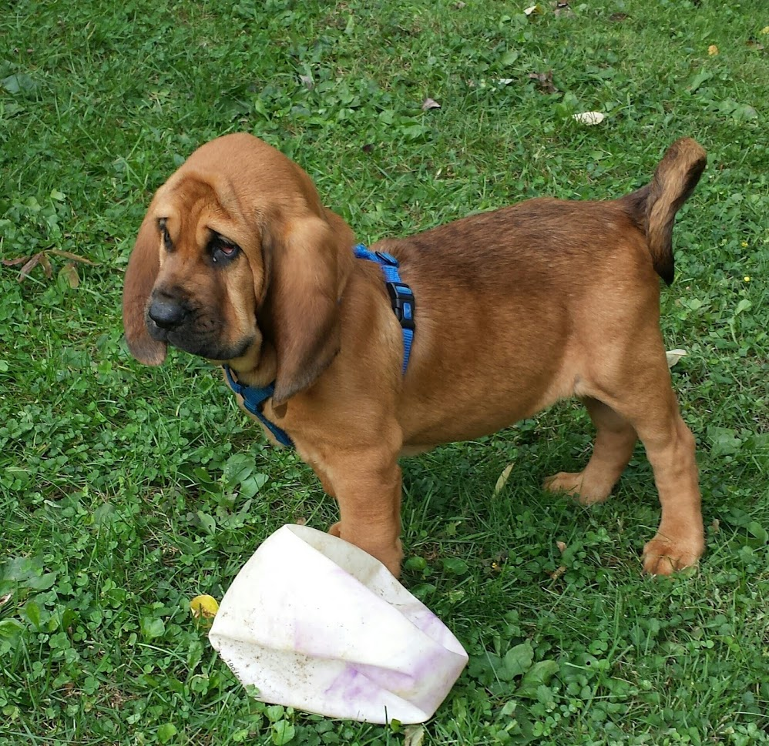
Redford-in-Training
No day at the beach.
When I first got him,
He was small with big feet.
This Photo by Unknown Author is licensed under CC BY-NC-ND

Slide 3
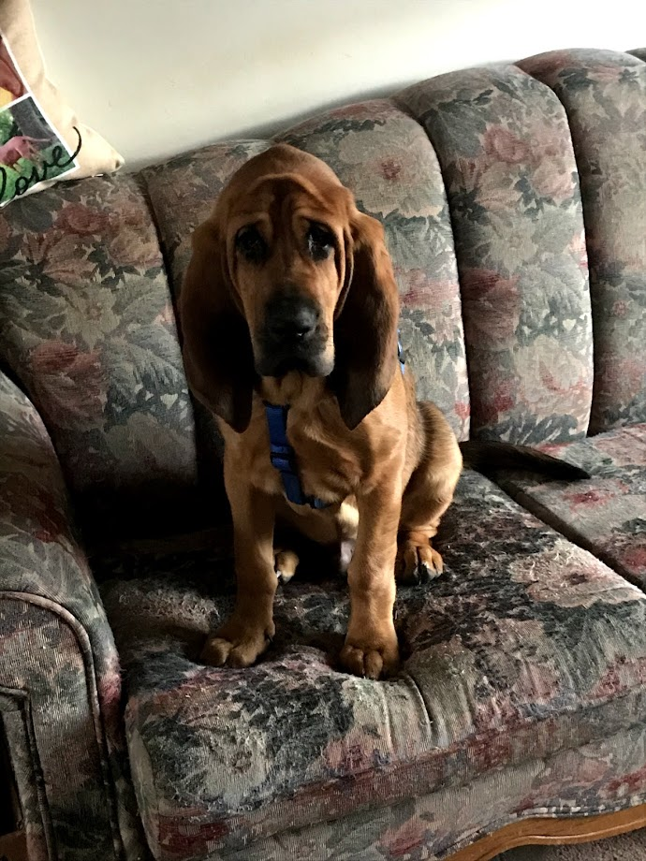
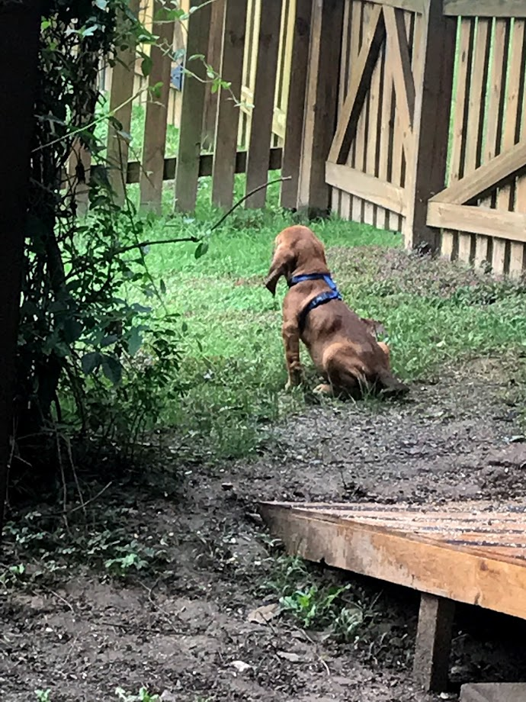
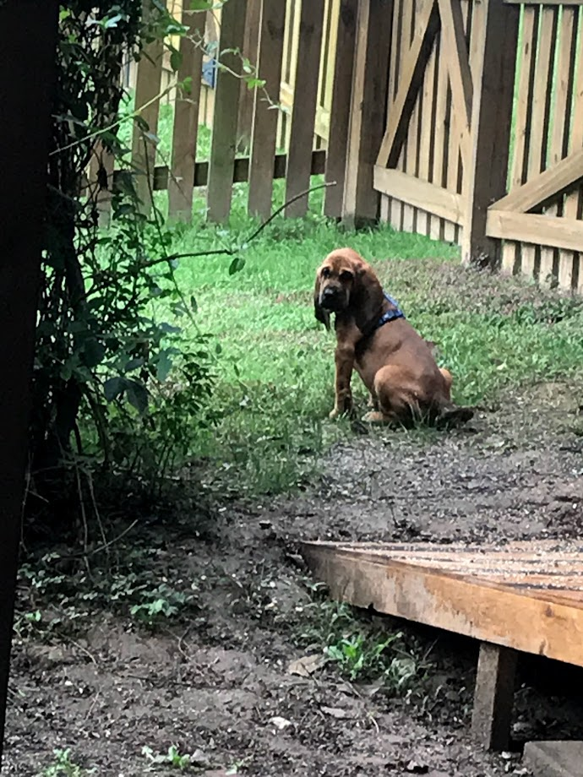
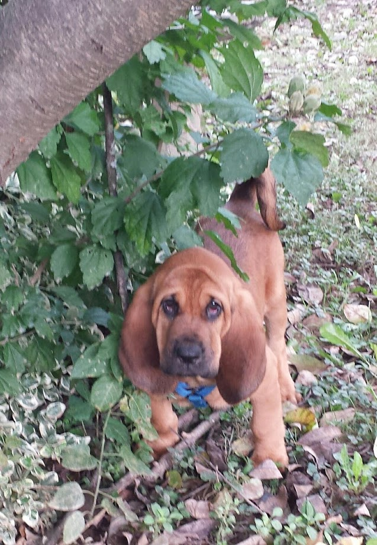

Slide 4
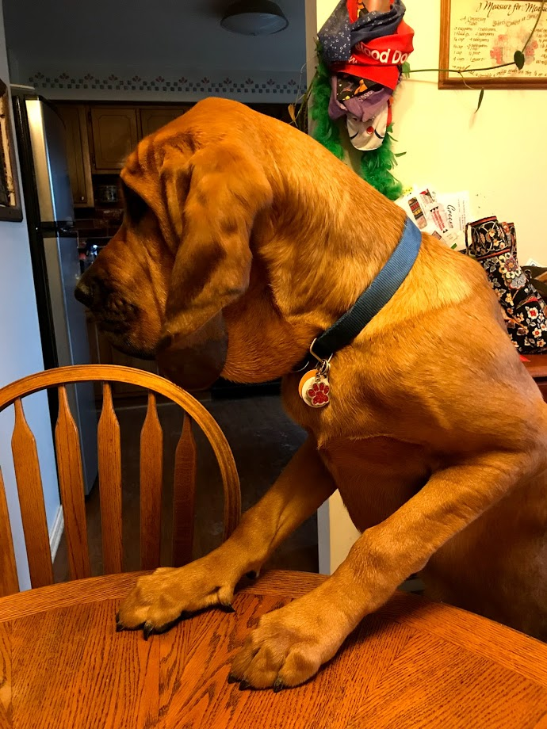
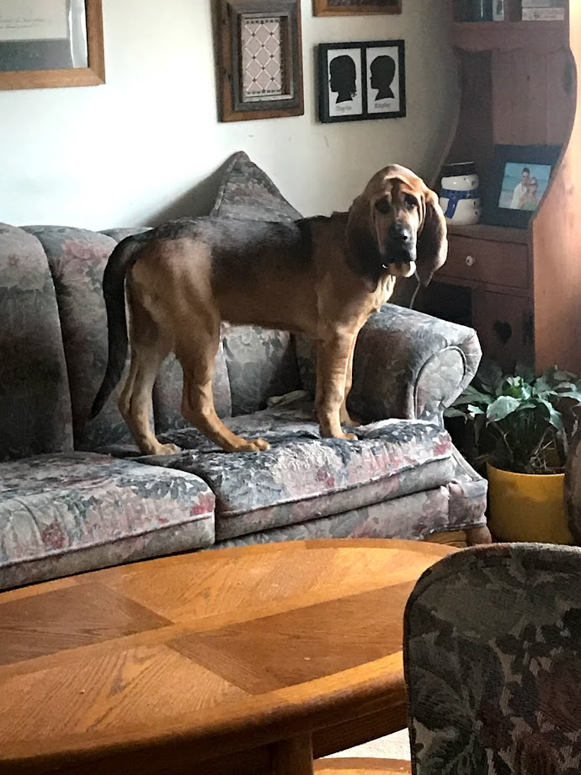
But grow quickly, he did,
Day after day,
Ten pounds a month,
That’s a lot, I’d say!

Slide 5
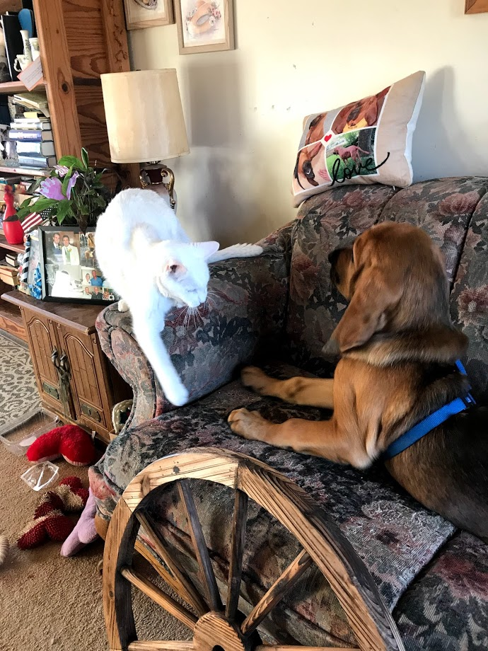
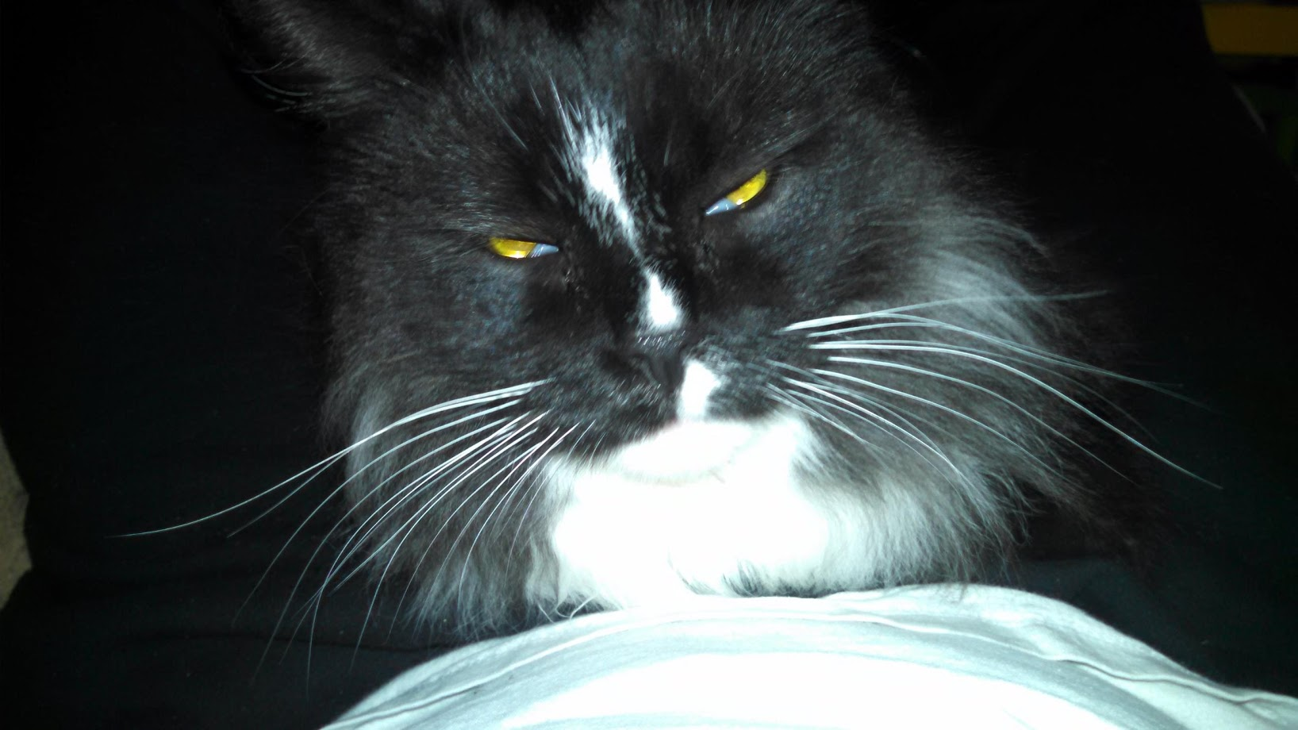
He first had sharp teeth,
Liked chasing the cats.
It wasn’t much fun,
When he got himself scratched!

Slide 6
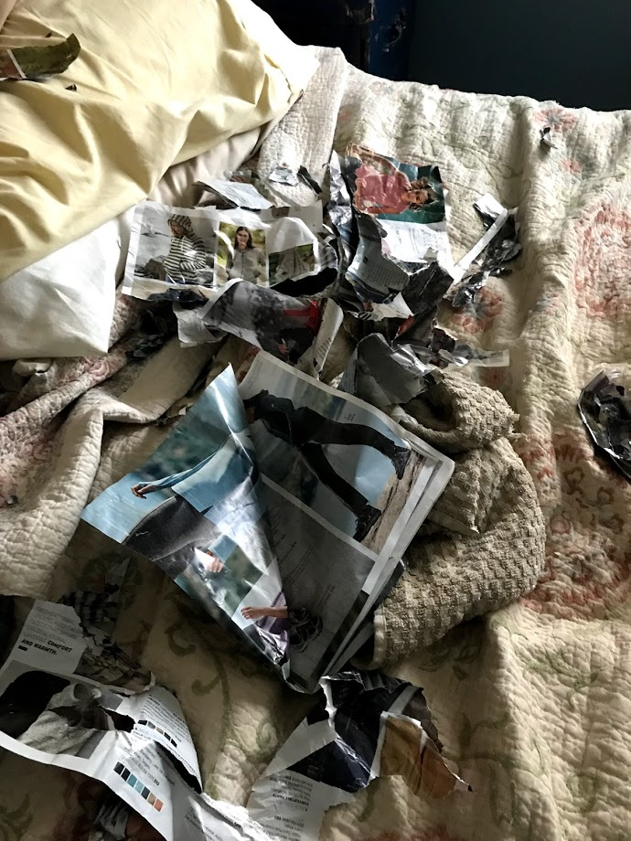
He tore up the mail
Before it was read.
The newspaper
Frequently ended in shreds.

Slide 7
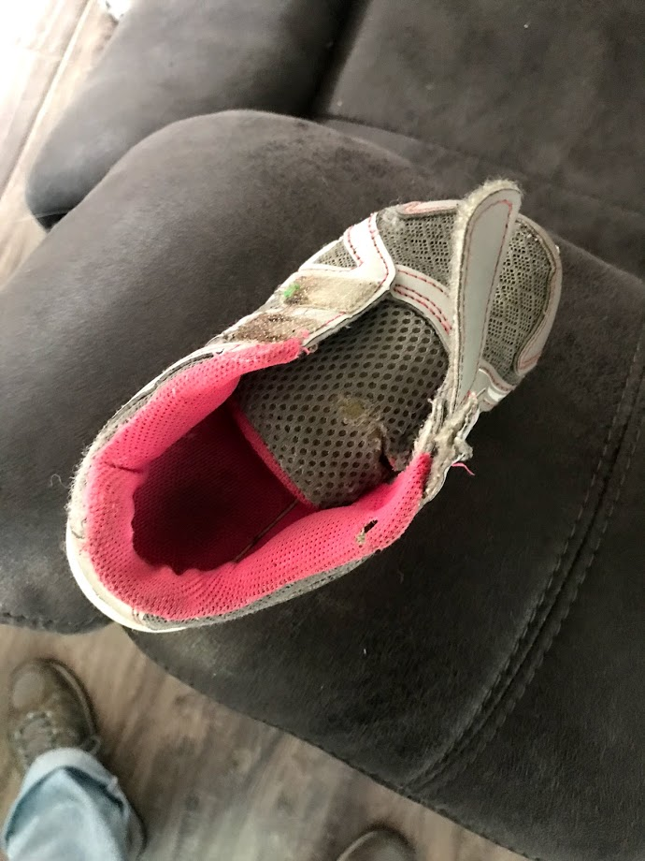
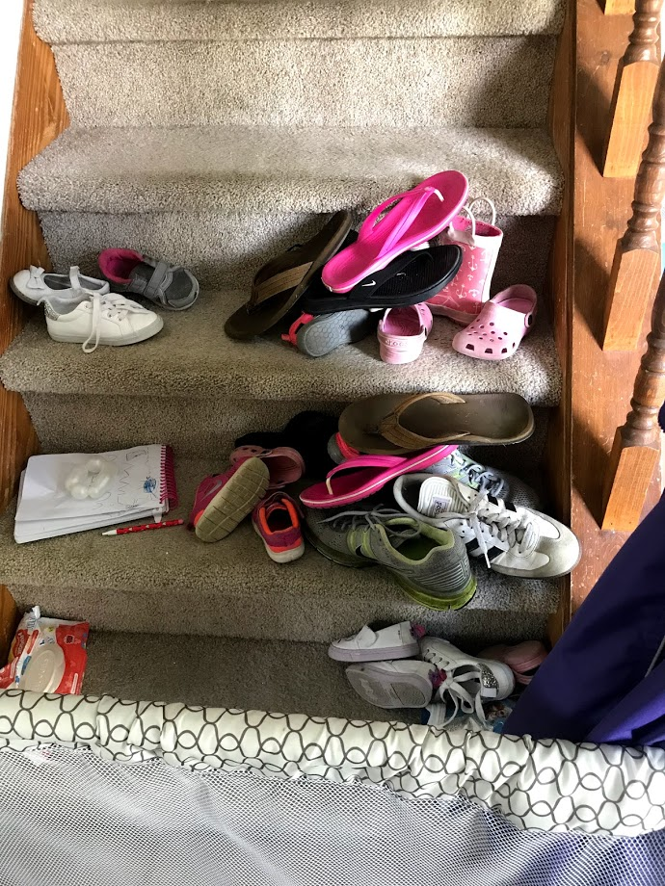
Socks, shoes, and pillows
Were part of his play.
He stole my slippers
And ran away…

Slide 8
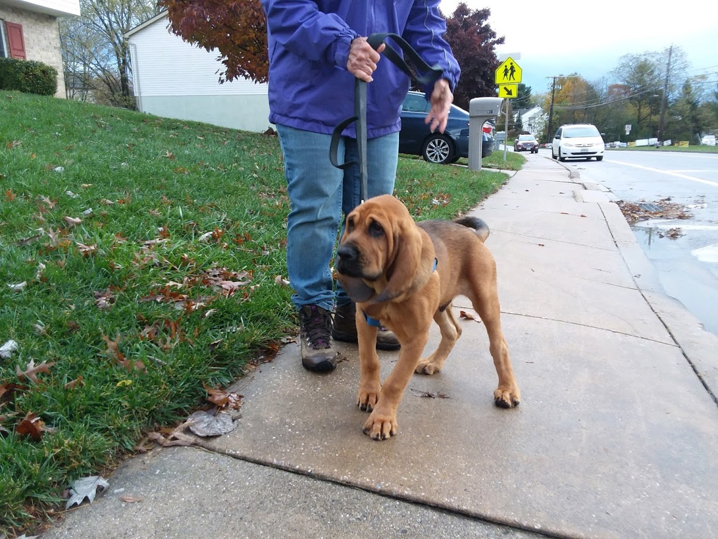
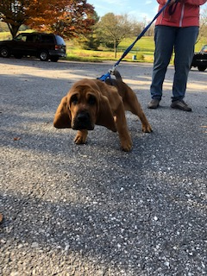
My neighbors worried He jumped and pulled
When we took walks. Tugging his lead.
We moved rather fast I repeated commands,
Around the block. But he wouldn’t heed.
He thinks it’s a game
When we pick up his poop.
He yanks at my clothes,
When I bend to scoop.

Slide 9
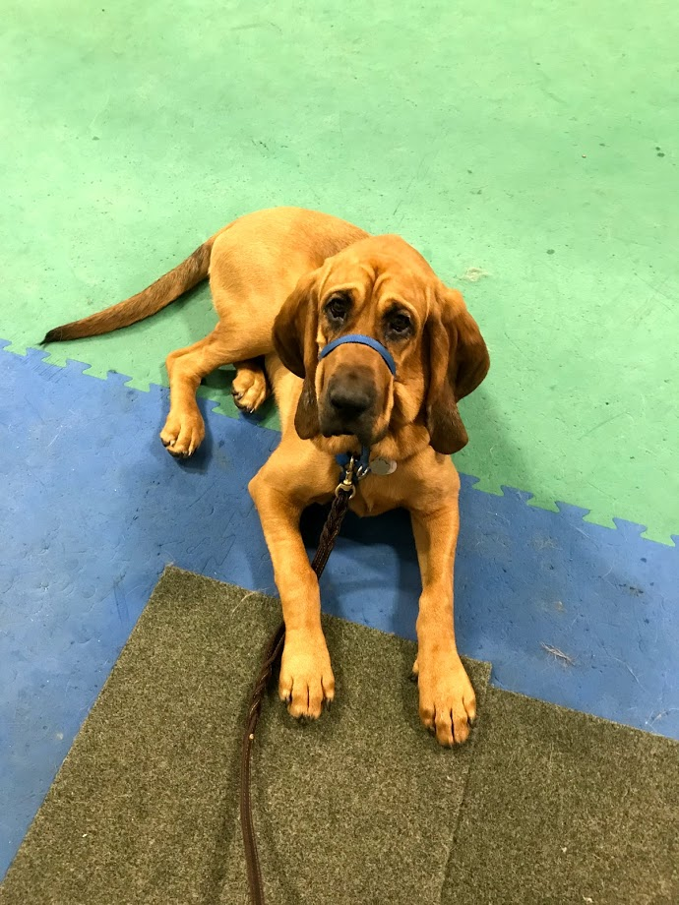
Off to puppy school
He did go.
He learned the word, “yes!”
He knew the word, “no!”

Slide 10
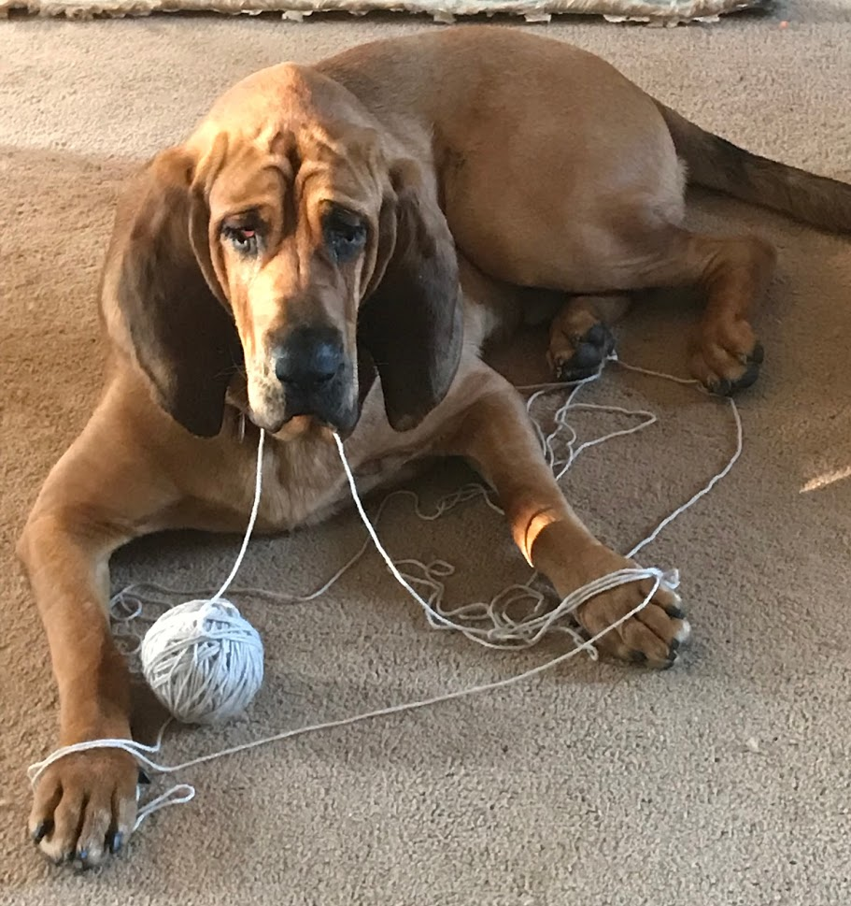
Redford’s learning rules
One by one,
But there are days
When it’s not much fun!

Slide 11
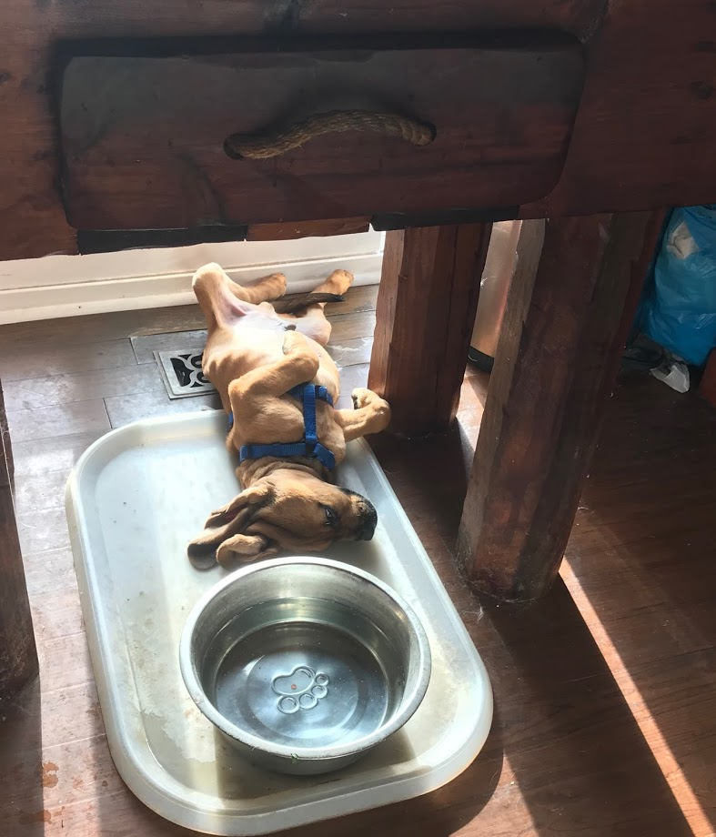
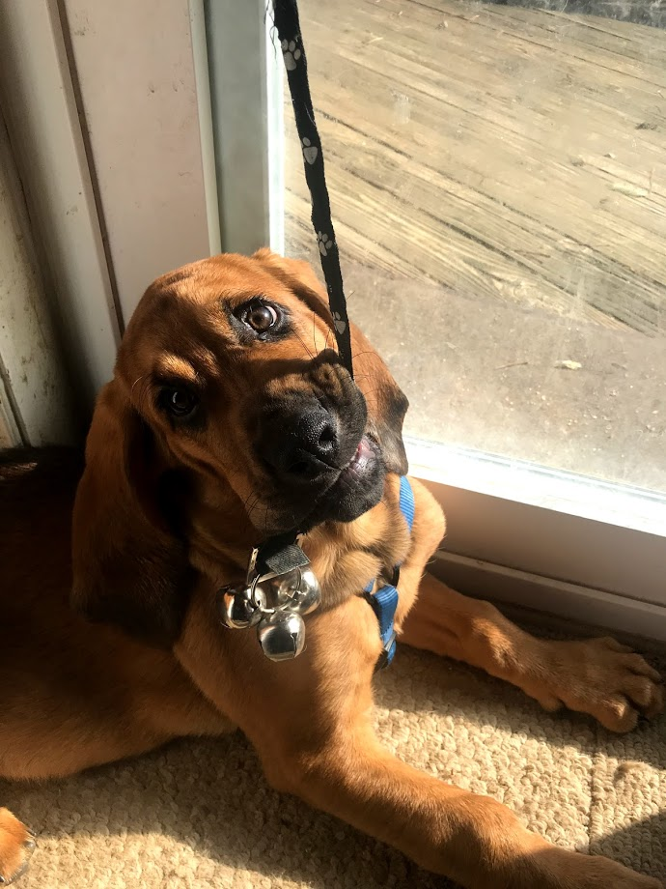
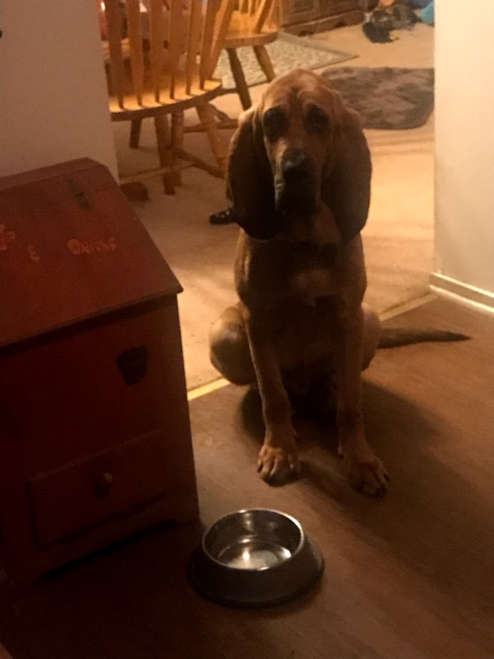
So what does Redford do that’s right?
He goes to bed and sleeps all night.
He rings a bell
To go outdoors.
When it’s time to eat,
He sits by his bowl.
(Ding-a-ling)

Slide 12
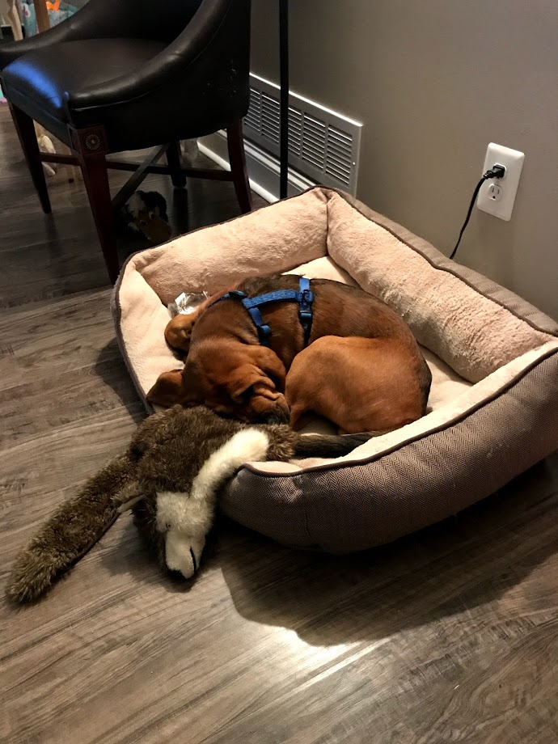
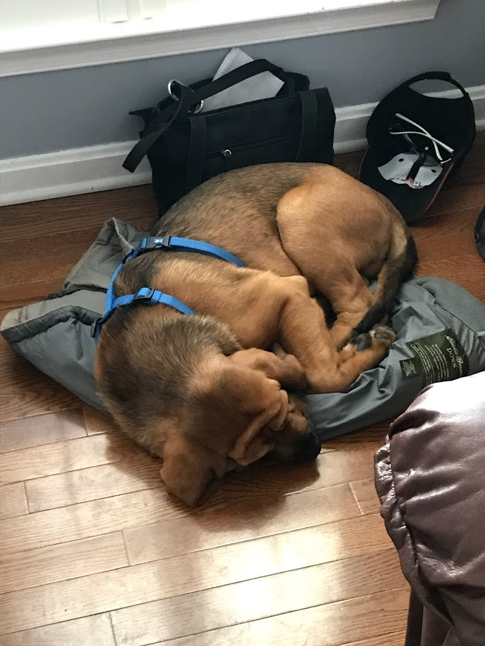
He likes people, birds,
Dogs, and cats.
When he’s told,
He goes to his mat.

Slide 13
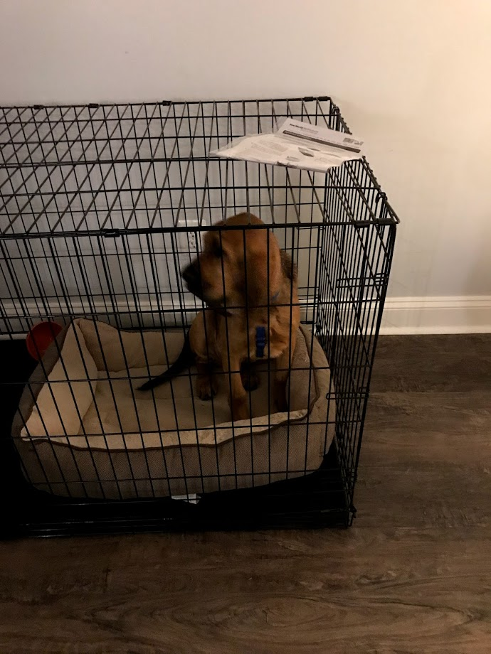
He knows commands:
Sit, down, come, stay.
He feels safe in his crate
Whether night or day.

Slide 14
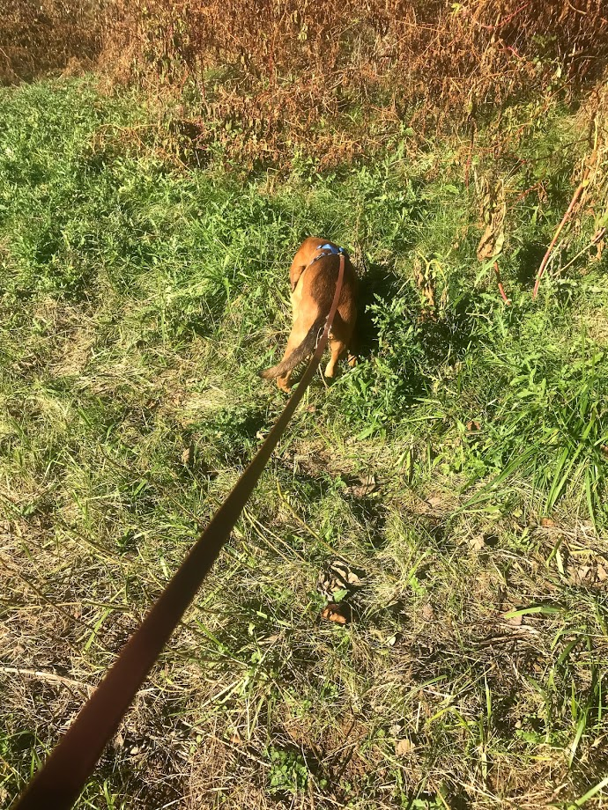
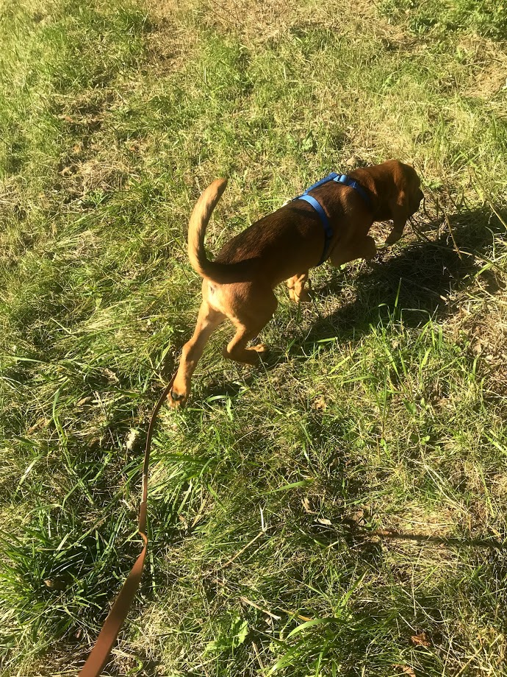
Redford likes to be busy
Sniffing around.
His nose likes to search
For things on the ground.
Redford seems to like
Being with me.
He sometimes comes
When I tap my knee.

Slide 15
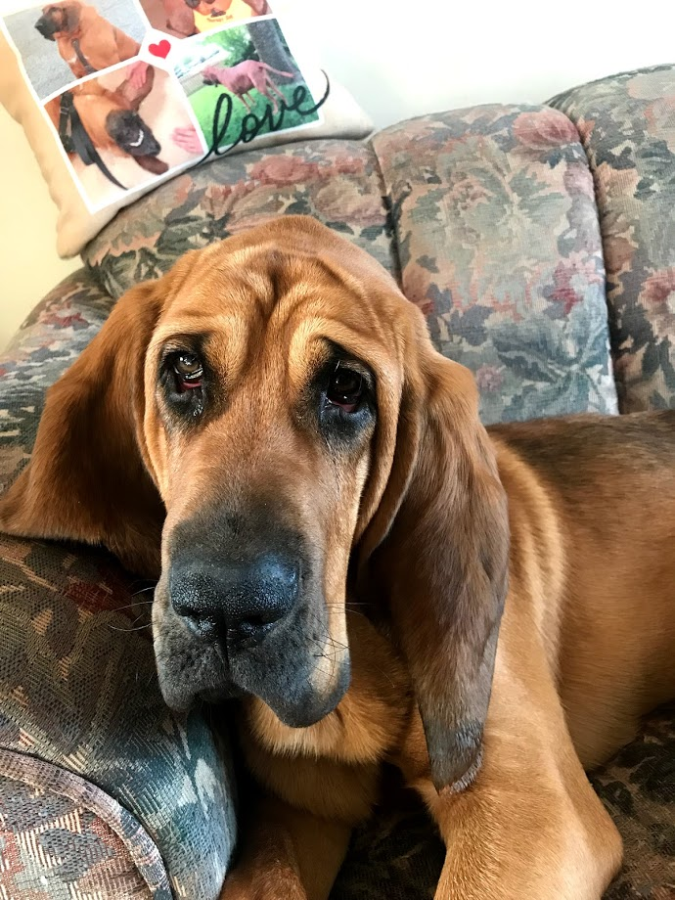
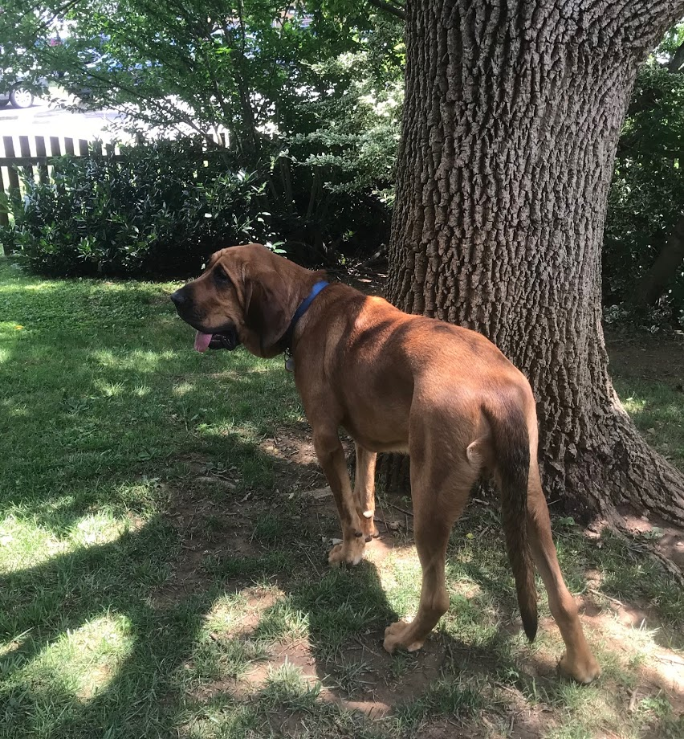
Come to think of it,
Redford’s a happy pup.
He loves life.
He just needs to grow up.

Slide 16
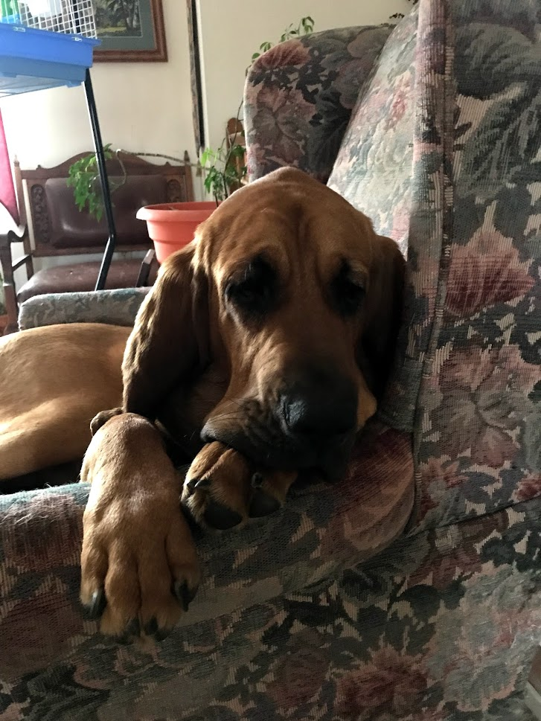
Redford thanks …
MyK9Buddy.com
Val and Marta

