Slide 1
Simplified Coding
Dirk M. Elston, MD
MUSC Dermatology

Slide 2
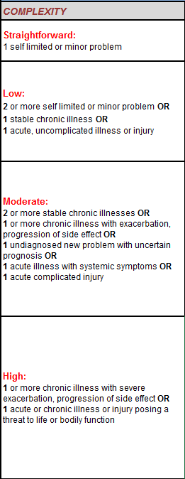
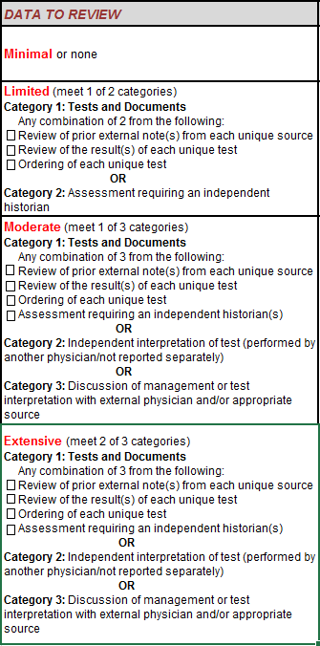
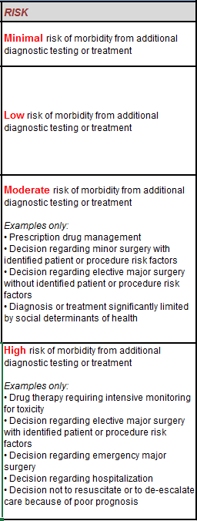
Prescription, biopsy/minor procedure,
Social determinant of health
High risk medication/ surgery or admission

Slide 3
Simple version | Complexity | Data | Risk
L3 | 2 or more minor Dx OR 1 chronic at target | 2 labs/outside notes OR Independent historian | OTC
L4 | 2 or more chronic Dx OR 1 not at target | 3 labs/notes/historian OR Independent interpretation of test (eg: biopsy CPC) OR Call a Doc to discuss management | Rx OR Social determinant of health
L5 | Severe flare OR Life threatening | 2 of the 3 below: - 3 labs/notes/historian - Independent interpretation of test (eg: biopsy CPC) - Call a Doc to discuss management | Drug requiring quarterly monitoring

