Slide 1
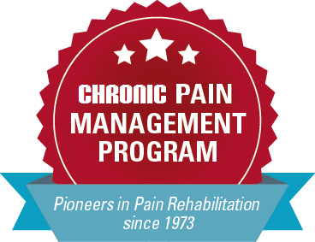
Pain Rehabilitation Strategies: The Unsung Opioid Alternative
Presented by:
Giuseppe “Joe” Siracusano, PT, DPT, MA, BSPT
Chronic Pain Management Program, Nebraska Medicine
Adjunct Assistant Professor, Physical Therapy Education
College of Allied Health Professions, UNMC
gsiracus@nebraskamed.com
cpmp@nebraskamed.com

Slide 2
DISCLOSURE DECLARATION
Pain Rehabilitation Strategies: The Unsung Opioid Alternative
Giuseppe “Joe” Siracusano, PT, DPT, MA, BSPT
Employee of Nebraska Medicine’s Chronic Pain Management Program
No products to promote
No off-label medication use guidance

Slide 3
Objectives:
By the end of the presentation the learner will be able to:
The overall goals of pain rehabilitation strategies considering reduction and elimination of Opioid use for chronic non-malignant/ medically stable pain
The basic components for pain rehabilitation
The similarities and differences between Pain Rehabilitation Strategies and Therapeutic Neuroscience Education (TNE)
The typical medical and non-medical search(es) a person may go through to address chronic pain(s)
Three changes to the Autonomic Nervous System related to chronic pains
Three changes to the Central Nervous System related to Chronic pains
The typical indications a person with chronic pain is a candidate for Pain Rehabilitation Strategies
Three common barriers to Pain Rehabilitation Strategies

Slide 4

Acute Pain
Acute Pain

Slide 5
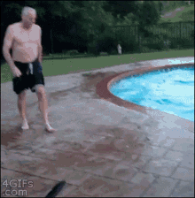
Acute Pain
Acute Pain

Slide 6
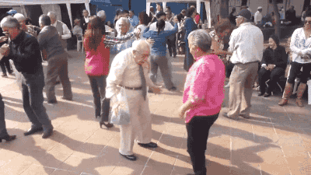
Acute Pain
Acute Pain

Slide 7

The Acute Pain Model
Cognizance
Pain Behaviors
Fear/ Suffering
Pain
Awareness
Nociception

Slide 8
Acute Pain
The result of tissue damage
  Pathology / Trauma is the cause
    Mechanical deformation
    Chemical irritation
Analgesics are useful
Treatment facilitates tissue repair
Absolute rest and/ or immobilization is appropriate
Short term
Pain ceases when tissues are repaired or healed
Not progressive
Examples: Fractures, contusions, lacerations, etc

Slide 9
Nociception vs Pain

Slide 10

Explain this……..

Slide 11
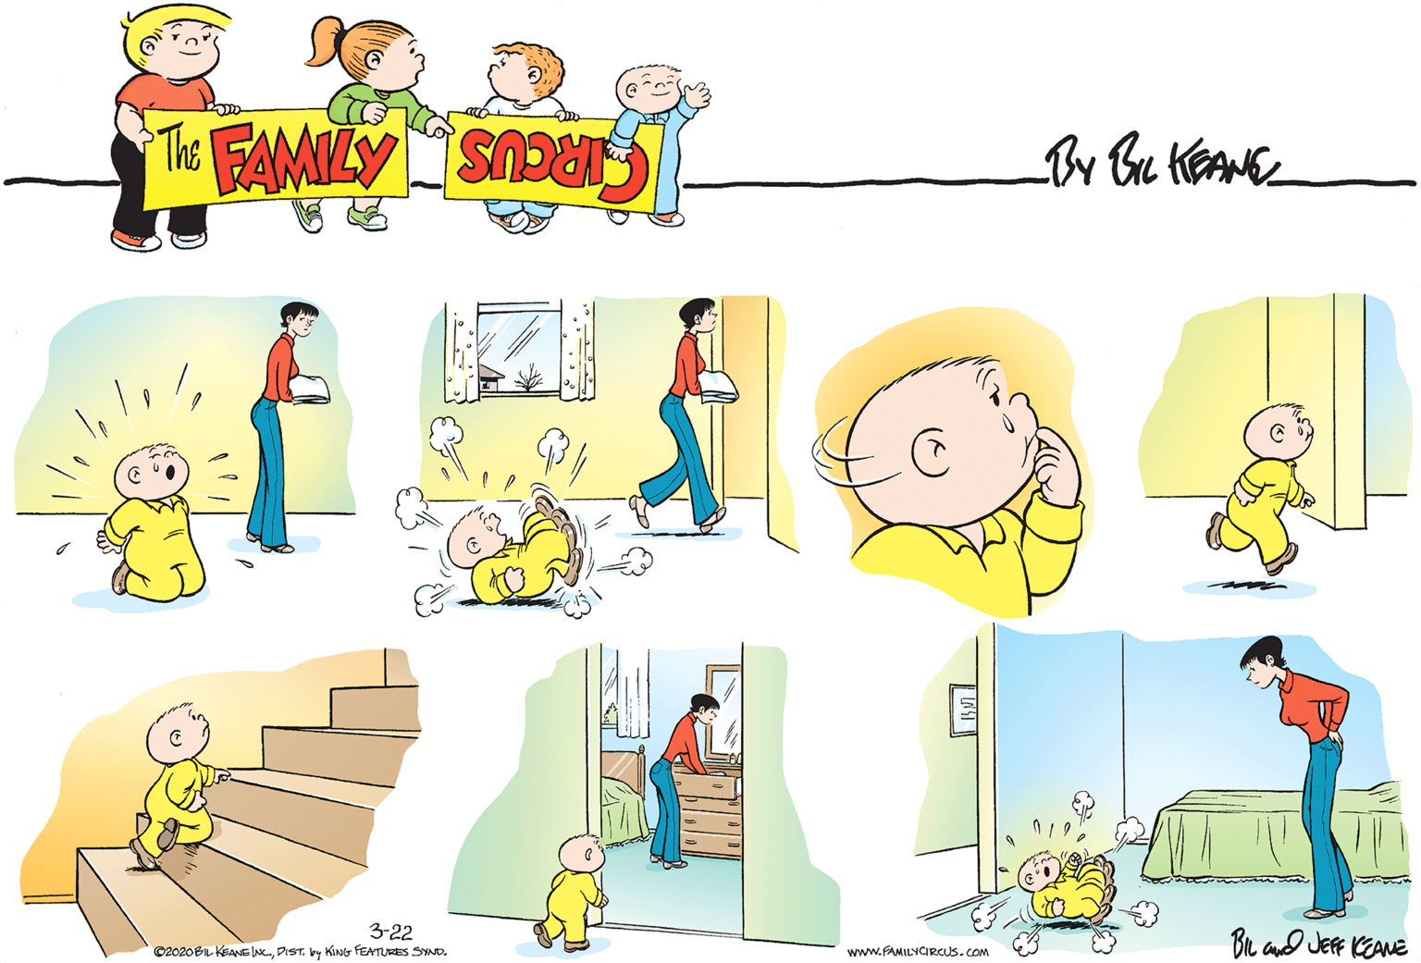
And this……..

Slide 12
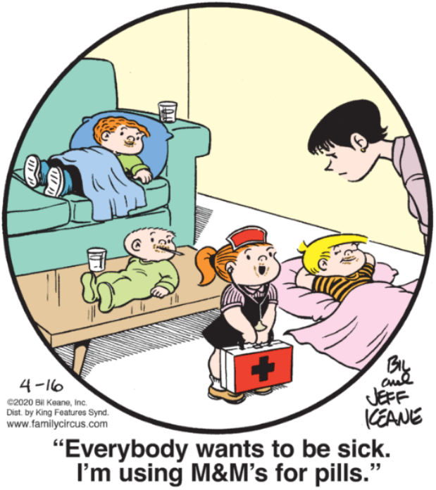
Pain “Fact” Errors

Slide 13
Pain “Fact” Errors
The Pain Nerve Ending
The Pain Nerve
The Pain Pathway
Nociception Equals Pain
The Pain messages from your body
When your body feels pain
The Degree of Pain indicates the degree of
  Injury severity
  Physiological pathology
  Anatomical pathology
  Biomechanical pathology

Slide 14
Chronic Non-malignant Pain/ Medically Stable Pain
Can be, but is not restricted to, the result of tissue damage
Treatment focused on correcting damage, mechanical irritations or minimization of on-going damage is usually limited and can be futile
Effective treatment addresses the elimination or minimization of DISABILITY which includes patient engagement and education
Absolute rest and/ or immobilization is NOT appropriate
Pathology MAY have initiated the process BUT is not exclusively the source of the current pain experience (or at all !)

Slide 15
Chronic Benign Pain / Medically Stable Pain
Analgesics are NOT useful (differing opinions,,,,, still)
Utilizing Non-Narcotic approaches for pain is Best Practice now
Long term – lasting longer than 3-6 months
Pain does NOT completely cease REGARLESS OF tissue repair or healing
The classic disease model DOES NOT APPLY
No lasting response to acute interventions
Symptoms can be progressive over time if not properly addressed due to PNS/ CNS/ ANS/ ENS sensitization
Examples: Fibromyalgia Syndrome (FMS), failed back syndrome, unresolved post-surgical pain, phantom limb pain, multiple pain sites, etc

Slide 16

CLINICAL TENDENCIES of Chronic Benign Pain
THE YELLOW FLAGS
Higher prevalence of work-related injuries
Greater health-care utilization
Higher utilization of opioid / narcotic analgesics
Higher incidence of failed surgical procedures
Greater functional impairment (relative to clinical findings)
More constant pain
Higher levels of emotional distress
More negative attitudes about the future

Slide 17

The
Medications:
  Tried them
  Don’t want to try them – “I don’t do that”, “I don’t like taking medications”
Injection therapy
  Trigger point injections
  Epidural Injection Therapy
  Botox/ Dysport injections

Slide 18

The
Other Needles:
  Dry needling
  Acupuncture
Surgical Procedures:
  Radio Frequency Ablation (RFA)
  Stimulator implantation
  Spinal surgeries

Slide 19

The Search:
OTHERS
Physical Therapy
Chiropractic
Massage Therapy
Acupuncture:
  Medical Acupuncture
  Chiropractic Acupuncture
  Traditional Chinese Medicine
Kratom
Medical Cannabis
Other Supplements

Slide 20

AHH, THE OPIOIDS
Medscape’s Ten Prescriptions Never to Write:
1. Alprazolam (Xanax®) (lorazepam [Ativan®] is safer)
2. Methadone for pain, unless very experienced
3. Opioids greater than 100 mg morphine equivalents daily
4. Carisoprodol (Soma®) or butalbital, which are short-acting barbiturates
5. Tramadol; it is not a safer option for high-risk patients
6. Short-acting psychostimulants (amphetamine, methylphenidate)
7. Meperidine (Demerol®)
8. Long-acting hydrocodone (Zohydro®)
9. Any opioid until you've assessed the patient's addiction and mental health background
10. Any prescription while the patient is under duress
10 Scripts Never to Write Charlie P. Reznikoff, MD March 16, 2015 http://www.medscape.com/viewarticle/841297?src=wnl_edit_tpal&uac=84097ER

Slide 21
AHH, THE OPIOIDS
Rebound Pain Phenomena
Hypothalamic/ Pituitary Dysfunction
  Oral or intrathecal
    Hormone imbalances
      Males and females
      Fertility function
      Other Emotional/ Cognitive/ Physiological disruptions
Emotional adverse effects
  Depression
  Anxiety
  Other de-motivations
Osteoporosis

Slide 22
AHH, THE OPIOIDS
Opioid hyperalgesia
  Characteristically more diffuse pain relative to initial pain experience
  Characteristically promotes reduced pain tolerance
    Adds pain in new body sites or ‘triggers’
  Increasing doses to get the same “effect”
    Doesn’t eliminate the pain – “takes the edge off”
      PMP average pain reduction from opioids / narcotics is 15-30%
      90% report ineffective pain reduction
      Patient resistance to medication reduction is common!
    Treating emotional distress – not nociception
http://www.medscape.com/viewarticle/811033 Melville, NA 16 Sept 2013

Slide 23
Some Citations
  Abs R, Verhelst J, Maeyaert J, Van Buyten JP, Opsomer F, Adriaensen H, Verlooy J, Van Havenbergh T, Smet M, Van Acker K. Endocrine consequences of long-term intrathecal administration of opioids. J Clin Endocrinol Metab. 2000 Jun;85(6):2215-22.
  Christo PJ, Grabow TS, Raja SN. Opioid effectiveness, addiction, and depression in chronic pain. Adv Psychosom Med. 2004;25:123-37.
  Nunes EV, Donovan SJ, Brady R, Quitkin FM. Evaluation and treatment of mood and anxiety disorders in opioid-dependent patients. J Psychoactive Drugs. 1994 Apr-Jun;26(2):147-53.
  Daniell HW. Opioid osteoporosis. Arch Intern Med. 2004 Feb 9;164(3):338; author reply 338.

Slide 24
The
Patients focus on pain relief, not function
  Opioids Associated With Higher Satisfaction With Care https://www.medscape.com/viewarticle/891079?src=wnl_edit_tpal&uac=84097ER accessed 23 March 2018
  Mark D. Sullivan, MD, PhD. How Chronic Pain Treatment Falls Short of Patient-Centered Care. NEJM Catalyst May 18, 2017 https://catalyst.nejm.org/chronic-pain-care-falls-short/ Accessed 7 April 2018

Slide 25
AHH, THE OPIOIDS
LOGISTICAL ISSUES
New York Times article (17 March 2016) featuring the challenges of Robert Wergin, MD Seward/ Millford, NE.
  Highlights the difficulties faced by front-line practitioners in regions where pain medicine and management resources are limited
  “The burden of monitoring patients for potential abuse, while still treating pain that is chronic and real, falls largely on these front-line gatekeepers.”
  http://www.nytimes.com/2016/03/17/health/er-pain-pills-opioids-addiction-doctors.html?smprod=nytcore-ipad&smid=nytcore-ipad-share&_r=1

Slide 26

AHH, THE OPIOIDS
We’ve all heard this !
From MedScape: Deaths from Opioid overdose outpace Deaths from Motor Vehicle Crashes
5 February 2016
http://www.medscape.com/viewarticle/858411?nlid=99105_3901&src=wnl_newsalrt_160204_MSCPEDIT&uac=84097ER&impID=980959&faf=1

Slide 27
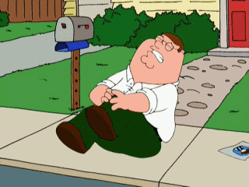
So, what if the pain doesn’t go away?

Slide 28
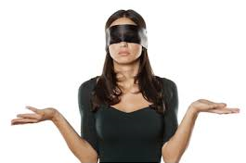
Pain
“The Blind Helper”

Slide 29

Neural Plasticity:
Keep the ‘Change’!

Slide 30

Negative Neuroplasticity
The Dark Side
The Dark Side of
THE FORCE

Slide 31

Negative Neural Plasticity
Topographic Smudging and Shrinking
  Poor motor control
  Altered sensory experiences
Adverse Topographic Competition
  Poor concentration
  Poor memory
  Deterioration of balance function
  Increased falls / injury incidence

Slide 32
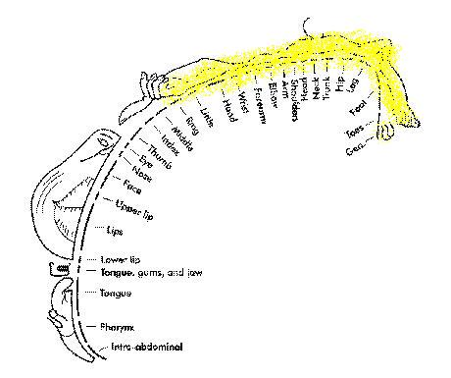
Neural Plasticity
CHRONIC
Homuncular
Smudging
From:
Lack of use
Abnormal use
Stress
Maladaptive thought

Slide 33
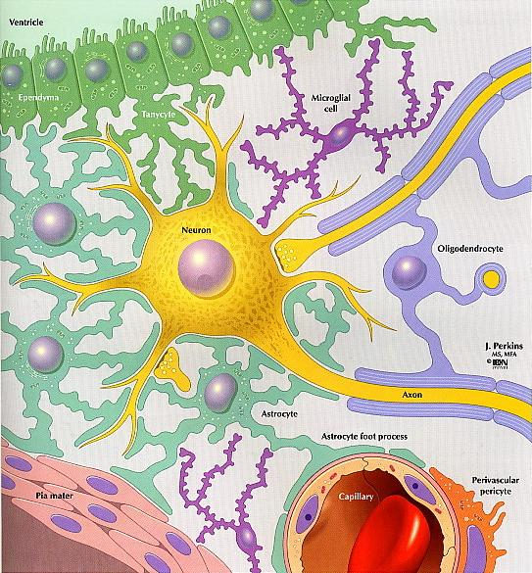
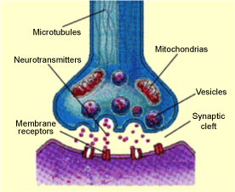
Negative Neural Plasticity
The Peripheral Nervous System (PNS)
  Neurogenic inflammation
  With or without local or systemic damage
  Caused by Central Sensitivity
  Causes Central Sensitivity

Slide 34
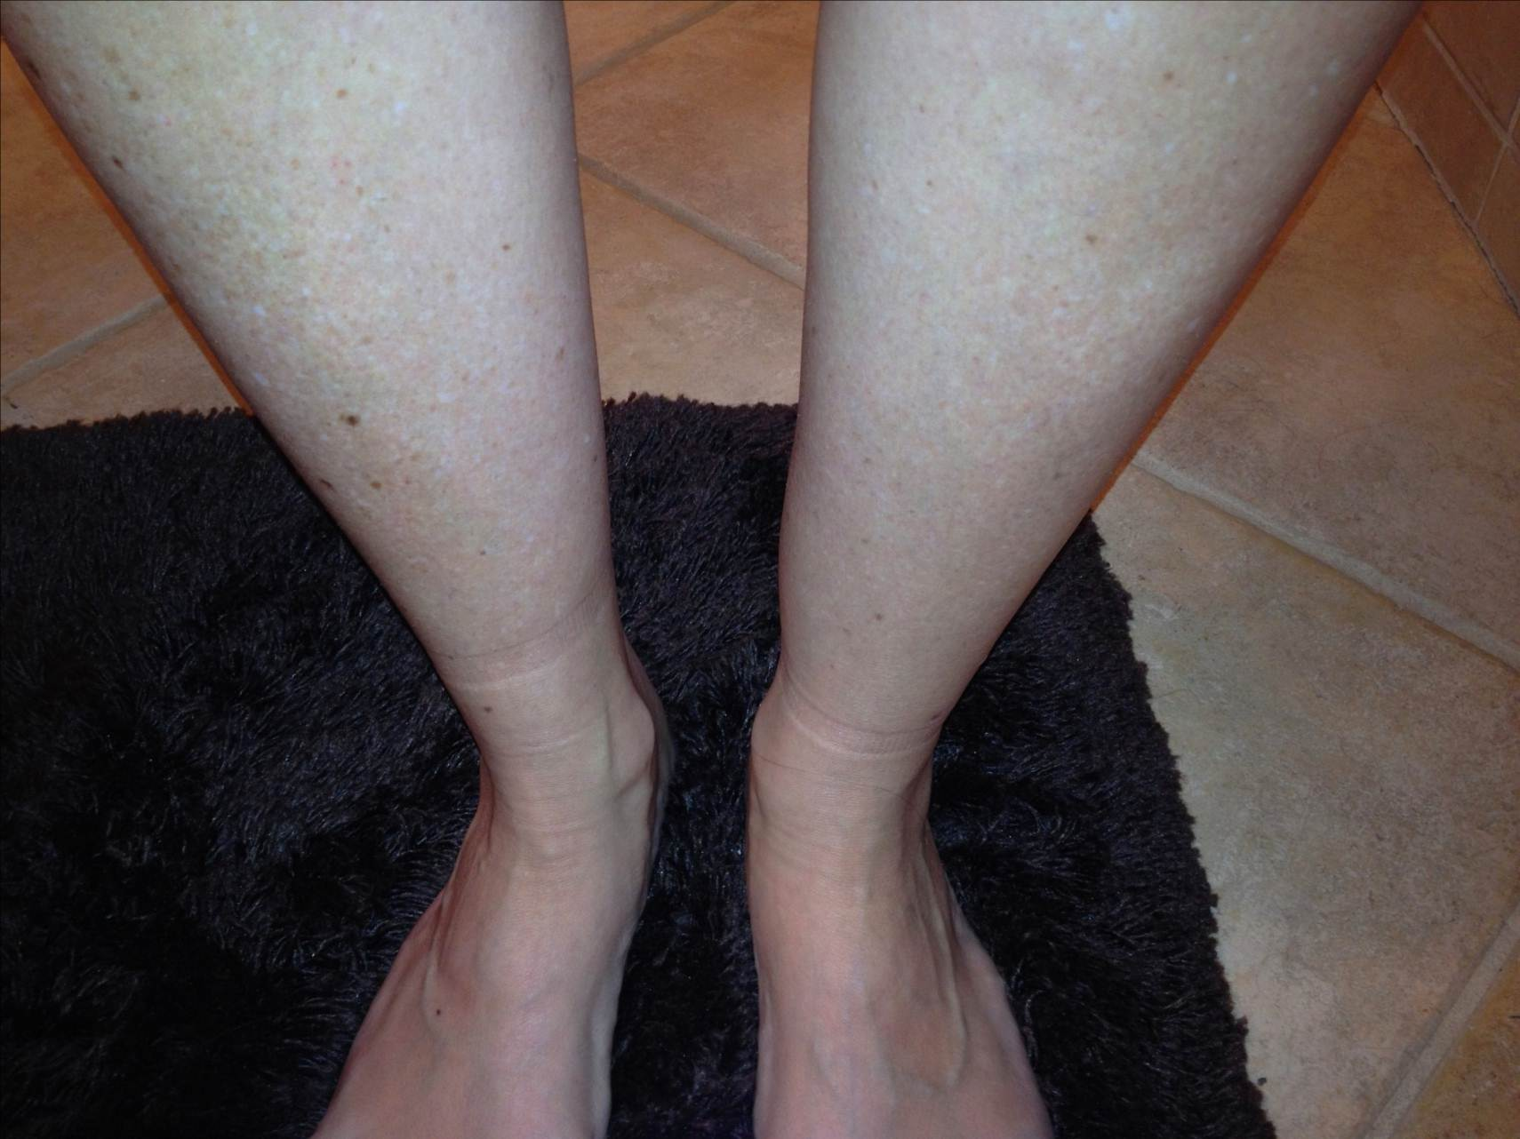
NEUROGENIC INFLAMMATION

Slide 35
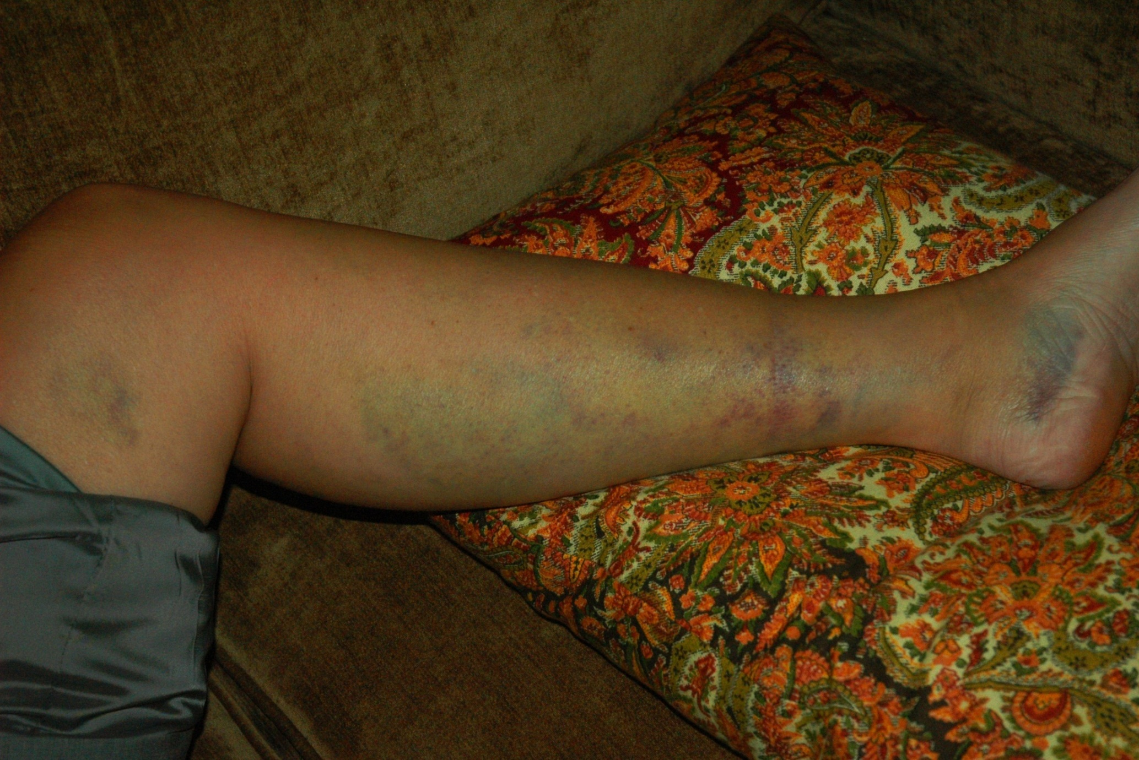
NEUROGENIC INFLAMMATION

Slide 36
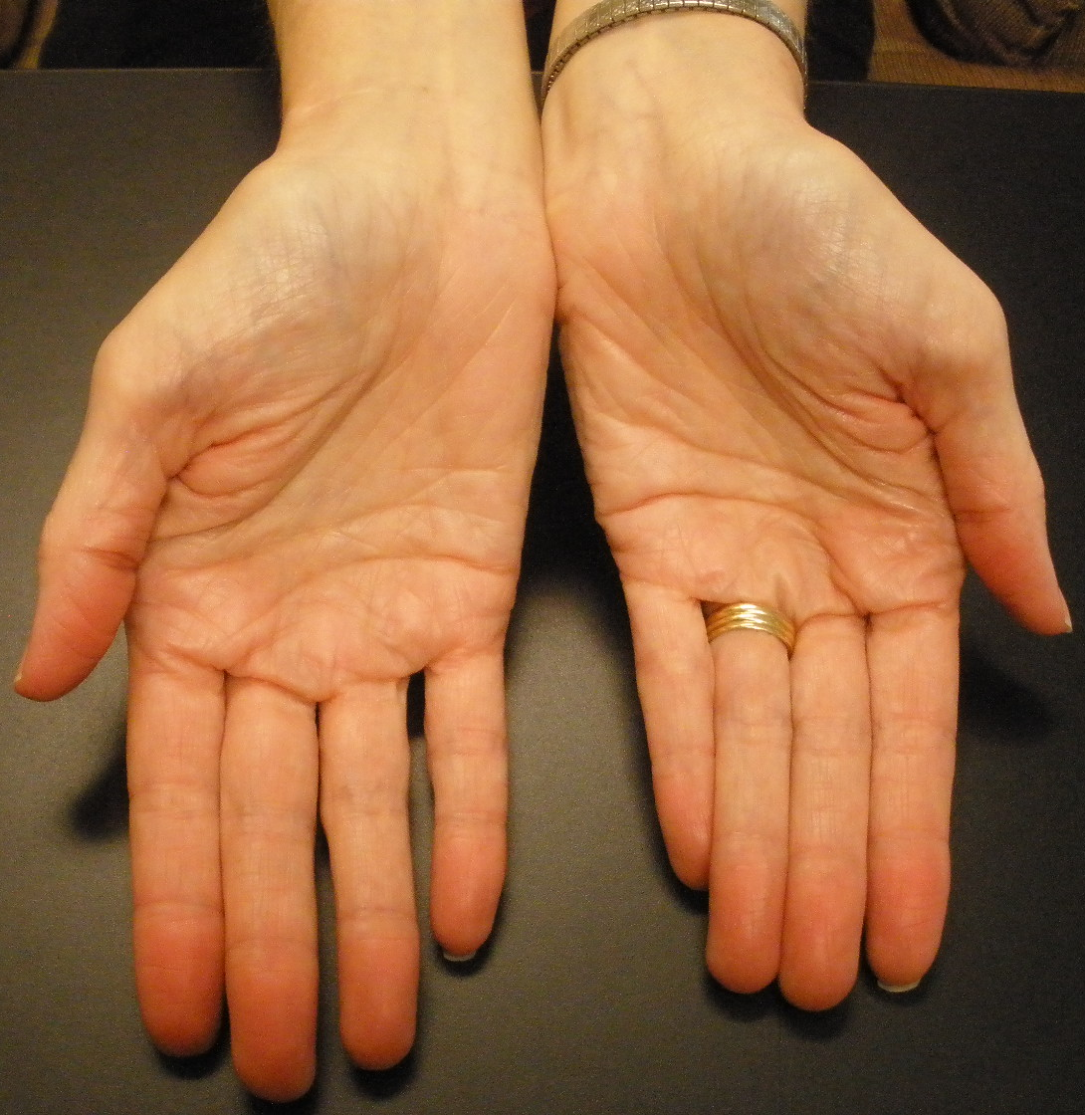
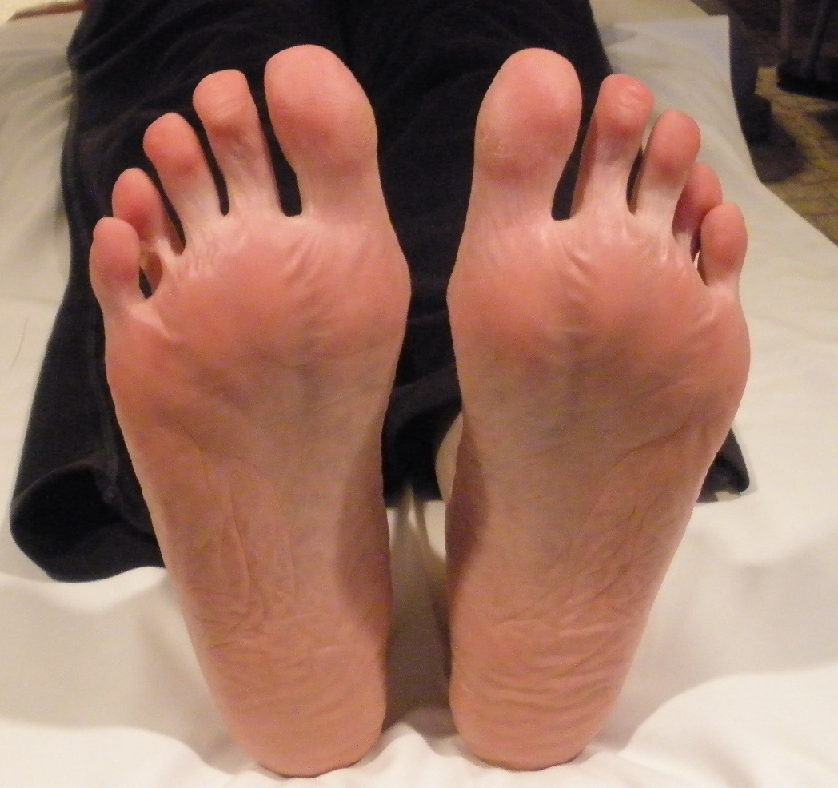
Neurogenic Inflammation
Results in and causes Central Sensitization

Slide 37
Negative Neural Plasticity
ENSLAVES
PAIN ENSLAVES THE BRAIN:
Chronic Flight/ Flight
Memory difficulties
Cognitive difficulties
  Reduced focus
  Impaired problem solving
Emotional biasing and lability
Physical Atrophy in the Brain
  Reduction of “cognitive reserve”
Mao CP, Wei LX, Zhang QL, Liao X, Yang XL, Zhang M. Differences in brain structure in patients with distinct sites of chronic pain: a voxel-based morphometric analysis. Neural Regen Res. 2013;8(32):2981-2990.

Slide 38
Pain ENSLAVES the brain
Brain atrophy in three different clinical populations indicates unique patterns of atrophy
    In chronic back pain, atrophy is mainly seen in the bilateral dorsolateral prefrontal cortex
    In fibromyalgia, atrophy is seen in the medial prefrontal cortex (MFC) as well as in more posterior regions, namely the superior temporal cortex (ST) and hippocampus (HP)
    In chronic tension headache, atrophy is seen in the medial prefrontal cortex, in posterior cingulate regions, and in the brainstem
Conceptual Models for Low Back Pain. Pain Clinical Updates Vol XVIII Issue 6 August 2010 http://www.iasp-pain.org/AM/AMTemplate.cfm?Section=HOME,HOME&CONTENTID=11730&TEMPLATE=/CM/ContentDisplay.cfm&SECTION=HOME,HOME

Slide 39

Virtual Body
Dys-representation
The brain “sees” the painful body part as larger than normal.
The
Elephant’s Foot Story

Slide 40
Virtual Body
Dys-representation
The brain “sees” the painful body part as larger than normal.
Moseley L, Parsons T, Spence C. Visual distortion of a limb modulates the pain and swelling evoked by movement. Current Biology; Volume 18, Issue 22, 25 November 2008, Pages R1047–R1048
Lotze M, Moseley L. Role of distorted body image in pain. Current Rheumatology Reports. December 2007, Volume 9, Issue 6, pp 488–496
Moseley L, Gallacec A, Spence C. Bodily illusions in health and disease: Physiological and clinical perspectives and the concept of a cortical ‘body matrix’. Neuroscience & Biobehavioral Reviews Volume 36, Issue 1, January 2012, Pages 34–46

Slide 41
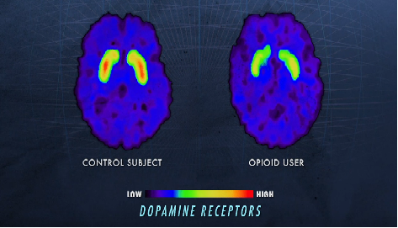
Neural Plasticity

Slide 42
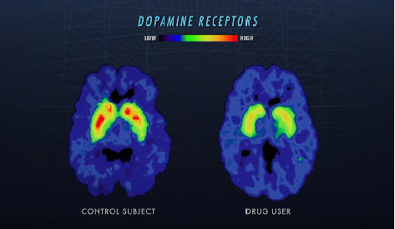
Neural Plasticity

Slide 43
Neural Plasticity +
Augmented Pain States
Definition: Pain that is out of proportion to the type and degree of injury
Dysfunction at home, at work, in recreational pursuits, emotional distress
Decreased libido
Fatigue

Slide 44
Neural Plasticity +
Augmented Pain States
Multiple Medication Sensitivities
Sleep disturbances
Memory complaints
Cognitive disruption and dysfunction
Hyper-arousable to environmental stimuli (internal and external)
  Cognitively/ Limbically Augmented Pain State (“CLAPS”)

Slide 45
Neural Plasticity +
Augmented Pain States
FMS
Failed surgical syndromes; Back, Neck, etc
IBS (any chronic abdominal pain)
CRPS
TMD
Interstitial Cystitis / Vulvodynia
Multiple chemical sensitivity syndromes
Chronic Tension / Migraine/ Mixed Headaches
BASICALLY any pain diagnosis that does not remit with the interventions of standard care
H P Rome Jr, J D Rome. Limbically augmented pain syndrome (LAPS): kindling, corticolimbic sensitization, and the convergence of affective and sensory symptoms in chronic pain disorders. Pain Med 2000 Mar;1(1):7-23. doi: 10.1046/j.1526-4637.2000.99105.x. https://pubmed.ncbi.nlm.nih.gov/15101960/

Slide 46
Negative Neural Plasticity
The Central Nervous System (CNS)
  Dysesthesias
  Photophobia, Phonophobia,
  Dysosmia, Dysgeusia,
  Pseudo seizures / Pseudo strokes
  Fatigue / Sleep disruptions
  Kinesiophobia, Algophobia, Kathisophobia
  Worsening of Mood disorders
  Worsening of Personality challenges/ disorders
  Other stress-related disorders
    Depression
    Anxiety

Slide 47
Negative Neural Plasticity
Autonomic Nervous System (ANS) Changes:
Digestive/ GI changes
Nausea
Dizziness/ Vertigo (Non-BPPV)
Medication sensitivities
Environmental sensitivities
  Weather sensitivities
  Cold
  Heat
  Humidity
Neuro-hormonal Dysfunction
Immune system changes

Slide 48
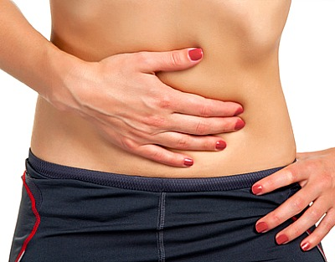
NEUROGENIC INFLAMMATION:
IBS – AKA chronic abdominal pain
Kelsey TL, Tanner-Smith EE, Russell AC, Hollon SD, Walker LS,.Comparative efficacy of psychological therapies for improving mental health and daily functioning in irritable bowel syndrome: A systematic review and meta-analysis. Clinical Psychology Review. Volume 51, February 2017, Pages 142–152
http://www.sciencedirect.com/science/article/pii/S0272735816300915

Slide 49

CENTRAL SENSITIVITY
Central Sensitivity Crosses Every Chronic Pain State & Syndrome

Slide 50

Positive Neuroplasticity
THE FORCE
The Other Side of
THE FORCE
The Other Side of

Slide 51
Positive Neural Plasticity
POSITIVE PLASTIC COMPETITION:
Topographic Proliferation (spread)
Topographic Refreshment
Beneficial Topographic Competition
Physical Proliferation of Brain Cells
  Directed utilization of the “Cognitive Reserve”
  Reclamation of ‘Eudaptive’ Cognitive Processes

Slide 52
Interventional Concepts in Neuroplasticity
Cognizance
Pain Behaviors
Fear/ Suffering
Pain
Awareness
Nociception

Slide 53
Interventional Concepts in Neuroplasticity
Requisites for therapeutic plastic changes
  Enriched Environment
  Getting on a Schedule
  Training
    Neuromuscular
    Social
    Intellectual (all forms of cognitive training)
    Behavioral
    Emotional
  Exercise: Not exclusively, cardiovascular exercise
Mora F, Segovia G, del Arco A. Aging, plasticity and environmental enrichment:
Structural changes and neurotransmitter dynamics in several areas of the brain.
Brain Research Reviews Volume 55, Issue 1, August 2007, Pages 78–88 doi:10.1016/j.brainresrev.2007.03.011

Slide 54
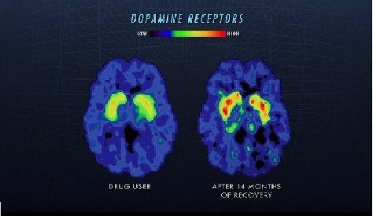
Neural Plasticity

Slide 55
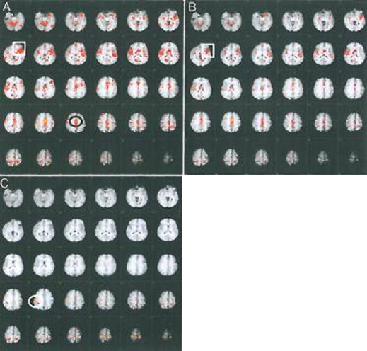
Interventional Concepts in Neuroplasticity
PAIN NeuroSCIENCE EDUCATION
A = immediately after initial instruction in the abdominal isometric contraction
B = after one week of daily practice x 5 minutes every hour of the abdominal task
C = after 2.5 hours of 1:1 pain physiology education (education performed right after the second scan)
Our Changing
Brain!

Slide 56

Interventional Concepts in Neuroplasticity
PAIN MANAGEMENT EDUCATION Components:
Pain is NORMAL
Clear information about Hurt vs Harm
Reassurance that “it’s not just in your head”
Explanation of the adverse changes in the NS
Reassurance that you (the clinician) know it is real and there is science to show it
Reassurance that the NS does change
Reassurance that Opioids are not the solution ( but can be the problem)
Assurance that there are effective ways to make it better
Assurance that making changes makes changes
but can
better

Slide 57
Victor T. Chang, MD; Brooke Sorger, PhD; Kenneth E. Rosenfeld, MD; Karl A. Lorenz, MD, MSHS; Amos F. Bailey, MD; Trinh Bui, PharmD; Lawrence Weinberger, PhD; Marcos Montagnini, MD, FACP. Pain and palliative medicine. Journal of Rehabilitation Research & Development Volume 44, Number 2, 2007: 279–294
Moseley L. Widespread brain activity during an abdominal task markedly reduced after pain physiology education: fMRI evaluation of a single patient with chronic low back pain. Australian Journal of Physiotherapy, 2005, v 61
Erickson KI, Voss MW, Prakash RS, et al. Exercise training increases size of hippocampus and improves memory. Proc Natl Acad Sci U S A. 2011;108:3017-3022.
The Fear-Avoidance Model of Pain in a Treated Clinical Sample. Adam J. Guck, M.A., Giuseppe C. Siracusano, DPT, P.T., Kimberly S. Kelly, Ph.D., Thomas P. Guck, Ph.D. Society of Behavioral Medicine Conference March 2013 San Francisco, CA
Speed-Walking: Evaluation of a Strategy to Reduce Fear/Avoidance Beliefs and Learned Pain Behavior in Patients with Chronic Non-Cancer Pain. Abstract Control number: 1866 Guck A, Siracusano G, Guck T September 2, 2010 at the International Association for the Study of Pain 13th World Congress on Pain; Montreal, CAN

Slide 58

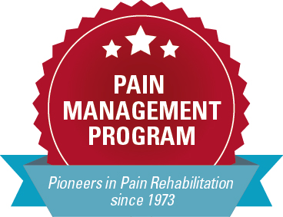
Features of Pain Rehabilitation
Making POSITIVE and VOLUNTARY PLASTIC CHANGES
by using the
PAIN MANAGEMENT FORMULA

Slide 59
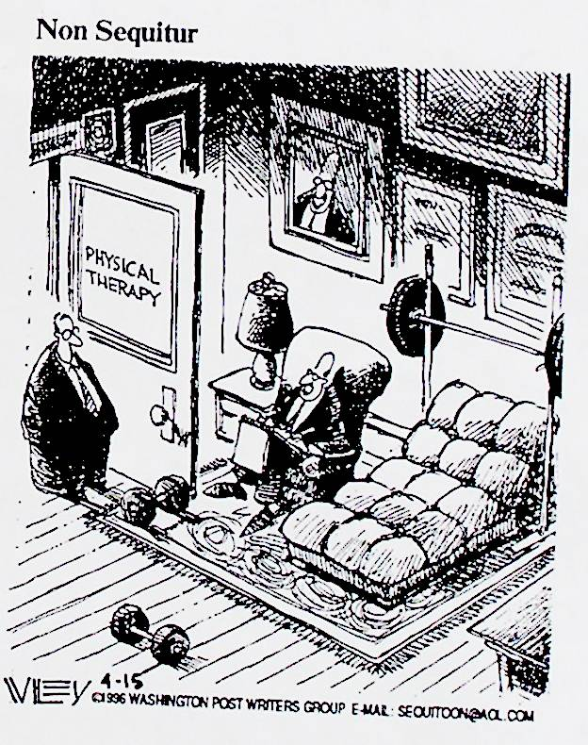

Slide 60

PAIN MANAGEMENT FORMULA
  Pain Science/ Management Education
  All forms of appropriate exercise
  Pacing physical activities
  Get on and stay on a schedule
    That includes Sleep Hygiene
  Mood management
    CBT
    Communication
    Counseling
    Relaxation exercises
    Getting your needs met
      Change your friends/ playground?
      “Brains need other (healthy) Brains”
  No narcotics for chronic pain
  Ice

Slide 61

Who Needs Pain Rehabilitation?
Who Needs Pain Rehabilitation?

Slide 62
When is the right time to recommend Pain Rehabilitation?
When the patient’s pain is refractory to medical interventions
When functioning continues to decline or does not improve
When a patient may be experiencing medication induced hyperalgesia and/ or problematic rebound pain
When the patient exhibits motivation to try alternative treatment options
When it appears that a patient is at risk of developing a chronic pain syndrome or has already done so
When a patient has chronic pain syndrome
    About 25% of people with chronic pain will develop a chronic pain syndrome.

Slide 63
Common Misconceptions about Pain Rehabilitation
Only Persons using narcotics need pain rehabilitation
Only Persons who abuse narcotics or other mood altering substances are candidates for pain rehabilitation
Only Persons who are addicted to substances are candidates for pain rehabilitation
Only Persons who are non-functioning or nearly non-functioning are candidates for pain rehabilitation
Medication Contracts are always sufficient
Physical therapy referrals alone are always sufficient
Psychology referrals alone are always sufficient
A referral to Pain Medicine Services alone is needed

Slide 64
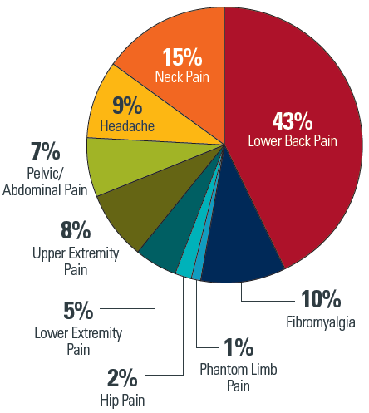
Pain Diagnoses Addressed at a Pain Program

Slide 65
Pain Rehabilitation Team
The Team
Patients
Physical Therapists
Nurses
Clinical Psychologists
Physicians

Slide 66
Barriers
Age and/ or Stamina
  Even 86 yr olds have completed the program successfully!
  As young as 13 years old have been
  treated in the program
Schedule
  This is necessary for positive neural plasticity and improving your ability to manage your pain
Distance
  Housing is provided
  Program Telehealth Version is available
Family Obligations/ Childcare / Pet-care
  Family specific, but there usually are resources within the family
  Program Telehealth Version is available

Slide 67
More Barriers
Fear of Medication Taper
  The Medical Provider is the best source of information and support for the necessity of a pain medication taper
  Suboxone/ Buprenorphine programs
Work Obligations
COVID-19
  Program Telehealth Version is available
Time
  The time investment now will reduce your time taken for medical pain interventions

Slide 68
Inquiries / Support Materials / Referrals:
Call (402) 559-4364
cpmp@nebraskamed.com

Slide 69

Notes:
Note: This is an optional ending slide you may use if desired.

