Slide 1
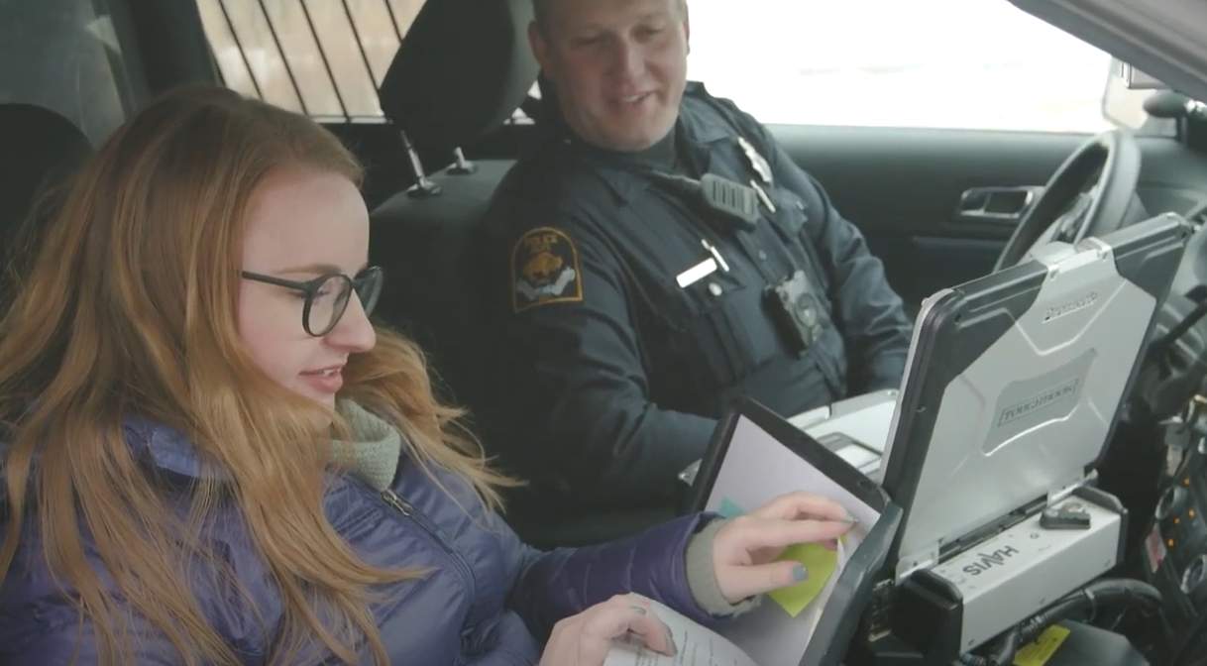
PARTNERS IN TIME: LAW ENFORCEMENT & BEHAVIORAL HEALTH COLLABORATION
Francis Gantner,
LIMHP, NCC, MA, BS

Slide 2
WHICH CATEGORY BEST DESCRIBES YOU?
When caring for community mental health…it takes a village.
A. Healthcare
B. Behavioral Health Professional/ Social Work
C. Law Enforcement
D. Student
E. Other

Slide 3
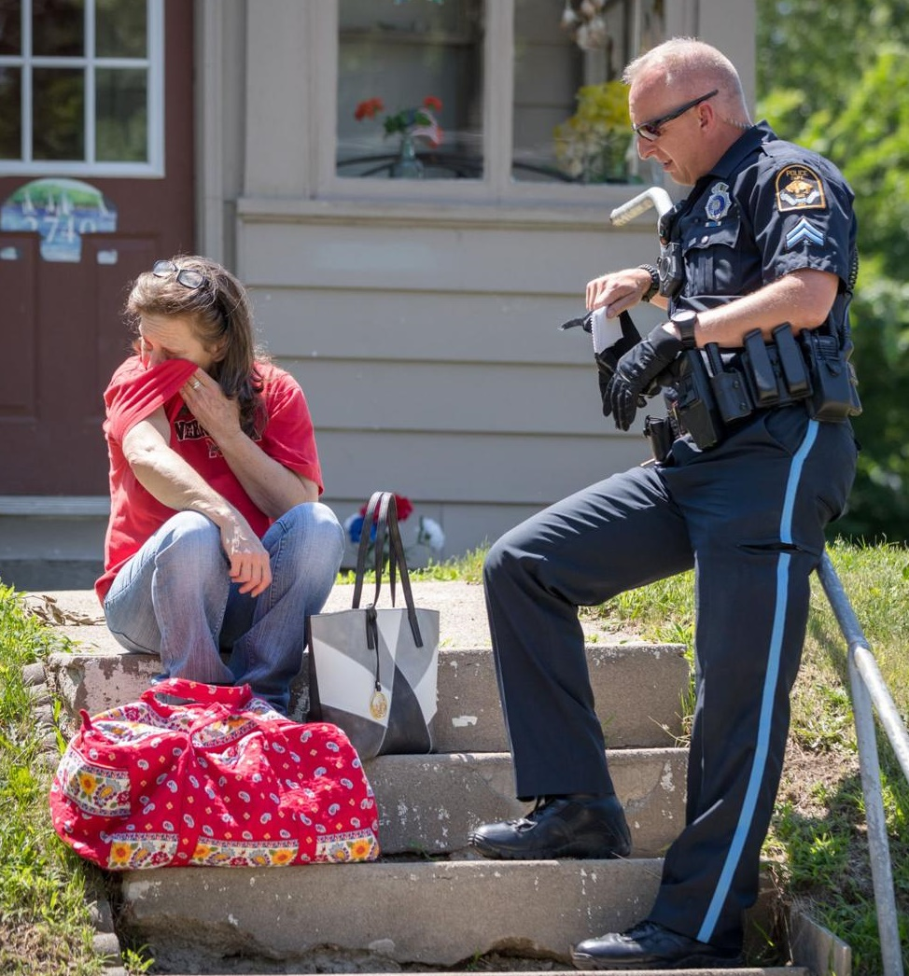
Why Law Enforcement & Behavioral Health Collaboration?
CHAT: What are your thoughts on why officers choose a career in law enforcement?

Slide 4
OFFICERS OFTEN 1ST TO RESPOND TO:
Behavioral Health Crisis
Suicidal/Homicidal Thoughts
Psychotic Symptoms
Bizarre behavior
Substance misuse/Overdose
Anxiety/Panic attack
Behavioral disturbance
Inability to care for basic needs (i.e. food, shelter, clothing, essential medical care, safety)
Inappropriate sexual behaviors
Calls W/ Behavioral Health Component
Emotional Distress related to:
Car Accident
Physical/Sexual Assault
Domestic Violence
Custody Battles
Death Notifications
Individuals with Mental Illness victimized due to perceived vulnerability

Slide 5
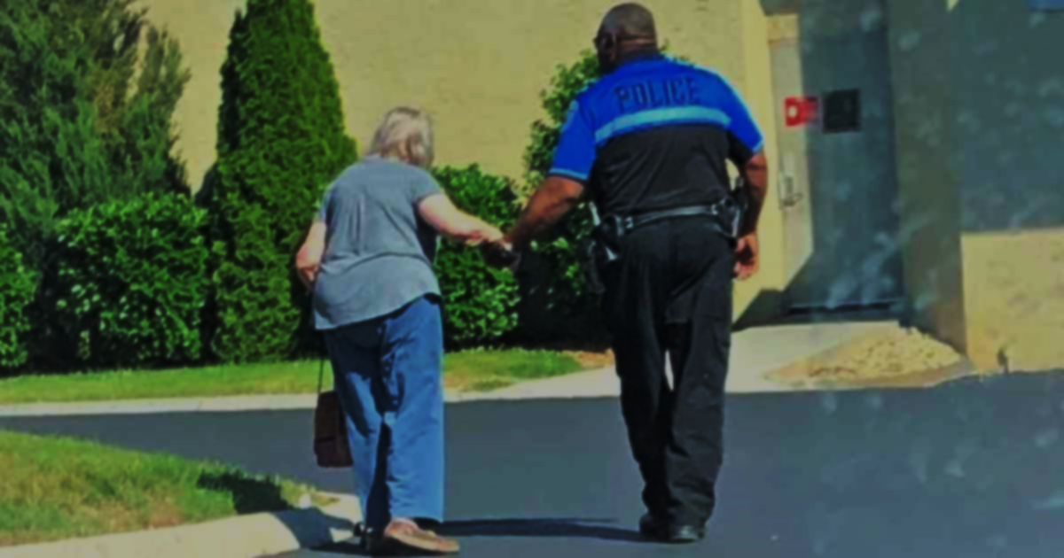
911 CALLS & OLDER ADULTS:
High regard for law enforcement *
Less likely to seek mental health treatment due to increased stigma *
Dementia-onset *
Confusion
Paranoid delusions
Hallucinations
Long-term substance misuse now resulting in medical complications *
Medical reasons for mental health related symptoms
Medication side effects
Urinary tract infections
Lack of understanding and education on opiate misuse (i.e. “My doctor prescribed it so it’s okay”)
Age-specific social stressors
Grief over loved ones
Diminished social supports *
Loss of independence *
Cognitive/Physical Decline *
Physical illnesses (including terminal) *
COVID concerns
Highest rate of death by suicide among older white males *
*Case Study- “Jack”
Notes:
Case study: Jack (RB), white male in his late 50s…lost his career in the medical technology field 10 years prior due to medical condition, loss of independence, loss of dignity, no longer felt comfortable socializing with those still in their careers, no social supports by the time I met him, alcohol use disorder beginning around loss of job, embarrassed of SUD and MI symptoms, denied SI however I often wondered if he was too embarrassed to admit the depth of the depressive struggle, cognitive decline, high regard for LE (often would refer to them as “hero”) and called often

Slide 6
OFFICER MH RESPONSIBILITIES
Respond immediately and appropriately to individuals often in the most severe phase of their mental health symptoms
Emergency Protective Custody
With little to no training on:
Identifying mental illness
Trauma-informed care
Autism & intellectual disabilities
Community resources
Suicide risk factors
Dangers associated with specific mental health symptoms
Without behavioral health collaboration and training are we setting our officers up for failure?

Slide 7
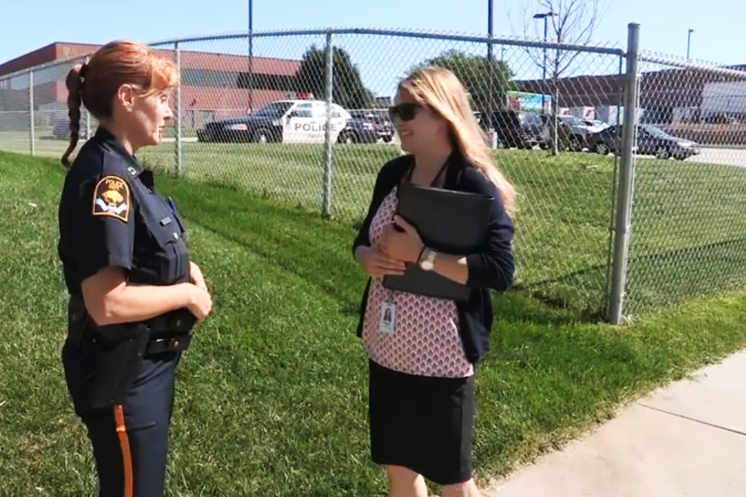
How can Law Enforcement & Behavioral Health Best Collaborate?
Lutheran Family Services & Omaha Police Department team up to offer best outcomes for those experiencing mental health crisis in the community.

Slide 8
CRISIS RESPONSE TEAM: Lutheran Family Services of Nebraska
On-call clinician available 24/7/365
Dodge, Douglas, & Washington counties
Telehealth
Assist in:
Jail & hospital diversion
Advise officers on need for EPC
Link individuals to appropriate community resources
Safety planning
911 call reduction by more holistic approach
Seamless link to in-house post-crisis services
Therapy
Medication management
Case management (partnership with Salvation Army)
Peer Support Specialist
Co-Responders collaborate with Omaha Police Department
Prescription lock box & handgun safe utilized in safety planning.

Slide 9
OMAHA, NE: Behavioral Health & Wellness Unit (BHWU)
Omaha Police Department utilizing mental health professionals to more effectively respond to crisis calls.
Lindsay Kroll,
LIMHP, NCC
OPD Mental Health Coordinator
Sgt. Jason Heft,
Mental Health & Wellness Unit Supervisor

Slide 10
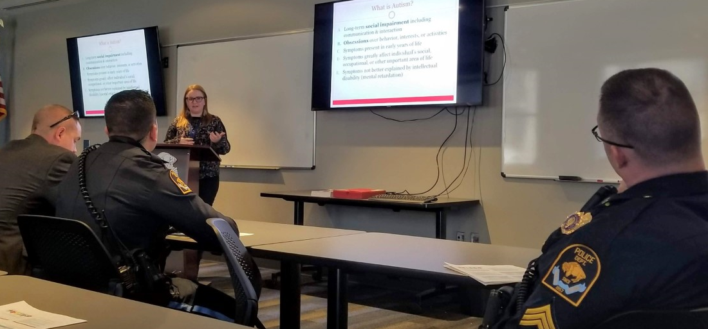
OMAHA, NE: Co-Responder Program
Masters-level clinicians embedded in police precincts
Self-dispatch or requested to scene via police radio
Engage in formal and informal training of officers
Formal trainings: Autism, Naloxone administration, Resources for youth, APS,
Informal trainings
Proactive outreach- Case Study: “Pamela” paranoid delusions
Care Coordination- Case Study: “Richard” 75 y/o veteran, social isolation, paranoid delusions, depression
Co-Responder leads OPD officers in Autism training- learning how this diagnosis can impact 911 calls as well as how to best respond.

Slide 11
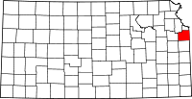
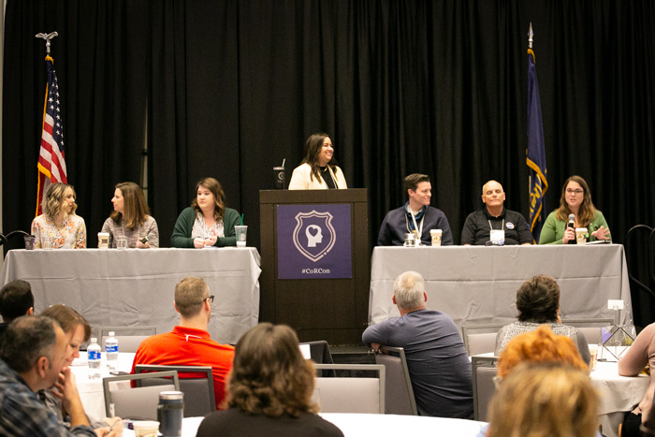
JOHNSON COUNTY, KS: Co-Responder Program
“The right intervention at the right time”
Celebrating 9 years
11 full-time Co-Responders dispersed over several police departments
School Co-Responder pilot program launched in July 2019
Involvement in death notifications & outreach to suicide survivors
Hosted 1st Annual Co-Responder Conference (CoRCon)
Funding through alcohol tax dollars as well as investments from participating police departments
Johnson County hosts the first ever Co-Responder Conference in February 2020.

Slide 12
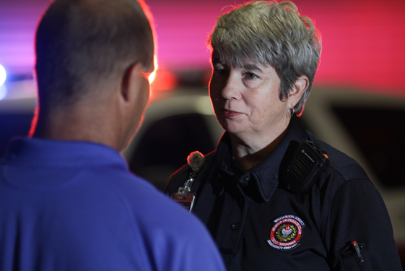
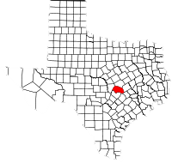
WILLLIAMSON COUNTY, TX: Mobile Outreach Team (MOT)
Celebrating over 15 years of law enforcement assistance
Teams of paramedics, social workers, and masters-level clinicians
Self-dispatch or initiated by dispatch or officer request
Opiate Risk Reduction Programs:
Community-Wide Trainings
Post-Overdose Follow Up
Connection to resources (Often MAT treatment)
Older Adults Response:
Altered mental status
Alcohol misuse- Case Study: “Lauren” in early 70s
Success with Older Adults:
Coordination with medical professionals
Harm-risk reduction

Slide 13
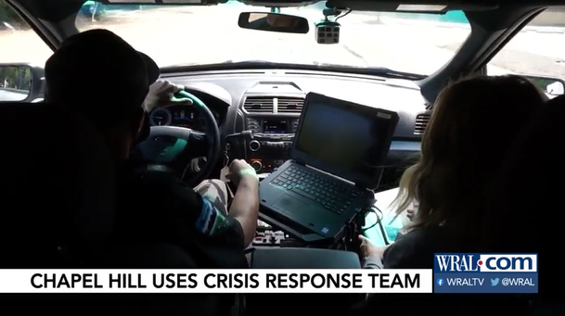
CHAPEL HILL, NC: Crisis Response Team
Unit began in 1973
Officer training
Required: CIT and ongoing in-service
Co-Response in-house trainings
Embedded Co-Responders provide 24/7 on-call coverage
Respond to:
Intimate partner violence/sexual violence
Victims of crimes
Psychiatric emergencies
Homicidal or suicidal persons
Runaway juveniles and missing persons
Hostages or barricaded persons
Stalking or harassment
Death notifications
Older adult case study: “Mary” frequently called on by passerby's for wandering while under influence of alcohol

Slide 14
CRISIS INTERVENTION TEAM TRAINING (CIT)
Began in Memphis, TN following tragic event
Celebrating over 30 years
Volunteer basis
Traditionally 40 hours of training
De-escalation skills and behavioral health education
Connection to community resources
Shown to reduce violent outcomes to 911 calls
CIT: Teaching Police How to Respond to a Mental Health Crisis – National Alliance on Mental Illness
Notes:
https://www.youtube.com/watch?v=-net9xEotXc&pp=QAA%3D

Slide 15
CIT HEARTLAND CHAPTER: Intro
Available to
Collaborative approach: service providers, peer supports, families, law enforcement, & community resource representatives
Available 4 times a year
Supplemental one day training with focus on youth

Slide 16
CIT HEARTLAND CHAPTER: Curriculum
Monday | Tuesday | Wednesday | Thursday | Friday
Overview of Mental Illness | Active Listening/ De-Escalation | Consumer Perspective | Mental Health Commitment Act | Family Perspective
 |  |  |  | Mental Health in Older Adults
Psychotropic Medications | Suicide | Site Visits Lasting Hope Orchard House Heritage Center Campus for Hope | Compassion Fatigue | Cultural Competency
Trauma | Development Disabilities |  | Scenario Based Training | Community Resources LOSS Team Safe Harbor Lasting Hope Mobile Crisis NE Family Helpline SAFE-T
Children & Adolescents | Crisis Intervention, Negotiation, & Tactical Aspects
WRAP: Wellness Recovery Action Plan | Critical Incident Debriefing | Last Site Visit- Douglas County Corrections | Auditory Hallucinations Experience | Scenario Based Training (cont.)

Slide 17
CIT HEARTLAND CHAPTER: Mental Health & Older Adults Presentation
Delirium
Hallmarks
Common causes
Dementia
Causes
Symptoms
Depression
Symptoms
Special considerations for older adults
Suicide risk
Drugs
Prescribed medications (i.e. opiates, benzodiazepines)
Alcohol
Driving- Case Study: “Linda”
Dr. Steven Wengel, M.D., specializes in geriatric psychiatry.
Notes:
Linda: backed

Slide 18
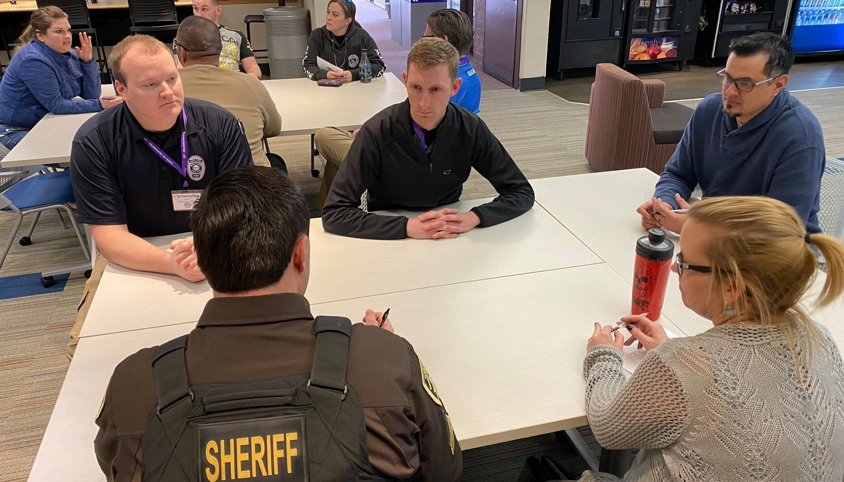
CIT HEARTLAND CHAPTER: Scenario-Based Training
Mental health crisis scenarios
Manic artist
Veteran with alcohol use disorder
Suicidal individual on bridge
Family disturbance
Suicidal individual w/ cuts on wrist
Individual experiencing paranoid delusions
Evaluated by law enforcement officer, mental health therapist, and peer support professional
Officers practice listening & de-escalation skills
Emphasize different outcomes
Hospital/Jail diversion
Connection to appropriate resources

Slide 19
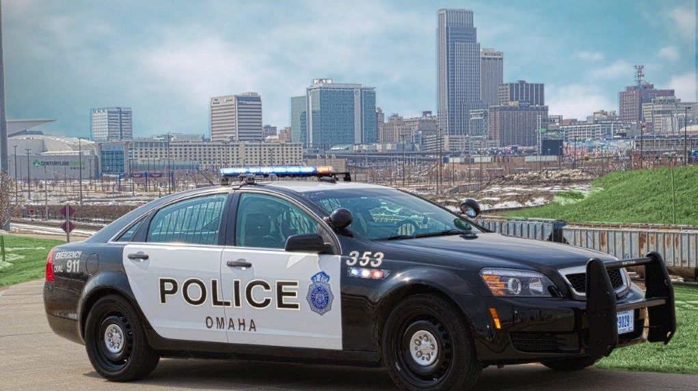
APPLICATION: Moving Forward
Medical & Mental Health Professionals
Law Enforcement
Volunteer to assist in officer training
Encourage consumers to complete WRAP plans:
“The most useful information I learned at CIT was about WRAP plans. This takes a lot of guess work out of responding to an individual in crisis. I now ask about WRAP on every mental health call I respond to.” – Ofcr Jaworski (OPD)
Apply for crisis response positions!
Utilize the behavioral health resources available in your department and community
Participate in mental health trainings such as CIT and Mental Health First Aid
Collaboration and training shown to
Reduce 911 calls in the long run
Reduce violent call outcomes
Increase best outcomes for civilians

Slide 20
APPLICATION: Moving Forward (cont.)
Students
All
Consider a career in law enforcement or crisis counseling; educate yourself in both fields to be well-rounded professional
Request CIT officers and/or crisis therapist when calling 911 for a behavioral health crisis
Be detailed in your description of the crisis
Participate in a ride-along to better understand the unique challenges officers face everyday

Slide 21
REFERENCES
CIT Heartland Chapter. (2020). Retrieved August 12, 2020 from https://heartlandcit.org.
Fisher, J. (2020 July 10). Chapel hill mental health counselors help police officers respond to 911 calls.
Jaworski, A., personal communication, 2020, September 3.
Johnson, M., personal communication, 2020, September 21.
Kroll, L., personal communication, 2020, September 21.
Limoges, E., personal communication, 2020, September 17.
Luetzen, K. (2020, August 22). Omaha Police Department starts pilot program aimed at addressing mental health crisis calls.
Lutheran Family Services. (2016, Febuary 19). Retrieved August 12, 2020 from https://lfsneb.org.
Lutheranfamilyservicesofnebraksa. (2020, March 31). Lutheran Family Services crisis response services and intervention program. YouTube. https://www.youtube.com/watch?v=rU8lFORaLzI
Omaha Police Department. (n.d.) Retrieved September 3 2020 from https;//police.cityofomah.org
McDowell, S. (2020 July 29). More mental health co-responders joining Johnson County law enforcement.
Munetz, M. R. (2012, September 21). The CIT program: More than training, more than a specialized police response.
Murphy, J., personal communication, 2020, September 18.
NAMI. (2015. October 26). CIT: Teaching police how to respond to a mental health crisis. YouTube. https://www.youtube.com/watch?v=-net9xEotXc&pp=QAA%3D
Sledge, D., personal communication, 2020, September 18.
Wankum, L. (2020, March 12). Mental health professionals discuss client confidentiality, uniform choice, funding issues at first National Co-Responder Conference.
Wengel, S., (2018, August 24). Common Mental Health Problems of Older Adults. Heartland Chapter Crisis Intervention Team Training, Omaha, NE.
Wesley, R., personal communication, 2020, September 10.

Slide 22
CONTACT
Francis Gantner, LIMHP, NCC
✆ : 402.444.6863
📩 : LTHOMAS@
REGIONSIX.COM
💻 : Add us on Facebook! NebraskaMHAC
📫 : 4715 S 132nd St,
Omaha, NE 68137
✆ : 402.899.0387
📩 : FRANNY.GANTNER@
GMAIL.COM
💻 : Add me on LinkedIn!
Francis B. Gantner

