Slide 1
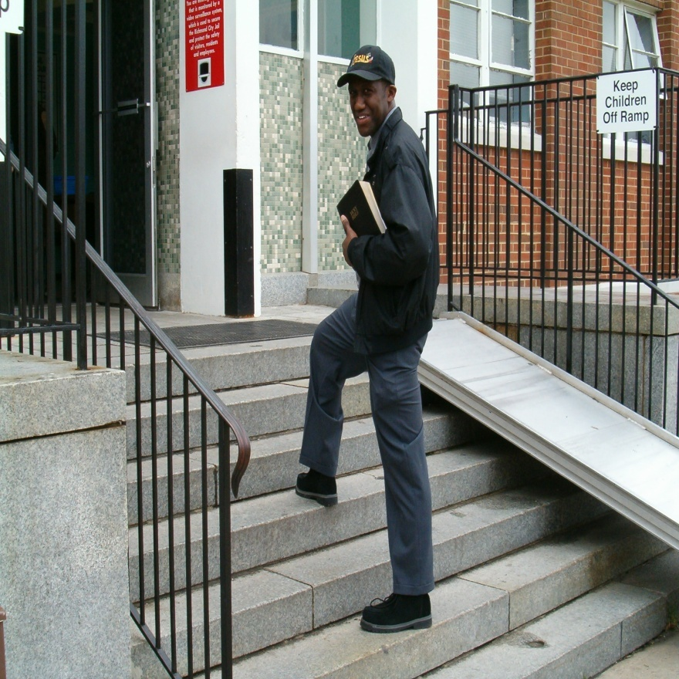
Creating Your Own Prison Ministry
By Chaplain William D. Holmes
Founder and President of the Heaven Bound Train International Prison Ministry

Slide 2
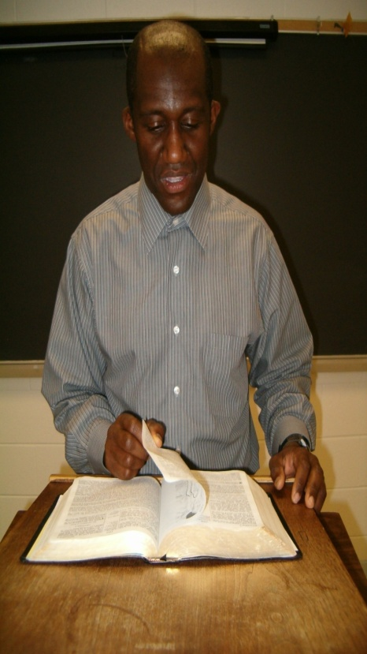
Objectives
Encourage spiritual growth
Spread the Word of God to the Incarcerated
Build up your confidence
Aid you into having an effective ministry
Encourage you to work faithfully for Jesus
Teach you wisdom how to gain favor with public officials

Slide 3
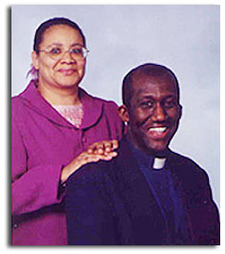
Introduction
The Lord has called me into prison ministry to be a blessing unto all of those who are incarcerated throughout the United States and Canada. Also in different parts of the world. With my lovely wife Sister Velvet by my side, our goal is to share the love of Jesus with the prison bound and demonstrate the power of God How God can change lives forever and heal your sick body. We want to help all of the local Chaplains at the Institutions we meet. This work is large and we cannot do it by ourselves. So we encourage all of you who are led into this field to work for Jesus. The purpose for this presentation is to help you organized an effective ministry. Help it to grow. Most of all that the prisoners get to turn from crime and sin by knowing the Lord Jesus as their personal Lord and Saviour.

Slide 4
Chaplain William Holmes
Graduate of Department of Criminal Justice with sevens years experience of working with state prisoners
Graduate of Criminal Justice Academy with twelve years of law enforcement experience.
Received training in chaplain services and graduate of chaplaincy program.
Graduate of ECPI College with an associate degree in Criminal Justice and minor in computer science
Currently completing Bachelor’s Degree in Criminal Justice with minor in computer science.

Slide 5
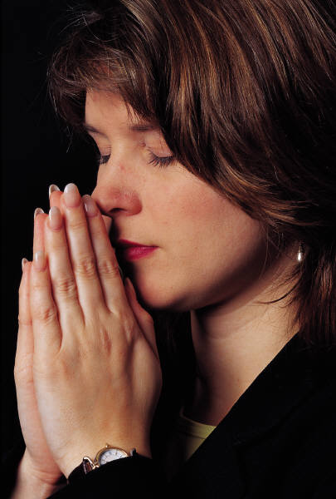
The Beginning
The first step is to have a calling from God-This is a ministry that is different from all other ministries. You must be dedicated in soul,mind,body and spirit. It takes much prayer, fasting and seeking God for spiritual strength. For you are going to need it when you face the prison environment. It can be a rough and challenging one. Inmates may refuse you but you must be dedicated to move on because there is someone who wants to do right.

Slide 6
Life Inside of a Prison
Life in a prison is different from life in the free world. Prison is a control environment. It is a community within itself. They have their own stores, barbershops, beauty salons, jobs,gyms, chapel for services of different faiths, schools, galleys to eat their meals. But it is on a smaller scale compared to the free world. Then when they violate a prison rule they are locked down in the inner prison. Jail within the prison. Each prison system varies.

Slide 7
Life Inside A Prison
You have prisoners of all types, some have mental problems, some are depressed and suicidal. Some have committed horrible crimes that are unimaginable. You must be able to reach those individuals not talking down to them but giving them hope to live and sharing with them the love of God. Do not try to offend any one but show them love and concern through Jesus.

Slide 8
Entering The Prison
Some institutions differ from others so check with the institution and see what their rules are in order to be accepted to come inside. Some institutions may require you to go through some training in chaplain work. Some institutions may not. So you have to check to see. If you have any relatives in the institution you want to visit let the staff know. Always be honest because do not be caught doing something against the rules!

Slide 9
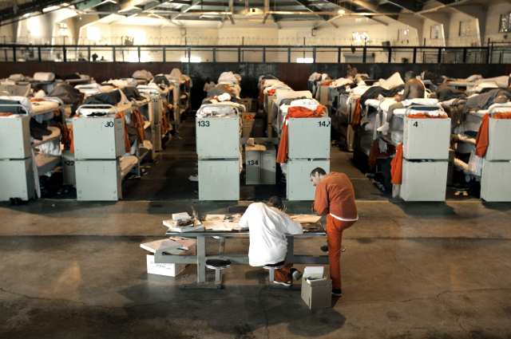
Entering a Prison
You need to contact the chaplain or administrator of the facility and fill out the necessary paper work. You will probably have a background investigation. Be true and cooperate. Follow all Intuitional rules and build your trust with staff. If you have a group submit all their names to be investigated. I stress cooperation with staff in the right manner.

Slide 10
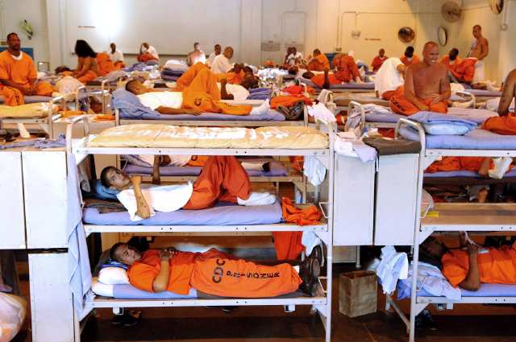
Entering a Prison
Once approved only do what you are allowed to do. If any changes occur let the institution know immediately. Abide by all rules of the Institution. Only bring approved materials and be ready at anytime to be searched. Be familiar with the prison’s search policy. Know what is not allowed in the prison (contraband) refrain from it.

Slide 11
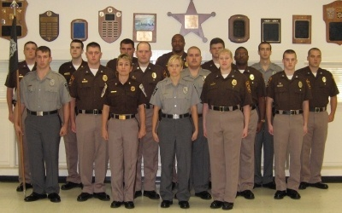
Dealing With Staff
Be cooperative and polite
Have proof of your approval to be there
1.Written paper signed by Administrator or head Chaplain
2. Proper Identification
All material you bring in make sure you take it out.
Request a staff to escort you throughout your visit. Your safety is Key to your success.
All Security matters are handle by the staff. Stay clear of any matters involving security.

Slide 12
Dealing With Inmates
Never do favors for Inmates that will violate prison rules.
When Counseling Inmates all information is confidential except when it involves criminal activity that will disrupt the prison. Then pass it on to reliable Staff. Respect their privacy.
Treat all Inmates the same. Have no respect of a person.

Slide 13
Dealing With Female Prisoners
It is part of my ministry to minister unto the many women who are behind prison bars. As you enter into this type of work you will find both male and female prisoners. So I advise you treat all female prisoners professionally at all times. Women have so many issues. Some are hurt due to drugs, abuse, prostitution, alcohol or domestic issues. They need to be consoled with seasoned words inspired by The Holy Ghost. Show love and concern as Jesus would. Give them hope for a new life in Jesus. Be there for them but do not get too personal with them.

Slide 14
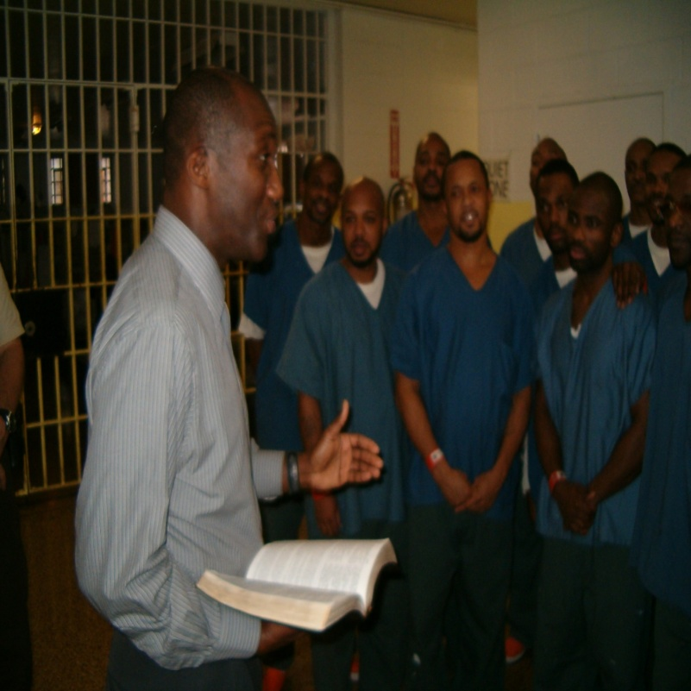
Worship Services with Inmates
When conducting your services be mindful you are in a prison setting.
Preach Jesus but I caution you not get into arguments with other faiths ( Muslims, Jehovah Witness, Catholics, Mormons, etc.)
In you services Never mention a religion name. If Inmates ask you directly tell them you preach and testify of Jesus and His love. You have no comment on other religions. If they seek additional information refer them to the prison Chaplain. You know about salvation through the Blood of Jesus. That is your message. The power of the Holy Ghost and Fire.

Slide 15
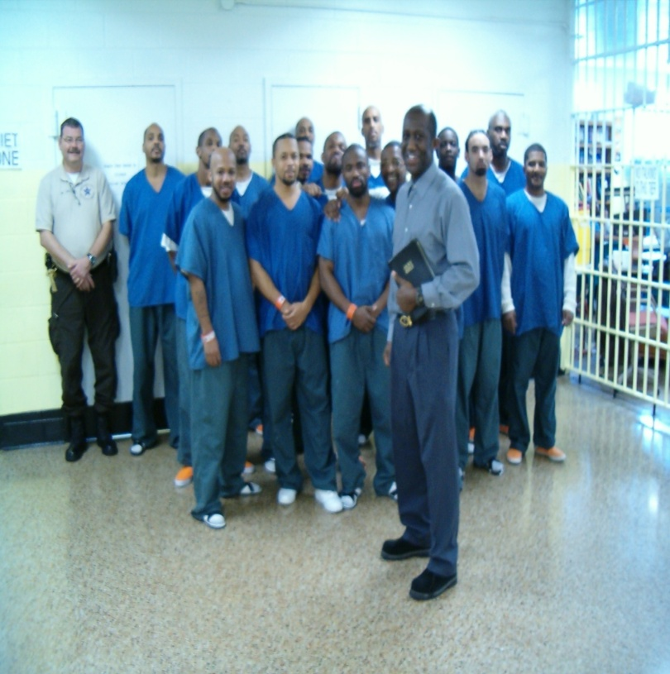
Worship Services with Inmates
Pray for them and demonstrate the power of God through healing, miracles, souls being saved and the Holy Ghosts falling in the service. Remember the prison setting so do not try to conduct the service like a church service in the free world. Conduct it with moderation. We are just there to give them a sample. When they get out the can enjoy the whole deal!

Slide 16
Doing One on One Counseling
It is necessary to visit all those who are locked in the inner prison who cannot come out for service. Provide one on one counseling. Listen to their concerns and answer their questions with love and consideration. Minister unto them, preach Jesus and pray for them. Do not pass items to them without the approval of staff. Do not accept favors from the Inmate. If you are not trained do not give legal advice to the Inmate. If an inmate refuse to hear you move on to the next one. Do not get into any arguments and do not force your faith upon anyone.

Slide 17
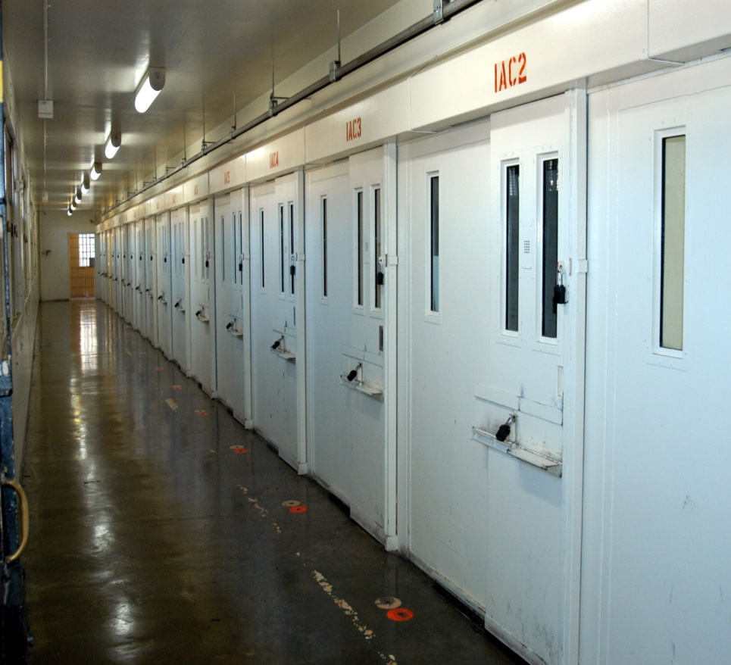
Inmates on Death Row
This is a part of my ministry which is very heart touching. Inmates who are near the end of the road of life needs the most help. This area require plenty of prayer and have your words seasoned with salt When you counsel a person on death row do not get into the argument whether they are innocent or guilty but show them Jesus love and forgiving spirit. Tell them that Jesus was sentenced to die for a crime he did not commit. Show them how that Jesus can help them to forgive themselves and the families of the victims. Encourage them to get their life right with God so they may have a home in Heaven. One day we all must leave this world. Be there for them and pray for them. Again I stress offer no legal advice unless you are trained.

Slide 18
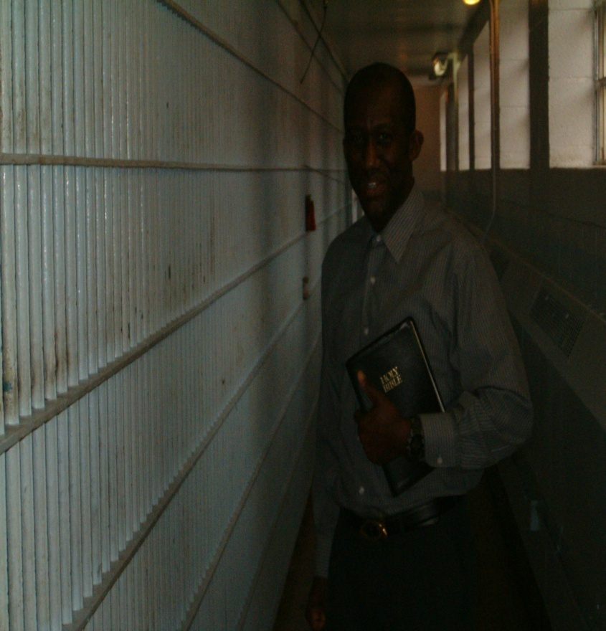
Conclusion
I feel that if you follow theses guidelines you will have an effective ministry.
Your ministry will grow
You will be able to go into prisons and jails because you know how to cooperate with staff and Inmates
You will gain trust with Staff and Inmates
Most of all you will be pleasing our Lord Jesus

Slide 19
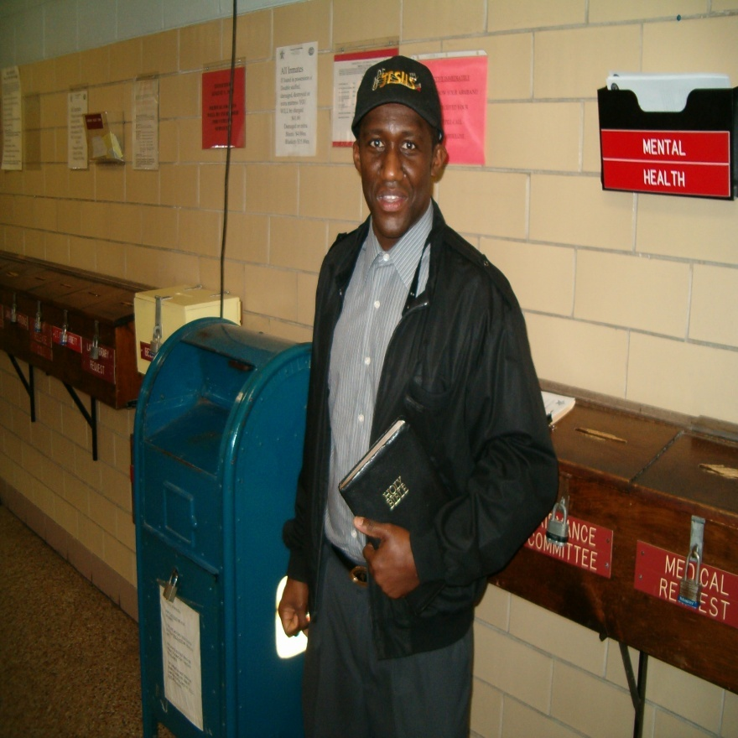
Bibliography
Sources: Created by Chaplain William D. Holmes all rights reserved 2008.
Need any more information contact me at my email address chaplainholmes@heavenboundtrain.org.
Website ministry www.HeavenBoundTrain.org.
Telephone 1-804-507-0517 USA
Mailing Address HeavenBound Train Prison Ministry International P.O. Box 38182 Richmond, Virginia 23231

