Slide 1
Move up in the Holy Ghost and Fire
Pastor Elder William D Holmes
Tried In the Fire Apostolic Faith Church
Richmond Virginia February 18, 2018

Slide 2
Objectives
Explain how to receive the Holy Ghost and Fire
The Functions of the Holy Ghost and Fire
The Evident Sign of the Holy Ghost
Levels you can climb in the Holy Ghost
Being Possessed by the Holy Ghost

Slide 3
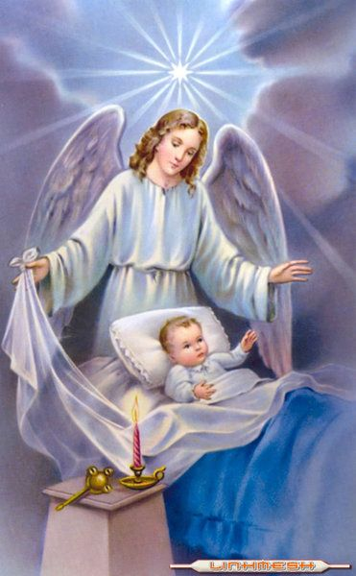
The Power of the Holy Ghost
The Glory of God to carry out His orders and desires. The Glory of God is in His Angels.

Slide 4
God Has many Angels
Angels That Praises Him
Angels That deliver messages to Earth answers to prayers of the saints
Angels that fight and defend the Throne against Satan and the fallen Angels

Slide 5
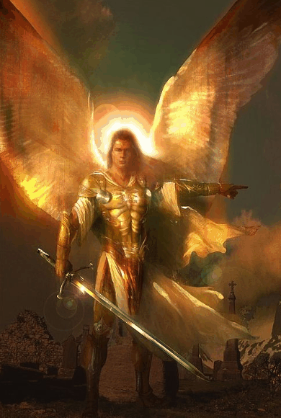
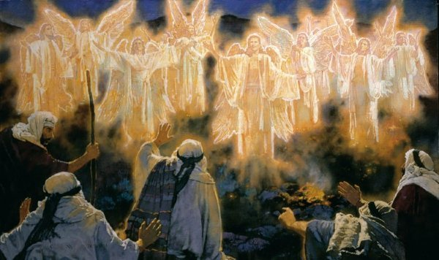
Types of Angels Of God

Slide 6
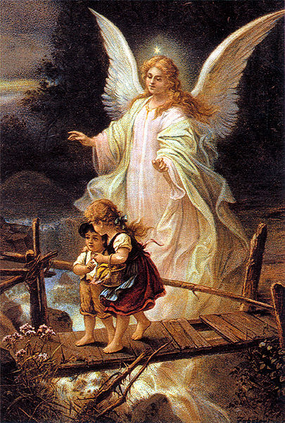
Angels are used to protect the Saints from Accidents,sickness,tragedy
Angel of Protection

Slide 7
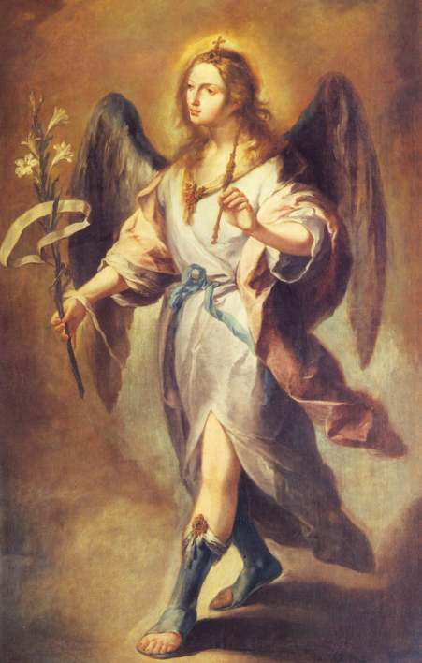
Arc-Angels

Slide 8
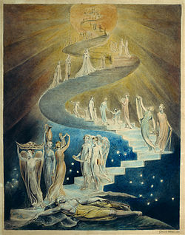
Angels of MessEngers
Carry prayers of the saint to God and bring back the answers to the saints.

Slide 9
Angels are On Earth
Pastor
Clergy
Holy Ghost Filled Saints

Slide 10
Every Holy Ghost Filled Christian Will
Full of Speaking in Tongues-Cast out devils
Heal the sick rebuke the devil of sickness in the mighty name of Jesus

Slide 11
Powerful Tongues
Make Satan obey you! Make demons and devils flee from you!
To communicate with God to receive instructions to defeat Satan.

Slide 12
Every Holy Ghost Child of God has a Halo around their head

Slide 13
You can Climb high in the holy Ghost
God will immune your body to sickness and diseases
God will renew your physical body with new youth. Make you feel like a thirty-three year old person!

Slide 14
Sickness is for Sinners! Sickness is not for the Saints of God
God will Immunize the Holy Ghost Saints of God that if Satan tries to attack: Hypertenison,diabetes,flu,cancer,common cold,arthiritis. The Holy Ghost will act like electricity to shock him destroying that disease completely out!

Slide 15
The Holy Ghost Will Shock Satan completely off of you!

Slide 16
God will reveal to you Dreams and Visions

Slide 17
God will Beautify your Physical Body
Beautify the flesh to shine like an Angel. Your face will shine as that of an Angel.

Slide 18
Sanctified people are Beautiful people

Slide 19
God will reveal unto you mysteries of the Scriptures
Open your mouth to speak with boldness the Word of God!
Words will come out like balls of Fire to knock Satan out.

Slide 20
God will make you a Burning and Shinning Light
Walk in the Spirit-Focus your mind on Jesus&Heaven all you do to the glory of God.
Live in the Spirit-Don’t be ashamed to let people know you are sanctified!

Slide 21
Burning and Shinning Light

Slide 22
God will elevate you so high in the Spirit
You can hear Angels singing songs of praises unto God!
God will even show you visions of Heaven
God will show you signs of the future of Earth and recognize where Satan’s seat is in the church.

Slide 23
Speaking In Tongues
Tongues to pray- Praying in Tongues are an effective way to defeat Satan. There are Tongues that Satan do not understand.
Tongues to Heal- Speak to drive out sickness and diseases
Tongues to Cast out Devils- Power to rebuke Satan and place Him under your feet.
Tongues to sing- Sing songs of Jesus in Tongues

Slide 24
SpeakInG IN Tongues
Speaking in Tongues are used to speak a powerful message to the church!
In doing this an interpreter is given to show to the people the wonderful working of the power of God

Slide 25
Speaking In Tongues

Slide 26
Stages You Can Receive the Holy Ghost and Fire
Baby Stage- The Holy Ghost only comes on a Sanctified Life! A person can receive the Holy Ghost but not in the fulness. It is there but you do not speak in Tongue much.
Full Stage- When a person is totally baptized with the Holy Ghost and Fire the evident signs will come with the speaking in Tongues.
The More Tongues you speak in the Spirit. The more spiritual you are.

Slide 27
Holy Ghost

Slide 28
God will take you up in the Third heaven
2 Corinthians 12:1-10 KJV - It is not expedient for me doubtless to glory. I will come to visions and revelations of the Lord.
² I knew a man in Christ above fourteen years ago, (whether in the body, I cannot tell; or whether out of the body, I cannot tell: God knoweth;) such an one caught up to the third heaven.
³ And I knew such a man, (whether in the body, or out of the body, I cannot tell: God knoweth;)
⁴ How that he was caught up into paradise, and heard unspeakable words, which it is not lawful for a man to utter.

Slide 29
Colossians 3:1-3
If ye then be risen with Christ, seek those things which are above, where Christ sitteth on the right hand of God.
² Set your affection on things above, not on things on the earth.
³ For ye are dead, and your life is hid with Christ in God.
⁴ When Christ, who is our life, shall appear, then shall ye also appear with him in glory.

Slide 30
Satan wants You to stay in the Flesh and worship the things of the Earth

Slide 31
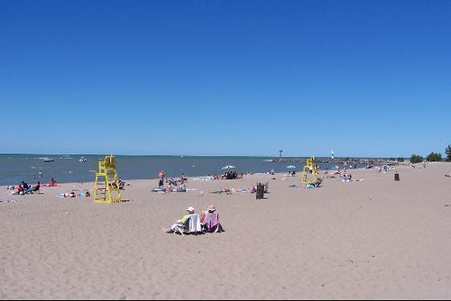
Satan wants You to stay in the Flesh and worship the things of the Earth

Slide 32
Satan wants You to stay in the Flesh and worship the things of the Earth

Slide 33
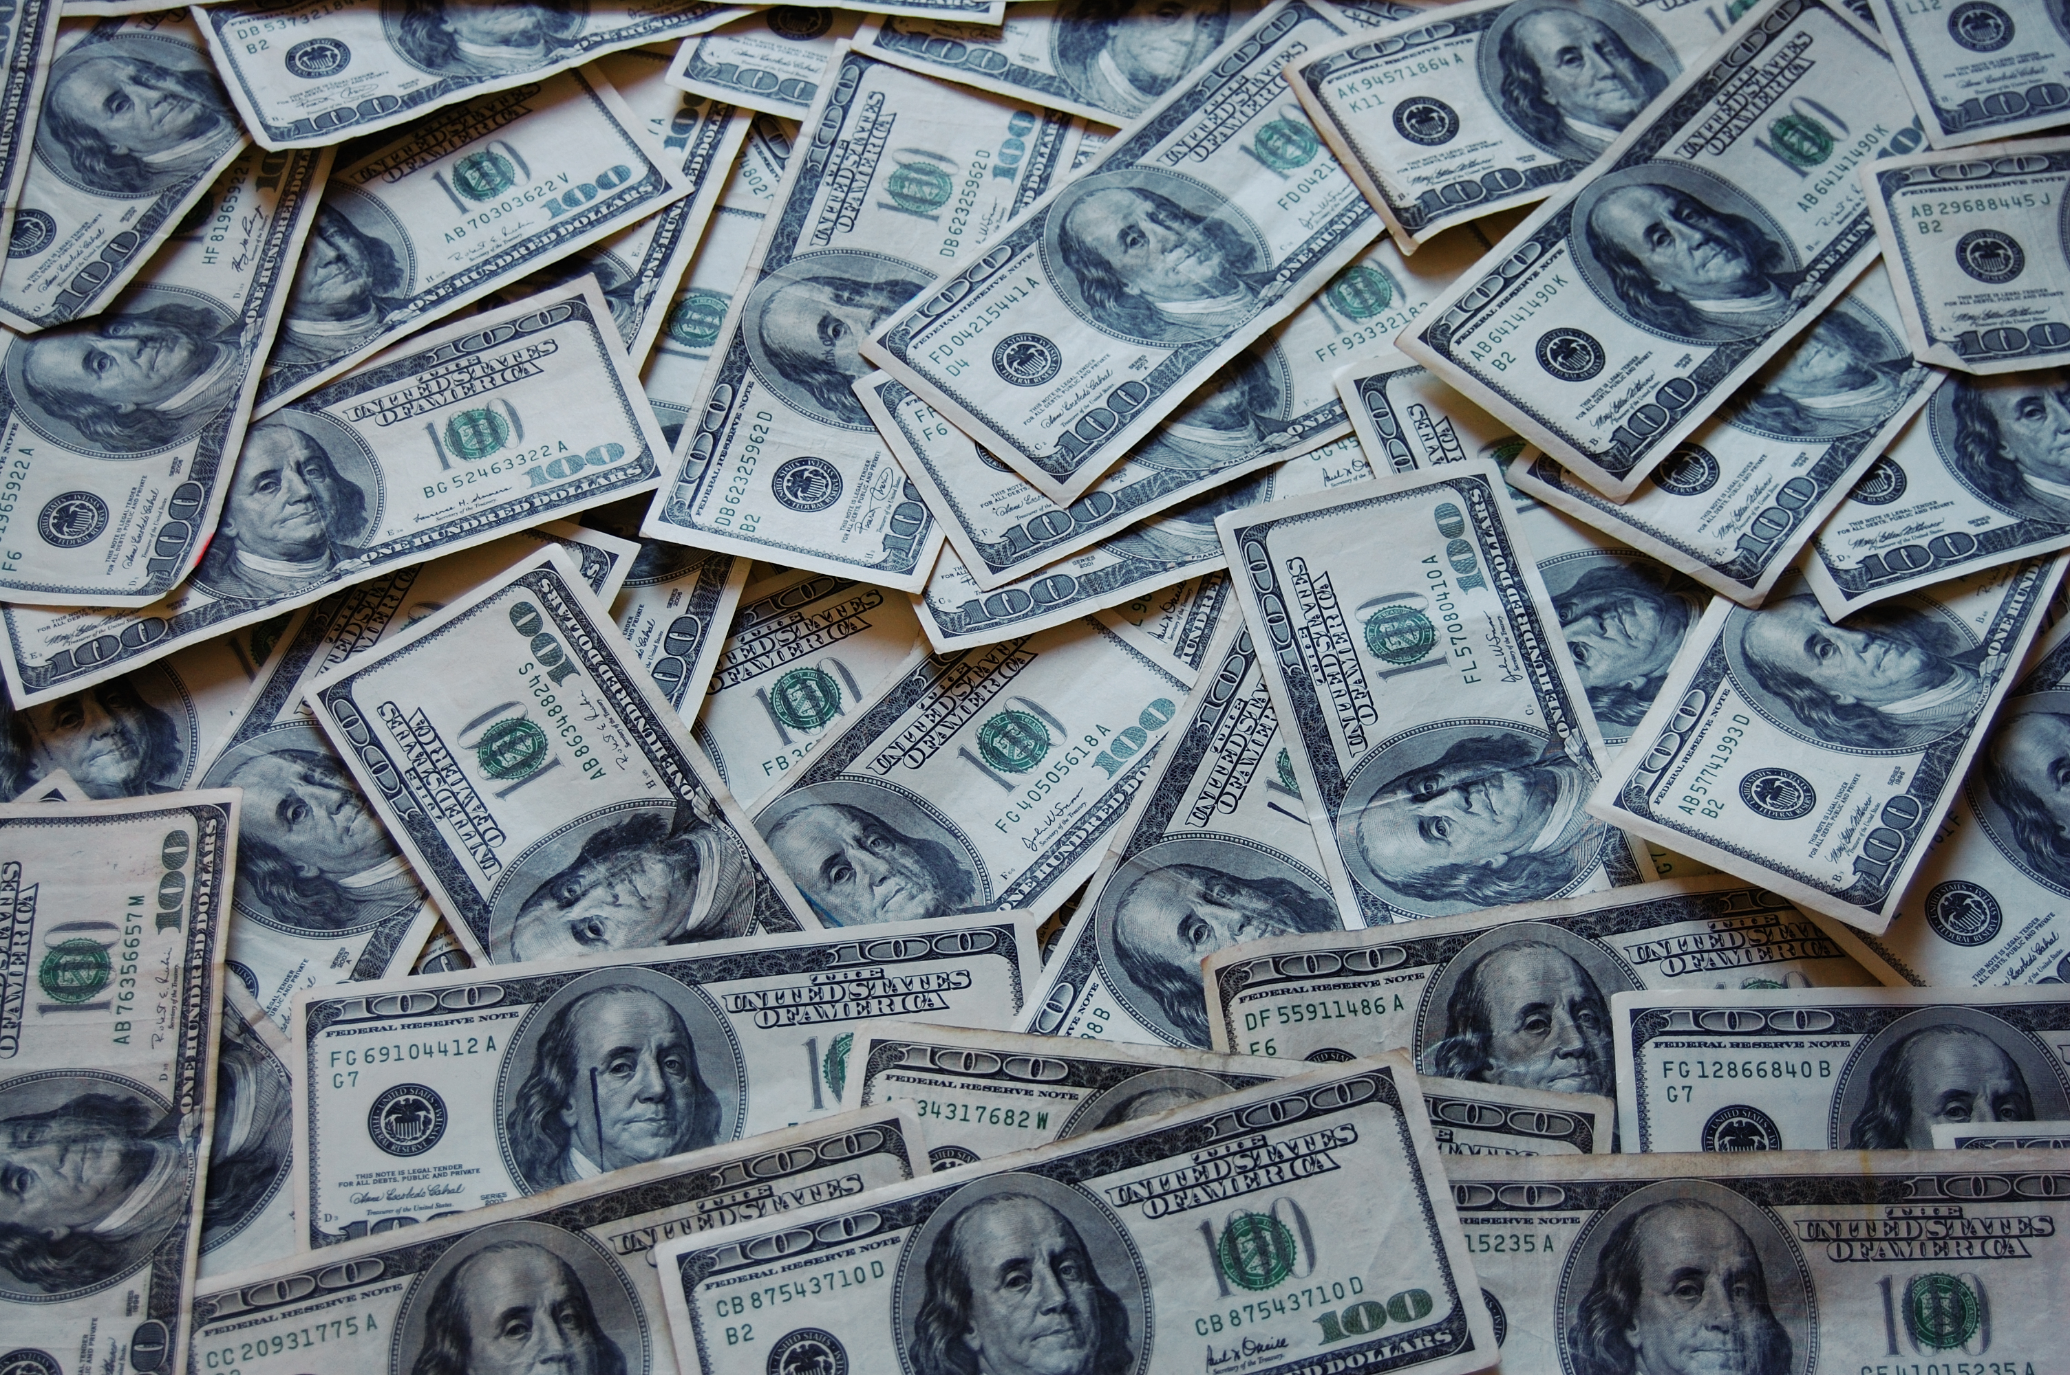
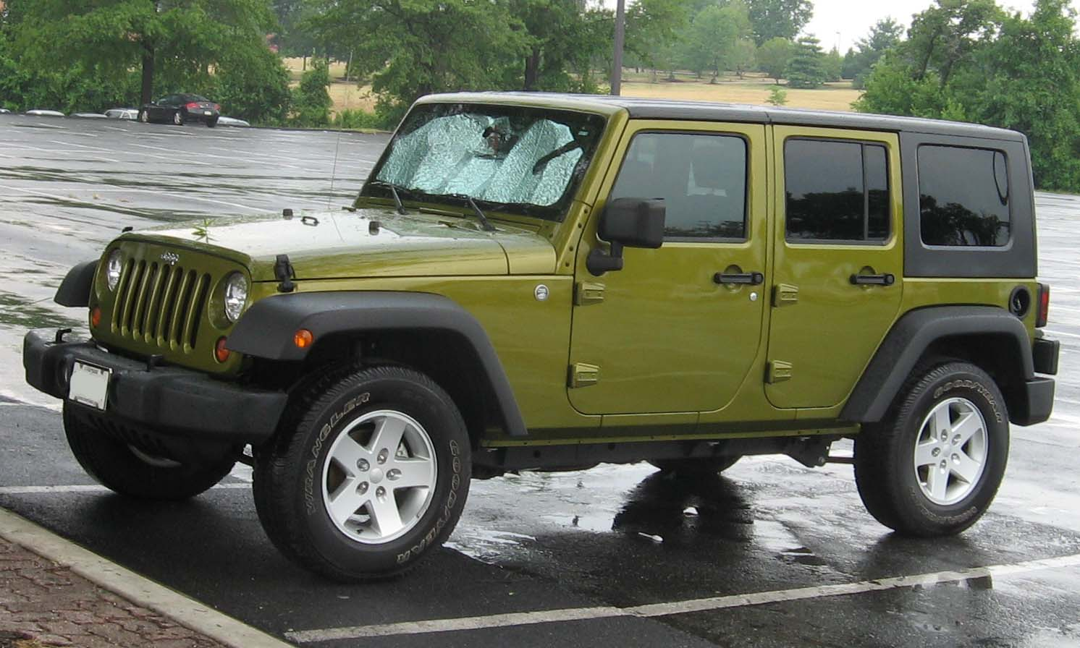
Spiritual Child of God Full of the Holy Ghost God will Give You

Slide 34
God Will Give A True Child of God

Slide 35
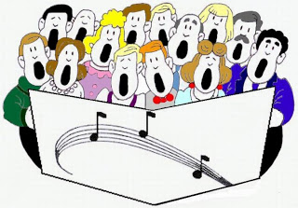
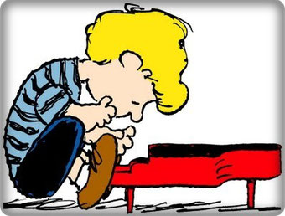
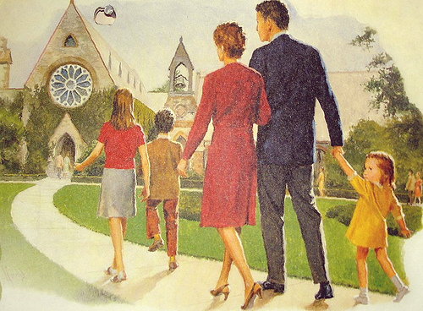
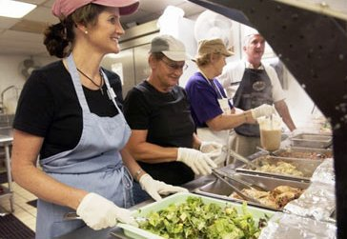
A True Child Of God love to

Slide 36
A Holy Ghost Believer Can climb in the Fruit of the Spirit
Galatians 5:22-23 King James Version (KJV)
²² But the fruit of the Spirit is love, joy, peace, longsuffering, gentleness, goodness, faith,
²³ Meekness, temperance: against such there is no law.

Slide 37
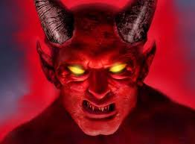
Climb in each part of the Fruit
Love- Baby stage- regular love you will treat people right and hold no grudge. Satan will try you with tough trials to quench your love.

Slide 38
Climb in Different parts of the Fruit
Moderate and strong love- Go the extra mile no matter what Satan throw in your way you will give in to none of His tactics. You will love no matter what people say or do. Satan cannot lay no type of bad feeling on you. You will be overflowing with the Love of God.

Slide 39
Climb in Different parts of the Fruit
Joy,peace gentleness, goodness, meekness,temperance,longsuffering, Baby stage you will rejoice,be satisified, easy to get along with do good works,will not commit the sins of the flesh,take abuse on the normal levels. Satan will try you at this level with test.

Slide 40
Climb in Different parts of the Fruit
Moderate and Strong Level: God will make you a brazen Wall and Iron pillar. God will take you up so high in the Spirit that no matter what Satan does. He cannot stop you from rejoicing, make you upset, cause you to backslide, become discourage, cause you to speak evil, yield to the sins of the flesh, feel like leaving the church, going to a lukewarm doctrine church. Satan cannot reach you at this level.

Slide 41
Know the Difference between the real and false

Slide 42
The Real Gift of the Holy Ghost and Fire

Slide 43
True Child of God love Praise Him!

Slide 44
Spiritual Child of God

Slide 45
The End
https://www.biblegateway.com/passage/?search=Colossians+3&version=KJV
Hope you all enjoyed and be inspired! Elder William D. Holmes

