Slide 1
Run the Spiritual Race to Heaven
By Elder William D. Holmes Pastor Tried In The Fire Church Richmond,Virginia Sunday January 7, 2018

Slide 2
Objectives
To prepare to run
Explain how to run
Hinders that can slow you down
How to avoid the devil traps
No looking back keep your eyes focus on Jesus
How fast can you run?

Slide 3
Bible Verse I Corinthians 9:24 KJV
“Know ye not that they which run in a race run all, but one receiveth the prize? So run, that ye may obtain.”
https://www.kingjamesbibleonline.org/1-Corinthians-9-24/

Slide 4
I Corinthians 9:25-27King James Version (KJV)
²⁵ And every man that striveth for the mastery is temperate in all things. Now they do it to obtain a corruptible crown; but we an incorruptible.
²⁶ I therefore so run, not as uncertainly; so fight I, not as one that beateth the air:
²⁷ But I keep under my body, and bring it into subjection: lest that by any means, when I have preached to others, I myself should be a castaway.

Slide 5
Every Child of God in order to run you must discipline yourself!
²³ And he said to them all, If any man will come after me, let him deny himself, and take up his cross daily, and follow me.
King James Version (KJV)

Slide 6
Deny yourself means to let go the Sins of the Flesh!

Slide 7
Turn your back to the world with its lust and desires

Slide 8
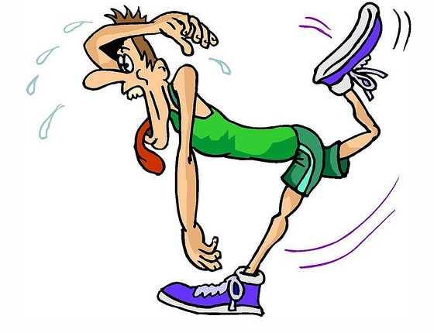
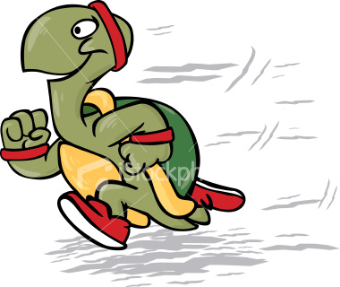
These Sins will hinder Your Fast Pace up the Highway of Holiness

Slide 9
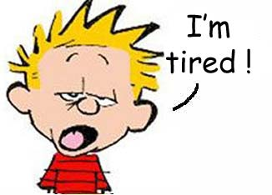
Slow down Runner will lose Interest in Serving the Lord!

Slide 10
Put On the Whole Amour of God That you will be able to Run the Race
Convertion- Forgiveness of sins Repent of your committed sins Acts 3:19 KJV
Justification- Peace with God all sins are forgiven Romans 5:1 KJV
Sanctification- Old inherited sin has been taken out washed in the blood of the lamb I Thessalonians 4:3-7 KJV
Baptism of the Holy Ghost and Fire- Seal you up from all sin. The Holy Ghost comes on a Sanctified Life Acts 2 Chapter I Thessalonians 5:22-23

Slide 11
It is important to get Rid of the Weights which can slow a runner down
Hebrews 12: 1 KJV Therefore, seeing we also are compassed about by so great a cloud of witnesses, let us lay aside every weight, and the sin which doth so easily beset us, and let us run with patience the race that is set before us

Slide 12
Weights are not sin but they are tools Satan use to lure you to sin!
Blemishes-weights that will slow a runner down! Excessive jewelry,make up,lipstick,high heels,paint your toe, finger nails,dresses and skirts that goes up like a window shade when you sit down to make you the spotlight instead of Jesus. These things Satan use to lure people into fornication and adultery.

Slide 13
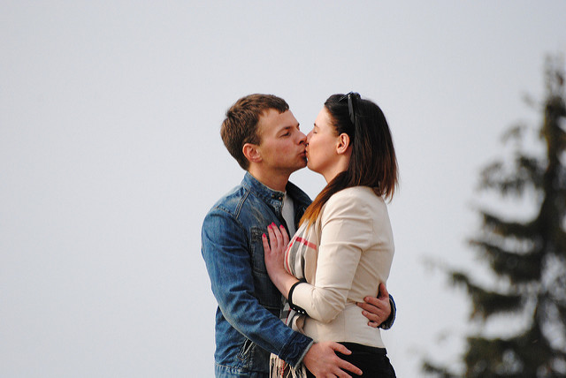
Examples of Blemishes
Kissing,Hugging and smooching between umarried people which could led to sin!

Slide 14
Wrinkles are misunderstandings between parties
Hebrews 12:14
¹⁴ Follow peace with all men, and holiness, without which no man shall see the Lord:
King James Version (KJV)
You must learn to forgive and don’t hold no grudge against anyone! Be clear on your part!

Slide 15
Wrinkles are no harm things
Playing marbles can lead to gambling
Playing cards,bingo can lead to gambling
Playing the lottery is gambling which is sin before God!
We should abstain from all appearance of evil. I Thessalonians 5:22 KJV

Slide 16
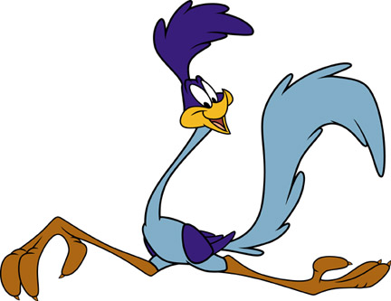
In order to Run fast we must get rid of everything that looks like Satan
It is important to be free so we can run free!

Slide 17
Satan cannot fly for he has a broken wings so he walks wants to devour you for he hates you!

Slide 18
Run fast up the Highway of Holiness
Praying-talking to God Pray at least three times a day!
Fasting- concentrating on the things of Heaven!
Hold your peace before the wicked- Don’t give holy things to dogs.
“Give not that which is holy unto the dogs, neither cast ye your pearls before swine, lest they trample them under their feet, and turn again and rend you.” St. Matthew 7: 6 KJV
Testify- Tell the people what things Jesus done for you!
Dance,shout and praise God!
Live right every day

Slide 19
Important to Dance and Shout for Jesus

Slide 20
Joy will help you Run fast and stay out of Satan’s way

Slide 21
It is important to work out your soul Salvation to make Heaven your Home

Slide 22
Jesus is waiting at Heaven’s Gate for you to come in!

Slide 23
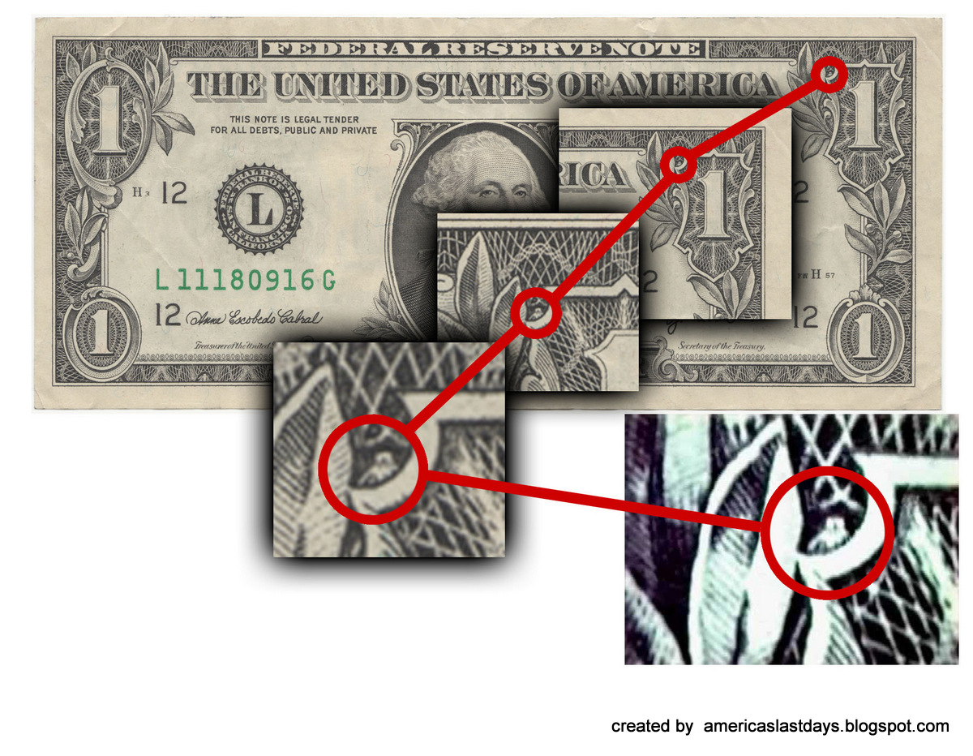
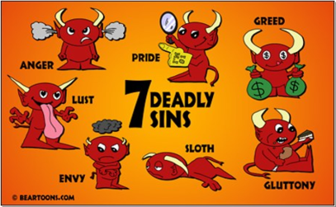
Run the Race and don’t let Satan slow you down with this world!

Slide 24
It is not worth your soul being lost

Slide 25
Make your decision before it will be too late

Slide 26
Credits
https://www.kingjamesbibleonline.org
https://www.biblegateway.com/
Youtube.com

Slide 27
The End
Elder William D. Holmes
Pastor Tried In the Fire Holiness Church Richmond,Virginia
Sunday January 7, 2018

