Slide 1
Where Will You Spend Eternity?
By
Elder William D. Holmes Pastor Tried In The Fire Church Richmond,Va

Slide 2
Everyone has a choice to make in Life
There are only two choices:
Life –Jesus
Death –Satan
Deuteronomy 30:15 KJV “Behold I have set before thee this day life and good,and death and evil:”

Slide 3
Death
The results of sin.
(Romans 6:23KJV) “ For the wages of sin is death;but the gift of God is eternal life through Jesus Christ our Lord.”
Satan lied to man back in the Garden of Eden.
(Genesis 3:4 KJV) “ And the serpent said unto the woman, ye shall not surely die:”

Slide 4
Death
(Genesis 3:5KJV) “For God doth know that in the day shall eat thereof, then your eyes shall be opened, and ye shall be as gods, knowing good from evil.”
The Tree of Knowledge of God and Evil causes man to know evil as well as good. This was not God’s Will.

Slide 5
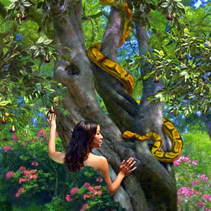

Slide 6
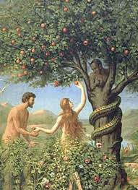
Adam and Eve at the Tree of Knowledge of Good and Evil

Slide 7
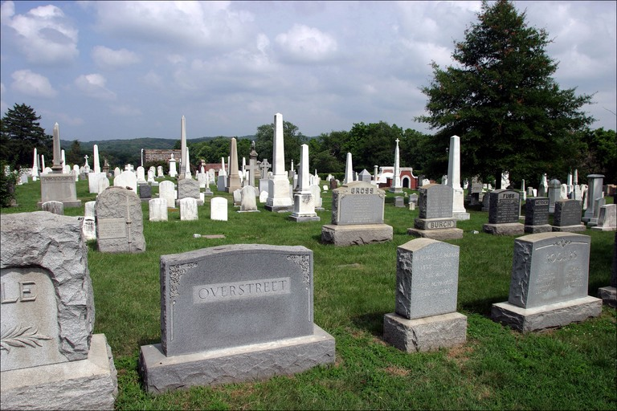
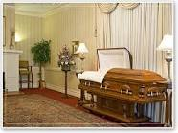
Death
Every time you pass by a funeral home or cemetery that is evidence that Satan lied to man!

Slide 8


As the Result of Adam Sin we have Trouble in the World Today

Slide 9
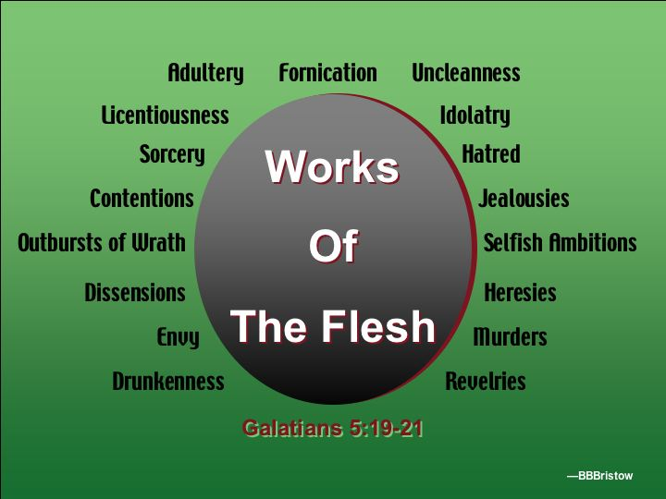
Death

Slide 10
The Tree of Knowledge of Good and Evil
The Life of a sinner is one who do good sometimes but sins some too! There are three levels of sinners:
Self righteous-life a good moral life but will have some skeletons in the closet. They will slip around and do their wrong hoping God will forgive them. Go to church and do good in the community. Some will claim the to have the Holy Spirit but say they cannot live free from sin. They complain about having trouble with the flesh. Some will cheat in their marriages and get devoices. This pleases Satan.

Slide 11
Classes of Sinners
Heathens-They are the one who do care have no respect for God Almighty. They don’t believe in the miracle working power of God. They only believe in the technology of man. They support pagan ways. They believe in the law of man. They support gay marriages,common law marriages and whatever man says. They say when a person dies there is no life after death. Those are your atheists. They fear death!

Slide 12
Classes of Sinners
Wicked- They have no respect for God and no respect for the law of man. Those are your theives,robbers,prositutes,gamblers,fights,rapists,witchcraft, talk profanity in their regular conversation,live their life in common law marriage, speak lies and use illegal drugs,fornicate and commit adultery.

Slide 13
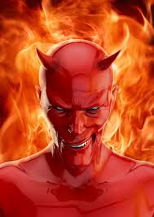
Satan is the cause of all Sin

Slide 14
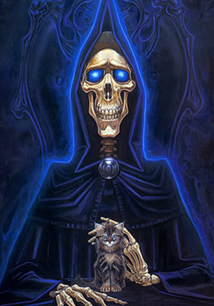
Death was issued by God to put an end to Sin

Slide 15
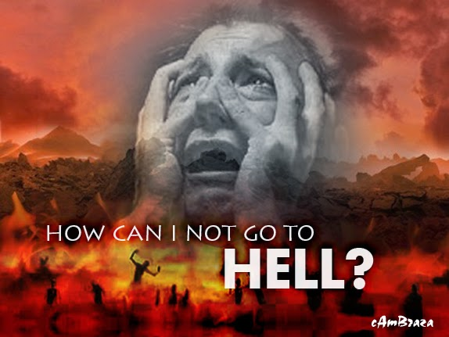
Hell Fire follow Death
Temperature in thousands of Degrees

Slide 16
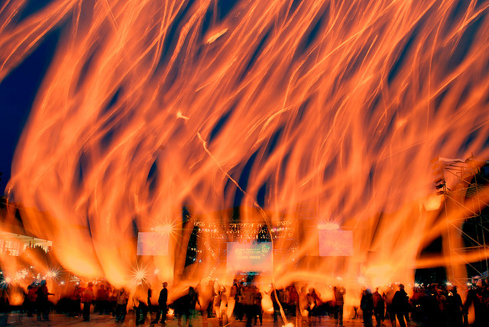
Hell
No cold water! No air condition or cool breeze! All the time burning in the fire and never burn up!

Slide 17
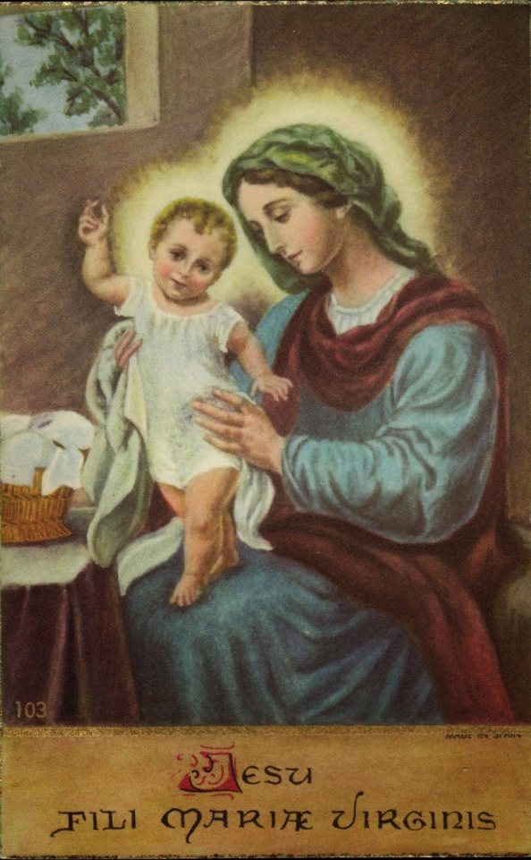
Life
Jesus come to save us from living our life in Sin. (St. Matthew 1:21KJV)

Slide 18
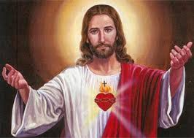
Life
Jesus was manifested to destroy the works of the devil.

Slide 19
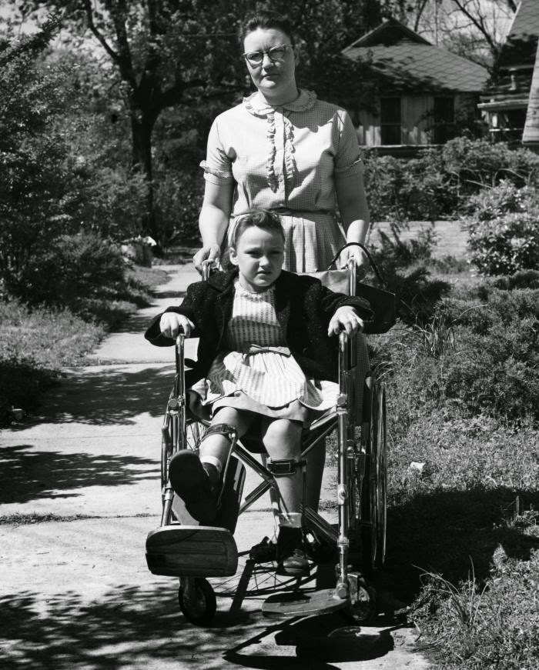

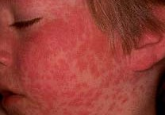
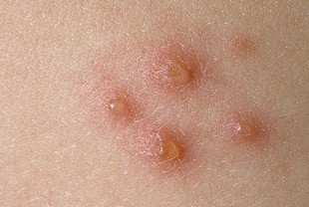
Jesus Will Destroy
All Sin
Sickness

Slide 20
There is power in the name of Jesus
Open blind eyes
Unstopped deaf ears
Cause the lame to walk
God is a God of miracles!
According to medical Science there are thirty-nine main Germs. Every disease and sickness known from man come from one of those thirty-nine. Jesus took a stripe for every one of those diseases.

Slide 21
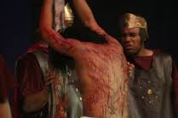
By the Stripes of Jesus we are healed

Slide 22
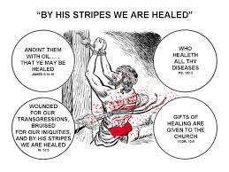
By His Stripes We are healed.

Slide 23
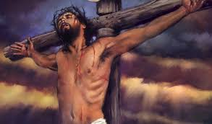
Jesus blood is for cleansing and the water for washing your soul
There is power in the blood of Jesus to wash every bit of sin out of you.

Slide 24

Satan’s Power over man got Destroyed at Calvary

Slide 25
Life
Repent-Pray ask the Lord to forgive you of our sins you will never sin any more. (2 Corinthinans 7:10-11)
Pray that prayer until your mind change and the heavy burden of guilt is lifted.
Convertion
In convertion the Lord Jesus will forgive you of all of our committed sins.

Slide 26
Life
Convertion-when the Lord forgive you of your sins your mind will change. You will have a mind to do right, read your bible and go to a fire hot church! With a converted mind you will work out your soul salvation.
Justification- When the Lord justify you by faith you will have peace with God. All of your committed sins are gone! (Romans 5:1KJV)

Slide 27
Life
Santification- When do the part we cannot do. Jesus will breathe a life in our soul and take out that old Adam nature of sin. Place in us a new nature that do not sin. (1 John 3:9KJV)
When Jesus comes in the devil goes out! Santification drives Satan completely out!
Convertion,justification only weakens the devil but it does not get him completely out!

Slide 28
Life
Through the blood of Jesus that will wash you and make you clean on the inside taking out the nature of sin out by the root. This what make us free from the bondage of sin. Jesus will fill you up from the top of your head to the sole of your feet. Walk, talk in you twenty-four hours a day.
The Blood of Jesus write our names in the Lamb Book of Life

Slide 29
Life
The Baptism of the Holy Ghost will come on a sanctified life. It will seal you up from the crown of your head to the soul of your feet. It will surround you twenty-four hours a day. Satan cannot break the seal of the Holy Ghost or wade through the blood of Jesus to get to you! You are protected under the blood of Jesus! (St. John 14:23 KJV) Satan cannot overpower the Holy Ghost and Jesus!

Slide 30

Holy Ghost

Slide 31
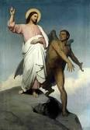
Life
Jesus whipped the Devil at Calvary!

Slide 32
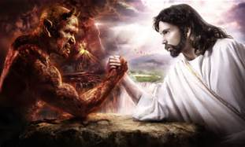
Life
Jesus whipped the Devil at Calvary

Slide 33
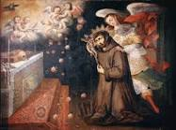
Life
A Saint of God! Protected by the blood of Jesus and Seal with the Holy Ghost and Fire

Slide 34
Satan do not want people to get Sanctified Through the blood of Jesus
So sin can reign in their life.
There are many church people going to church and still going to Hell Fire because of the presence of sin! No body can serve two masters! Either you are a Saint of God living free from sin or a servant of sin which is a sinner.

Slide 35
Three Classes of Christians
Righteous- Converted, baptized in water signifying you are turning from the world of sin and living now on for Jesus. Justified by faith have peace with God and peace with your fellow man. Love your enemies. Seek the Lord to be sanctified through the blood of Jesus.
Holy- Those who are washed in the blood of Jesus have joy in their soul and peace in their mind. Dance, shout and praise God with a glory, Hallelujah. The desire of sin has been taken out and their name is written in the Lambs Book of Life.

Slide 36
Three Classes of Christians
Saints of God- Baptized and Filled with the Holy Ghost and Fire. The Power of God will come in their life and fill them up from the sole of their feet to the crown of their head. The power of the Holy Ghost will take control of their tongue and tie it to the roof of their mouth and loose it to speak in an unknown language that Jesus says. The Holy Ghost preserves you and keep you from all sin.

Slide 37
Three Classes of Christians
Saints of God-Full of the fruit of the Spirit and no time for Satan or sin. Love the Lord God with all their heart,soul and mind. On fire for God and love a hot service with the anointing of the Holy Ghost at work. Live holy at home and let Jesus shine in their life twenty-four hours a day.

Slide 38

The Fruit of the Spirit

Slide 39
This is what some Christians want to say Today
Fruit of the Spirit mixed in with fornication, lie hatred or adultery. Some say they are having trouble with yielding to the flesh. Some young people give in to fornication saying they cannot stand. Others give in to divorces and cheating in their marriages. They claim they have the Holy Spirit. What do you say?

Slide 40
Questions
Can light and darkness be in the same room at the same time?
Can oil and water mix together?
How can a child of God mix with a sinner at the same time?

Slide 41
Note
The life of a sinner is one who may not be sinning every minute but they are living in sin twenty-four hours a day. If anybody sin anytime doing the day or night that qualifies them as a sinner! How many sins did Adam and Eve commit in the Garden of Eden? Do you think God love Adam and Eve any better than us? If God put them out of the Garden because of one sin, what do you think about us?

Slide 42
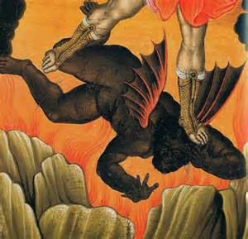
Jesus
Jesus comes to cast Satan out of us when he Sanctifies us through his blood.

Slide 43
A Christian who is saved,Sanctifed and Baptized and Filled with the Holy Ghost and Fire
Steadfast in the faith
Fruit of the Spirit abundant in their heart.
Strong prayer and fasting before God.
Work faithfully in the church and supports the service of the Lord.
Believe in living holy before God keeping all of God commandments and Statues.

Slide 44
The Life of a New Convert Baby in Christ.
Feel good! Testify I love everybody!
Learning how to live holy. Denying themselves
Learn when they fall into temptation and will pray and die daily, crucifying the flesh. Get baptized in water as a testimony to forsake the world of sin to live from now on for the Jesus. New converts are the one who will dress with necklaces, women wear pants,earrings,men wear long hair. People are living in common law marriages. They are learning. Have patience with them!

Slide 45
Life of A Sanctified Person
Live a life free from all sin.
Sanctified the way you look on the outside.
Dance and shout of praise! Glory and Hallelujah!
Sing a praise in your soul.
In the Word of God! Live the Word of God!
Able to stand temptation of the enemy.

Slide 46
Life of A Holy Ghost Filled Person
Speak in unknown tongues
Power of God will quicken your body.
Witness to the lost of the power of God
Dance and shout under the anointing of the Power of God.
Exhibit the Fruit of the Spirit in their everyday life.
Comes on a sanctified life.

Slide 47
Heaven
Those who are sanctified through the blood of Jesus.
Baptized and Filled with the Holy Ghost and Fire.
The blood of Jesus will write your name in the Lambs Book of Life.
Only the pure in hearts shall see God. (St. Matthew 5:8KJV)

Slide 48
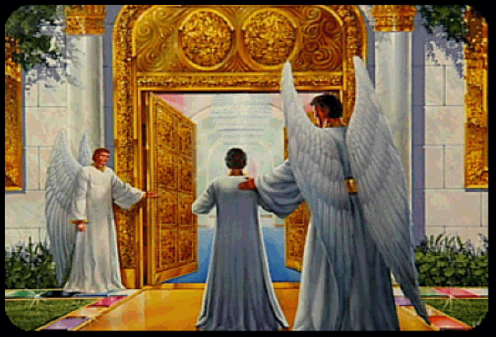
Heaven

Slide 49

Heaven
Well Done thou good and Faithful Servant enter in the joys of the Lord!
If the righteous scarcely be saved, where would the sinners and ungodly appear? (1 Peter 4:18 KJV)

Slide 50
A Child of God
Protected by the blood of Jesus
Baptized and Filled with the Holy Ghost and Fire
Satan is on the outside. In order for Satan to get to you he has to break the seal of the holy Ghost, wade through the blood of Jesus. By the time Satan gets to you he would be saved himself. You know that devil will never get saved! Satan cannot get beyond all that power to get to you.

Slide 51
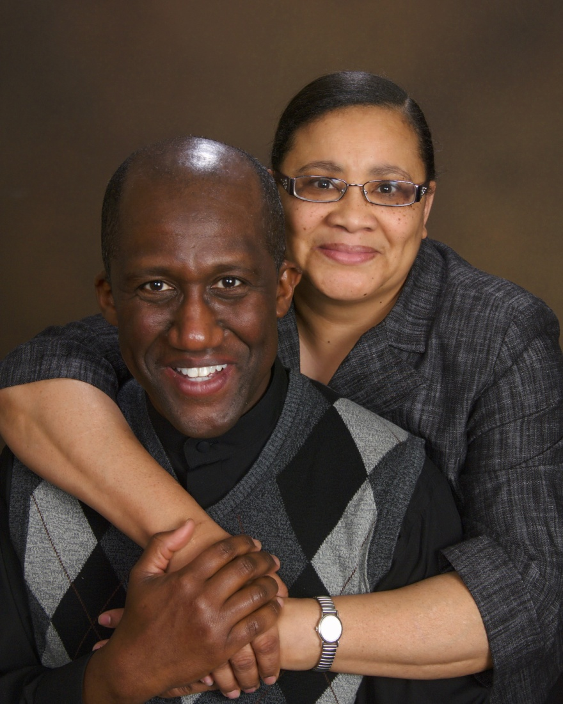
The End
Pastor Elder William and Sister Velvet M Holmes

