Slide 1
Notes:
Guide: Please be sure to go through the slides in Standard view (default view) or Presenter View (see page 4 of the User Guide) to check for Tips and Guides provided, and to familiarize yourself with the content. It is important to note that the slides are best-suited to Slideshow View (and Presenter View), so although items may seem out of place in Standard view, they fit in seamlessly when in Slideshow View (and Presenter View).

Slide 3
Notes:
Guide: Click on any shape to take you to its corresponding slide, or proceed to slide 4 to start from the first (square).

Slide 4
Notes:
Contents locked. Please purchase the full version to unlock them.

Slide 5
Notes:
Contents locked. Please purchase the full version to unlock them.

Slide 6
Notes:
Contents locked. Please purchase the full version to unlock them.

Slide 7
What shape is it?
Triangle
Notes:
Guide: The shape will transition in automatically. To reveal the answer (and proceed to the next slide afterward), press the spacebar/front arrow key/enter key, or click anywhere on the slide. Clicking on the home icon will take you back to the shape directory (slide 3).
Tip: Elicit from students the name of the shape. You could also do a bit of drilling by having them spell it and say it out loud.

Slide 8
Notes:
Guide: no action required

Slide 9
Notes:
Guide: The animation for the tracing guide will start after the slide’s entrance. You can replay the tracing guide by clicking on the shape icon in the top-left corner. To go back to the shape directory, click on the home icon. Press the spacebar/front arrow key/enter key, or click anywhere on the slide to proceed to the next side.

Slide 10
Notes:
Contents locked. Please purchase the full version to unlock them.

Slide 11
Notes:
Contents locked. Please purchase the full version to unlock them.

Slide 12
Notes:
Contents locked. Please purchase the full version to unlock them.

Slide 13
Notes:
Contents locked. Please purchase the full version to unlock them.

Slide 14
Notes:
Contents locked. Please purchase the full version to unlock them.

Slide 15
Notes:
Contents locked. Please purchase the full version to unlock them.

Slide 16
What shape is it?
Pentagon
Notes:
Guide: The shape will transition in automatically. To reveal the answer (and proceed to the next slide afterward), press the spacebar/front arrow key/enter key, or click anywhere on the slide. Clicking on the home icon will take you back to the shape directory (slide 3).
Tip: Elicit from students the name of the shape. You could also do a bit of drilling by having them spell it and say it out loud.

Slide 17
Notes:
Guide: no action required

Slide 18
Notes:
Guide: The animation for the tracing guide will start after the slide’s entrance. You can replay the tracing guide by clicking on the shape icon in the top-left corner. To go back to the shape directory, click on the home icon. Press the spacebar/front arrow key/enter key, or click anywhere on the slide to proceed to the next side.

Slide 19
Notes:
Contents locked. Please purchase the full version to unlock them.

Slide 20
Notes:
Contents locked. Please purchase the full version to unlock them.

Slide 21
Notes:
Contents locked. Please purchase the full version to unlock them.

Slide 22
Notes:
Contents locked. Please purchase the full version to unlock them.

Slide 23
Notes:
Contents locked. Please purchase the full version to unlock them.

Slide 24
Notes:
Contents locked. Please purchase the full version to unlock them.

Slide 25
Notes:
Contents locked. Please purchase the full version to unlock them.

Slide 26
Notes:
Contents locked. Please purchase the full version to unlock them.

Slide 27
Notes:
Contents locked. Please purchase the full version to unlock them.

Slide 28
Notes:
Contents locked. Please purchase the full version to unlock them.

Slide 29
Notes:
Contents locked. Please purchase the full version to unlock them.

Slide 30
Notes:
Contents locked. Please purchase the full version to unlock them.

Slide 31
What shape is it?
Star
Notes:
Guide: The shape will transition in automatically. To reveal the answer (and proceed to the next slide afterward), press the spacebar/front arrow key/enter key, or click anywhere on the slide. Clicking on the home icon will take you back to the shape directory (slide 3).
Tip: Elicit from students the name of the shape. You could also do a bit of drilling by having them spell it and say it out loud.

Slide 32
Notes:
Guide: no action required

Slide 33
Notes:
Guide: The animation for the tracing guide will start after the slide’s entrance. You can replay the tracing guide by clicking on the shape icon in the top-left corner. To go back to the shape directory, click on the home icon. Press the spacebar/front arrow key/enter key, or click anywhere on the slide to proceed to the next side.

Slide 34
Notes:
Contents locked. Please purchase the full version to unlock them.

Slide 35
Notes:
Contents locked. Please purchase the full version to unlock them.

Slide 36
Notes:
Contents locked. Please purchase the full version to unlock them.

Slide 37
What shape is it?
Notes:
Tip: In this section, students will have to choose the shape that closely matches the object shown. (pages 4 to 6 of the worksheet)

Slide 38
Notes:
[cookie]
Tip: To aid students, you can have them trace the cookie and then try to match the outline with the correct shape.
Guide: The shape options will transition in automatically. Clicking on the wrong shape will cause it to teeter (blink for circles) in place, while clicking on the right shape will transition you to the next slide.

Slide 39
Notes:
Guide: no action required

Slide 40
Notes:
Guide: no action required

Slide 41
Notes:
Guide: Press the spacebar/front arrow key/enter key, or click anywhere on the slide to proceed to the next side.

Slide 42
Notes:
Contents locked. Please purchase the full version to unlock them.

Slide 43
Notes:
Contents locked. Please purchase the full version to unlock them.

Slide 44
Notes:
Contents locked. Please purchase the full version to unlock them.

Slide 45
Notes:
Contents locked. Please purchase the full version to unlock them.

Slide 46
Notes:
Contents locked. Please purchase the full version to unlock them.

Slide 47
Notes:
Contents locked. Please purchase the full version to unlock them.

Slide 48
Notes:
Contents locked. Please purchase the full version to unlock them.

Slide 49
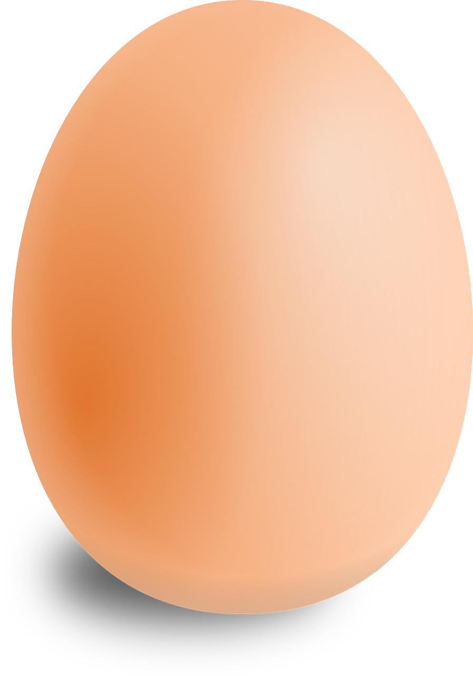
Notes:
[egg]
Tip: To aid students, you can have them trace the egg and then try to match the outline with the correct shape.
Guide: The shape options will transition in automatically. Clicking on the wrong shape will cause it to teeter (blink for circles) in place, while clicking on the right shape will transition you to the next slide.

Slide 50
Notes:
Guide: no action required

Slide 51
Notes:
Guide: no action required

Slide 52
Notes:
Guide: Press the spacebar/front arrow key/enter key, or click anywhere on the slide to proceed to the next side.

Slide 53
Notes:
Contents locked. Please purchase the full version to unlock them.

Slide 54
Notes:
Contents locked. Please purchase the full version to unlock them.

Slide 55
Notes:
Contents locked. Please purchase the full version to unlock them.

Slide 56
Notes:
Contents locked. Please purchase the full version to unlock them.

Slide 57
Notes:
Contents locked. Please purchase the full version to unlock them.

Slide 58
Notes:
Contents locked. Please purchase the full version to unlock them.

Slide 59
Notes:
Contents locked. Please purchase the full version to unlock them.

Slide 60
Notes:
Contents locked. Please purchase the full version to unlock them.

Slide 61
Notes:
Contents locked. Please purchase the full version to unlock them.

Slide 62
Notes:
Contents locked. Please purchase the full version to unlock them.

Slide 63
Notes:
Contents locked. Please purchase the full version to unlock them.

Slide 64
Notes:
Contents locked. Please purchase the full version to unlock them.

Slide 65
Notes:
Contents locked. Please purchase the full version to unlock them.

Slide 66
Notes:
Contents locked. Please purchase the full version to unlock them.

Slide 67
Notes:
Contents locked. Please purchase the full version to unlock them.

Slide 68
Notes:
Contents locked. Please purchase the full version to unlock them.

Slide 69
Notes:
[kite]
Tip: To aid students, you can have them trace the kite and then try to match the outline with the correct shape.
Guide: The shape options will transition in automatically. Clicking on the wrong shape will cause it to teeter (blink for circles) in place, while clicking on the right shape will transition you to the next slide.

Slide 70
Notes:
Guide: no action required

Slide 71
Notes:
Guide: no action required

Slide 72
Notes:
Guide: Press the spacebar/front arrow key/enter key, or click anywhere on the slide to proceed to the next side.

Slide 73
Notes:
Contents locked. Please purchase the full version to unlock them.

Slide 74
Notes:
Contents locked. Please purchase the full version to unlock them.

Slide 75
Notes:
Contents locked. Please purchase the full version to unlock them.

Slide 76
Notes:
Contents locked. Please purchase the full version to unlock them.

Slide 77
Complete the shape
Notes:
Tip: In this section, students will have to choose the correct half to complete the shape. (pages 6 and 7 of the worksheet)

Slide 78
Notes:
Contents locked. Please purchase the full version to unlock them.

Slide 79
Notes:
Contents locked. Please purchase the full version to unlock them.

Slide 80
Notes:
Contents locked. Please purchase the full version to unlock them.

Slide 81
Notes:
Contents locked. Please purchase the full version to unlock them.

Slide 82
Notes:
Contents locked. Please purchase the full version to unlock them.

Slide 83
Notes:
Contents locked. Please purchase the full version to unlock them.

Slide 84
Notes:
Tip: You can provide hints of what the whole shape is using objects from earlier in the lesson or your immediate surroundings.
Guide: The options transition in automatically. Clicking on the wrong shape will cause it to teeter in place, while clicking on the right shape will transition you to the next slide.

Slide 85
Cone
Notes:
Guide: no action required

Slide 86
Cone
Notes:
Guide: Press the spacebar/front arrow key/enter key, or click anywhere on the slide to proceed to the next side.

Slide 87
Notes:
Tip: You can provide hints of what the whole shape is using objects from earlier in the lesson or your immediate surroundings.
Guide: The options transition in automatically. Clicking on the wrong shape will cause it to teeter in place, while clicking on the right shape will transition you to the next slide.

Slide 88
Hexagon
Notes:
Guide: no action required

Slide 89
Hexagon
Notes:
Guide: Press the spacebar/front arrow key/enter key, or click anywhere on the slide to proceed to the next side.

Slide 90
Notes:
Contents locked. Please purchase the full version to unlock them.

Slide 91
Notes:
Contents locked. Please purchase the full version to unlock them.

Slide 92
Notes:
Contents locked. Please purchase the full version to unlock them.

Slide 93
Notes:
Contents locked. Please purchase the full version to unlock them.

Slide 94
Notes:
Contents locked. Please purchase the full version to unlock them.

Slide 95
Notes:
Contents locked. Please purchase the full version to unlock them.

Slide 96
Find the shape
Notes:
Tip: In this section, you may want to split students up into pairs/groups (if large enough) and give them one try each to find the matching shape. If using a touchscreen device, you could make this a tactile/kinesthetic activity.
Note: Given the nature of this activity, there is no corresponding worksheet for it.

Slide 97
Notes:
Contents locked. Please purchase the full version to unlock them.

Slide 98
Notes:
Contents locked. Please purchase the full version to unlock them.

Slide 99
Notes:
Contents locked. Please purchase the full version to unlock them.

Slide 100
Notes:
Guide: Click/tap on a card to flip it over and reveal a shape. If the wrong card is clicked/tapped, it will reveal a shape and flip back over automatically. If the right card is clicked/tapped, it will transition you to the next slide.

Slide 101
Notes:
Guide: no action required

Slide 102
Notes:
Guide: Press the spacebar/front arrow key/enter key, or click anywhere on the slide to proceed to the next side.

Slide 103
Notes:
Contents locked. Please purchase the full version to unlock them.

Slide 104
Notes:
Contents locked. Please purchase the full version to unlock them.

Slide 105
Notes:
Contents locked. Please purchase the full version to unlock them.

Slide 106
Notes:
Guide: Click/tap on a card to flip it over and reveal a shape. If the wrong card is clicked/tapped, it will reveal a shape and flip back over automatically. If the right card is clicked/tapped, it will transition you to the next slide.

Slide 107
Notes:
Guide: no action required

Slide 108
Notes:
Guide: Press the spacebar/front arrow key/enter key, or click anywhere on the slide to proceed to the next side.

Slide 109
Notes:
Contents locked. Please purchase the full version to unlock them.

Slide 110
Notes:
Contents locked. Please purchase the full version to unlock them.

Slide 111
Notes:
Contents locked. Please purchase the full version to unlock them.

Slide 112
Notes:
End of slides

Slide 113
THANK YOU for trying out our demo lesson.
Please purchase the full version to unlock additional features and content.

