Slide 1

Welcome to Open House!
2024
This Photo by Unknown Author is licensed under CC BY-NC-ND

Slide 2

CAR SIGNS
You will be given a car sign. Please display your car sign in your window at pick-up so we are able to clearly see it.
A small pants hanger works great to hang it from your rearview mirror.
Drop off and pick up will be drive-thru style. We will come out to get your child from the car and put them in the car at dismissal.
*PLEASE PULL FORWARD TO STRAP YOUR CHILD INTO THEIR SEAT SO WE CAN KEEP THE LINE MOVING.*

Slide 3
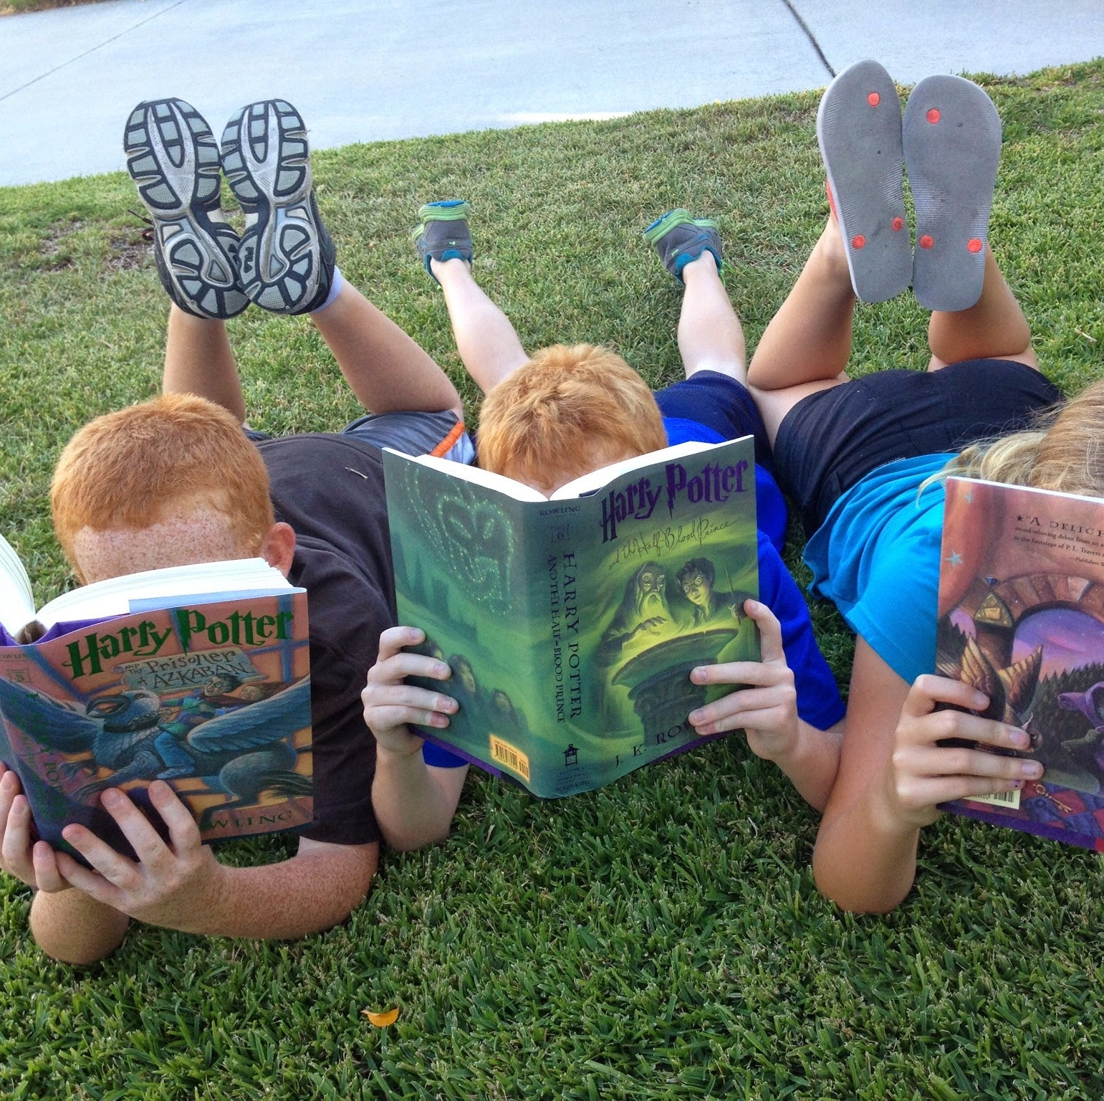
Handbook
Please take a moment to look through the handbook. Nearly everything you need to know about preschool is in there! If you do have any questions after reading through it, please feel free to ask your child’s teacher!

Slide 4

Communication
You will get a calendar and newsletter every month.
Please check your child’s backpack every day after school for additional information.

Slide 5

Kroger Community Rewards Program
To Use the Kroger Community Rewards Program:
Simply visit http://www.kroger.com. Once logged into your Kroger account you can search for Zion Lutheran Church Preschool either by name or IS375 and then click Enroll. New users will need to create an account which requires some basic information, a valid email address and a rewards card.
This is such an easy way to support the preschool and we are so thankful for the opportunity to participate in Kroger's Community Rewards program. If you have any problems, please let me know how I can help.
This Photo by Unknown Author is licensed under CC BY-SA

Slide 6

Germs …
Please help us by keeping your child at home
if they are displaying any of the following symptoms:
• Temperature of 100 degrees Fahrenheit • Fatigue
or higher • Muscle or body aches
• Fever • Headache
• Chills • Loss of taste or smell
• Cough • Sore throat
• Shortness of breath • Congestion or runny nose
• Difficulty breathing • Nausea or vomiting
• Diarrhea

Slide 7
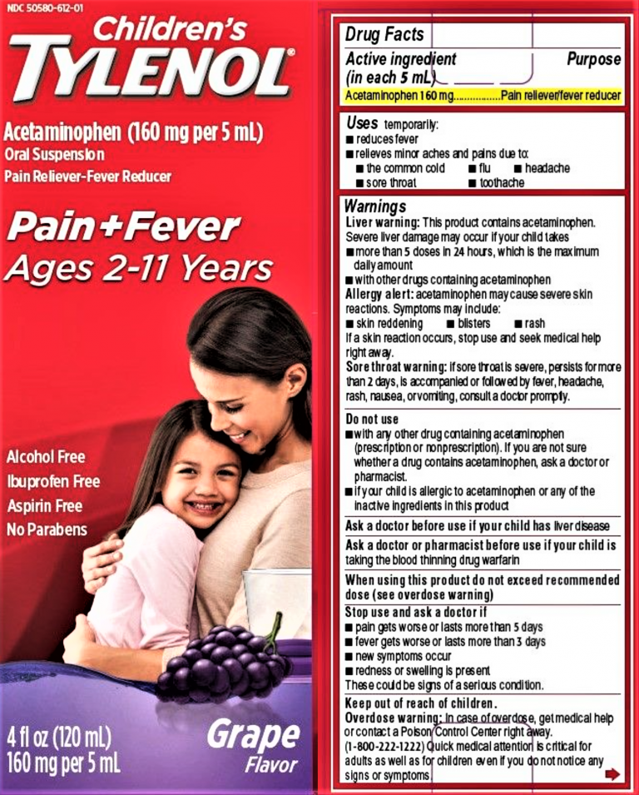
More on germs!
We also ask that you don’t give them Tylenol and go ahead and send them to school.
It’s something many of us have done at one time or another.
Please help us by being upfront that your child isn’t feeling well, keep them home until they are symptom free.
Thank you for your help!
This Photo by Unknown Author is licensed under CC BY

Slide 8
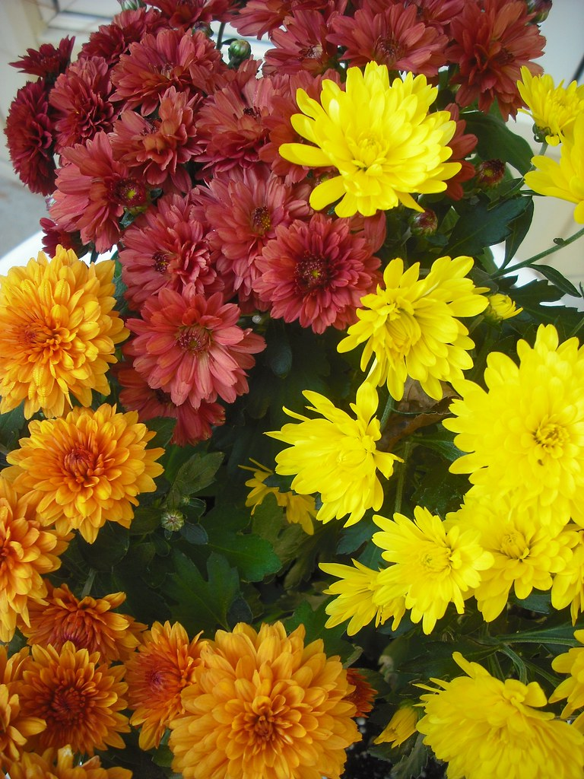
It’s time for MUMS!
It's time for mums again! We are excited to be having this fundraiser again this year through Furst Florist.
Our fundraiser will kick off September 2nd.
Orders are due to Alisa by September 16th and delivery will be September 27th - just in time for fall!
More information to come SOON!
This Photo by Unknown Author is licensed under CC BY-NC-ND

Slide 9

for joining us this evening!

