Slide 1
National Advisory Council
Members make their individual wisdom and insight on issues of Doctrine and biblical standards
Members offer themselves as instruments of mentoring younger ministers
Members are available to teach, exhort and minister to brethren at major conferences and meetings.
The Council arbitrates on issues or disputes within the Fellowship
The Council functions as the National Ordination Board of the Fellowship

Slide 2
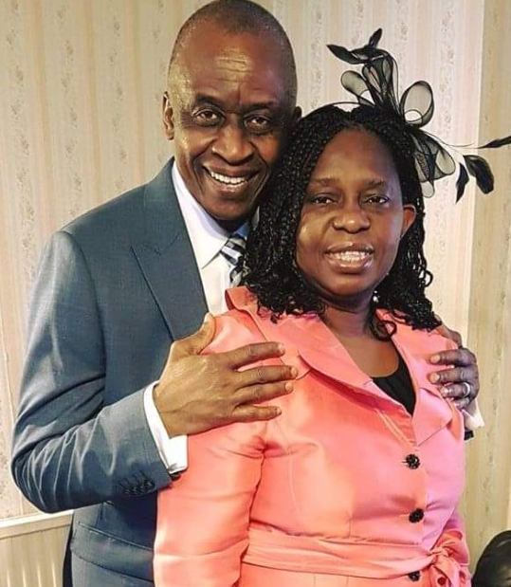
Apostle George & Pastor Grace Akalonu
International President

Slide 3
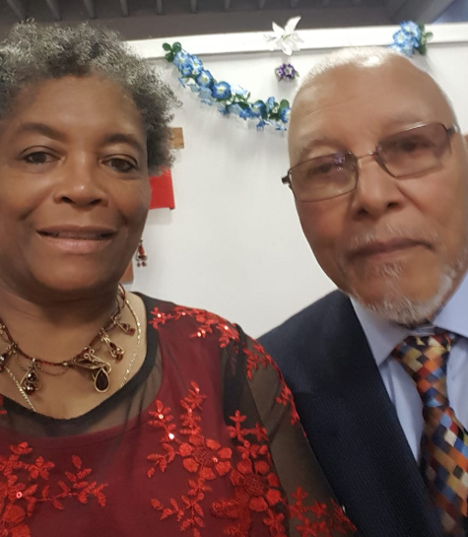
Apostle Fred & Pastor Kathleen Harris
National Advisory Council Chair
IMF USA Trustee Member

Slide 4
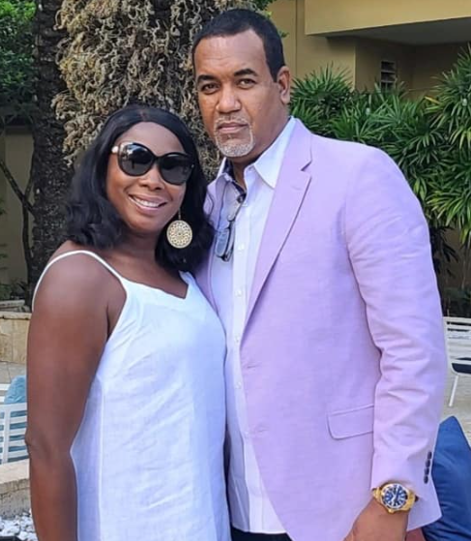
Apostle William & Lady Kenya Spence
National Advisory Council

Slide 5
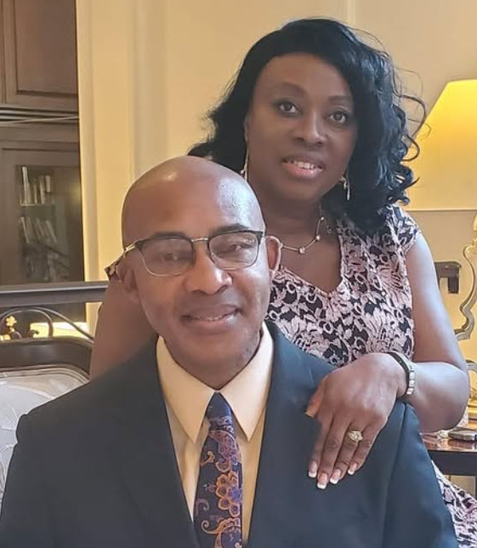
Apostles Didy & Julia Oparaocha
National Advisory Council

Slide 6
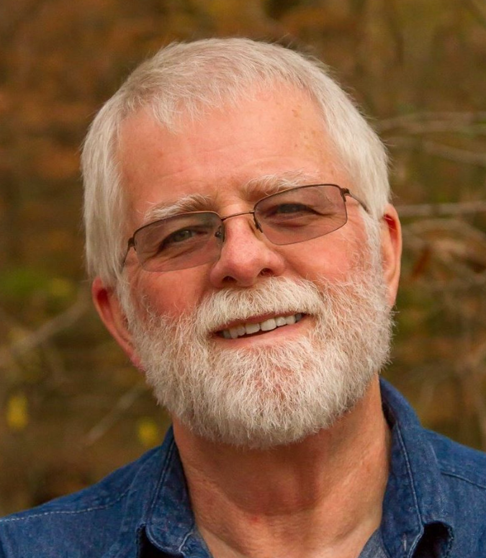
Apostle Dennis Sharp
National Advisory Council

Slide 7
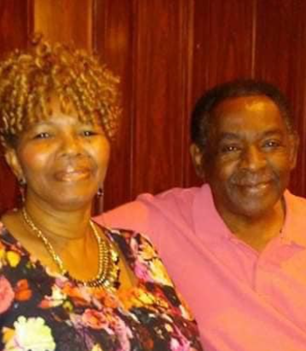
Apostle Geneva & Elder Henry Young
National Advisory Council

Slide 8
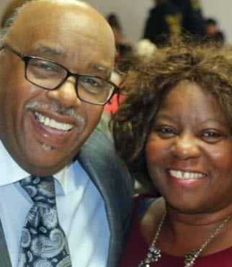
Apostles James & Lady Diane Holley
National Advisory Council

Slide 9
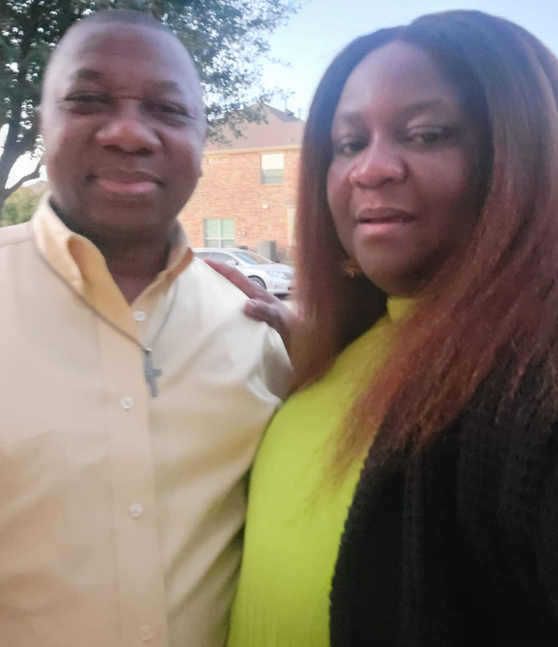
Pastor O.C. & Lady Edith Obikaram
National Advisory Council

Slide 10
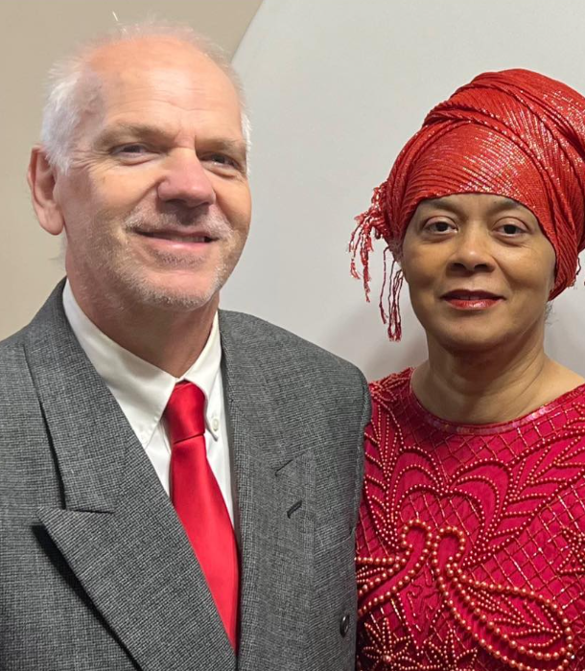
Apostle Sharon & Elder Barry Thomas
National Advisory Council

Slide 11
National Board of Trustees

Slide 12
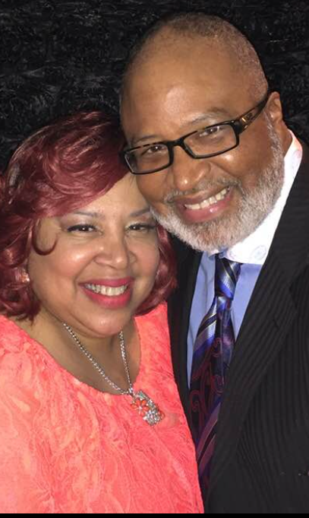
Apostles Terance & Victoria Blount
National Advisory Council Member
IMF USA Trustee, Secretary

Slide 13
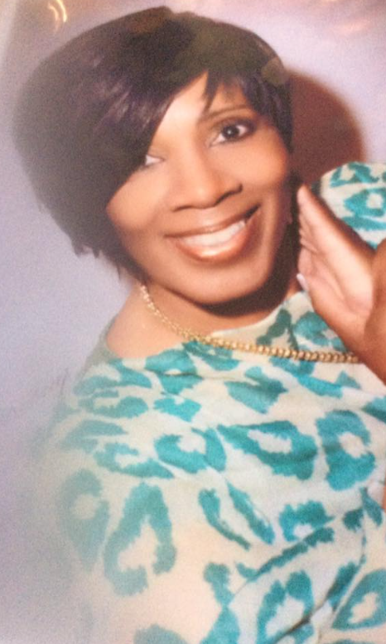
Apostle Brenda Jamison
Global Director Women in Ministry National Advisory Council Member
IMF USA Trustee Member

Slide 14
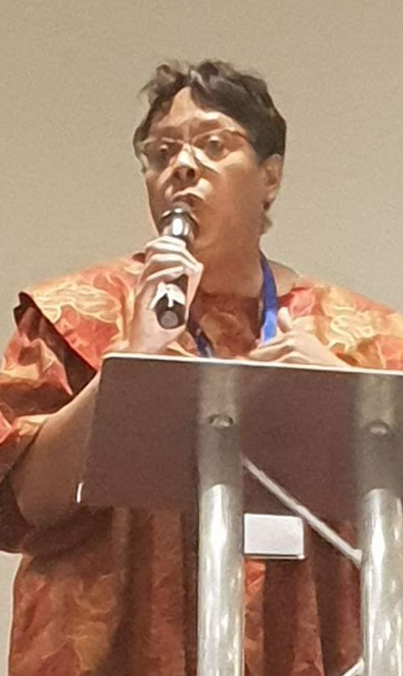
Teacher Stephanie Foster
Global Director Administration
National Advisory Council Member
IMF USA Trustee Member

Slide 15
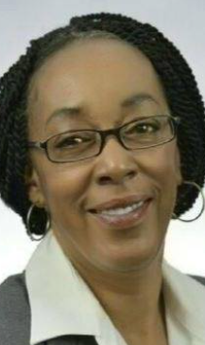
Apostle Dr Katherine Jones
Global Director Communications
Advisory Council Member
IMF USA Trustee Member

Slide 16
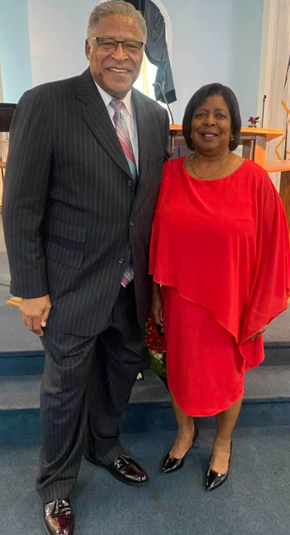
Apostle Sheldon & Lady Deborah Southerland
IMF USA Board of Trustee Member

Slide 17
National Executive Committee

Slide 18
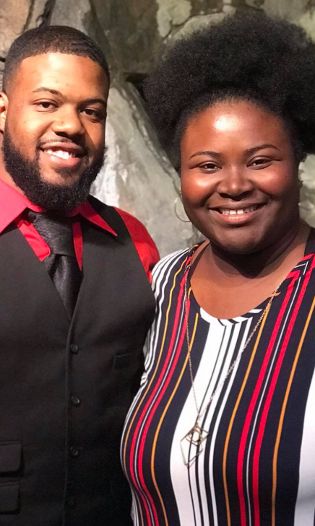
Deputy President
Ministers Tavon & KeAsha Green

Slide 19
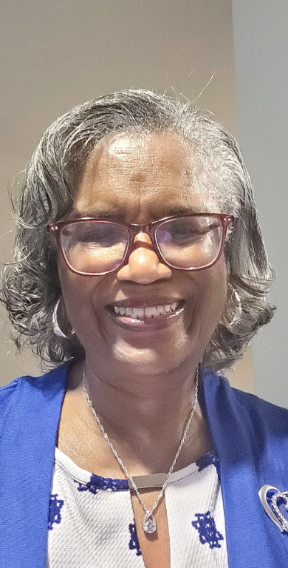
Director Prayer Intercession & Spiritual Warfare
Minister Ann Watson

Slide 20
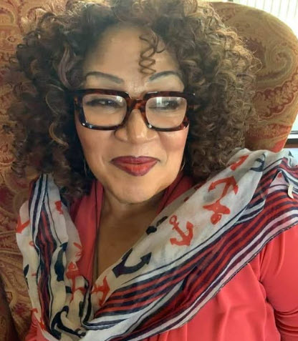
We Care Director
Minister Rose Etuka

Slide 21
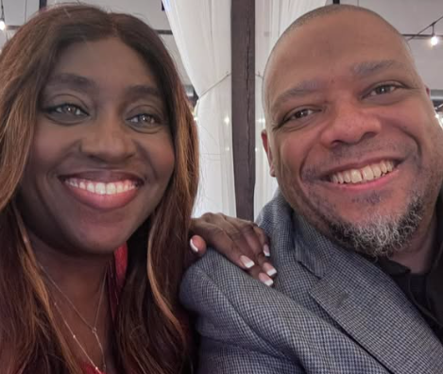
Director Women in Ministry
Pastors Niral & Ose Burnett

Slide 22
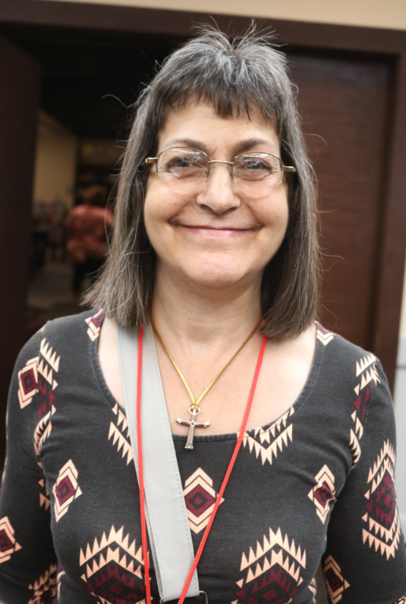
Director Church Growth
Minister Missy Soppick

Slide 23

Director Mobilization
Minister Telitha Courmier

Slide 24
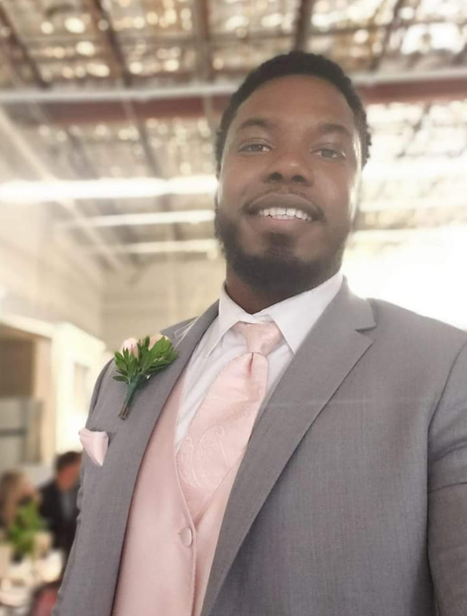
Director Youth & Next Generation
Minister Elijah Jawon Louis Banks

Slide 25
Ex Officio
Ex Officio Officers are given ad hoc assignments by the National President and Secretary General
Ex Officio Officers are also Regional Coordinators of the Fellowship at the City or State levels

Slide 26
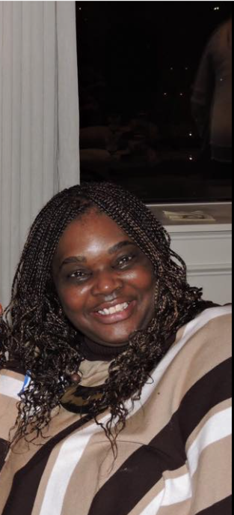
Ex Officio
Minister Michelle Wilson

Slide 27
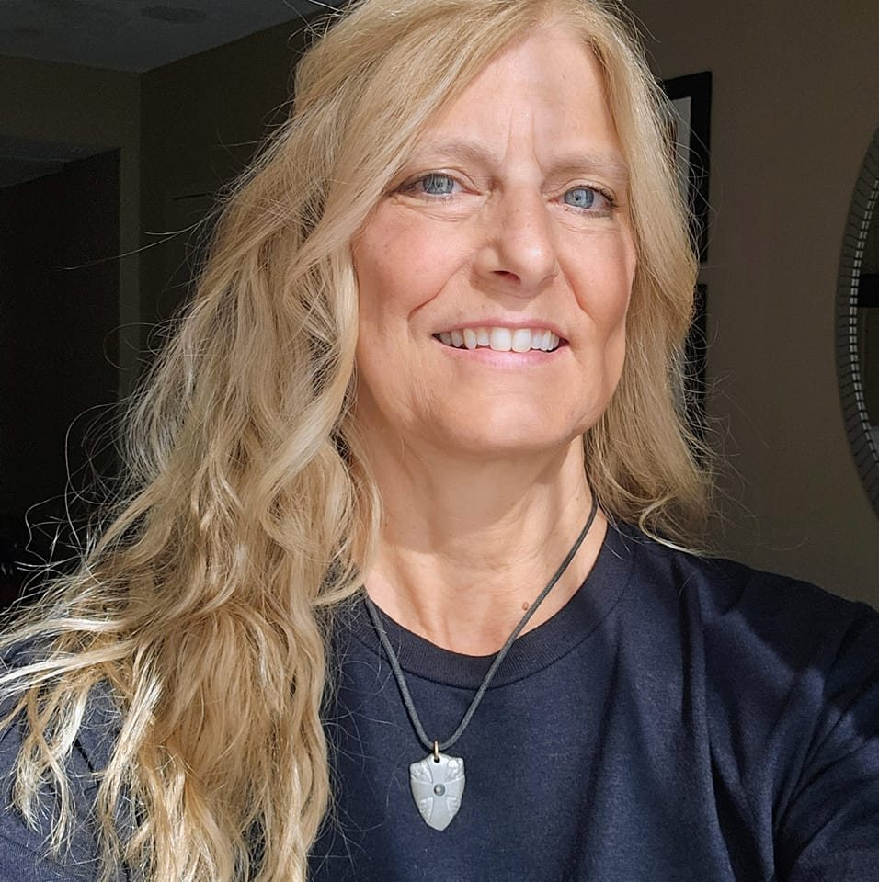
Ex Officio
Minister Bonnie Gardner

Slide 28
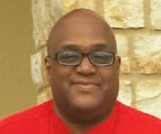
Ex Officio
Apostle Otha Bell

