Slide 1
History of Spaceflight
Part 1-The Early Years
Frank Buzzard
NASA Space Shuttle and International Space Station Chief Engineer-Retired

Slide 2
Early dreamers of space travel Konstantin Tsiolkovsky 1857-1935
The founding father of Russian rocketry and astronautics who lived in Kaluga, Russia. Deaf from scarlet fever he could not attend school. Self-educated and inspired by Jules Verne, he published, 'The Exploration of Cosmic Space by Means of Reaction Devices', in 1903. This pivotal work laid out the fundamental theories on rocket and spacecraft design, rocket trajectories and astronautics . He published approximately 90 works on space travel and related subjects.
Delta Velocity = Isp g ln (Mass initial/Mass final)

Slide 3
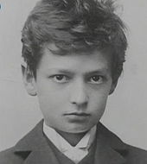
Early dreamers of space travel Hermann Oberth 1894-1989
Born to a German family in Austria-Hungary, Oberth was fascinated by Jules Verne’s “From Earth to the Moon”. He built his first model rocket at 14. He derived the concept of multi-stage rockets independent of Tsiolkovsky. In 1923 he published "By Rocket into Planetary Space“ then expanded in 1929 to "Ways to Spaceflight“. In 1929, Oberth conducted a static firing of his first liquid-fueled rocket motor, which he named the Kegeldüse assisted by 18 year old student Werhner Von Braun. Oberth consulted on the first film ever to have scenes set in outer space, Frau Im Mond, "The Woman in the Moon“. Later he described space-based reflecting telescopes, space stations, electric-powered spaceships, and space suits.
young Oberth 1901
Father of German rocketry and astronautics

Slide 4
Early dreamers of space travel Robert H. Goddard 1882-1945
American Robert H. Goddard created the world's first liquid fueled rocket which he successfully launched on March 16, 1926. He launched 34 rockets up to 1941 reaching an altitude of 1.6 miles and a speed of 600 mph. Two of Goddard's 214 patents — a multi-stage rocket design (1914), and liquid-fuel rocket design (1914) — were key milestones toward spaceflight. His 1919 book, A Method of Reaching Extreme Altitudes, is one of the classic texts of 20th century rocket science.
Goddard developed crucial rocket flight control innovations—three-axis control, gyroscopes, and steerable thrust.
Ridiculed in the press, Goddard became highly protective of his work and privacy likely limiting the expansion of American rocket science knowledge.
Robert H Goddard Father of American rocketry

Slide 5
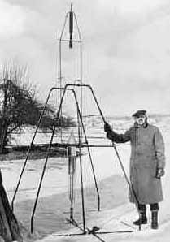
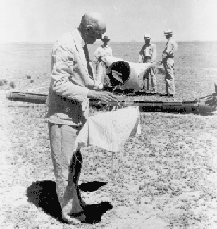
Goddard first liquid fueled rocket March 16, 1926 Auburn, Mass. “Tried rocket at 2:30. It rose 41 feet & went 184 feet, in 2.5 seconds after the lower half of the nozzle burned off.”
Goddard inspecting rocket, nosecone, and parachute in Roswell, NM in 1937.

Slide 6
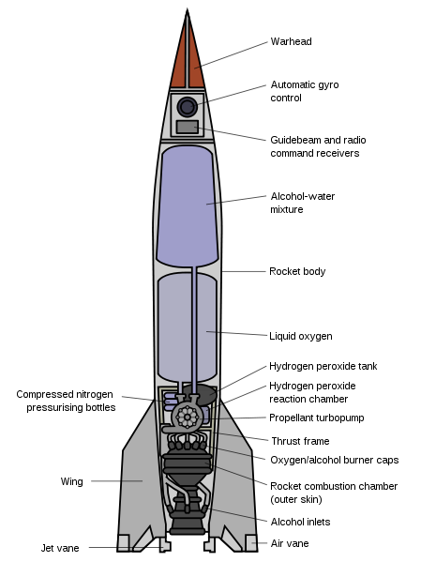
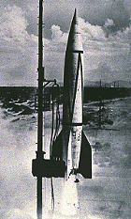
Wartime Germany leads the way to Space
3000 A-4/V-2 rockets fell on London and Antwerp in 1944
First successful flight Oct 3,1942
A modern rocket well ahead of its time
A-4/V2 key technologies were
large liquid-fuel rocket engines, supersonic aerodynamics, gyroscopic guidance and rudders in jet control .
46 feet high, weight 28,000 lbs Thrust 56,000 lbs,
Payload 2200 lbs, range 200 mi, max speed Mach 3.5, max altitude 60 miles

Slide 7
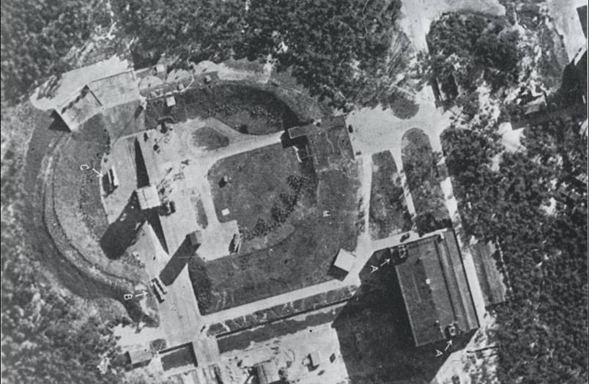
A-4/V-2 test site and production
Peenemunde A-4/V-2 test site VII from British reconnaissance photo
Entrance to V2 factory at Dora-Mittelbau concentration camp built after British bombs destroyed Peenemunde in 1943-44

Slide 8
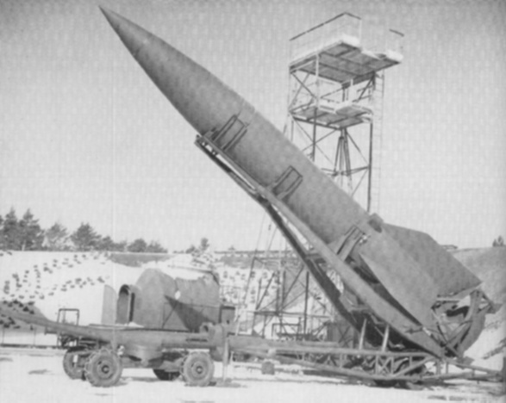
V-2 test flight and meillerwagen launcher

Slide 9
Peenemunde VIP visit May 26, 1943
At the extreme left is Dr. Walter Thiel, A-4/V-2 propulsion designer, next is Councilor Plendel. The officer behind him is Colonel Claus Count Schenk von Stauffenberg. To the right walks Infantry General Herbert Olbricht. Grand Admiral Karl Dönitz in the naval greatcoat. General Heinz Brandt hands behind his back. Walter Dornberger turned to talk while von Braun in the dark suit follows to his left.

Slide 10
Wernher Magnus Maximilian, Freiherr von Braun 1912-1977
Wernher von Braun was born in Wirsitz, province of Posen, in Germany in 1912. He was the second of three sons of an aristocratic family. His father, Magnus Freiherr von Braun, served as a Minister of Agriculture in the Weimar Republic. His mother, Emmy von Quistorp (1886–1959), could trace her ancestry through both parents to royalty, a descendant of Phillip III of France, Valdemar I of Denmark, Robert III of Scotland, and Edward III of England. Wernher von Braun was an accomplished amateur cello and piano musician playing Beethoven and Bach.
Von Braun developed an early interest in astronomy and rocket propulsion. In 1930 he attended the Technical University of Berlin where he joined the the "Spaceflight Society” and assisted Willy Ley and Hermann Oberth in their liquid-fueled rocket motor tests. Von Braun was awarded a doctorate in physics in 1934 from the University of Berlin. Walter Dornberger became the military commander at Peenemünde, with von Braun as technical director. The Peenemünde group developed liquid-fuel rocket engines for aircraft , A-4/V-2 ballistic missile, and the Wasserfall anti-aircraft missile.

Slide 11
Most German rocket scientists go to USA
On June 20, 1945, von Braun and about 1,000 other German engineers and family members traveled from east Germany into the U.S.-held western zone, just ahead of the advancing Red Army. They would work in the USA.
One German rocket engineer, sized up his options in April 1945: “We despise the French, we are mortally afraid of the Soviets, we do not believe the British can afford us. So that leaves the Americans.”
The Soviets found the V-2 underground production center at Mittelwerk mostly abandoned, its top personnel gone, and key documents missing. Americans had shipped completed V-2s west.
Russian Boris Chertok had arrived in Germany two months earlier to search for and evaluate Nazi V-2 technology.
Helmut Gröttrup, a top expert on the V-2’s flight control system, and some colleagues accepted the Russian promise to stay and work in Germany. They restarted the V-2 production at Mittelwerk. Stalin secretly ordered 500 engineers and families and 7000 workers to Russia in Oct 1946.
A group, led by Gröttrup worked for Sergei Korolev, Chief Designer for Space.
A group, led by V-2 propulsion specialist Erich Putze, worked for Valentin Glushko, the other principal figure in Russian rocket propulsion.

Slide 12
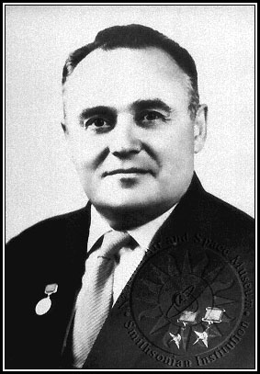
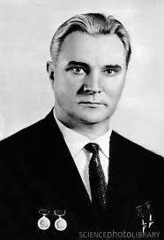
Like the Germans, the Russians had an active rocket club in the 1920s-30s, leading to Korolev's RP-318, Russia's first rocket propelled manned aircraft, powered by Glushko's ORM-65 rocket engine. Korolev and Glushko were thrown into the Soviet gulag in 1938 during the peak of Stalin's insane purges. Both worked in prison design bureaus until release in 1944.
Valentin Glushko, Soviet Chief Designer, of all rocket engines at OKB-456 1946-1974. Led NPO Energia 1974-1989 and design of Energia LV and Buran spaceplane.
Sergei Korolev (1907-1966) was the secret “Chief Designer” who guided the R-7 rocket design that launched Sputnik (1957) and Gagarin ( 1961)

Slide 13
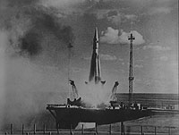
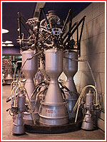
Korolev’s R-7 is the first ICBM which flies Sept 7, 1957 after 3 failures from Tyuratam (Baikonur). R-7 launches Sputnik Oct 4, 1957 and Yuri Gagarin in Vostok-1 capsule April 12, 1961. Over 500 R-7 and evolved Soyuz rockets have launched from this pad.
Glushko’s RD-108 engine, which powered the second stage of the R-7 rocket. Four R-7 boosters used the similar RD-107 engine

Slide 14
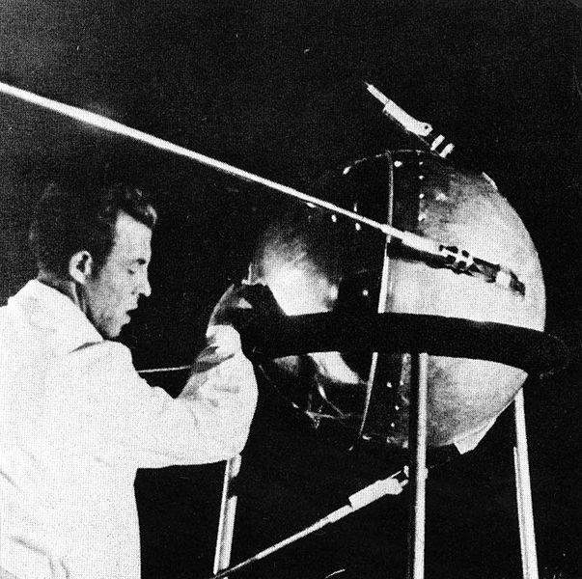
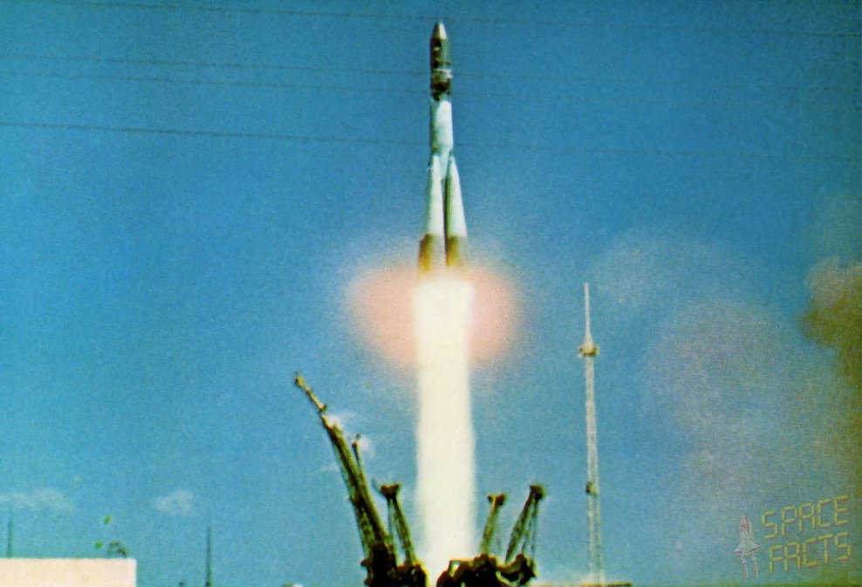
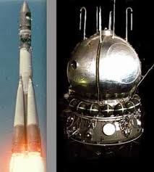
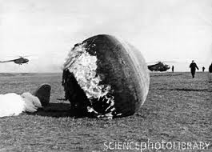
Sputnik 1 launched Oct 4, 1957-
The first artificial earth satellite
Vostok-1 Capsule and Yuri Gagarin launch and landing
April 12, 1961.
First manned spaceflight and first manned orbital mission.

Slide 15
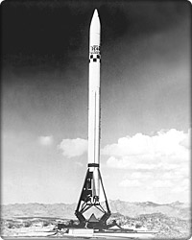
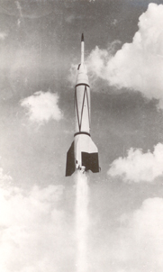
America moves German rocket scientists to White Sands Missile Range, New Mexico to aid a fledgling US rocket program
V-2/Bumper WAC flew 8 times (five failures) from May 1948 including two flights from Cape Canaveral. Flight 5 altitude 390 km/244 mi reaching Mach 5.2 a record until 1957
Douglas Aircraft /JPL developed WAC-Corporal sounding rocket first flight Oct 1945 reached 70 km/45 mi

Slide 16
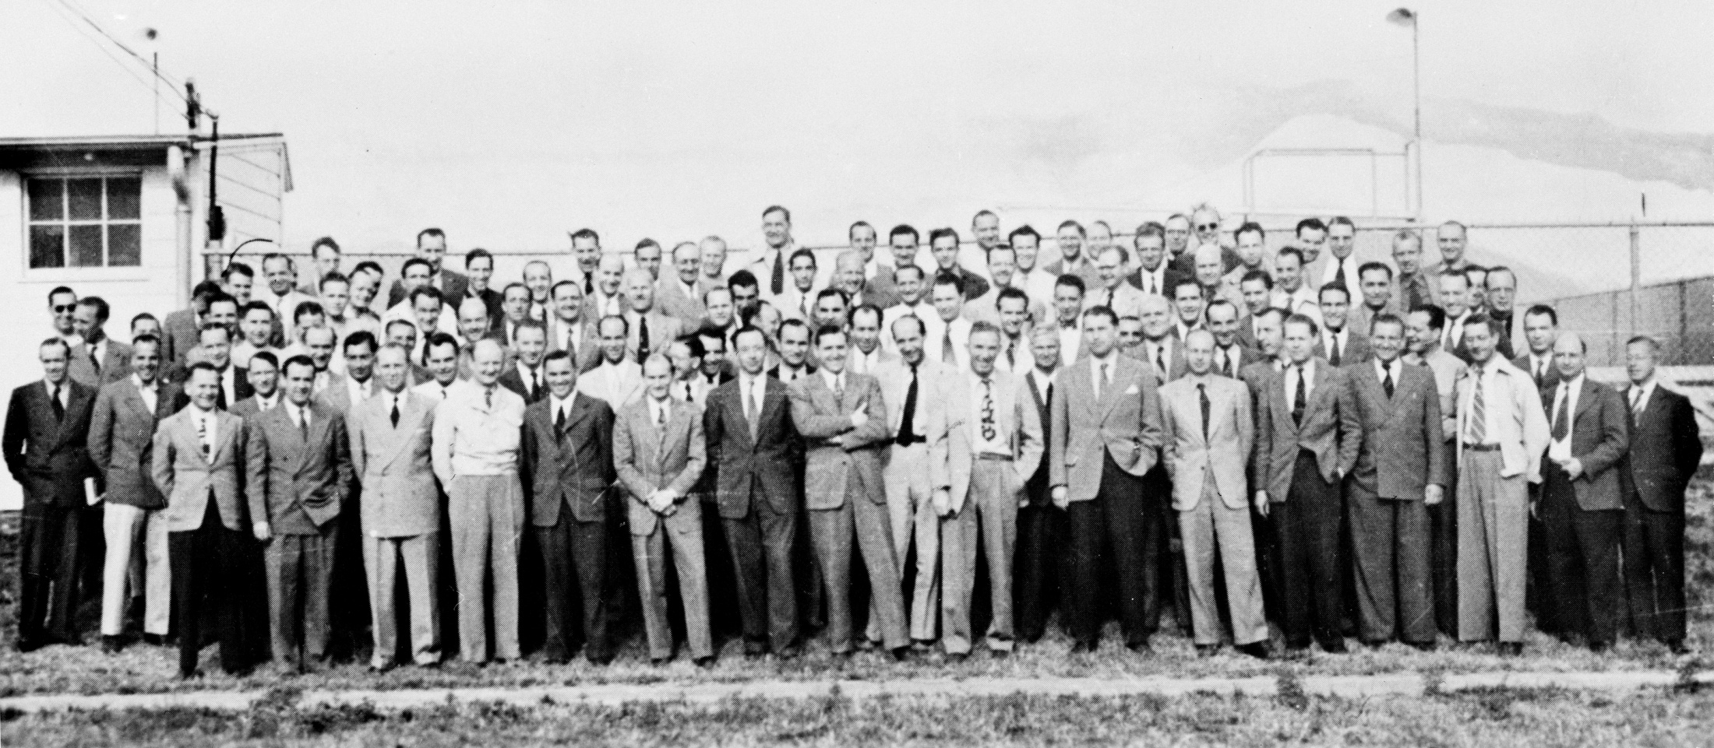
OSS ‘Operation Paperclip’ brings German rocket scientists to Ft Bliss, TX in January 1946. OSS expunged from the public record the scientists' Nazi Party memberships and created false employment and political biographies for the scientists to circumvent President Truman's anti-Nazi exclusion which would have prevented most German rocket scientists from immigrating to America .
Wernher von Braun

Slide 17
After Sputnik, America’s first civilian satellite launch attempt ends in spectacular failure
Following the stunning and unexpected launch of Sputnik in Oct 1957 and Sputnik 2 with Laika the dog in Nov 1957, America’s first attempt to launch a satellite with the US Navy developed Vanguard 1 explodes on the launch pad December, 6, 1957.
Von Braun and his Redstone Arsenal US Army team had lost the competition to the US Navy in 1955 to launch the first US earth orbiting satellite as part of the 1957 International Geophysical Year (IGY) project .
Disappointed but undeterred, von Braun and his team quietly continued work on the Jupiter-C rocket and Explorer 1 spacecraft with William Pickering’s JPL team and James Van Allen developing the Explorer 1 satellite. They launched America’s first satellite into orbit on January 31, 1958 .

Slide 18
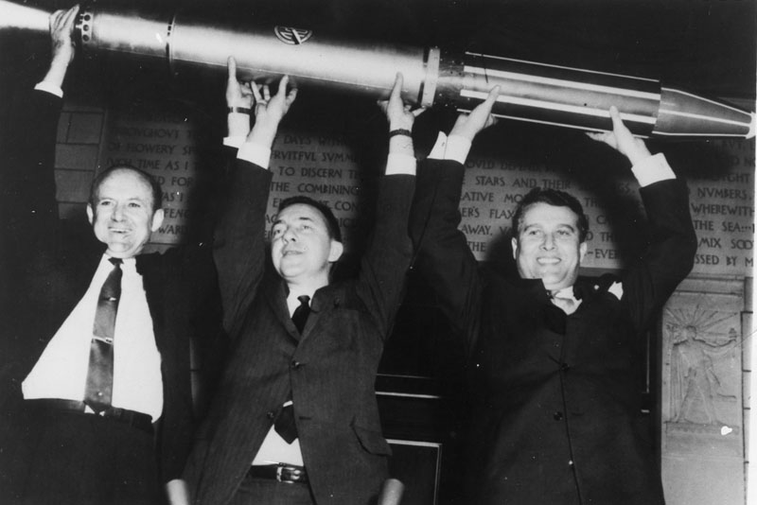
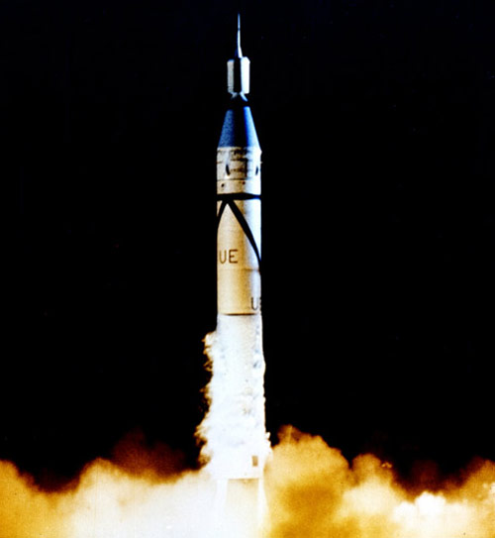
Wernher von Braun
Pickering, Van Allen, Von Braun proudly display Explorer 1 model
Von Braun and Walt Disney “Man In Space” TV Series 1955 about Space Exploration
Jupiter-C and Explorer 1
First US Satellite
Jan 31, 1958

Slide 19
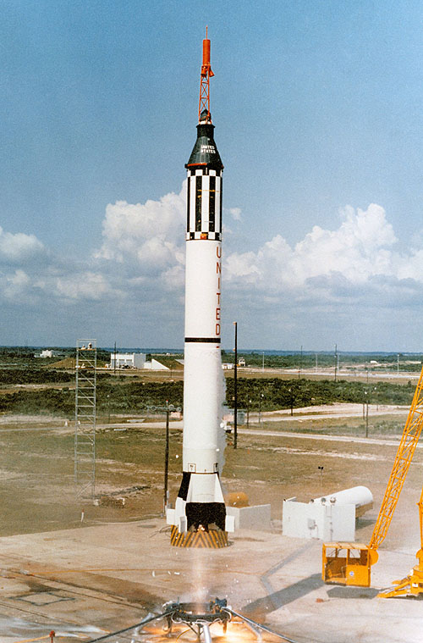
Werhner von Braun and the Huntsville, Alabama Redstone Arsenal team develop the man rated Redstone rocket derived from the Jupiter-C to carry America’s first man in space in a Mercury capsule developed by the manned spacecraft center in Houston, TX.
Alan Shepard rides the Redstone on May 5, 1961 on a 15 minute suborbital flight in the Mercury spacecraft Freedom 7 as the first American in Space.
Gus Grissom rides the second Redstone in the Mercury capsule Liberty Bell 7 on July 21, 1961.

Slide 20
America’s first ICBM—Atlas—operational Oct 1959
May 1954 Convair’s Atlas program was formally given the highest national priority. First flight was June 1957. 4 of the first 8 test flights failed. The first successful flight to full range occurred 28 November 1958. Atlas ICBMs were deployed operationally from 31 October 1959 to 12 April 1965. Atlas placed four Mercury astronauts in orbit (Feb 20, 1962-May 1963) and became the foundation for a family of highly successful space launch vehicles--Atlas Agena, Atlas Centaur, evolving to Atlas V using a Russian RD-180 engine.
Atlas ICBM was 85 feet tall, 10 feet diameter weighing 260,000 lbs at launch with 360,000 lbs of thrust and range 9000 mi.

Slide 21
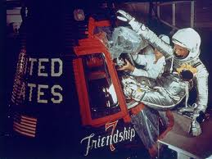
America’s first man in orbit
John Herschel Glenn, Jr becomes the first American to orbit the earth Feb 20, 1962 completing 3 orbits of the Earth

Slide 22
Atlas family of launch vehicles 1957-2012

Slide 23
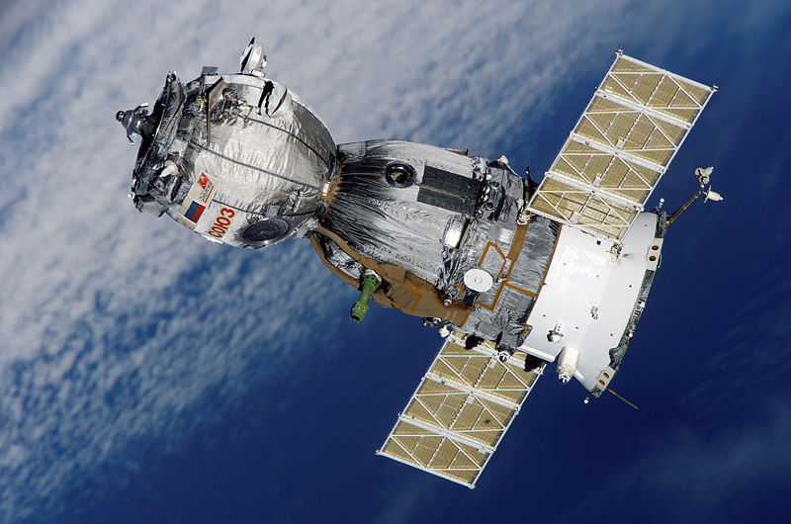
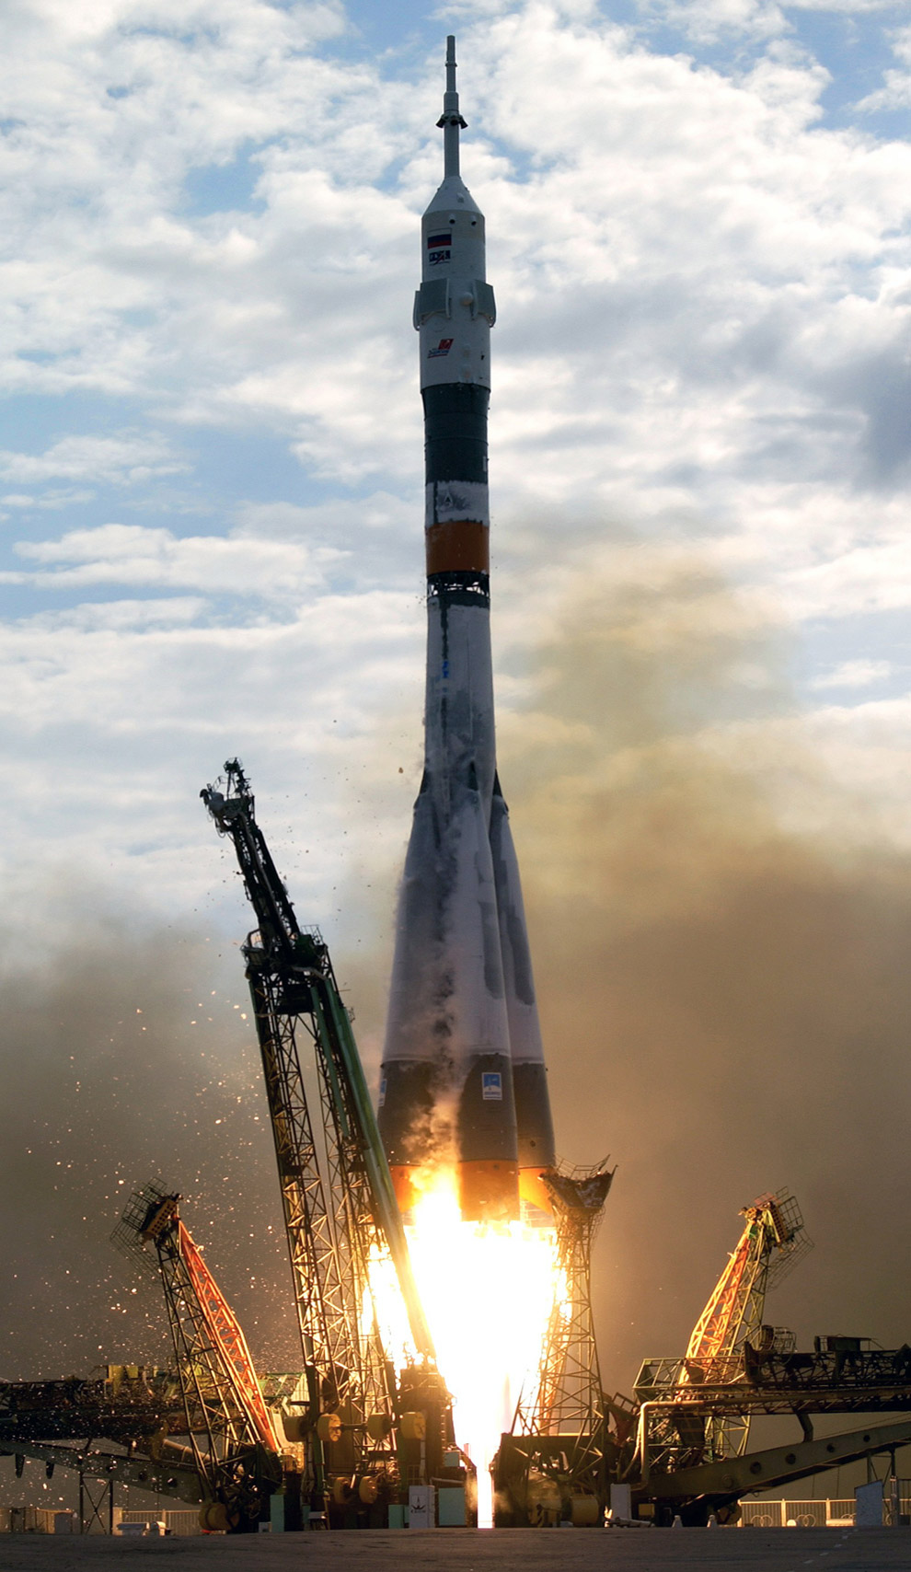
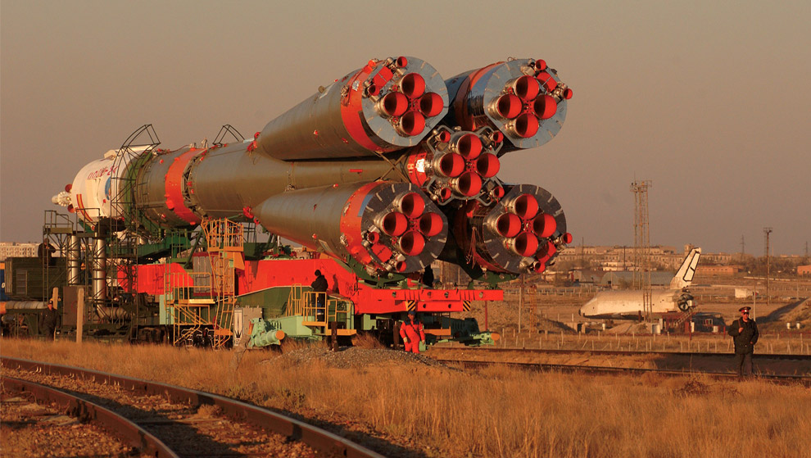
Evolved Soyuz launcher and 3 person Soyuz capsule

Slide 24
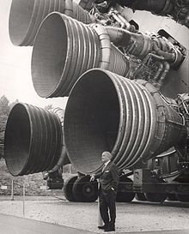
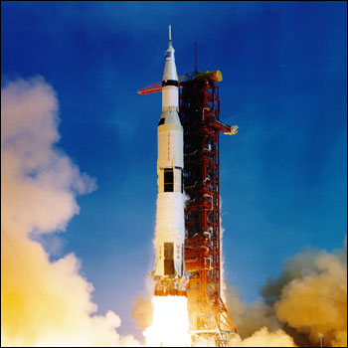
Werhner von Braun—the premiere rocket scientist of the 20th century
Apollo 11 Liftoff July 16, 1969
Von Braun and JFK at Redstone Arsenal, AL 1963
Von Braun with his mighty Saturn V F1 engine MSFC

Slide 25
The Earth is the cradle of mankind,
but one cannot remain in the cradle forever.
Konstantin Tsiolkovsky
You can view video and slides for this lecture at my website
frankbuzzard.com

