Slide 1
History of Spaceflight
Part 2-Man in Space
Frank Buzzard
NASA Space Shuttle and International Space Station Chief Engineer-Retired

Slide 2
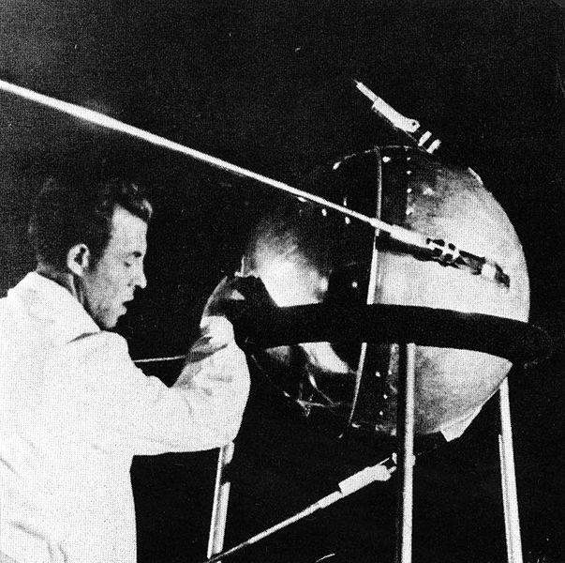
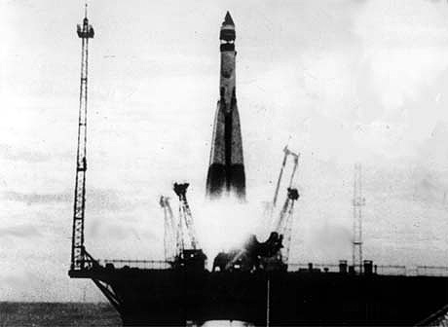
Russia changes the world on October 4, 1957
Sputnik first artificial Earth satellite launch

Slide 3
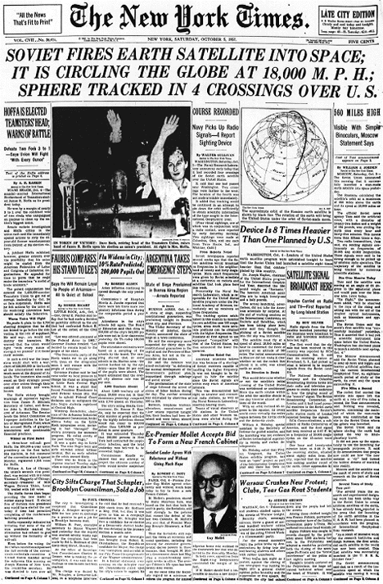
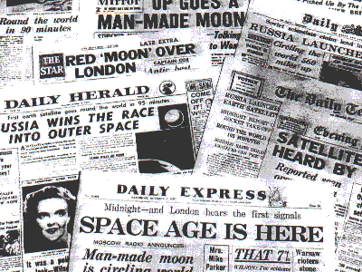
Sputnik shocks the world and starts the space race
London and NY Times headlines
October 5, 1957

Slide 4
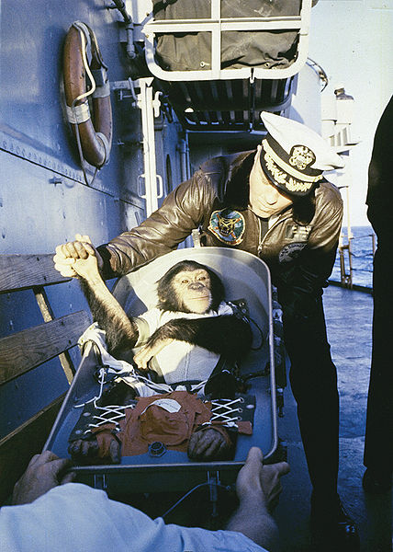
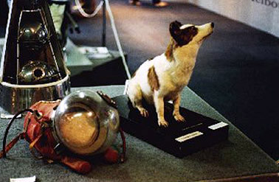
Russia and America launch animals into space
Laika rides Sputnik 2 into orbit Nov 1957. Belka and Strelka launch and return to earth Nov 1960. One of Strelka’s pups named Pushinka was presented to JFK’s daughter Caroline by Khrushchev in 1961.
Ham flies suborbital on MR-2 Jan 1961. Enos orbits the earth in MA-5 Nov 1961.

Slide 5
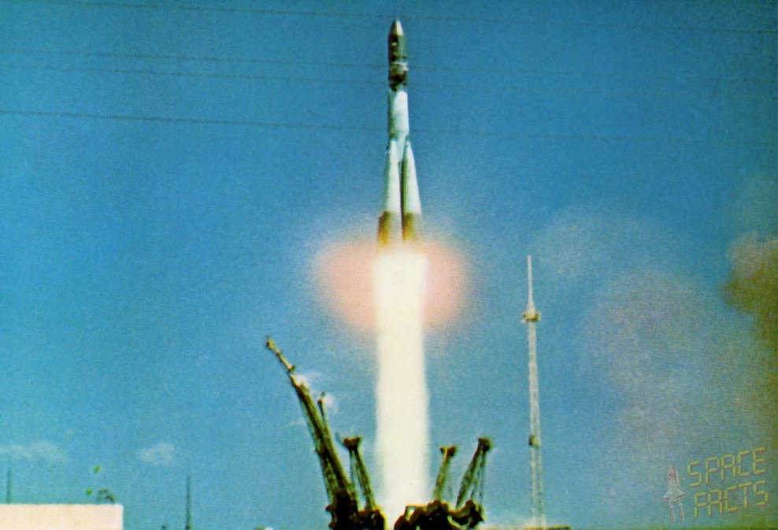
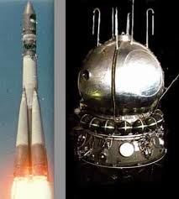
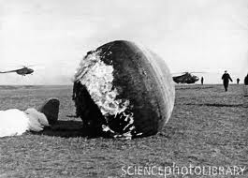
Russia stuns the world again with the first human to orbit the earth.
Vostok-1 capsule and Yuri Gagarin launch and landing
April 12, 1961.
First manned spaceflight and first manned orbital mission.

Slide 6
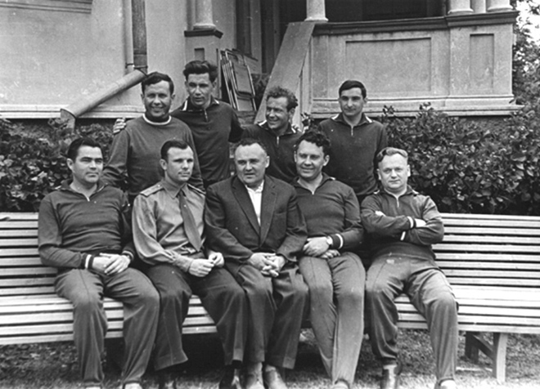
Russian Cosmonauts with Chief Designer Korolev at Black Sea resort of Sochi after Yuri Gagarin’s historic first flight 1961. Gagarin and Popovich right of Korolev. Two training officials to the left. Back Row: Nikolayev, Nelyubov (removed for misbehavior), Titov, Bykovsky

Slide 7
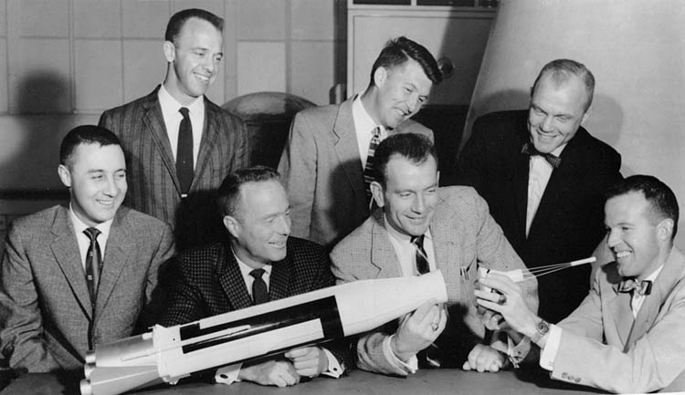
NASA selects Mercury 7 Astronauts April 1959 from 110 military pilots
Front Row: Gus Grissom, Scott Carpenter, Deke Slayton, Gordon Cooper
Back Row: Alan Shepard, Wally Schirra, John Glenn
1962 photo

Slide 8
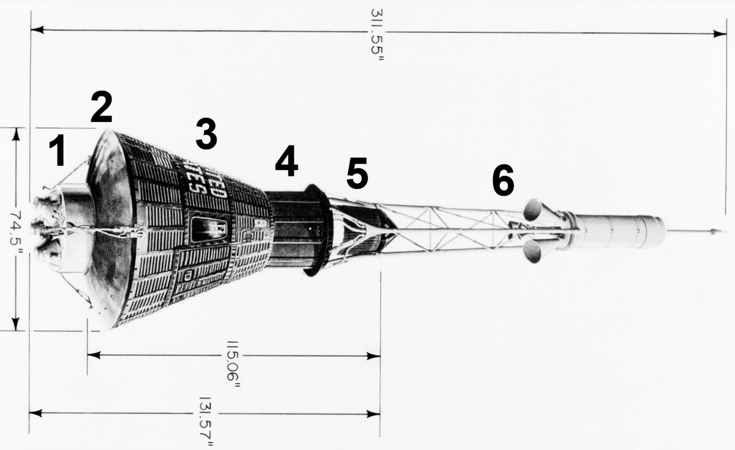
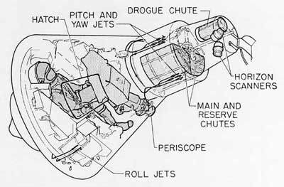
Mercury capsule functions
Retrorocket package
Heatshield
Crew compartment
Recovery compartment
Antenna section
Launch escape system
Mercury capsule design led by NASA Max Faget. 20 built by McDonnell Aircraft Company St Louis, Missouri. 16 flew in space. 4 manned launches.
One crewmember. 1.7 m3 volume. 120 controls: 55 electrical switches, 30 fuses and 35 mechanical levers. Cone shape stable during reentry.

Slide 9
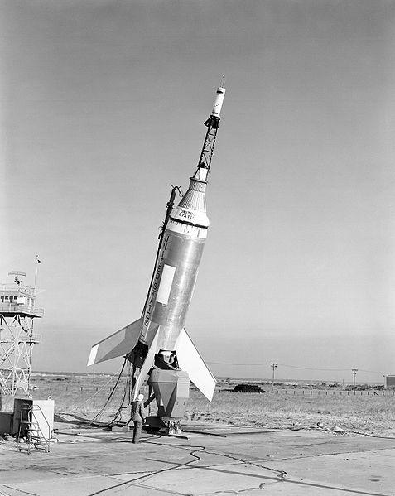
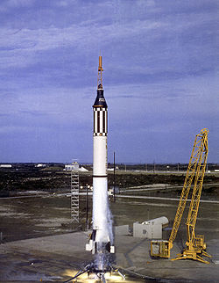
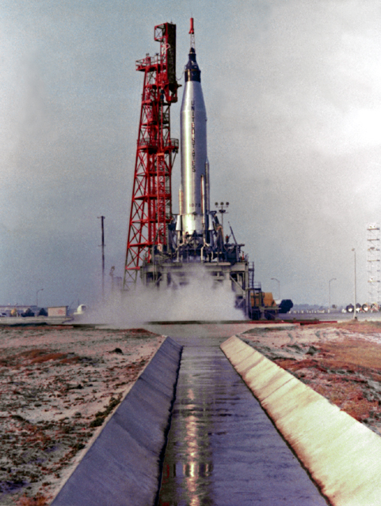
America tests Mercury capsule using Little Joe, Redstone, and Atlas rockets
Little Joe 5 tests first production Mercury capsule and launch escape system Nov 1960 and Mar 1961.
Atlas tests Mercury capsule in orbit on MA-4 Sept 1961. First 3 MA flights failed 7/60-4/61 as astronauts watched.
Redstone rocket tests Mercury capsule suborbital Dec 1960 and Ham chimpanzee Jan 1961.

Slide 10
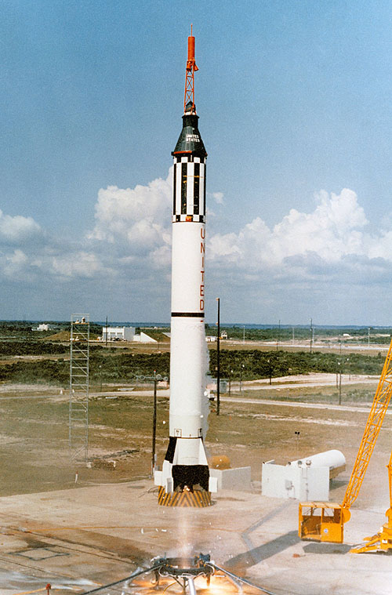
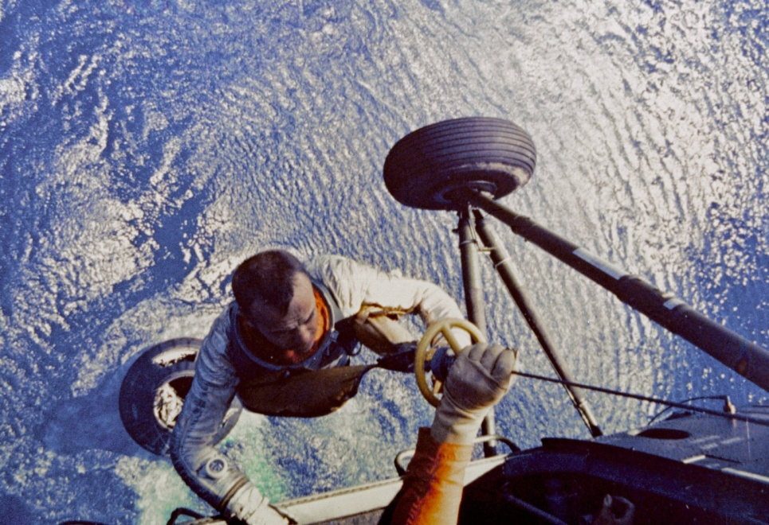
Werhner von Braun and the Huntsville, Alabama Redstone Arsenal team develop the man rated Redstone Rocket derived from the Jupiter-C to carry America’s first man in Space in a Mercury capsule developed by the manned spacecraft center in Houston, TX.
Alan Shepard rides the MR-3 Redstone rocket on May 5, 1961 on a 15 minute suborbital flight in the Mercury spacecraft Freedom 7 as the first American in Space.

Slide 11
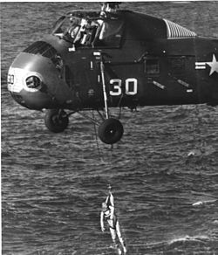
Virgil ‘Gus’ Grissom MR-4 repeats Shepard’s suborbital flight July 1961
Explosive hatch prematurely blows. Capsule fills with water and sinks. Grissom nearly drowns before recovery by second helicopter.
MR-4 liftoff July 21, 1961
Duration 15:37. Altitude 118 mi. Landing 302 mi downrange
First flight of new window and new explosive hatch on Mercury capsule

Slide 12
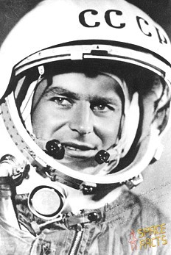
But Russia continues to upstage America
Vostok 2 launches Gherman Titov into space for an entire day August 6, 1961 completing 17 orbits and studying the effects of long term weightlessness on the human body. Titov demonstrates effective manual control of his spacecraft. As on Vostok 1 the Service Module fails to separate from the reentry module and burns off. Titov like Gagarin ejects and lands safely.

Slide 13
America’s first ICBM—Atlas—operational Oct 1959
May 1954 Convair’s Atlas program was formally given the highest national priority. First flight was June 1957. 4 of the first 8 test flights failed. The first successful flight to full range occurred 28 November 1958. Atlas ICBMs were deployed operationally from 31 October 1959 to 12 April 1965. Atlas placed four Mercury astronauts in orbit (Feb 20, 1962-May 1963) and became the foundation for a family of highly successful space launch vehicles--Atlas Agena, Atlas Centaur, evolving to
Atlas V using a Russian RD-180 engine beginning in 2000.
Atlas ICBM was 85 feet tall, 10 feet diameter weighing 260,000 lbs at launch with 360,000 lbs of thrust. Range 9000 mi.

Slide 14
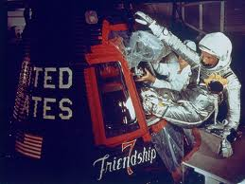
America’s first man in orbit
John Herschel Glenn, Jr. becomes the first American to orbit the earth Feb 20, 1962 on MA-6 completing 3 orbits of the Earth

Slide 15
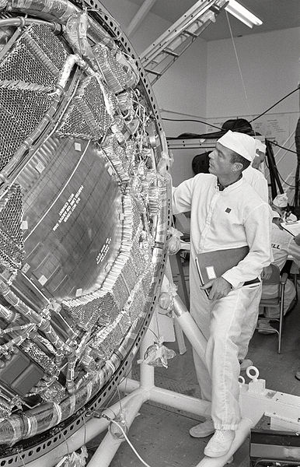
Scott Carpenter orbits in Aurora 7 May 24, 1962
America’s second Mercury 3 orbit flight. Excessive fuel consumption, attitude misalignment and manual retrofire causes an overshoot of the intended landing area 250 miles. 40 minutes later a helicopter spots Carpenter in a raft. Recovery is delayed 3 hours. Carpenter never flies in space again.

Slide 16
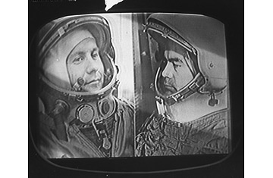
Russia launches Vostok 3 and 4 for a rendezvous in space
Andrian Nikolayev orbited the Earth 64 times in Vostok 3 during four days in space in August 1962-
A feat not matched by America until Gemini IV in June 1965.
Pavel Popovich launches the next day in Vostok 4 coming within 4 miles of Vostok 3 in earth orbit.

Slide 17
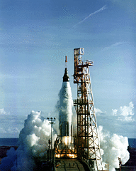
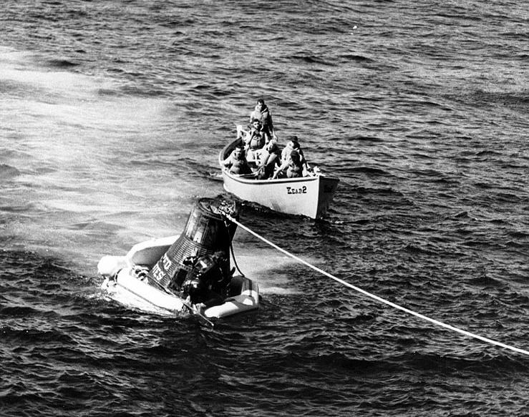
Wally Schirra flies Sigma 7 for nine hours-seven orbits-on 3 Oct 1962. He lands within ½ mile of USS Kearsarge.

Slide 18
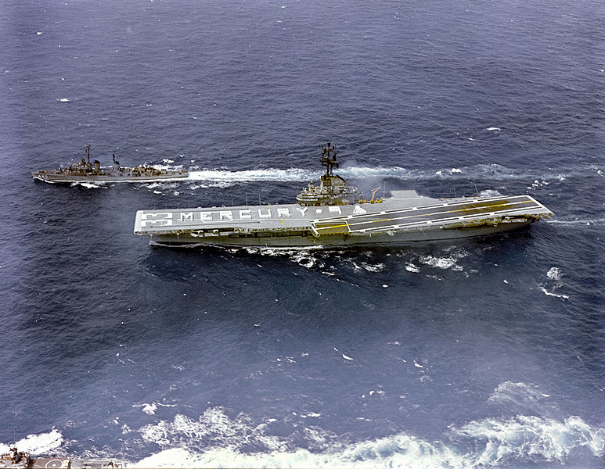
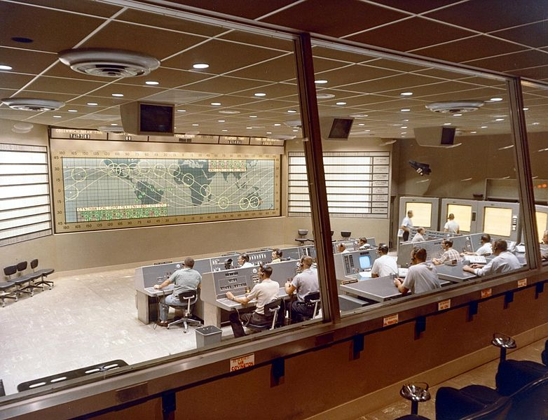
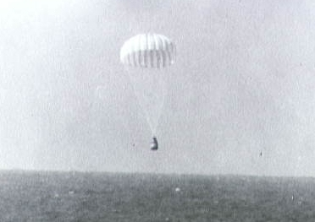
Gordon Cooper flies Faith 7 (MA-9) for 22 0rbits/34hrs 20 minutes ending the Mercury program. Extra batteries and O2 tanks added to extend mission duration. Cooper executes perfect manual reentry

Slide 19
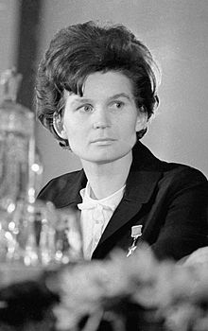
Russia continues to lead in space. Vostok 5 and 6 attempt another rendezvous and launch the first woman in space
Valentina Tereskova pilots Vostok 6 two days later. Closest approach to Vostok 5 is 3 mi. Both land June 19
Valerey Bykovsky pilots Vostok 5 June 14, 1963. Orbit is lower than planned.

Slide 20
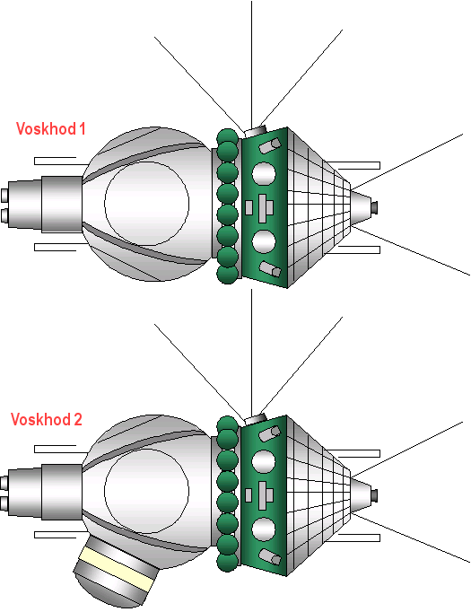
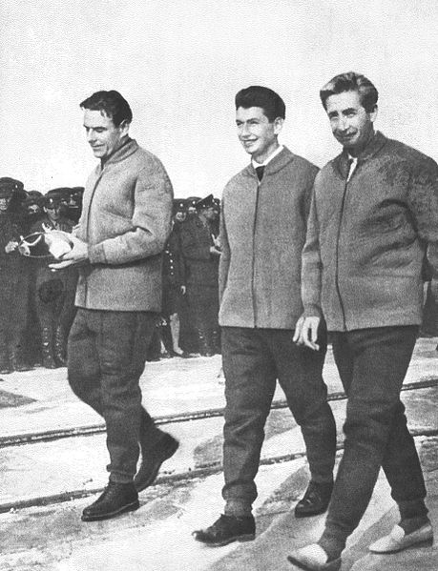
Another Russian first launches 3 man crew on a 24 hour flight in the Voskhod 1 (Sunrise) spacecraft 12 Oct 1964. Valdimir Komorav, Konstantin Feoktistov, Boris Yegorov fly without spacesuits in their cramped Voskhod capsule which was a modified Vostok w/o ejection seats.

Slide 21
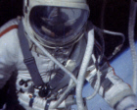
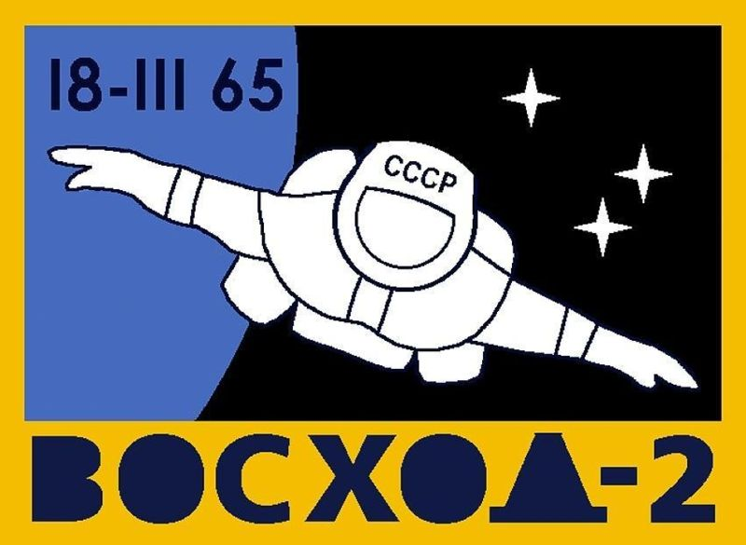
Alexei Leonov conducts first spacewalk 18 March 1965 with Pavel Belyayev. Leonov has to depressurize his expanded space suit after 12 minute spacewalk to reenter the capsule. 46 sec late manual deorbit due to a failed automatic control system caused the spacecraft to land 240 mi long in Siberia. Crew spends cold night (-22F) alone before rescue party arrives on skis the next day.

Slide 22
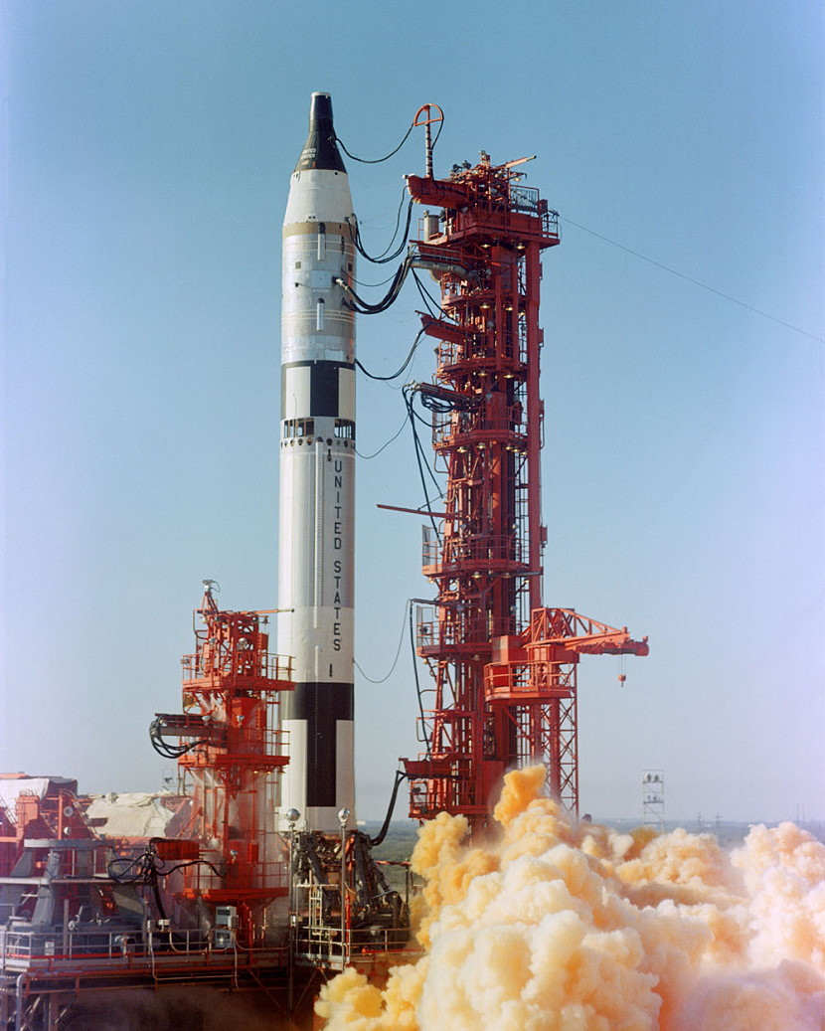
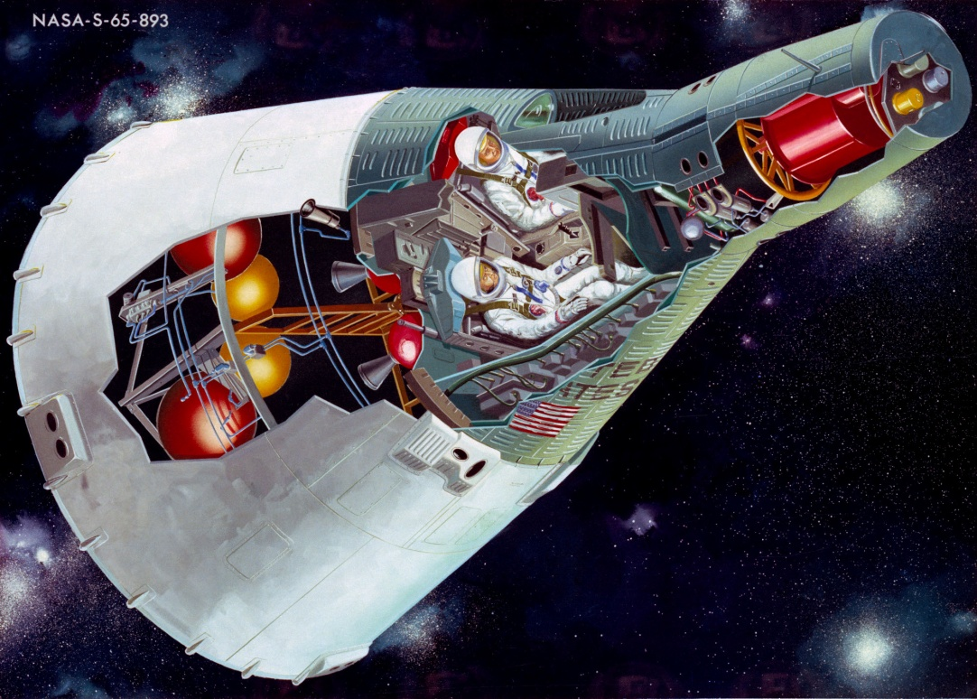
NASA moves from Mercury to Gemini two crew to demonstrate capabilities in space required to go to the Moon. 2 week duration. Orbital rendezvous and docking. Mated vehicle control and propulsion. Spacewalks. The spacecraft design, assembly, and operations team excels and surpasses the Russians for the first time in the Space Race.
Gemini spacecraft has separate crew capsule and propulsion and power service module. Four ton spacecraft. First use of fuel cells and onboard computer in space. Designed and built by McDonnell Aircraft. The Titan 2 ICMB launch vehicle propels ten manned missions to space 1965-66.

Slide 23
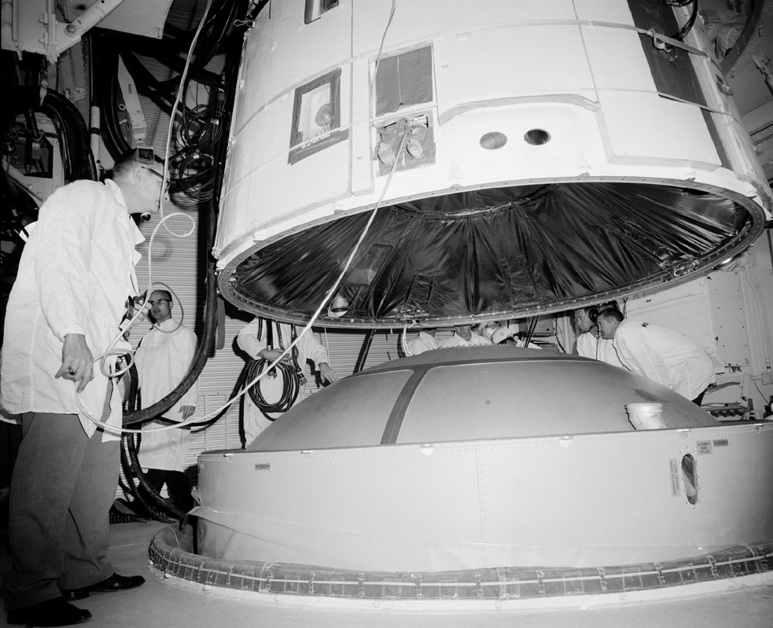
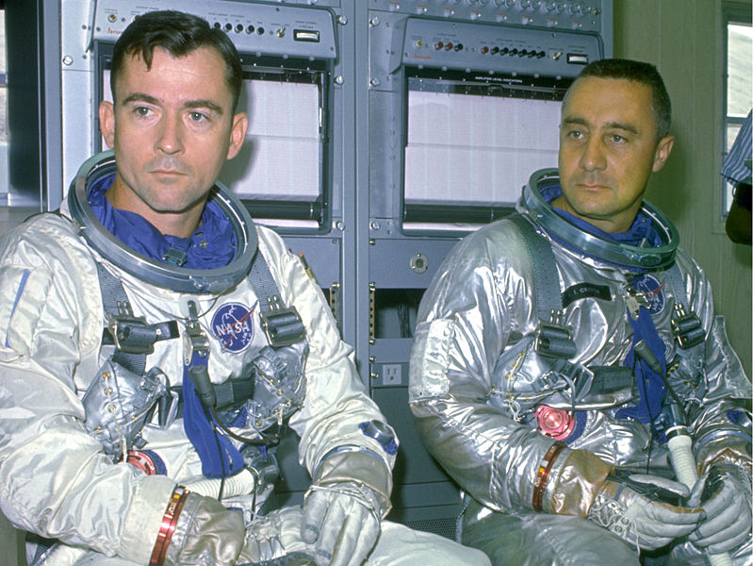
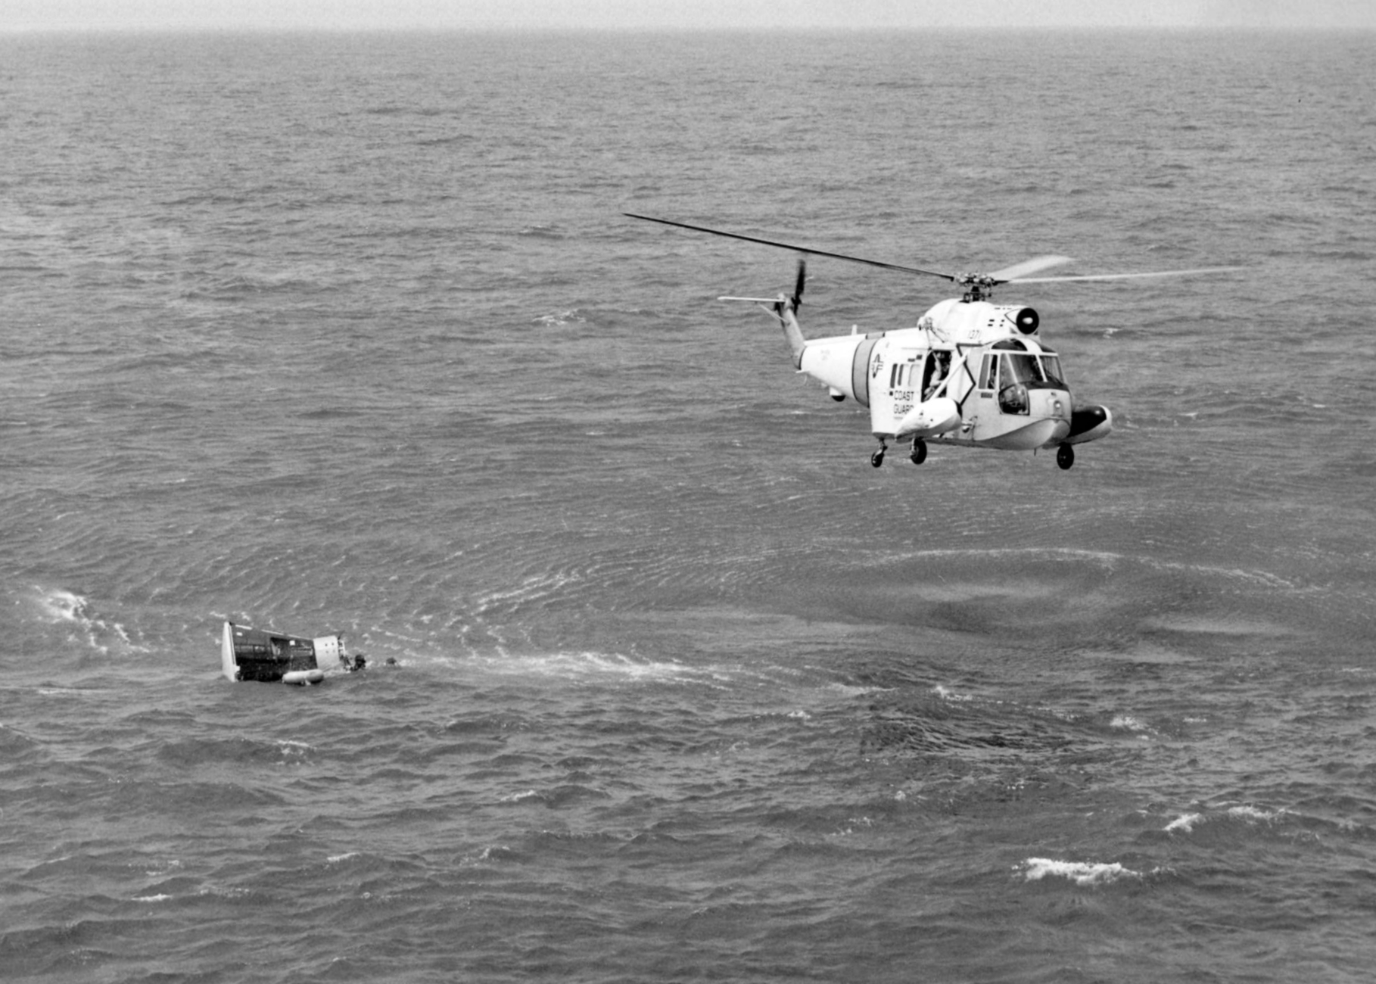
Gemini 3 launches 23 March 1965 on three orbits with commander Gus Grissom and pilot John Young in the ‘unsinkable Molly Brown’. Proved Gemini spacecraft design. First manned spacecraft orbit change. First demonstration of reentry lift to control splashdown point.

Slide 24
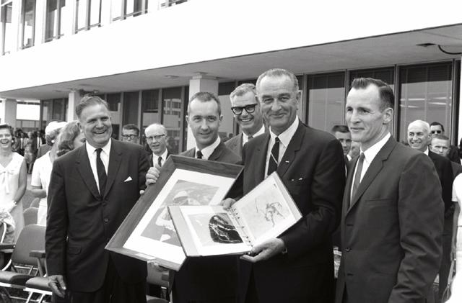
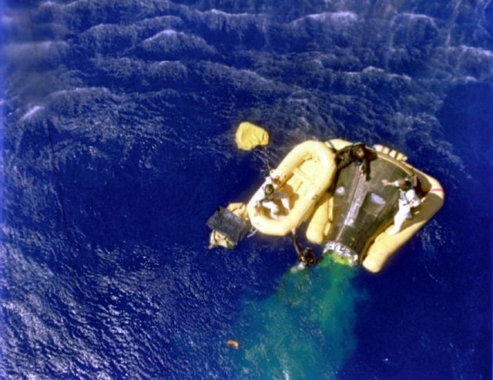
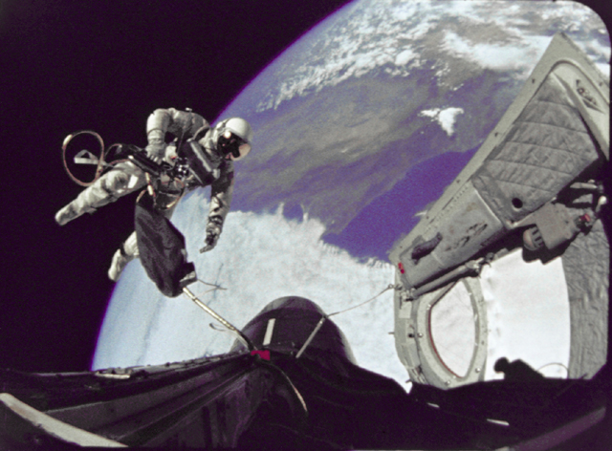
Gemini 4 carries James McDivitt and Ed White in a 4 day, 66 orbit flight 3-6 June 1965 approaching the 1963 Vostok 5 flight duration. Ed White conducts the first American spacewalk lasting 20 minutes. America closes the gap on the Russians for the first time.

Slide 25
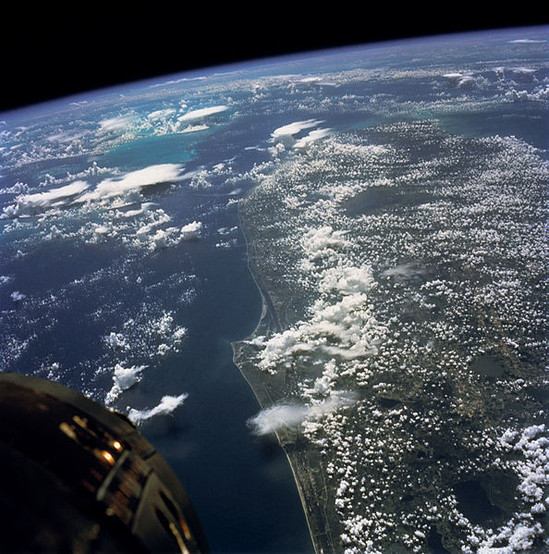
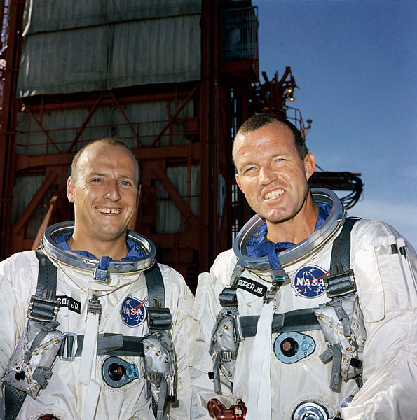
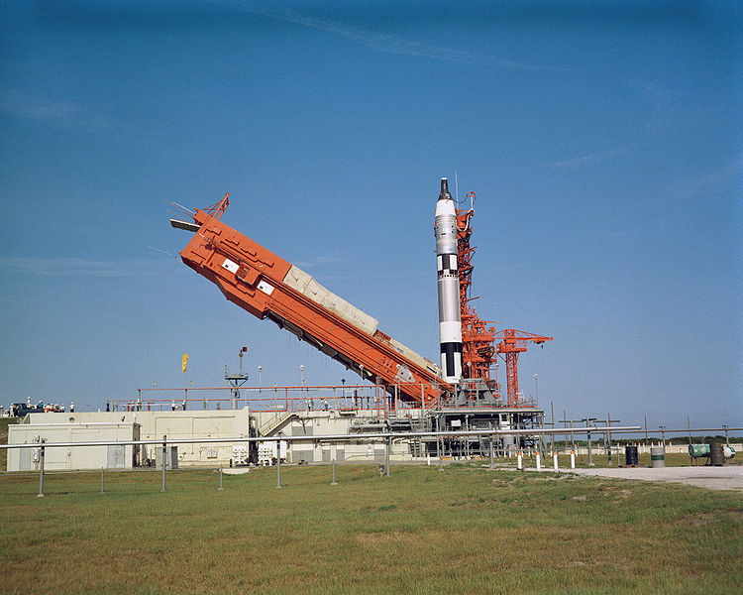
Gemini 5 launches Gordon Cooper and Pete Conrad to an 8 day 120 orbit flight on 21 August 1965. First use of Fuel Cells for electrical power in space. First GNC evaluation for future rendezvous and docking missions. Ground team successfully worked around several time critical problems-- resolved fuel cell shutdown and restart, failed thruster, replan of rendezvous procedure, cold spacecraft.

Slide 26
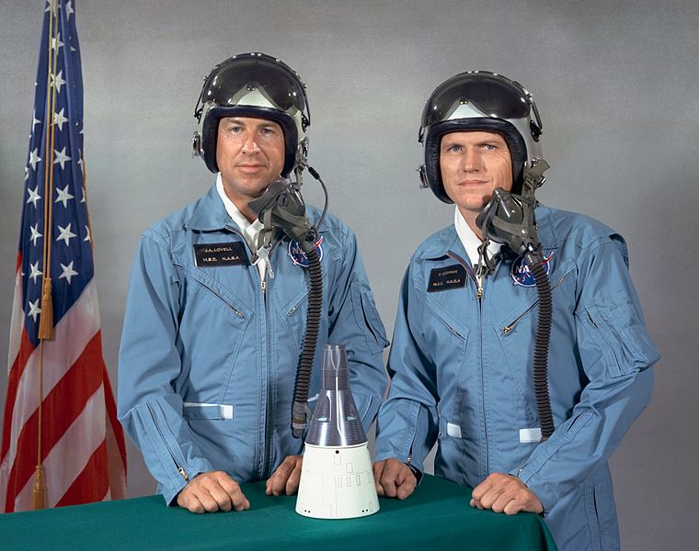
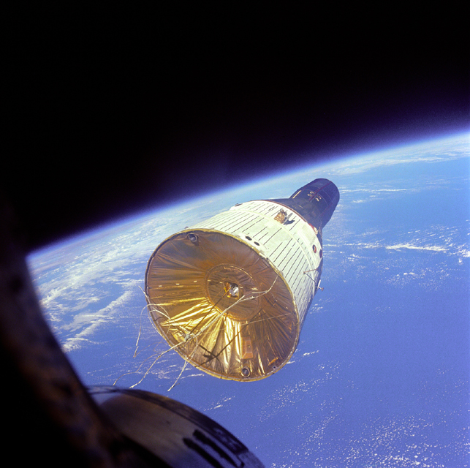
Gemini 7 launches Jim Lovell and Frank Borman 4 Dec 1965. Gemini 6 was rescheduled after Atlas/Agena failure and first launch pad abort. Gemini 6 launches 15 Dec 1965. Gemini 6 and 7 rendezvous in space. Gemini 7 completes marathon and crew grueling 14 day mission.

Slide 27
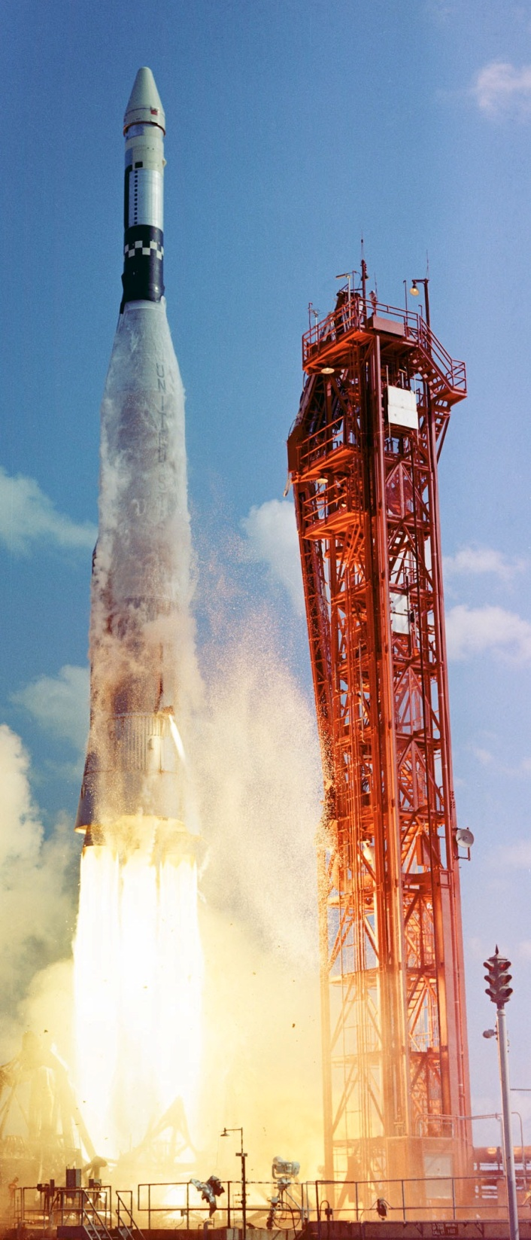
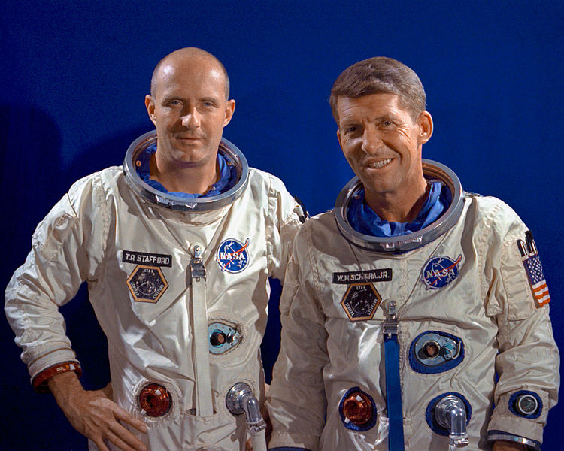
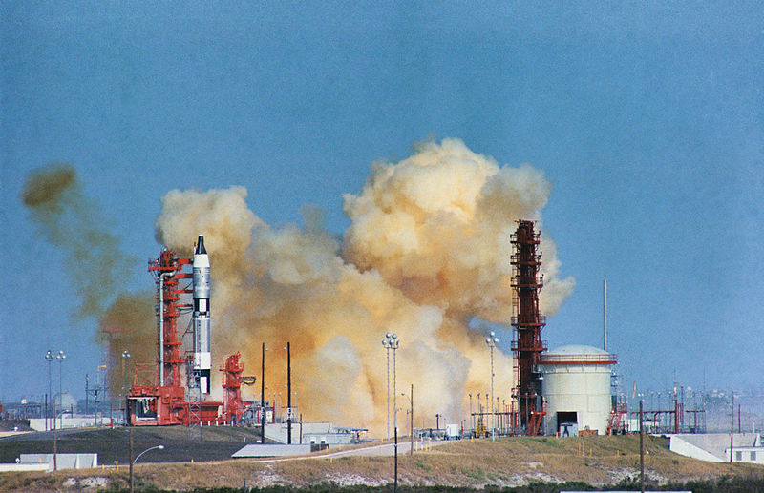
Gemini 6 with Wally Schirra and Tom Stafford launch is scrubbed 25 Oct 1965 when Atlas/Agena target vehicle fails after launch 15 minutes before Gemini 6 scheduled liftoff. NASA replans missions and Gemini 7 launches first in Dec with Gemini 6A to follow and prove rendezvous process in space.
Gemini 6A second launch attempt results in pad abort 12 Dec. Schirra coolly decides to sit on live rocket without ejecting. Extraordinary NASA effort fixes the problems and successfully launches 15 Dec 1965. Gemini 6 and 7 make rendezvous in space and fly formation for 5 hours. First live telecast of Gemini 6 landing and recovery. America finally takes the lead in the race to the Moon!

Slide 28
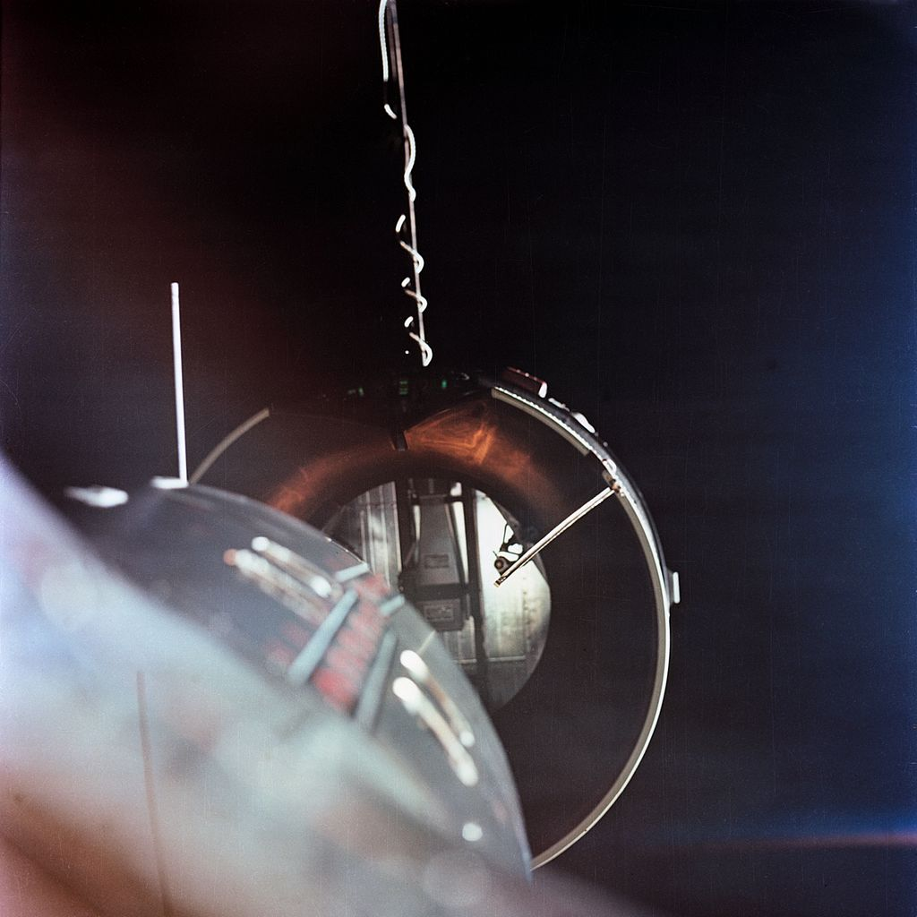
Gemini 8 with Neil Armstrong and David Scott launch 3-16-66 on their first spaceflight for a historic first rendezvous and docking with the Atlas Agena target vehicle. After a perfect docking, Armstrong notices an uncommanded roll of both spacecraft. It is America’s first emergency in space! Armstrong undocks and a stuck on Gemini thruster spins the rate up to near blackout conditions for both astronauts. Out of ground control, Armstrong shuts down the primary Gemini control system and engages the Re-entry control system to stabilize the spacecraft. This requires an early return to the backup Reentry site in the Pacific. The ground team and astronauts learn valuable lessons in dealing with emergencies in space .

Slide 29
Gemini 9A launches June 3, 1966 with backup crew Tom Stafford and Gene Cernan following the tragic death in a T-38 crash killing astronauts Elliot See and Charles Bassett Feb 28, 1966. Agena spacecraft fairing fails to separate so rendezvous succeeds, but docking fails. Gene Cernan conducts extensive space-walk but nears exhaustion with no handholds and no force reaction devices in zero gravity.

Slide 30
John Young commands Gemini 10 July 19, 1966 with Michael Collins and docks with their Agena spacecraft. They execute the first docked spacecraft reboost to a record high altitude of 764 km/478 mi using the Agena engine and a double rendezvous with the dead Gemini 8 Agena. Mike Collins conducts two space-walks with similar difficulties as Gene Cernan. Collins camera and a retrieved micrometeoroid collector float away . Tethering equipment in zero-g is needed. NASA learns that handholds, foot restraints, and underwater training are crucial to space-walk success. NASA surges ahead of the Russian space program and proves the critical ground and flight team procedures for rendezvous and docking in space required for Apollo and the Moon landings.

Slide 31
Gemini 11 launches September 12, 1966 with Charles “Pete” Conrad and Richard Gordon. They rendezvous with their Agena on the first orbit simulating a direct ascent rendezvous required for the Lunar Lander returning to the Apollo Command Module. They demonstrate the first spin stabilized tether with their Agena upper stage achieving a new altitude record of 1370 km/850 mi. Dick Gordon conducts two space-walks. They docked and undocked four times.

Slide 32
Gemini 12 launches November 11, 1966 with James Lovell and Edwin “Buzz” Aldrin. The last flight of Gemini proves the new space walk underwater training procedures and spacecraft hand and footholds to react zero gravity forces. Buzz Aldrin conducts three flawless spacewalks. Gemini 12 makes multiple orbit changes, conducts a manual rendezvous using the onboard computer and charts following a rendezvous radar failure, and conducts an automatic reentry.
NASA is ready to go to the Moon!

