Slide 1
History of Spaceflight
Part 3-The Race to the Moon
Frank Buzzard
NASA Space Shuttle and International Space Station Chief Engineer-Retired

Slide 2
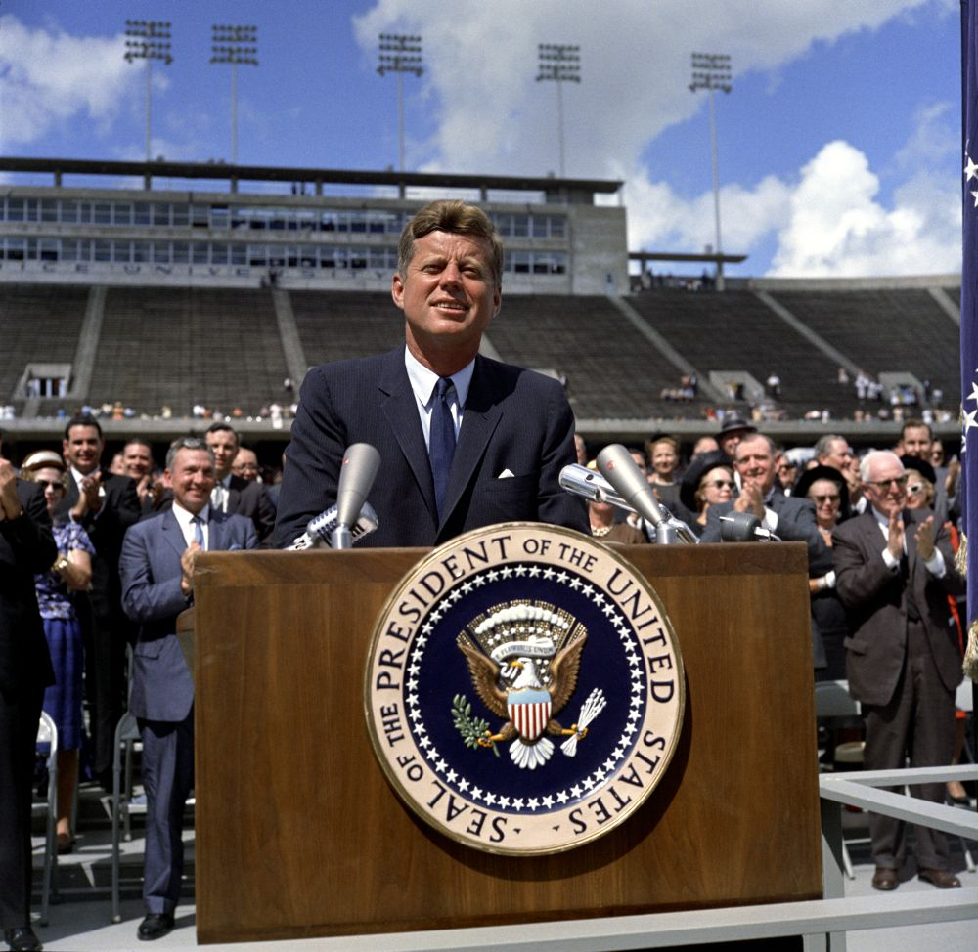
JFK challenges America—lead the space age and go to the Moon and return in this decade.
….this generation does not intend to founder in the backwash of the coming age of space. We mean to be a part of it--we mean to lead it…
We have vowed that we shall not see space filled with weapons of mass destruction, but with instruments of knowledge and understanding….
We set sail on this new sea because there is new knowledge to be gained, and new rights to be won, and they must be won and used for the progress of all people…
May 25, 1961 Congress
Sept 12, 1962 Rice University
We choose to go to the moon. We choose to go to the moon in this decade and do the other things, not because they are easy, but because they are hard, because that goal will serve to organize and measure the best of our energies and skills, because that challenge is one that we are willing to accept, one we are unwilling to postpone, and one which we intend to win…. And, therefore, as we set sail we ask God's blessing on the most hazardous and dangerous and greatest adventure on which man has ever embarked.

Slide 3
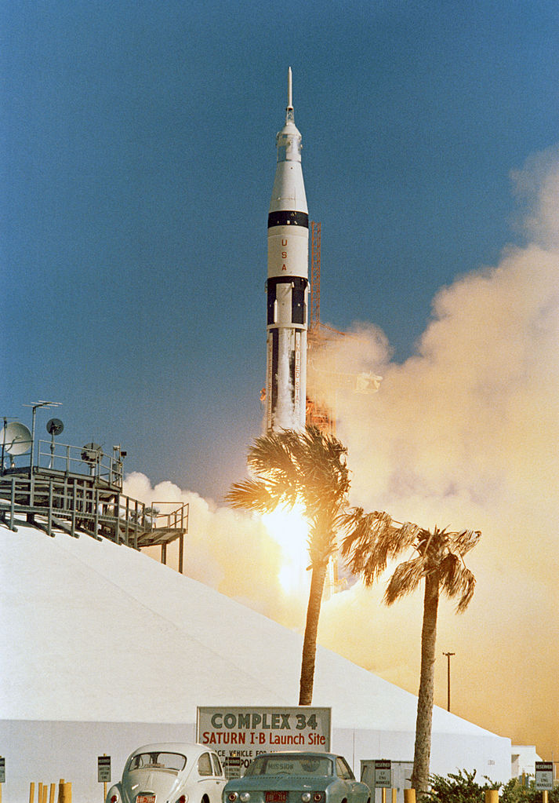
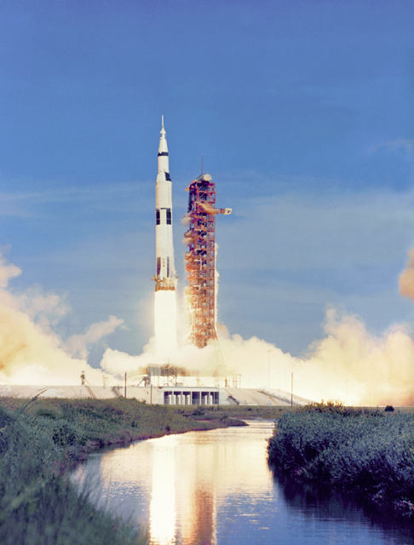
Apollo required huge new rockets
Apollo required more than seven years of spacecraft and launch vehicle development and testing before the first manned missions could be flown. Test flights of the Saturn 1 launch vehicle began in October 1961 and lasted until September 1964. Two unmanned test flights of the giant Saturn V flew in November 1967-Apollo 4 (AS 501) and January 1968 (AS 502). The Saturn V lifted 260,000 lbs (120,000 kg) to LEO and sent 220,000 lbs (100,000 kg) to the Moon

Slide 4
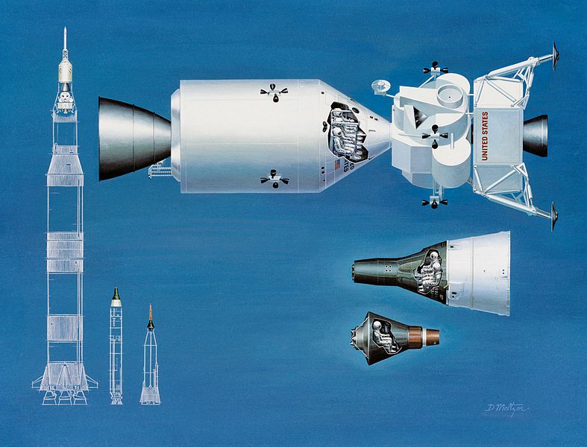
…..And new spacecraft

Slide 5
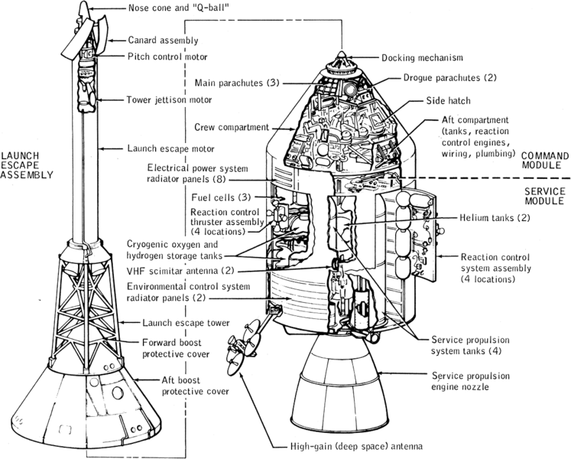

Slide 6
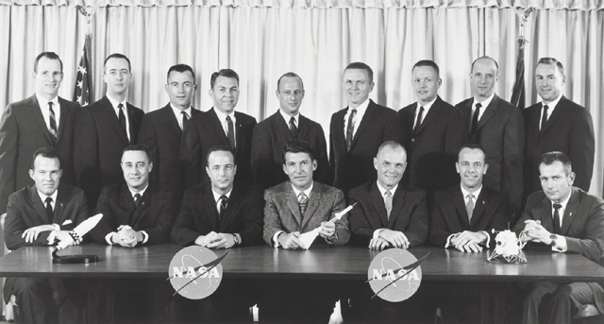
….And new astronauts

Slide 7
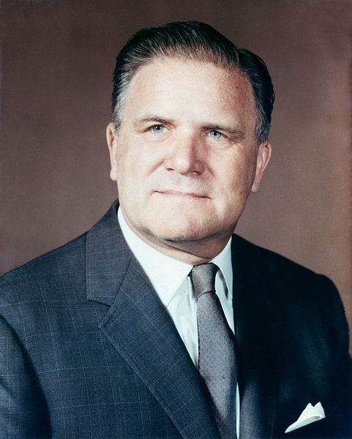
….And inspired and gifted leadership
James E Webb served as the second Administrator for NASA from February 14, 1961, to October 7, 1968. Webb was born on October 7, 1906, in Tally Ho, North Carolina. After receiving a B.A. in education from the University of North Carolina, he went on to serve as a pilot in the Marine Corps and later graduated from George Washington University with a law degree.
James Webb guided the agency through the Apollo years, taking responsibility for the failure of Apollo 1 and the death of three astronauts. He retired in 1968 and served on many advisory boards. He died in 1992.

Slide 8
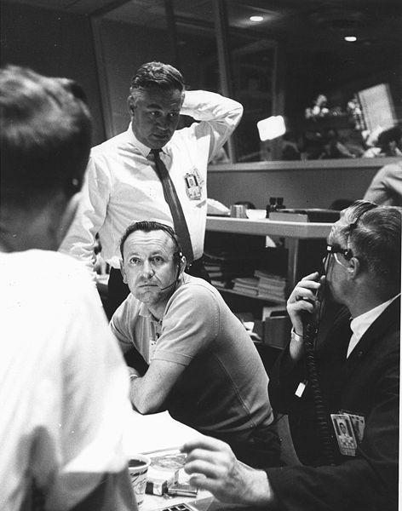
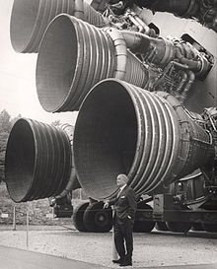
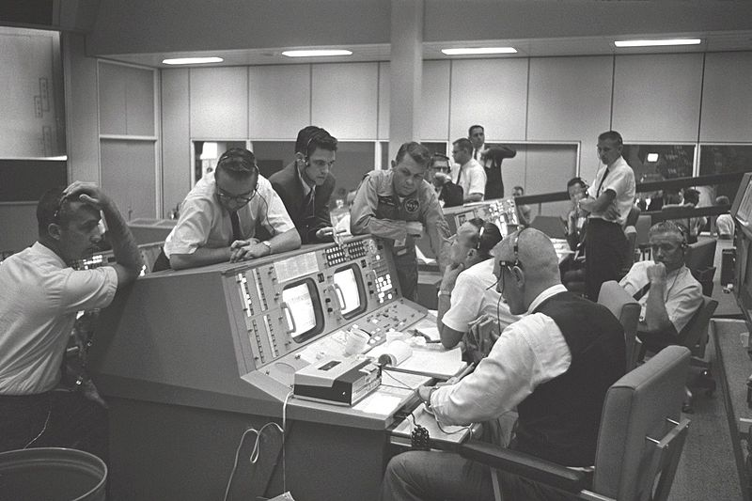
….And more inspired and gifted leadership
Werner Von Braun
Marshal Spaceflight Center
MSFC
Chris Kraft and
Walt Williams at Cape Canaveral-Mercury Control Center
Kraft, Gene Kranz, and astronauts confer on MA-9 go for 22 orbits May 1963 at MSC (JSC) Houston

Slide 9
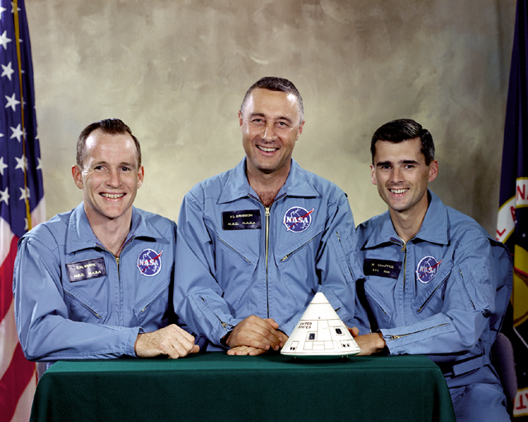
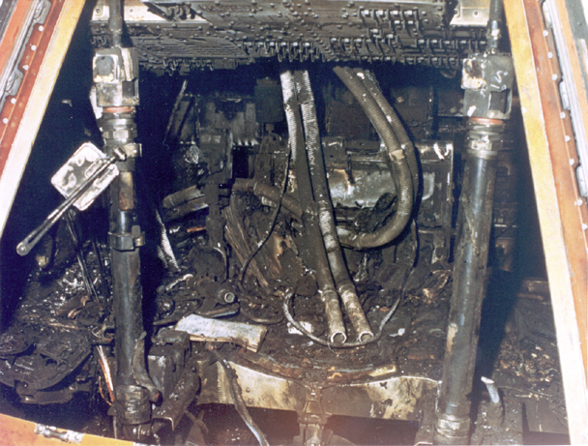
…But tragedy strikes Apollo 1 crew Jan 27, 1967
Gus Grissom, Ed White, and Roger Chaffee die during a routine ground test at KSC in the Block 1 Command and Service Module (CSM). An electrical short causes a violent fire in the pure oxygen capsule environment. The crew can not open the hatch before being overcome by toxic gases and heat. NASA is shocked and the nation mourns, but Frank Borman leads a NASA team with North American and redesigns a much safer Block 2 CM with a new hatch, fire resistant materials, and a normal atmosphere. NASA concentrates on Saturn launch vehicle unmanned testing. The entire Apollo program and schedules are reworked. Honoring JFK’s goal, NASA overcomes the tragedy and flies a new Block 2 CM with Apollo 7 crew in 20 ½ months.

Slide 10
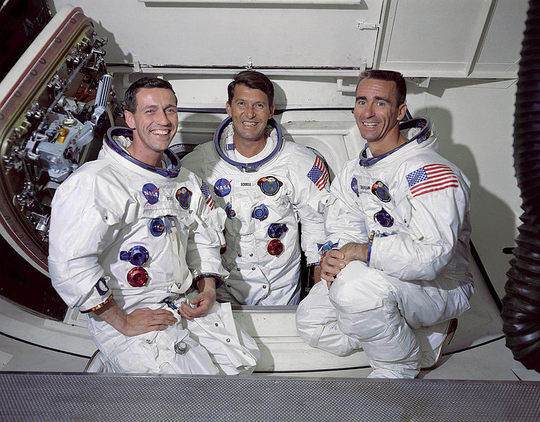
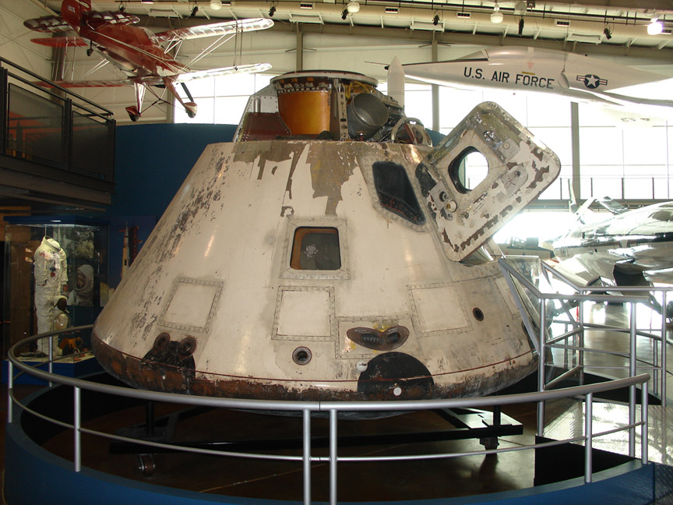
Apollo 7 is the first CSM manned mission Oct 11, 1968
Wally Schirra, Donn Eisele, and Walt Cunningham launch on the first manned Saturn 1B and prove the Block 2 CM life support, power, flight control, communication, rendezvous, and propulsion systems of the Service Module (SM) with eight burns on an 11 day mission. Testy communication and debate with the ground on procedures changes results in none of these astronauts every flying in space again. But Apollo 7 CSM redesign is a great success leading to a gutsy and risky next flight decision by NASA on Apollo 8

Slide 11
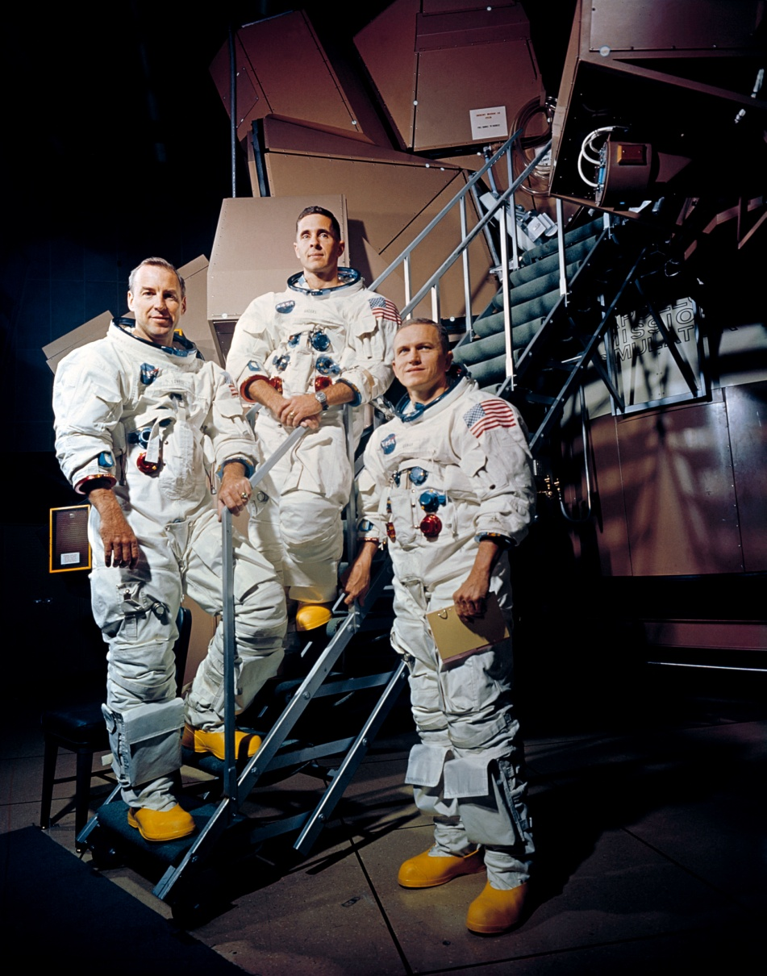
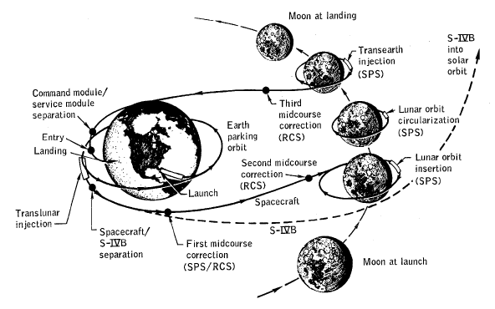
Apollo 8 circles the Moon Christmas 1968
The Lunar Module (LM) is months behind schedule. Russia flies animals around the moon Sept 68 on Zond 5. Can Russia fly cosmonauts around the moon next? NASA secretly replans Apollo 8 to fly around the moon in 4 months on the first crewed flight of the mighty Saturn V rocket
Frank Borman, Jim Lovell, and William Anders spend Christmas ‘out of this world’ circling the Moon. A triumph for NASA and America

Slide 12
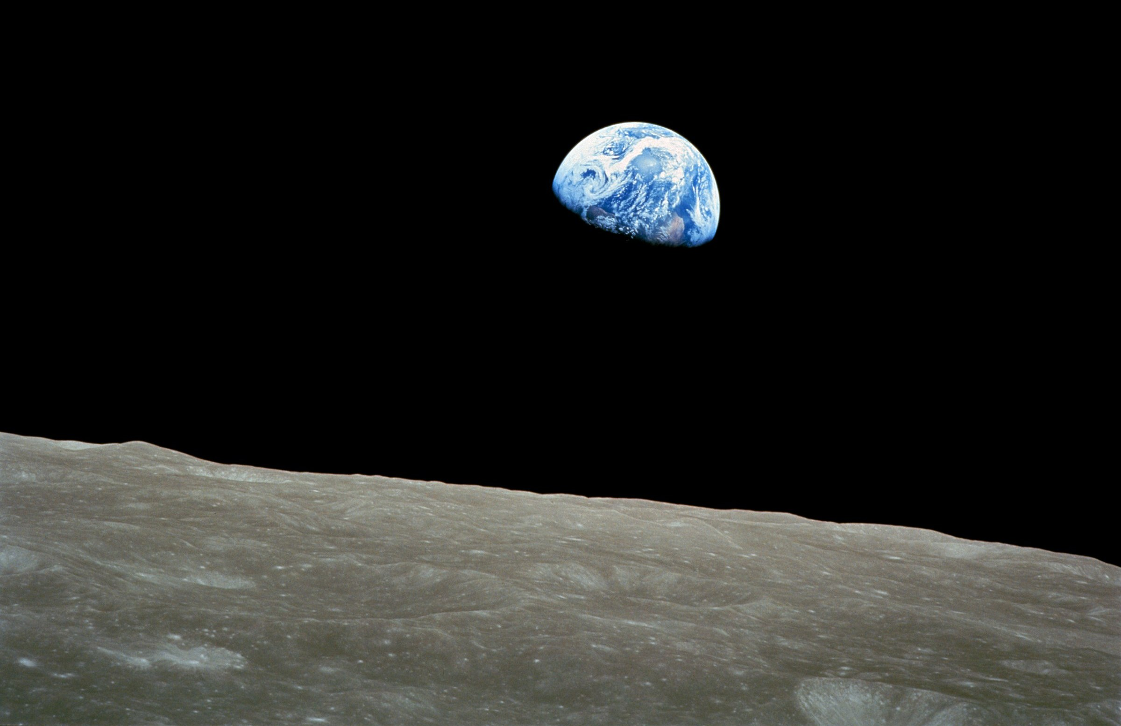
….And changes our view of Earth forever

Slide 13
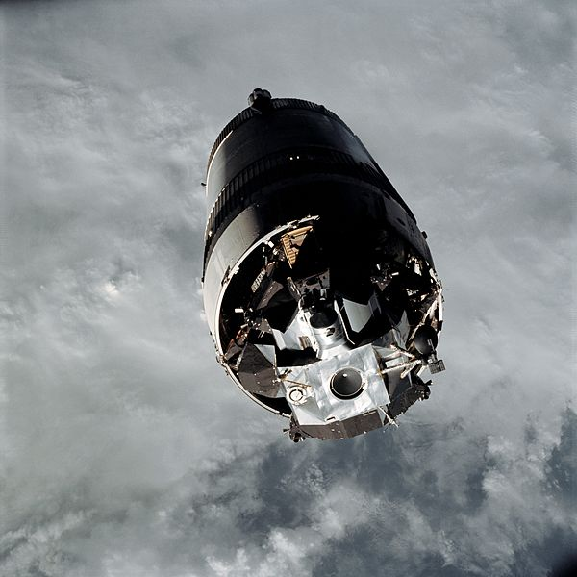
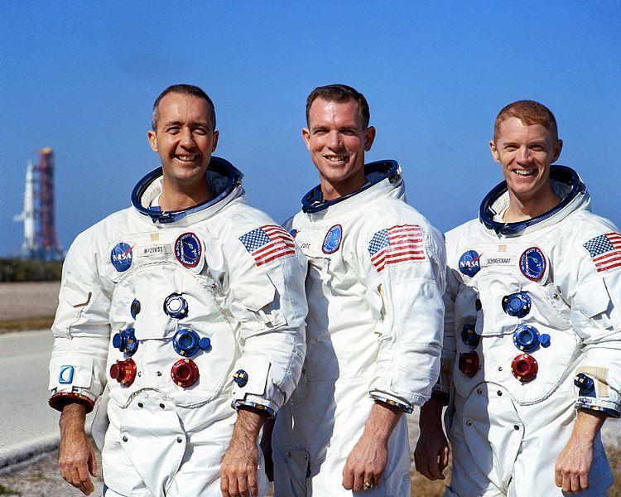
Apollo 9 Lunar Module test flight in Earth orbit March 3-13, 1969
Jim McDivitt, Dave Scott, Rusty Schweickart tested several aspects critical to landing on the Moon, including the LM engines, backpack life support systems, navigation systems, and docking maneuvers
LEM ‘Spider’ in the S-IVB third stage ready for CSM ‘Gumdrop’ docking and extraction

Slide 14
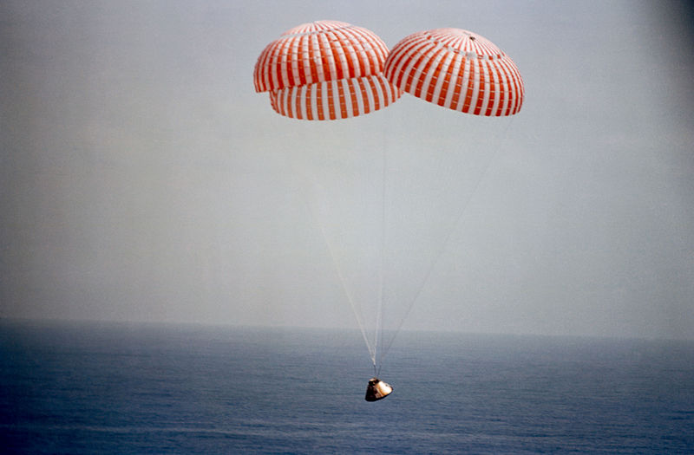
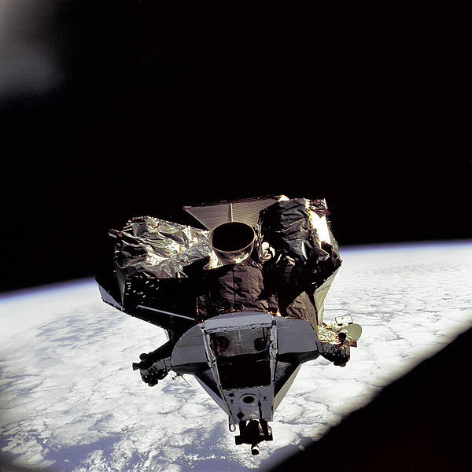
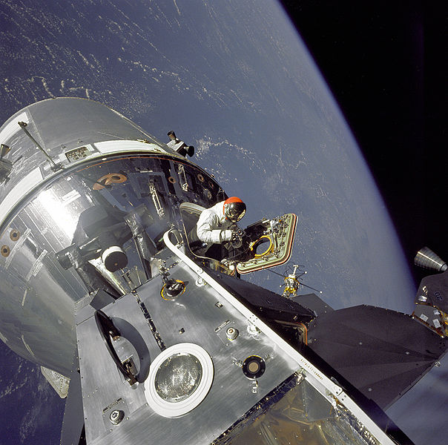
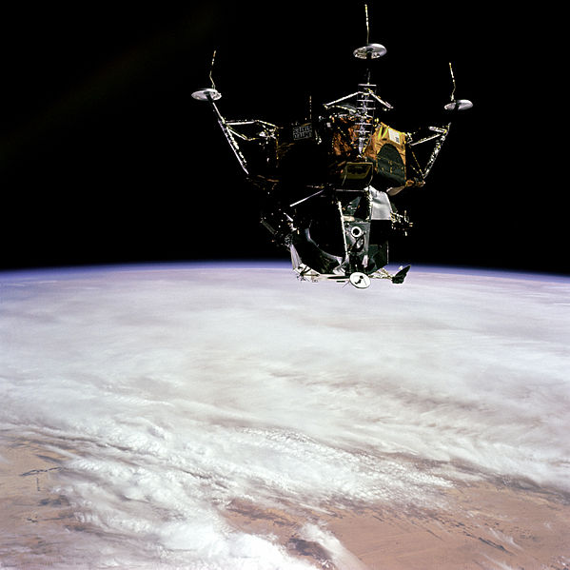
Apollo 9 LEM undocked flying on her own. All systems AOK!
Descent engines tested. Ascent section separated and tested.
America is almost ready to land on the Moon!
Dave Scott tests EVA suit on EVA from ‘Gumdrop’

Slide 15
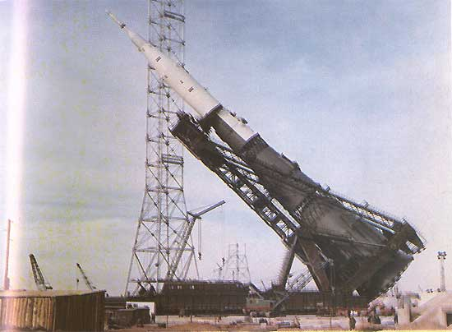
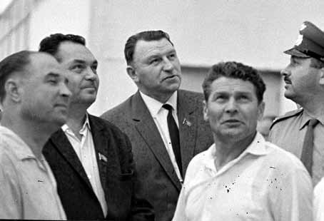
What about Russia’s race to the Moon?
Soviets design the N1 rocket
The N1 rocket had 30 LOX/Kerosene engines in the first stage generating 11 Million lbs of thrust. Second stage had 8 engines and 3 Mil lbs thrust. Third stage had 5 engines to make earth orbit. The L3 upper section contained the earth to moon transfer engines, the LK Lunar Lander, and the LOK Lunar orbiter. The Soviets attempted four N1 launches between February 1969 and November 1972 all ending in spectacular failures.
Senior management shown prior to the launch of the first N-1. From left to right, Anatoly Kirillov, Vasiliy Mishin, Sergey Afanasyev, Boris Dorofeyev, and V. I. Snegirev.

Slide 16
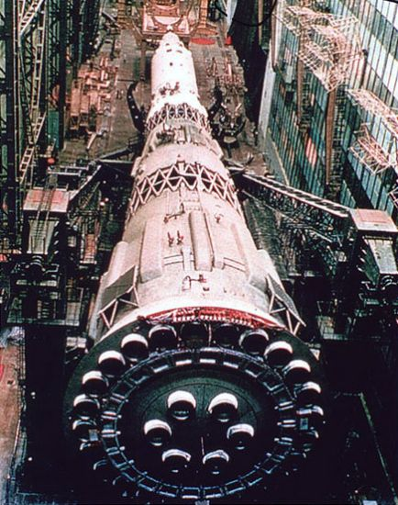
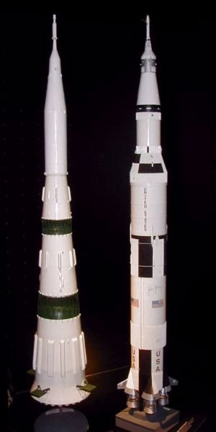
Massive N1 and Saturn V are the largest rockets in the world!

Slide 17
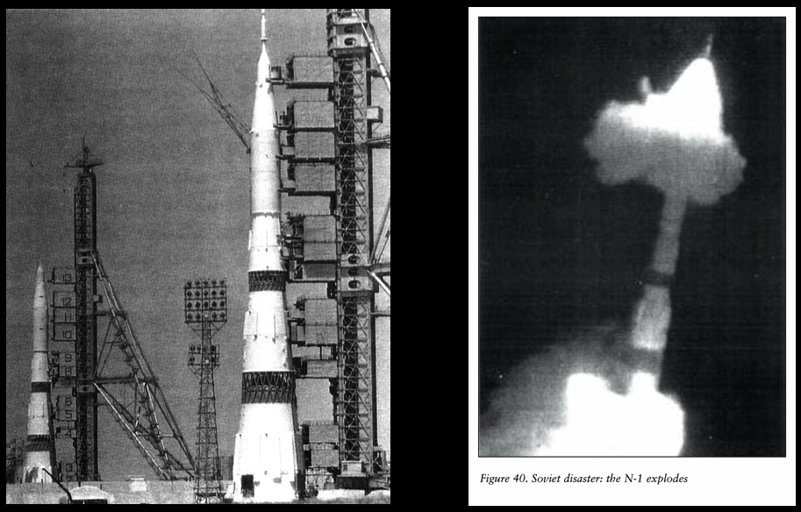
First N1 explodes 68 sec after liftoff from engine fire in first stage in Feb 69.
Second N1 clears tower and falls back to launch pad destroying it in July 69

Slide 18
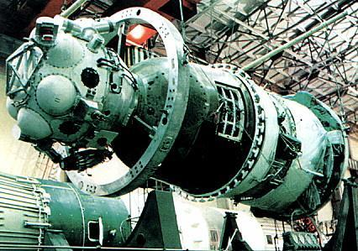
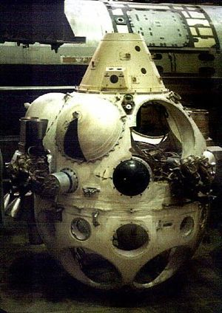
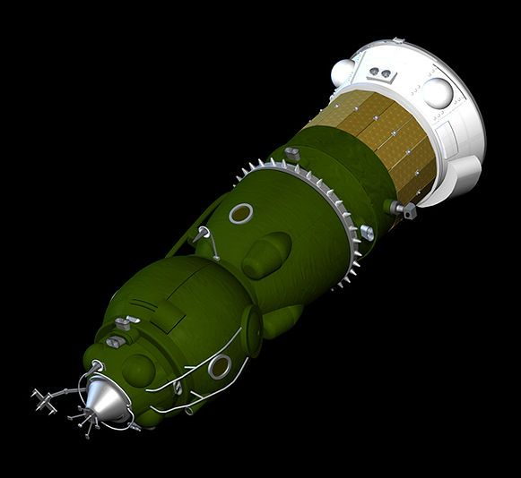
Russia designs the lunar orbital module (LOK) based on Soyuz design
LOK reaction control and docking module

Slide 19
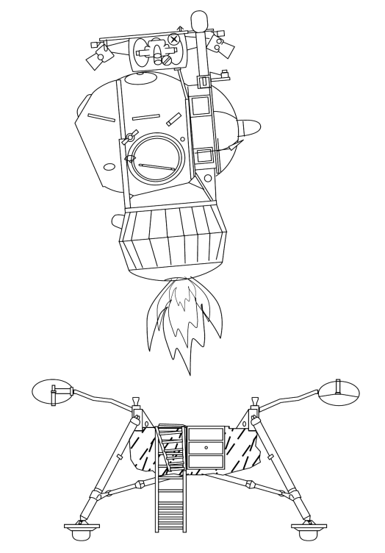
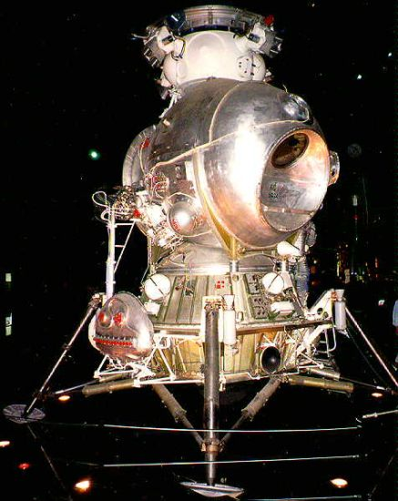
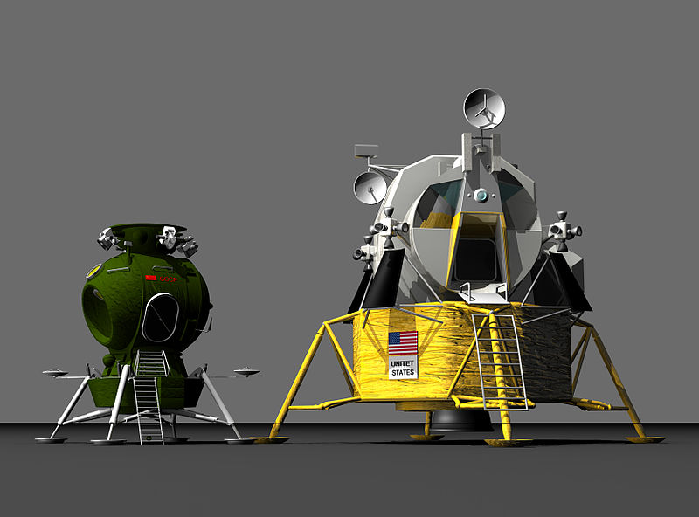
Russia designs the lunar lander (LK Lunniy Korabl)
Drawing of LK ascent from lunar surface
LK and LEM size comparison

Slide 20
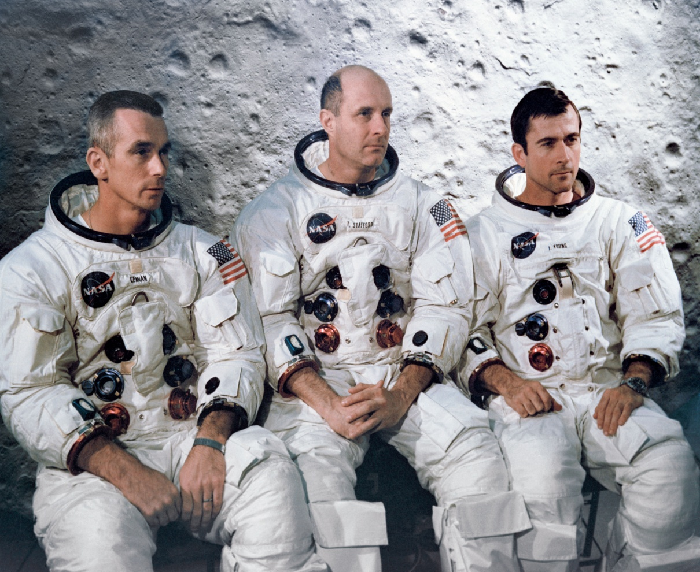
Apollo 10--Dress rehearsal for the first lunar landing May 18-26, 1969
Tom Stafford, John Young, Gene Cernan fly within 8.4 mi/13.5 km of the moon’s surface testing all systems—flight and ground—required to land on the moon.

Slide 21
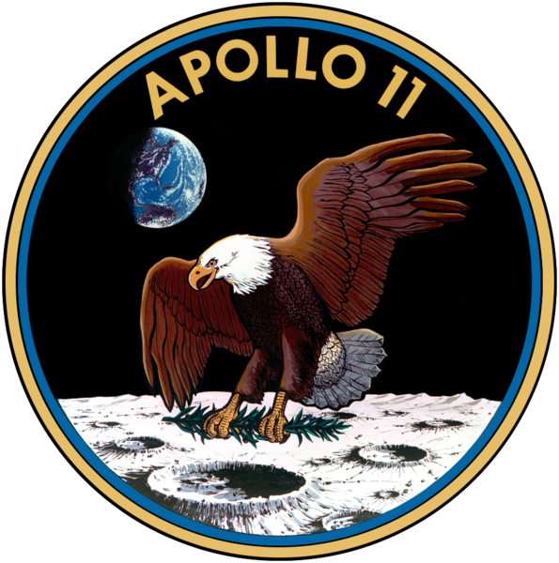
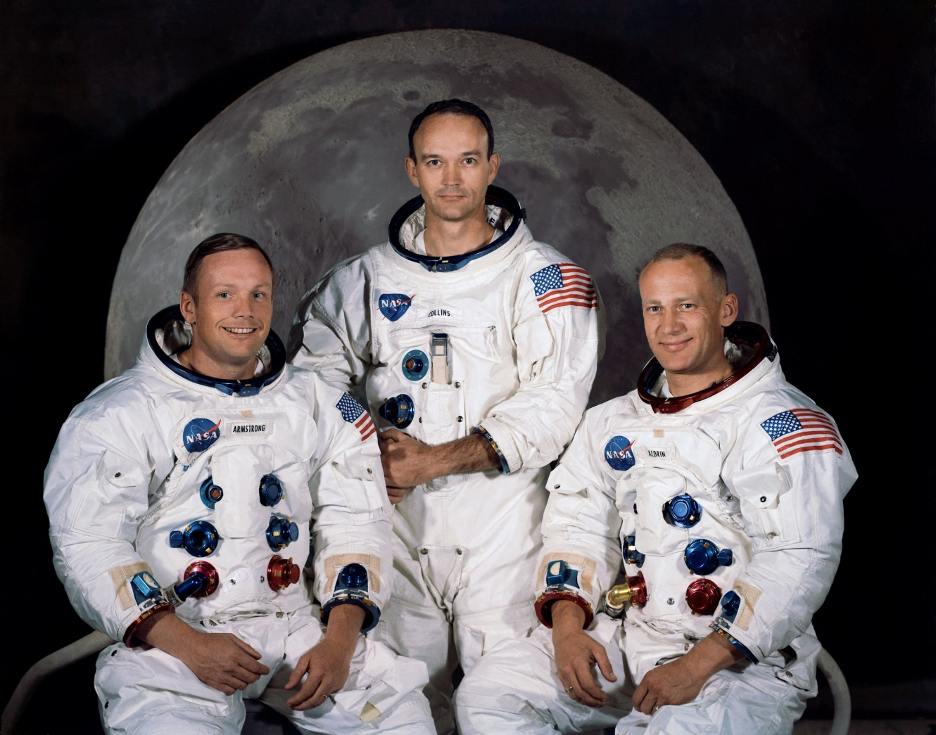
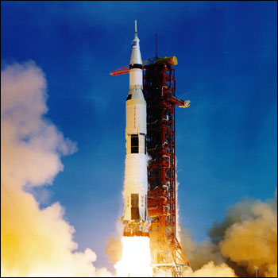
Apollo 11 begins July 16, 1969
Neil Armstrong, Michael Collins, and Edwin “Buzz” Aldrin head for the moon
and a place in exploration history.

Slide 22
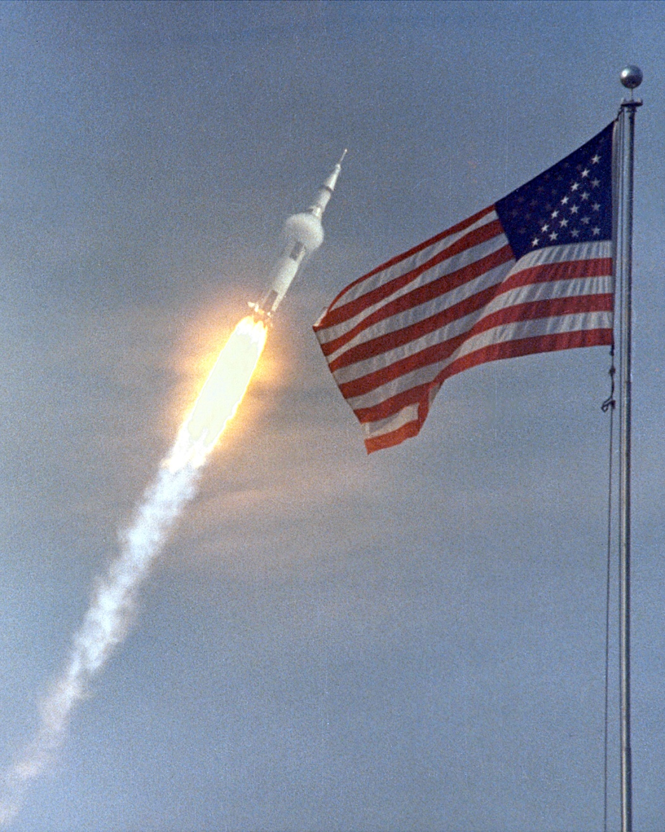
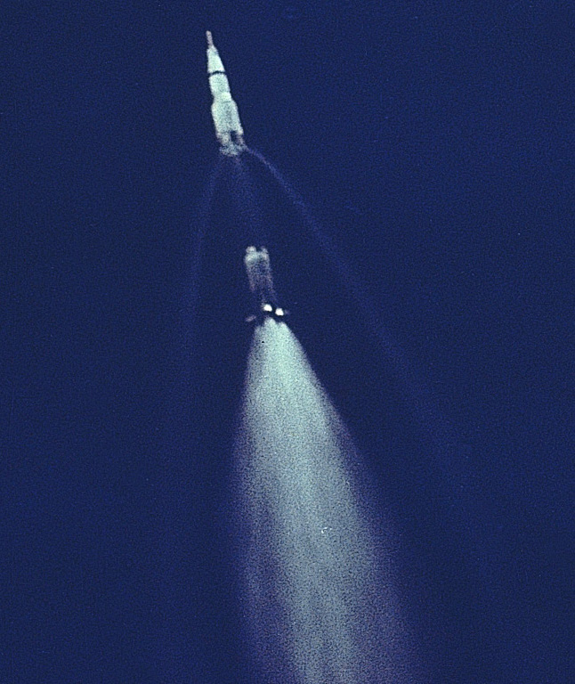
Millions watch from Cape Canaveral

Slide 23
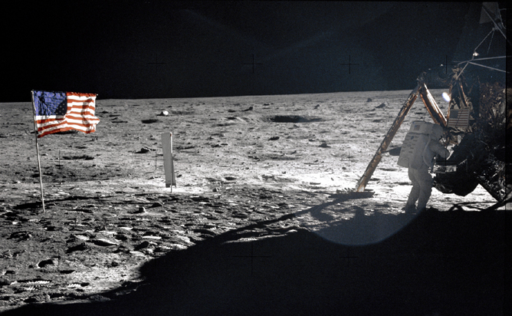
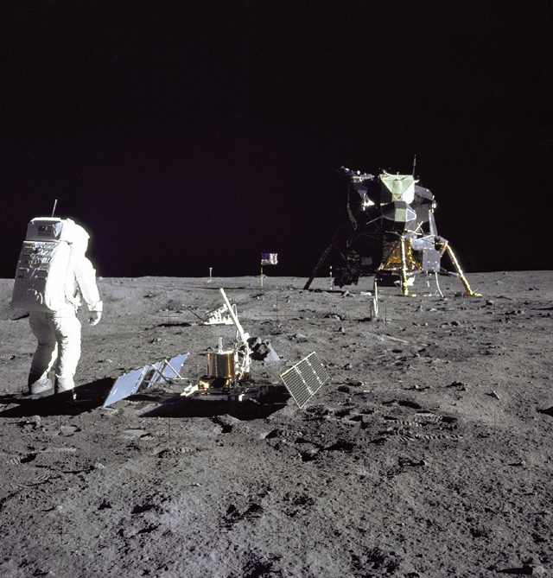
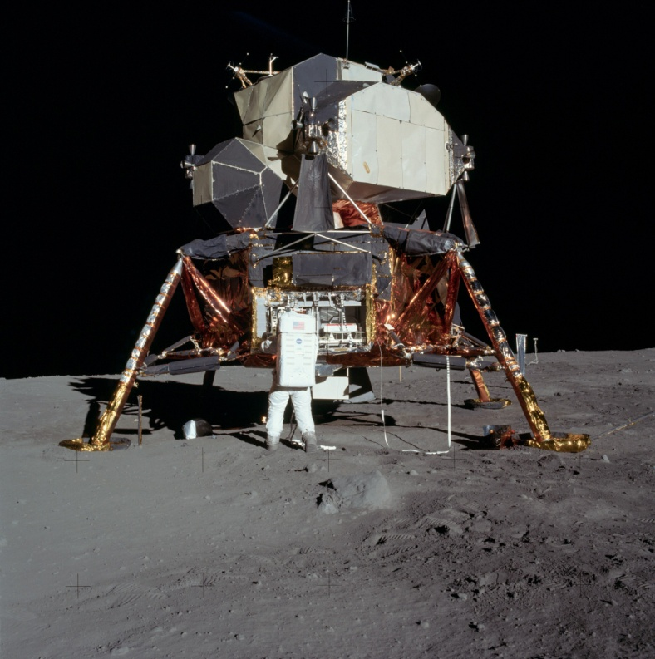
America triumphs July 20, 1969
“Houston, The Eagle has landed…”
“That’s one small step for man…
one giant leap for mankind”

Slide 24
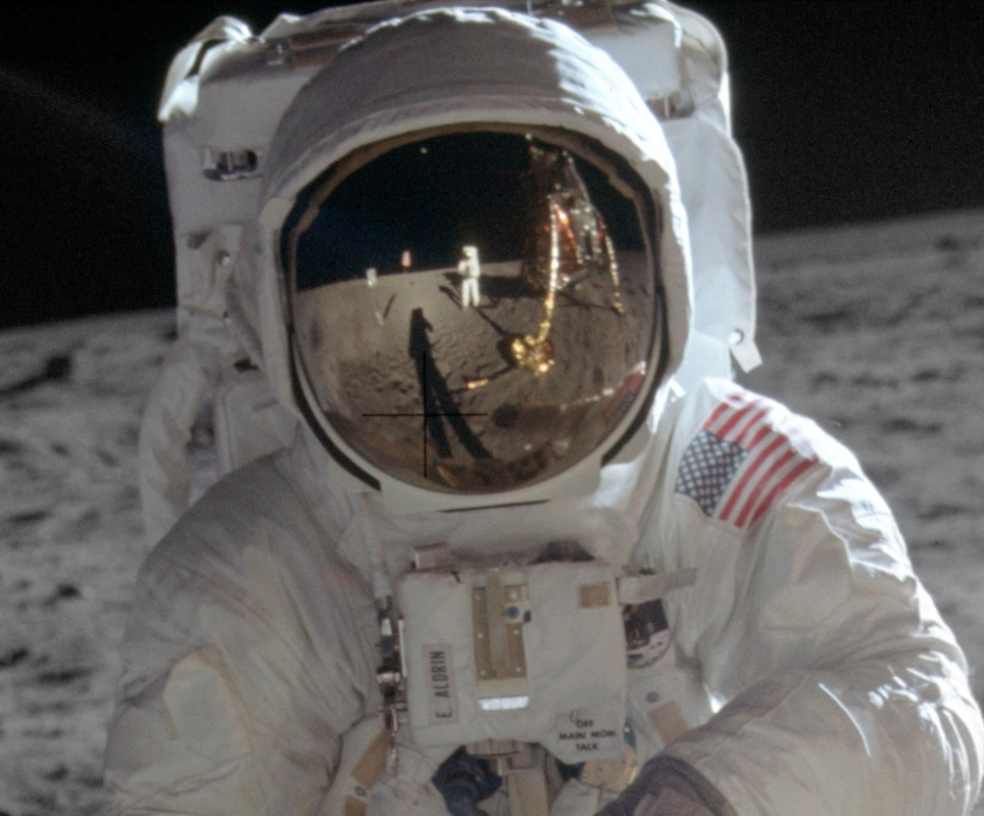
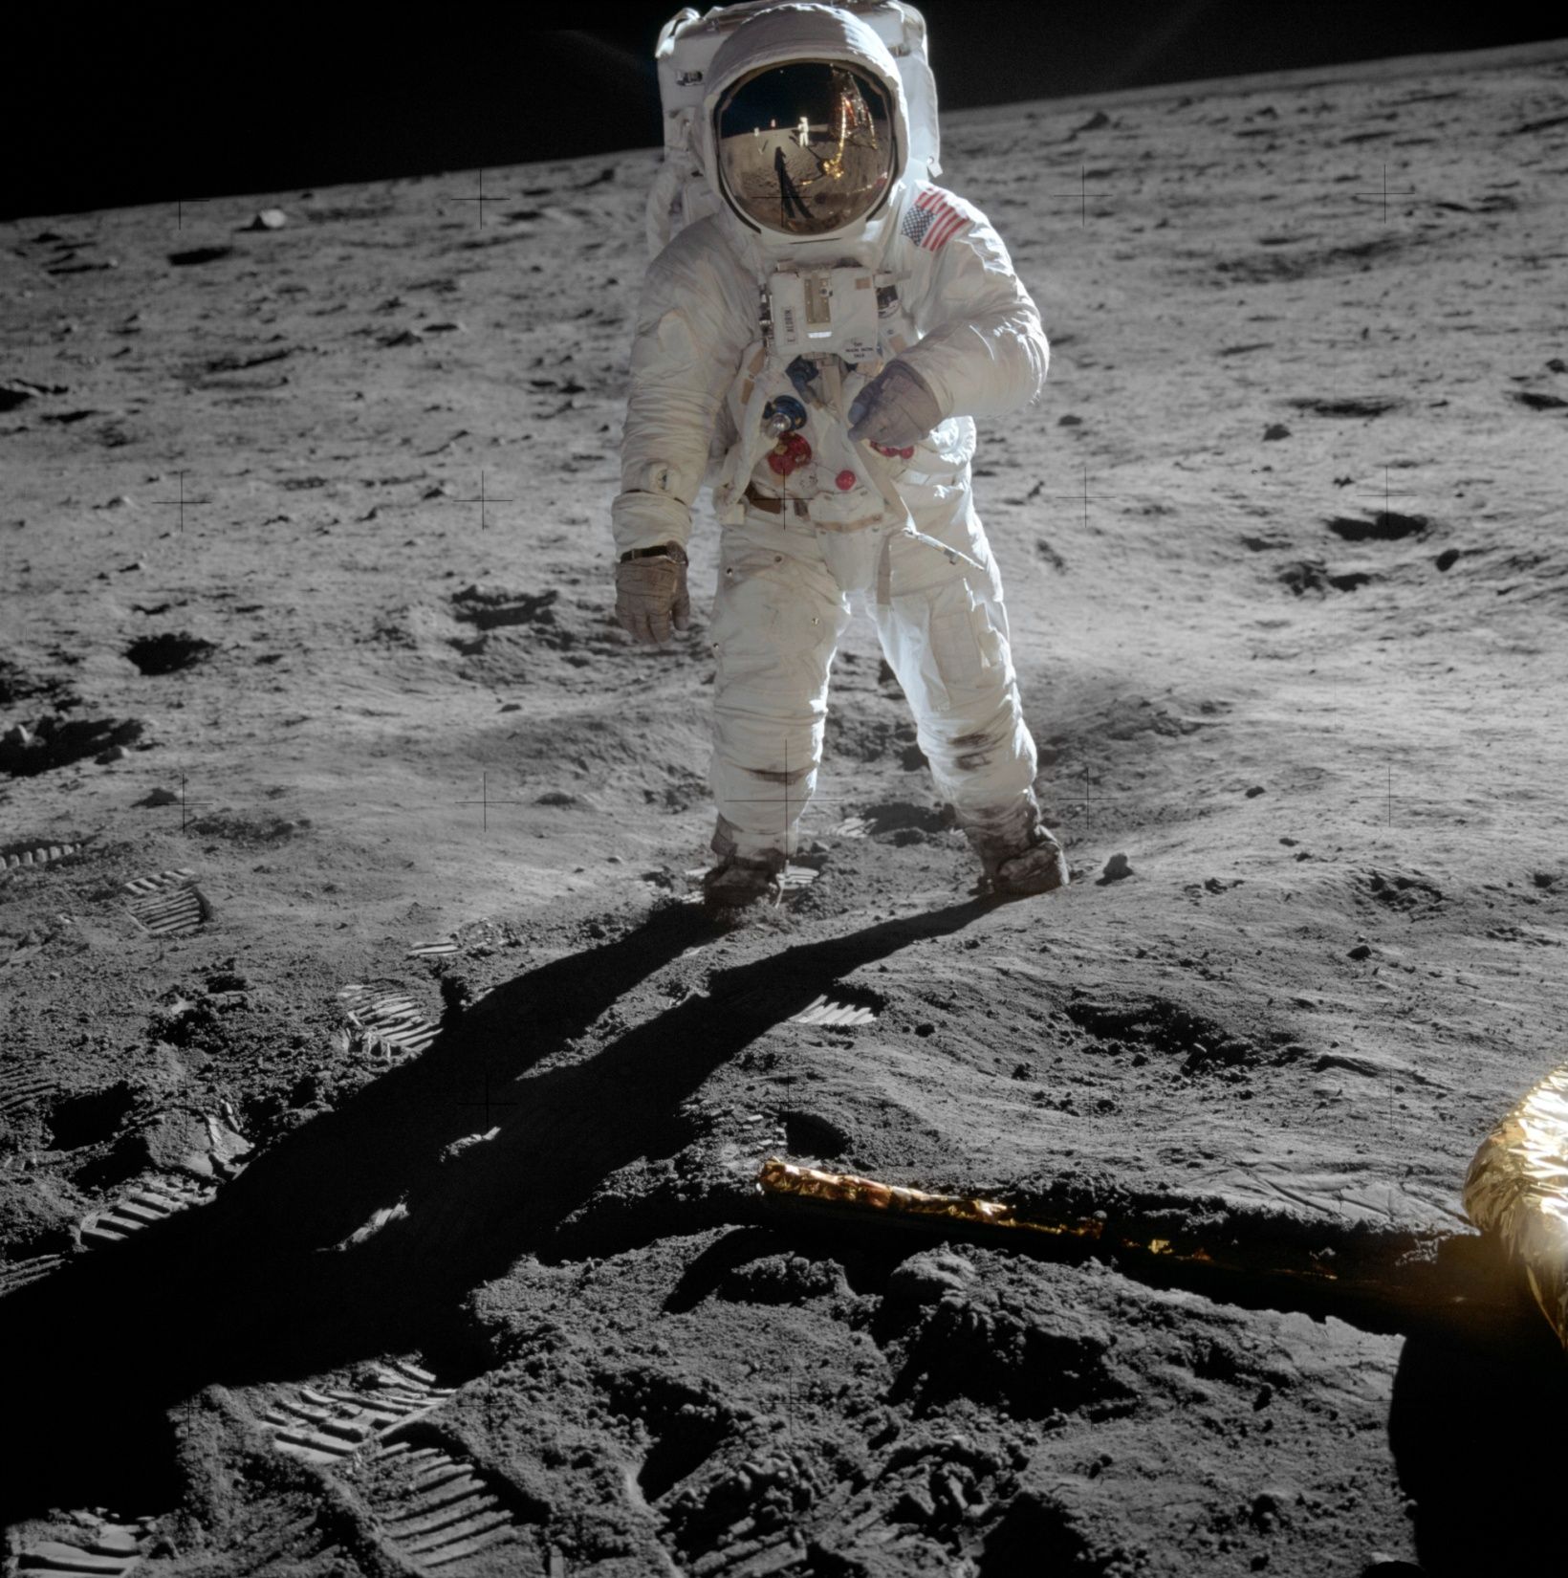
Armstrong taking picture reflected in Aldrin’s visor

Slide 25
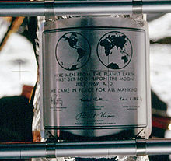
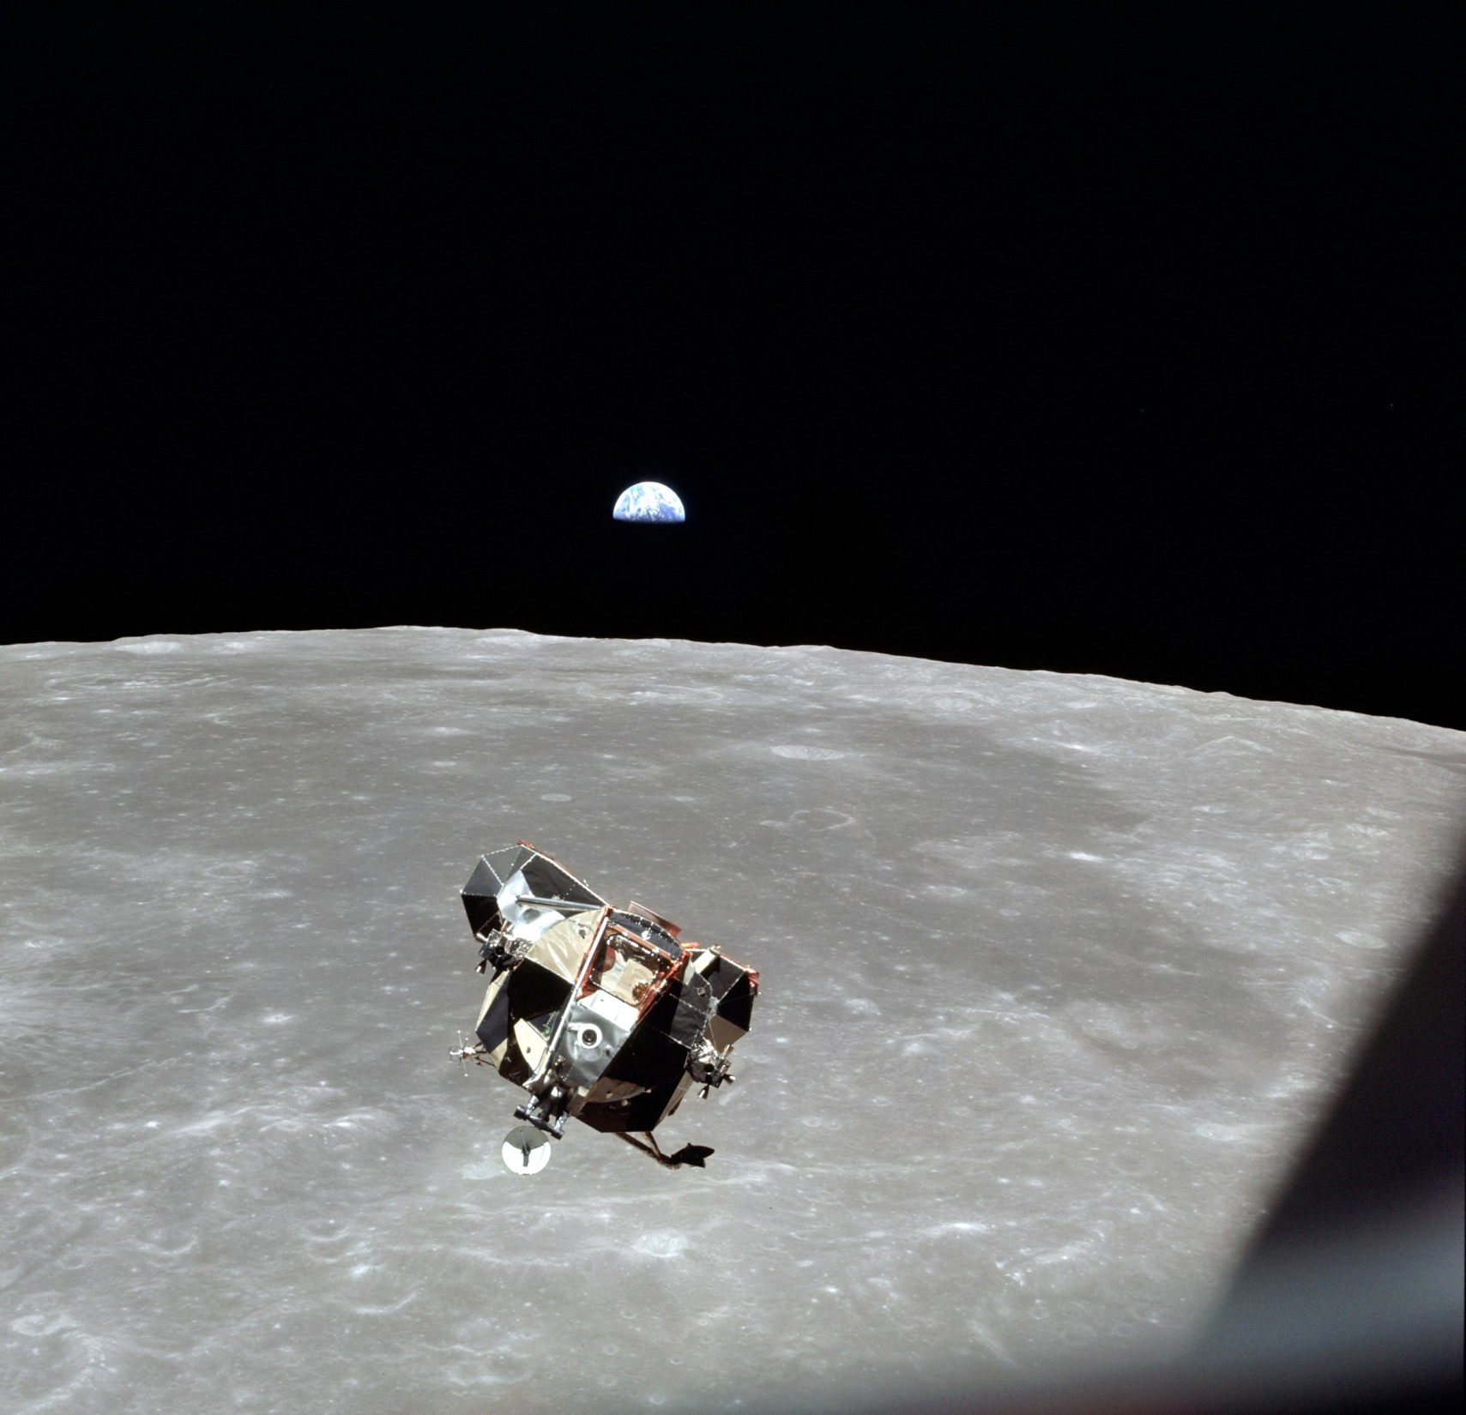
We came in peace
for all mankind
The LEM ‘Eagle’ approaching CSM ‘Columbia’
in lunar orbit

Slide 26
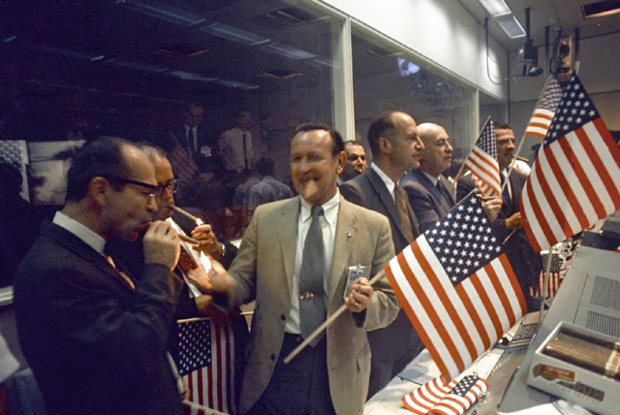
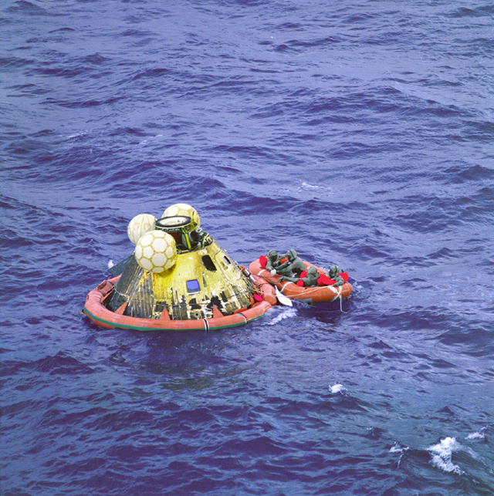
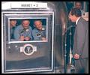
And a worldwide celebration begins….

Slide 27
Apollo 12 explores the “Ocean of Storms” and Surveyor 3 Nov 1969
Apollo 12 night launch is struck by lightning
Pete Conrad and Alan Bean walk to the Surveyor
Pete Conrad Richard Gordon
Alan Bean

Slide 28
Apollo 13 explosion in space April 1970. LM becomes lifeboat.
Mission Control and America’s contractor team save the crew.
SM O2 tank explodes 56 hrs after launch robbing CSM of power
Jim Lovell, Jack Swigert, Fred Haise

Slide 29
Apollo 14 explores the Fra Mauro lunar highlands Feb 1971
Alan Shepard
Stuart Roosa
Edgar Mitchell

Slide 30
Russia loses 3 Cosmonauts in a Soyuz 11 reentry accident
Russia turns to orbital space stations with Salyut 1. Georgi Dolbrovolski, Vladislav Volkov, Viktor Patsayev perish June 30, 1971 during reentry when their Soyuz capsule pressurization valve fails.

Slide 31
Apollo 15 carries Dave Scott, Al Worden, Jim Irwin to the Hadley rille in July-August 1971. They spend 3 days on the lunar surface, test the first lunar rover, prove a new spacesuit, and deploy a sub satellite in lunar orbit. This is the first of the Lunar “J” missions that focus on science and extended stays with greater mobility. They bring back the “Genesis rock” from the early solar system formation.

Slide 32
Apollo 16 carries John Young, Tom ‘TK’ Mattingly, and Charlie Duke to the Descartes highlands in April 1972.
Young and Duke spend 3 days on the surface with the second lunar rover to explore large regions. TK performs a deep space EVA to retrieve film

Slide 33
Apollo 17 is mankind’s last trip to the Moon in December 1972. Gene Cernan, Ron Evans, and geologist Harrison Schmitt explore the Taurus- Littrow valley for lunar samples older than the Mare Imbrium impact. Again lunar science is key to the design and execution of the mission.
America loses interest in the Apollo program after six lunar landings and Congress cancels the Apollo 18, 19, and 20 missions.

Slide 34
America moves to an orbiting space station—Skylab—May 1973
Skylab’s meteroid debris shield tears off during launch ripping off one entire solar array. Lack of power and high temperatures threaten the mission. Ground teams fabricate a sun shade and tools to free the jammed solar array. Skylab 2 crew launches 11 days later and repairs the damage in the first ever onorbit repair space walk.
Skylab 1 crew spends 28 days in space
Pete Conrad, Paul Weitz,
Joe Kerwin

Slide 35
Skylab proves humans can live and work in space.
Space Shuttle and Space Station are next for America.
Skylab reenters July 11, 1979. A few pieces survive and land in Australia
Skylab 2 crew--Alan Bean, Jack Lousma, Owen Garriott launch July 28, 73 and spend 59 days in space
Skylab 3 crew Gerald Carr, William Pogue, Ed Gibson launch Nov 16, 73 and spend 85 days in space

Slide 36
Détente in space—Apollo Soyuz Test Project—July 1975
Tom Stafford, Vance Brand, Deke Slayton, Alexei Leonov, Valeri Kubasov

