Slide 1
How has space exploration benefited you?
Frank T. Buzzard
Chief Engineer Space Shuttle and Space Station
NASA retired

Slide 2
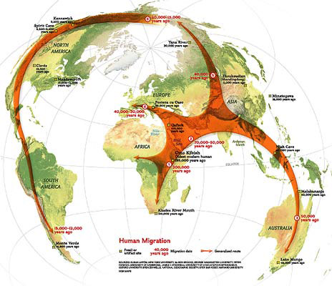
Why do we explore?
It is a fundamental part of our human nature. It is in our DNA. Survival. Curiosity. Exploration is in our soul!

Slide 3
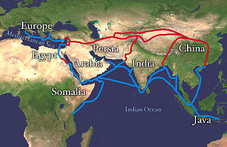
Why do we explore?
Expand our civilization, culture, trade, and wealth
The lucrative Chinese Silk Trade began during the Han Dynasty (206BC-220AD) continuing thru Greek, Roman, and Byzantine Empires. Ottomans closed the land route in 1453 at the fall of Constantinople. The need for a sea trade route to Asia was the driving force of Portuguese Exploration to China in the early 1500s.

Slide 4
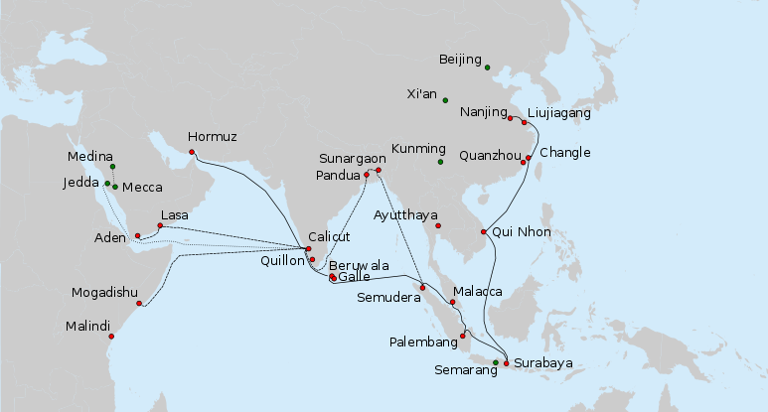
Chinese sea exploration 1405-1433
Voyages of Zeng He
Admiral Zeng He conducted 7 voyages of trade, diplomacy, and power projection throughout the Indian Ocean with a huge fleet of 300 ships and 28,000 men. He ruthlessly suppressed hated pirates plundering the Chinese and SE Asian seas. The Xuande Emperor forbid any more voyages and burned the fleet. Zeng He died at sea.

Slide 5
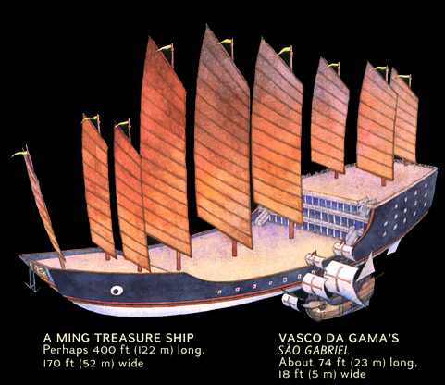
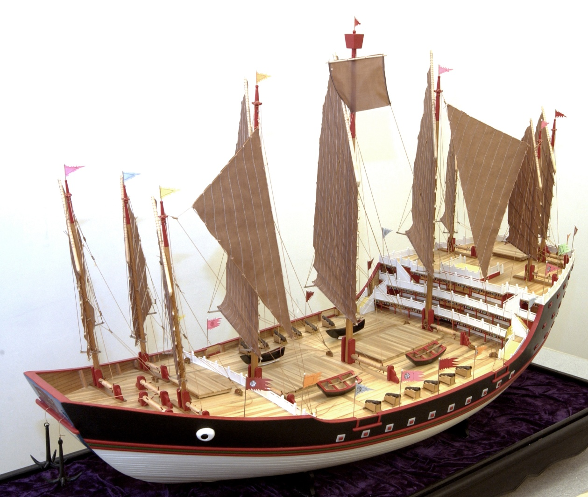
Note the relative size of Vasco da Gama’s Portuguese flagship and a ship of Admiral Zeng He’s 300 ship fleet
A model of Admiral Zeng He’s flagship

Slide 6
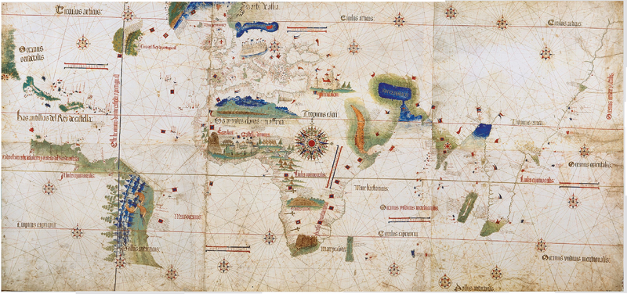
Why do we explore?
New opportunity. Status and reward. Economic growth.
Cantino World Map of 1502. It incorporates new geographical information based on four series of voyages: Columbus to the Caribbean, Cabral to Brazil, Vasco da Gama followed by Cabral to eastern Africa and India, and the brothers Corte-Real to Greenland and Newfoundland. Except for Columbus, all had sailed under the Portuguese flag.

Slide 7
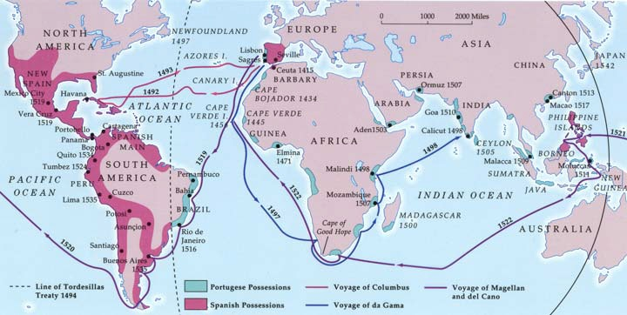
The Age of Discovery-1418 thru 1500s
The Portuguese under Henry the Navigator (1394-1460) led the way. They developed Caravel ship design, lateen sails, new navigational instruments. Spain, England, France led exploration in late 1500s-mid 1600s. The Dutch dominated trade in 1600s founding the Dutch East India company in 1602. Trade wealth gave the Dutch a strong navy 1590-1710 breaking the Portuguese sphere of influence in the India Ocean and Orient by early 1700s.

Slide 8
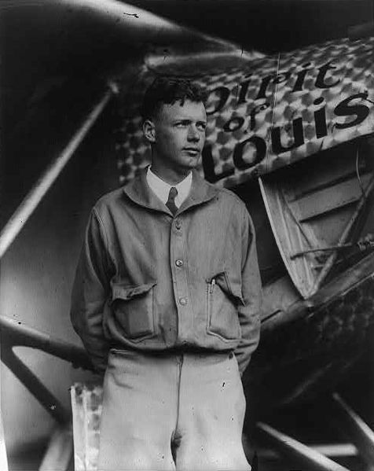
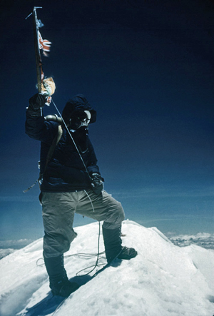
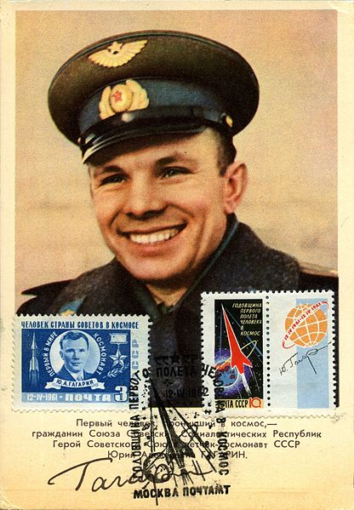
Why do we explore?
The challenge. To understand the unknown.
“To boldly go where no one has gone before!”
Yuri Gagarin first human spaceflight
April 12, 1961
Charles Lindbergh first solo Atlantic flight May 20-21, 1927
Hillary and Norgay summit
Mt. Everest May 29, 1953

Slide 9
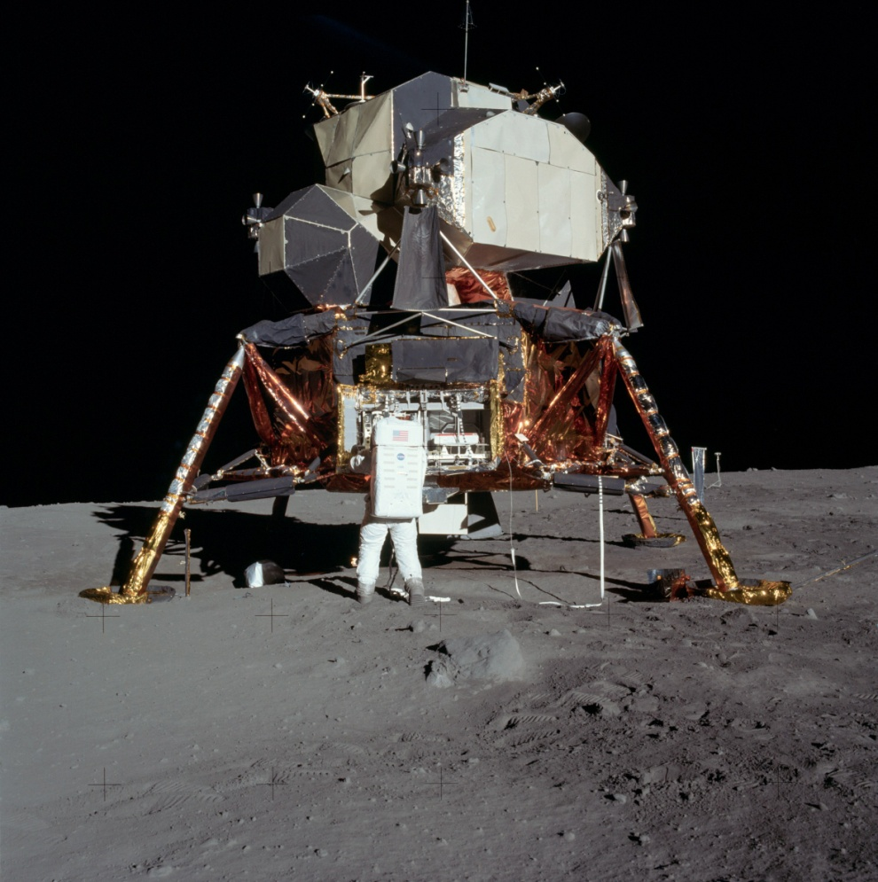
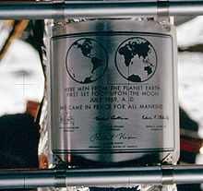
Why do we explore?
To drive technology development, world leadership, and economic growth. To enhance national security.
“Speak Softly and carry a big stick”
America lands on the moon July 20, 1969
We came in peace for all mankind

Slide 10
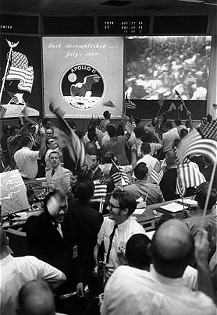

Who can forget the world’s celebration of America’s triumphant landing on the moon?
Apollo 11 astronaut families erupt with joy!
Mission Control goes wild!

Slide 11
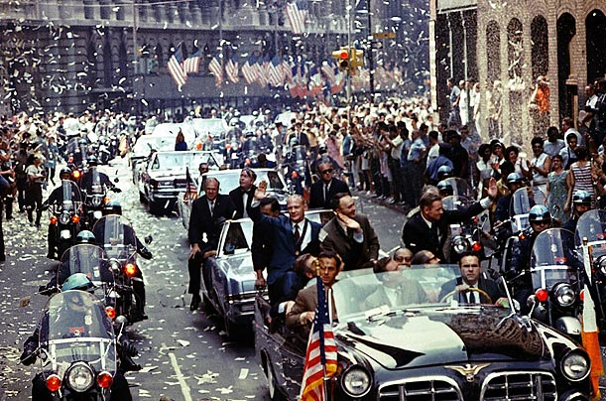
Apollo 11 NYC ticker tape parade

Slide 12
Indirect benefits of space exploration
Inspiring the next generation
  Leadership in science, math, and technology development
  Attracting our best and brightest at the cutting edge
  Going where no one has gone before for the benefit of all
A Continued belief in American Excellence and respect in ourselves and around the world
A better world for our children and grandchildren
Understanding and solving our environmental issues
Building trust and cooperation among nations—ISS
Learning to live and work in space—the next frontier
The ability to colonize our solar system. Perhaps avoid the fate of the dinosaurs?

Slide 13
Direct benefits space exploration
Satellites
  Instant, world-wide communications
  World-wide television
  Weather forecasts, hurricane warning, climate modeling
  GPS navigation
  Earth resources monitoring and crop forecasts
  Transportation tracking and optimization-aircraft, ships, rail, trucks, canals
  Military surveillance and real-time command and control
  Solar storm monitoring and radiation warning
  Astronomy and Cosmology Research—understanding our universe and solar system

Slide 14
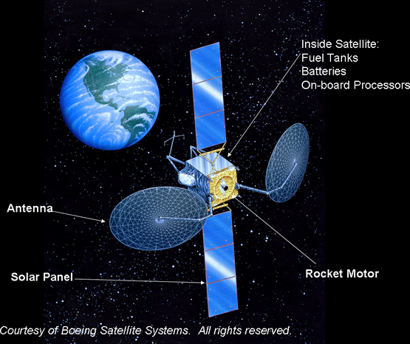
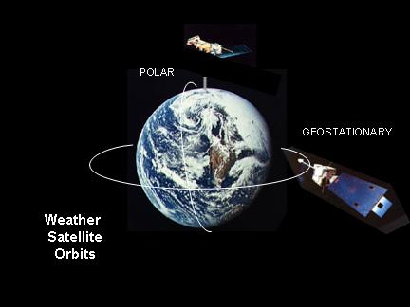
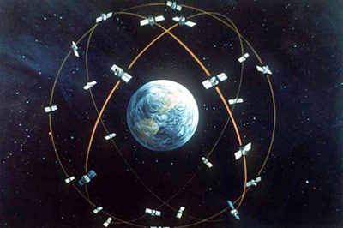
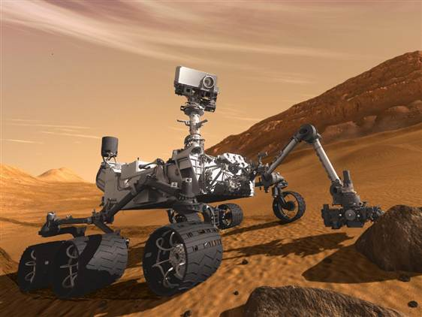
Communication Satellite
GPS
Curiosity Rover on Mars

Slide 15
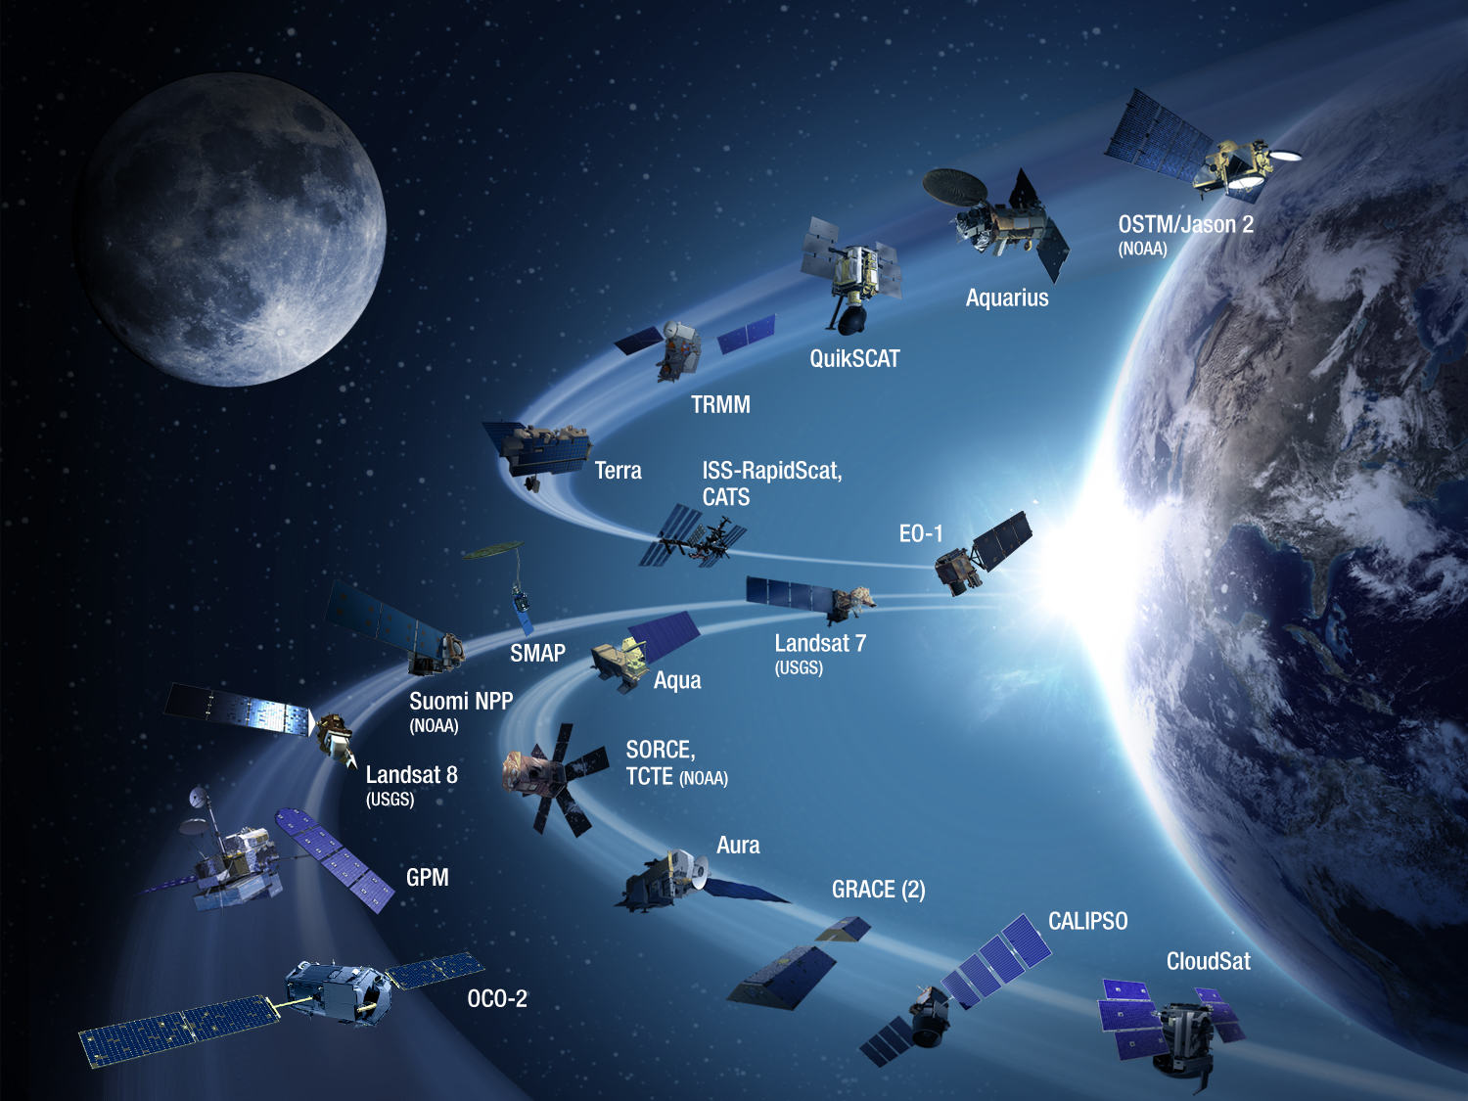
Understanding our atmosphere protects life on Earth

Slide 16
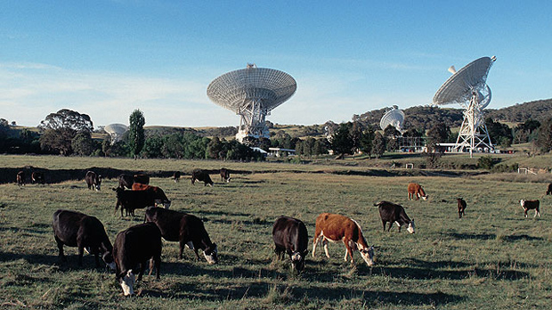
NASA Deep Space Network Canberra, Australia
Located at Tidbinbilla 35kms SW of Canberra , Australia has supported space exploration since 1965. Canberra Space Center is currently supporting 45 space missions-command, control, and telemetry

Slide 17
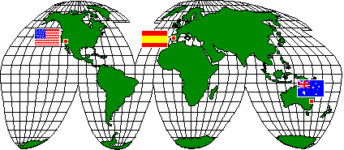
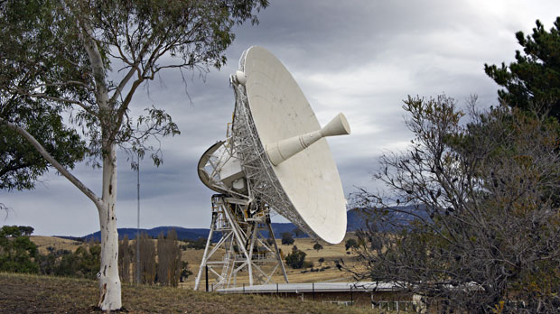
NASA Deep Space Network DSN allows continuous communication with spacecraft from 3 world sites 120 deg apart
Canberra, Australia DSN 46 transmitted to the world Neil Armstrong's first steps on the moon July 69

Slide 18
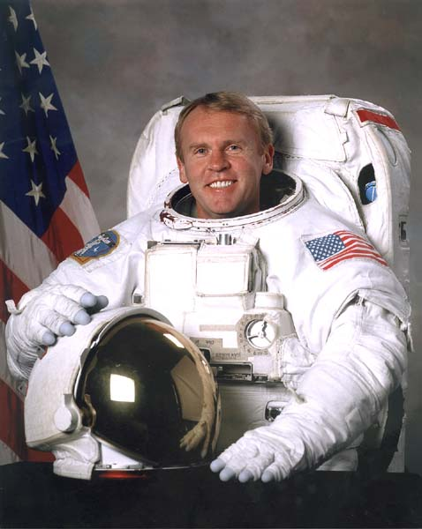
Australian Astronaut
Andy Thomas, born Dec 1951 in Adelaide, flew on four Space Shuttle missions.
Andy was selected as a NASA astronaut in 1992. He flew a long duration mission on the Russia space station Mir in 1998 completing 141 days in space and 2,250 orbits of the earth

Slide 19
Direct benefits of space exploration
Technology Driver
  Computers--smaller, faster, more memory, lower power
  Data compression and transmission—smart cell phones, voice , text, fax, internet, science collaboration, data processing
  Green energy and battery advances—Solar cells, fuel cells, Nickel metal hydride, Lithium Ion, conversion efficiency
  Materials research—composites, ceramics, kevlar, semiconductors/ICs, high strength/light weight metals
  Medical monitoring and diagnostics—MRI, Cat Scan, heart monitors, ER and ambulance support, heart pump
  Power and propulsion—high efficiency, low noise, reliability
  Aerodynamics and structures—high speed, low drag, high temperature performance
  Water purification—pure water for remote locations

Slide 20
Direct benefits of space exploration
Economic growth
  Technology spinoff to multiple applications. A better life for all who follow us.
  New industries, products and manufacturing innovation
  Robotics and manufacturing efficiencies
  $1 spent on space generates $8 growth in manufacturing, medicine, research, education, transportation infrastructure.
Peace through strength
  Surveillance and Command Control and Communication-C3
  Smart weapons and intelligent robotic systems
  Overwhelming superiority and power projection
Many more examples of valuable “Spinoff Technologies” we use in everyday life are found at Spinoff.nasa.gov

Slide 21
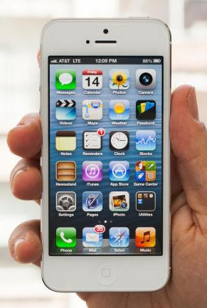
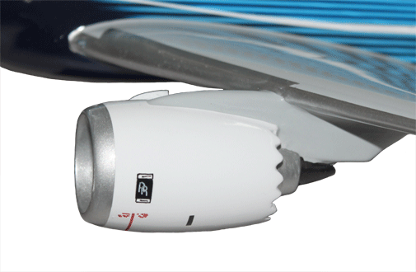
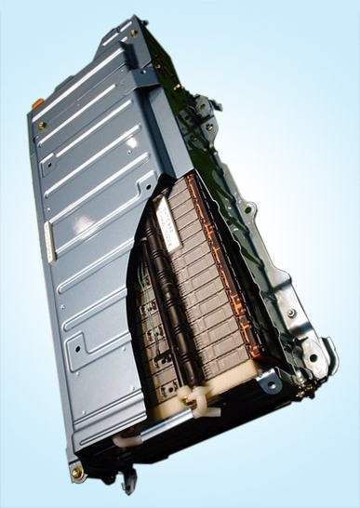
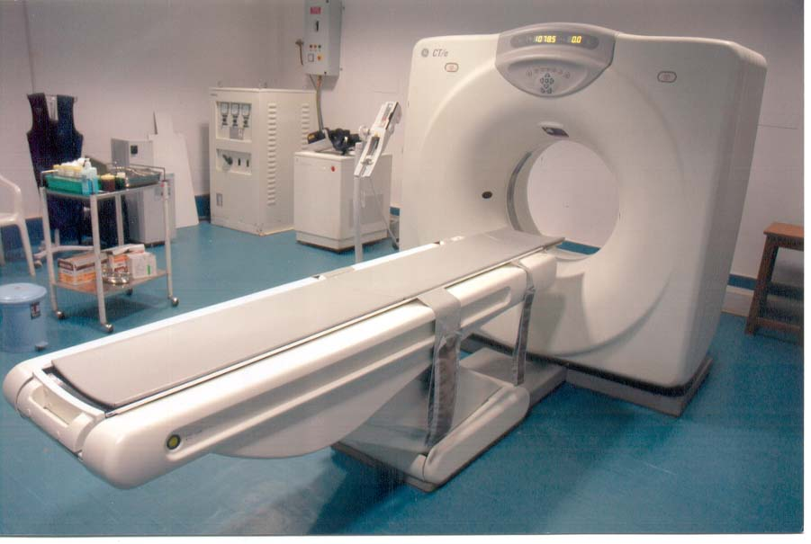
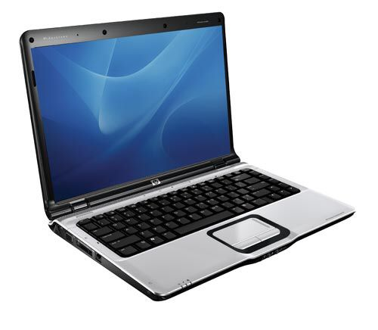
Lithium car battery pack
787 jet engine
iPhone 5 and laptop computer
CT-Scan

Slide 22
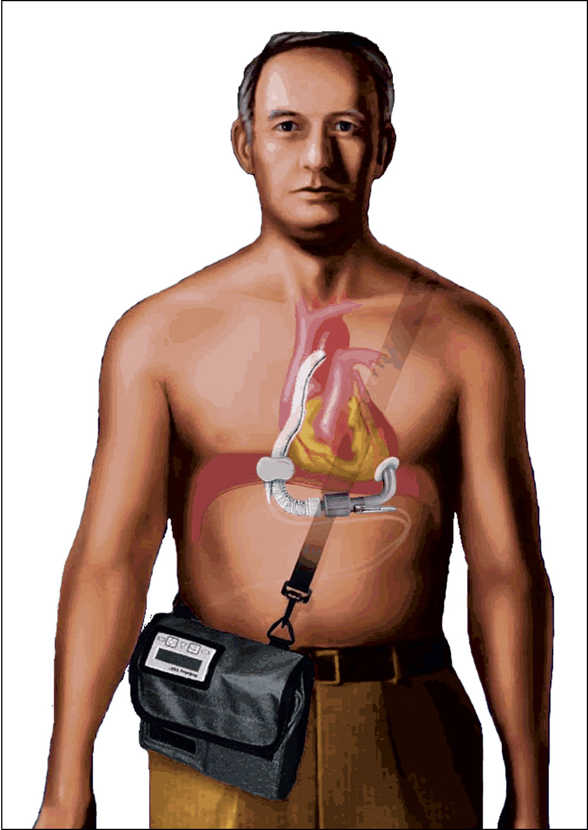
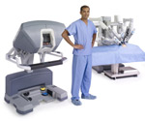
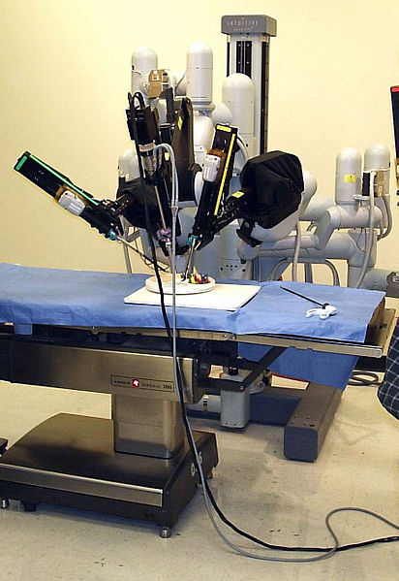
da Vinci® robot assisted surgical systems
Laparoscopic Surgery Robot
Developed using NASA telerobotics technologies
MicroMed DeBakey VAD® is a ventricular assist device that functions as a "bridge to heart transplant“ developed from NASA rocket engine fluid flow expertise.

Slide 23
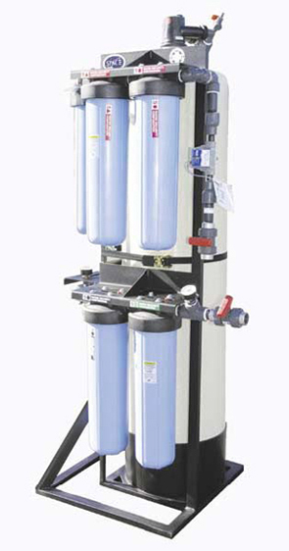
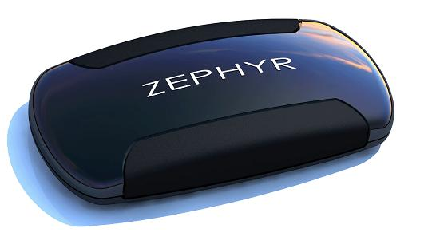
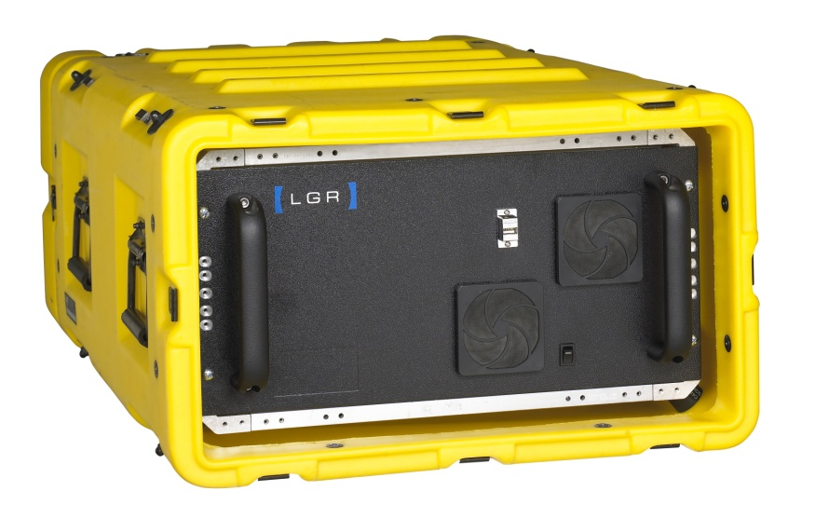
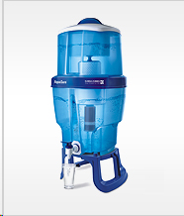
NASA developed water purification and recycling equipment on ISS has been utilized by Water Security Corporation to remove contaminants, bacteria, and viruses in remote locations and highly polluted water sources.
Galaxy water treatment system and purification cartridge provides one year of clean water per family in India.
Zephyr monitors critical physiology data
Derived from ISS astronaut monitoring
NASA developed analyzers monitor greenhouse gases, air and water pollutants

Slide 24
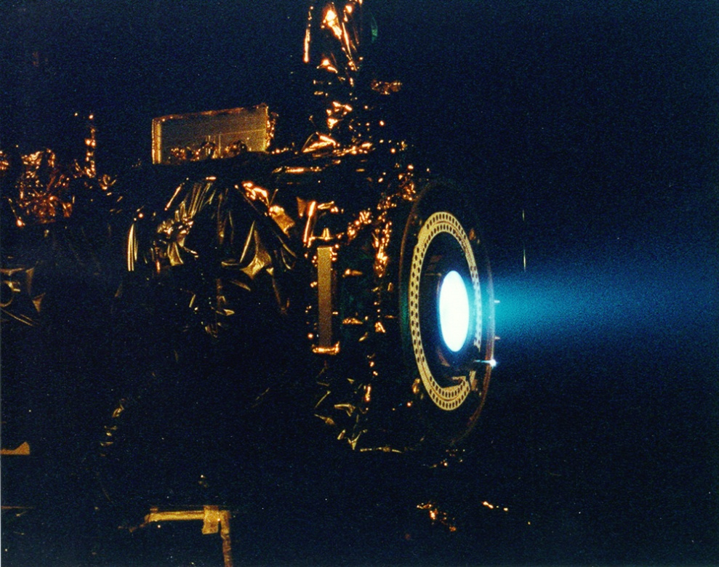
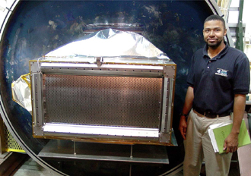
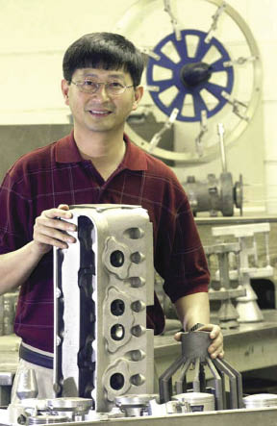
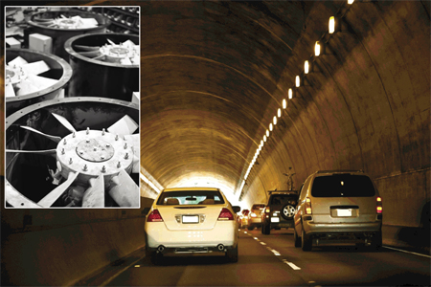
Ion Thruster
Deep Space One
HiPEP
MSFC-398
Hi strength
Aluminum
Alloy is3 times lighter than steel.
Aircraft
And auto engines and
Tunnel fans.

Slide 25
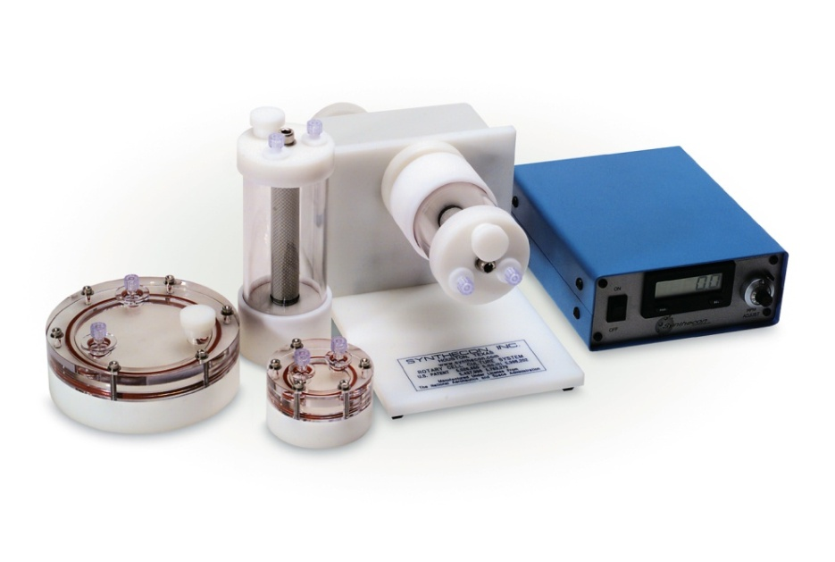
Bioreactors drive advances in tissue engineering
Johnson Space Center
Synthecon Inc.
Houston, Texas
NASA Technology
Grows biological cells in Zero-G
Rotating the wall of the bioreactor in Zero G prevented cell damaging turbulence
Benefits
Fast tissue growth helps burn Patients grow own skin grafts
complex and three-dimensional cell structures are possible
10 times more cells produced vs standard systems
Spinoff 2011
Health and Medicine

Slide 26
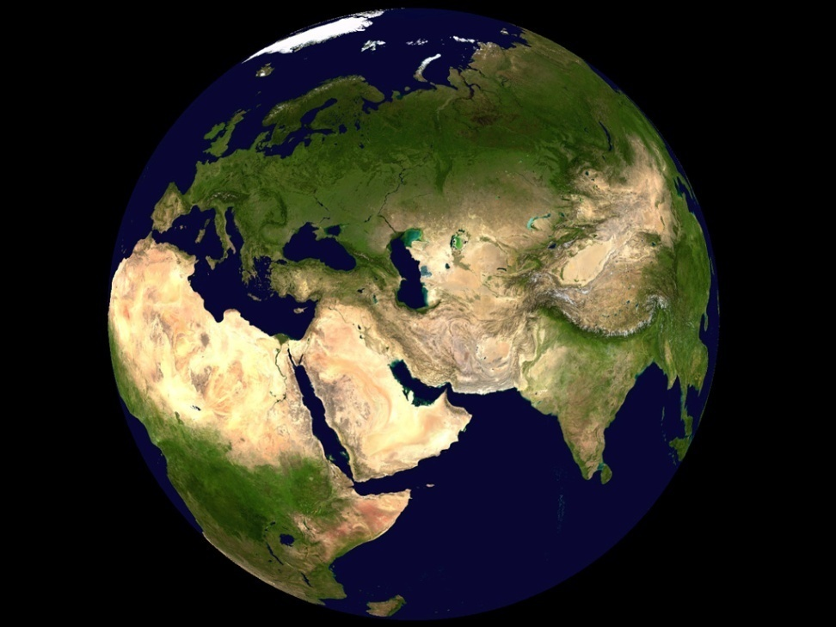
World Wind tools reveal environmental change
Ames Research Center
Intelesense Technologies
Honolulu, Hawaii
NASA Technology
NASA has an unmatched store of data on Earth’s surface
To visualize this data in a 3D format, NASA built a software program called World Wind
Technology for public health and environmental monitoring
Benefits
monitoring 6,500 acres of native forest in Hawaii
creating global heat maps and satellite feeds of maritime domains
Spinoff 2011
Energy and Environment

Slide 27
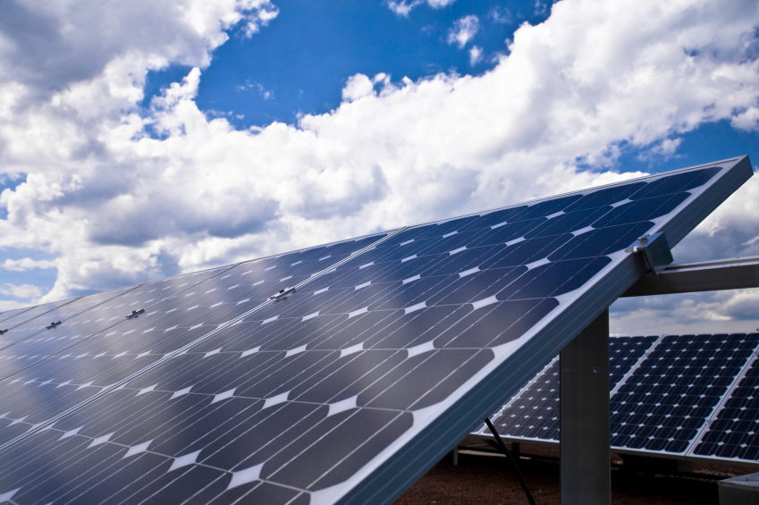
Coating processes boost performance of solar cells
Glenn Research Center
Special Materials Research and Technology Inc. (SPECMAT)
North Olmstead, Ohio
NASA Technology
Solar cells power most of NASA’s spacecraft.
Technology and manufacturing efficiency improvements apply directly to renewable energy.
Benefits
New coating is more efficient and stays clean longer
Solar cells have highest performance and lowest cost in the industry
Spinoff 2011
Energy and Environment

Slide 28
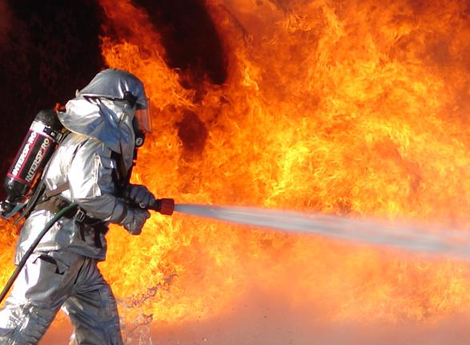
High-pressure systems suppress fires in seconds
Marshall Space Flight Center
HMA Fire/Orbital Technologies Corporation (ORBITEC)
Madison, Wisconsin
NASA Technology
Ultra-high pressure (UHP) vortex flows derived from rocket engines
Benefits
Puts out fires 80 percent faster using only 6 percent as much water
extinguishes car gasoline fire in 9 seconds
Spinoff 2011
Public Safety

Slide 29
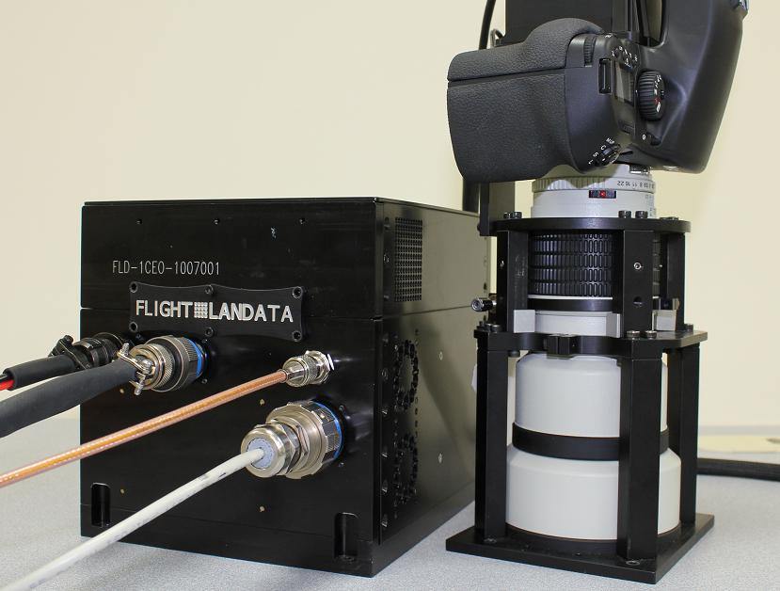
Imaging systems provide maps for U.S. soldiers
Goddard Space Flight Center
Flight Landata Inc.
North Andover, Massachusetts
NASA Technology
NASA Landsat data provides detailed 3D maps for military use
Benefits
high-resolution, 3D surface data for tactical missions and intelligence gathering direct to soldiers on the ground
Spinoff 2011
Public Safety

Slide 30
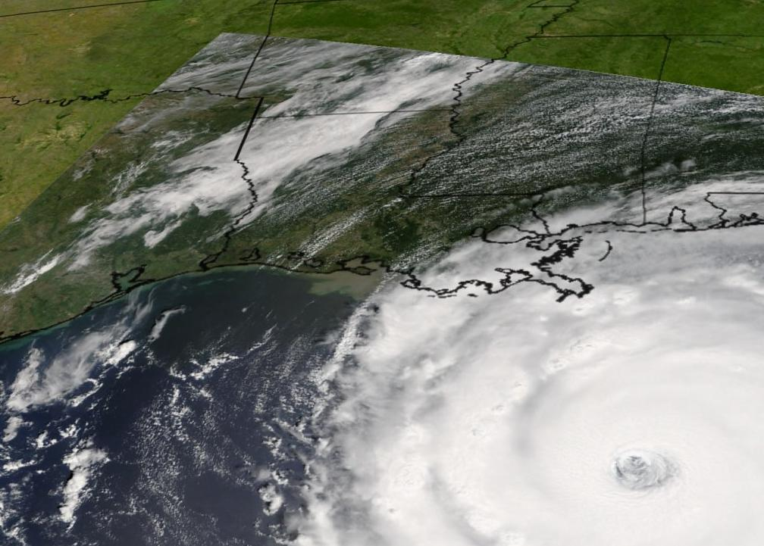
Information systems coordinate emergency management
Stennis Space Center
NVision Solutions Inc.
Bay St. Louis, Mississippi
NASA Technology
NASA Earth-observing satellites data provided to FEMA and local agencies
Benefits
NVision’s Real-Time Emergency Action Coordination Tool (REACT) is used by all Federal and local government agencies to coordinate emergency response and management
Spinoff 2011
Public Safety

Slide 31
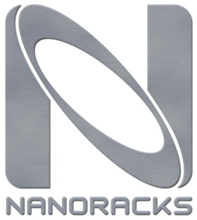
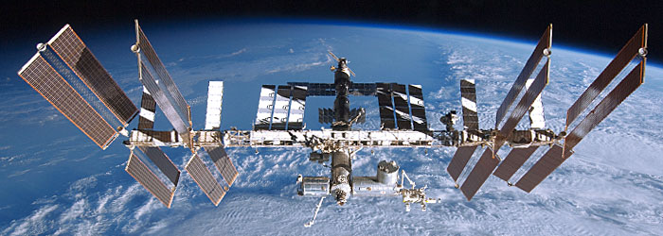
NanoRacks: making ISS accessible to all
Commercial service to ISS – “The UPS of outer space shipping”
Offers commercial transportation and delivery service to researchers, experimenters, government, and even to students!
  Simple plug and play platforms that anyone can design
  Many college, high school and even middle school experiments flown to ISS
Helps “ordinary” people use ISS by working with NASA to arrange flights
  Flights 6-8 times a year. Less than a year lead time
Many “atypical’ users finding interesting things to do in space by using NanoRacks
www.nanoracks.com

Slide 32
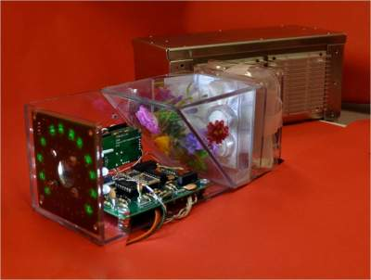
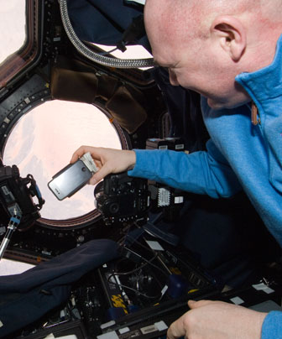
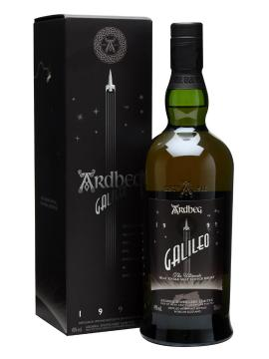

Experiment by high school in Silicon Valley, flown by NanoRacks
First iPhone in space!
Terpenes whiskey experiment on ISS arranged by NanoRacks. and award winning Ardbeg Galileo
NanoRacks “NanoLab” onboard the Shuttle

Slide 33

We must prudently balance our expenditures to the end results we desire
  NASA is 0.4% of the “Veterans Benefits spending 4%”
  We the voters are responsible for electing politicians spending our m0ney that reflects our priorities.

Slide 34

NASA Budget has been flat for decades
John Glenn flight
Apollo 11
Shuttle starts
Shuttle 1st flight
ISS 1st flight

Slide 35
What does history says happens to cultures that abandon exploration as a national priority?
China burns Admiral Zeng He’s fleet in 1430s and China turns inward.
Portugal turns away from exploiting their exploration advances under Henry the Navigator and cede leadership to the Spanish, French, English, and Dutch.
America retires the Space Shuttle without an American replacement to carry US astronauts to space. We buy seats on a Russian rocket to the International Space Station ISS
Exercise to the reader to make a conclusion…..

Slide 36
Can we afford to explore space? YES
Space Exploration costs less than ½ penny of the federal budget
No federal investment has a higher ROI that has so significantly improved our lives-one dollar of space exploration has generated eight dollars of economic growth
The challenge of space continues to inspire and drive the next generation
We stretch our technology, advance science and understanding, provide peace thru strength

Slide 37
Can we afford to not invest in space? NO
History teaches that societies that pushed their frontiers have prospered
Societies that turn away from exploration have withered
No Society has gone wrong investing in exploration
The symbols of Sputnik, Yuri Gagarin and John Glenn in space, Moon landings, Space Shuttle, International Space Station remind us that we are indeed capable of achieving great feats benefiting all mankind
Therefore, let us continue to lead the exploration of space

Slide 38

Bottom Line? We would not be in America without our European ancestor’s imperative to explore!

Slide 39
You can view video and slides for this lecture at my website
frankbuzzard.com

