Slide 1
Mars—next for human exploration?
Frank T. Buzzard
Space Shuttle and International Space Station Chief Engineer
NASA Retired

Slide 2
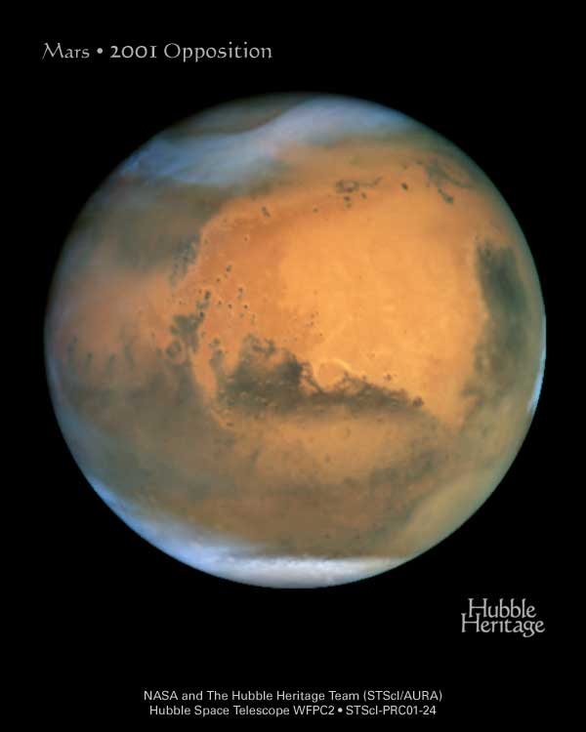
Mars is ½ the radius of Earth orbiting the sun in 1.881 years at 1.38-1.67 AU with a 24.62 hour rotation and 25.3 deg tilt. Mars surface gravity is 0.38 g
Mars red color is iron oxide. Mars permanent polar caps are water ice with a thin layer of frozen CO2. Mars atmosphere is 95% CO2 equivalent to 100,000 feet Earth pressure (6-10 mbar Mars surface vs Earth 1015 mbar ). Liquid water does not exist at this low pressure. Surface temperature ranges from 80 deg F at equator to -200 deg F at poles. Air temp rarely exceeds 32 deg F.

Slide 3
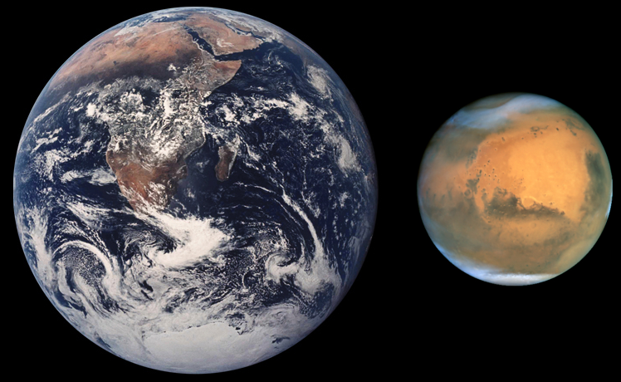
Relative size of Earth and Mars
Mars is ½ the radius of Earth
Mars Gravity is 0.38 g

Slide 4
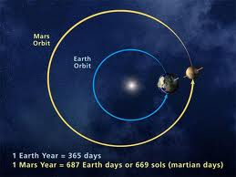
Mars orbit is more eccentric than Earth’s near circular orbit
varying between 1.38-1.67 AU from the Sun

Slide 6
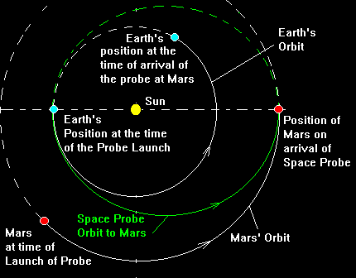
Lowest energy transfers to Mars take 259 days or 8 2/3 months each way launching 96 days before Mars opposition. We must add 11% to Earth’s orbital velocity of 29.7 km/sec to go to mars. 90% of this extra velocity (3 km/sec) must be removed to enter orbit around Mars. 26 months separate launch opportunities

Slide 7
USA Mariner Spacecraft Exploration of Mars and Venus
Mission | Launch Date | Launch Vehicle | Mission | Results
Mariner 1 | 22JUL1962 | Atlas-Agena D rocket | Venus Flyby | Launch failure.
Mariner 2 | 27AUG1962 | Atlas-Agena D rocket | Venus Flyby | Successful.
Mariner 3 | 5NOV1964 | Atlas-Agena | Mars Flyby | Failed to reach Mars.
Mariner 4 | 28NOV1964 | Atlas-Agena | Mars Flyby | First successful Mars flyby. Returned 22 photos.
Mariner 5 | 14JUN1967 | Atlas-Agena | Venus Flyby | Successful.
Mariner 6 (Mariner F) | 24FEB1969 | Atlas-Centaur | Mars Flyby | Successful.
Mariner 7 (Mariner G) | 27MAR1969 | Atlas-Centaur | Mars Flyby | Successful.
Mariner 8 (Mariner H) | 9MAY1971 | Atlas-Centaur | Mars Orbiter | Launch failure.
Mariner 9 (Mariner I) | 30MAY1971 | Atlas-Centaur | Mars Orbiter | Successful Mars orbiter.
Mariner 10 | 3NOV1973 | Atlas-Centaur | Venus & Mercury Flybys | Successful.

Slide 8
Getting to Mars is HARD!
15 of 15 Russian Mars Missions failed between 1960 and 1973
3 of 6 American Mars Missions failed between 1964 and 1973
USA Mariner 4 flyby (1964) and Mariner 9 orbiter (1971) gave us the first spacecraft photos of Mars surface.
Viking 1 and 2 Mars Orbiters and Landers in 1976 were spectacular technical successes. Great Photos. Search for life was indeterminate.
Mars USA Sojourner Rover landed in 1996. Great Success.
USA Spirit and Opportunity Rovers landed in 2003. Still working
USA Mars Reconnaissance Orbiter in 2006. Still working.
USA Mars Curiosity Science Lab landed in 2012. Still working
More that ½ of Mars International missions have failed in the last 50 years.

Slide 9
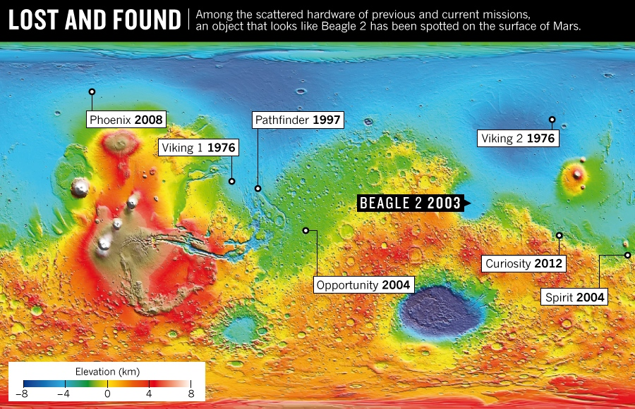
Landing spots on Mars

Slide 10
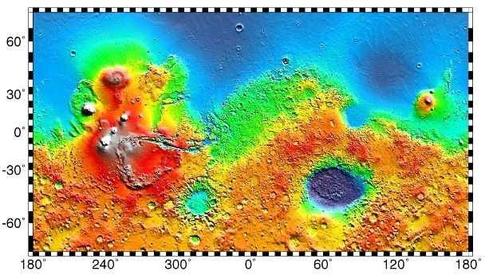
The Tharsis Volcanic Bulge is antipodal (180 deg) opposite on Mars to the Hellas Impact Basin
Red is high altitude. Blue is low altitude
Olympus Mons
Tharsis Buldge
Hellas Impact Basin

Slide 11
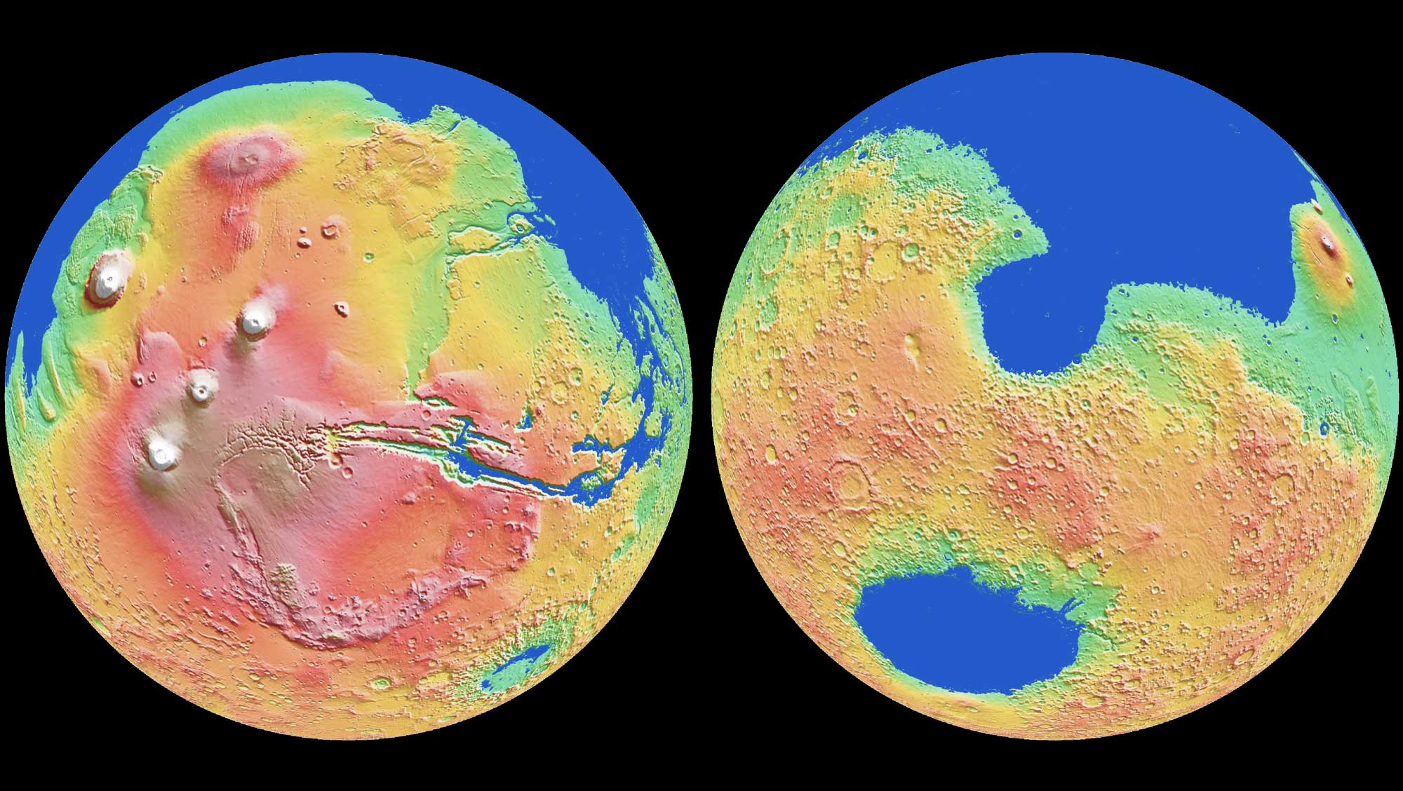
March 2015 NASA/ESO Infrared telescope studies of deuterium (heavy water) show Mars had a large ocean in its northern hemisphere over one mile deep and as large as the Atlantic Ocean for several billion years after Mars was formed.

Slide 12
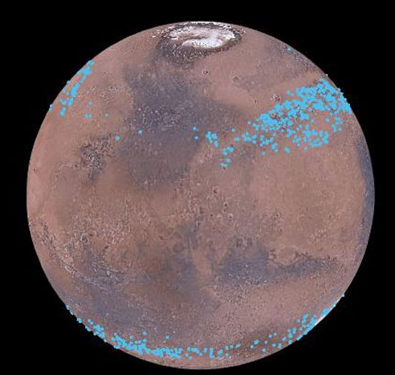
Mars has ice glaciers covered with thick dust
Recent analysis of MRO radar data shows water ice glaciers hidden under thick dust layers on Mars. Enough ice to cover Mars with a one meter thick ice coating!
Image Credit:
NASA/Nanna Karlsson/NBI

Slide 13
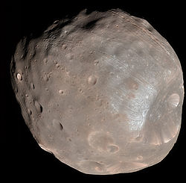
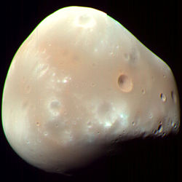
Mars has two satellites—Phobos and Deimos—in near circular orbits. Both were discovered in 1877 by Asaph Hall
Phobos 22km wide orbits
9400 km/5875 mi above Mars every 7.66 hrs. Speedy Phobos rises in west and sets in east every 11 hours
Deimos 13 km wide orbits
23000 km/14375 mi above Mars every 30.35 hrs. Deimos rises in east and slowly sets in west in 2.7 days

Slide 14
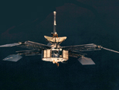
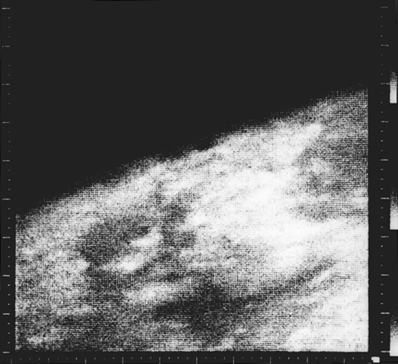
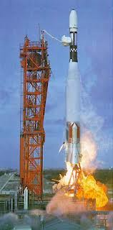
Mariner 4 returned the first flyby photos of Mars July 1965

Slide 15
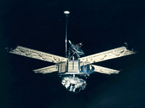
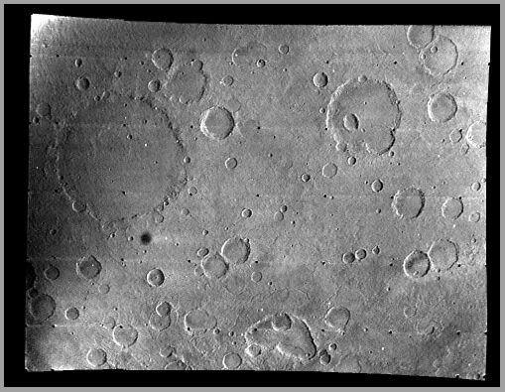
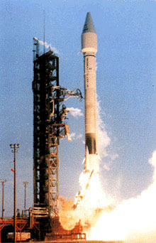
Mariner 6 & 7 found cratered Terrain on Mars in Feb and Mar 1969

Slide 16
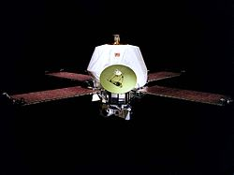
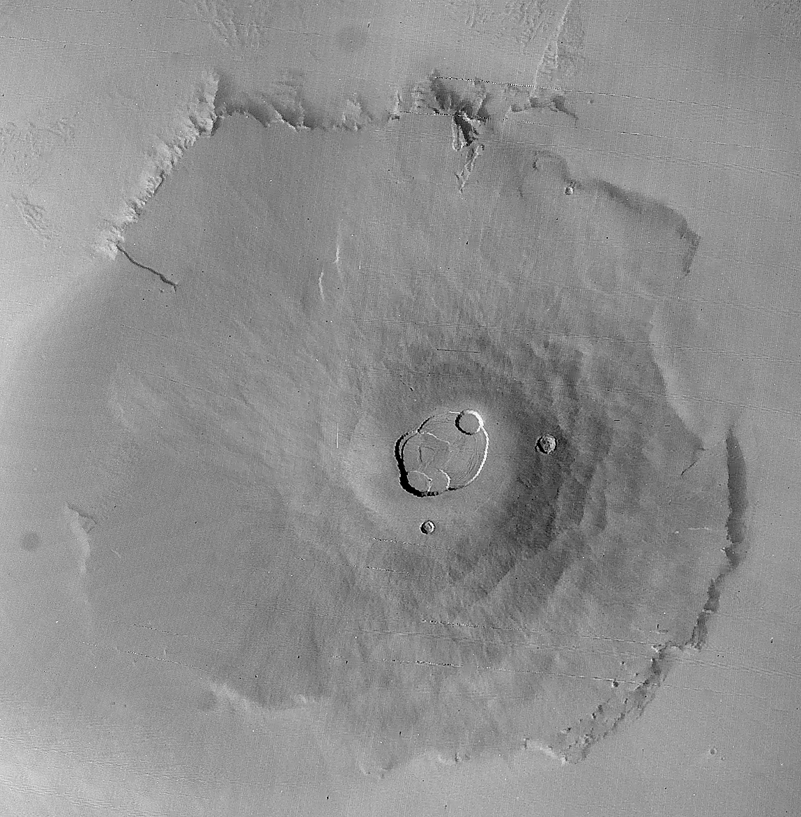
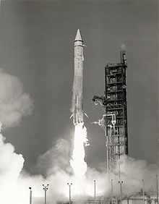
Mariner 9 returned first orbital images of Mars in May 1971
Olympus Mons is 22 km (14 mi/70Kft) high and 600 km (370 mi) wide

Slide 17
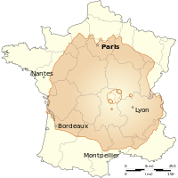
Mars Olympus Mons volcano compared to France

Slide 18
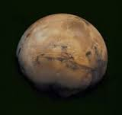
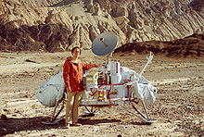
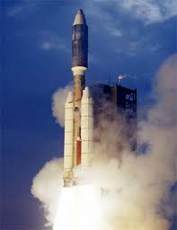
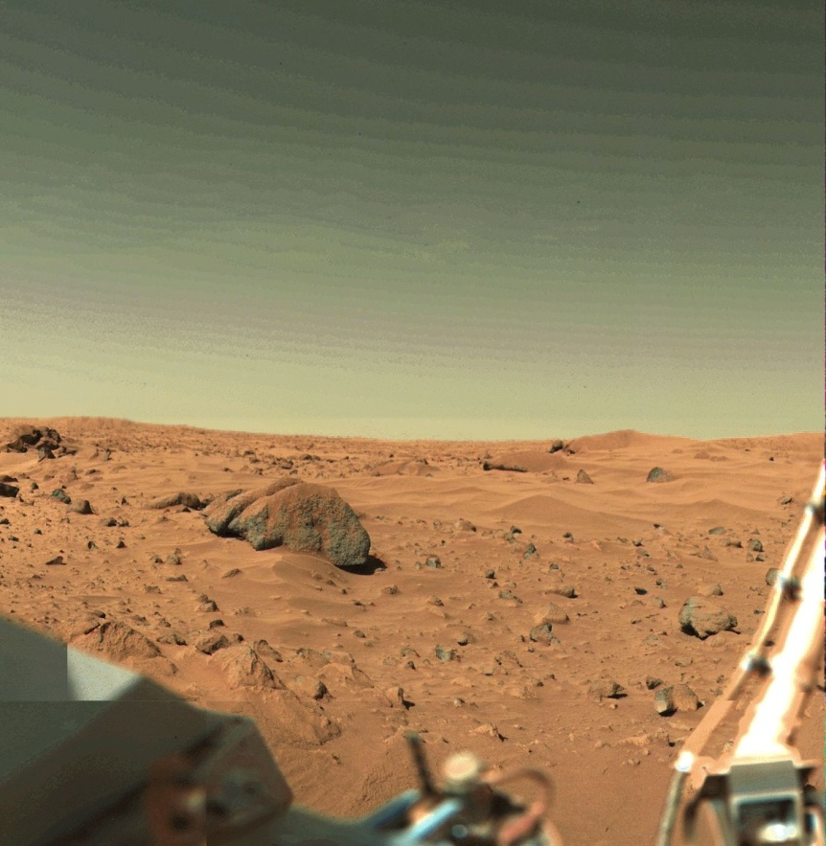
Viking 1 & 2 land on Mars in 1976. Awesome technical success!
Carl Sagan and lander model (left). Valles Marineris from orbit (right)
Titan/Centaur Rocket-largest in USA .
Viking Lander Mars Surface Photo

Slide 19
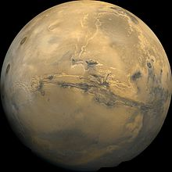
And you thought the Grand Canyon was big?
Valles Marineris is an unbelievable canyon on Mars that is 4000 km (2500 mi) long, 200 km (120 mi) wide, and 7 km (4.5 mi) deep.
LA
NYC

Slide 20
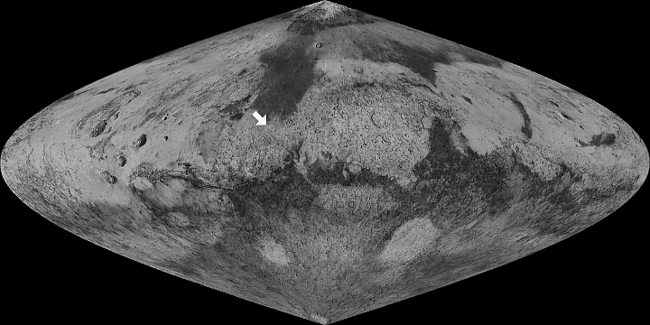
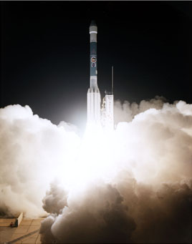
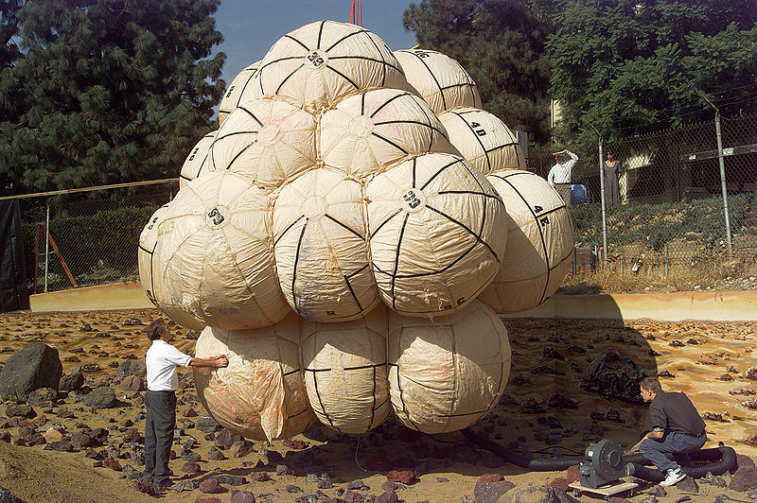
Mars Pathfinder/Sojourner Rover launch Dec 4, 1996 and landing July 4, 1997 continued Mars surface exploration
Delta II launch
Landing site
Unique airbag system absorbs landing impact bouncing 16 times

Slide 21
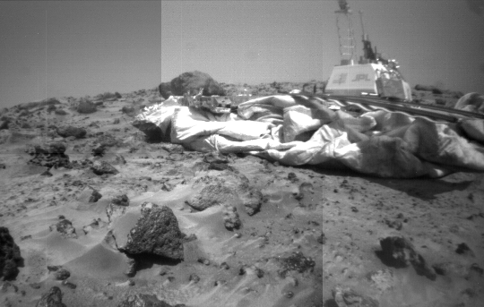
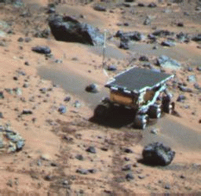
Carl Sagan memorial station studied atmospheric structure-85 days
Sojourner Rover studied chemical composition of rocks and soil
JPL designed lander and base station that deployed the rover
Sojourner finds clear evidence of a much warmer and wetter past on Mars from soil and rock chemical analysis

Slide 22
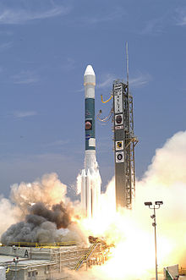
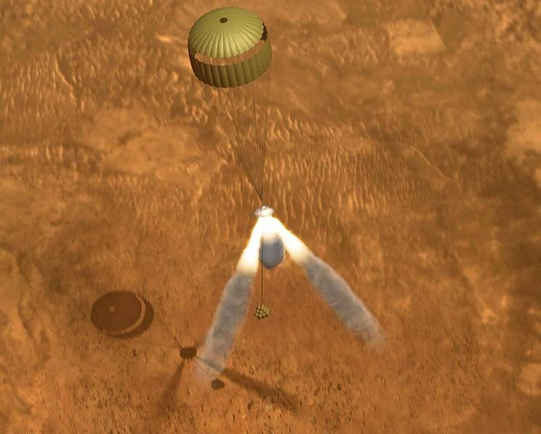
NASA launches twin rovers Spirit and Opportunity to Mars in 2003
Spirit and Opportunity rovers land by parachute, airbag, and rocket deceleration assist.

Slide 23
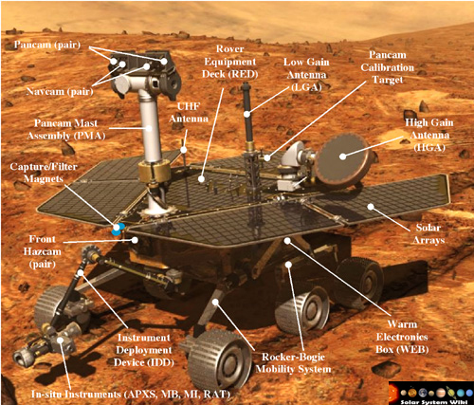
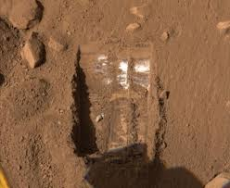
Spirit and Opportunity make great new discoveries!
Opportunity is still operating 13 years after landing
Water Ice on Mars!

Slide 24
11 years after landing on Mars, Opportunity looks at top of Cape Tribulation before climbing to the top
The beautiful view from the top
Rim of Endeavour Crater

Slide 25
Opportunity completes a marathon drive on Mars!

Slide 26
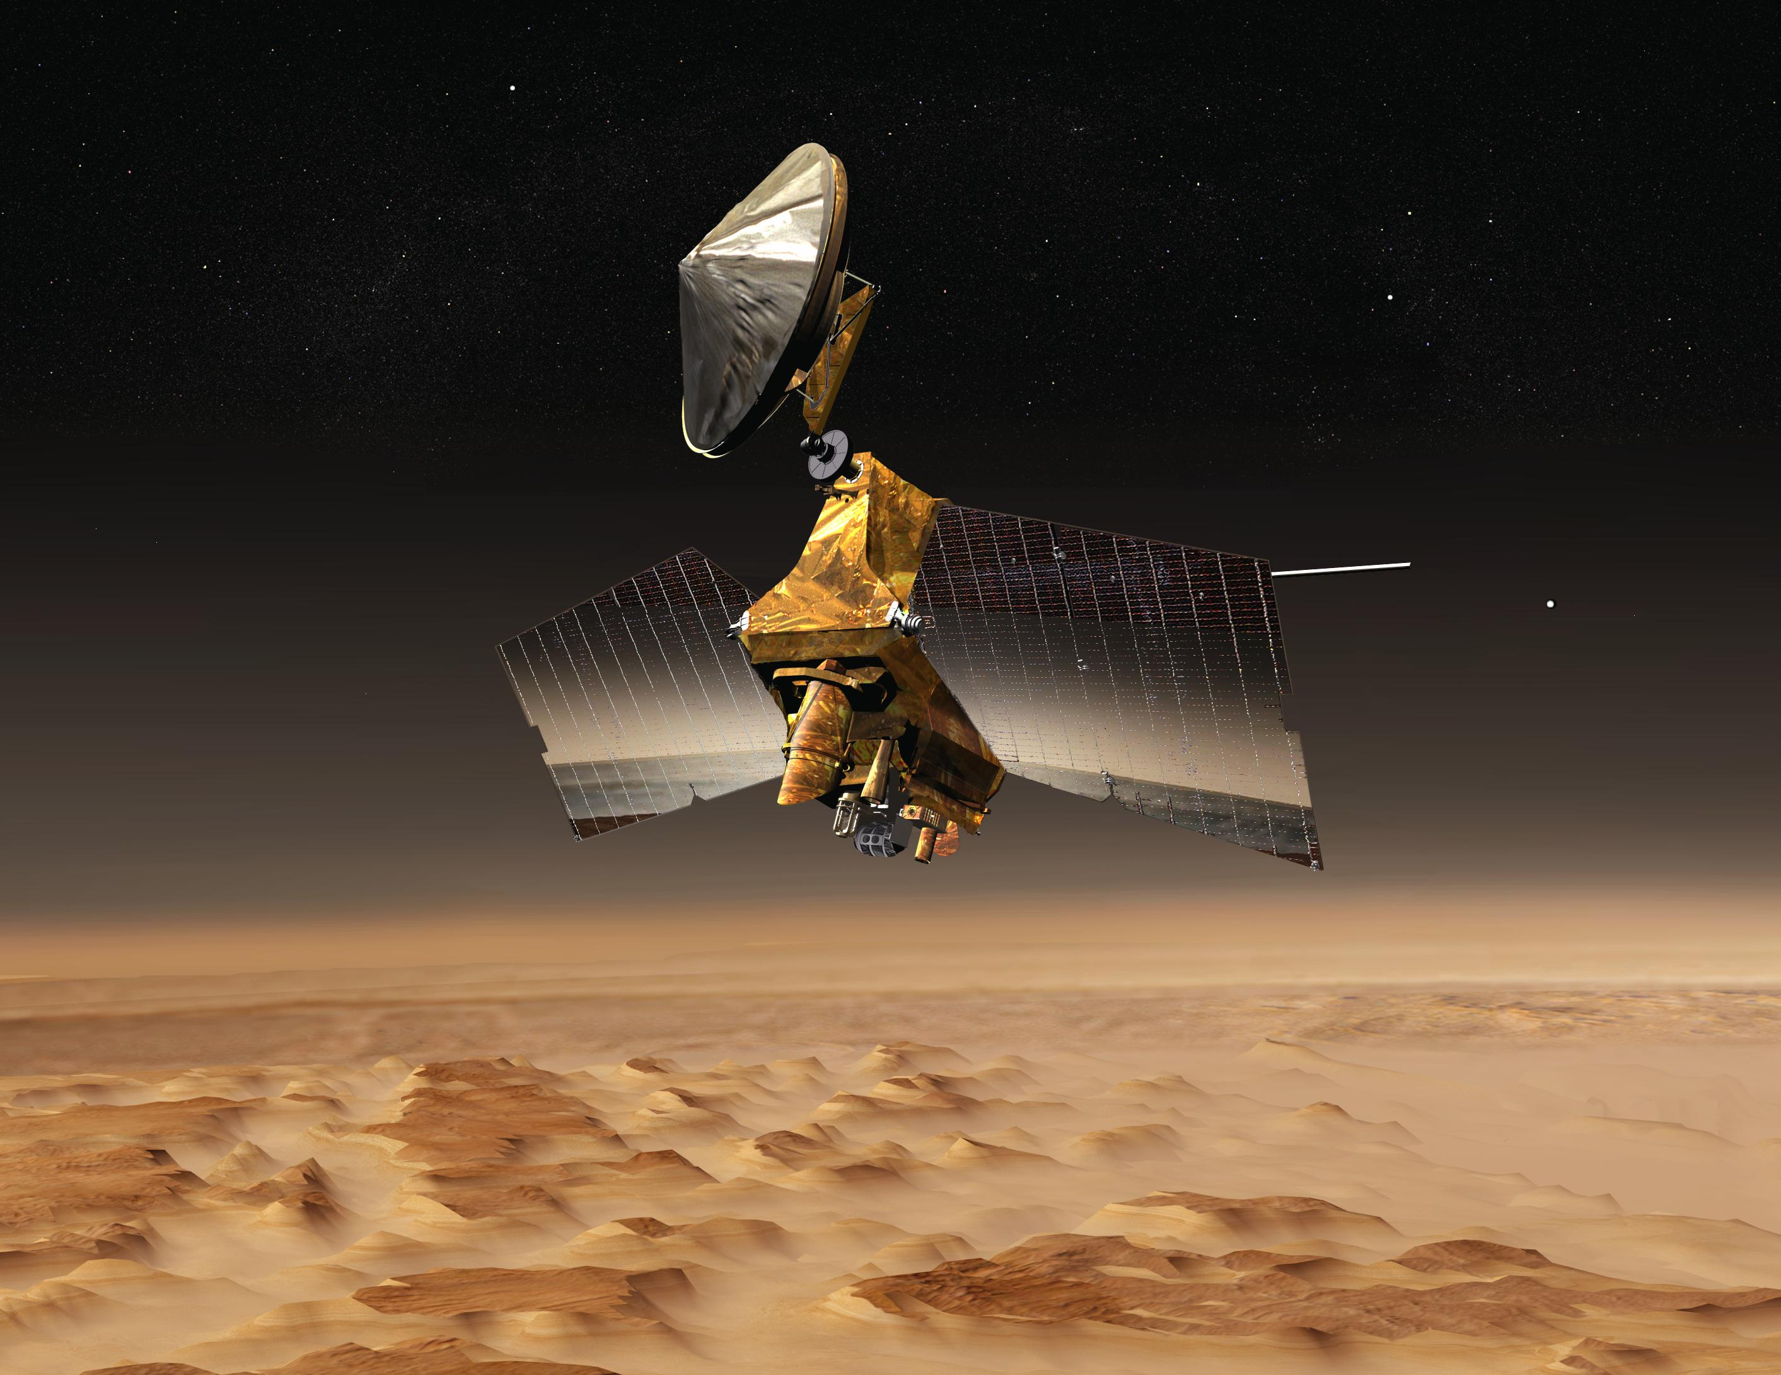
Mars Reconnaissance Orbiter (MRO) with HiRISE camera orbits Mars in 2006
Photo credit NASA JPL

Slide 27
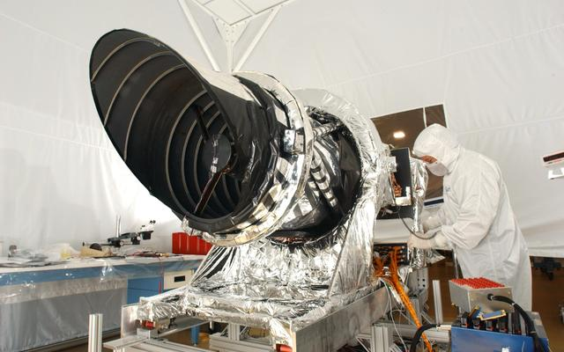
HiRISE (High Resolution Imaging Science Experiment) sees 3 ft/1 m objects in visible light and surface minerals in near infrared light
Photo credit NASA JPL

Slide 28
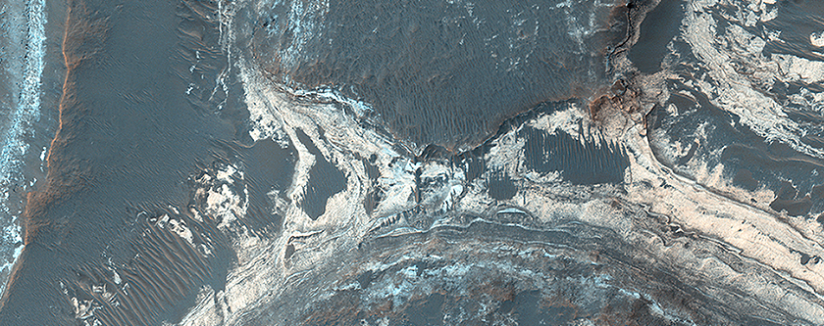
MRO Photographs show stunning detail
Colorful sediments near Hellas impact basin
Photo credit NASA/JPL/Univ of AZ

Slide 29
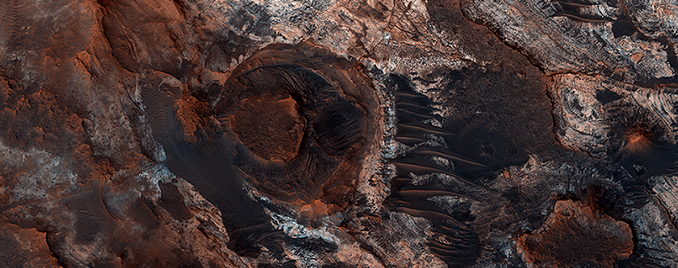
MRO Photographs show stunning detail
Flowing liquid water carved this small section of the Mawrth Valley exposing this unique geological diversity
Photo credit NASA/JPL/Univ of AZ

Slide 30
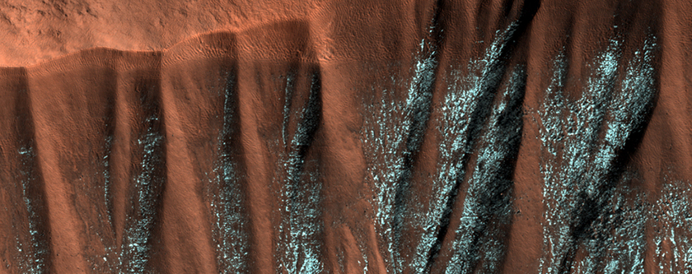
MRO Photographs show stunning detail
Frosted gullies in crater wall
Photo credit NASA/JPL/Univ of AZ

Slide 31
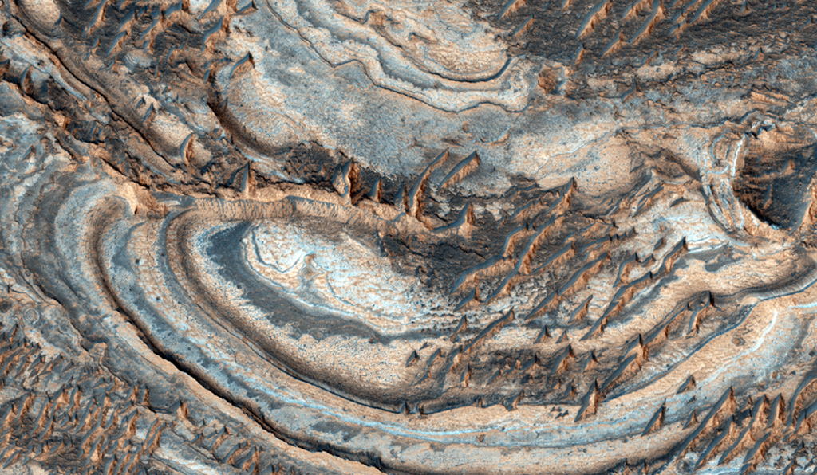
Opal Deposits near the Vallis Marineris
This HiRISE image gives some clues to how the minerals are expressed on the surface. The banded bedrock is visible beneath a partial cover of much younger dunes.
uahirise.org/ESP_022620_1690

Slide 32
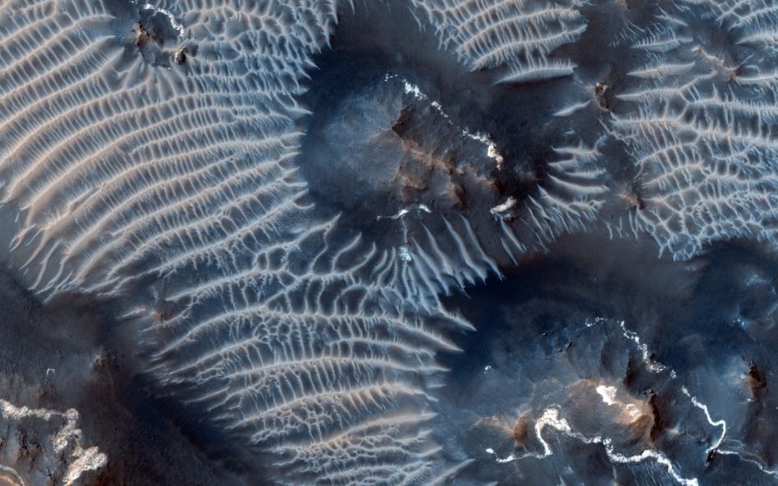
Colorful windblown sand bars, perched high on the Tharsis rise near the Valles Marineris canyon system.
Photo credit NASA JPL

Slide 33
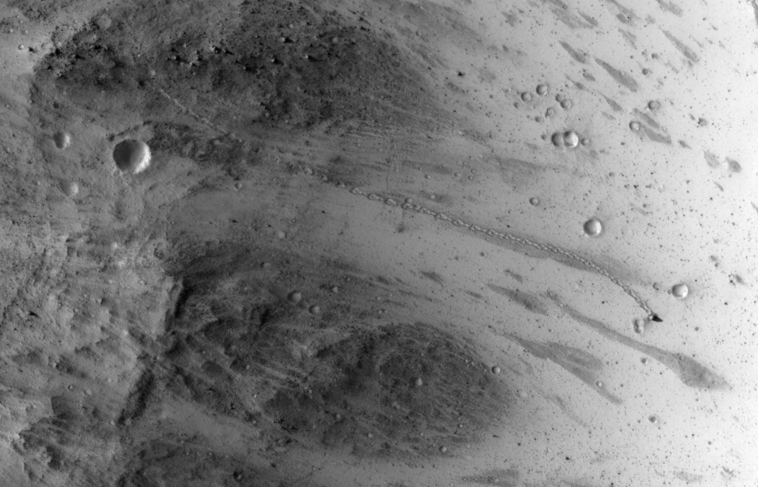
MRO Photographs show stunning detail where large rock rolls down Mars hill.
HiRISE captures 20’x12’
(6m x 3.5m)
rock path down a steep Mars Hill. Path is 1/3 mile or 500 m long. Photo taken July 3, 2014.
Photo credit
NASA/JPL
U. of AZ
Rock Path down hill

Slide 34
Remember Mariner 4 flyby photo of Mars in 1965? We’ve come a long way, baby!

Slide 35
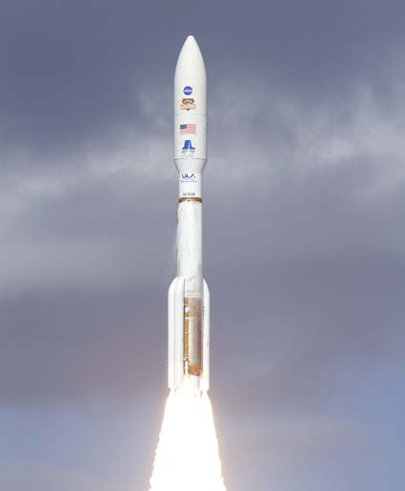
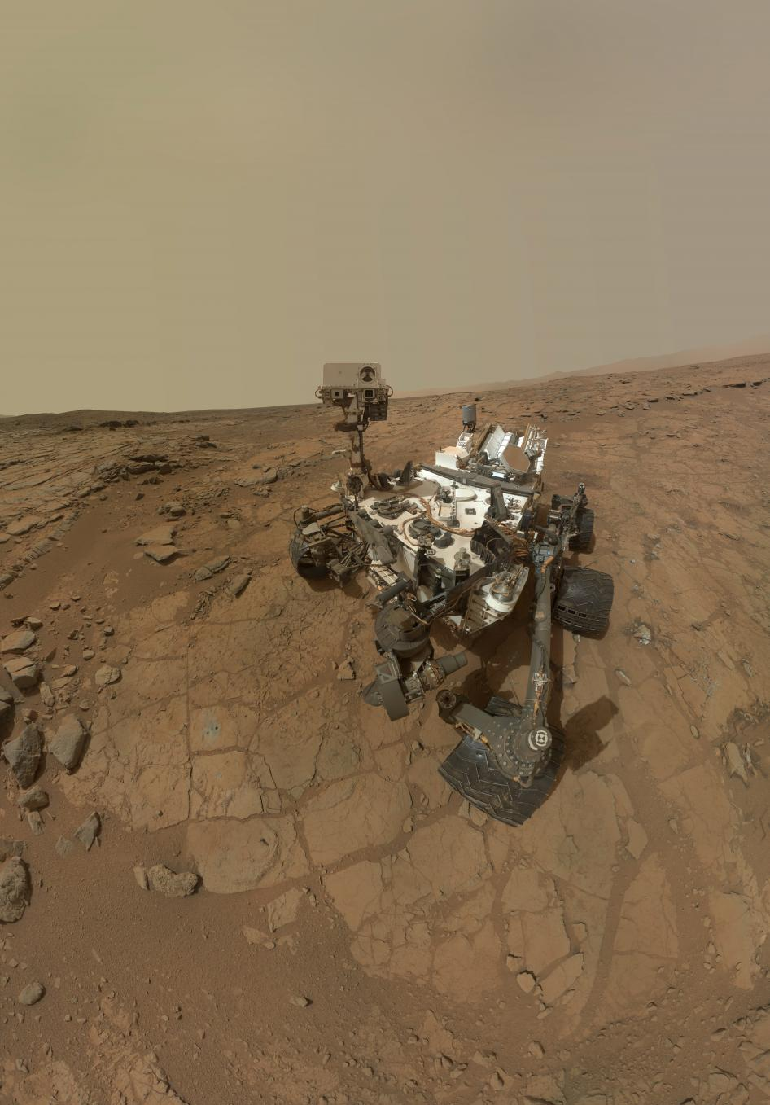
NASA launches Curiosity Rover in Nov 2011 and lands on Mars Aug 2012
Curiosity is the size of a compact car
Atlas V heavy lift rocket

Slide 36
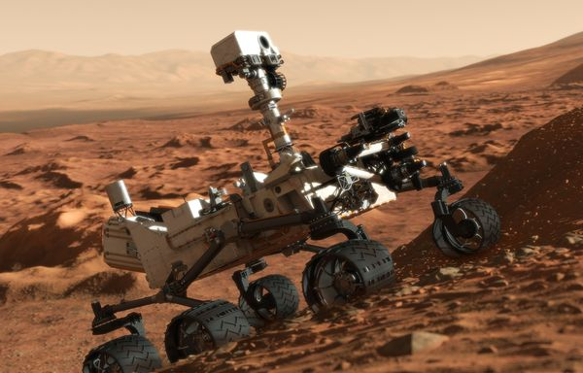
Curiosity is “following the water” and looking for the building blocks of life
Science Objectives
Determine whether life ever arose on Mars
Characterize Mars’ climate and geology
Prepare for human exploration of Mars
Cameras
Spectrometers
Radiation detectors
Environmental sensors
Atmospheric sensors

Slide 37
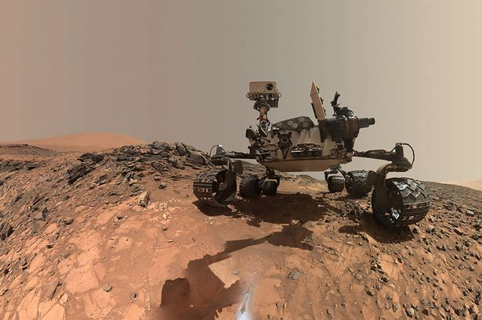
Curiosity detects large water deposits one meter under Gale Crater
Using its Dynamic Albedo of Neutrons (DAN) tool, which looks for the hydrogen of water molecules, Curiosity detected evidence of a huge amount of water just beneath the surface.
Image credit: NASA/JPL-Cal Tech/MSSS

Slide 38
Billion-Pixel View From US Lander Curiosity on Mars at Rock Nest
Photo credit-JPL/NASA

Slide 39
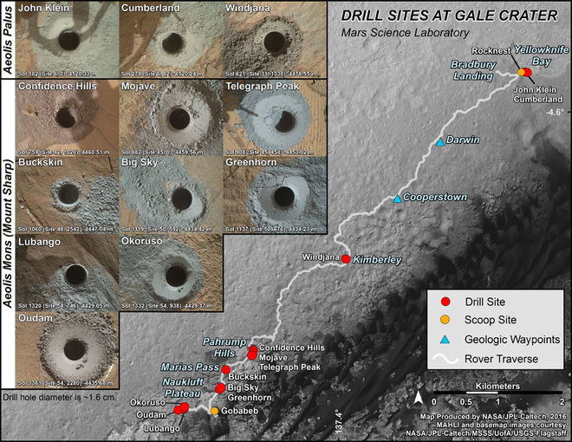
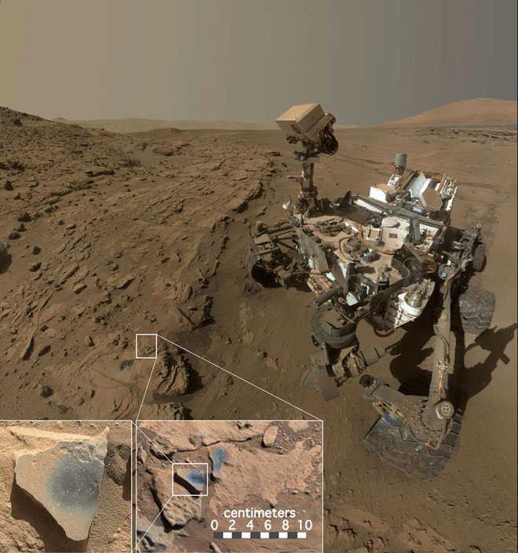
Curiosity doing geology on Mars
Curiosity takes 14 rock and soil samples along the rim of Gale Crater
Manganese-oxide minerals on these rocks require an abundant water and a strong oxidizing environment to form.

Slide 40
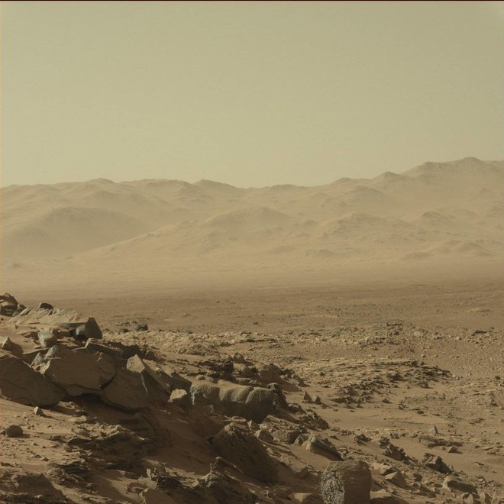
Curiosity sees magnificent desolation on Mars

Slide 41
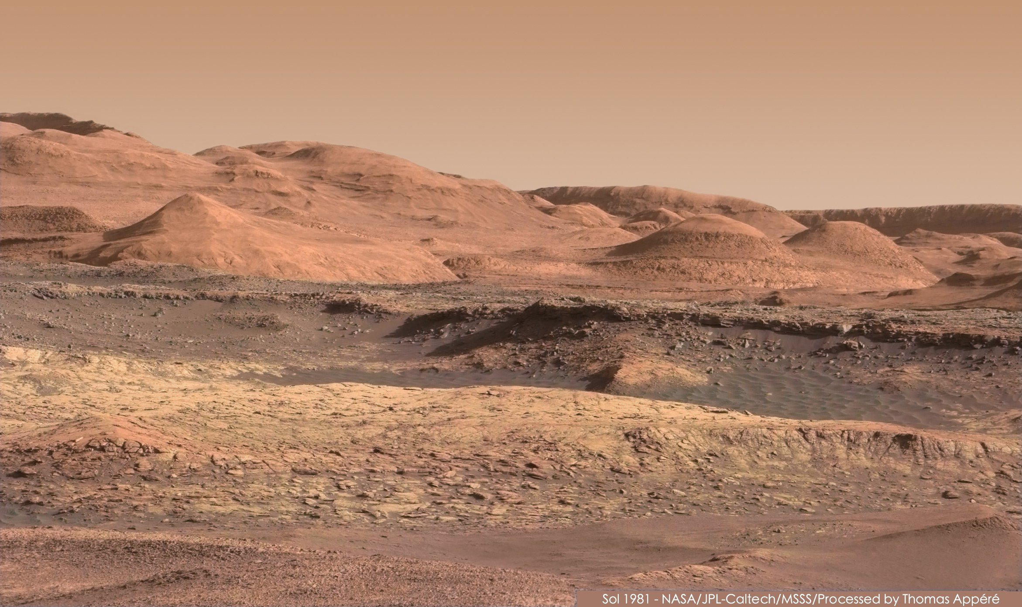
Curiosity sees magnificent desolation on Mars

Slide 42
Curiosity looks at Earth from Mars
Credit: NASA/JPL-Caltech/MSSS/TAMU

Slide 43
Mars Reconnaissance Orbiter-MRO-continues to take unprecedented resolution photos of Mars since 2006
Curiosity Landing Site
Rover Tracks
Curiosity Rover
Curiosity Lander at Yellowknife Bay taken from Mars orbit 192 miles or 307 kilometers away
Photo credit NASA/JPL/Univ of AZ

Slide 44
Why Explore Mars?
To Understand Global Climate Change in our solar system. Where did all the water go and why? Implications for life on Earth?
To Advance Technology that can be applied in new products we use on Earth everyday.
Exploration, curiosity, the challenge, and the desire to understand is a fundamental part of our human nature.
Enable economic growth and enhance national security.
Inspire our youth and increase knowledge.
Learn to travel, live, and work in space—the next frontier.
Enhance the ability to colonize and utilize the resources of our solar system. Perhaps avoid the fate of the dinosaurs?
Because it is there!

Slide 45
You can view video and slides for this lecture at my website
frankbuzzard.com

