Slide 1
Reflections of a Chief Engineer Space Shuttle
Frank Buzzard
Space Shuttle Chief Engineer, 1994-96
NASA retired

Slide 2
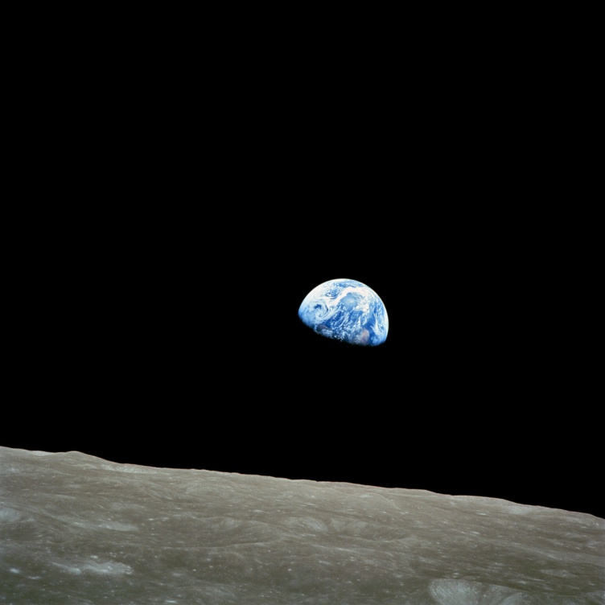
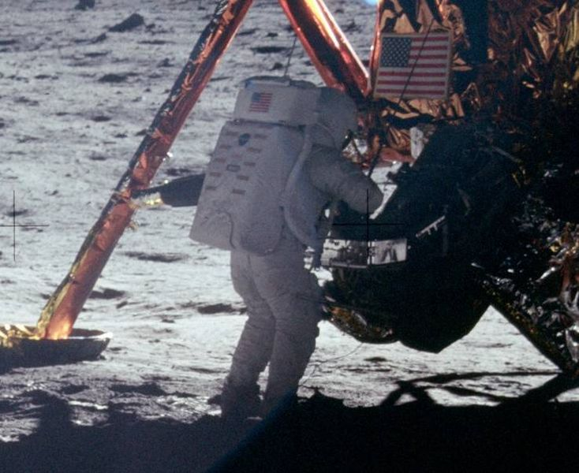
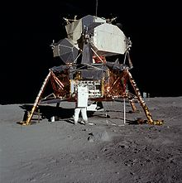
The Apollo legacy-America changed the world forever, and American leadership led us to the Space Shuttle!

Slide 3
We dreamed of a reusable space plane to build a space station--A transportation node to go to Mars.
“I have decided today that the United States should proceed at once with the development of an entirely new type of space transportation system designed to help transform the space frontier of the 1970's into familiar territory, easily accessible for human endeavor in the 1980's and '90's.
This system will center on a space vehicle that can shuttle repeatedly from Earth to orbit and back. It will revolutionize transportation into near space, by routinizing it. It will take the astronomical costs out of astronautics. In short, it will go a long way toward delivering the rich benefits of practical space utilization and the valuable spinoffs from space efforts into the daily lives of Americans and all people.” Richard M Nixon
President Richard M. Nixon and NASA Administrator James C. Fletcher announced the Space Shuttle program had received final approval in San Clemente, California, on 5 January 1972.

Slide 4
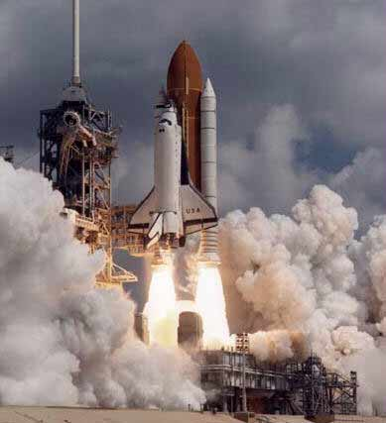
Space Shuttle design evolution was highly driven by budget constraints. Reusability and airline-like operation would reduce cost was the goal.

Slide 5
NASA had awesome technical challenges to overcome.
MSFC— New structures and materials development, testing and certification. Reusable SSME & RSRM/SRB systems. The External Tank/ET is the structural backbone of the system.
SSC—SSME testing and certification test stands
KSC—New and modified launch and landing facilities, Shuttle element and payload processing & checkout, SRB recovery, Orbiter post landing safing, and Orbiter turnaround for the next mission in the Orbiter Processing Facility/OPF.
JSC—Mission operations, crew training, Orbiter systems with life support, FOFS avionics, Remote Manipulator System/RMS integration, reusable TPS, system integration and program management

Slide 6
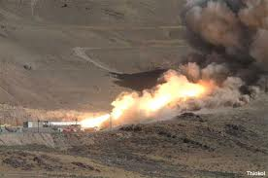
NASA accomplished major testing for first flight
Space Shuttle main engine Testing at Stennis Space Center, MS.
LH2/LO2 with 512K lbf thrust. SSME is the first throttleable and reuseable rocket engine
Solid rocket motor testing at Promontory Utah near site of the transcontinental railroad meeting. World’s largest solid rocket motor at 2.8 Mil lbf liftoff thrust and weighing 1.3 mil lbs while burning for 122 seconds. The SRM parachutes into the Atlantic 122 nmi downrange and is recovered and reused multiple times.

Slide 7
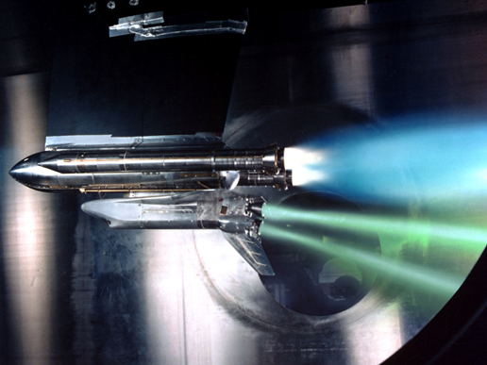
NASA accomplished major testing for first flight
1975 Langley Research Center reentry wind tunnel test with electron beam simulating ionized flow at Mach 25
Glenn Research Center Shuttle wind tunnel test with SRB and SSME rocket plumes simulating a failed main engine

Slide 8
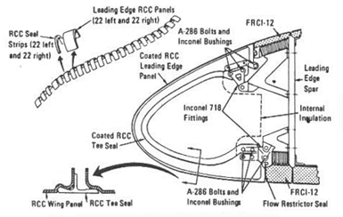
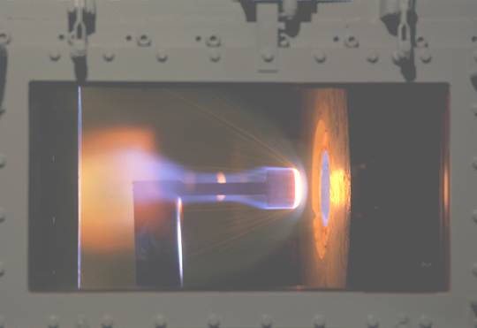
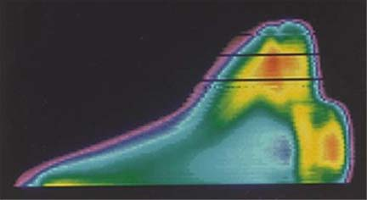
NASA accomplished major testing for first flight

Slide 9
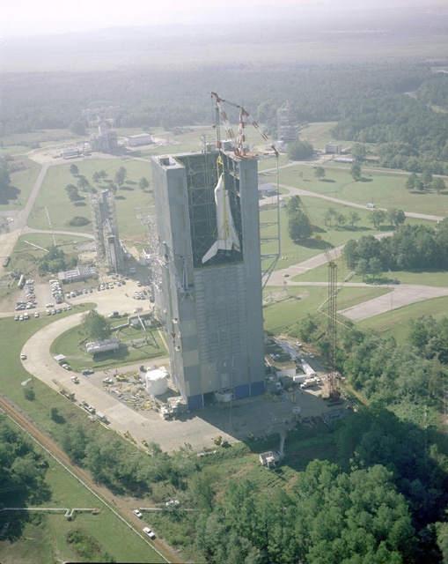
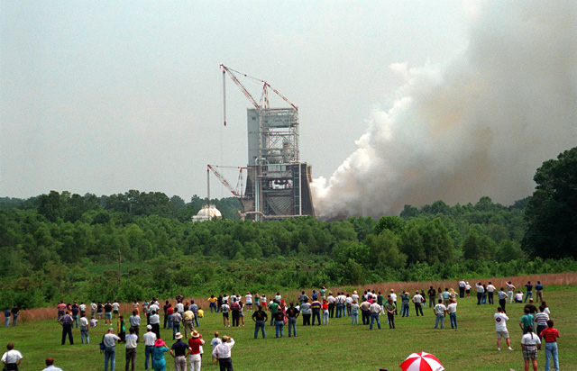
NASA accomplished major testing for first flight

Slide 10
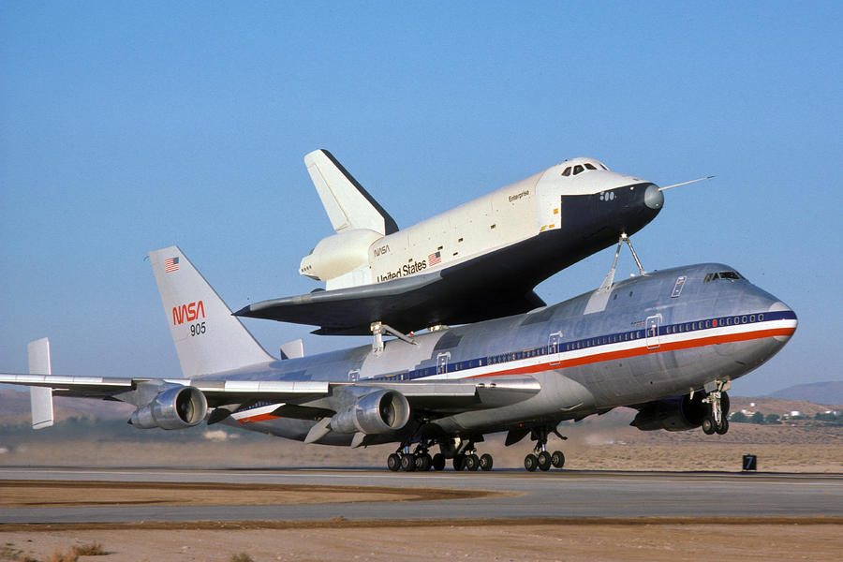
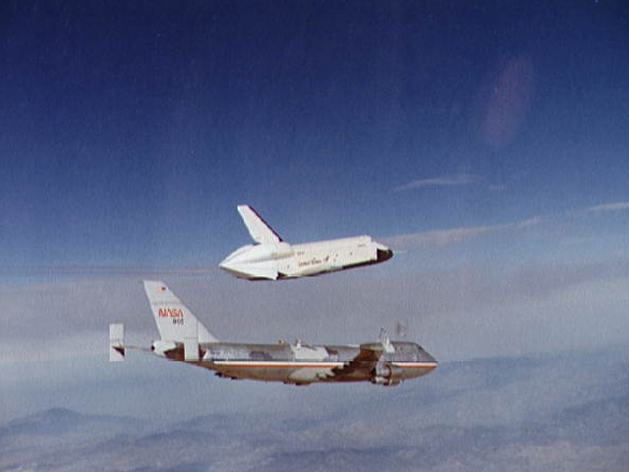
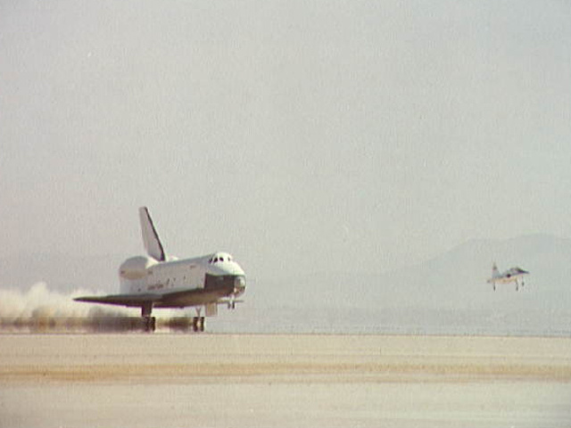
Enterprise approach and landing test flights, 1977

Slide 11
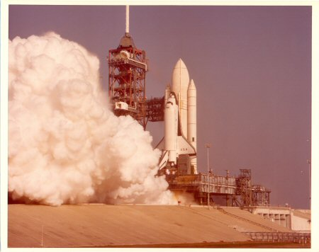
NASA accomplished major testing for first flight
STS 1 stack in VAB, Dec 1980
STS 1 flight readiness firing, Feb 1981

Slide 12
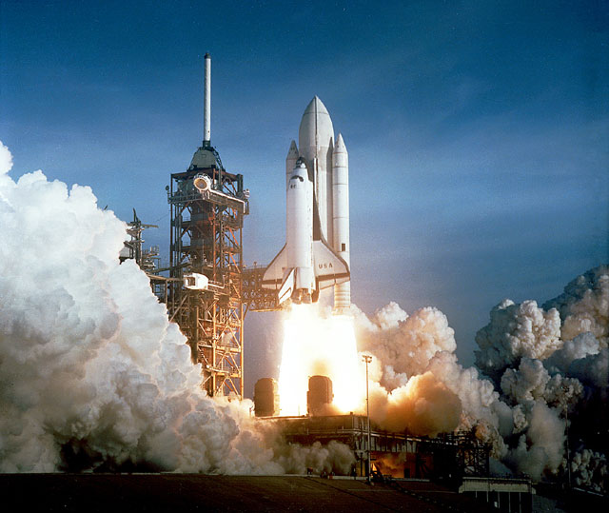
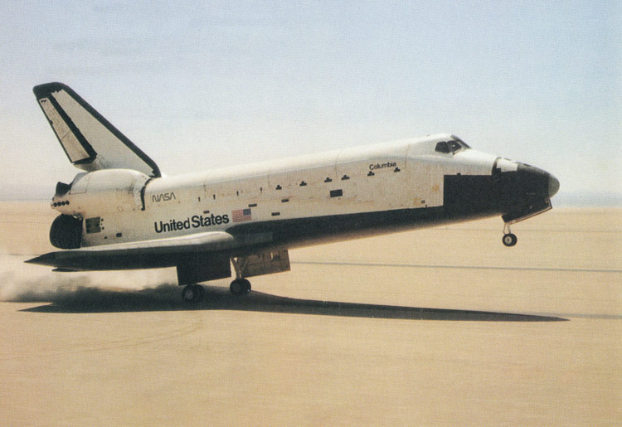
“It worked…the damn thing worked!” Frank Buzzard, MCC Guidance to Jim I’anson, Entry Guido and WW2 B-17 pilot
Full up crewed mission April 12-14, 1981 STS 1

Slide 13
STS 1 Crew John Young and Robert Crippen launched on Yuri Gagarin 20 year anniversary, 12 April 1981

Slide 14
Our keys to success
A clear objective and a common goal built on past success, hardware, facilities, and hard won expertise.
Division of labor aligned with NASA center core competencies
Engineering excellence and outstanding people building on past successes and processes
Facilities, tools, and budget to do the job
Building multi-center and contractor relationships based on humility, trust, sincerity, respect, and commitment to the mission
Acceptance of a better idea is a strength, not weakness
Lead from the front and by example
Communicate! Communicate! Communicate!

Slide 15
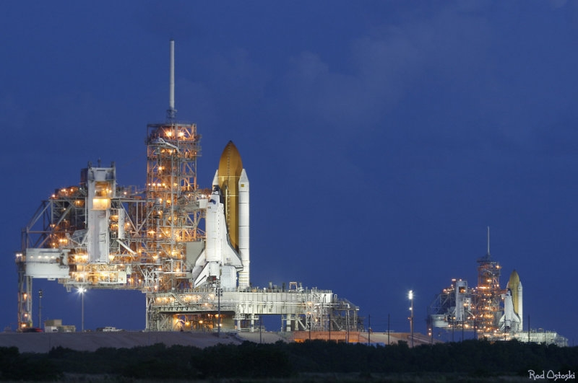
Awesome Sight! Two Shuttles on the launch pads.

Slide 16
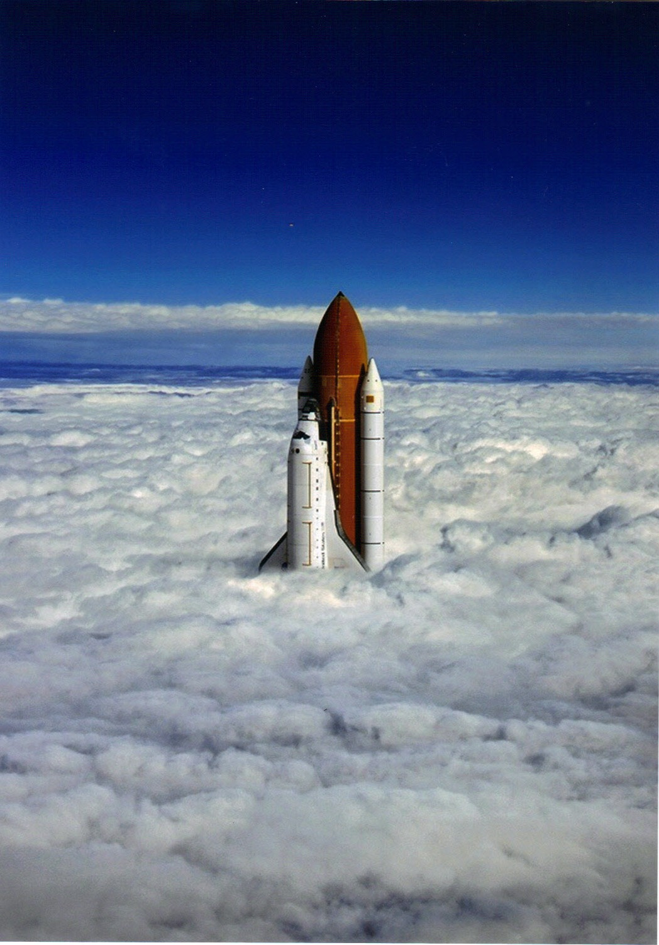
Surreal Shuttle rollout at Kennedy Space Center in a fog bank.

Slide 17
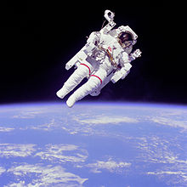
Astronaut Bruce McCandless flies like Buck Rogers!
April 1983 on STS 31 was the first flight of the Manned Maneuvering Unit-MMU.
Bruce leaves the Shuttle cargo bay and flies alone in space.

Slide 18
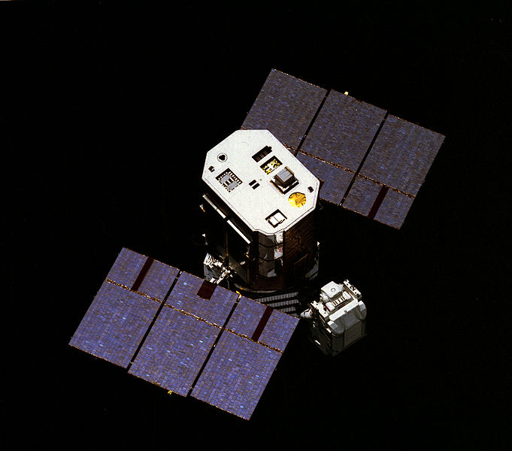
Shuttle’s amazing and unique capabilities are demonstrated on the solar max satellite repair mission.
George “Pinky” Nelson attempts capture of solar max satellite on STS 41-C, April 1984
Astronauts repair satellite in Shuttle cargo bay and special cradle

Slide 19
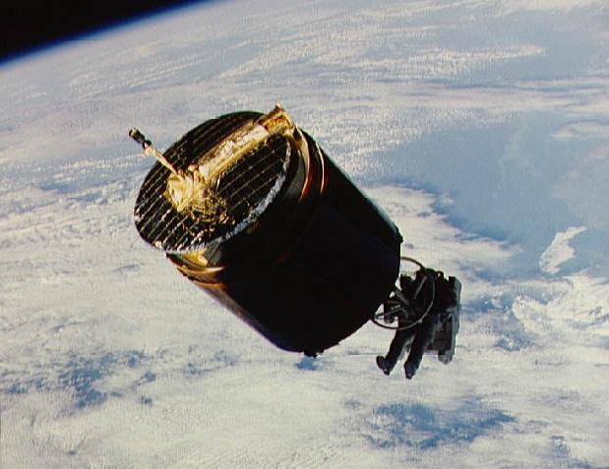
ST 51-A Westar 6 and Palapa B-2 satellite retrieval and return, Nov 1984
Dale Gardner in MMU captures Westar 6 with the “stinger”.
Dale Gardner and Joe Allen hold a "For Sale" sign for the Westar 6 and Palapa B-2 satellites.

Slide 20
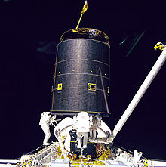
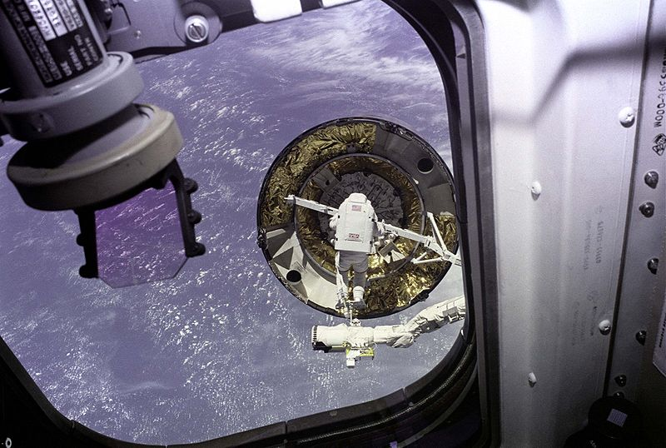
STS 49 Intelsat VI repair
Pierre Thout attempting capture bar snag of Intelsat VI stranded in LEO by March 1990 Titan launch--STS 49, May 1992
Risky hand grasp succeeded by 3 EVA crew Thout, Heib, Akers with Dan Brandenstein formation flying on 3rd rendezvous

Slide 21
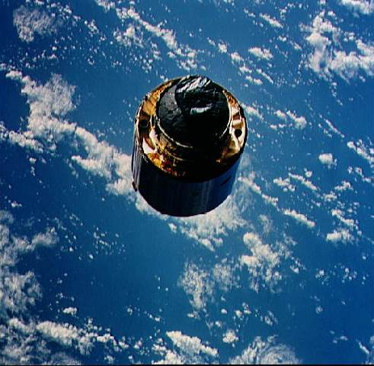
STS 49 Intelsat VI repair
Installing the capture bar after hand capture
Intelsat VI deploy with new perigee kick motor

Slide 22
We launched NASA’s great observatories

Slide 23
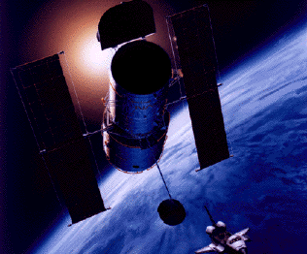
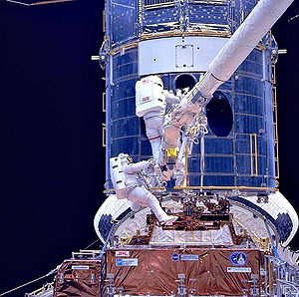
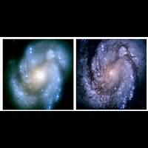
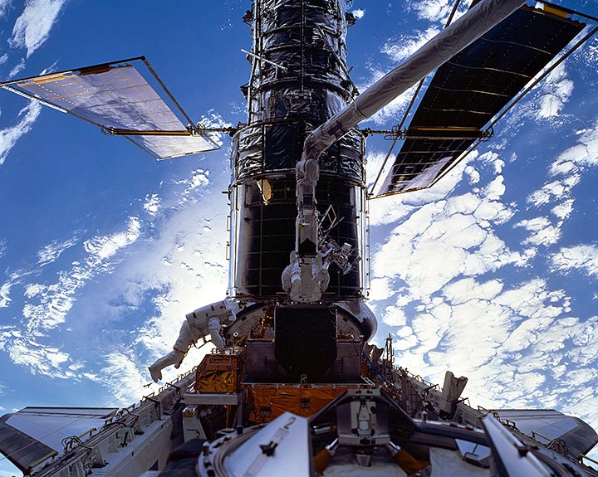
We repaired Hubble space telescope with upgrades five times

Slide 24
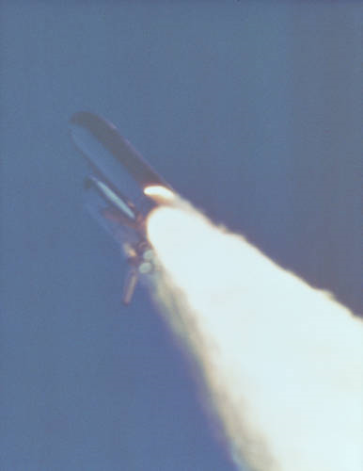
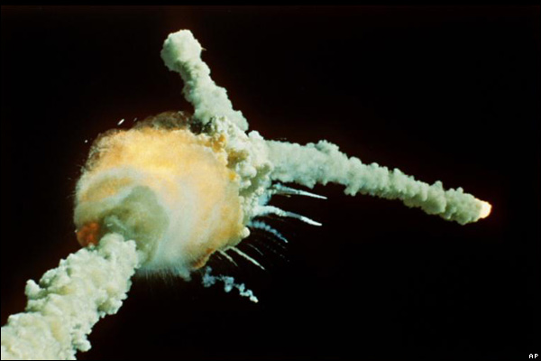
We flew and learned, but we paid a terrible price. We fixed design deficiencies and flew again to honor our fallen and their sacrifice.
Challenger STS 51-L, January 28, 1986

Slide 25
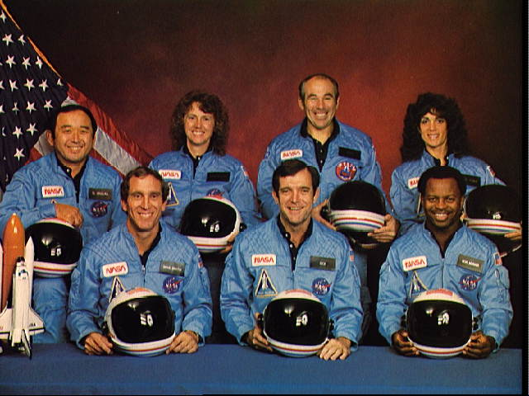
Challenger Crew STS 51-L
(front row) Michael J. Smith, Dick Scobee, Ronald McNair
(back row) Ellison Onizuka, Christa McAuliffe, Gregory Jarvis, Judith Resnik

Slide 26
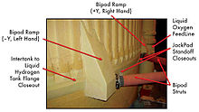
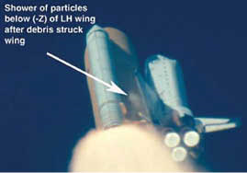
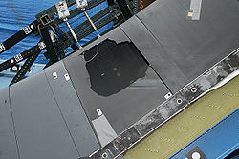
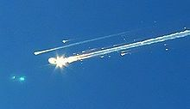
STS 107 Columbia February 1, 2003
Breakup over Texas
RCC panel foam impact test

Slide 27
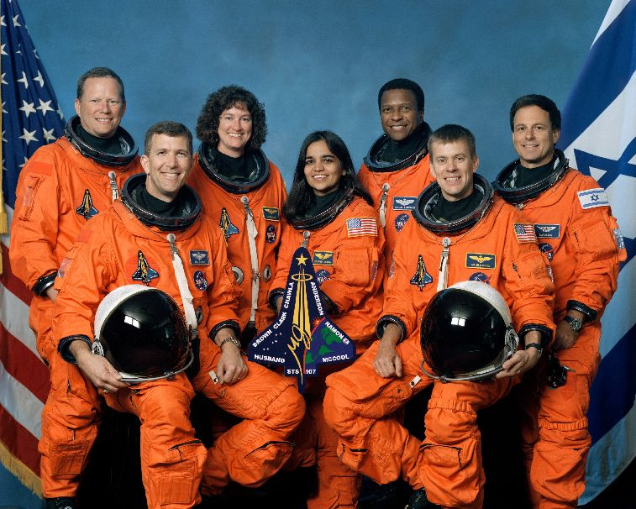
Columbia Crew STS 107
(L to R) David M. Brown, Rick D. Husband, Laurel Clark, Kalpana Chawla, Michael P. Anderson, William C. McCool, Ilan Ramon

Slide 28
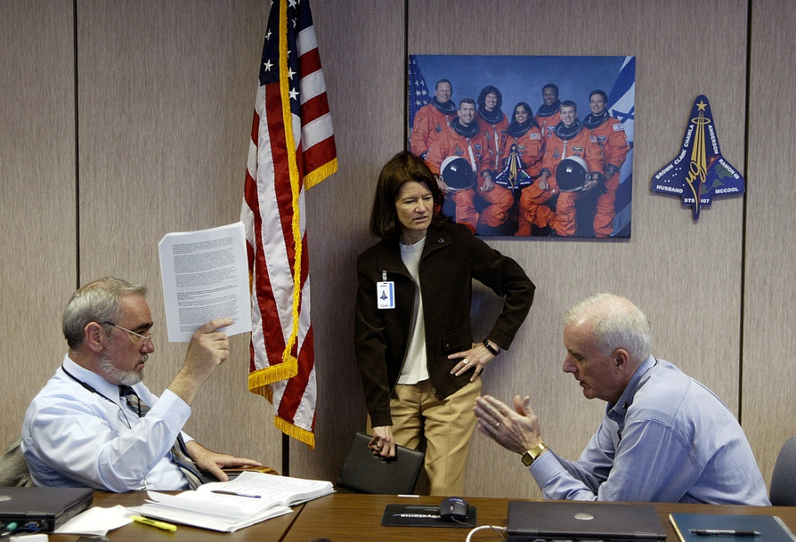
Columbia Accident Investigation Board
Frank Buzzard, Dr. Sally Ride, Admiral Harold Gehman

Slide 29
Flight experience leads to safety improvements
Dramatically improved SRB field joint design post Challenger
ET insulation shedding reduction and design changes post Columbia
Two GPC failures on STS-9 due to generic age related dendrite growth on computer boards solved by AP101B GPC upgrade
STS-9 APU fuel line cracks/hydrazine leak and APU turbine blade cracks initiates IAPU safety enhancements for Orbiter and SRB
Significant safety margin improvements from redesigned SSME turbopumps HPFTP HPOTP, Block 2 SSME controller, and Large Throat Main Combustion Chamber-LTMCC
Evolved External Tank design improves payload to orbit and enables ISS at 51.6 deg inclination. LWT, SLWT, Aluminum Lithium tank
Improved tires, brakes, and drag chute
Haines IMU upgrade solves life issues and improves performance.
Continuous improvement in space suits, gloves, and onorbit tools.

Slide 30
Chief Engineer reflections on design changes
Flying with design deficiencies you think you understand completely requires extreme caution. Challenge the test data and modeling. Have a healthy skepticism. Beware success induced complacency when flight data says, “it ain’t doing what I expected!”
Deciding between necessary redesigns and “better is the enemy of good enough” improvements is difficult. Quantitative risk assessment of before and after change is vital.

Slide 31
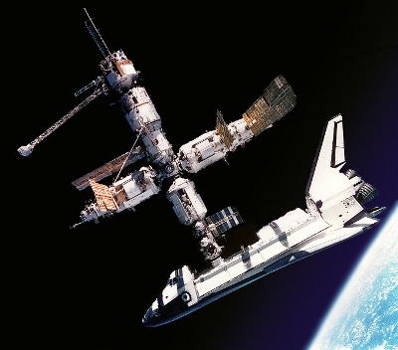
We redesigned Space Station Freedom adding Russia in 1994. Shuttle visited MIR space station 10 times between 1994 and 1998. Seven American astronauts flew to MIR. 16 nations collaborated and cooperated to learn to work with our Russian colleagues to support MIR and then redesign and build the International Space Station—ISS.

Slide 32
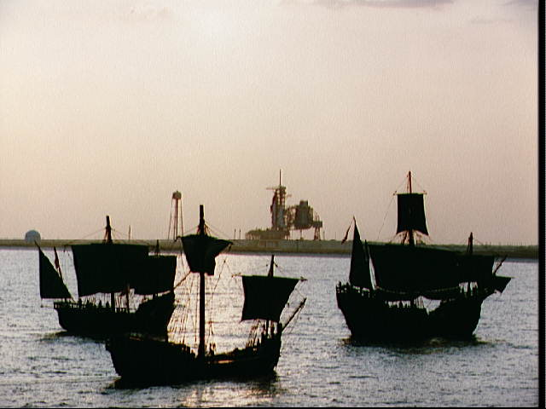
And now, if we have the national will and leadership, on to Mars and exploring our Solar System

Slide 33
You can view video and slides for this lecture at my website
frankbuzzard.com

