Slide 1
Wonders of our Universe
Part 1
Realm of the Galaxies
Presented by Frank Buzzard
Space Shuttle and International Space Station Chief Engineer
(NASA retired)

Slide 2
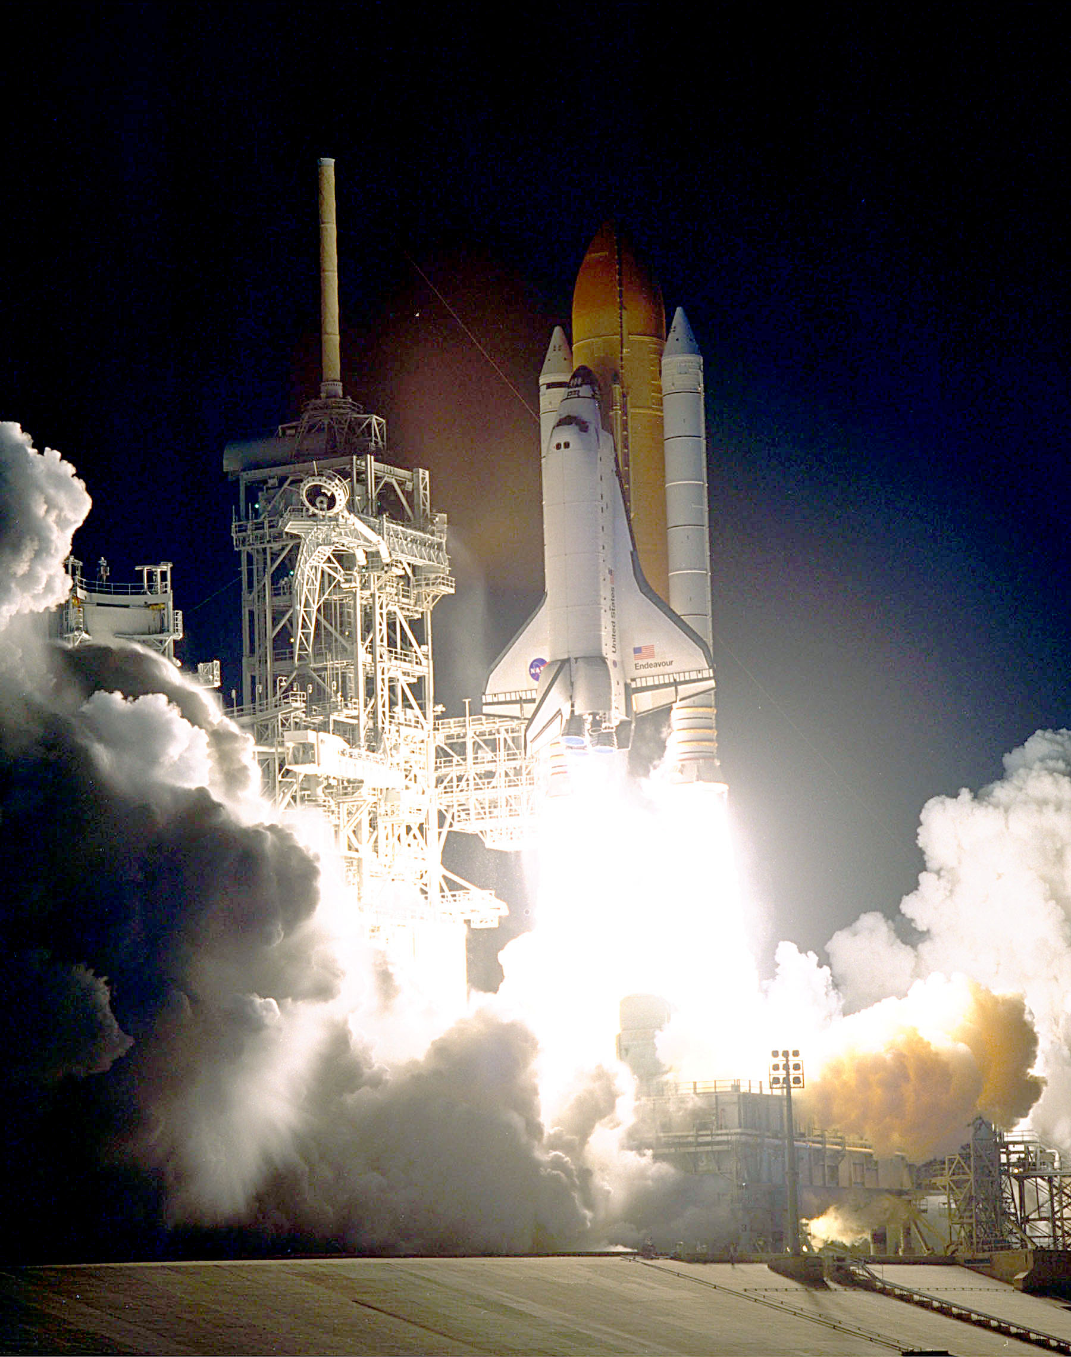
STS 31 April 1990 Discovery launched the Hubble Space Telescope (HST)
Photo Credit: NASA for all photos unless otherwise noted

Slide 3
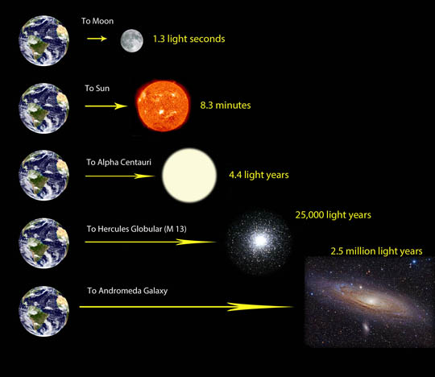
Distances in the universe are vast!
we measure distance in light years
Light travels very fast!--186,000 miles per sec or 300,000 kms
One light year is very far!-- 5.9 trillion miles or 9.5 trillion kilometers

Slide 4
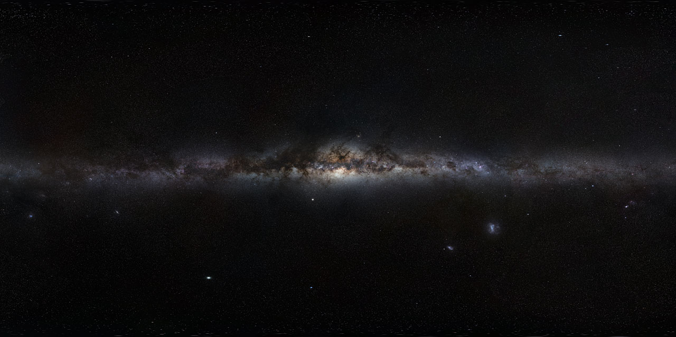
Our Milky Way Galaxy
Via Lactea or kyklos galaktikos "milky circle"
A barred spiral galaxy 100-120K LYs across containing 200 billion stars. 13.2 billion yrs old.
Our solar system is located 2/3 of way out from the center in the Orion-Cygnus arm.
Our Sun rotates about the galactic center once every 250 million years.

Slide 5
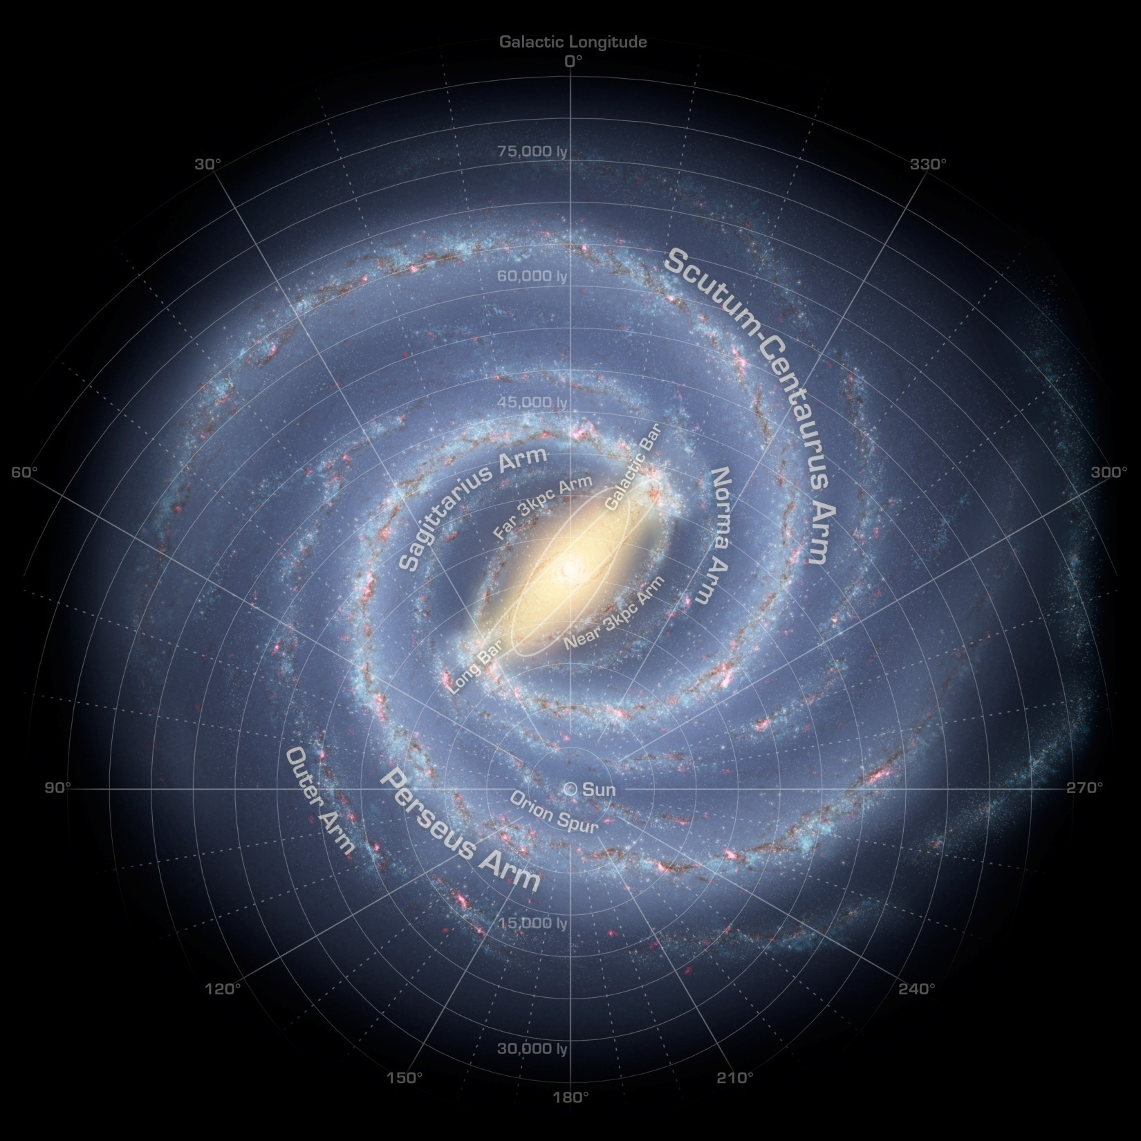
How our Milky Way Galaxy might look to an outside observer from Andromeda
Our Sun

Slide 6
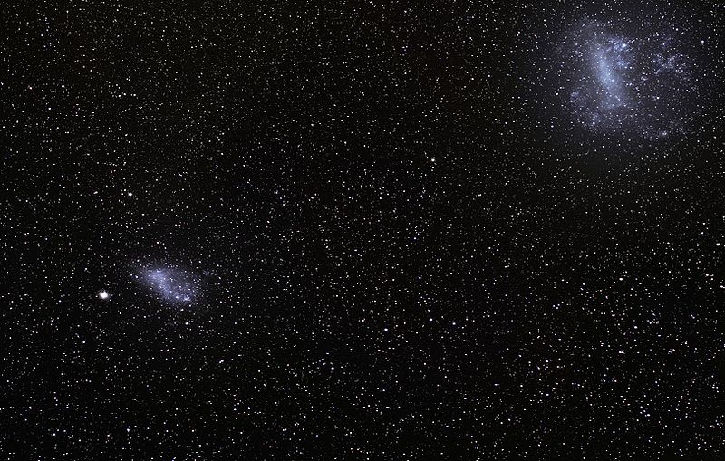
Our companion galaxies-Large and Small Magellanic Clouds
LMC and SMC are 160K and 200K LYs away in the southern sky
First recorded by Persian Azophi in 964 . Observed by Vespucci 1504 and Magellan 1519. LMC has vigorous star formation within its Tarantula Nebula

Slide 7
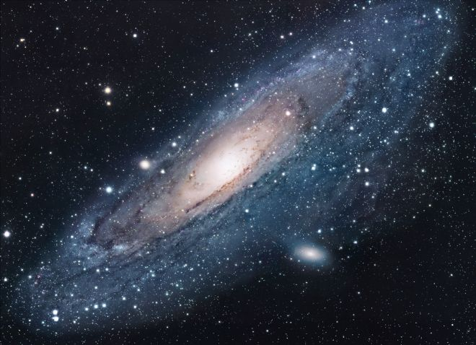
Andromeda Galaxy-M31
2.2 MLY s from Earth moving toward us at 300,000 mph
165,000 LYs in diameter
Edwin Hubble determined Andromeda was an external galaxy to our Milky Way in 1924
Hubble also discovers red shift and expanding Universe

Slide 8
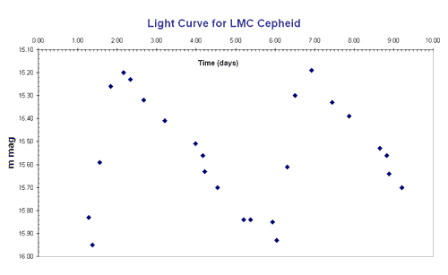
Discovery that Andromeda is an external galaxy
Henrietta Leavitt
(1868 - 1921)
Finds 47 Cepheid Variable stars in the LMC and SMC in early 1900s
Reasons all are at same distance and finds luminosity vs period relationship –standard candle!
Ejnar Hertzsprung calculates distance to SMC and LMC and Howard Shapley deduces size of Milky Way

Slide 9
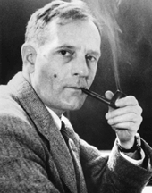
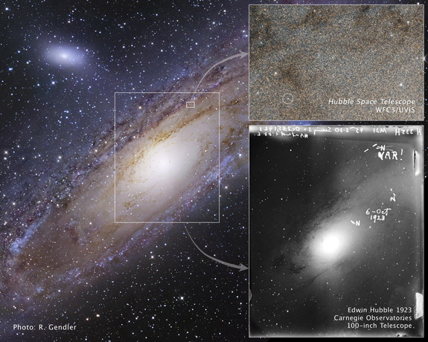
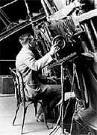
Edwin Hubble finds cepheid variable star in Andromeda in 1923 and proves Andromeda is a distant galaxy outside the Milky Way.
Edwin Hubble
1889-1953

Slide 10
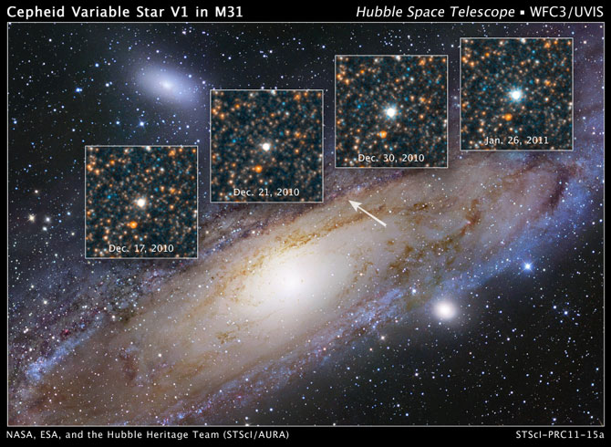
Hubble telescope photo of Andromeda V1

Slide 11
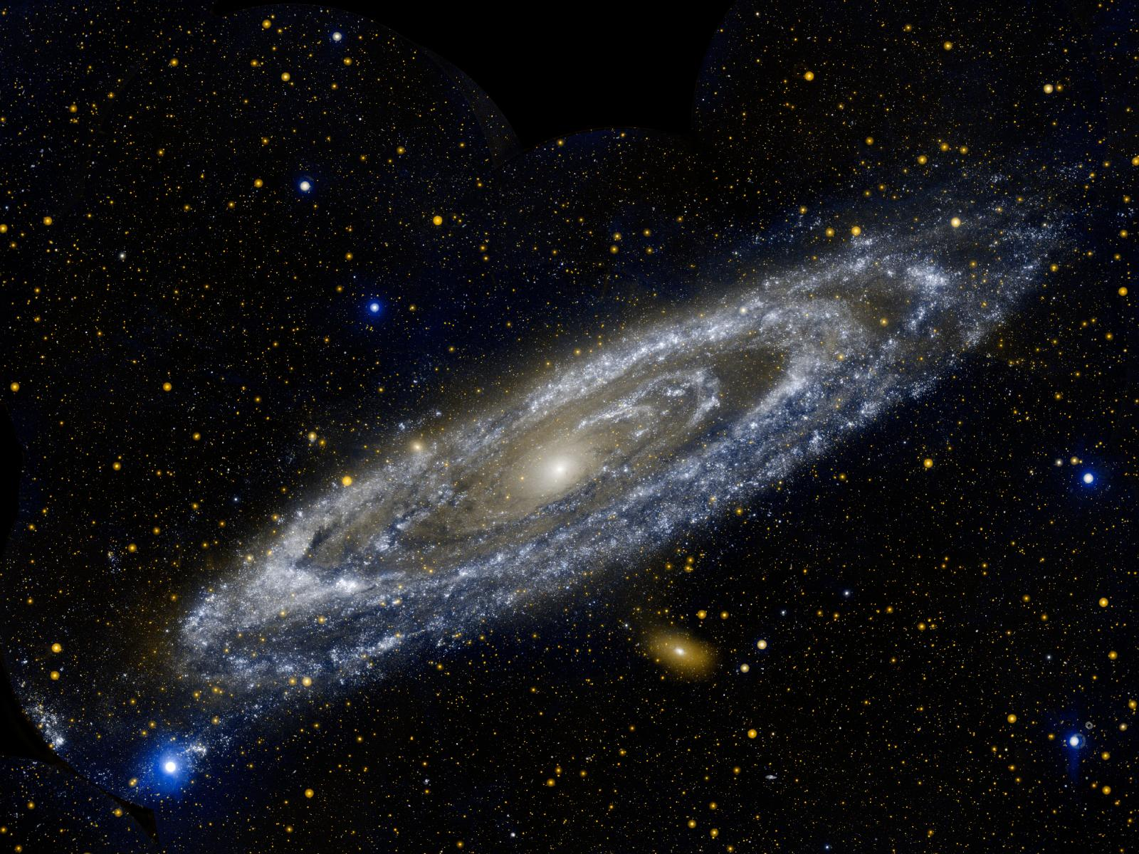
Andromeda in ultraviolet light taken by GALEX (Galaxy Evolution Explorer) satellite. The bands of blue-white making up the galaxy's striking rings are neighborhoods that harbor hot, young, massive stars.
NASA JPL/Caltech Photo

Slide 12
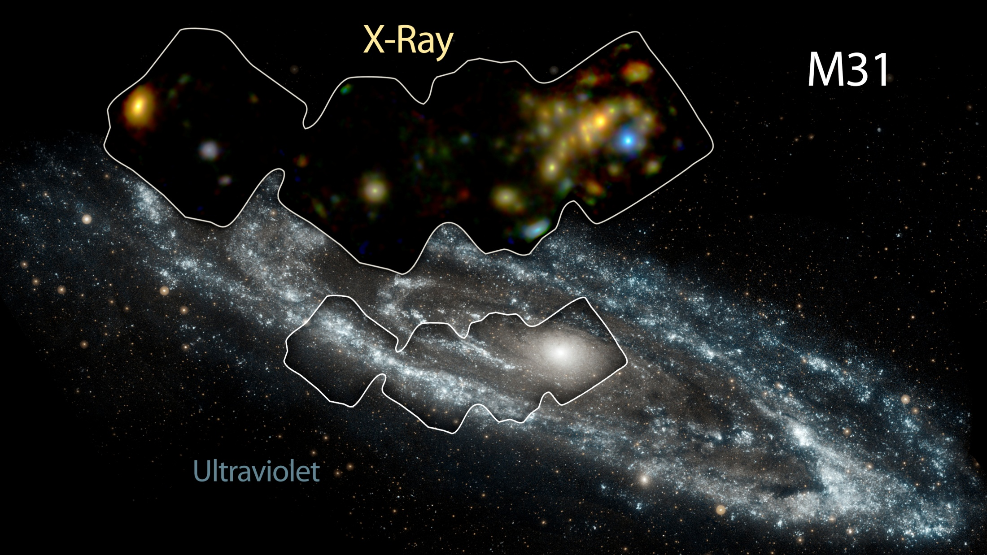
NASA’s Nuclear Spectroscopic Telescope Array (NuSTAR) views 40 neutron star/black hole binaries in high energy X-rays believed to heat gas and drive the early evolution of the universe and galaxies
Andromeda

Slide 13
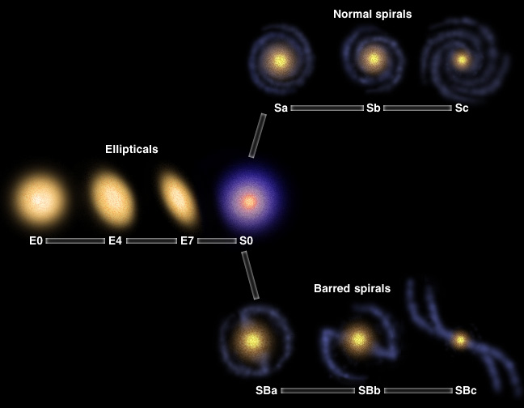
Edwin Hubble’s classification of galaxies

Slide 14
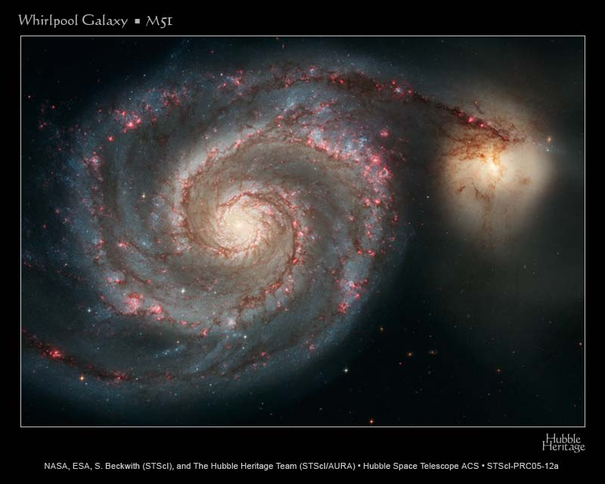
Whirlpool Galaxy-M51
23 MLYs away in Canes Venatici or “hunting dogs” near Ursa Major
Discovered in 1774 by Charles Messier
Its companion galaxy, NGC 5195 was discovered by Pierre Mechain in 1781.

Slide 15
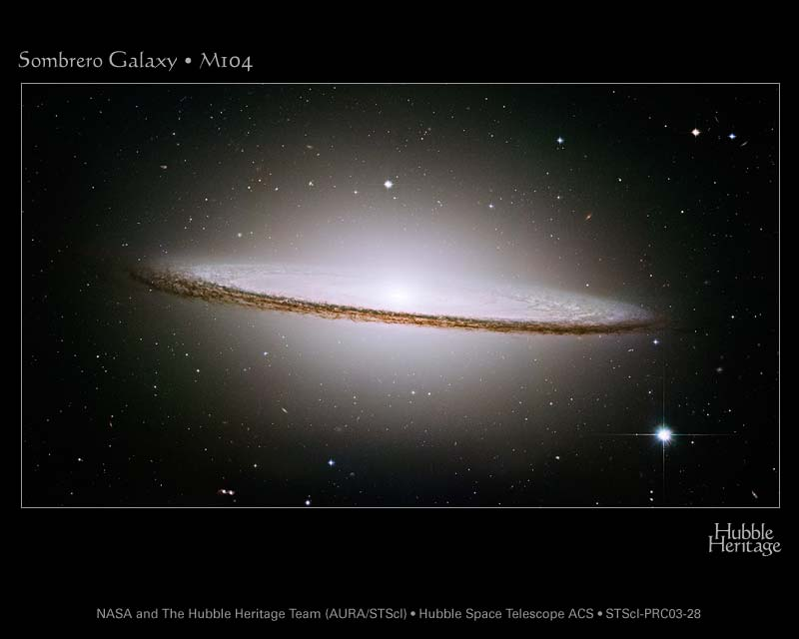
Sombrero galaxy-M104
30 MLYs away in the constellation Virgo.
Discovered by Pierre Mechain in 1767.
Stunning dust lane in the disc and a large central bulge suggesting a powerful, central black hole

Slide 16
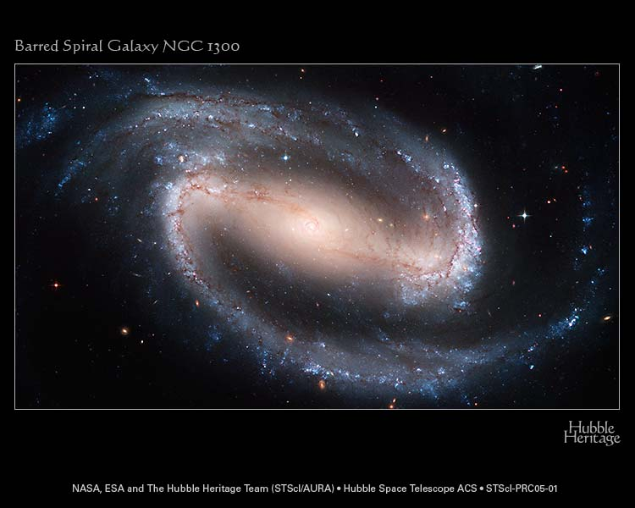
Located in Eridanus 61.3 MLYs away
NGC 1300’s nucleus shows an extraordinary and distinct spiral structure that is about 3,300 LYs long.
Only galaxies with large-scale bars appear to have these grand-design inner disks — a spiral within a spiral

Slide 17
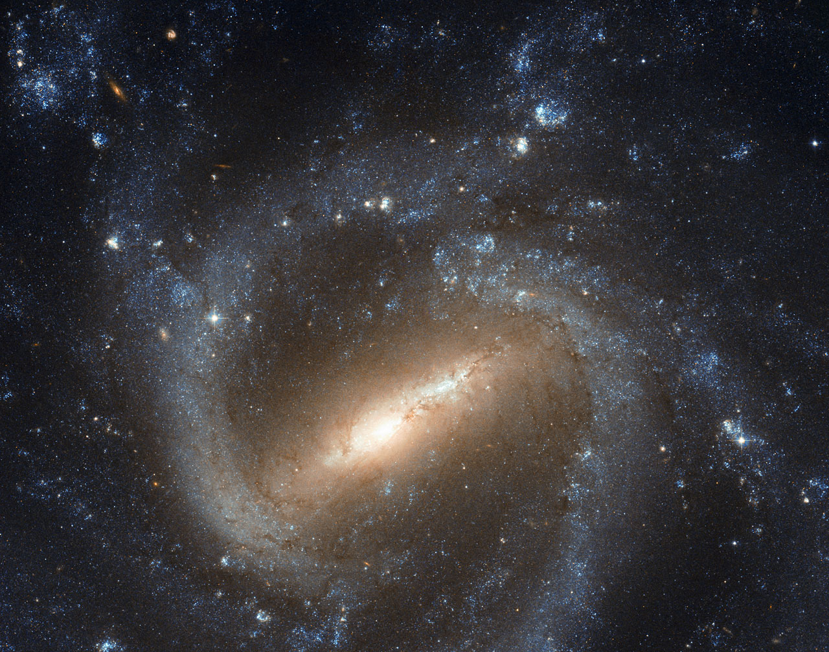
Barred spiral galaxy NGC 1073 in Cetus—The sea monster
A beautiful barred spiral galaxy believed to be much like our Milky Way. NGC 1073 is 55 MLYs away.
Distant Quasars shine far away in the background.
Distant Quasars

Slide 18
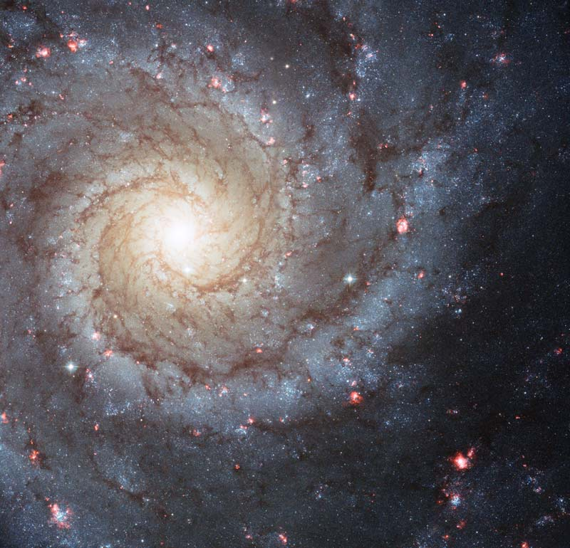
Bright knots of glowing gas light up the arms of spiral galaxy M74
Two clear spiral arms give M74 the designation Grand Spiral Galaxy
M74 is 32 MLYs away in the constellation Pisces.

Slide 19
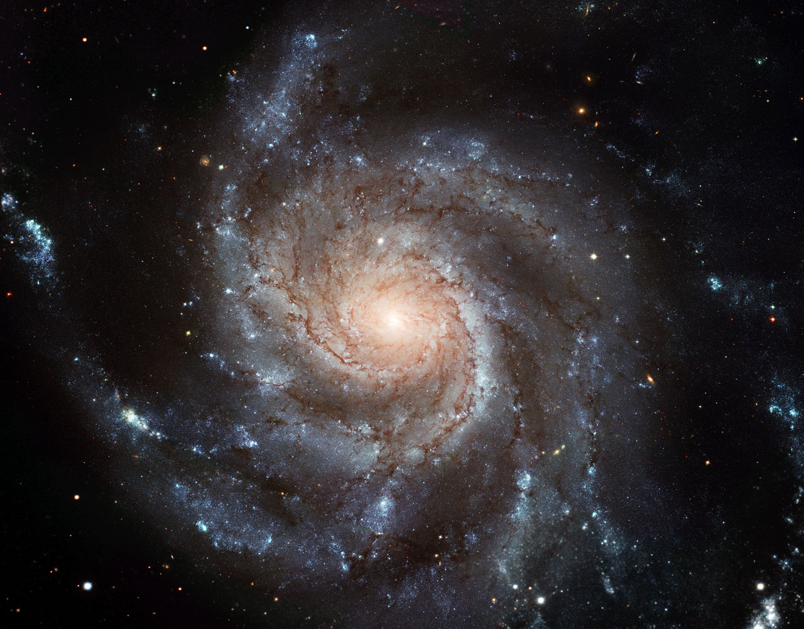
M101 is a large, stunningly beautiful spiral galaxy 21 MLYs away in Ursa Major.
Large clumps of hot young stars dominate the spiral arms.
M101 is 70% larger than our Milky Way galaxy
The Pinwheel Galaxy-M101

Slide 20
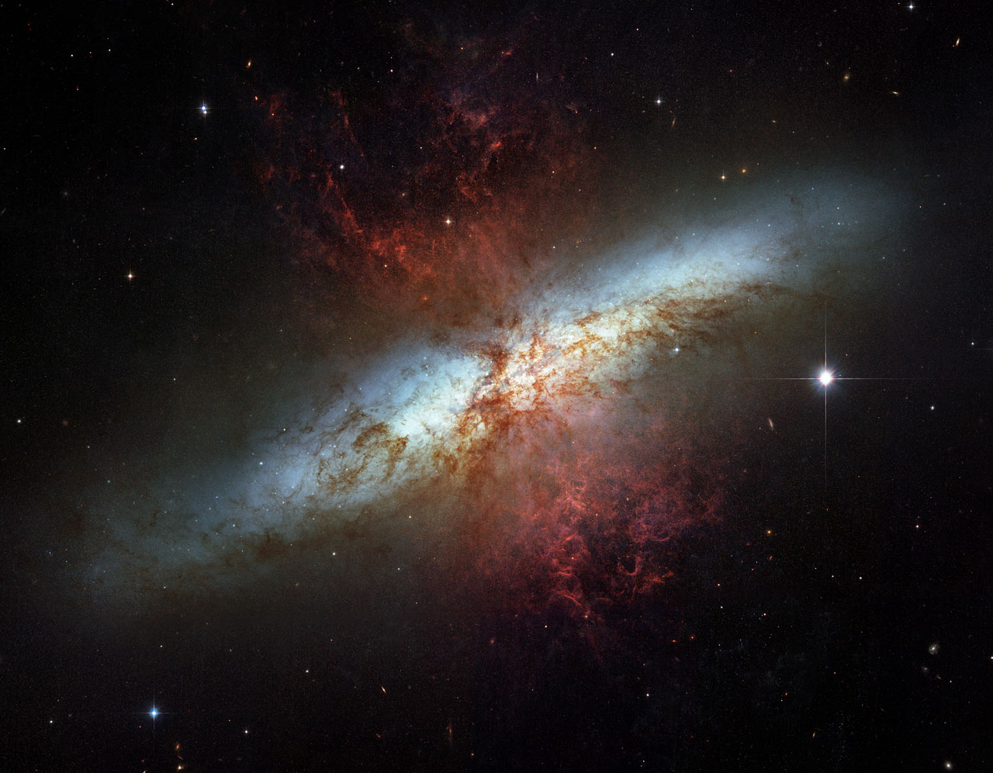
M82 is a starburst galaxy creating new stars at an exceptionally high rate.
Flame-like plumes of glowing hydrogen blast out from its central regions where young stars are being born 10 times faster than in our Milky Way Galaxy.
Cigar Galaxy M82-12 MLYs away in Ursa Major

Slide 21
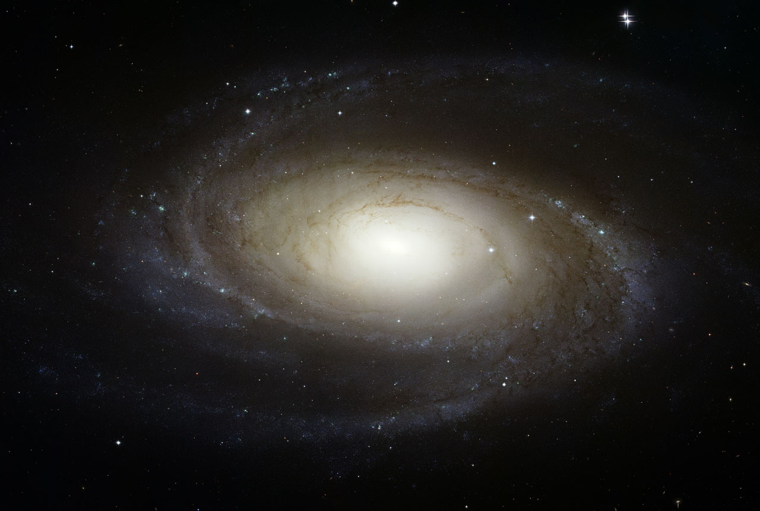
M81 Bode’s galaxy is 11.7 MLYs away in Ursa Major. Its active nucleus harbors a supermassive black hole of 70 million solar masses.

Slide 22
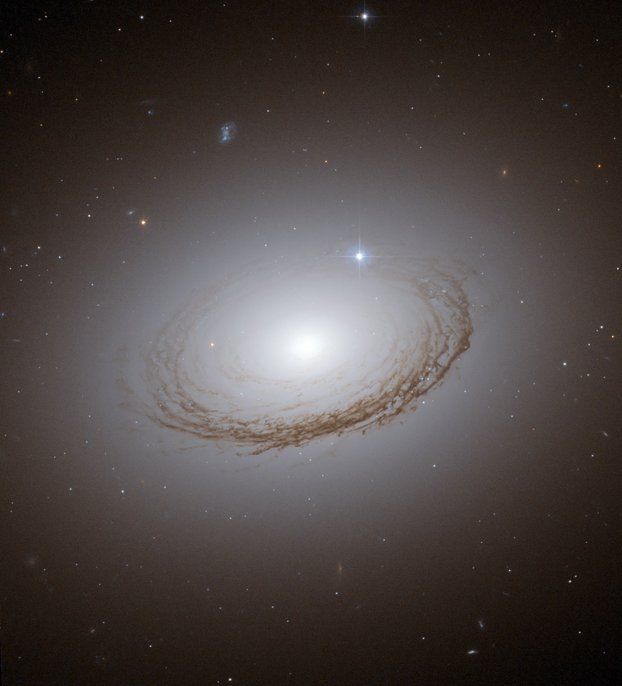
Dramatically backlit dust lanes in NGC 7049 by the millions of stars in the halo around the galaxy.
NGC 7049 in the southern sky constellation Indus lies 100 MLYs from Earth

Slide 23
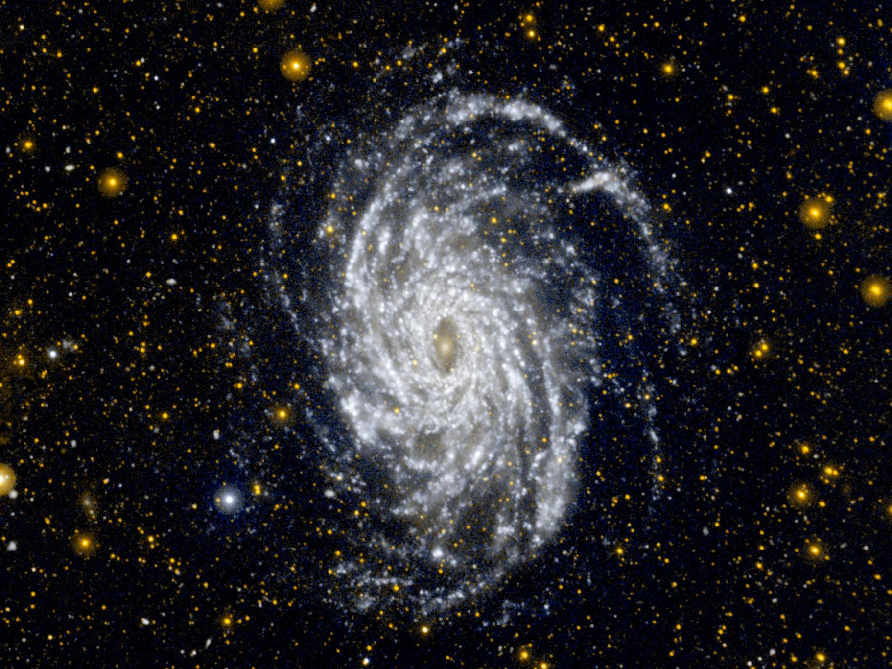
This UltraViolet photo of NGC 6744 in the constellation Pavo is 30 MLYs away. NASAs Galaxy Evolution Explorer satellite took this stunning photo showing the vast extent and detailed structure of the spiral arms.

Slide 24
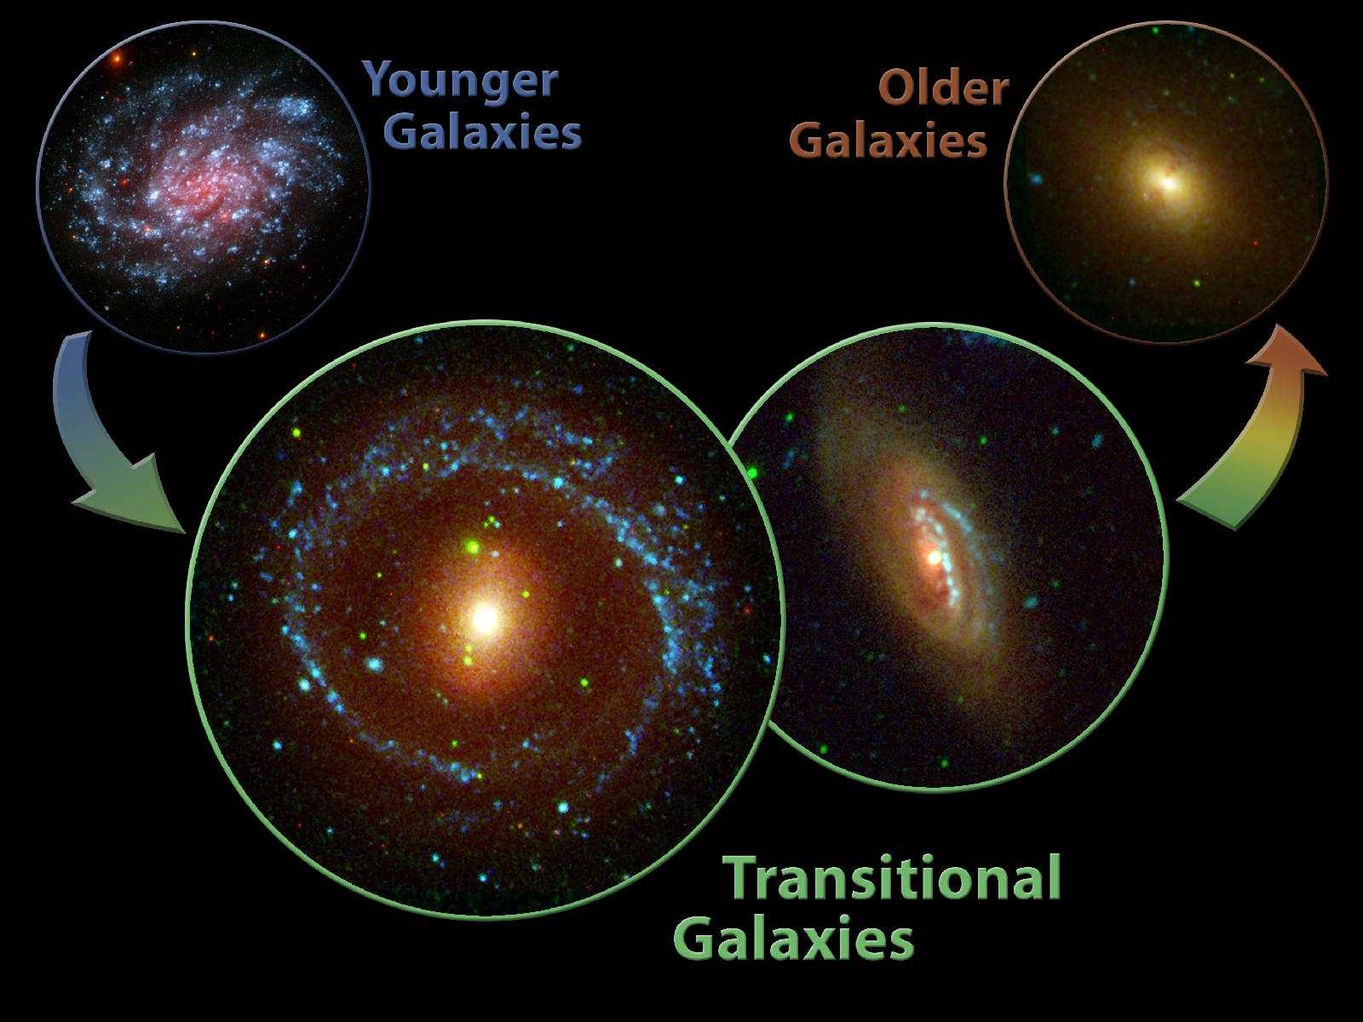
Observations from the Galaxy Evolution Explorer allowed astronomers to trace the development of galaxies

Slide 25
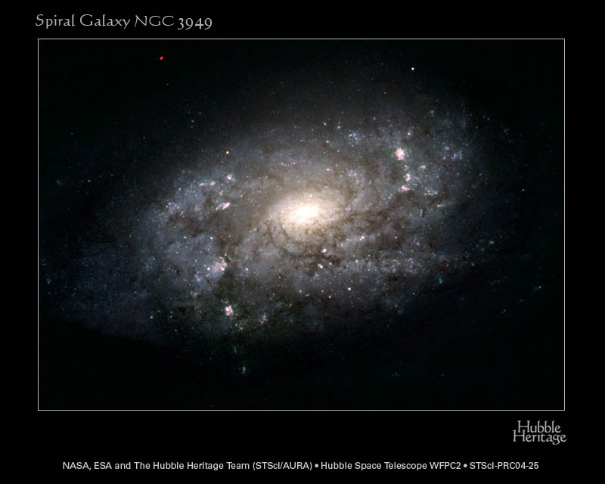
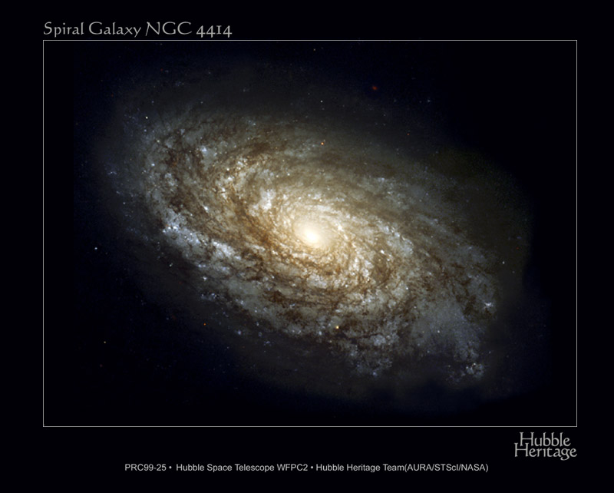
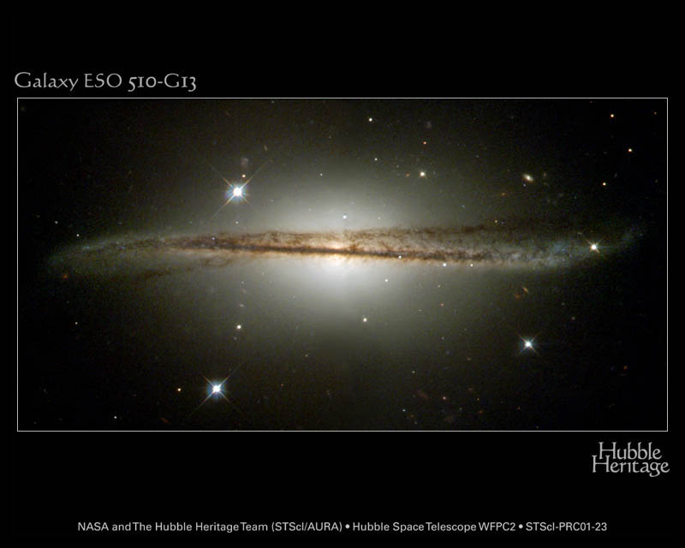
150 MLYs away in Hydra--the
heavily warped equatorial dust plane suggests a gravitational interaction with another galaxy.

Slide 26
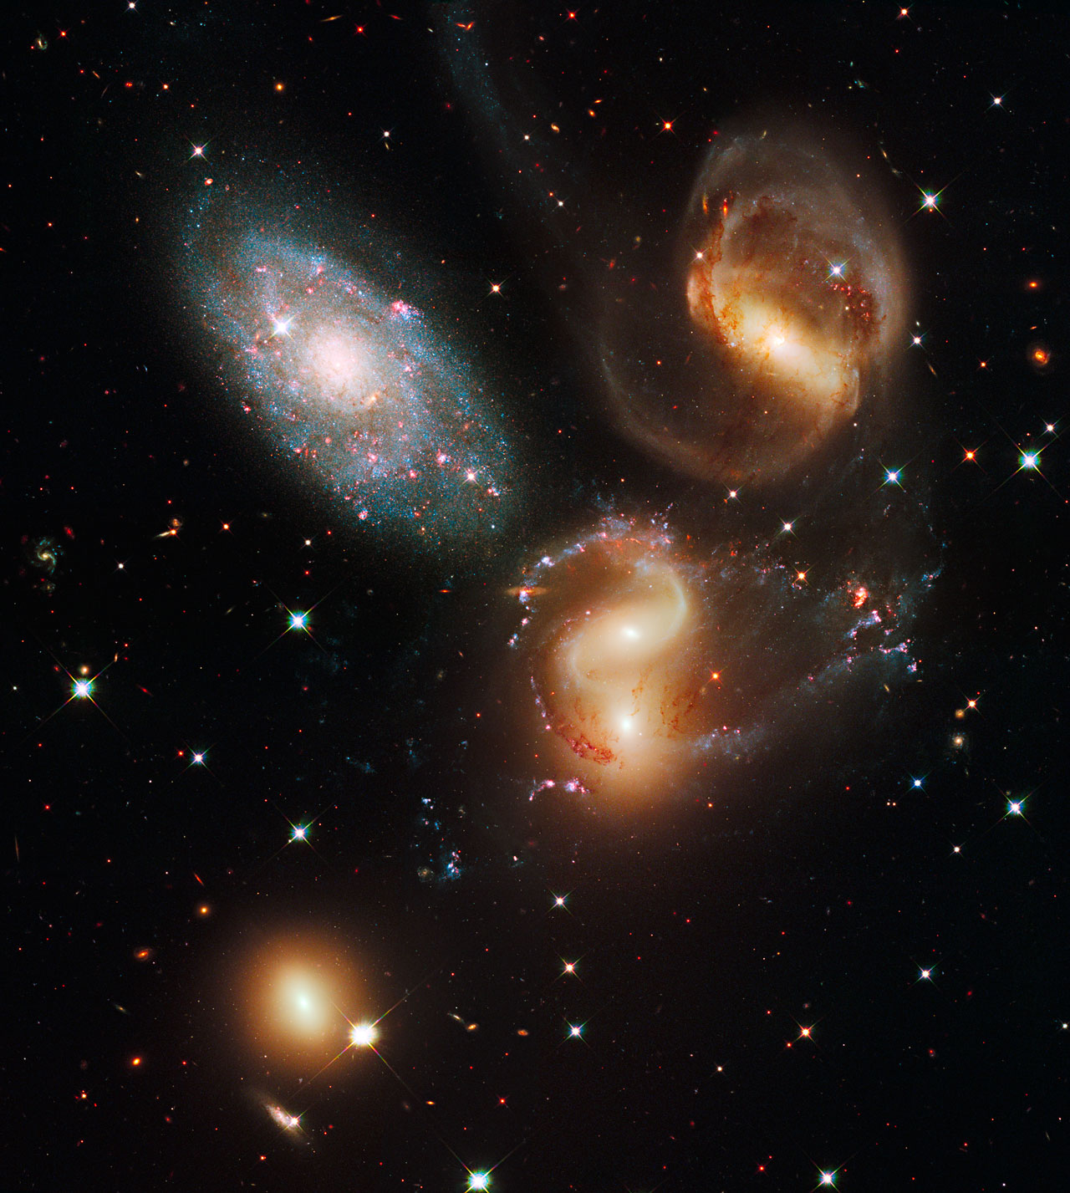
Stephan’s Quintet is the first compact galaxy group discovered in 1877 by Edouard Stephan. A cosmic dance of violent galactic collisions against a backdrop of thousands of faraway galaxies. These interactions have sparked a frenzy of star birth in the central pair of galaxies.
Stephan’s quintet lies about 300 MLYs from Earth in Pegasus.

Slide 27
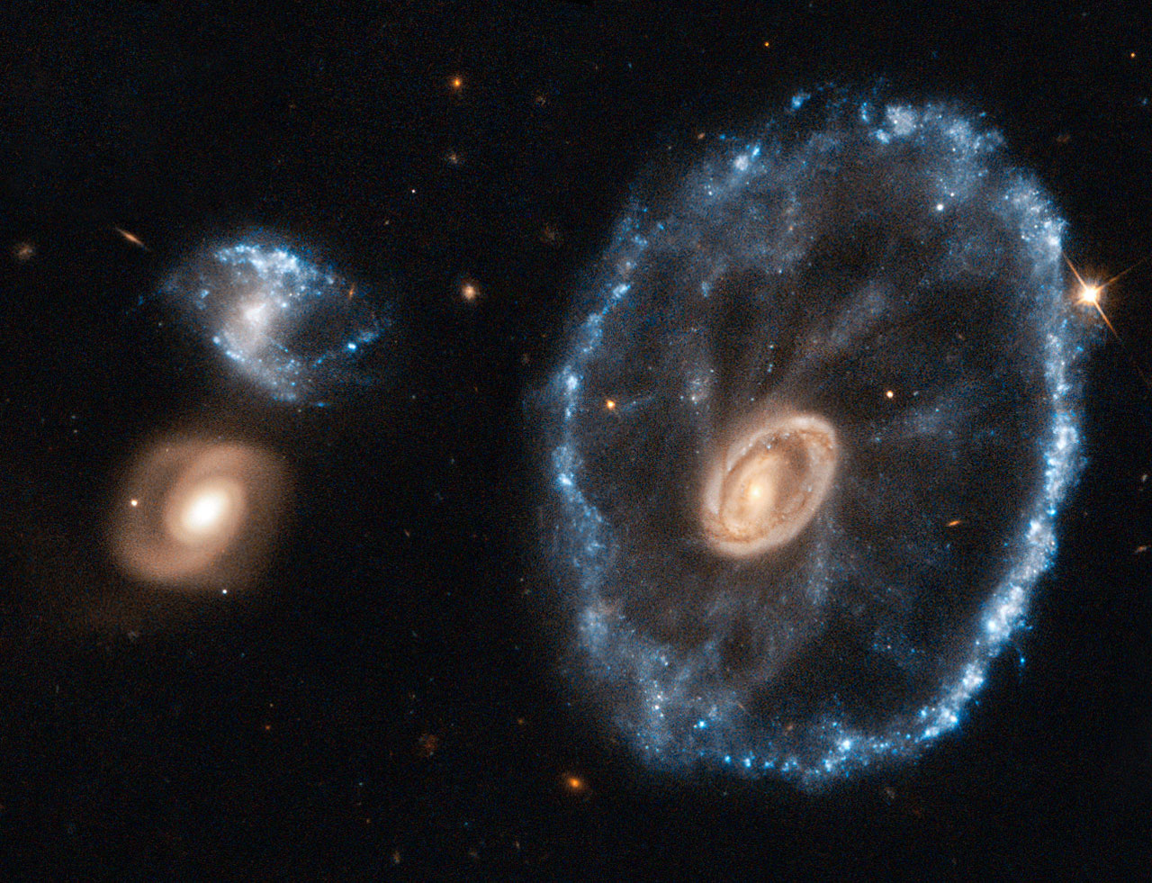
the cartwheel shape of this rare ring galaxy is the result of a violent galactic collision. A smaller galaxy has passed right through a large disc galaxy and produced shock waves that swept up gas and dust and sparked regions of intense star formation (appearing blue).
Cartwheel galaxy--500 MLYs away in Sculptor

Slide 28
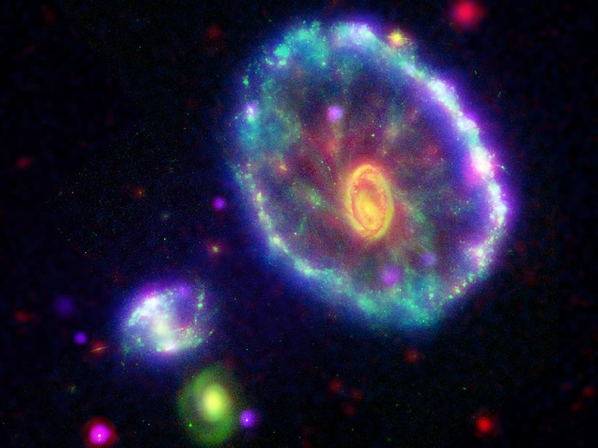
This composite image of the Cartwheel galaxy shows a rainbow of multi-wavelength observations from NASA missions, including the Galaxy Evolution Explorer (blue), the Hubble Space Telescope (green), the Spitzer Space Telescope (red) and the Chandra X-ray Observatory (purple).

Slide 29
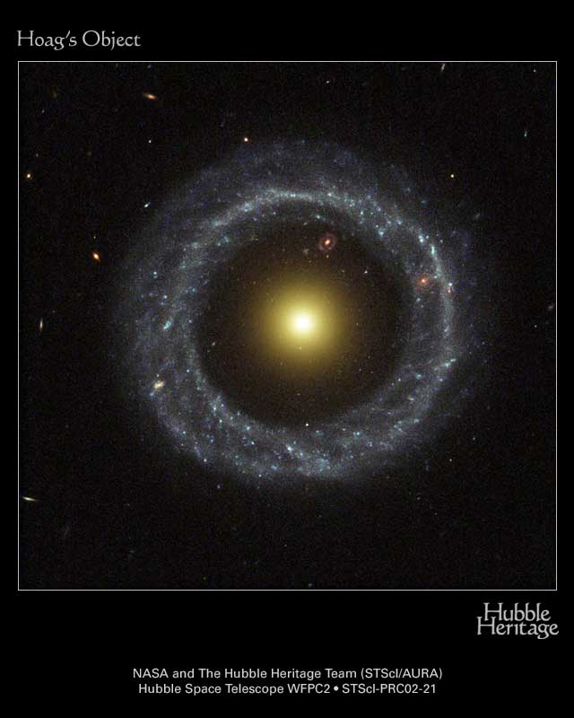
Hoag’s Object
An unusual ring galaxy
600 MLYs away in Serpens
Discovered by Arthur Hoag in 1950
Old central object with young ring of stars
No known formation mechanism
Note another ring galaxy behind Hoag’s object at 1 o’clock inside the ring

Slide 30
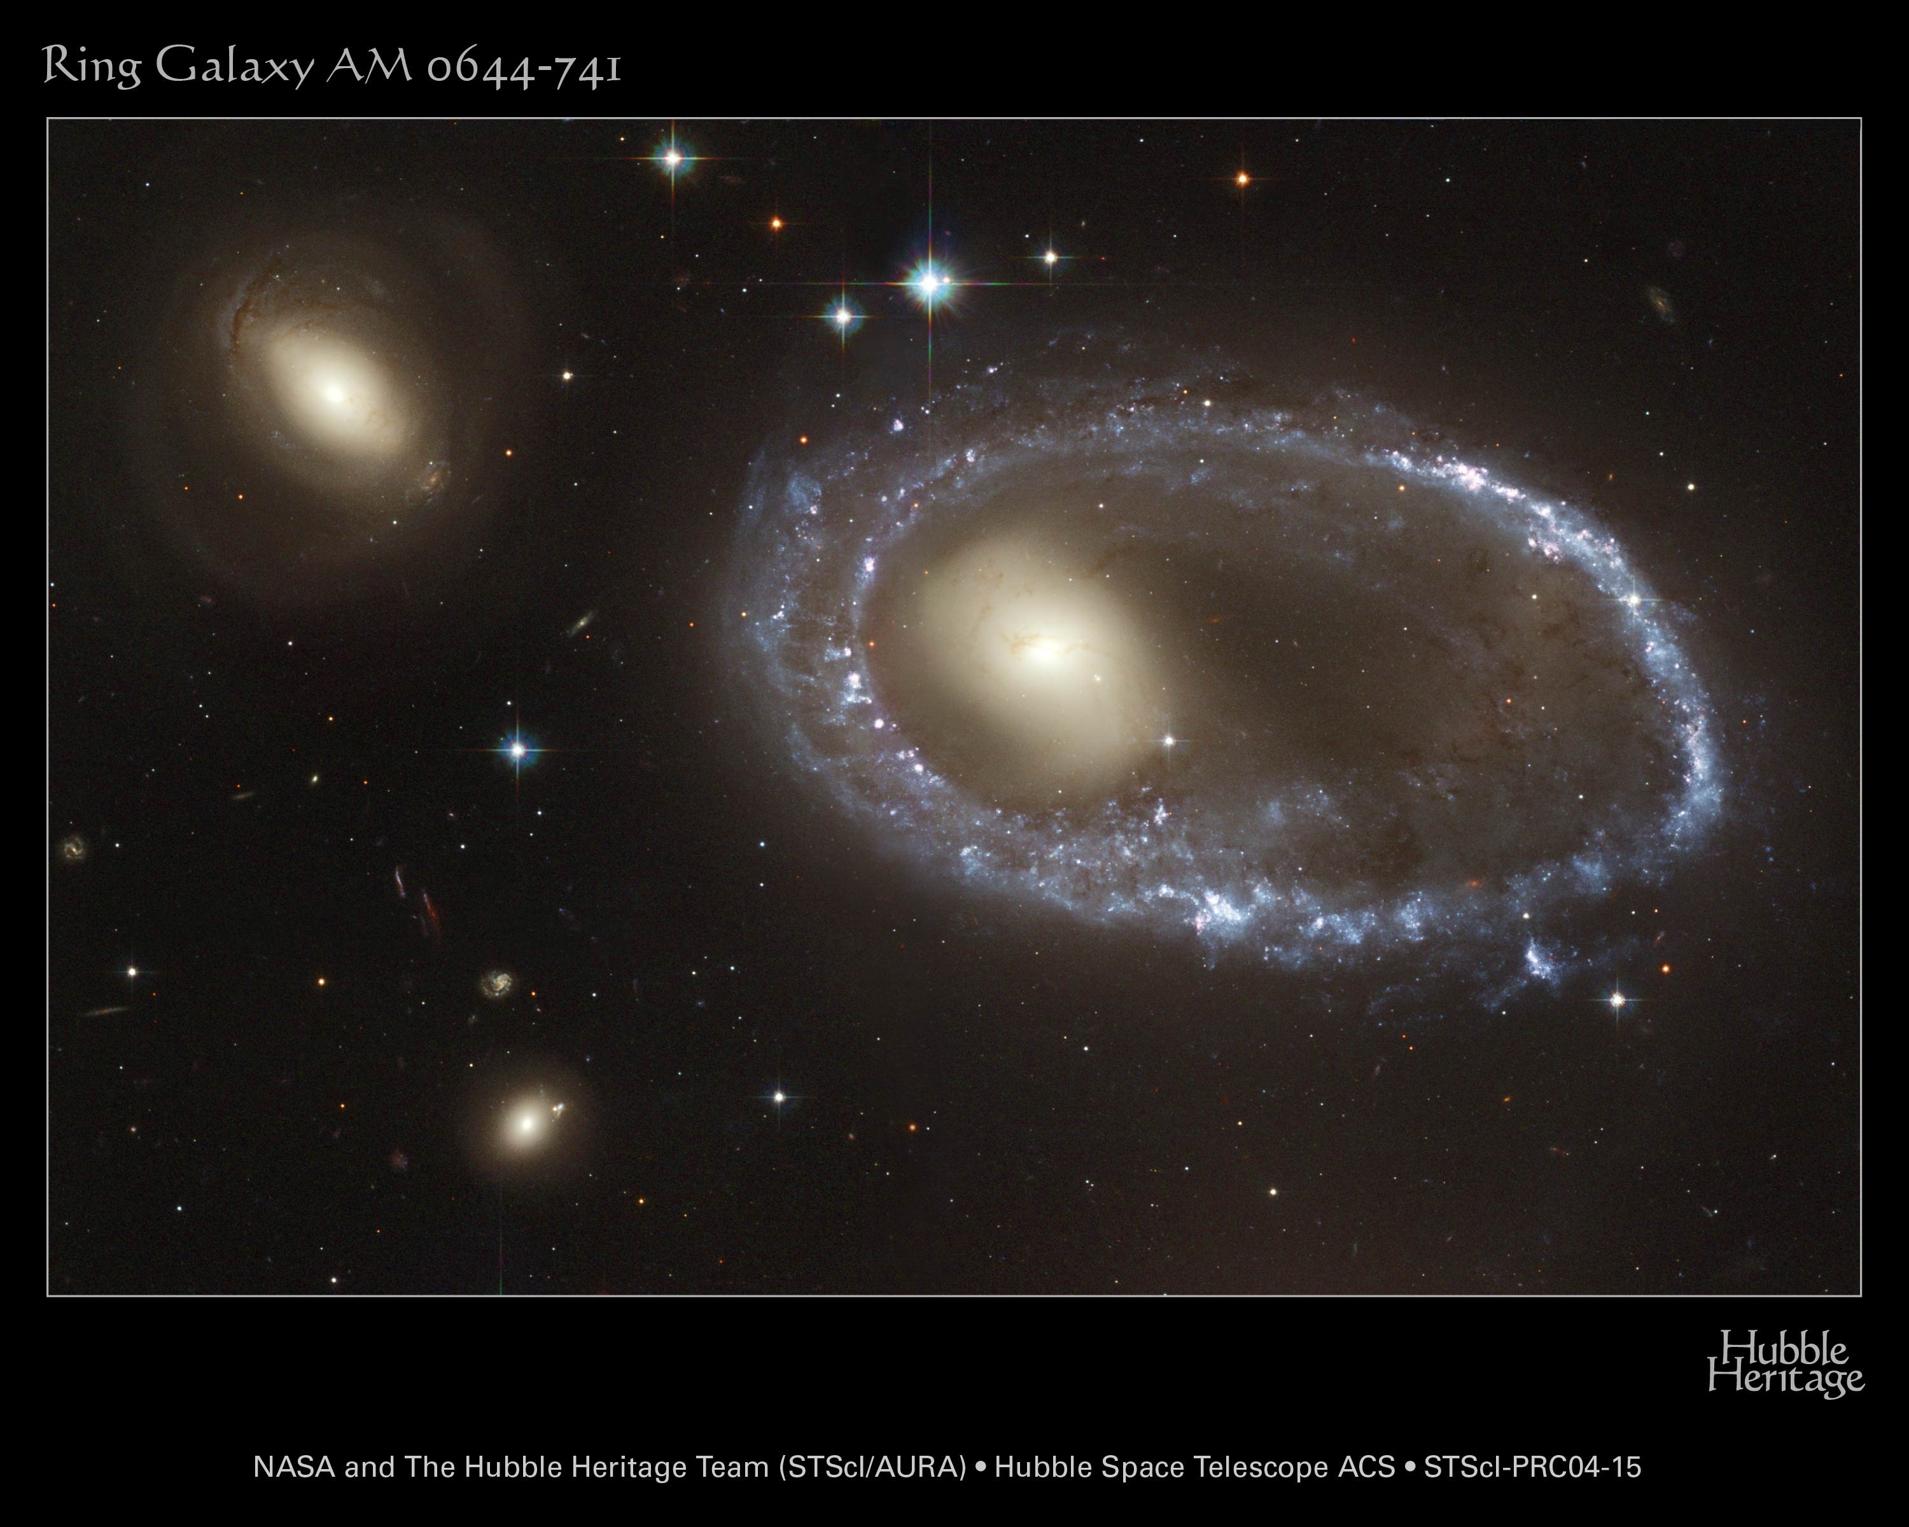
Young, hot blue stars ring the nucleus of AM 0644-741

Slide 31
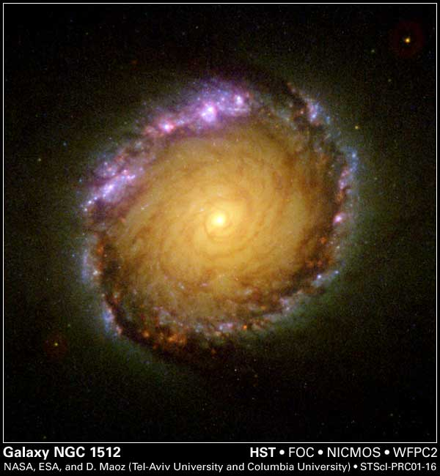
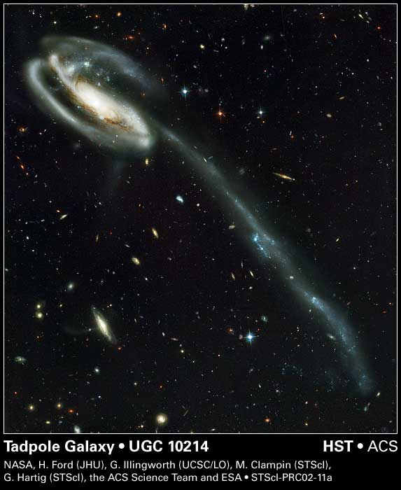
NGC 1512 is 30 MLYs away in Horologium. Older stars in the center with an outer ring of young, hot stars
Tadpole Galaxy is 400 MLYs from Earth in Draco. It is a gravitationally disrupted barred spiral galaxy as two galaxies had a close encounter. The other dwarf galaxy is upper left between the spiral arms

Slide 32
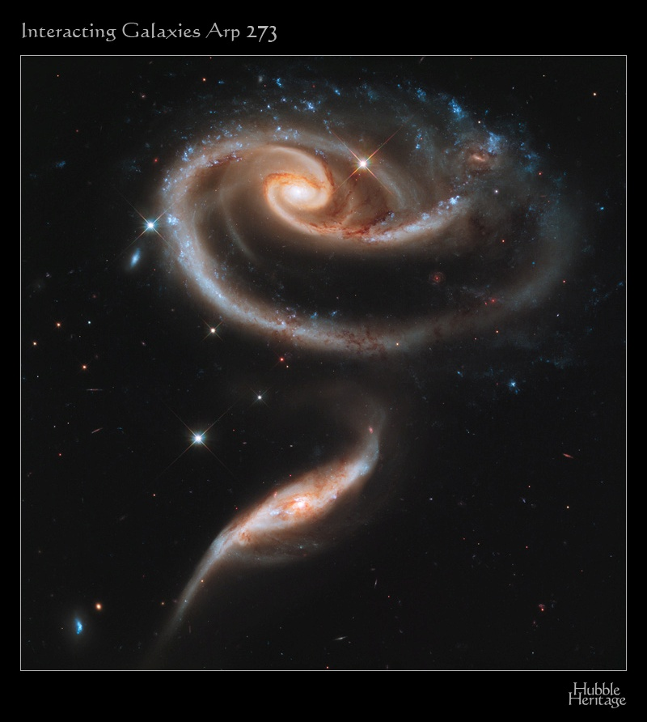
The Rose
Two stunningly beautiful interacting galaxies 300 MLYs from earth in the constellation Andromeda
Smaller UGC 1813 below plunged off-center thru the 5 times larger UGC 1810 causing massive tidal distortions and a tenuous bridge between the two galaxies
The blue crown is formed of massive, young, intensely hot stars glowing fiercely in UV

Slide 33
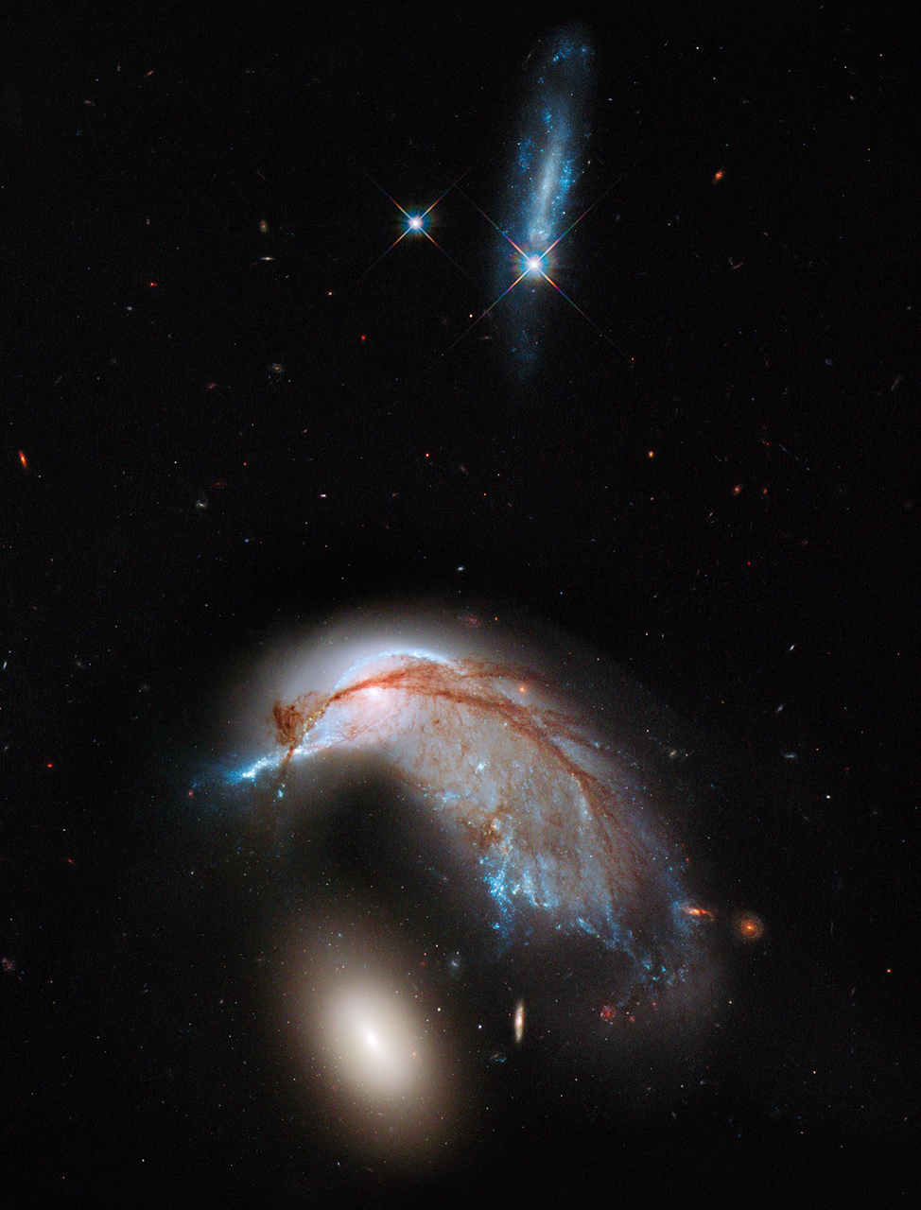
ARP 142
A colliding spiral galaxy and an elliptical companion galaxy. Note the young blue stars of the heavily distorted spiral galaxy caused by the gravitational tidal interactions. The older reddish dust has been thrown out of the arms of the no longer spiral galaxy.
Photo credit Hubble Heritage site

Slide 34
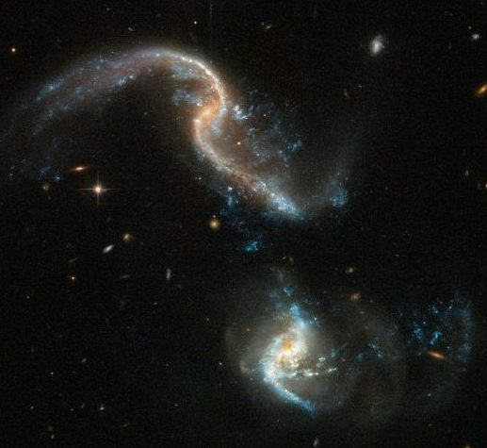
ARP 256 Colliding Galaxies in Cetus 350 MLYs from Earth
The blue stars at the ends of the distorted spiral arms are new, hot stars collapsed from the disturbed gas in the two interacting galaxies

Slide 35
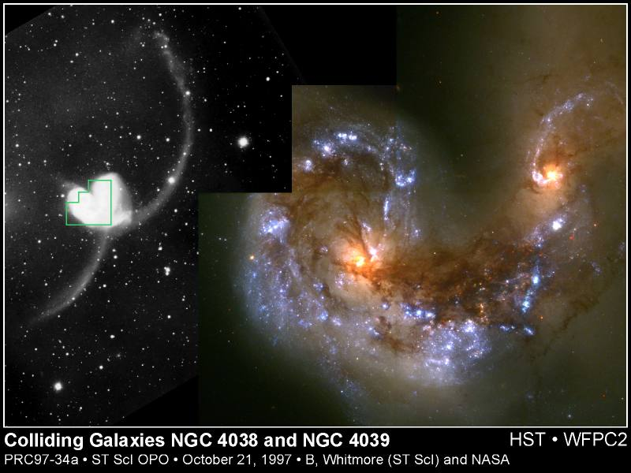
Over 1000 star clusters burst to life in the colliding core of two galaxies which began about 600 Million years ago
Two streamers of ejected stars extending far beyond the original galaxies make the antennae shape.
Antennae galaxy
45 MLYs away in Corvus

Slide 36
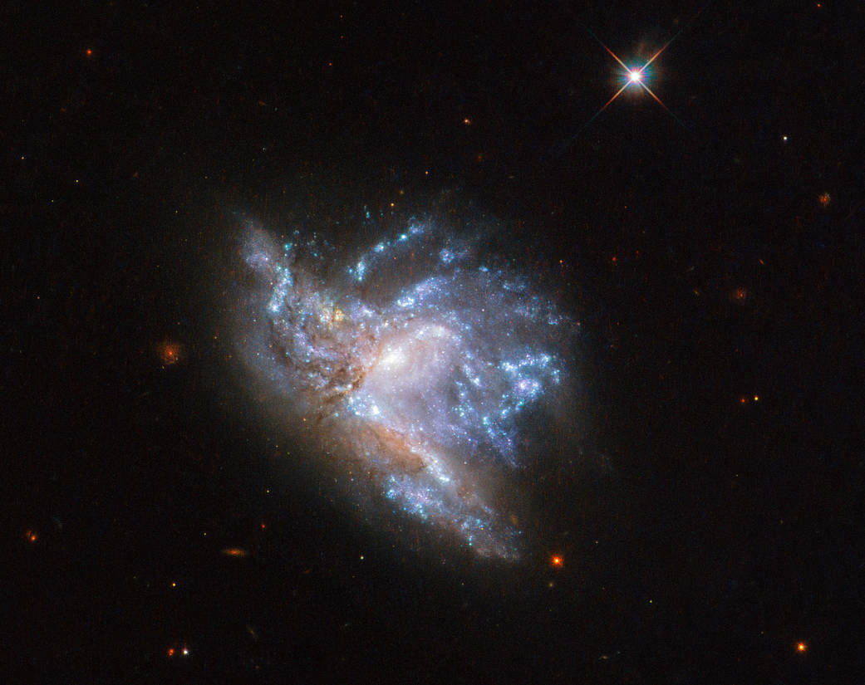
NGC 6052 is a pair of colliding galaxies in the constellation Hercules, about 230 million light-years away

Slide 37
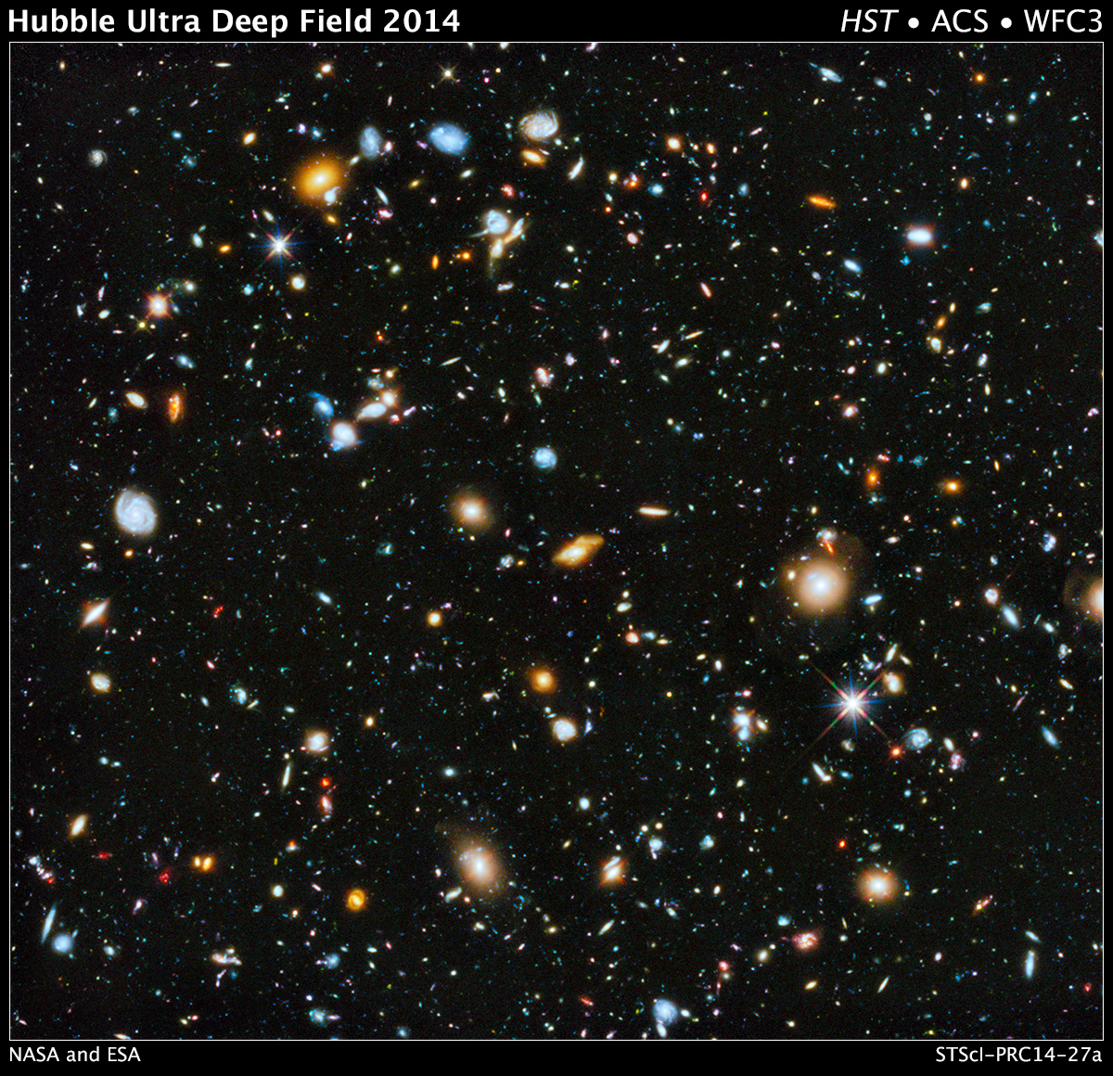
In one of the darkest parts of the sky in Fornax, the Hubble telescope saw 10,000 galaxies, in this 23-day and 841 orbit time exposure.
About 100 small, red galaxies date to 450 million years after the Big Bang.
The larger, closer, brighter galaxies-- well-defined spirals and ellipticals – date to about 1 billion years ago, when the cosmos was 13 billion years old

Slide 38
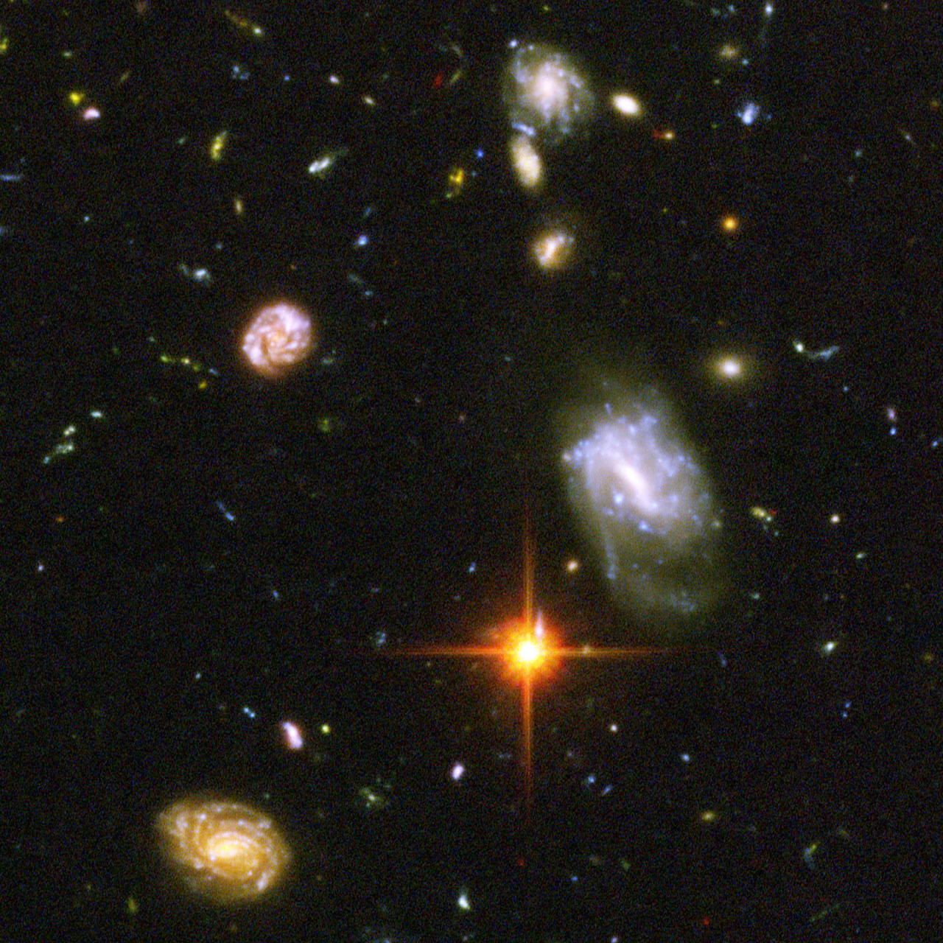
A close-up of the HST Deep Field photo of 10,000 galaxies shows a dramatic galactic brawl as galaxies interact tidally due to close encounters

Slide 39
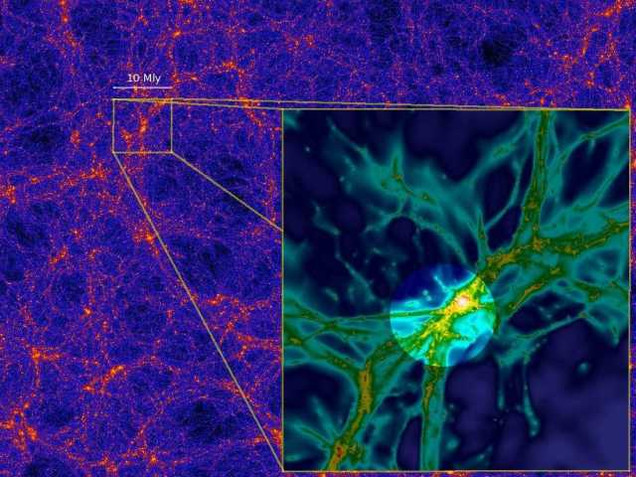
Vast clusters of galaxies have formed in an immense
cosmic web of filaments formed after the Big Bang

Slide 40
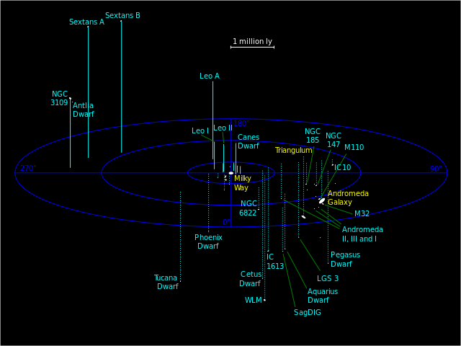
Our Milky Way and Andromeda are the two largest galaxies in our Local Group that is nearly 3 million light years in diameter

Slide 41
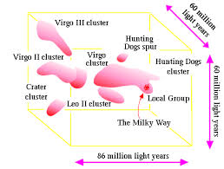
Our Local Group is part of the immense Virgo supercluster of galaxies along the cosmic web of filaments

Slide 42
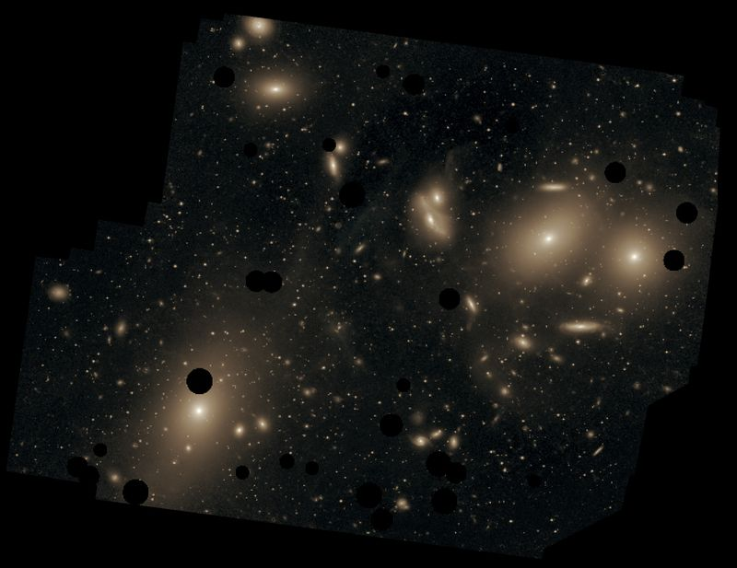
The beautiful Virgo Cluster of Galaxies

Slide 43
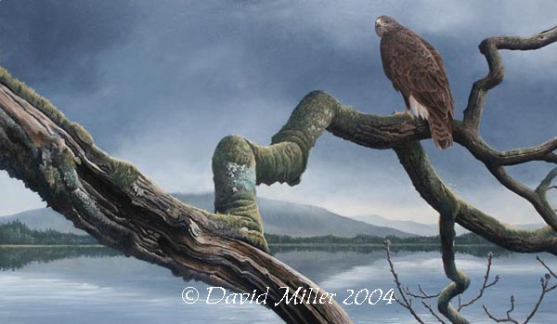
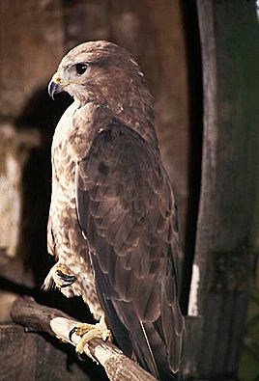
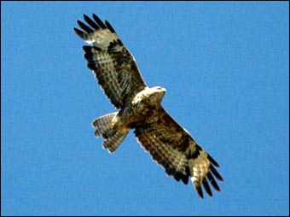
Common Buzzard at Loch Awe Scotland
Common Buzzard
(Buteo Buteo)
In flight

Slide 44
The heavens declare the glory of God; the skies proclaim the work of His hands.
Psalms 19:1
You can view video and slides for this lecture at my website
frankbuzzard.com

