Slide 1
Wonders of our Universe
Part 2
Inside the Milky Way
Presented by Frank Buzzard
Space Shuttle and International Space Station Chief Engineer (NASA retired)

Slide 2
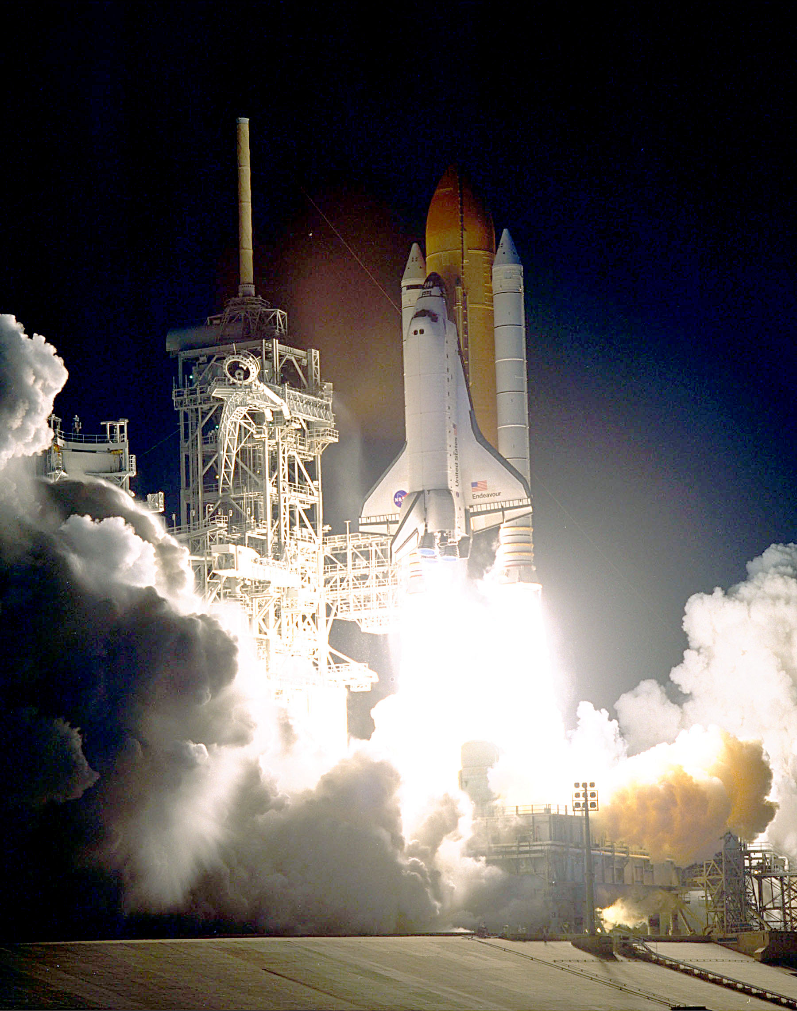
STS 31 April 1990 Discovery launched the Hubble Space Telescope (HST)
Photo credit for all photos NASA unless otherwise noted

Slide 3
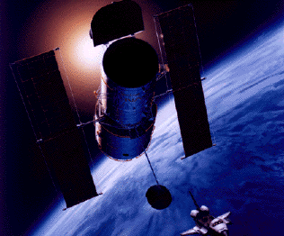
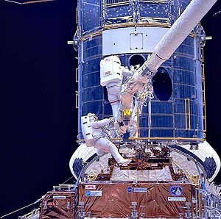
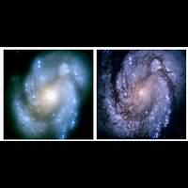
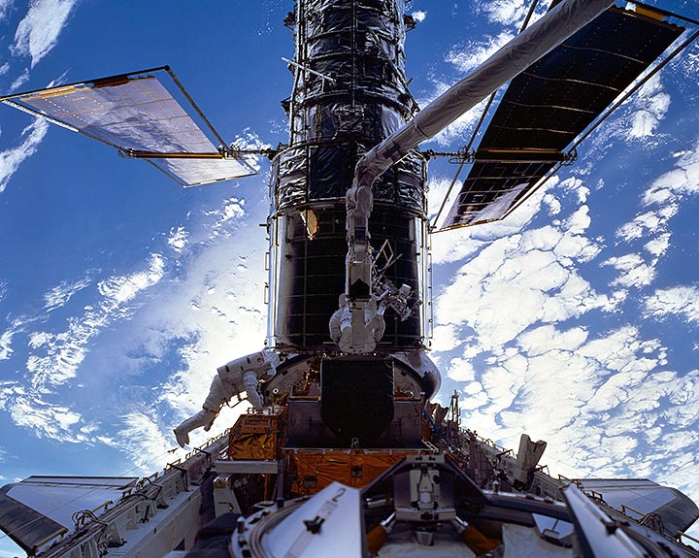
Hubble mirror flaw
Before After

Slide 4
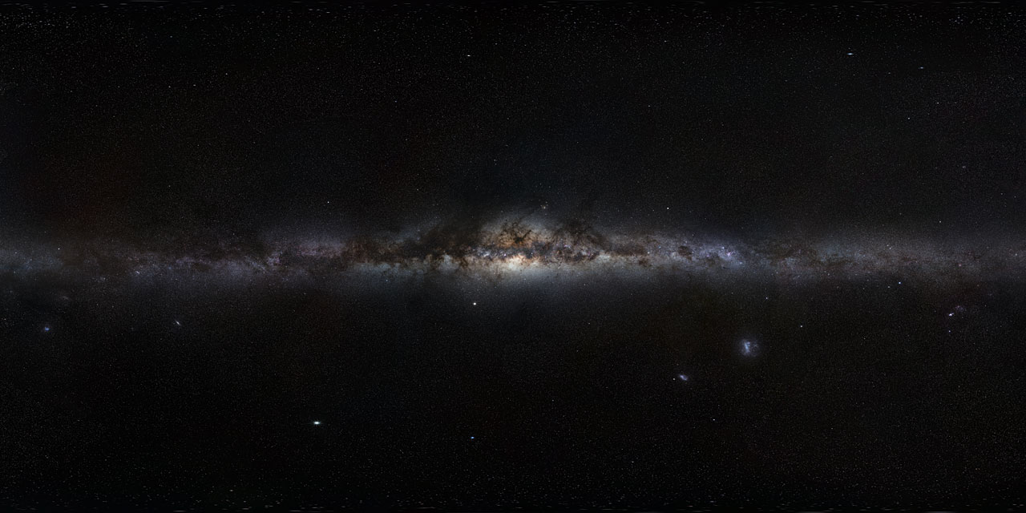
Our Milky Way Galaxy
via lactea or kyklos galaktikos "milky circle"
A Barred spiral galaxy 100-120K LYs across containing 200 billion stars. 13.2 billion yrs old.
Our solar system is located 2/3 of way out from the center in the Orion-Cygnus arm.
Our sun rotates about the galactic center once every 250 Million years

Slide 5
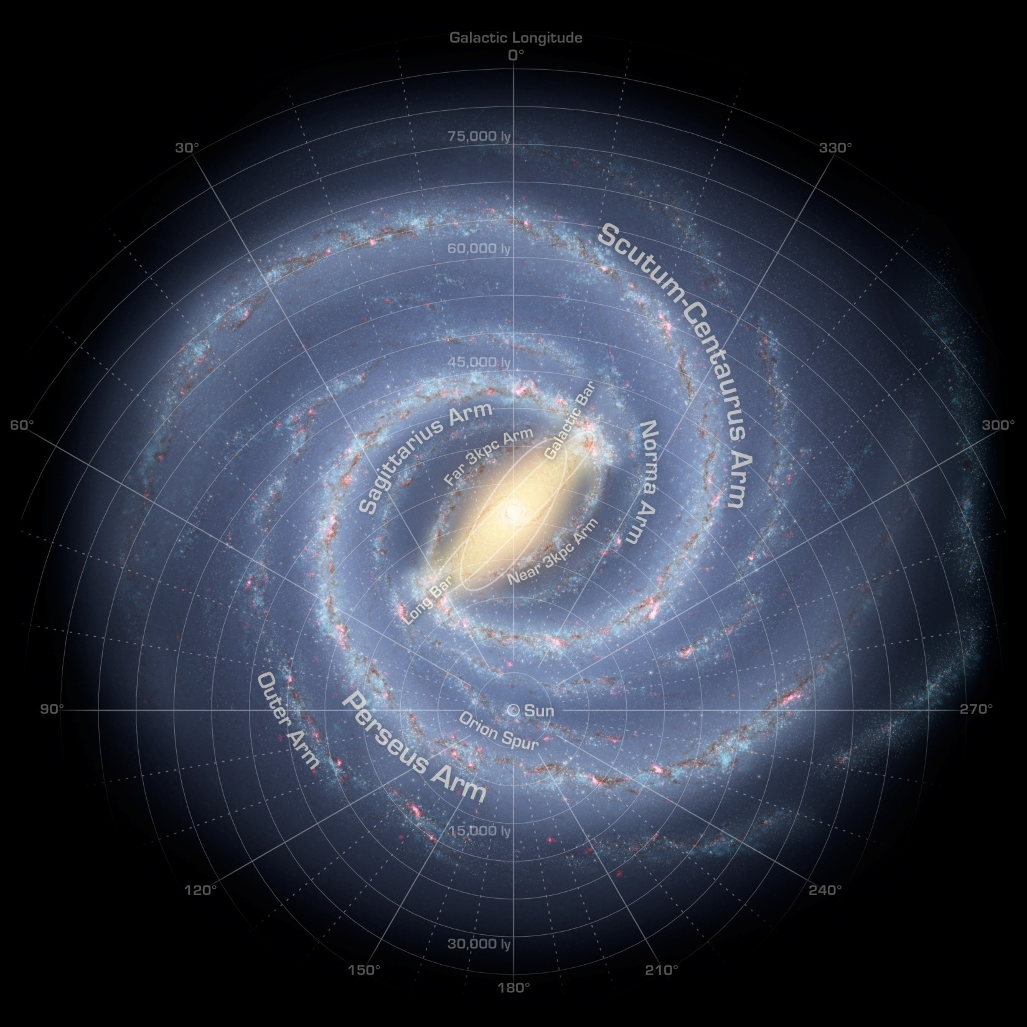
How our Milky Way galaxy might look to an outside observer from Andromeda
Our Sun

Slide 6
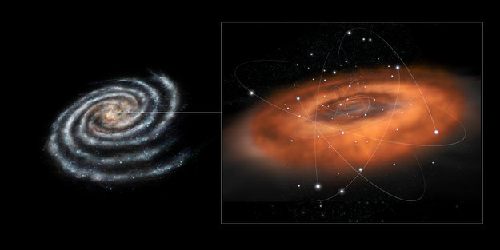
Credit: ESA–C. Carreau
The center of our Milky Way contains a super massive black hole four million times the mass of our sun. A dense torus of hot molecular gas and dust surrounds the galactic center and occupies the innermost 15 light-years of our galaxy.

Slide 7
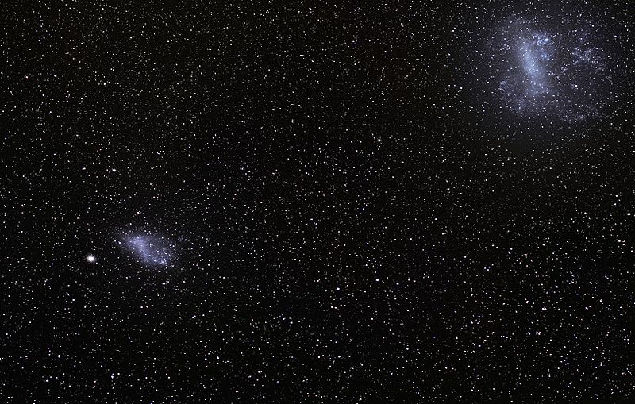
Our companion galaxies-Large and Small Magellanic Clouds
LMC and SMC are 160K and 200K LYs away in the southern sky
First recorded by Persian Azophi in 964. Observed by Vespucci 1504 and Magellan 1519 LMC has vigorous star formation within its Tarantula Nebula

Slide 8
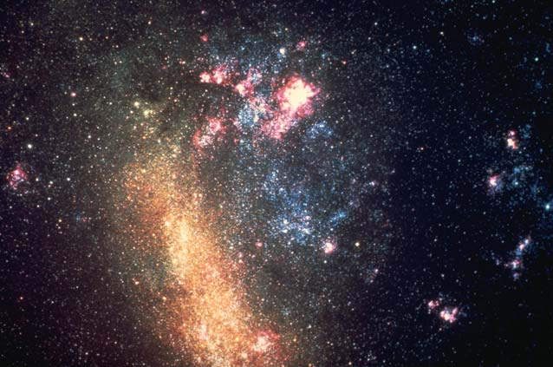
Large Magellanic Cloud—our Milky Way’s companion galaxy
Active star formation in the Tarantula Nebula
Young Hot Blue Stars
Older Cooler Red Stars
Photo credit
AURA/NOAO/NSF

Slide 9
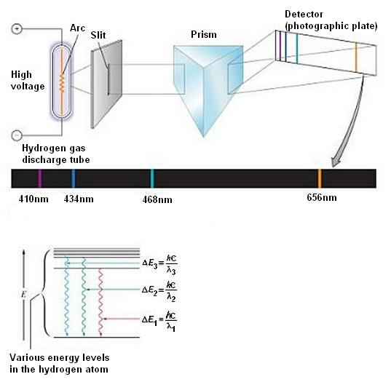
How do we learn what elements are in the stars? We use a spectroscope on our telescopes. Each element has a unique quantum ‘fingerprint”. Hydrogen has the Johann Balmer series discovered by experiment in 1885 before quantum mechanics confirmation in 1930s

Slide 10
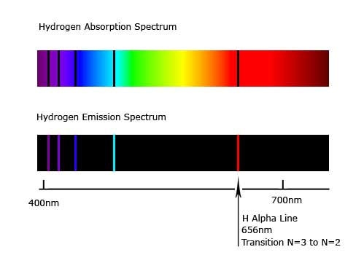
Cold hydrogen in interstellar space absorbs the hydrogen electron quantum levels of light from a distant source
Hot hydrogen emits the same electron quantum levels of light.

Slide 11
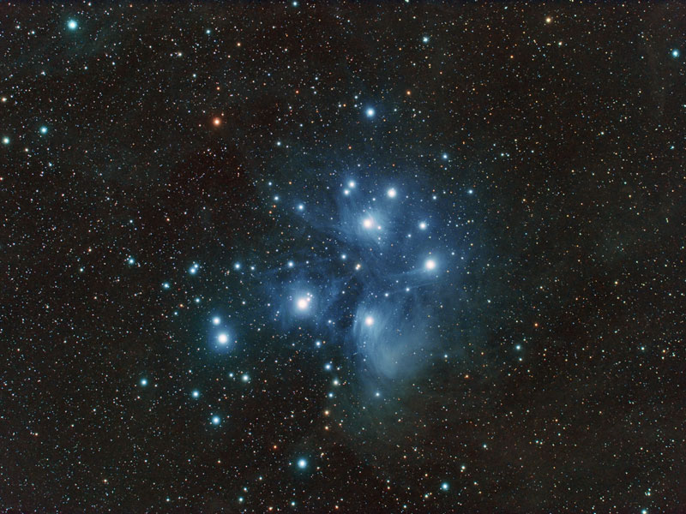
The Pleiades
“The Seven Sisters” in Taurus
An open star cluster
400 LYs away and 13 LYs across
“Can you bind the chains of the Pleiades…”
Job 38:31

Slide 12
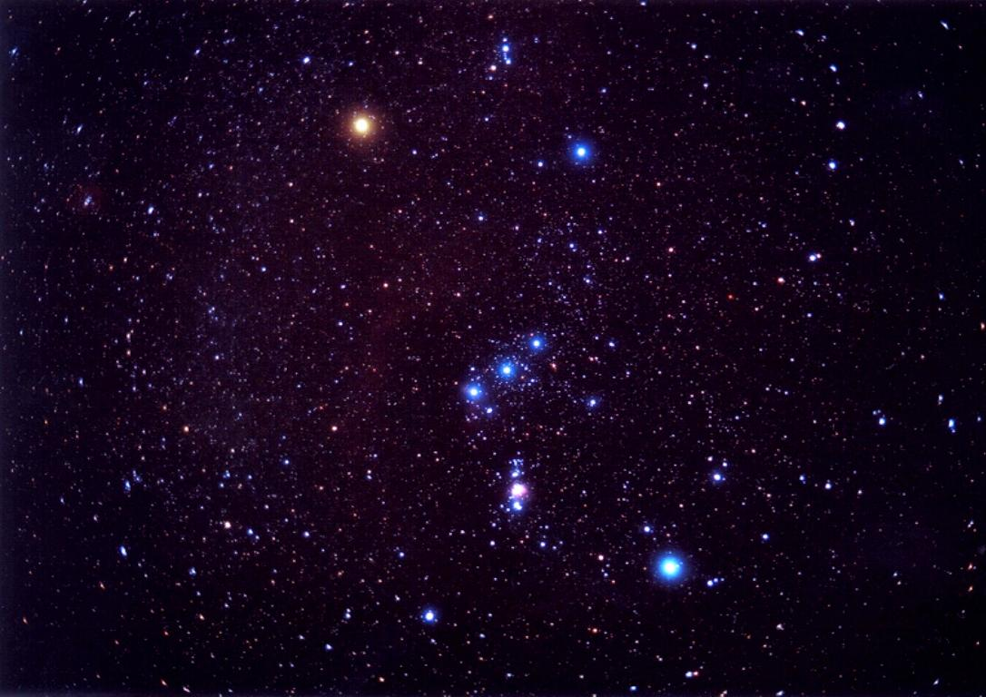
Orion the Hunter
Betelgeuse
Betelgeuse
600 LYs and 25 Solar mass
Rigel
900 LYs and
20 Solar mass
“…or loose the cords of Orion?”
Job 38:31
Rigel

Slide 13
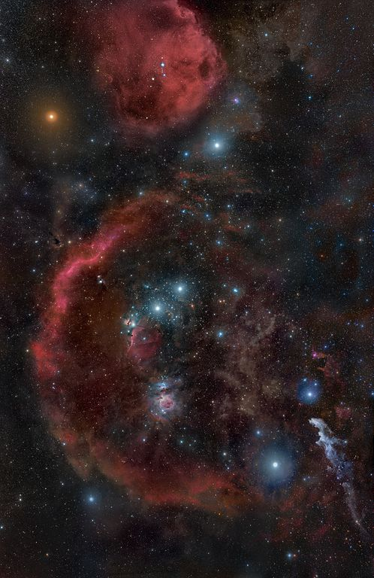
A giant cloud of molecular gas surrounds Orion where new stars are forming .
Betelgeuse
Barnard’s Loop
Horsehead Nebula
Great Nebula of Orion
Witchhead Nebula
Rigel

Slide 14
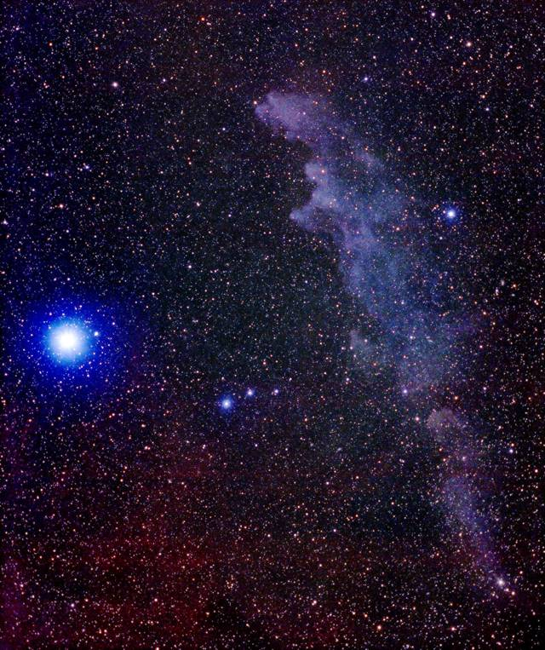
Rigel and the Witchhead Nebula
Rigel in Orion shines 40,000 times brighter than our sun. It is 800 LYs away and its powerful radiation is reflected off the Witchhead Nebula 40 LYs from Rigel

Slide 15
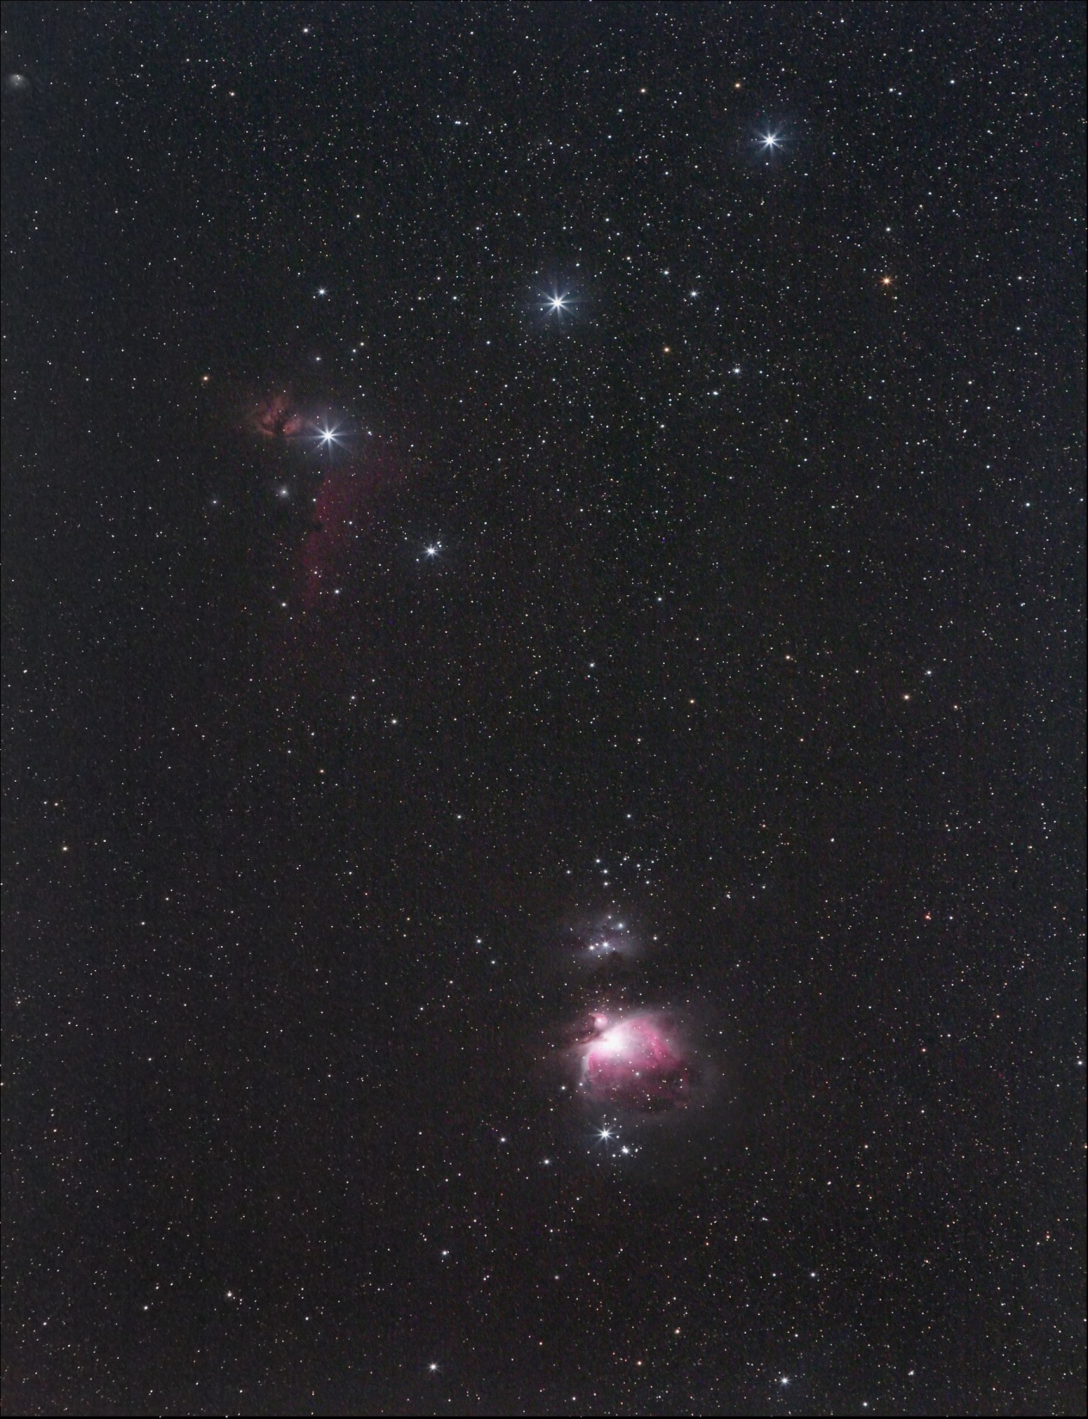
The Egyptian pyramids of Giza are aligned like the Belt stars of Orion
The Great Nebula of Orion

Slide 16
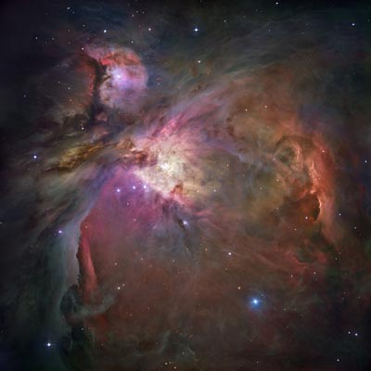
Great Nebula of Orion
1,500 LYs away 13 LYs across
Stellar nursery of
new stars
Supersonic solar winds cause bow shock waves in the nebula gas.
Trapezium’s 4 massive stars carve out a cavity in the nebula with strong solar winds and UV light.

Slide 17
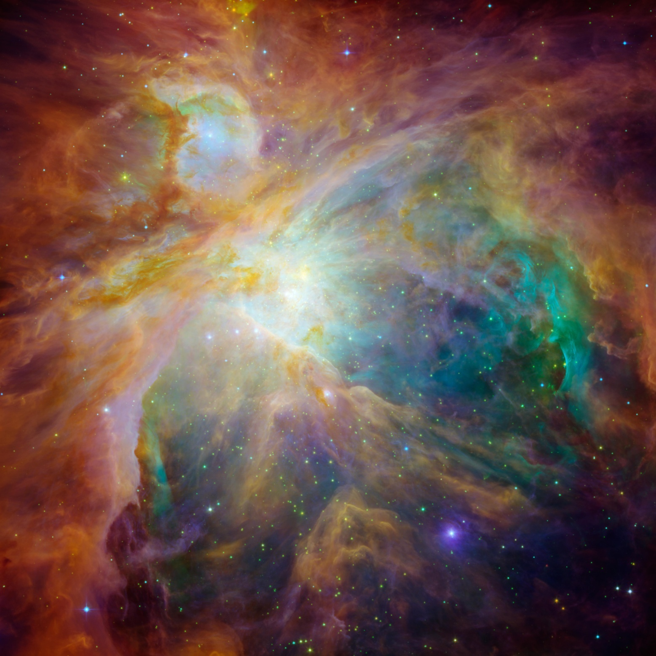
Orion Nebula
Hubble and Spitzer space telescopes composite image of Infrared and visible light

Slide 18
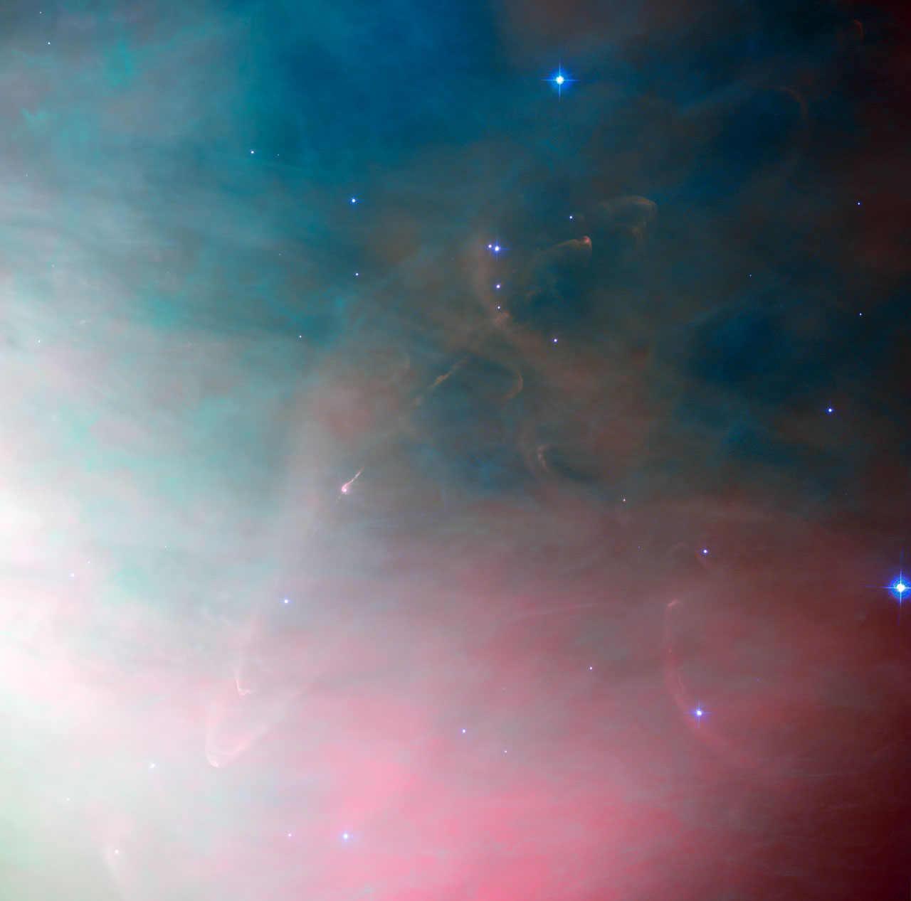
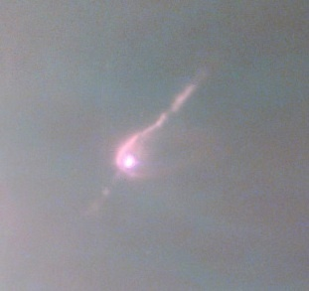
Herbig-Haro 502 Star Formation in Orion Nebula
a very young star surrounded by the cloud of gas from which it formed. This leftover material forms planets and eventually solar systems as intricate as our own.

Slide 19
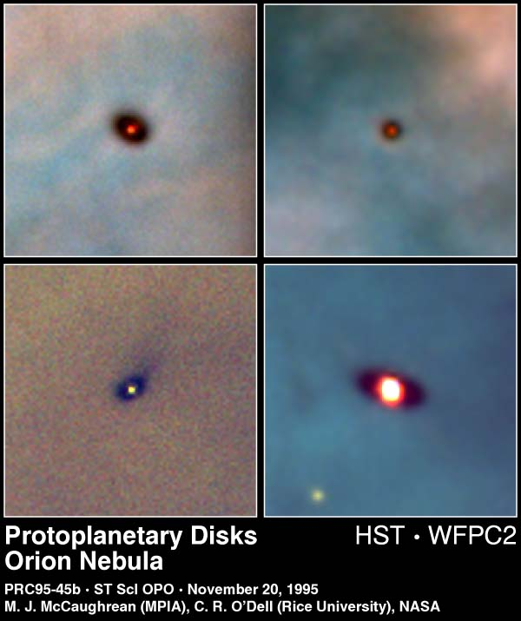
Disks of dust and gas surround young stars about 1 Million years old in Orion Nebula
The disks range in size from two to eight times the size of our solar system
Our solar system probably formed from a disk like this about 4.6 billion years ago

Slide 20
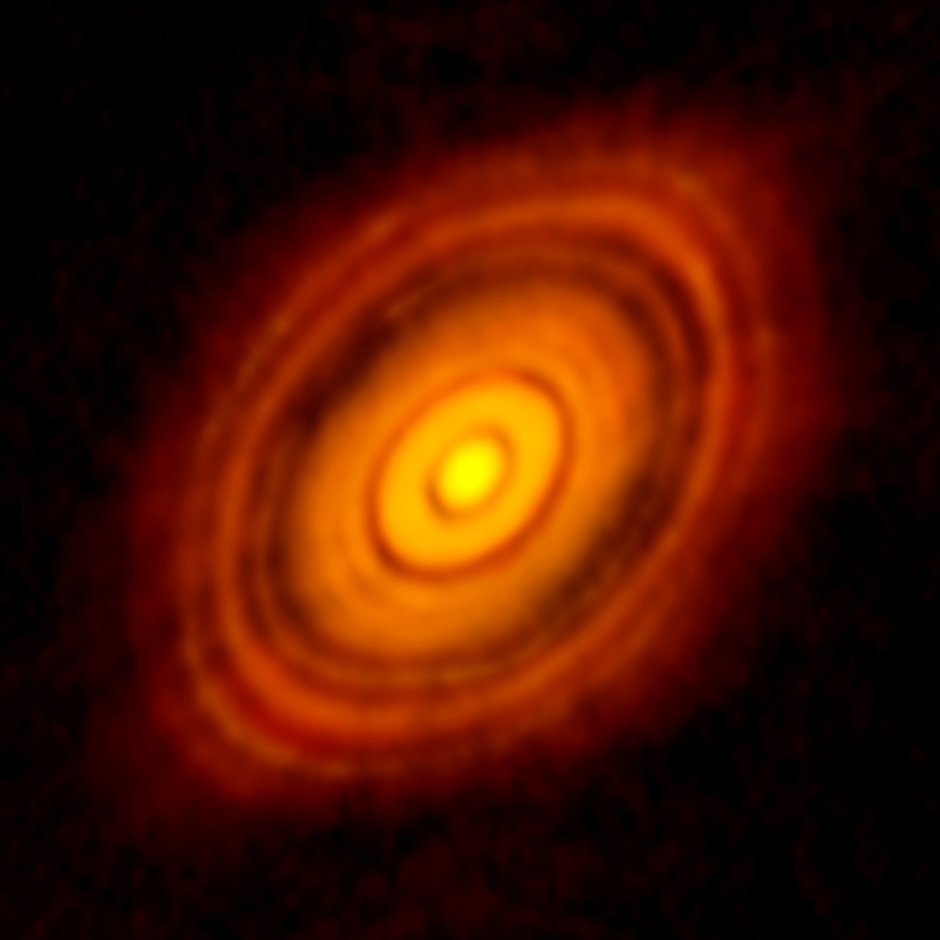
HL Tau is a young star (1 mil years old) located 450 LYs away in Taurus. Planetary formation is clearly evident in the ring gaps. HL Tau can not be seen in visible light because it is surrounded by dust and gas. This image will change planetary evolution theories of young stars!
Photo Credit: ALMA (NRAO/ESO/NAOJ

Slide 21
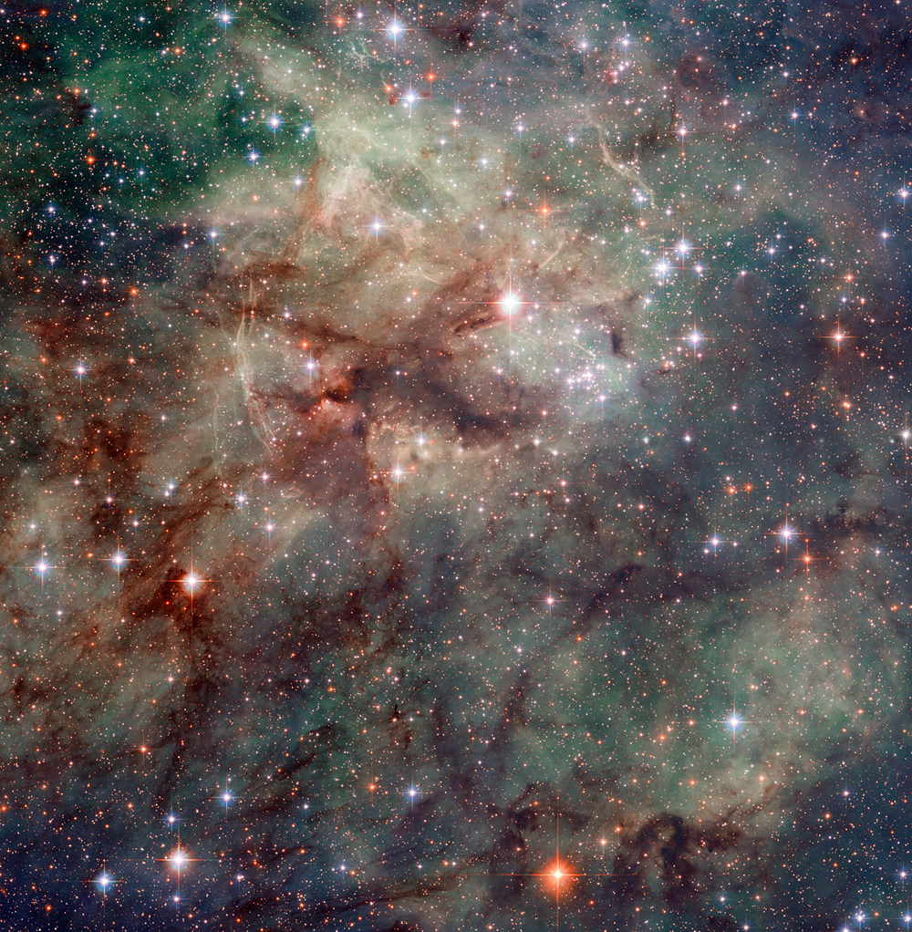
Tarantula Nebula
30 Doradus or NGC 2070
The most active stellar formation region is in the Large Magellanic Cloud. Supernova 1987A in the Tarantula Nebula is the closest since the invention of the telescope

Slide 22
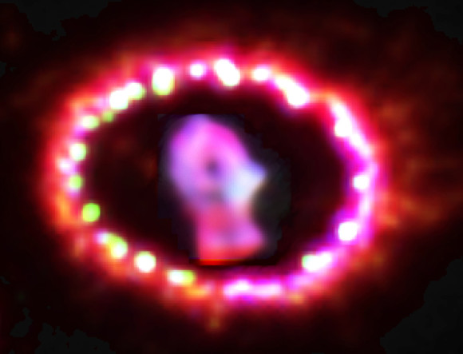
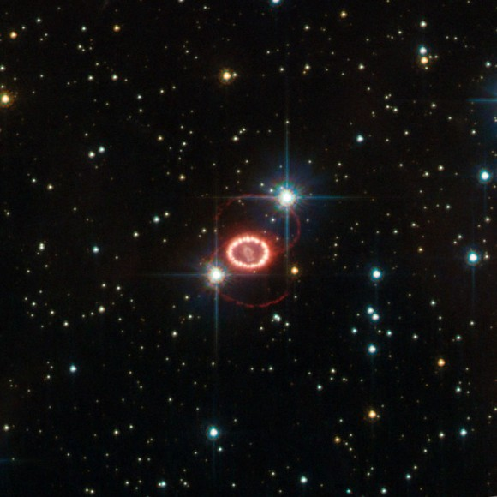
Supernova 1987A exploded in the LMC 160,000 years ago. It appeared to Earth Astronomers in Feb 1987
Supernova 1987A is the closest stellar explosion since the Supernova of 1604 called Kepler’s star which was before the invention of the telescope.
Image Credits: NASA/HST

Slide 23
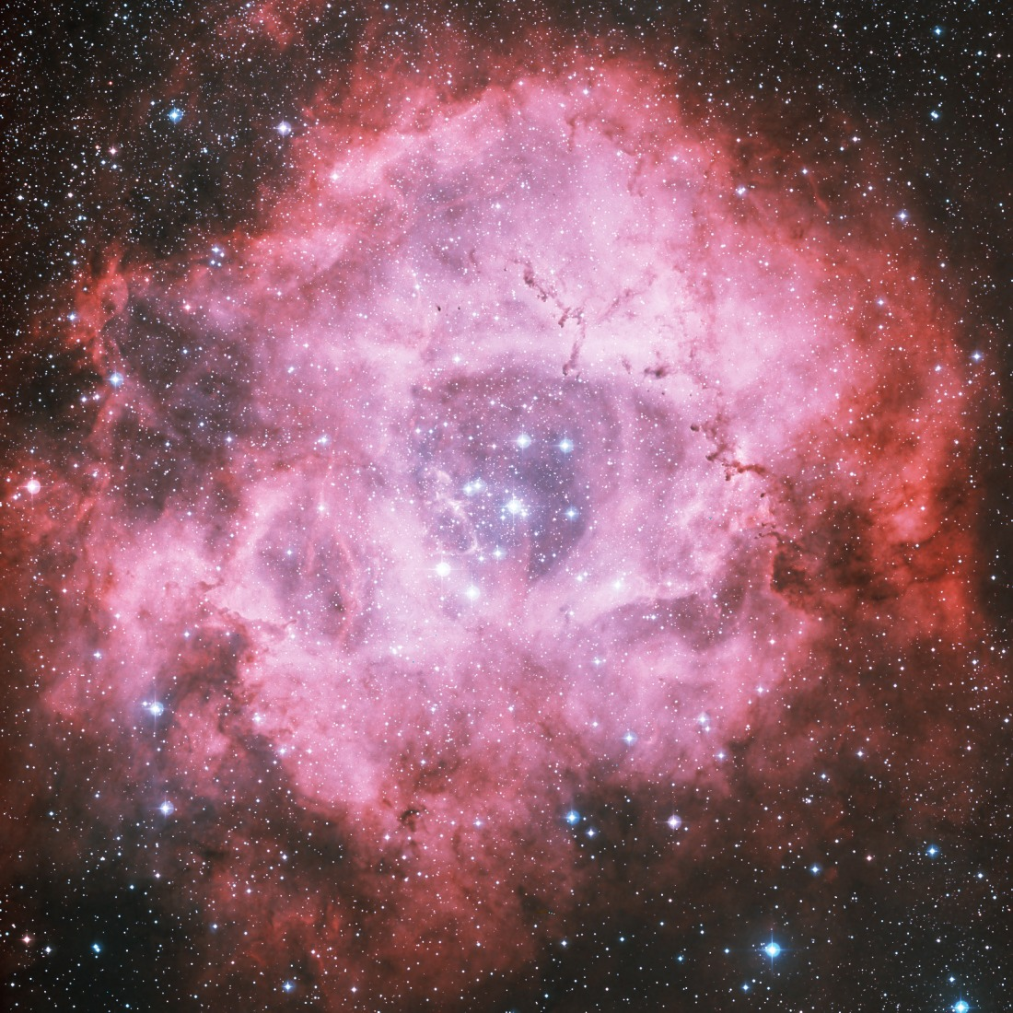
Rosette Nebula
A large 130 LY across emission nebula 5200 LYs away in the Monoceros region of our Milky Way
Hot, young stars in the center emit intense X-Rays and strong stellar wind blowing gas away causing the central hole

Slide 24
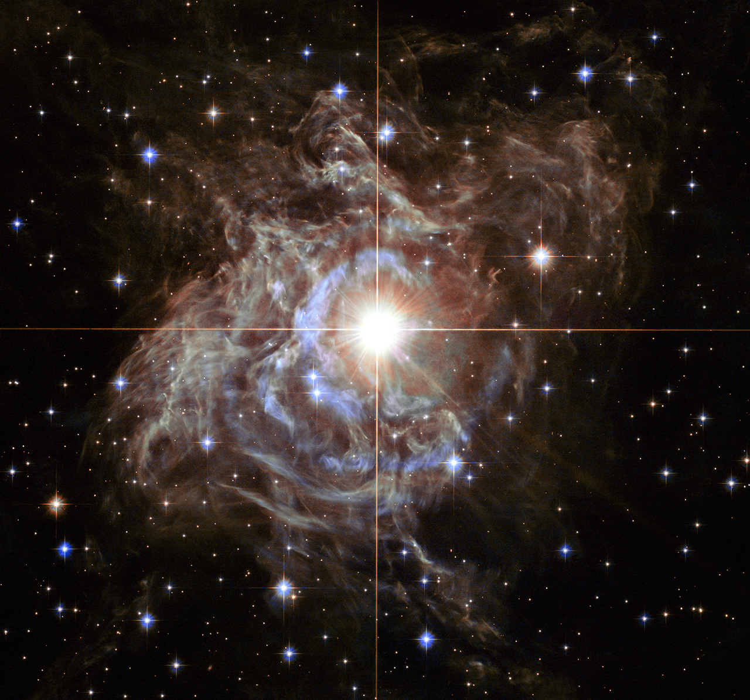
RS Puppis Cepheid Variable Star
RS Puppis in the Southern Hemisphere rhythmically brightens and dims over a six week period. This beautiful “light echo” is created by the Cepheid’s changing pulses of light propagating outward thru the nebula’s dust and gas

Slide 25
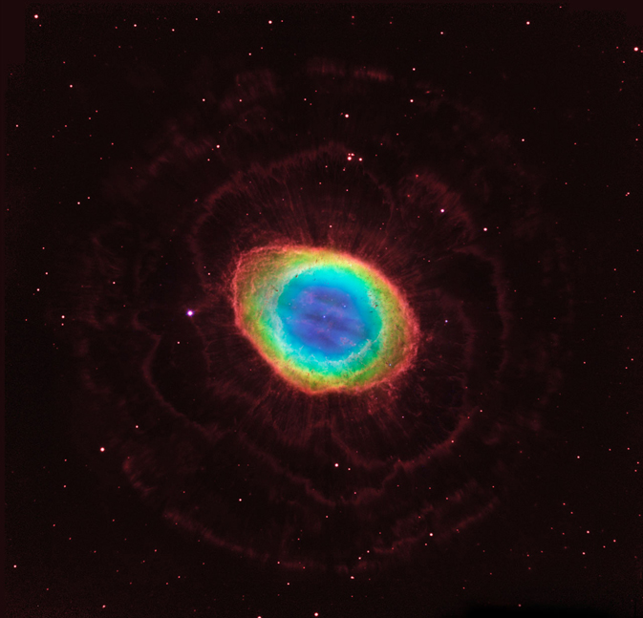
The Ring Nebula is about 2,000 light-years from Earth and measures roughly 1 light-year across. Located in the constellation Lyra, the nebula is a popular target for amateur astronomers. The white dwarf collapsed star excites the helium to glow blue

Slide 26
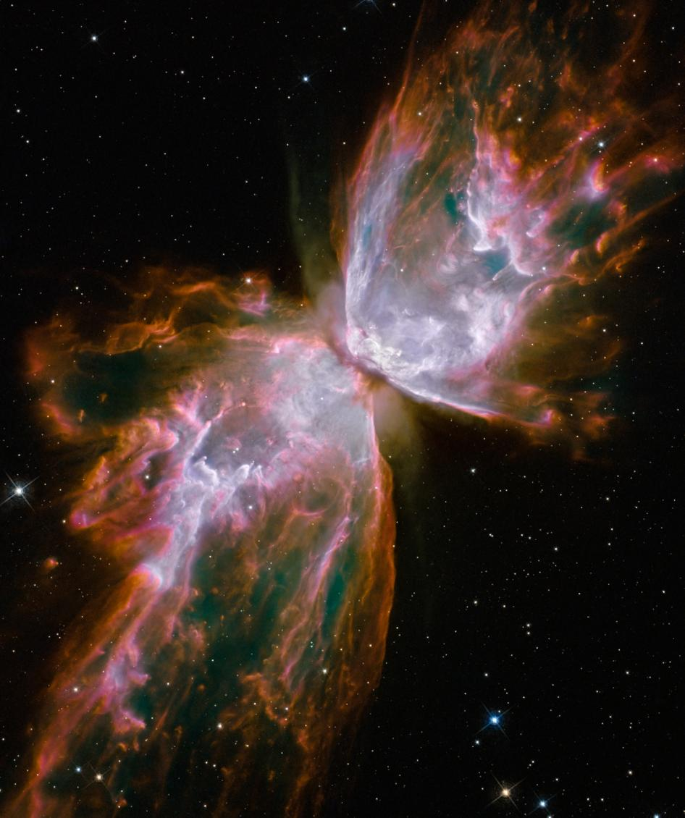
Butterfly Nebula
A dying star at the center of NGC 6302 gives off intense UV light that illuminates the dust and gas in the Butterfly’s wings.
The wings are 3 LYs across and this planetary nebula is 4000 LYs away in the constellation Scorpio

Slide 27
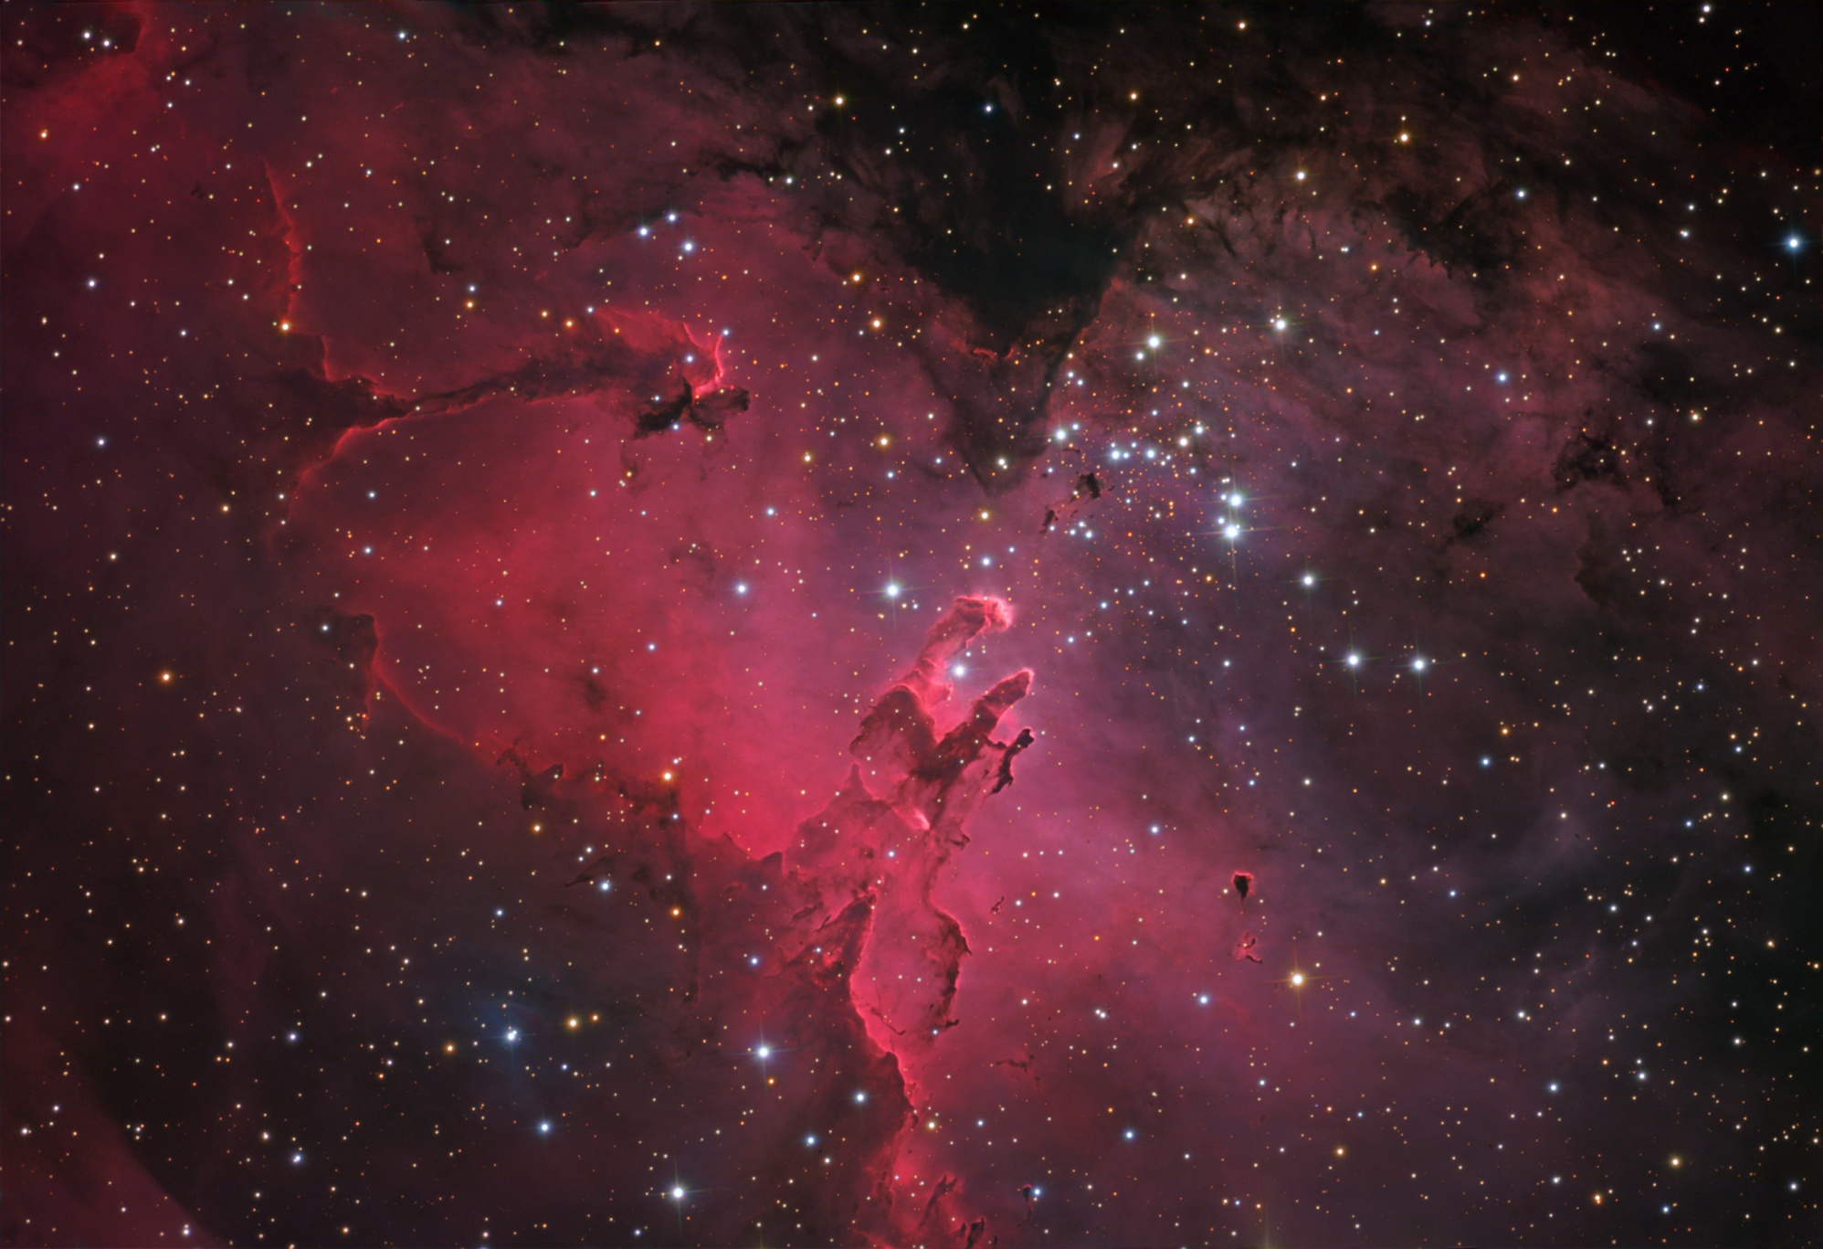
Eagle Nebula-M16-Stunning clouds of dust and glowing gas
7000 LYs away in Serpens Cauda-the tail of the snake

Slide 28
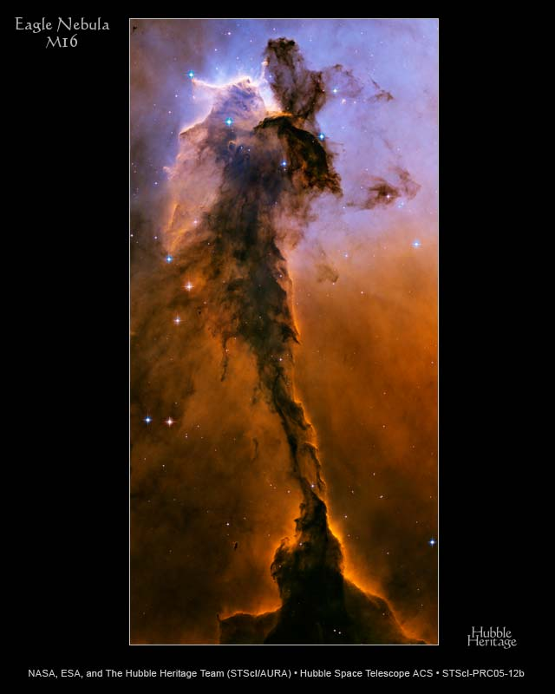
Fairy of Eagle Nebula M16
A 10 LY tower of gas, dust and star cluster 6500 LYs away in Serpens
A bow shock wave from massive, nearby star radiation is blowing away the top-left of the nebula forming new stars
Carbon and Silicon compound dust grains absorb light and form dark lanes lower center

Slide 29
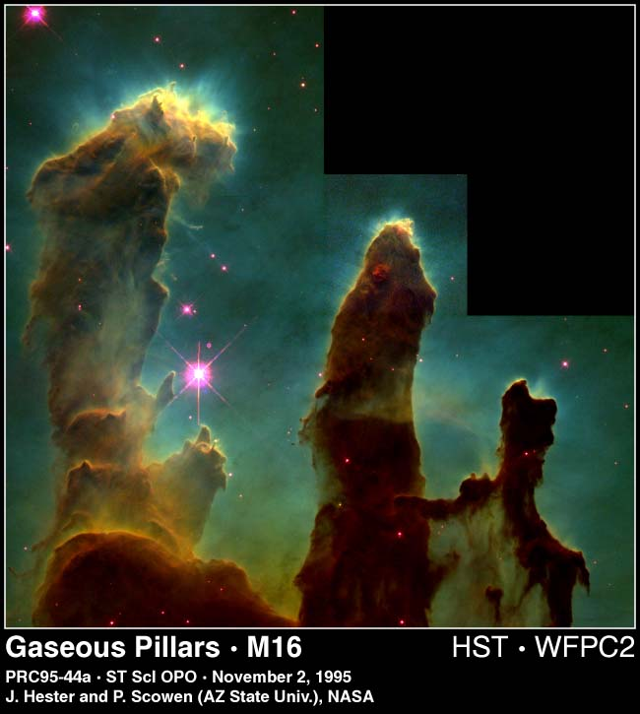
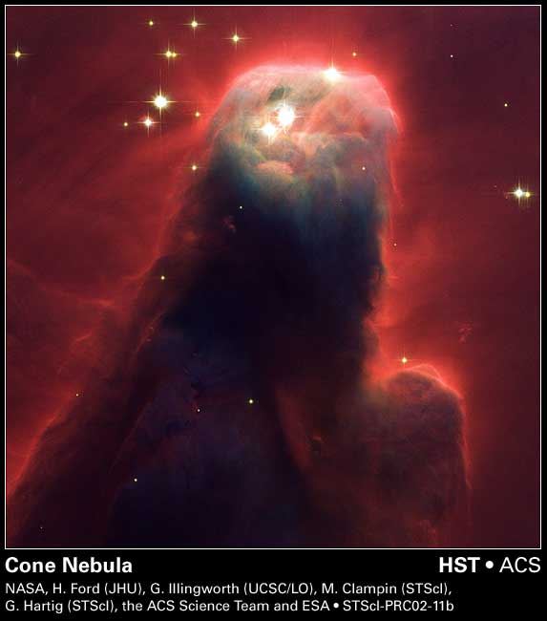
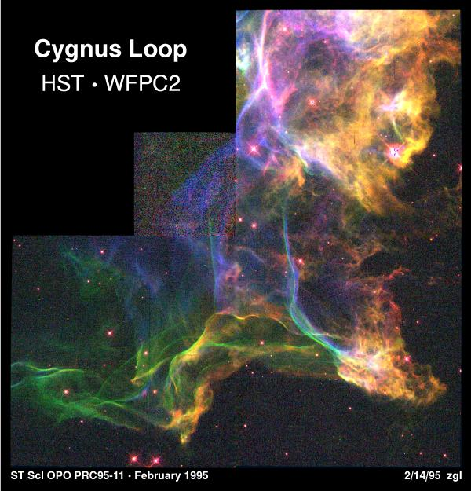
Eagle Nebula Pillars of Creation-7 LYs tall

Slide 30
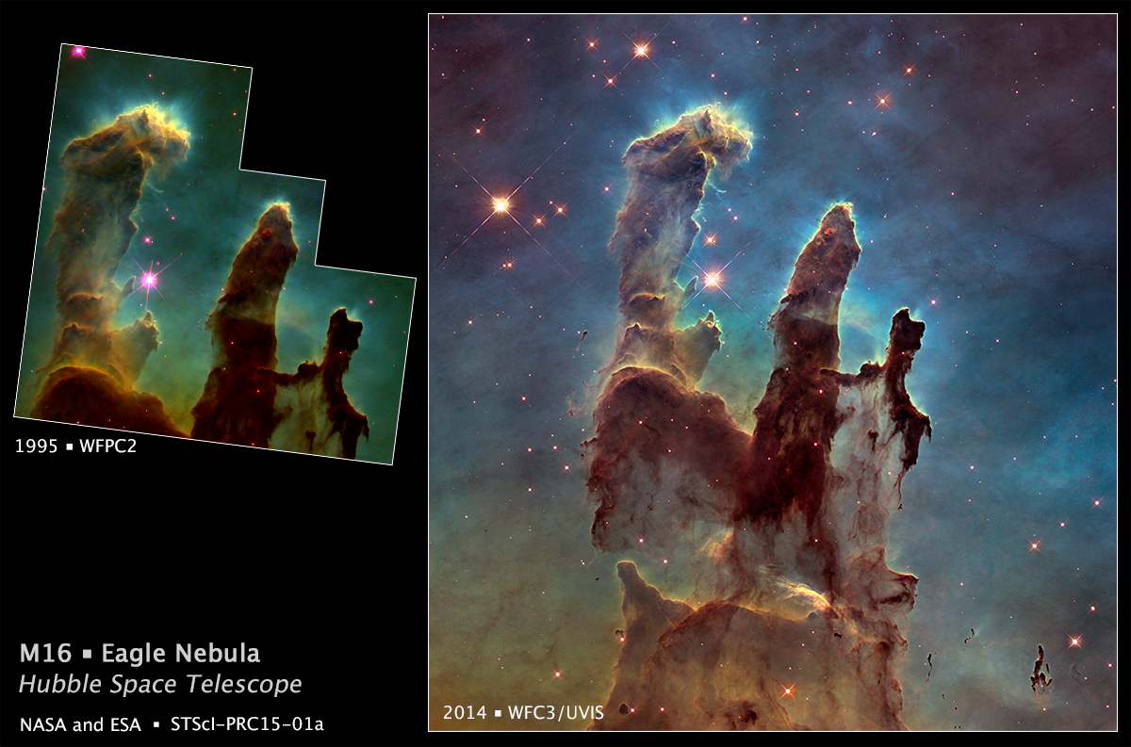
Upgrading Hubble by the Space Shuttle was revolutionary. Note the resolution increase from the WFPC 3 Camera upgrade in 2009

Slide 31
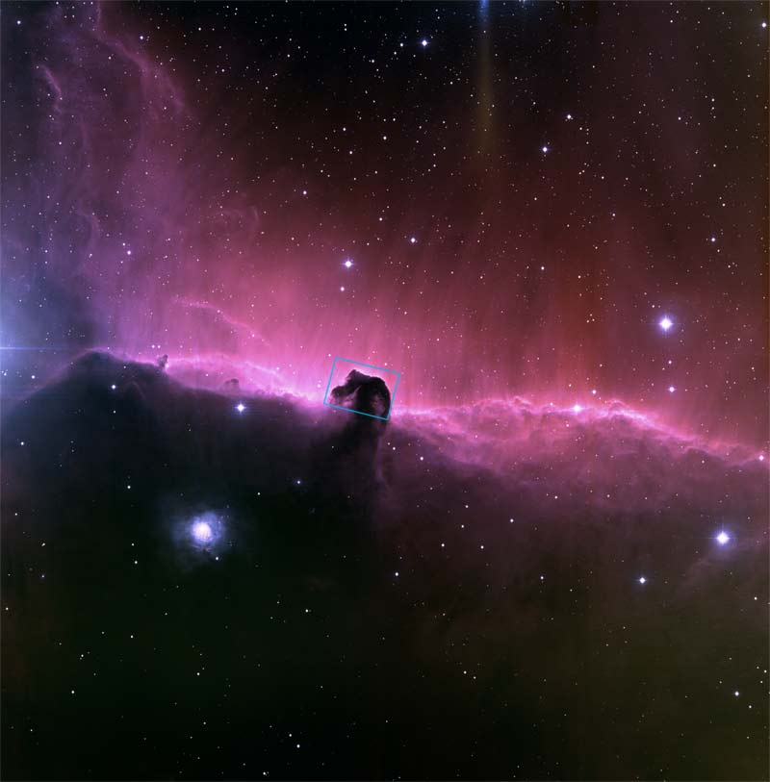
Horsehead Nebula 1500 LYs away in Orion just below Alnitak in Orion’s belt
Red Glow behind thick dust Horsehead comes from hydrogen gas ionized by nearby star Sigma Orionus

Slide 32
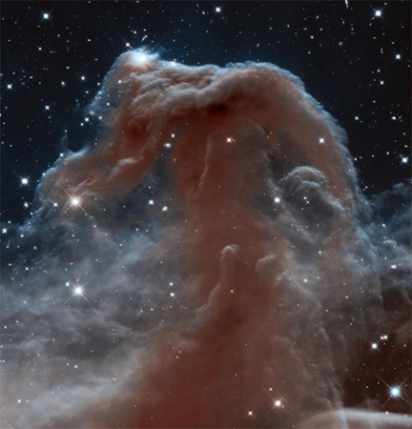
Dramatic 2013 Infrared photo of the Horsehead Nebula in Orion taken by the upgraded Wide Field Camera 3 installed by Shuttle astronauts in the final 2009 servicing mission.
Photo credit NASA

Slide 33
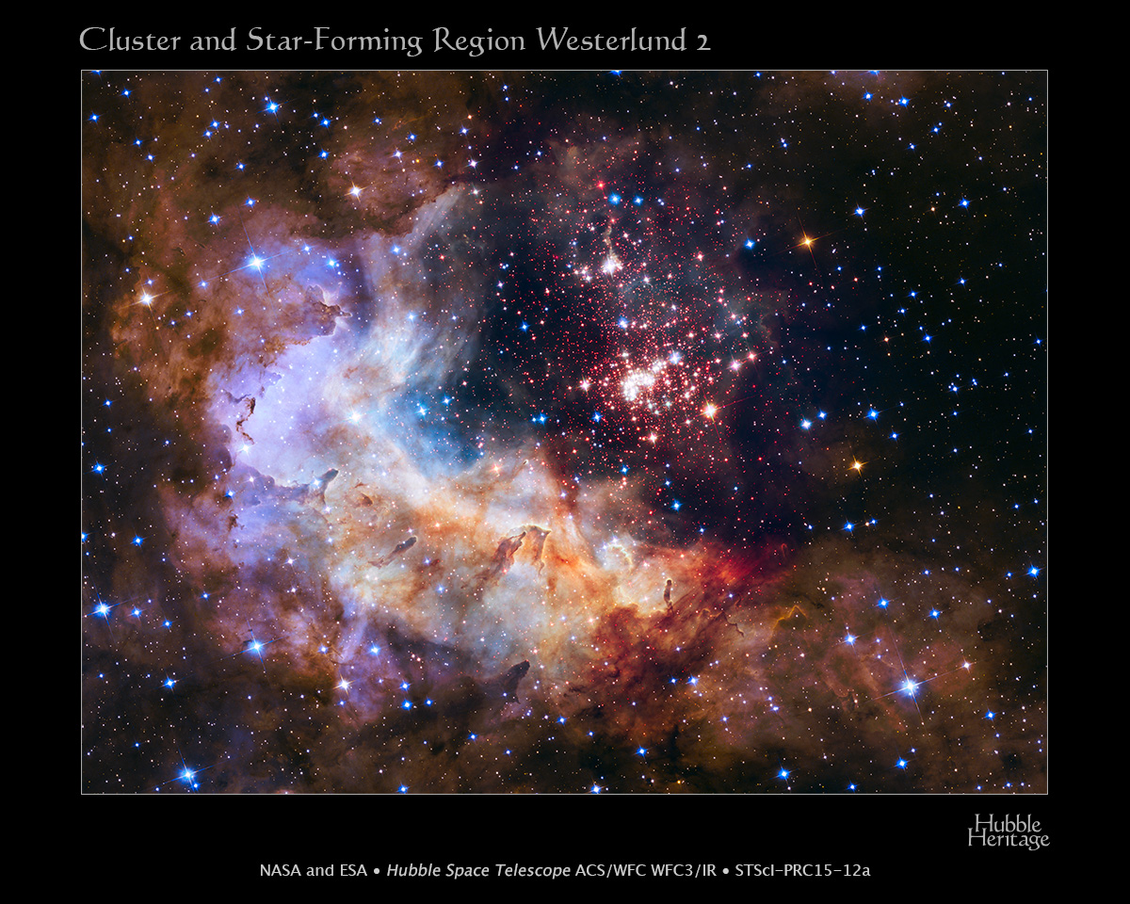
Celestial Fireworks in Carina, 20 KLYs away as the young star cluster’s radiation excites the nebula gas and dust.
Red is hydrogen. Blue-green
is oxygen.

Slide 34
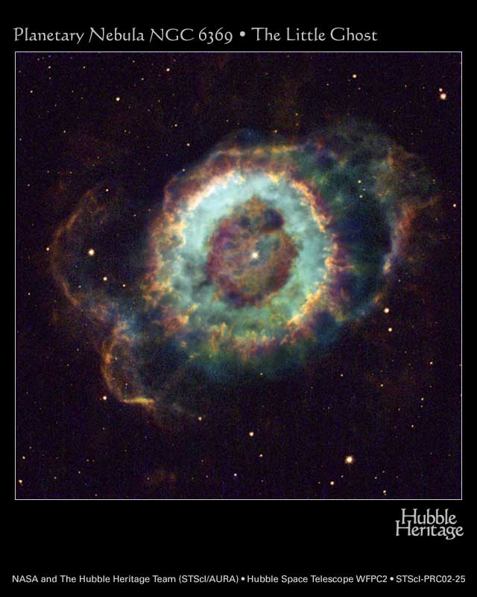
Little Ghost Nebula 2000 LYs away in Ophiuchus
A dying star expels its outer layers leaving a white dwarf in the center of a planetary nebula –misnamed because it looked like a planet in small telescopes .
Intense UV light from the white dwarf ionizes the oxygen, hydrogen, and nitrogen atoms which recombine and give off the blue, green, and red light

Slide 35
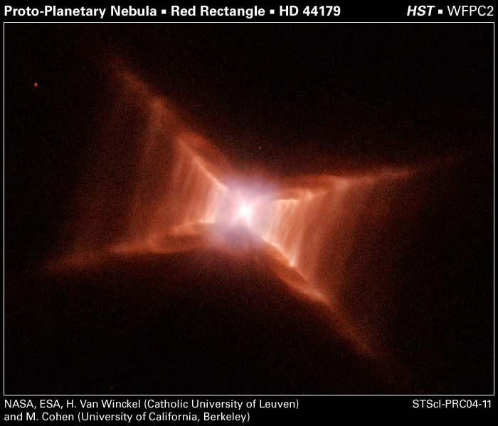
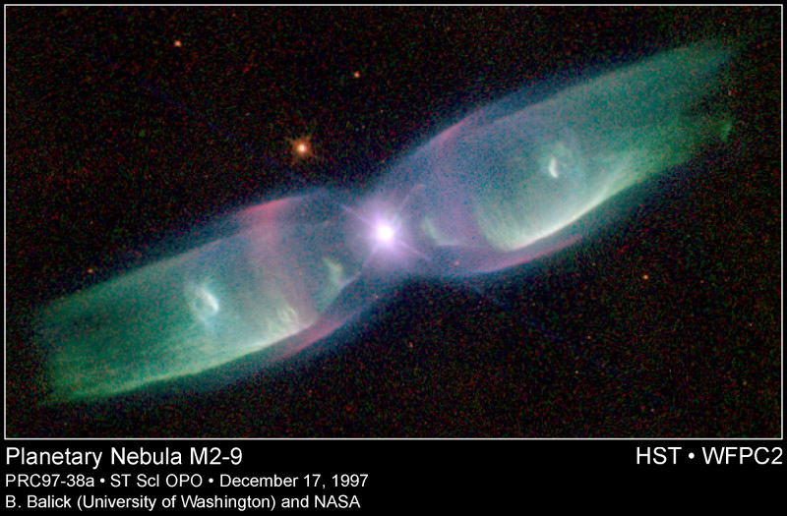

Slide 36
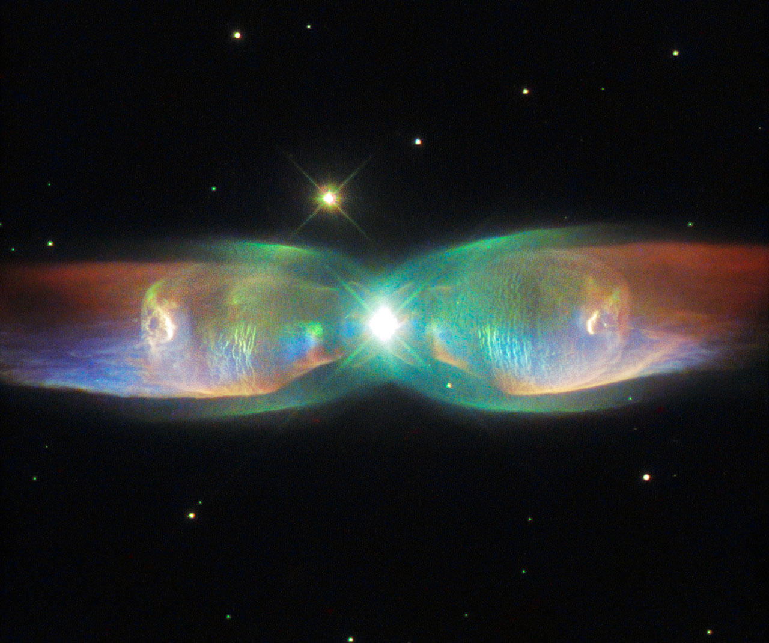
Stunning new Hubble view of M2-9 Twin Jet Nebula which exploded 1200 years ago
Image credit: ESA/Hubble/NASA

Slide 37
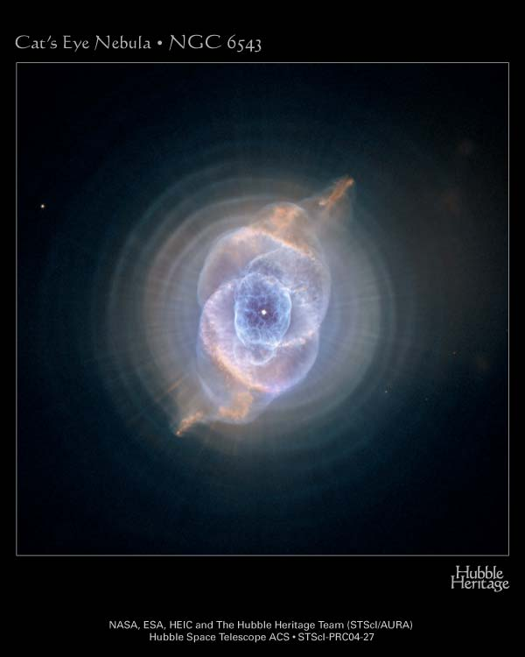
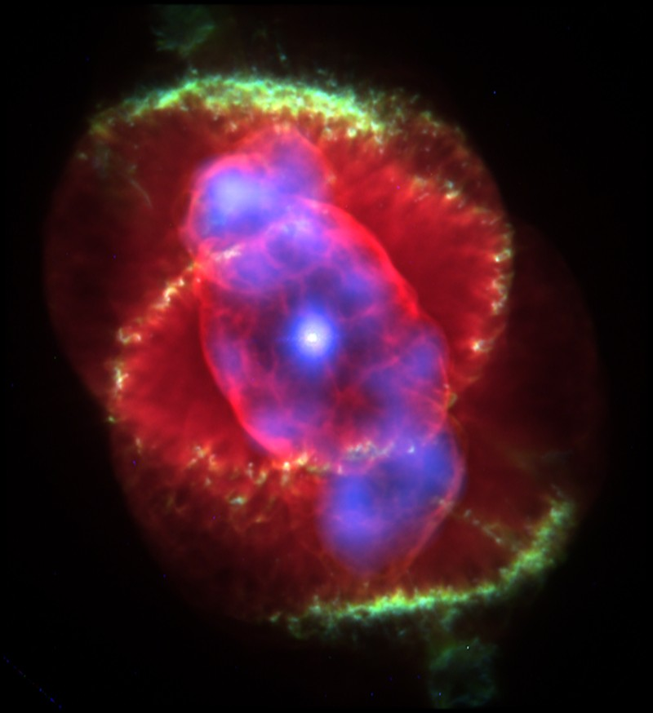
Cat’s Eye nebula composite Hubble and Chandra Xray photo
Red ionized H and N. Green is O
Blue is hot gas emitting Xrays
Cat’s Eye Planetary Nebula 3300 Lys away in Draco. Mysterious and complex structure

Slide 38
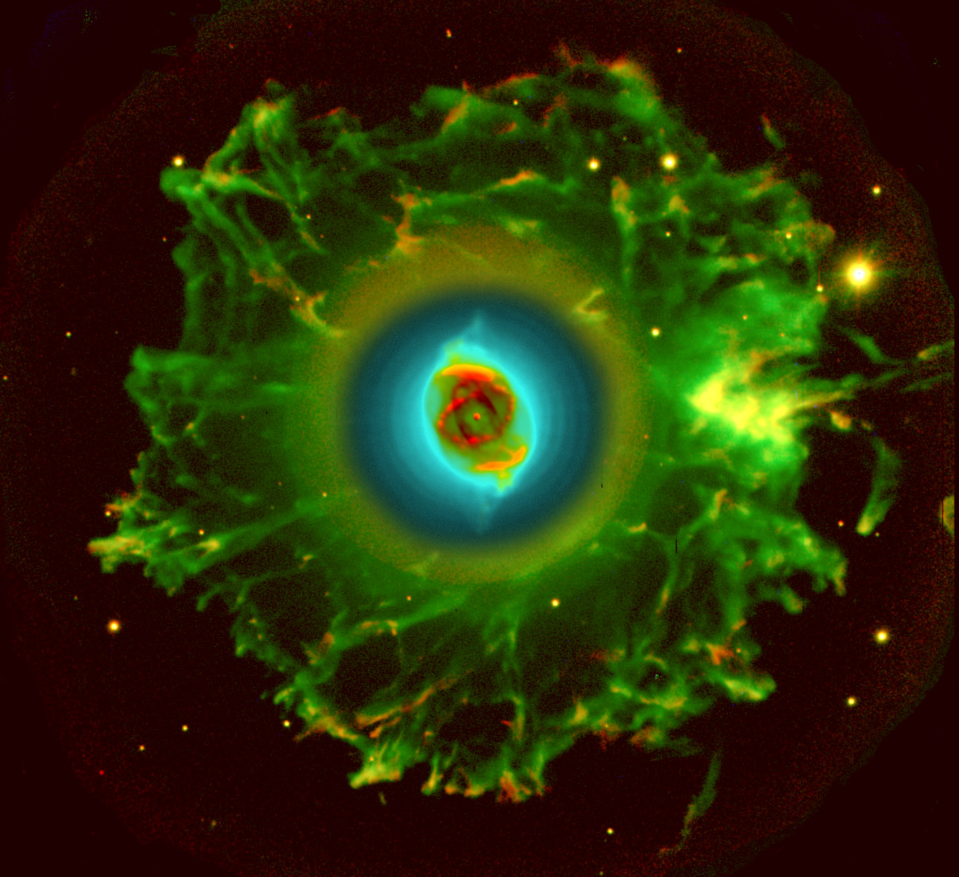
Haunting symmetry of the halo of gas surrounding the Cat’s Eye Nebula NGC 6543
False color image to show the extremely faint gases in the halo of this exploded star.
Green is Oxygen. Red is Nitrogen.
Image credit: R. Corradi and D. Goncalves
Halo of the Cat’s Eye Nebula is over 3 Lys across

Slide 39
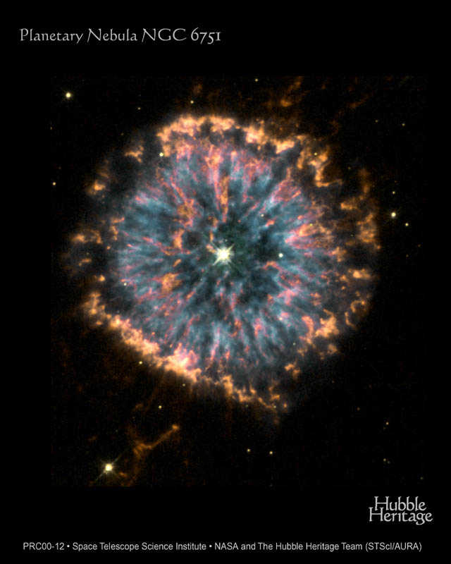
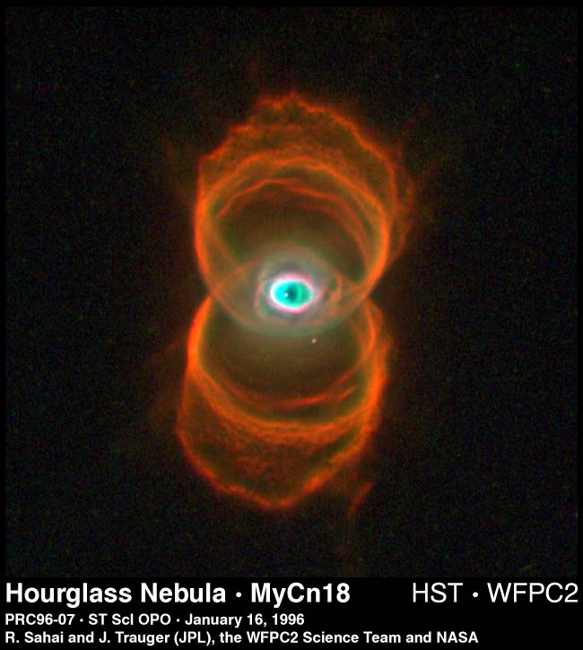
Planetary Nebula in Aquila 6500 LYs away and 0.8 LYs in diameter
The “Eye of God” looks back from 8000 LYs away in the southern constellation Musca

Slide 40
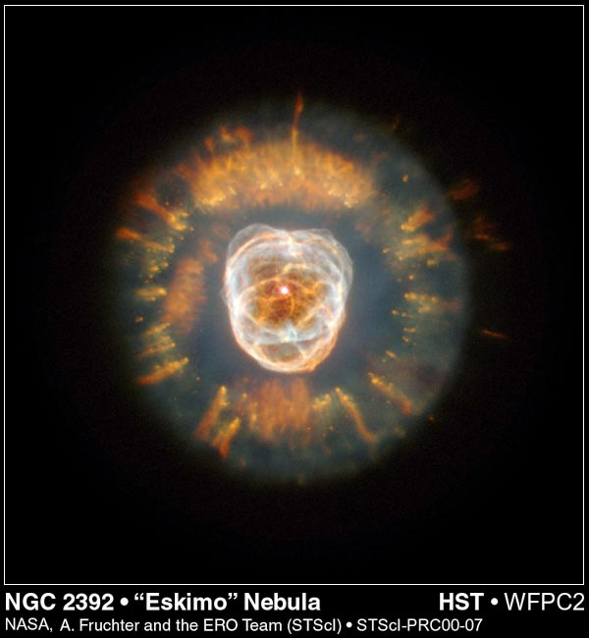
Eskimo Nebula
2870 LYs away in Gemini
A bipolar, double shelled planetary nebula discovered by William Herschel in 1787
The outer disk contains unusual light-year long orange filaments.

Slide 41
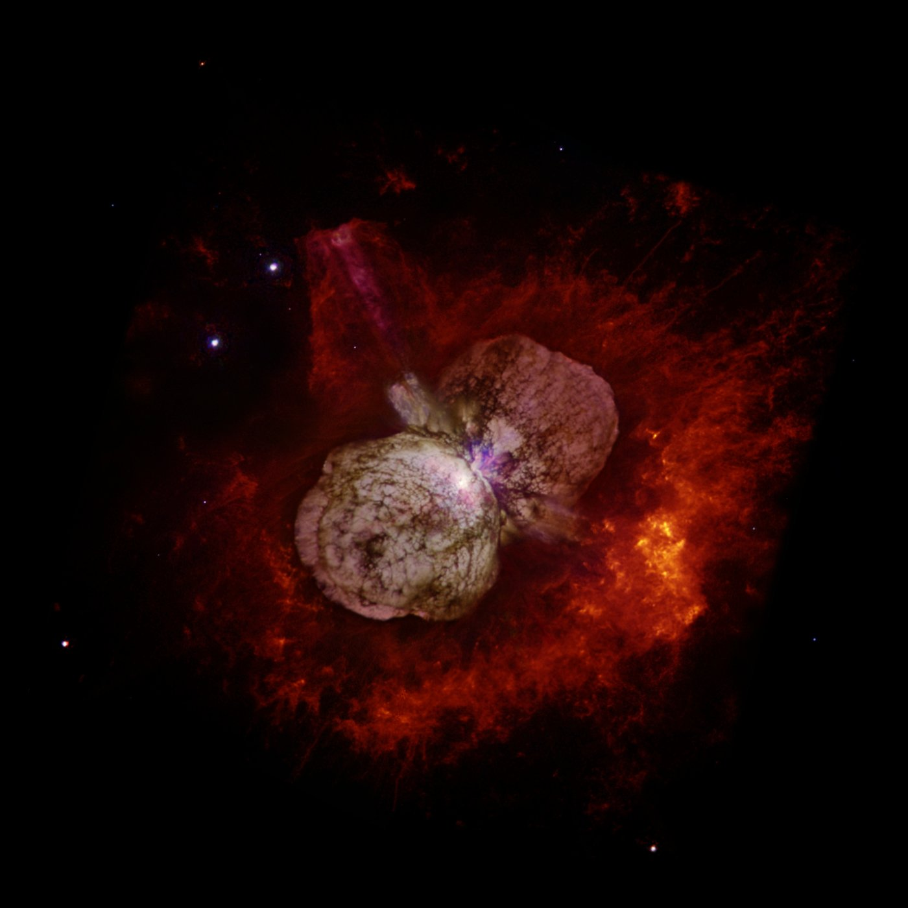
Homunculus Nebula first seen on Earth in 1840 is 7500 LYs away and lies within the Eta Carinae Nebula in the Southern constellation Carina.
The Homunculus Nebula was created in an explosion of two massive stars-30 and 90 times our suns mass.
Recent studies show the nebula accelerates particles to near light speed and creates large numbers of cosmic rays.

Slide 42
Planetary Nebula
Exploding Stars
Hubble Photo Gallery

Slide 43
Monocerotis Red Supergiant star goes Nova Jan 02
20,000 LYs away
13.7 LYs across the gas cloud
4000 times brighter than normal explosion causes flashbulb like “light echo” progressively illuminating new layers of gas shells as the light moves outward

Slide 44
Crab Nebula
Located 6,500 LYs away in Taurus
10 LYs across
Supernova explosion in 1054 AD recorded by people in Japan, China, North Korea, and Americas
Visible in broad daylight for months before fading away

Slide 45
Crab Nebula
Composite photo combining Hubble and Herschel telescope images
Hubble visible light filters looking for Oxygen and Sulfur.
Herschel far infrared shows dust in red color

Slide 46
Cassiopeia A
Supernova exploded about 1666 AD
10,000 LYs away and 13 LYs across
Mysteriously, no mention of this massive star’s Supernova explosion in history

Slide 47
Supernova remnant W49B may contain the most recent black hole formed in the Milky Way galaxy. This 2013 image combines X-rays , radio telescope , and IR data. W49B is a thousand years old, as seen from Earth, and is at a distance about 26,000 light years away.

Slide 48
Plaque on Pioneers 10 and 11. Launched 1972-73.
First spacecraft to Escape the Solar System

Slide 49
Ah, but a man’s reach should exceed his grasp…
Or what’s a Heaven for?
Robert Browning

Slide 50
“When I consider Your heavens, the work of Your fingers, the moon and the stars, which you have set in place, what is man that you are mindful of him, the Son of Man that you care for him?.”
You can view video and slides for this lecture at my website
frankbuzzard.com
Psalm 8:3-4

