Slide 1
Wonders of our Universe
Part 3
Our Solar System
The Sun and Rocky Planets
Presented by Frank Buzzard
Space Shuttle and International Space Station Chief Engineer (NASA retired)

Slide 2
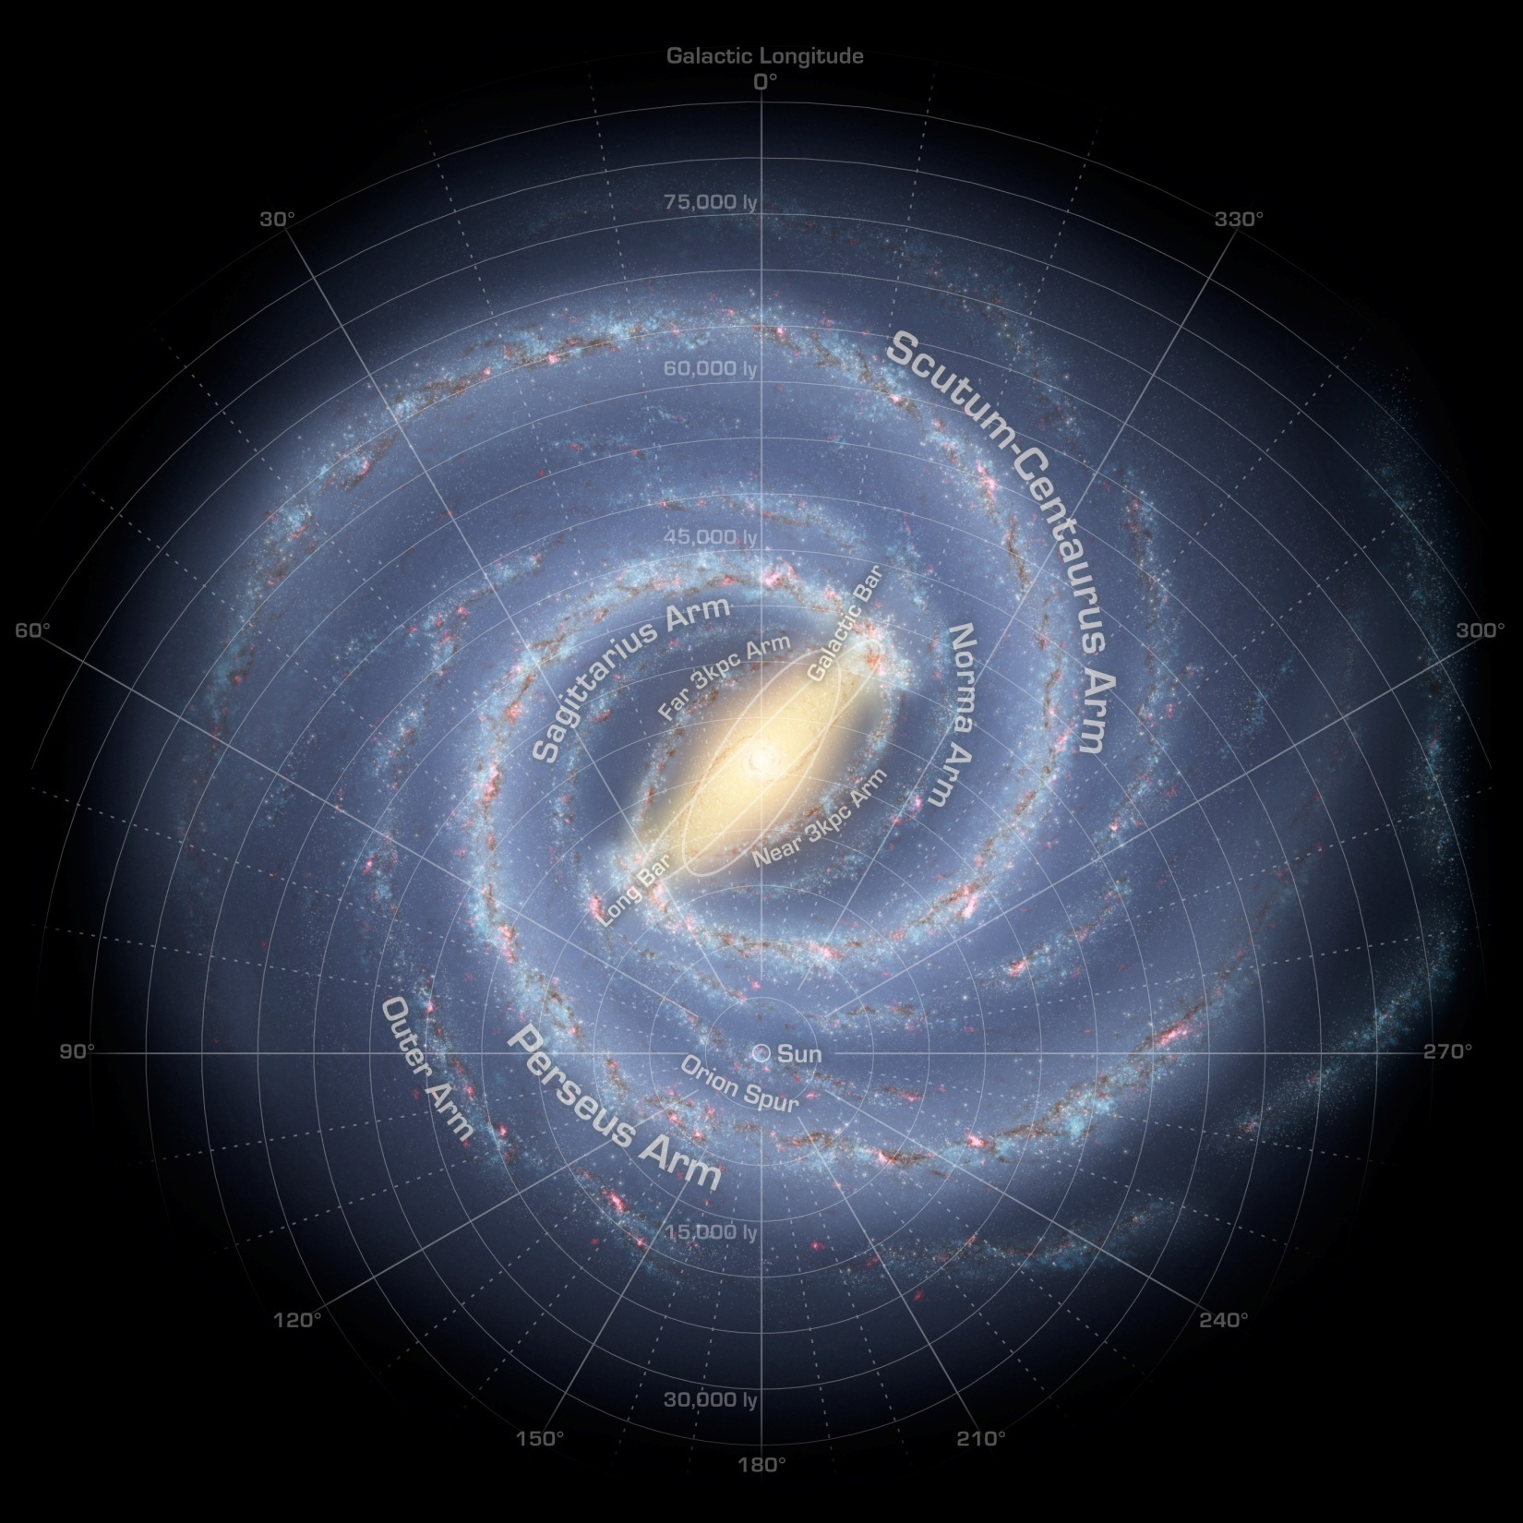
How our Milky Way Galaxy might look to an outside observer

Slide 3
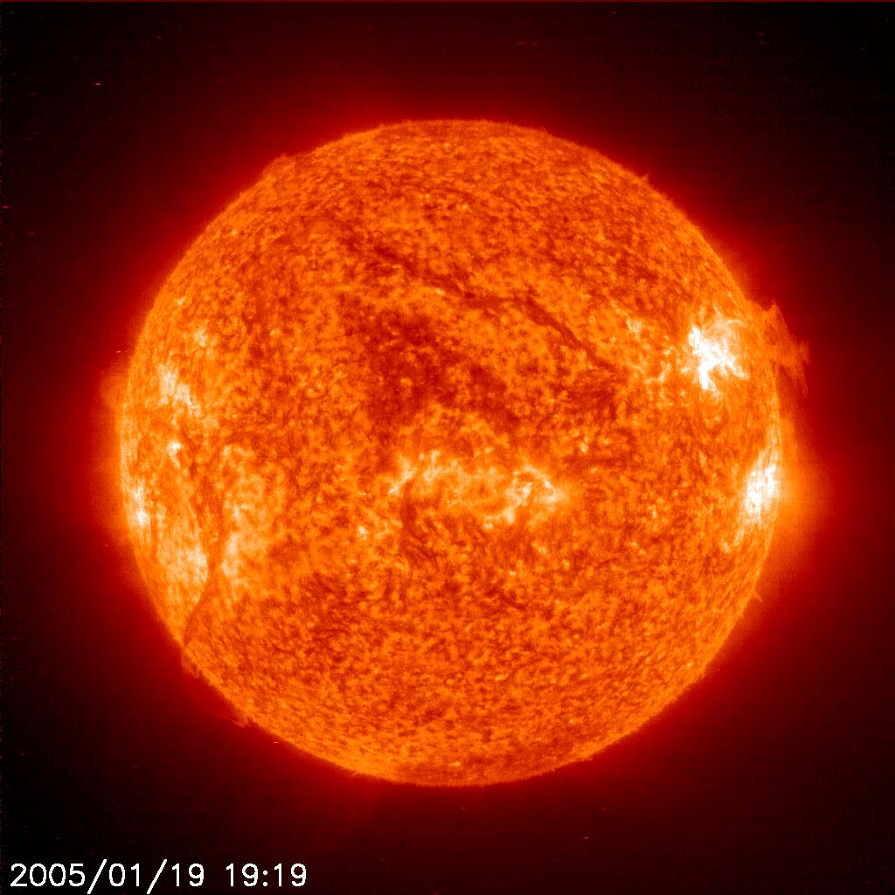
Our Sun dominates our solar system with a
diameter of 1,392,000 km/ 863,040 mi or 109 times that of Earth, and its mass of 2×10³⁰ kilograms-- 330,000 times that of Earth--accounts for 99.86% of the total mass of the Solar System. The sun is 75% H2 and 23% He. Surface temperature is 5500 C/9932 F. Our sun rotates in 26 days at the poles and 34 days at the equator.

Slide 4
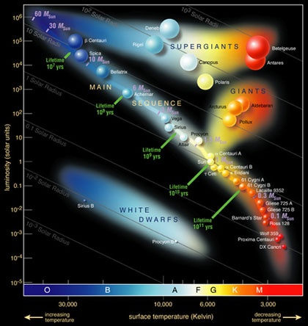
Stars evolve based on initial mass and luminosity
Hertzsprung–Russell diagram 1910 was a major step forward in understanding stellar evolution. They compared Spectral class (temperature and mass) to Luminosity (Brightness). The Main Sequence is where stars spend most of their lives.
Our Sun

Slide 5
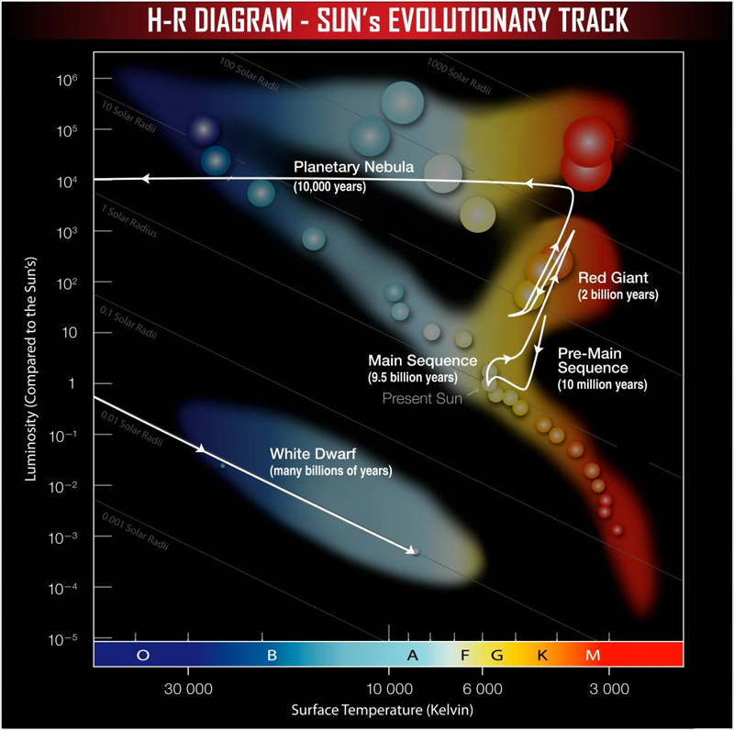
Our Sun will evolve to a Red Giant and White Dwarf

Slide 6
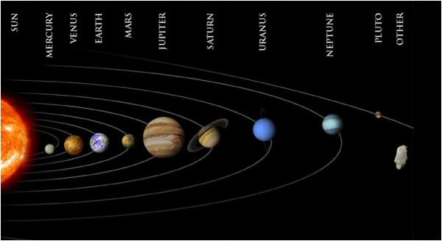
Our Solar System
Not to distance scale

Slide 7
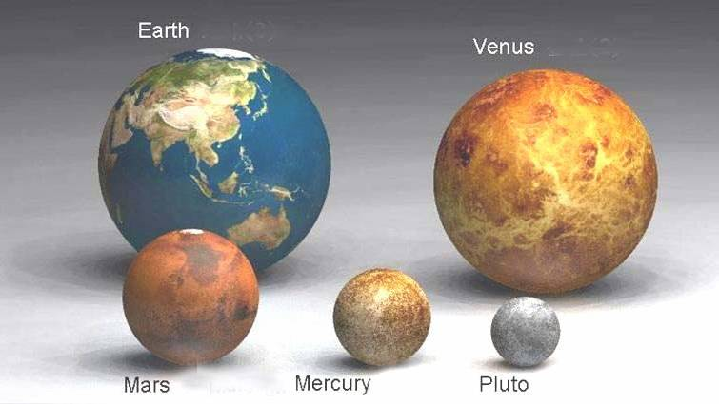
Now let us look at relative sizes of planets. The Rocky or Terrestrial Planets.

Slide 8
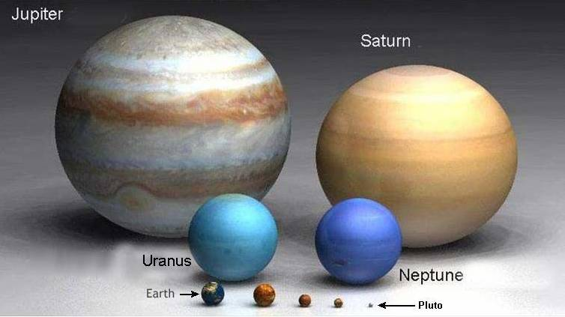
Now the Gas Giants vs Rocky Planets

Slide 9
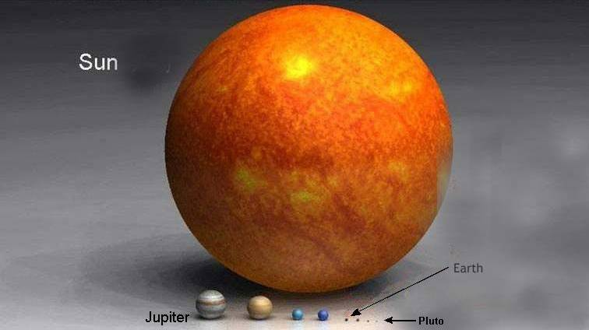
Now the Sun versus our Planets

Slide 10
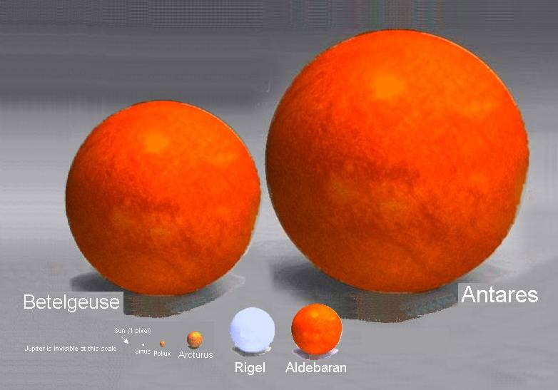
Now our Sun versus other stars
Antares is 550 light years away. 15th brightest star in the sky.

Slide 11
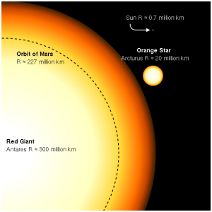
How Big is Antares versus our Solar System?
Antares, brightest Star in Scorpio, puts out 60,000 times the energy of our sun. Antares is 17 more massive with a radius 883 times greater than our sun

Slide 12
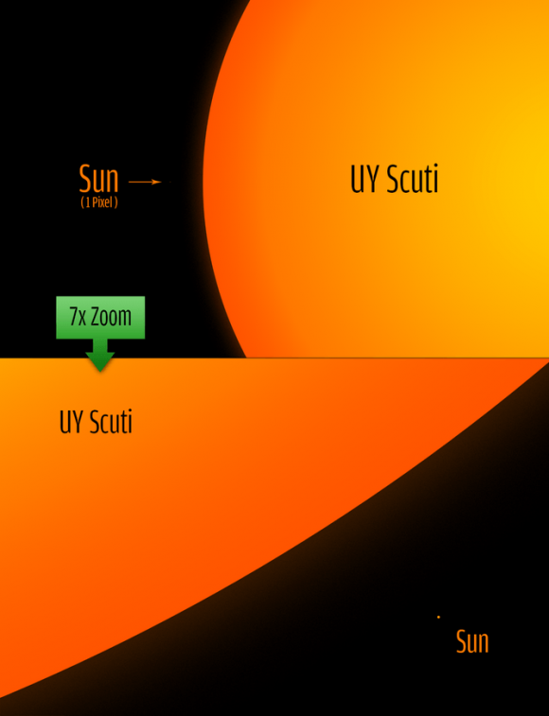
The largest star found to date is 9000 LYs from Earth. UY Scuti is 30 times more massive and 1700 times our sun’s radius or 9 AU. The surface of UY Scuti would extend almost to Saturn (9.5 AU) in our solar system. Now that is a
BIG STAR!!!
Image credit: Phillip Park

Slide 13
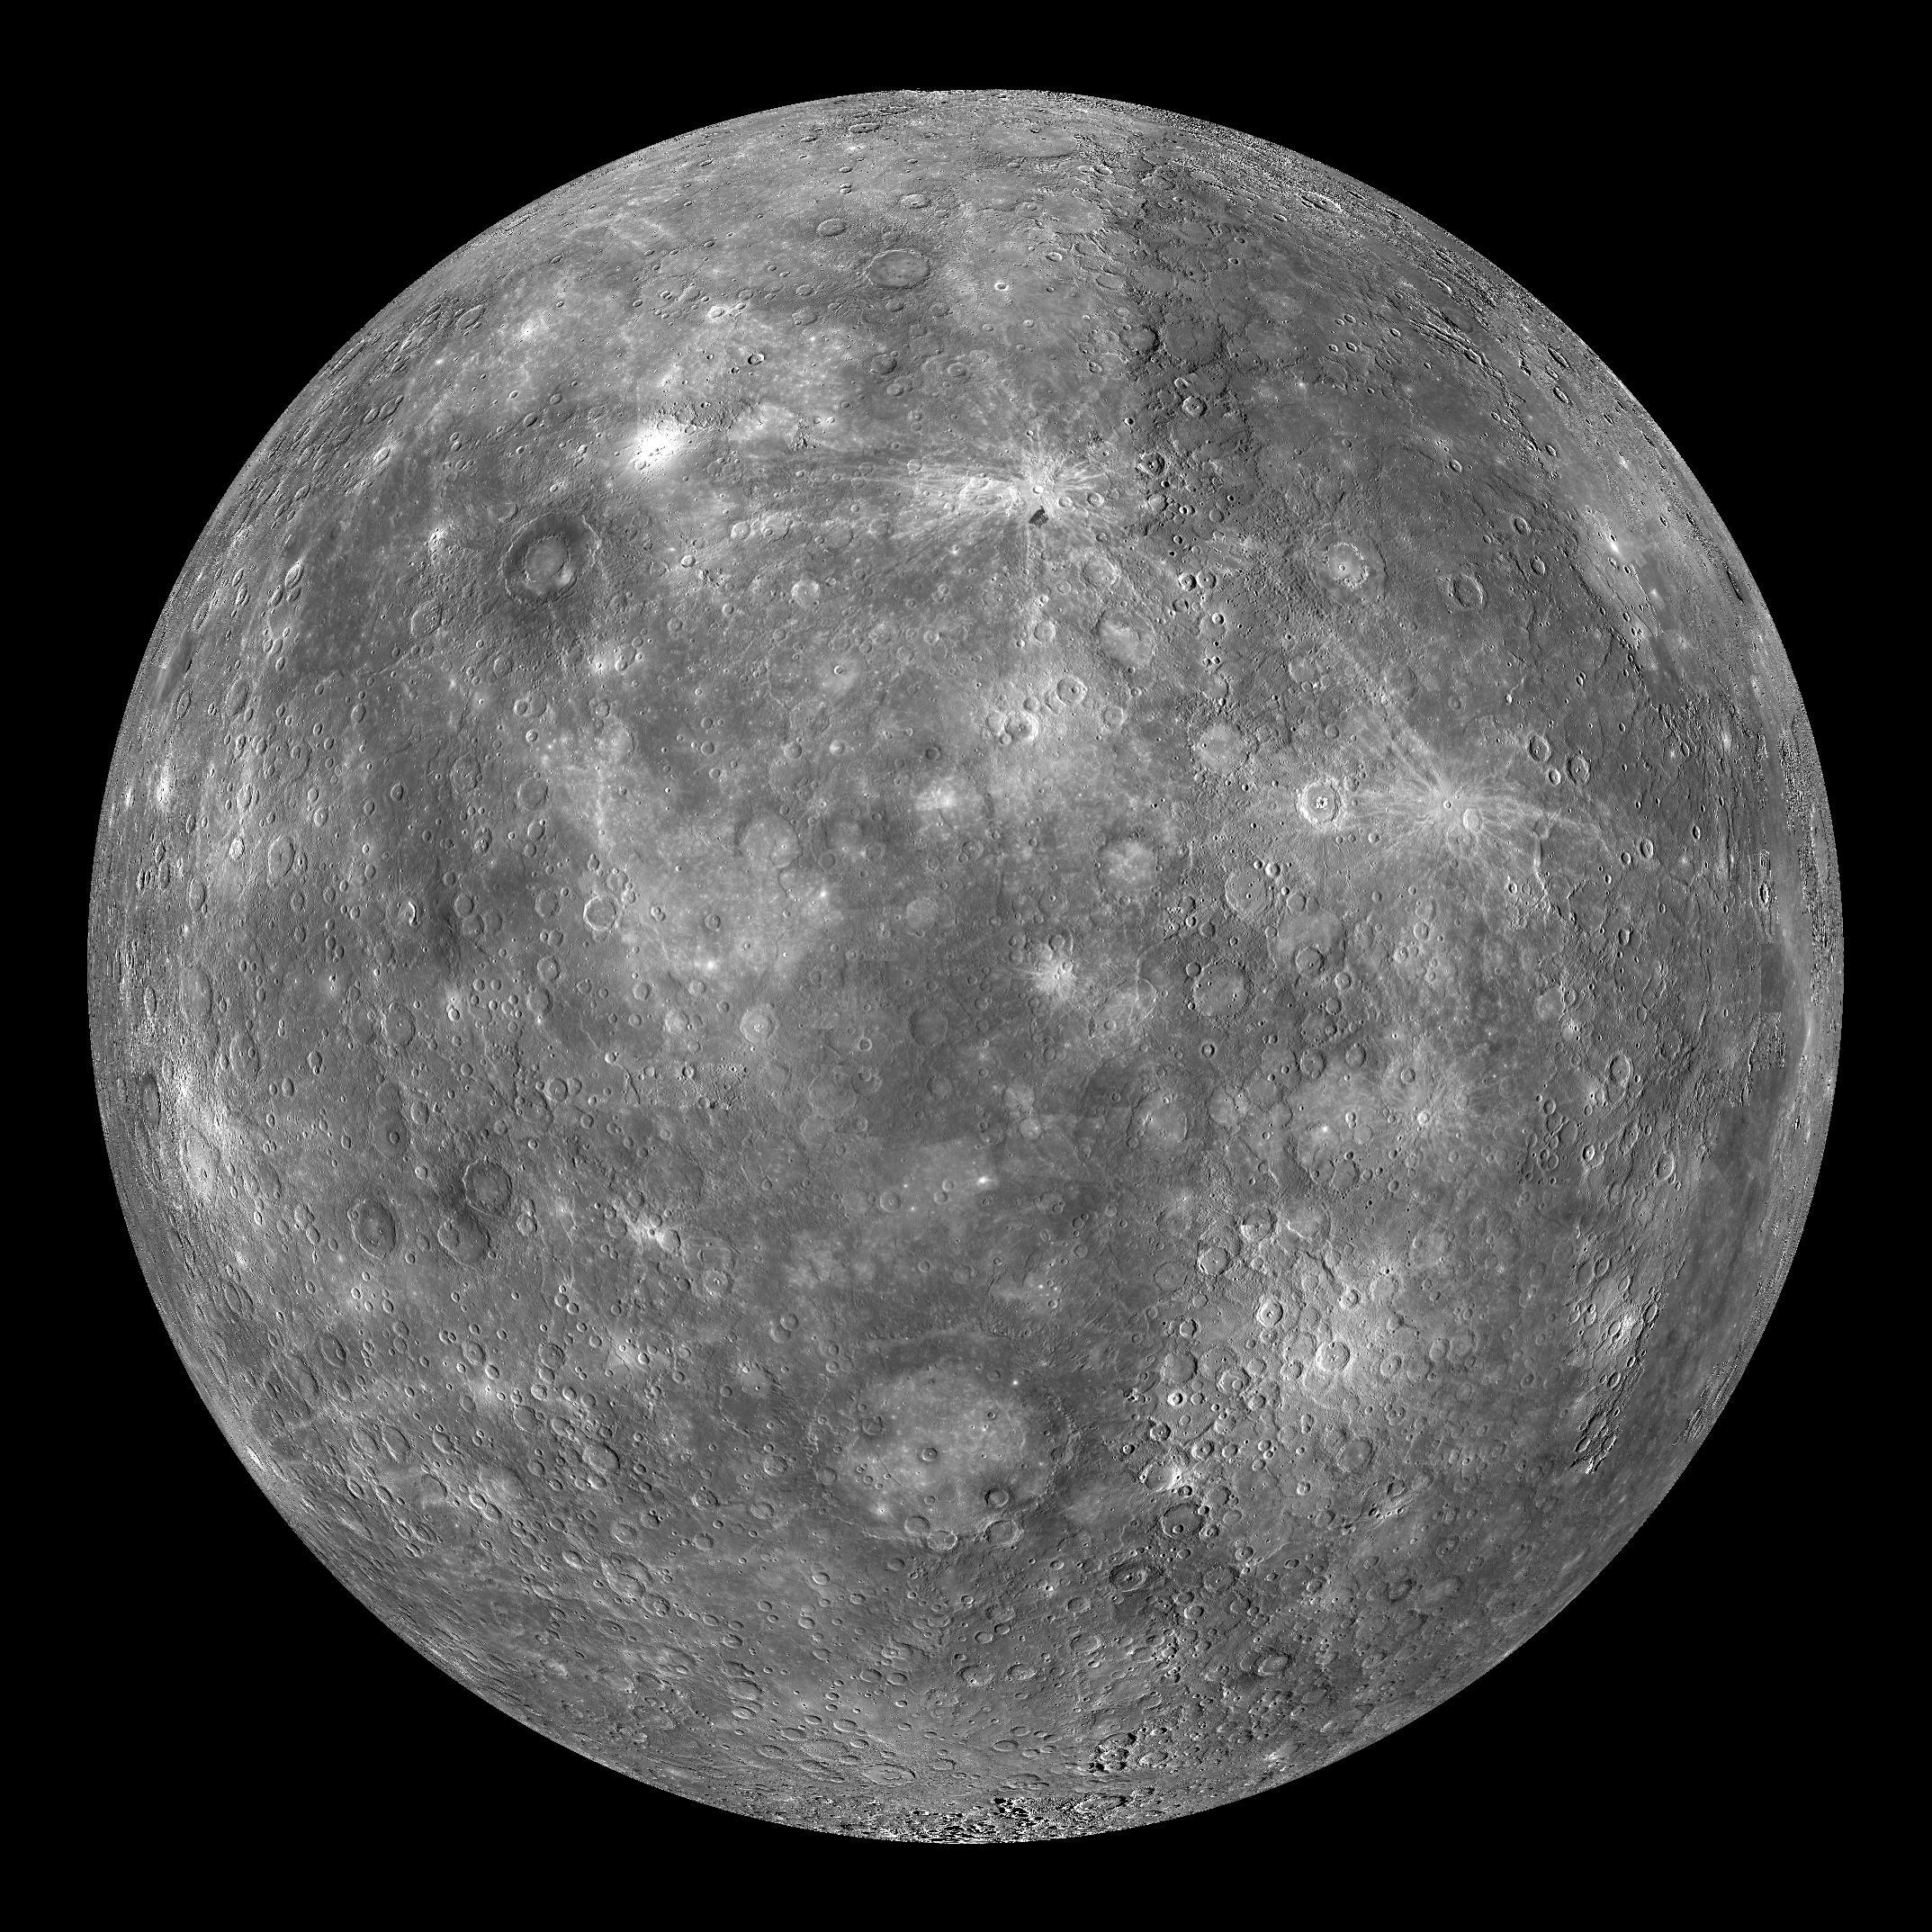
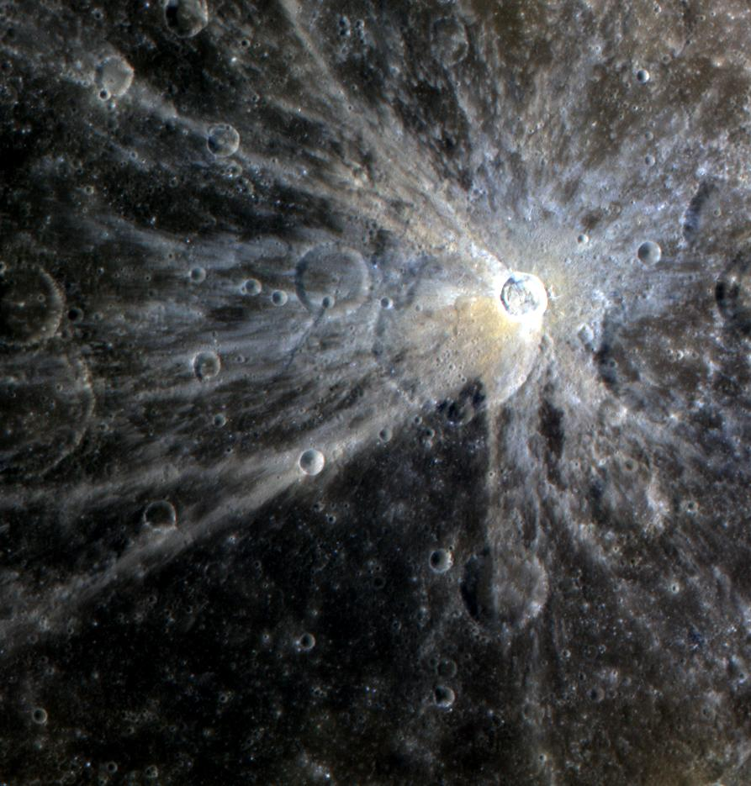
Mercury orbits the sun every 88 days at 1/3 Earth’s distance to the sun. Mercury rotates 3 times for every two orbits. Mercury is exceptionally dense-5.4g/cm3-with a large iron core and small magnetic field about 1% of Earth’s
Mena Crater

Slide 14
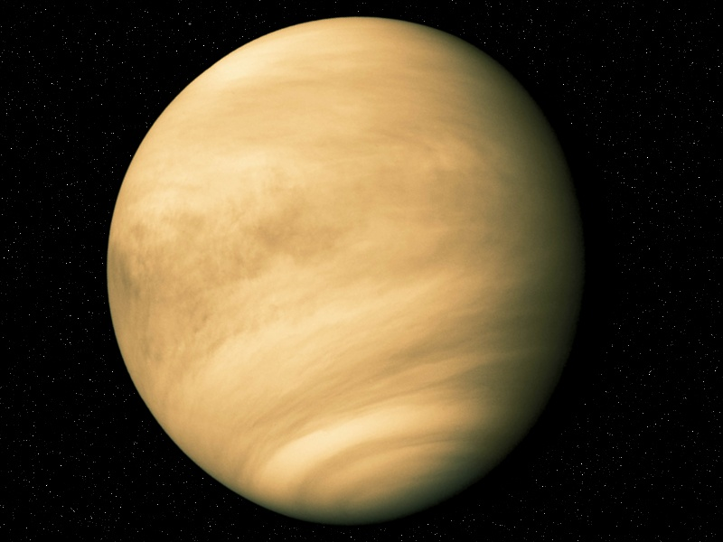
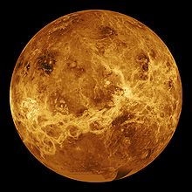
Venus our second planet is Earth’s near twin in size and mass.
But Venus’ CO2 atmosphere is 92 times higher pressure than Earth and her 860 deg F surface temperature would melt lead. Venus orbits in 225 days at ¾ Earth’s distance from the sun. Venus’ unusual retrograde rotational period is 243 days. Venus’ thick sulphuric acid clouds obscure the surface.
Visible light image
Radar surface image

Slide 15
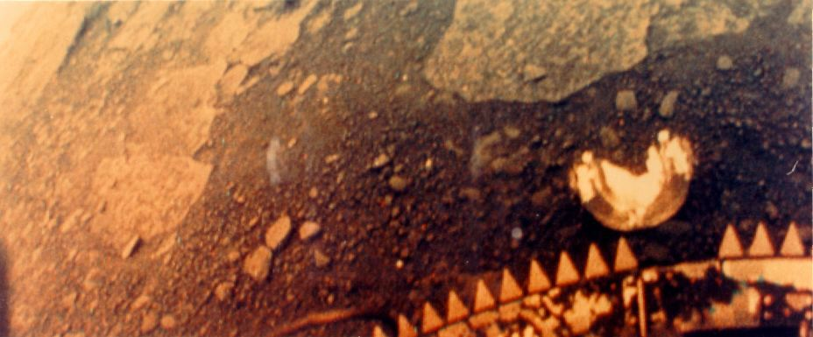
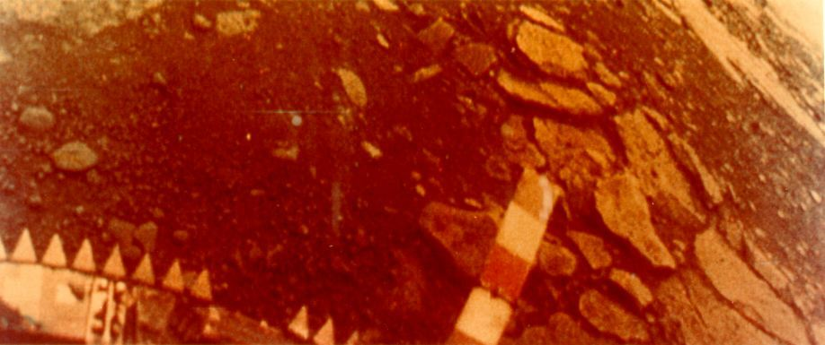
Venus surface taken by Russian Venera 13 landed March 3, 1982

Slide 16
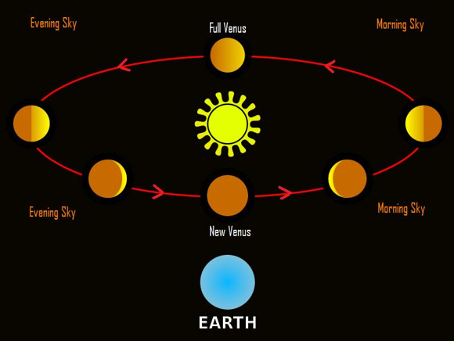
Venus exhibits “phases” like our moon as it orbits the sun inside Earth’s orbit. Venus reaches maximum brightness 36 days prior to inferior conjunction at magnitude -4.9. That is 25 times brighter than the brightest star Sirius.
Superior Conjunction
Inferior Conjunction

Slide 17
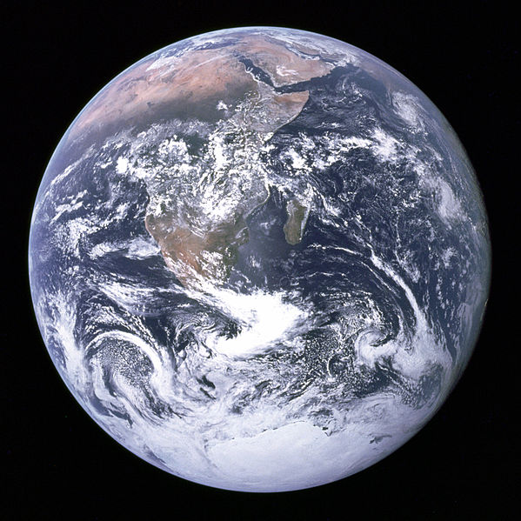
Earth is largest (dia 12742 km/7900 mi) of the four terrestrial planets orbiting the Sun every 365.26 days at a speed of 29.78 km/s or 66,469 mph at a distance of 93 million miles or 1 Astronomical Unit AU. Earth’s axis is tilted 23.5 deg causing our seasons. Our atmosphere is 78% N2 and 21% O2 with a surface temperature (average 14 C or 57 F) that allows liquid water. Earth is believed to be 4.54 BYrs old.

Slide 18
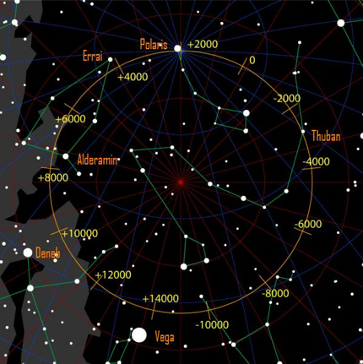
Earth’s rotation axis wobbles like a top.
The 26,000-year precession cycle causes the north celestial pole to move counter-clockwise in front of the backdrop of stars at about one degree every 72 years.

Slide 19
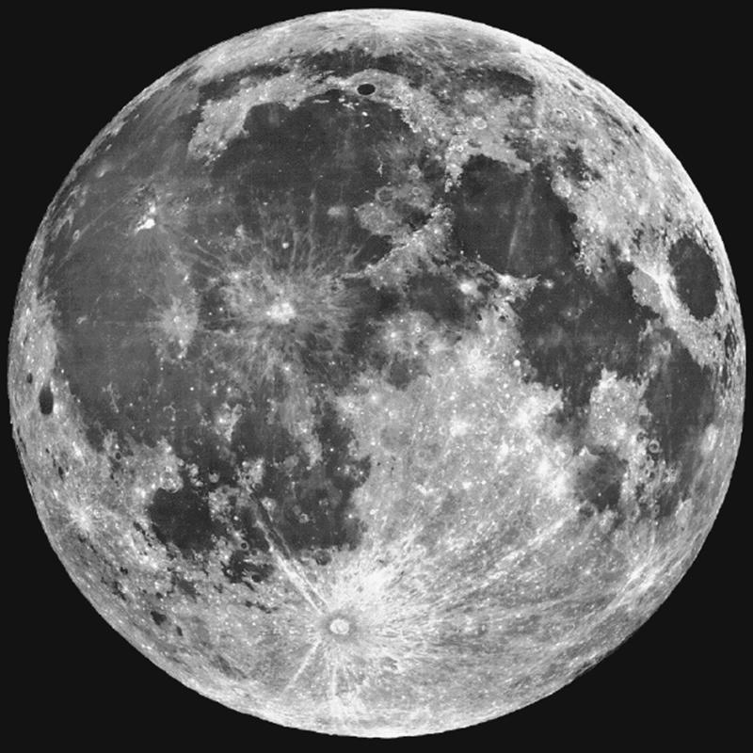
Our Moon is ¼ the Earth’s diameter (3474 km/2154 mi) , 1/81 Earth’s mass, and orbits Earth every 29.53 days at an average distance of 238,400 miles. Our moon is believed to have formed 4.52 billion years ago after a Mars sized object (Theia) struck the Earth a glancing blow exploding huge amounts of Earth’s crust into orbit forming the Moon.
Gravitational interaction of the Moon with Earth causes ocean tides, stabilizes our axial tilt, and gradually slows Earth’s rotation.

Slide 20
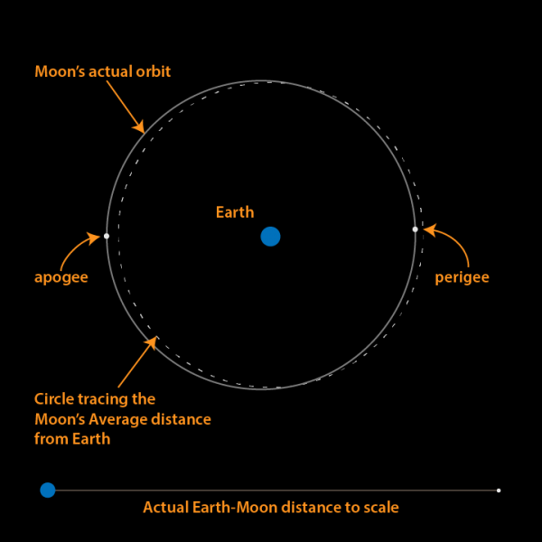
The Moon’s orbit is an ellipse, not a circle.
A super moon occurs when the moon is closed to Earth at perigee 221,958 miles or 357,207 km.
The smallest apparent diameter of the moon occurs when the moon is farthest from Earth at apogee 252,651 miles or 406,603 km
The average orbital distance of the moon is 238,855 miles or 384,400 km
diagram credit:
Brian Koberlein

Slide 21
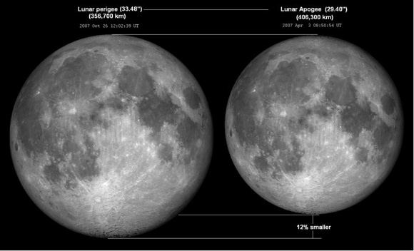
apparent diameter of the moon at perigee—Supermoon—and apogee

Slide 22
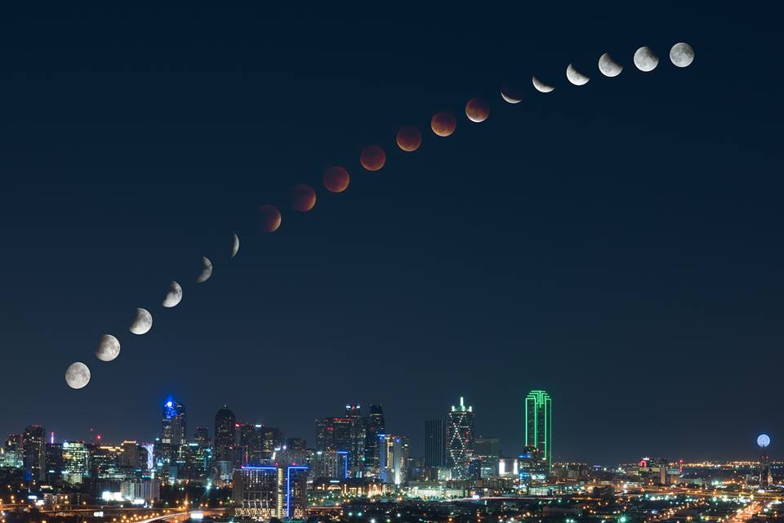
Lunar Eclipse over Dallas September 27, 2015
Photo Credit: Mike Mezueul-mikemezphotography.com

Slide 23
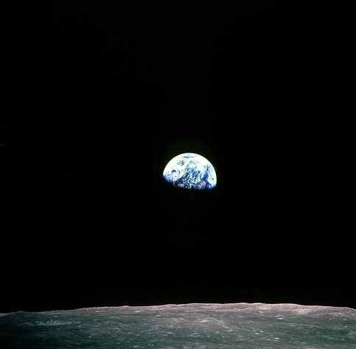
Earthrise seen from Apollo 8 lunar orbit.
A view that forever changed our perception of “Mother Earth”

Slide 24
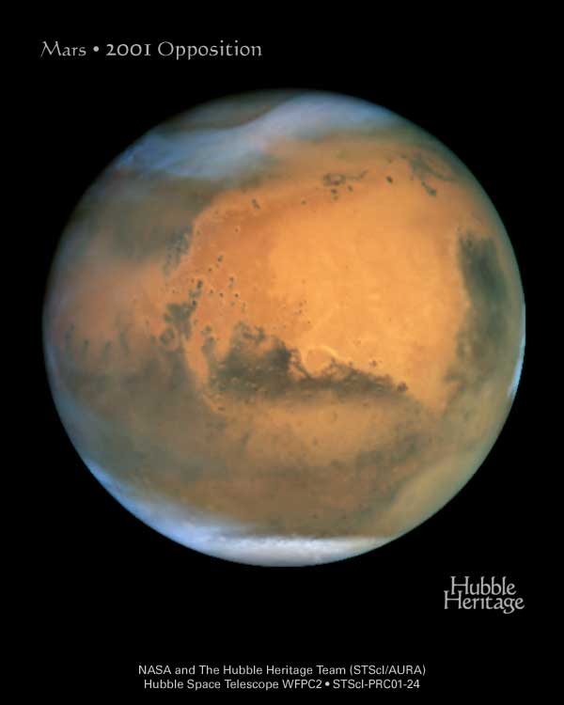
Mars is ½ the radius of Earth orbiting the sun in 1.881 years at 1.38-1.67 AU with a 24.62 hour rotation and 25.3 deg tilt. Mars surface gravity is 0.38 g.
Mars red color is iron oxide. Mars permanent polar caps are water ice with a thin layer of frozen CO2. Mars atmosphere is 95% CO2 equivalent to 100,000 feet Earth pressure (6-10 mbar Mars surface vs Earth 1015 mbar ). Liquid water does not exist at this low pressure. Surface temperature ranges from 80 deg F at equator to -200 deg F at poles. Air temp rarely exceeds 32 deg F.

Slide 25
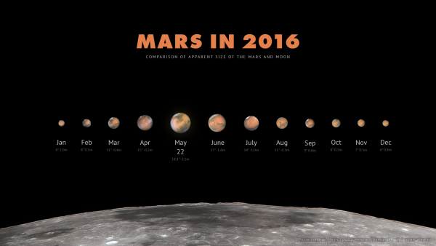
The apparent size and brightness of Mars changes dramatically when Earth and Mars are on the same side of the Sun in Opposition
Photo credit: Mikhail Chubarets

Slide 26
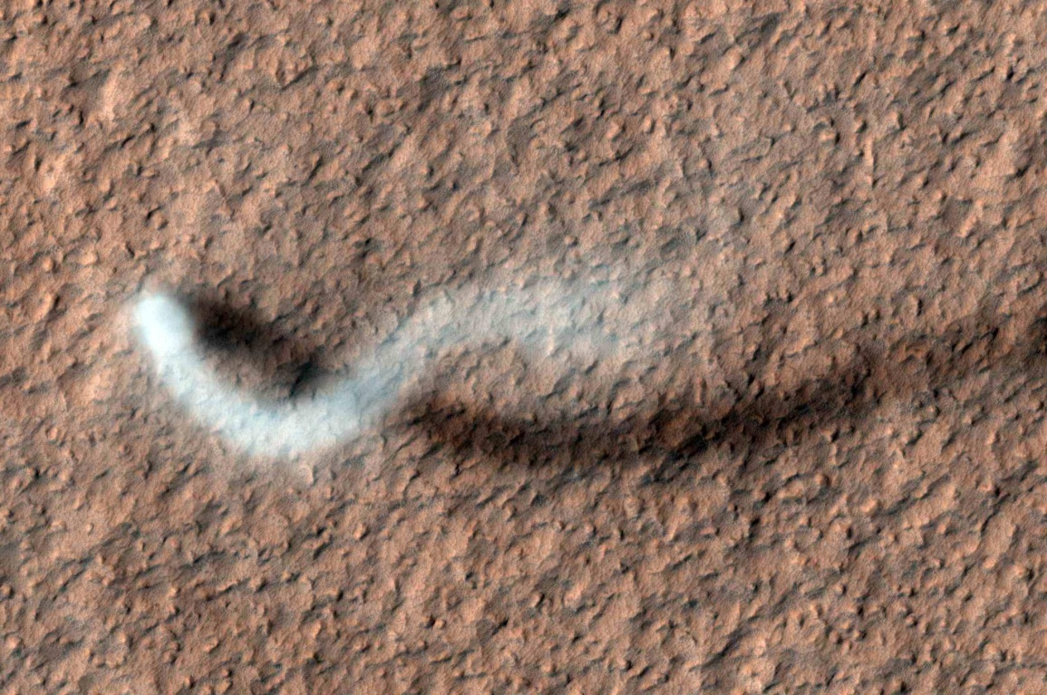
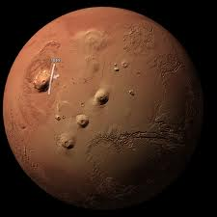
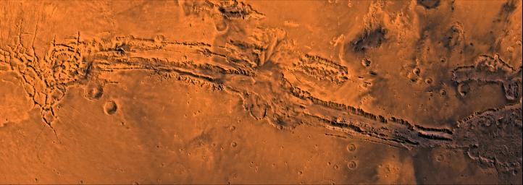
MRO captures a dust devil on Mars more than half-a-mile (800 meters) tall
Olympus Mons shield volcano. 82K ft tall. And 340 mi wide. Also the Tharsis region 3 volcanoes which are antipodal to Hellas Impact Basin
Valeris Maneris. As wide as USA. 6 times deeper than Grand Canyon

Slide 27
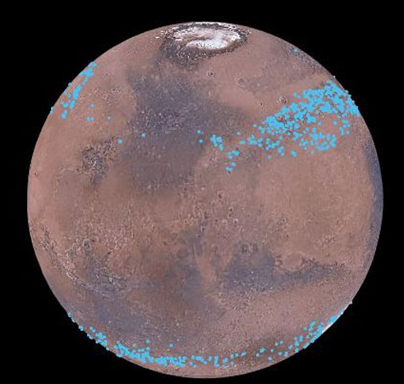
Mars has ice glaciers covered with thick dust
Recent analysis of MRO radar data shows water ice glaciers hidden under thick dust layers on Mars. Enough ice to cover Mars with a one meter thick ice coating!
Image Credit:
NASA/Nanna Karlsson/NBI

Slide 28
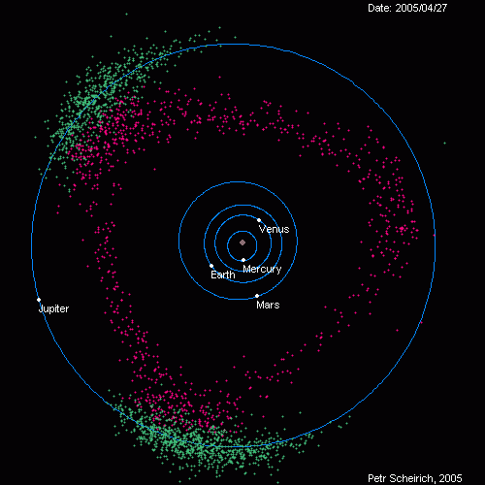
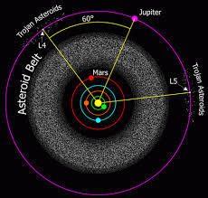
Between Mars and Jupiter is the Asteroid Belt
A planet should be here, but Jupiter’s gravity kept it from forming

Slide 29
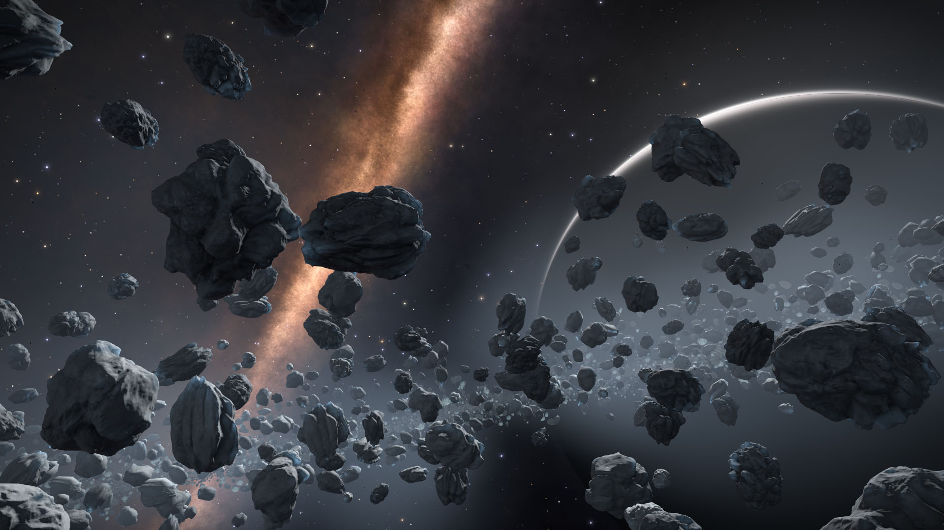
What the Asteroid Belt might look like

Slide 30
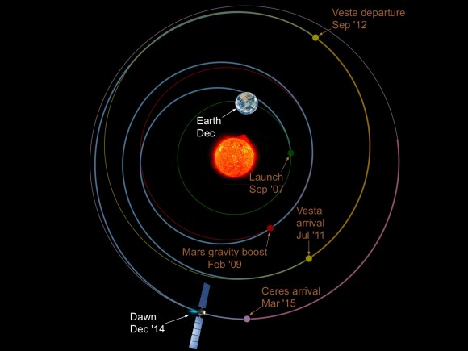
NASA’s Dawn Spacecraft is exploring Vesta and Ceres in the Asteroid Belt

Slide 31
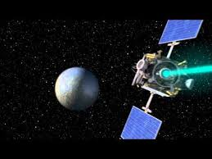
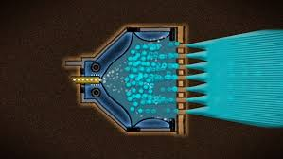
Dawn’s High Efficiency Ion Thruster
Dawn’s ion or plasma thrusters use 10 kw of electricity to accelerate Xeon atoms producing .02 lb (.090 N) thrust.
Ion propulsion is nearly ten times more efficient than chemical propulsion
Continuous low-thrust shortens orbital transfer times
Image credits: NASA

Slide 32
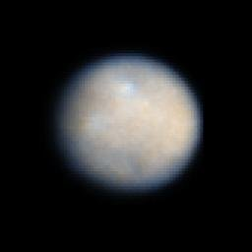
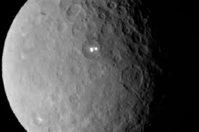
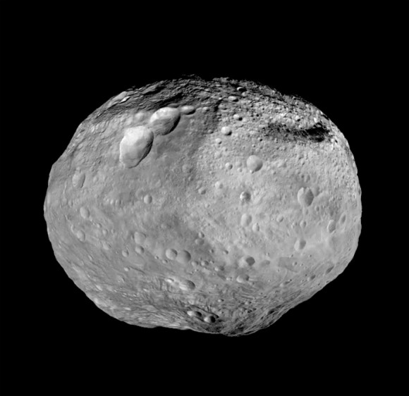
Ceres is the largest asteroid
609 mi (974 km) dia at 2.77 AU
Ceres Hubble photo 2004
Dawn discovers twin bright spots in Ceres crater
Vesta is the second largest asteroid
331 mi (530 km) dia at 2.1 AU
Dawn Spacecraft arrived at Vesta in July 2012 and left August 2012 for Ceres arriving in February 2015
Image credits: NASA/JPL

Slide 33
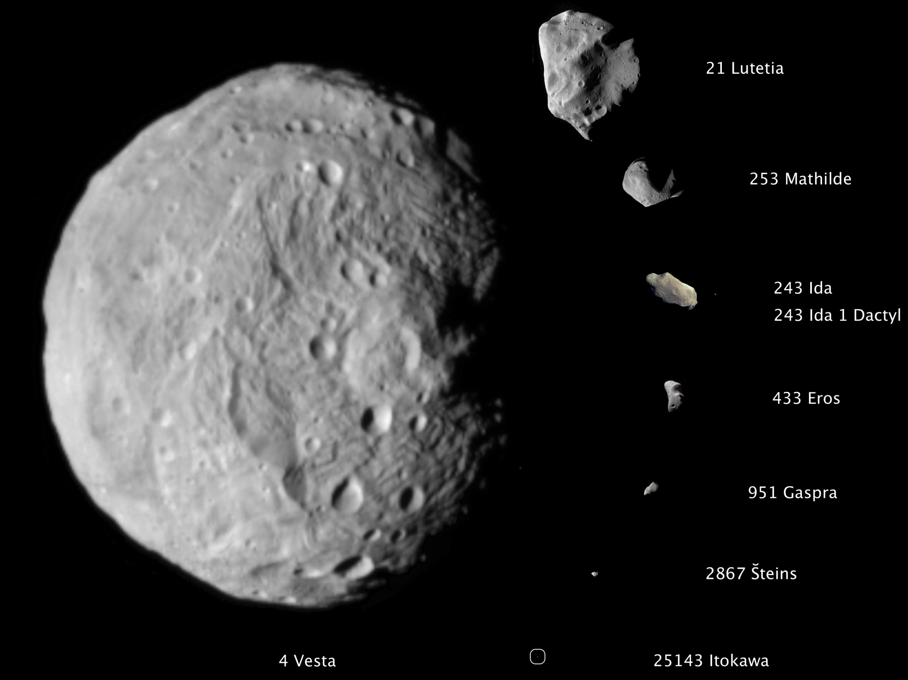
Vesta’s Gravity makes it circular in shape
Smaller asteroids have irregular shape

Slide 34
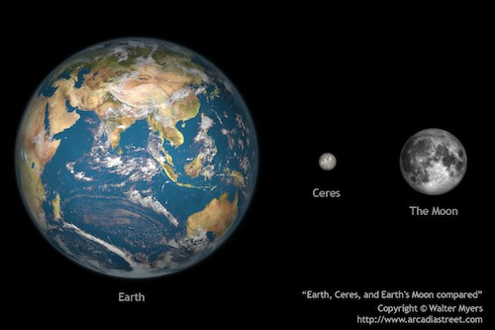
Ceres is much smaller than Earth and our Moon

Slide 35
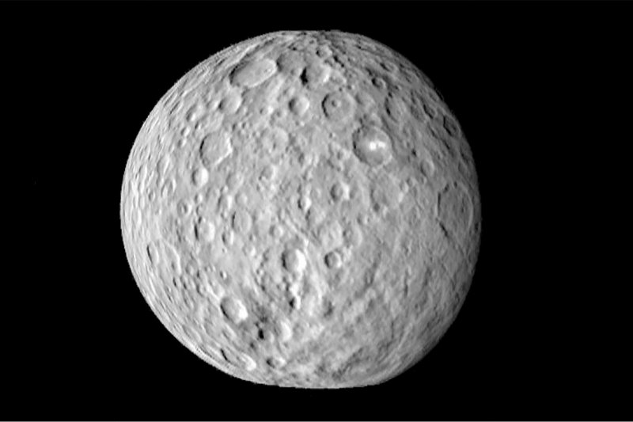
Ceres is Heavily Cratered

Slide 36
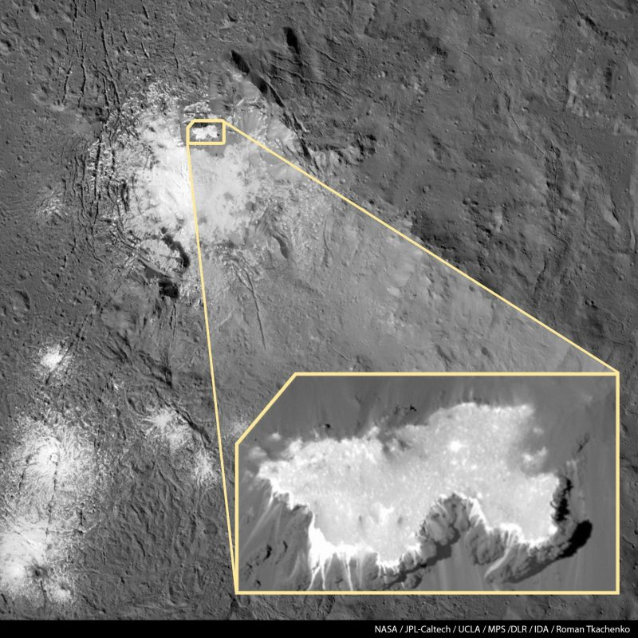
Ceres’ mysterious white spot identified as Sodium Carbonate-Na2CO3

Slide 37
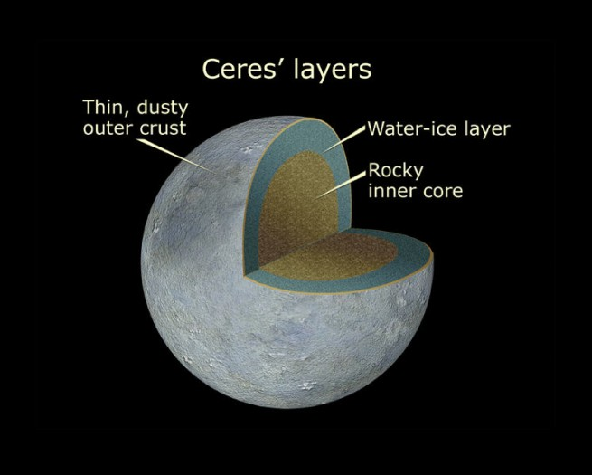

Slide 38
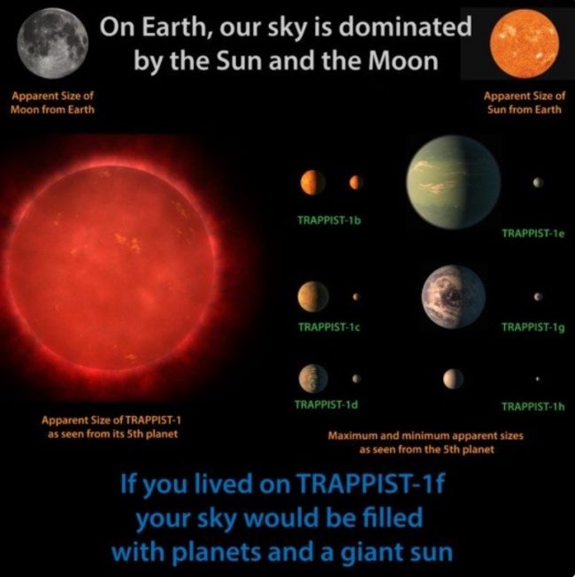
TRAPPIST-1 is a planetary system 39 light years from the Solar system within the constellation Aquarius. The central star is a white dwarf 12 times less massive than the Sun and only slightly larger than Jupiter. Three of the seven planets are rocky with sizes like Venus and Earth and are in the habitable zone where liquid water could exist.
Image Credit:
Brian Koberlein

Slide 39
“Praise the Lord from the heavens….
All His heavenly hosts….
Sun and moon….
All you shining stars.
Let them praise the name of the Lord,
for He commanded and they were created.
He set them in place for ever and ever.”
Psalms 148:1-6

