Slide 1
Wonders of our Universe
Part 4
Our Solar System
The Gas Giants and Beyond
Presented by Frank Buzzard
Space Shuttle and International Space Station Chief Engineer (NASA retired)

Slide 2
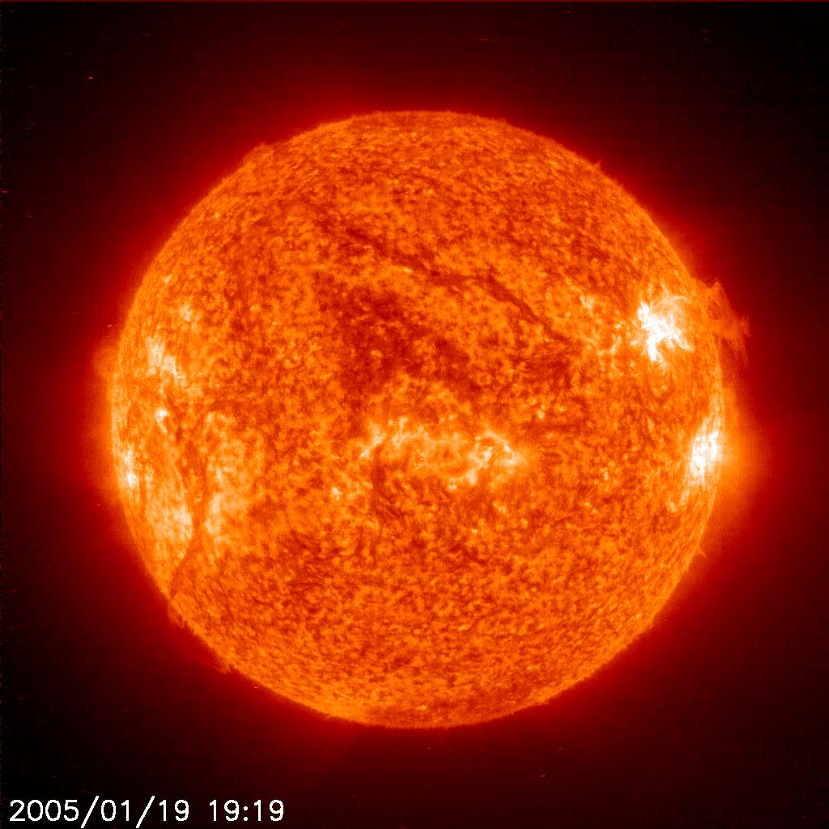
Our Sun dominates our solar system with a
diameter of 1,392,000 km/ 863,040 mi or 109 times that of Earth, and its mass of 2×10³⁰ kilograms, 330,000 times that of Earth) accounts for about 99.86% of the total mass of the Solar System. The sun is 75% H2 and 23% He. Surface temperature is 5500 C/9932 F. Our sun rotates in 26 days at the poles and 34 days at the equator.

Slide 3
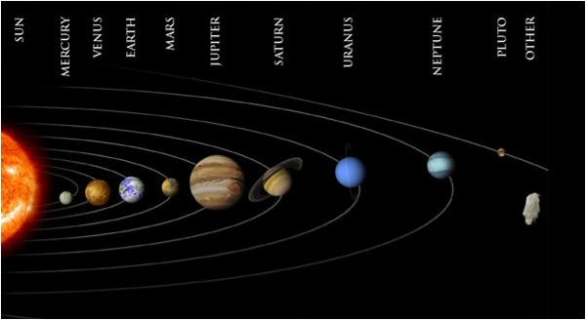
Our Solar System
Not to distance scale

Slide 4
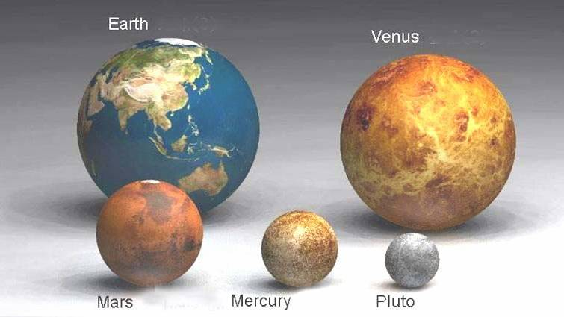
Let us look at relative sizes of planets Rocky or Terrestrial Planets

Slide 5
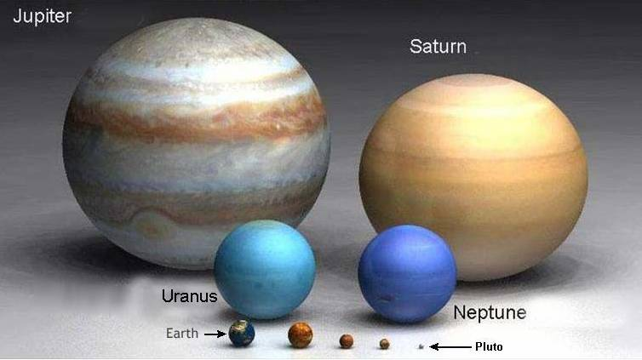
Now the Gas Giants vs Rocky Planets

Slide 6
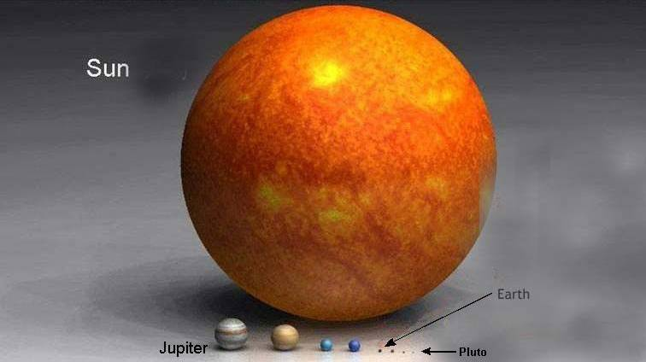
Now the Sun versus our Planets

Slide 7
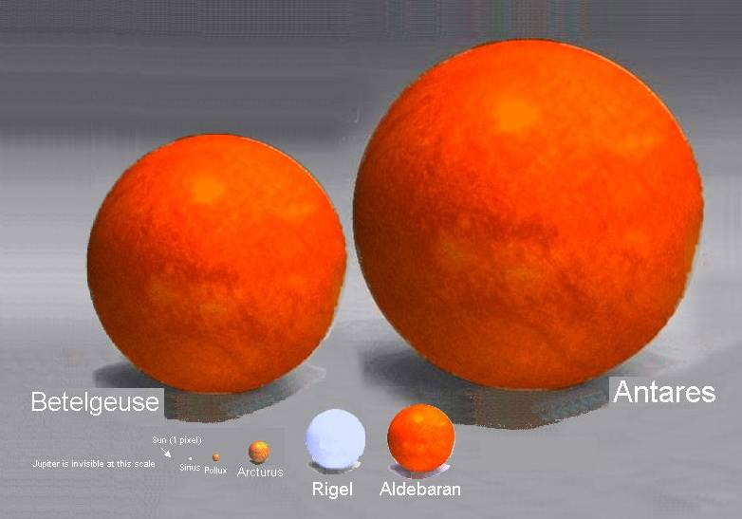
Now our Sun versus other stars
Antares is 550 light years away. 15th brightest star in the sky.

Slide 8
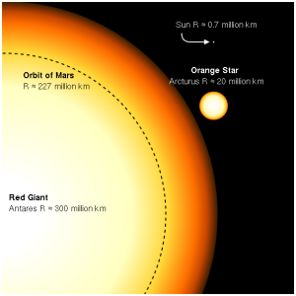
How Big is Antares versus our Solar System?
Antares, brightest Star in Scorpio, puts out 60,000 times the energy of our sun. Antares is 17 more massive with a radius 883 times greater than our sun

Slide 9
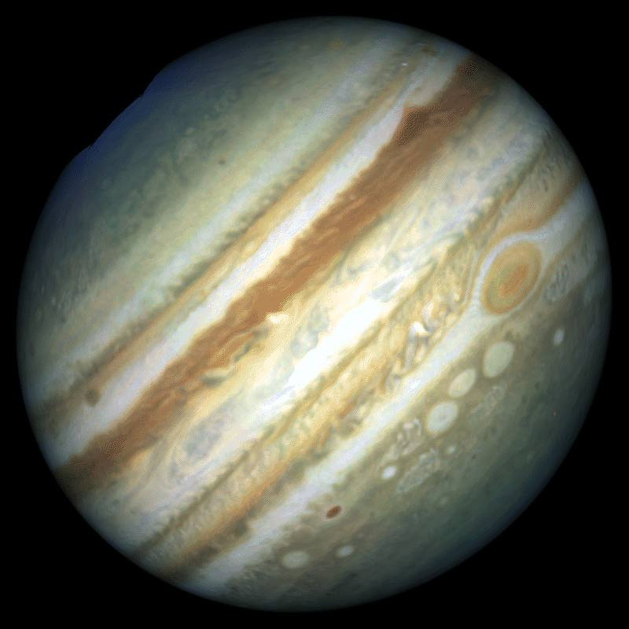
Our fifth and largest planet Jupiter has 2 ½ times the mass of all planets combined and is 318 times Earth’s mass. Jupiter rotates in ten hours and orbits the sun in 11.86 years 5.2 times further from the sun than Earth.

Slide 10
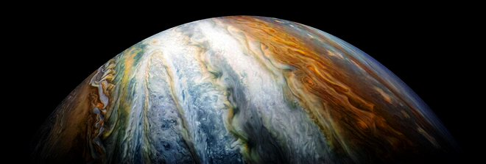
Jupiter’s ammonia sulphur compound clouds look like a beautiful painting

Slide 11
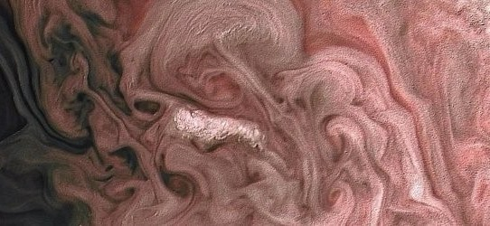
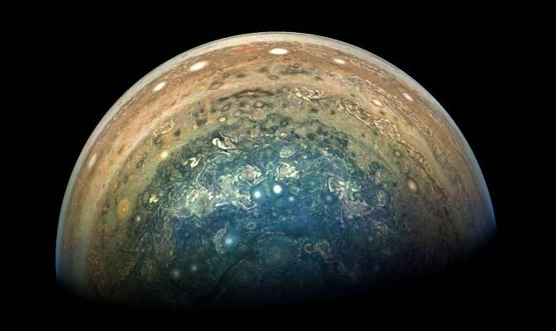
Juno Spacecraft Closeups
Magnificent Rose Colored Clouds
Jupiter’s South Polar region clouds

Slide 12
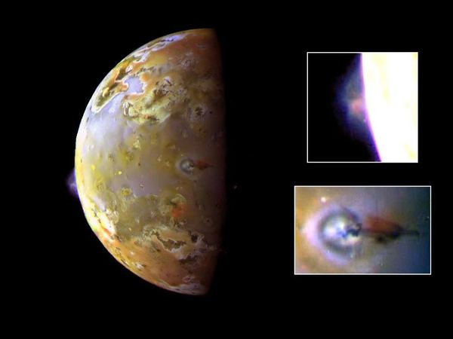
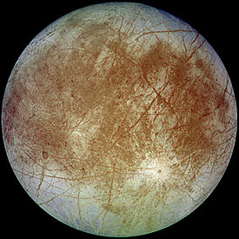
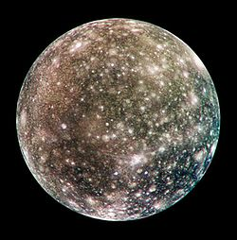
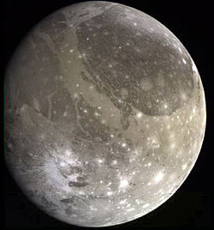
Io
Europa
Ganymede
Callisto
Jupiter's Galilean Satellites

Slide 13
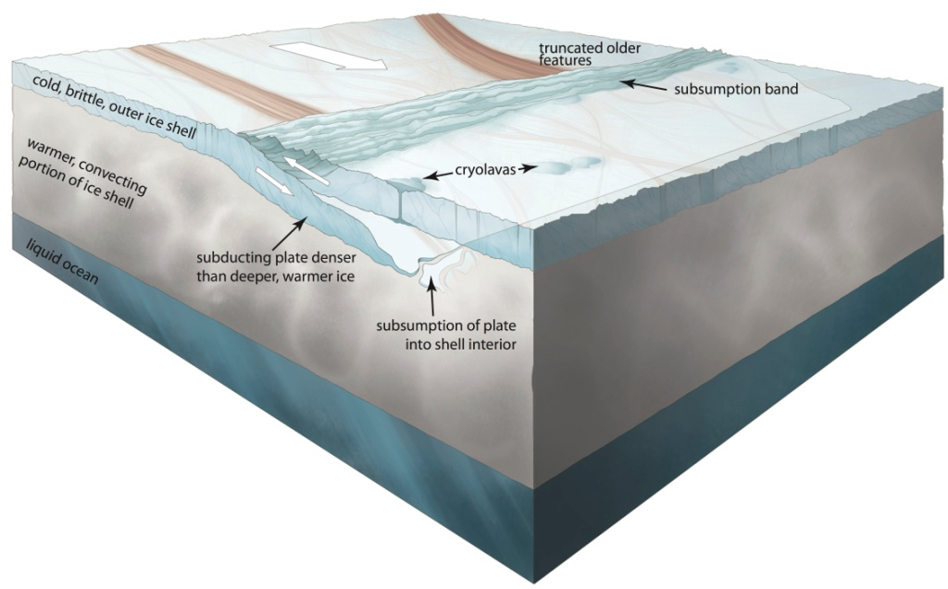
Europa has an ocean and ice plate tectonics!
A proposed NASA science mission to Europa would melt through the surface ice plates and look for life in Europa’s liquid oceans
Image Credit: Noah Kroese, I.NK

Slide 14
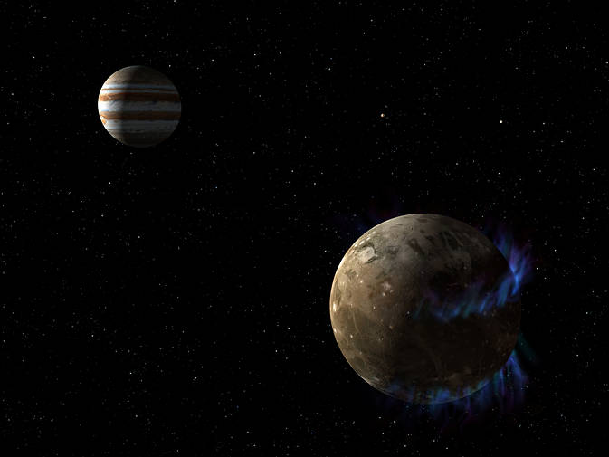
Ganymede also has an ocean beneath the icy crust!
Ganymede’s magnetic field interacts with Jupiter’s magnetic field. NASA’s Hubble Space Telescope observed aurorae on the moon . A saline ocean under the moon’s icy crust best explains shifting in the auroral belts measured by Hubble.
Image Credit: NASA/ESA

Slide 15
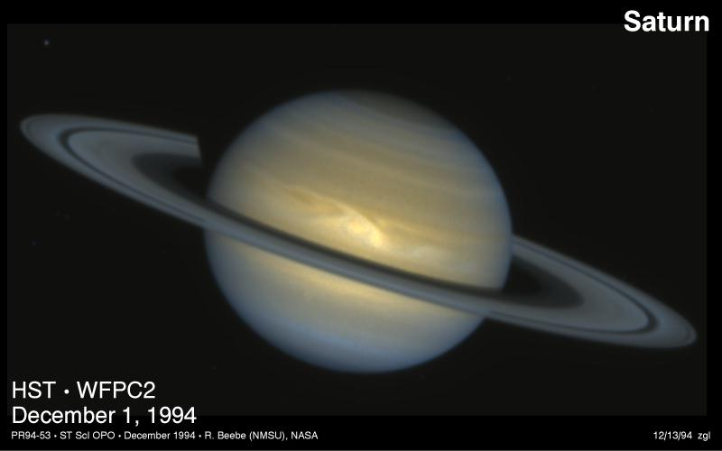
The sixth planet Saturn is a gas giant 95 times Earth’s mass, nine times our radius, and ten times further from the Sun than us. Saturn rotates in 10.5 hours and takes 29.46 years to orbit the Sun

Slide 16
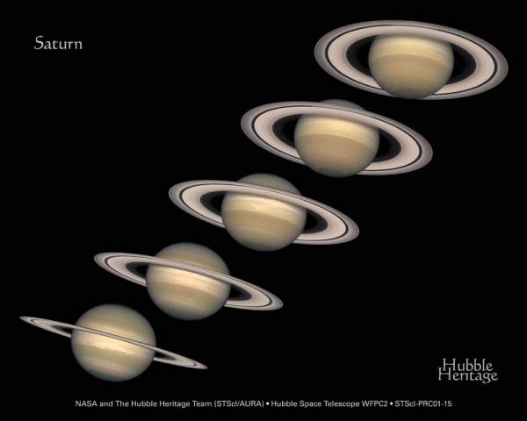
Saturn’s magnificent rings change their angle as we see them from Earth as Saturn orbits the sun

Slide 17
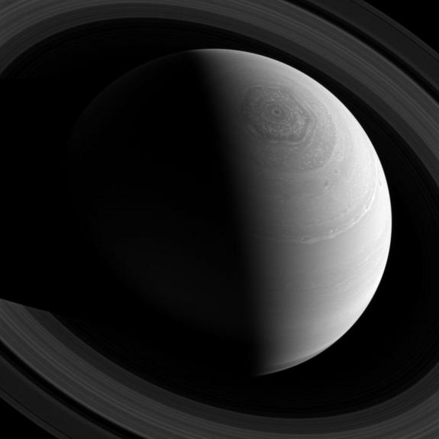
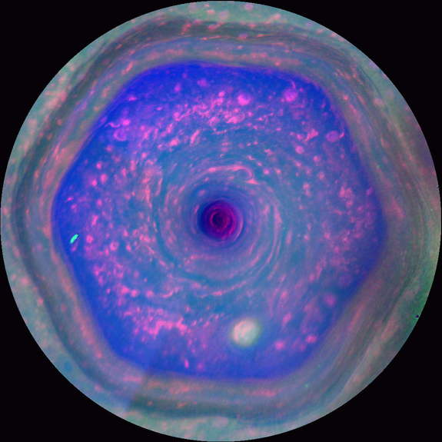
Cassini Spacecraft discovers a stunning hexagonal polar vortex at Saturn’s North Pole

Slide 18
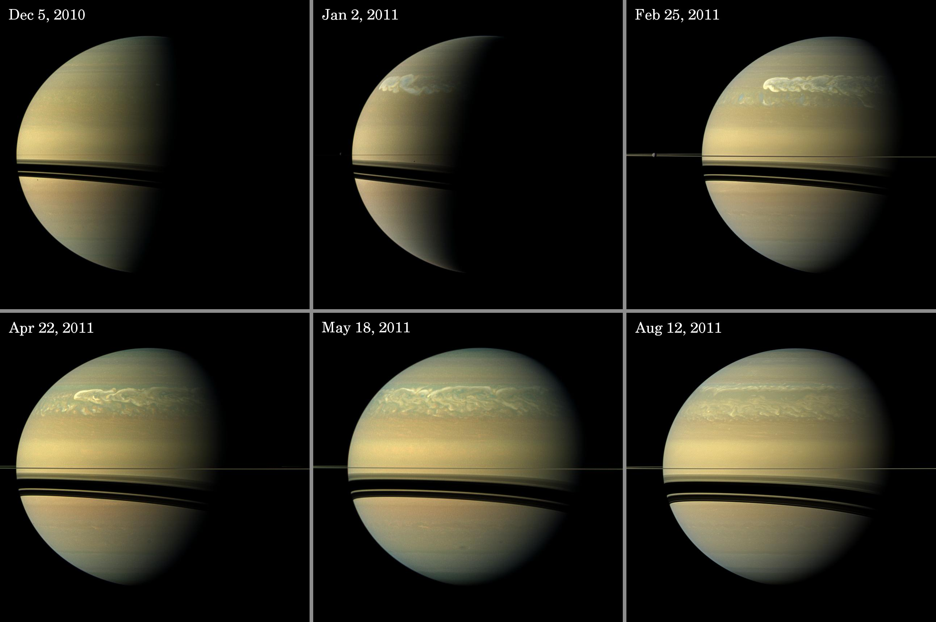
…and a planet encircling storm in 2011
Image Credit: Caltech/JPL-SSI

Slide 19
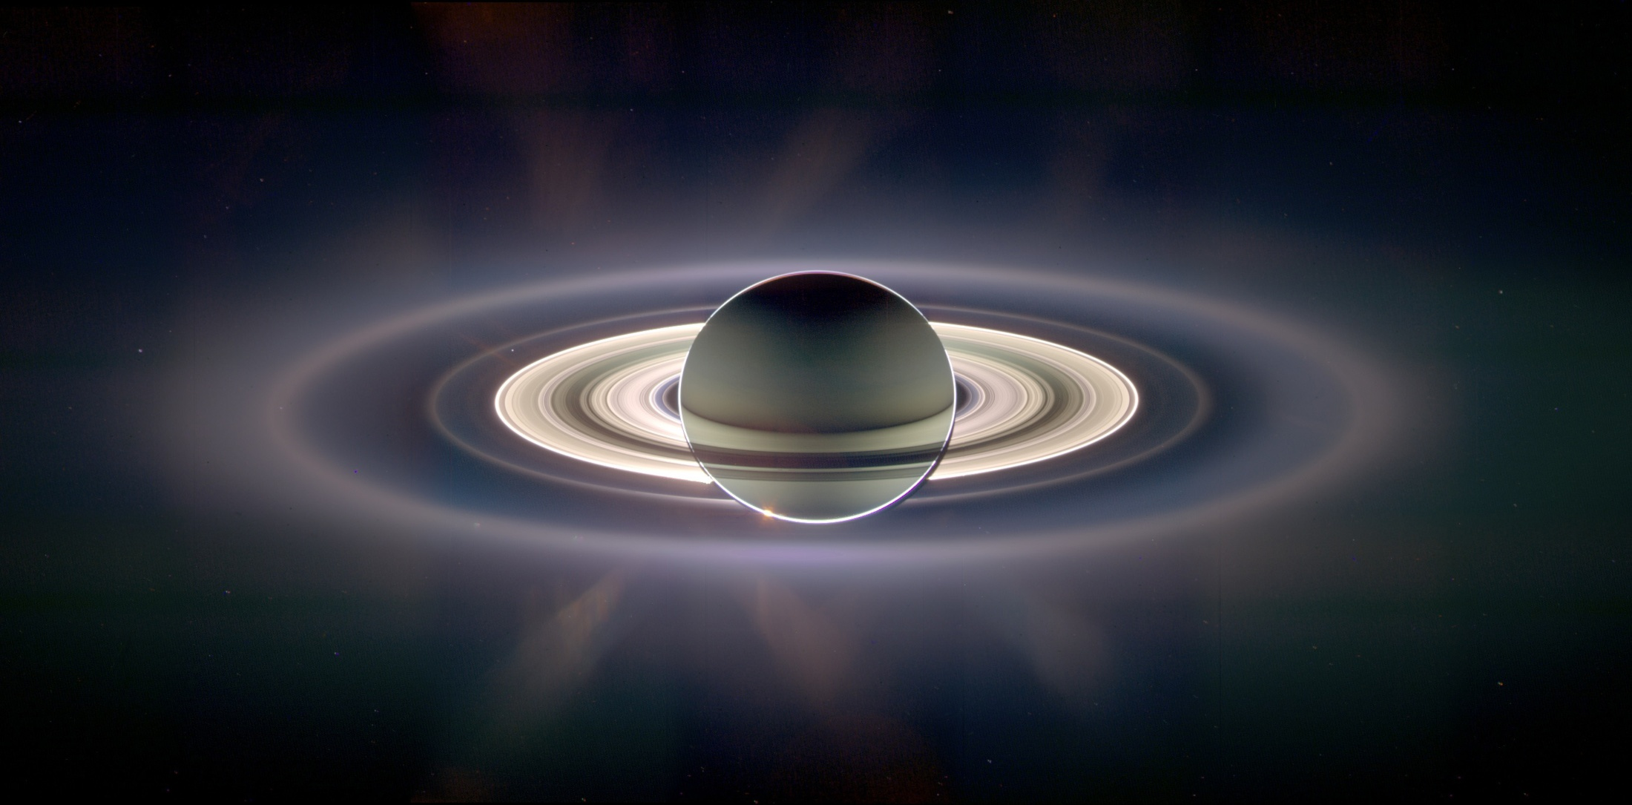
Cassini Spacecraft looks at Saturn Rings backlit with the Sun behind Saturn.

Slide 20
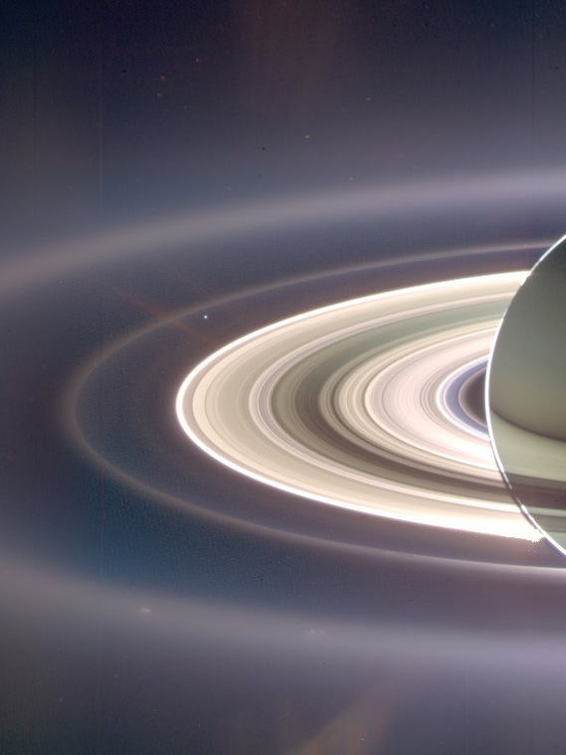
Cassini looking back toward the Sun captures Earth in the backlit rings of Saturn

Slide 21
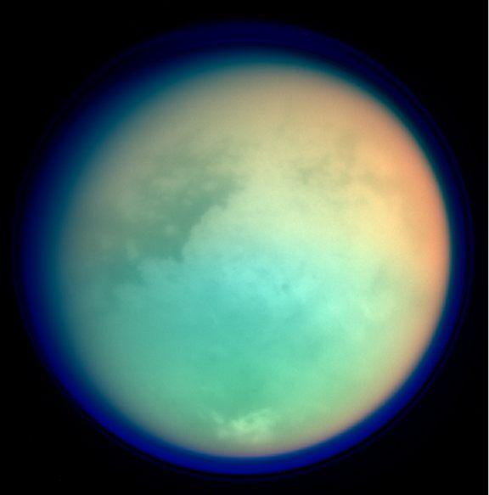
Titan, the largest moon of Saturn was discovered by Christiaan Huygens in 1655.
The only moon with a dense atmosphere of mostly nitrogen. Titan has liquid methane or ethane lakes with shorelines!
Titan is larger than Mercury but only ½ the mass.
Titan orbits Saturn every 16 days with the same side facing Saturn like our moon.
Titan

Slide 22
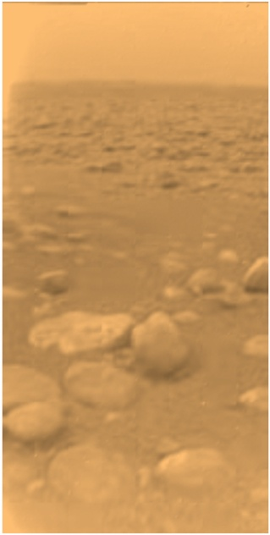
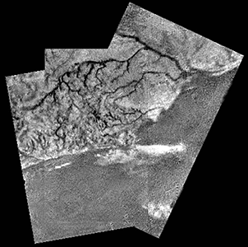
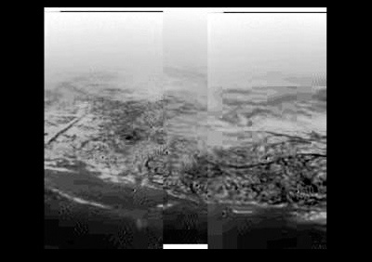
Huygens probe lands on Titan.
Surface temperature of
-170 C/-274 F results in liquid Methane oceans, shorelines, and rivers!
Titan’s surface is composed of dirty water ice and hydrocarbon ice
Descent photo from
8 km/5mi

Slide 23
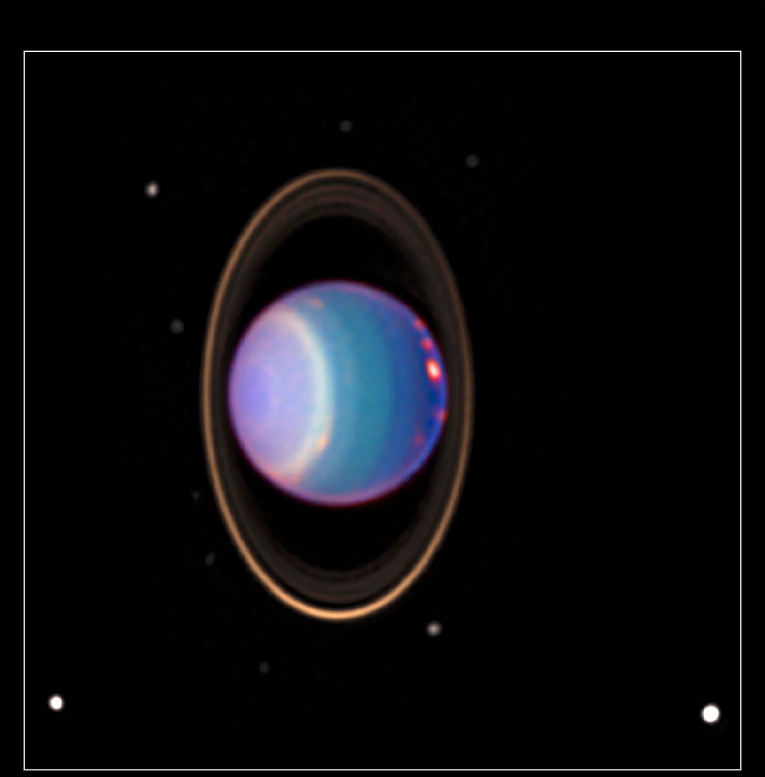
Uranus was the first planet discovered by telescope in 1781 by William Herschel.
Uranus is 4 times Earth’s diameter, 14.5 times Earth mass, and orbits the Sun every 84.3 years at 19.2 AU. Uranus rotates every 17.2 hours, but its spin axis is unusually tilted at 98 deg so that its polar regions point at the sun twice a Uranian year.
Uranus’ atmosphere is mostly H2 and He with ices of water, ammonia, and methane.

Slide 24
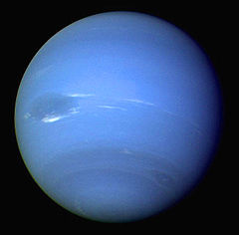
Neptune was the first planet discovered by mathematical prediction of perturbations in Uranus orbit. Discovered in 1846 by John Galle within one degree of the prediction of Le Verrier.
Neptune is 3.9 larger than Earth, 17 times Earth’s mass, and orbits the sun every 164.8 years at 30.1 AU. Neptune rotates every 16.1 hours.
Neptune’s atmsophere is H2, He, and ices of water, ammonia, and methane. Neptune’s largest moon is Triton.

Slide 25
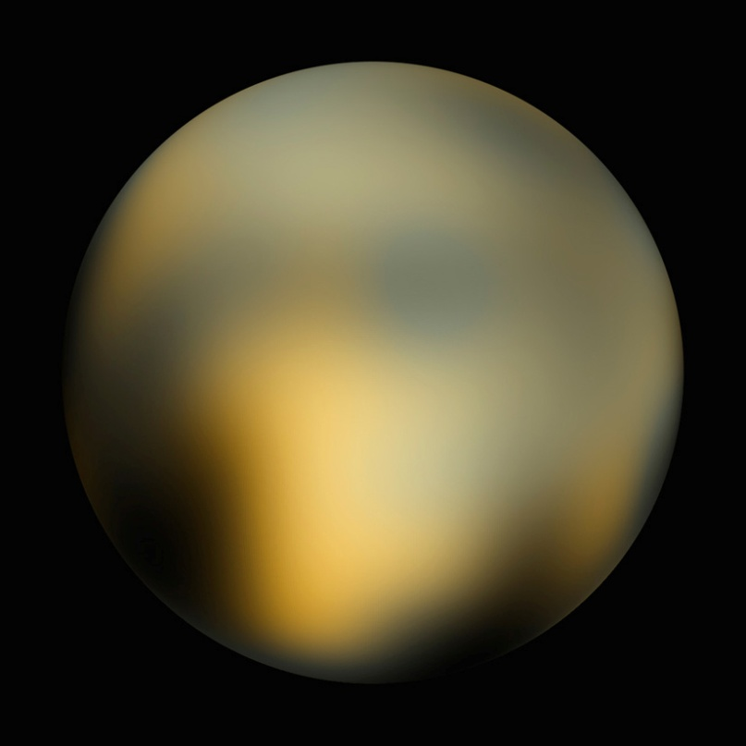
Pluto discovered in 1930 by Clyde Tombaugh was reclassified in 2006 as a dwarf planet of the Kuiper Belt
Pluto is mostly rock and ice with a highly elliptical orbit ranging from 29.7 (inside Neptune’s orbit 1979-1999) to 48.9 AU and inclined to the ecliptic at 17 deg. Pluto orbits the sun every 248 years. Pluto is 1/5 the size of Earth and only 1/5 the mass of our Moon.
Pluto has four known moons with Charon the largest. Pluto has a very thin atmosphere of N2, CH4, and CO derived from ices of these substances on its surface. Surface temperature is -230 C/-382 F. Our first spacecraft to visit Pluto was the New Horizons in 2015, a nine year flight time.
Pluto and Charon

Slide 26
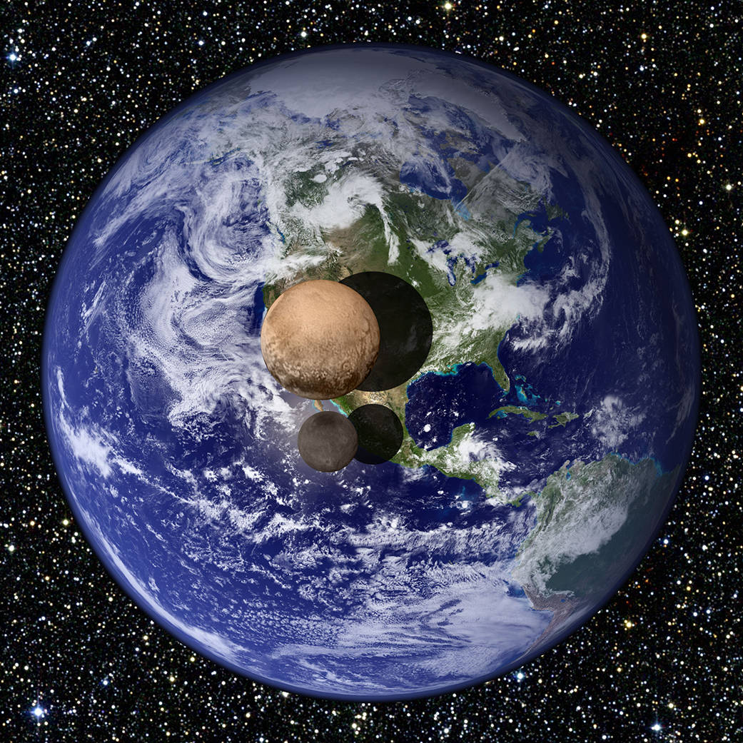
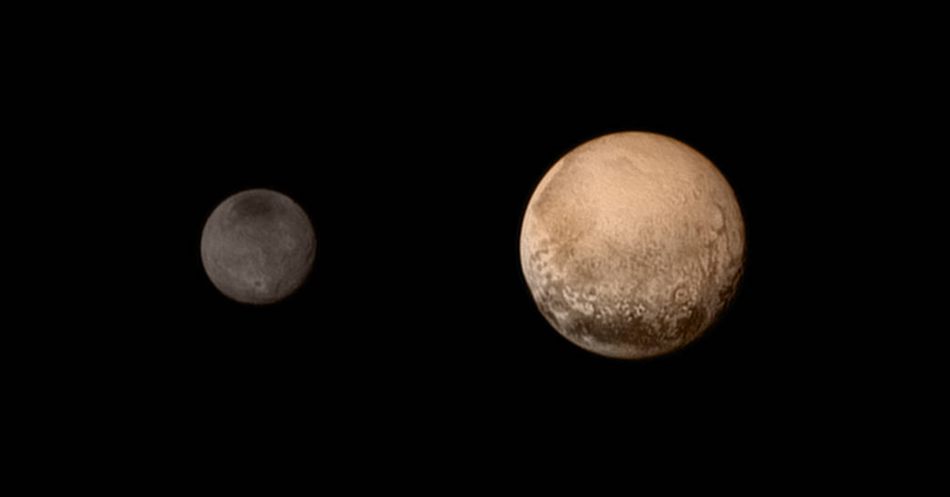
New Horizons Spacecraft provides dramatic new photos of Pluto and Charon July 14, 2015
Earth, Pluto, Charon Relative Size
Charon
Pluto

Slide 27
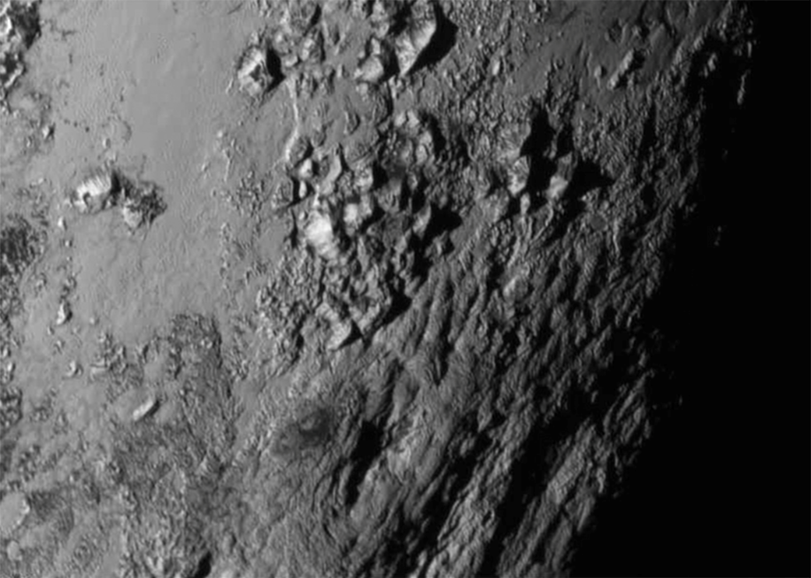
Dramatic 11,000 foot mountains of ice on Pluto
The lack of craters on Pluto and mountain building suggest Pluto’s crust is active and young.

Slide 28
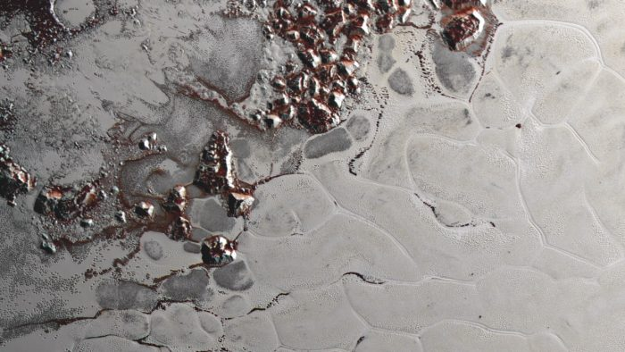
Convection cells of churning Nitrogen ice driven by internal heat in Pluto’s Sputnik Planum region are less than one million years old! A blink of an eye in geological time perspective!

Slide 29
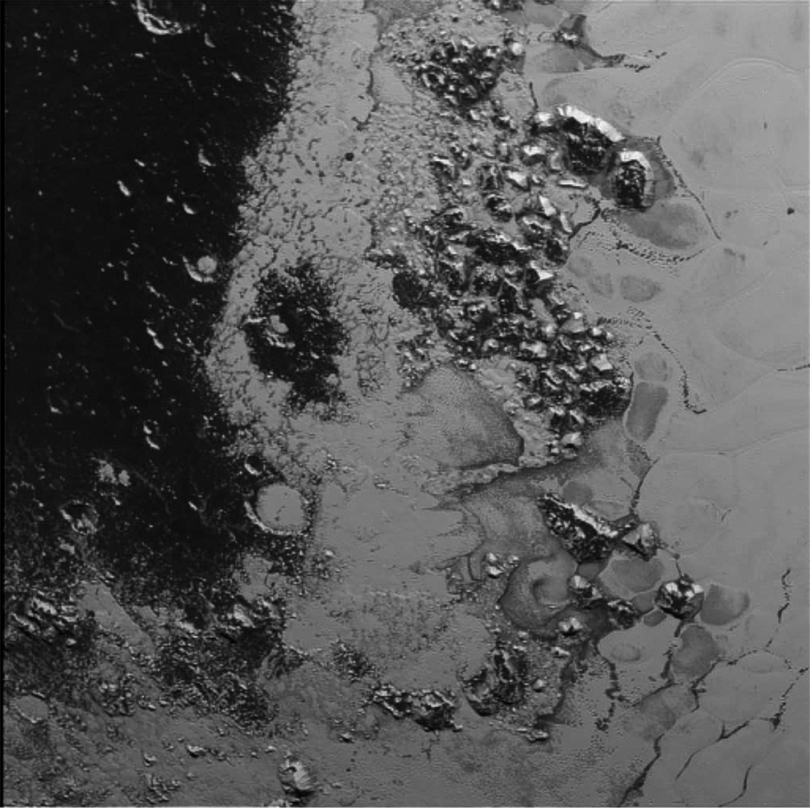
Stark contrast in Light and Dark regions on Pluto
These newly discovered mountains on Pluto are more like Earth’s Appalachian Mountains

Slide 30
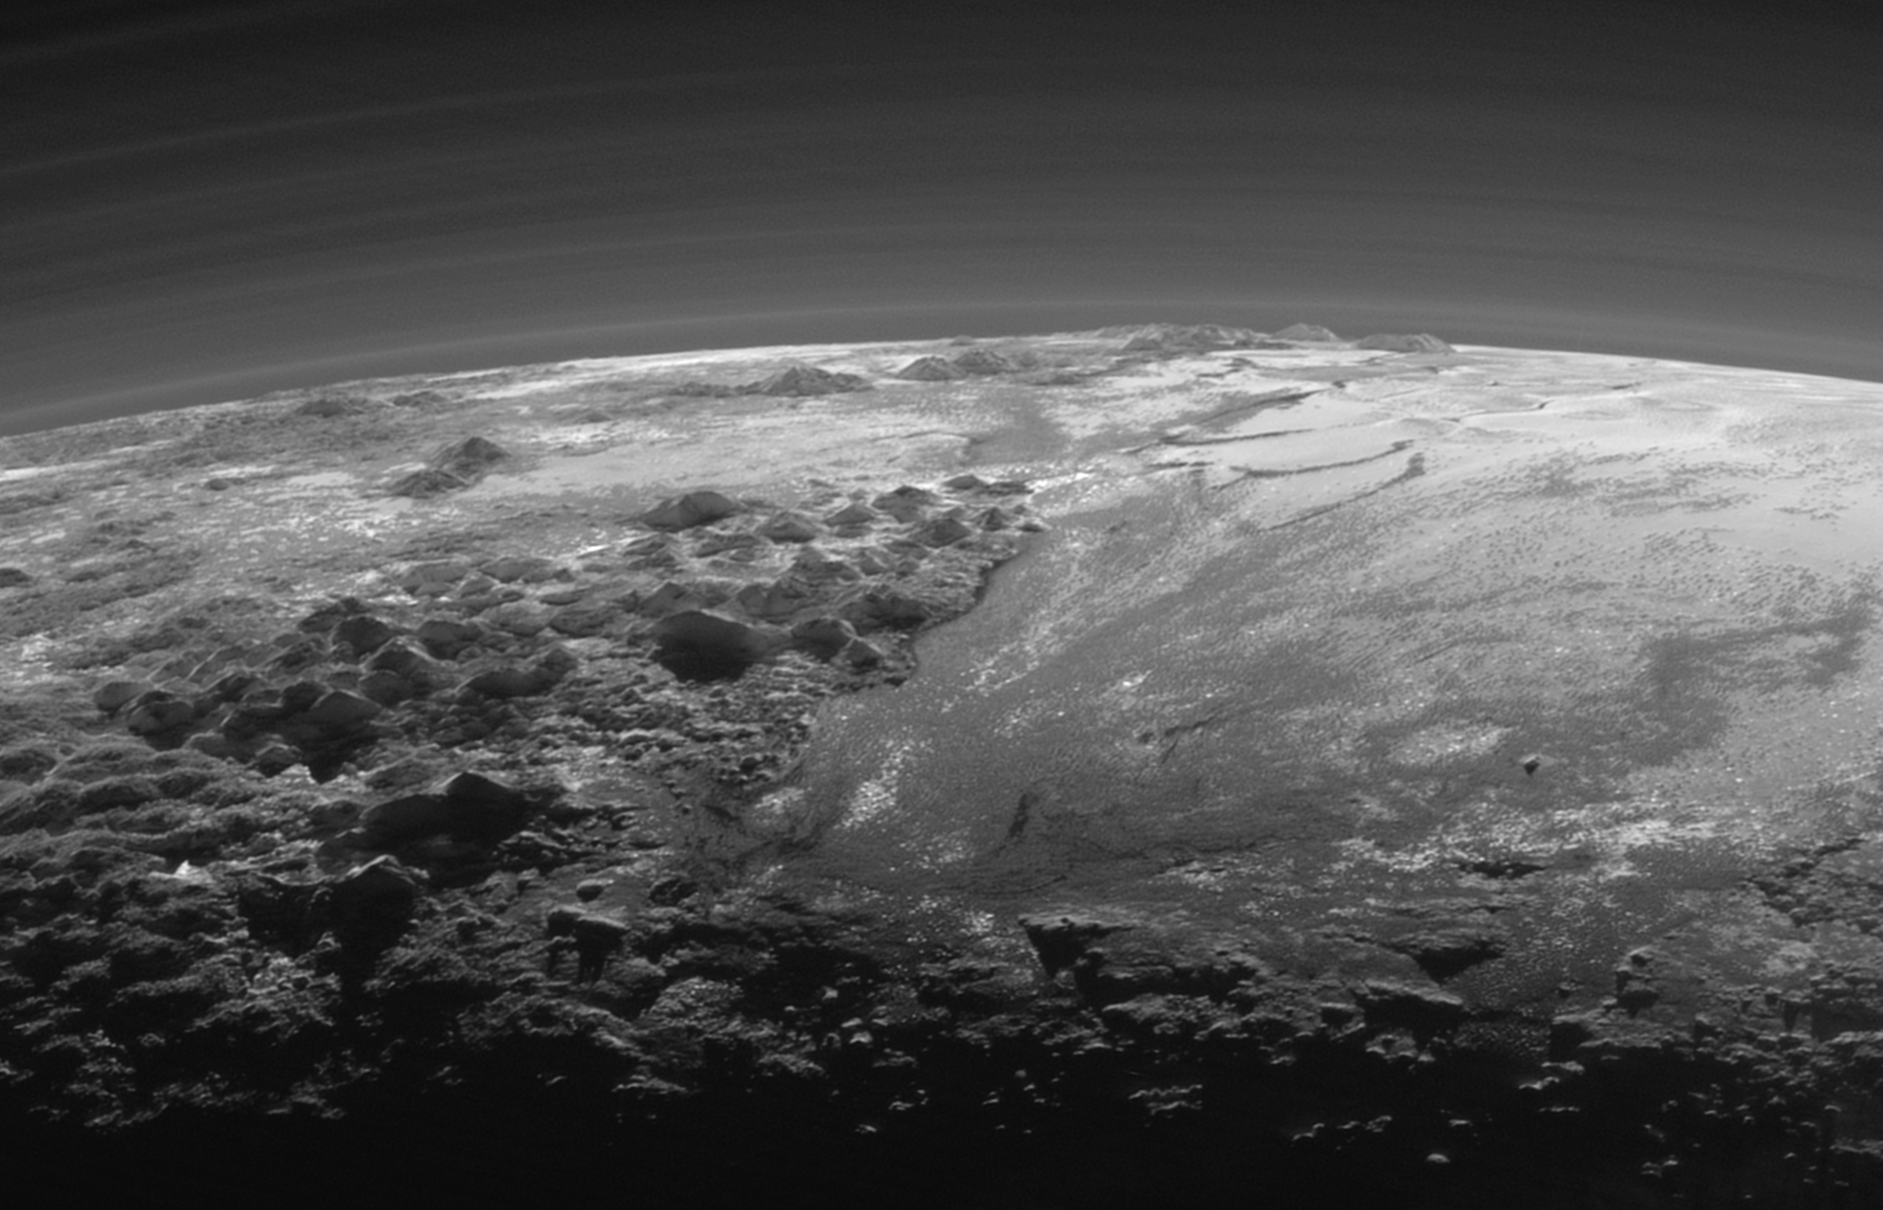
New Horizons looks back at Pluto sunset to see 11,000 ft (3500 m) mountains of Ice on the left with flat ice plains extending to Pluto’s horizon. The backlighting highlights more than dozen layers of haze in Pluto’s thin atmosphere

Slide 31
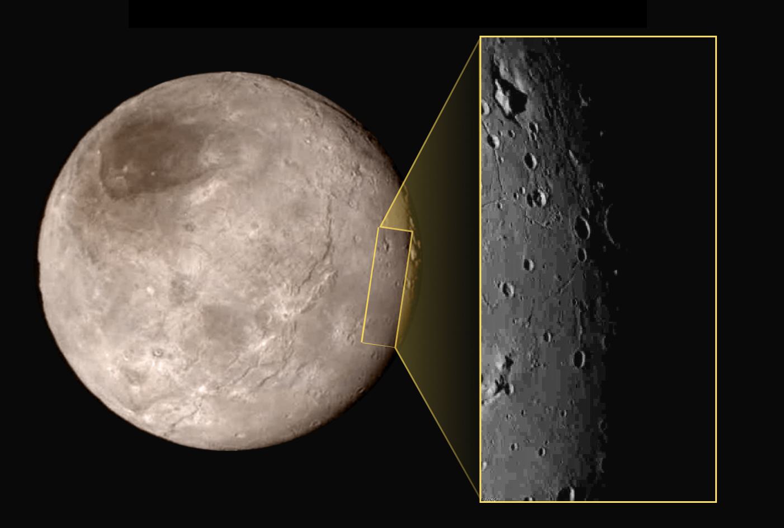
Charon has a Mountain with a Moat!

Slide 32
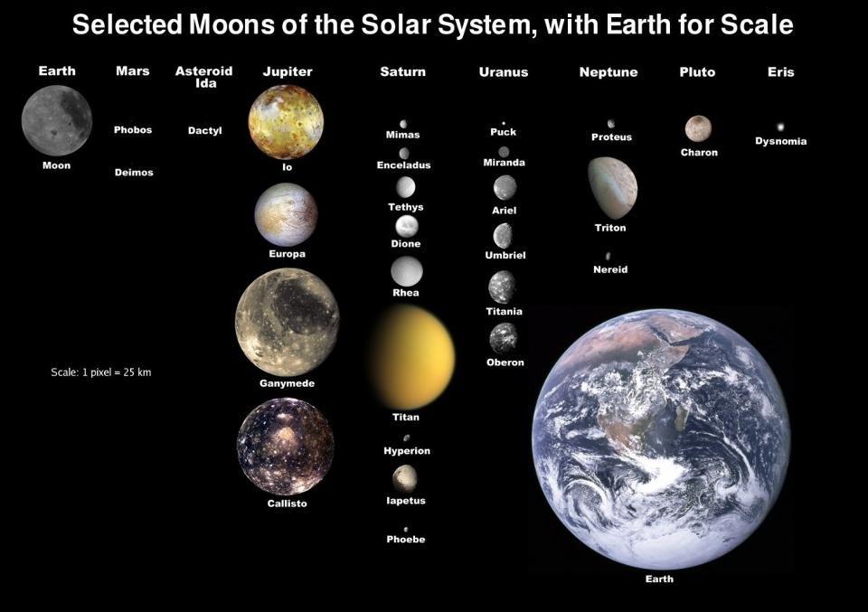

Slide 33
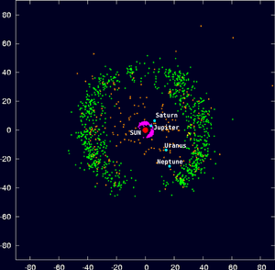
The outer reaches of our solar system from 30 to 50 AU is called the Kuiper Belt. It consists of small bodied remnants of the solar system formation. They are largely frozen ‘volatiles’ or ices of ammonia, methane, and water. It is home to 3 known dwarf planets Pluto, Haumea, and Makemake.
A scattered disk of objects out to 100 AU contains the largest known dwarf planet Eris orbiting the sun between 38 and 98 AU every 557 years
Known Kuiper Belt Objects

Slide 34
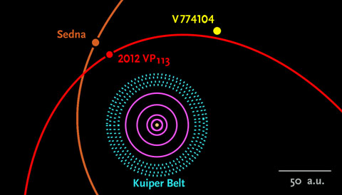
New object discovered Oct 2015 is 100 times further from our Sun than Earth!
V774104 estimated to be 300-600 miles/500-1000 km across is 100 AU (9.6 billion miles/15.4 billion km) from the Sun. It joins Sedna and 2012 VP113 as the most distant objects known orbiting our Sun well outside the Kuiper Belt.
Neptune's orbit at 30 AU
Image credit: Scott Sheppard / Carnegie Inst. for Science

Slide 35
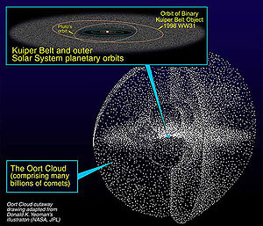
The hypothesized home of comets by Dutch astronomer Jan Oort is called the Oort cloud. It is believed to extend out to 50,000 AU or nearly a light year from the sun and consists of an inner disc and outer shell.
These objects are mostly frozen ices of water, ammonia, and methane. The objects in the Oort cloud are only loosely bound to the sun and are easily perturbed by passing stars and the Milky Way Galaxy itself.
The Oort Cloud-Home of Comets

Slide 36
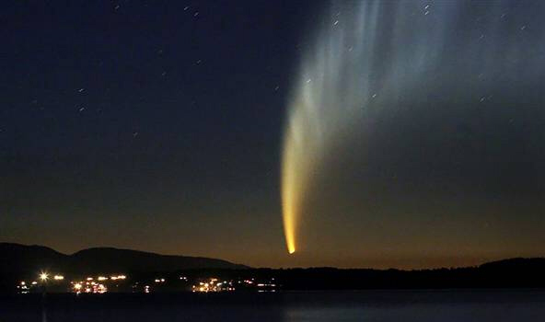
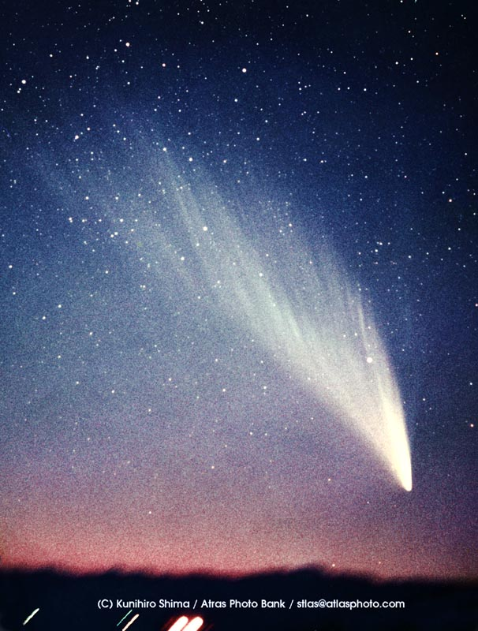
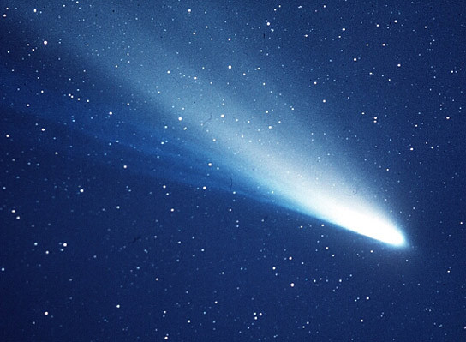
Comet McKnaught 2007 viewed from Chile
Comet West 1976
Hailey’s comet 1986

Slide 37
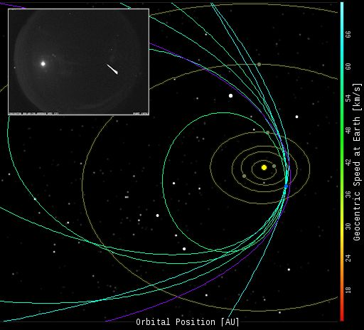
Earth passes thru Comet Swift-Tuttle debris every August creating the Perseid meteor shower. Some recent trajectories from NASA Meteoroid Environment Office
Photo credit Bill Cooke, NASA

Slide 38
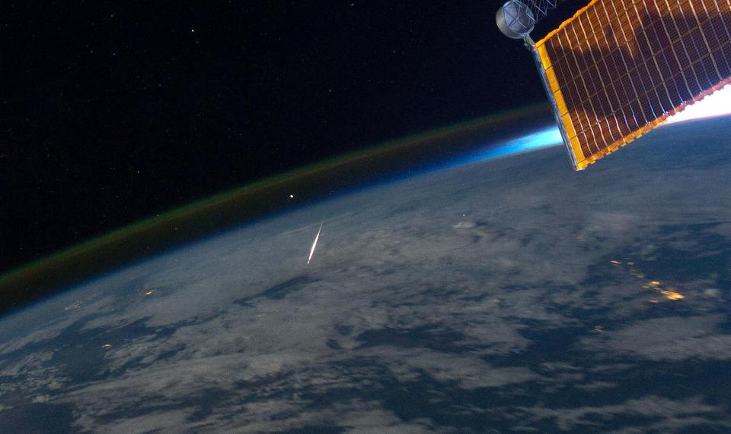
A Perseid meteor moving at 134,000 MPH burns up in Earth’s atmosphere as seen from the International Space Station passing over China August 2011
Arcturus
Perseid Meteor

Slide 39
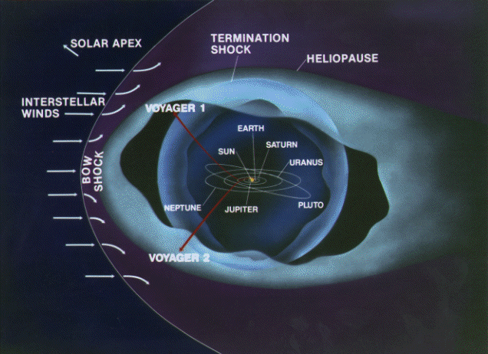
Voyager 1 is 13.6 Billion miles from Earth and Voyager 2 is 11.3 Billion miles. Both launched in 1977 have been traveling out of our solar system for 4 decades.

Slide 40
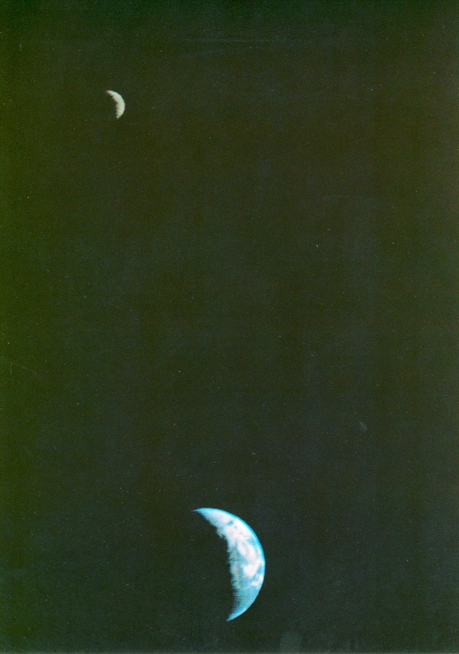
Voyager 1 snapped this picture of Earth-Moon Sept 18, 1977. Voyager 1 was directly over Mt. Everest on the night side and 11.66 million km (7.25 mil mi) from Earth on the way to Jupiter.
Voyager 1 is the farthest spacecraft from Earth at 13.6 billion mi (142 AU).
One way communication time is 19 hr 52 mins via the NASA Deep Space Network (DSN)

Slide 41
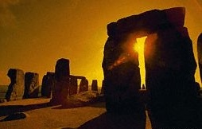
Stonehenge constructed 2 to 3 millennium BC has astronomical alignments to the solstices and equinoxes and the 18.6 year Lunar cycle

Slide 42
Mayan priest-astronomers from 2000 BC to 1500 AD understood lunar cycles, predicted eclipses, and accurately calculated heliacal risings of Venus as the Morning and Evening star. Their calendar suggests they understood the Earth’s 26,000 year precession of the equinoxes.
Mayan Calendar
Astronomical observatory at Chichen Itza

Slide 43
Anasazi ruins at Chaco Canyon
Simulated shadow of moonrise at northern minor lunar standstill-18.6 year cycle
Pueblo Indians recorded the 18.6 year lunar cycle of rising positions of the moon at major and minor standstills using slabs and spiral markings in stone at Fajada Butte
http://www.solsticeproject.org/lunarmark.htm

