Slide 1
The LivePlan Method
for Strategic Planning
Palo Alto Software, Maker of LivePlan
PLAN
MANAGE
GROW

Slide 2
LIVEPLAN WHO WE ARE

Slide 3
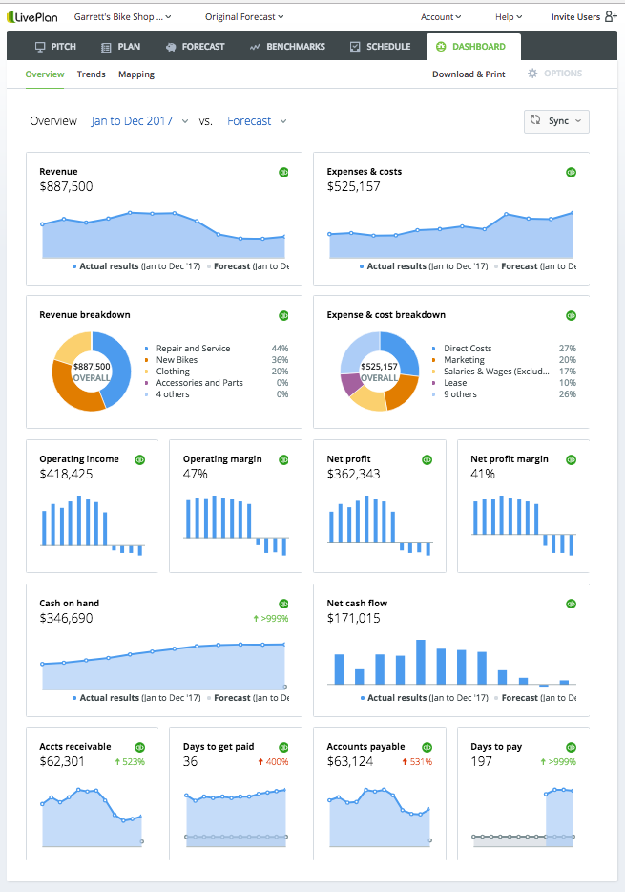
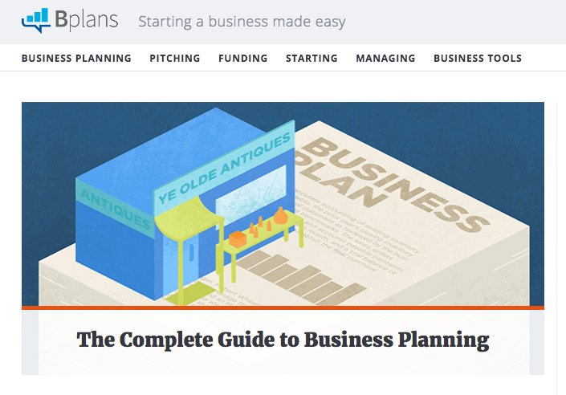
BUILT BY EXPERTS
20+ year history in business planning + financial management tools
Bplans.com and LivePlan
LivePlan: Pitch, Plan, Forecast, Benchmarks, Milestones, KPI Dashboard
1.5M uniques per month
Over 1M entrepreneurs
world-wide
STAYING POWER
Notes:
Palo Alto, maker of LivePlan, has a 20 year history of developing business planning software.
Our roots are in a product called Business Plan Pro (a desktop product), and in an online presence at a website called Bplans.com, where we offer content related to business planning.
Our Founder created the Lean Planning Method and taught business planning in California and at the University of Oregon for years.
There are over 1M entrepreneurs who use or have used our products to build, track and grow their businesses.
From that history came LivePlan: a cloud based, SAS toolset.
LivePlan was launched in 2012
LivePlan’s scope is Pitch, Plan, Financial Forecast (including standard financial reports), Benchmarking, Milestone Schedule, KPI dashboard.
It’s meant to take the business owner from concept to plan to ongoing management and tracking, which makes it the perfect toolset for comprehensive strategic advising services.
Because of the way it’s set up, it implements a method for the advisor naturally, which makes it easy for an individual, or a group to implement and get up and running. It’s what really sets this tool apart from others in the space. It has a broad scope, but it’s focused in nature. The method is what we’ll cover today.

Slide 4
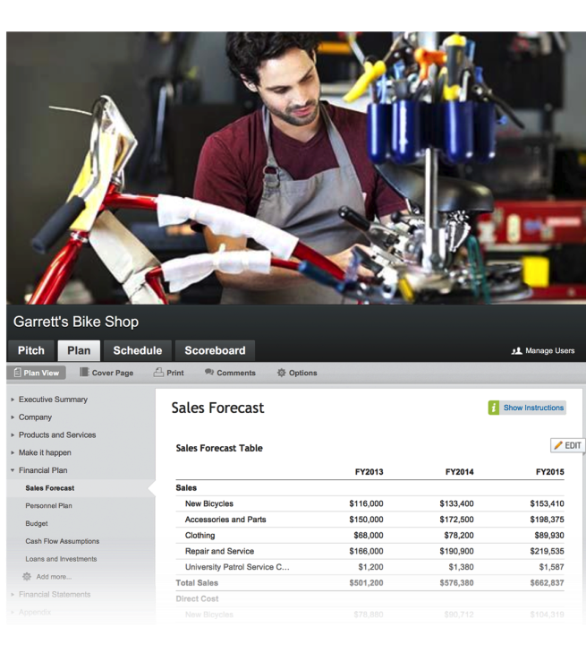
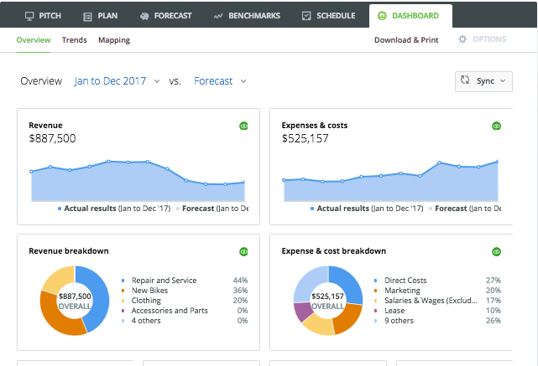
LIVEPLAN
DESIGNED FOR GARRETT
Garrett is a target persona.
Garrett is:
34 y/o college graduate
First-time entrepreneur
Loves innovating & creating bike parts
Novice at business
Parts manufacturing expert
Garrett’s needs guide our daily development decisions.
Notes:
LivePlan was built with the small business owner in mind.
This is our persona for LivePlan. Garrett is the owner of Garrett’s Bike Shop.
Garrett knows how to build, repair and sell bikes.
Garrett does NOT know what a P&L statement is. He might not even know what the word Revenue means.
Garrett needs help, either in building his business plan, or in managing his cash-flow, or in setting and tracking goals, or in all of the above.
He either comes to his accountant right away and asks for help, or he might use LivePlan on his own to get started with a business plan, but as his business becomes successful the first thing he does is hire an accountant, and at the very least, a bookkeeper. That’s where you come in, to offer strategic advising services. More than just bookkeeping or traditional accounting. You want to offer strategic planning advice.

Slide 5
LIVEPLAN FEATURE-SET OVERVIEW

Slide 6
LIVEPLAN OVERVIEW
PITCH - Lean Plan
PLAN - formal business plan
FORECAST - financial projections
BENCHMARKS - SageWorks Profitcents
SCHEDULE - milestone deadlines
DASHBOARD - key performance indicators

Slide 7
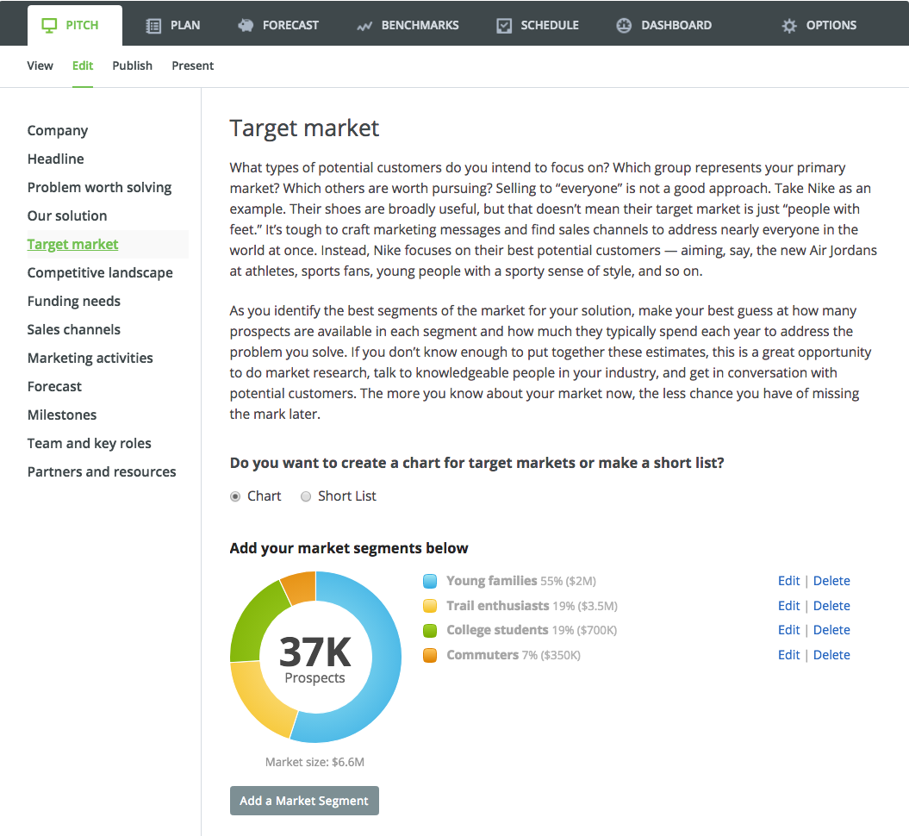
PITCH LEAN PLAN
Business Solution
Target Market & Sales Channels
Progress Milestones
Team, Partners & Resources

Slide 8
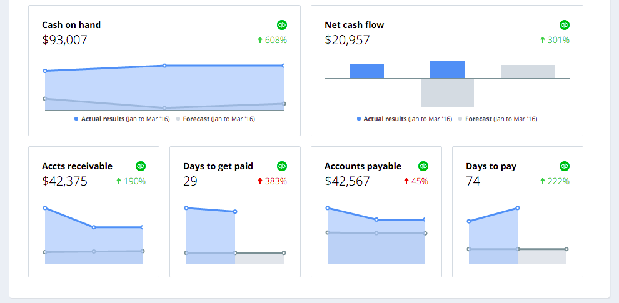
DASHBOARD MONITOR PROGRESS
Key Performance Indicators
Revenue, Expenses, AR, AP, Cash
Forecast vs Actuals
Graph format

Slide 9
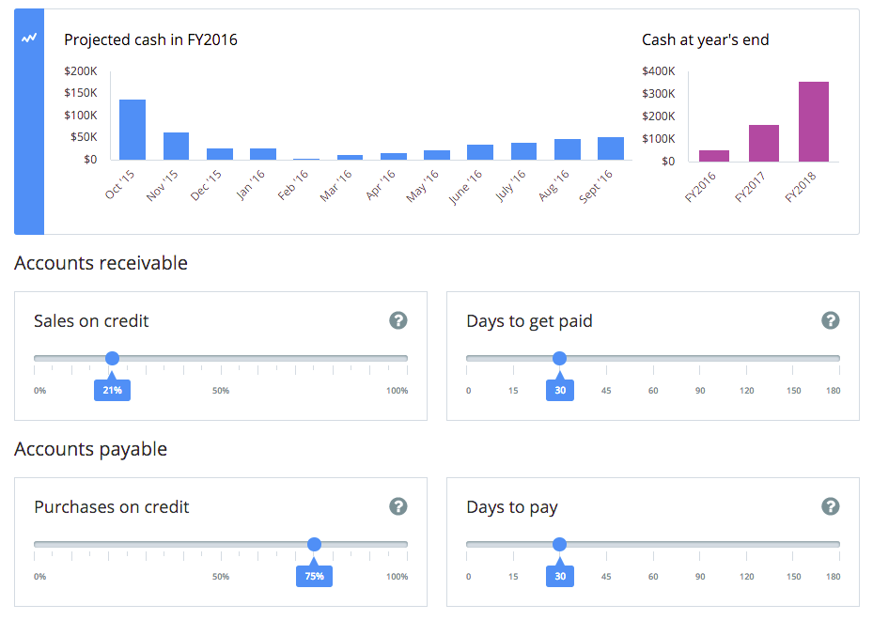
CASH FLOW FORECAST
Set assumptions
See projected burn rate
Predict and plan

Slide 10
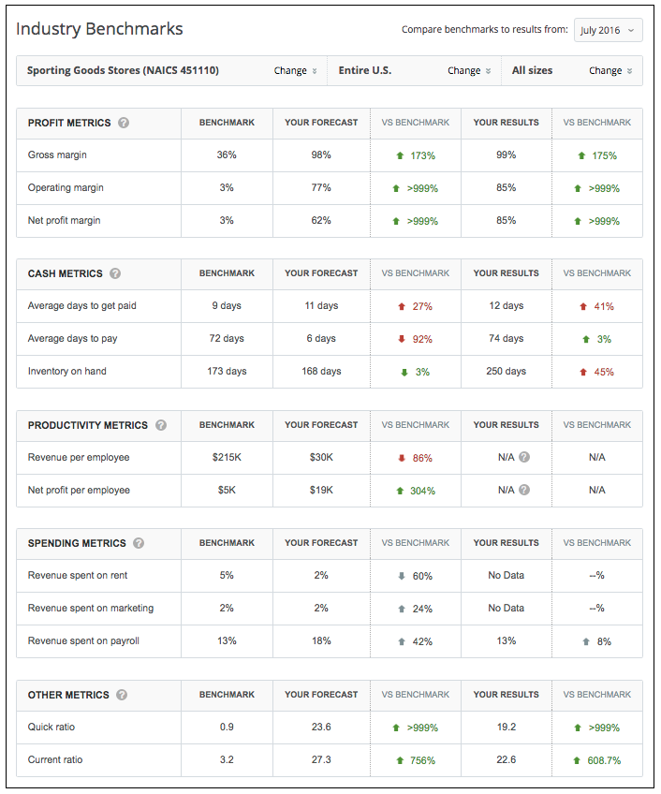
BENCHMARKS
LEAN
SageWorks Profitcents data
Industry/Region/Size
Forecast v Actual
Lean metrics

Slide 11
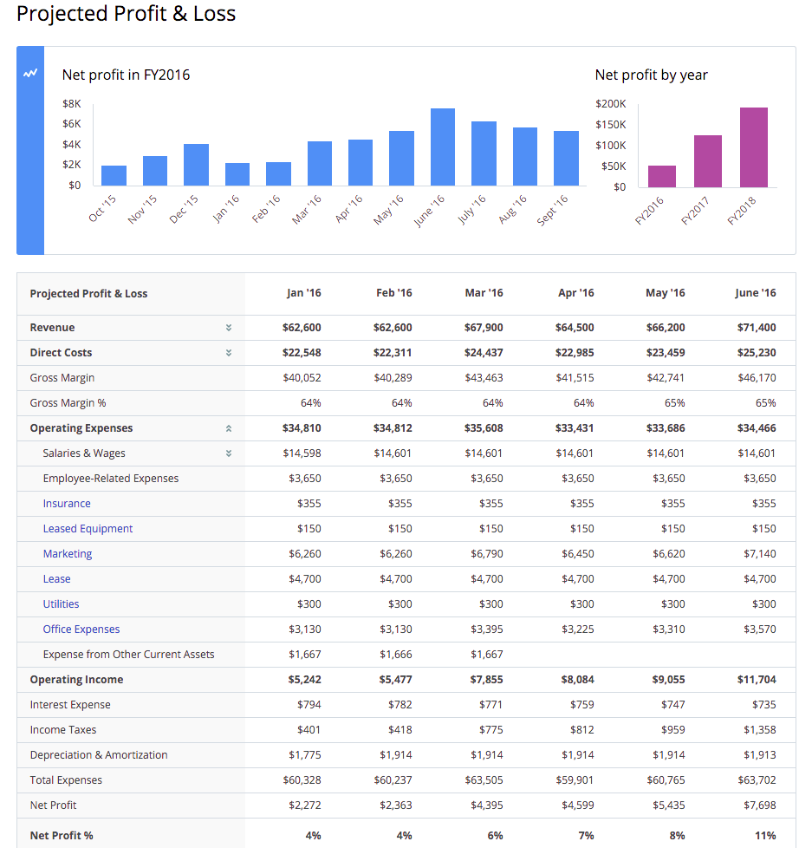
FINANCIAL STATEMENTS FORECAST
Profit & Loss
Balance Sheet
Cash Flow
Data and Graph format

Slide 12
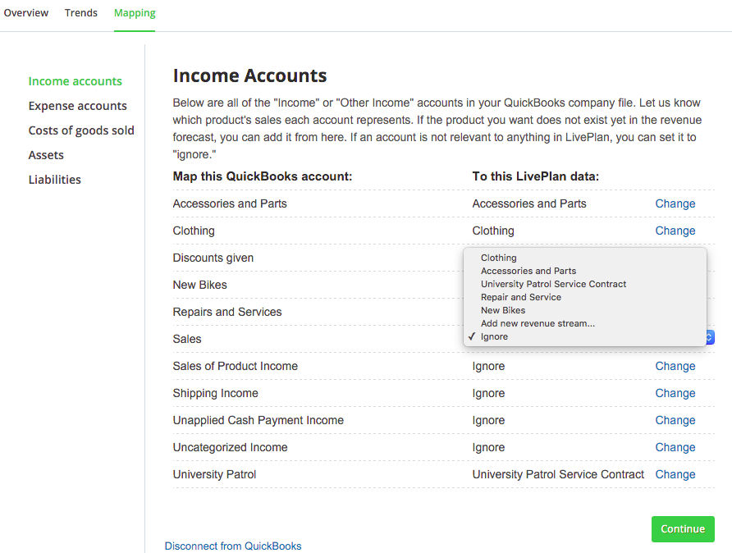
SET UP MAP ACCOUNTS
LivePlan syncs to QBO & Xero
Automatic mapping by system - can be edited by user
LivePlan does NOT push back to accounting solution

Slide 13
LIVEPLAN MAKES BUSINESS BETTER

Slide 14
ACCOUNTANT AS STRATEGIC ADVISOR
Kick Off
Plan
Model
Build
Advise
Notes:
So here we have the LivePlan Method, at the topmost level. The main tasks.
Plan
Model
Build
Analyze/Report
Adjust
This provides a framework for the rest. Under each one then, we have a set of tasks, and a Work Product or Deliverable. This organization of the work provides a clear framework for you as our client to know what to expect and when, and for our firm to work together the right way to deliver advising services to you.
Let’s review each in turn.

Slide 15
LIVEPLAN METHOD - #1 Kick Off
Frame Relationship
Define offering
Set expectations
Learn goals
Launch advisory
Notes:
Kick-Off, for establishing your service offering with your client and setting expectations, and really hooking them on the concept of advising.

Slide 16
LIVEPLAN METHOD - #2 Plan
lean planning:
what do they sell?
how do they sell it?
Who to?
Who and what do they rely on?
Notes:
Plan, for doing the Lean Planning work of establishing the business model. What do they sell, how do they sell it, and to whom?

Slide 17
LIVEPLAN METHOD - #3 Model
Analyze financials
growth patterns
Revenue : Expenses
forecasting categories
Notes:
During the modeling step we will analyze your historical data and establish growth patterns and ratios for your financial forecast

Slide 18
LIVEPLAN METHOD - #4 Build
business roadmap
full financial forecast
Notes:
During Build we will build your full financial forecast: P&L, Cash Flow and Balance Sheet, all available in a cloud based application that you can easily access for viewing and to update. This is where the plan and the historical actuals come together to create a financial roadmap.

Slide 19
LIVEPLAN METHOD - #5 Advise
Cyclical Meeting
Business Decisions
Notes:
AND FINALLY, we reach the Advise phase, where we have regular meetings to review your business performance and help you make business decisions to drive the growth you are looking to achieve.

Slide 20
THE LIVEPLAN METHOD
Notes:
We are excited to work with small business clients in an advisory relationship!

Slide 21
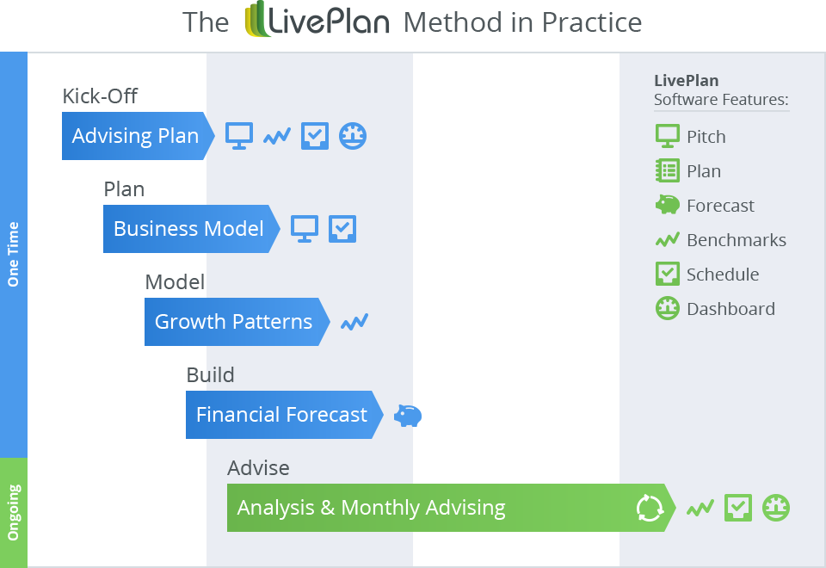
Notes:
As a business process, the first 4 phases of the LivePlan Method happen one time, in the first month of the relationship.
The final phase happens monthly, and is where you will make your margin on your fixed price service offering.

Slide 22
Notes:
The whole idea of the overall method

