Slide 1
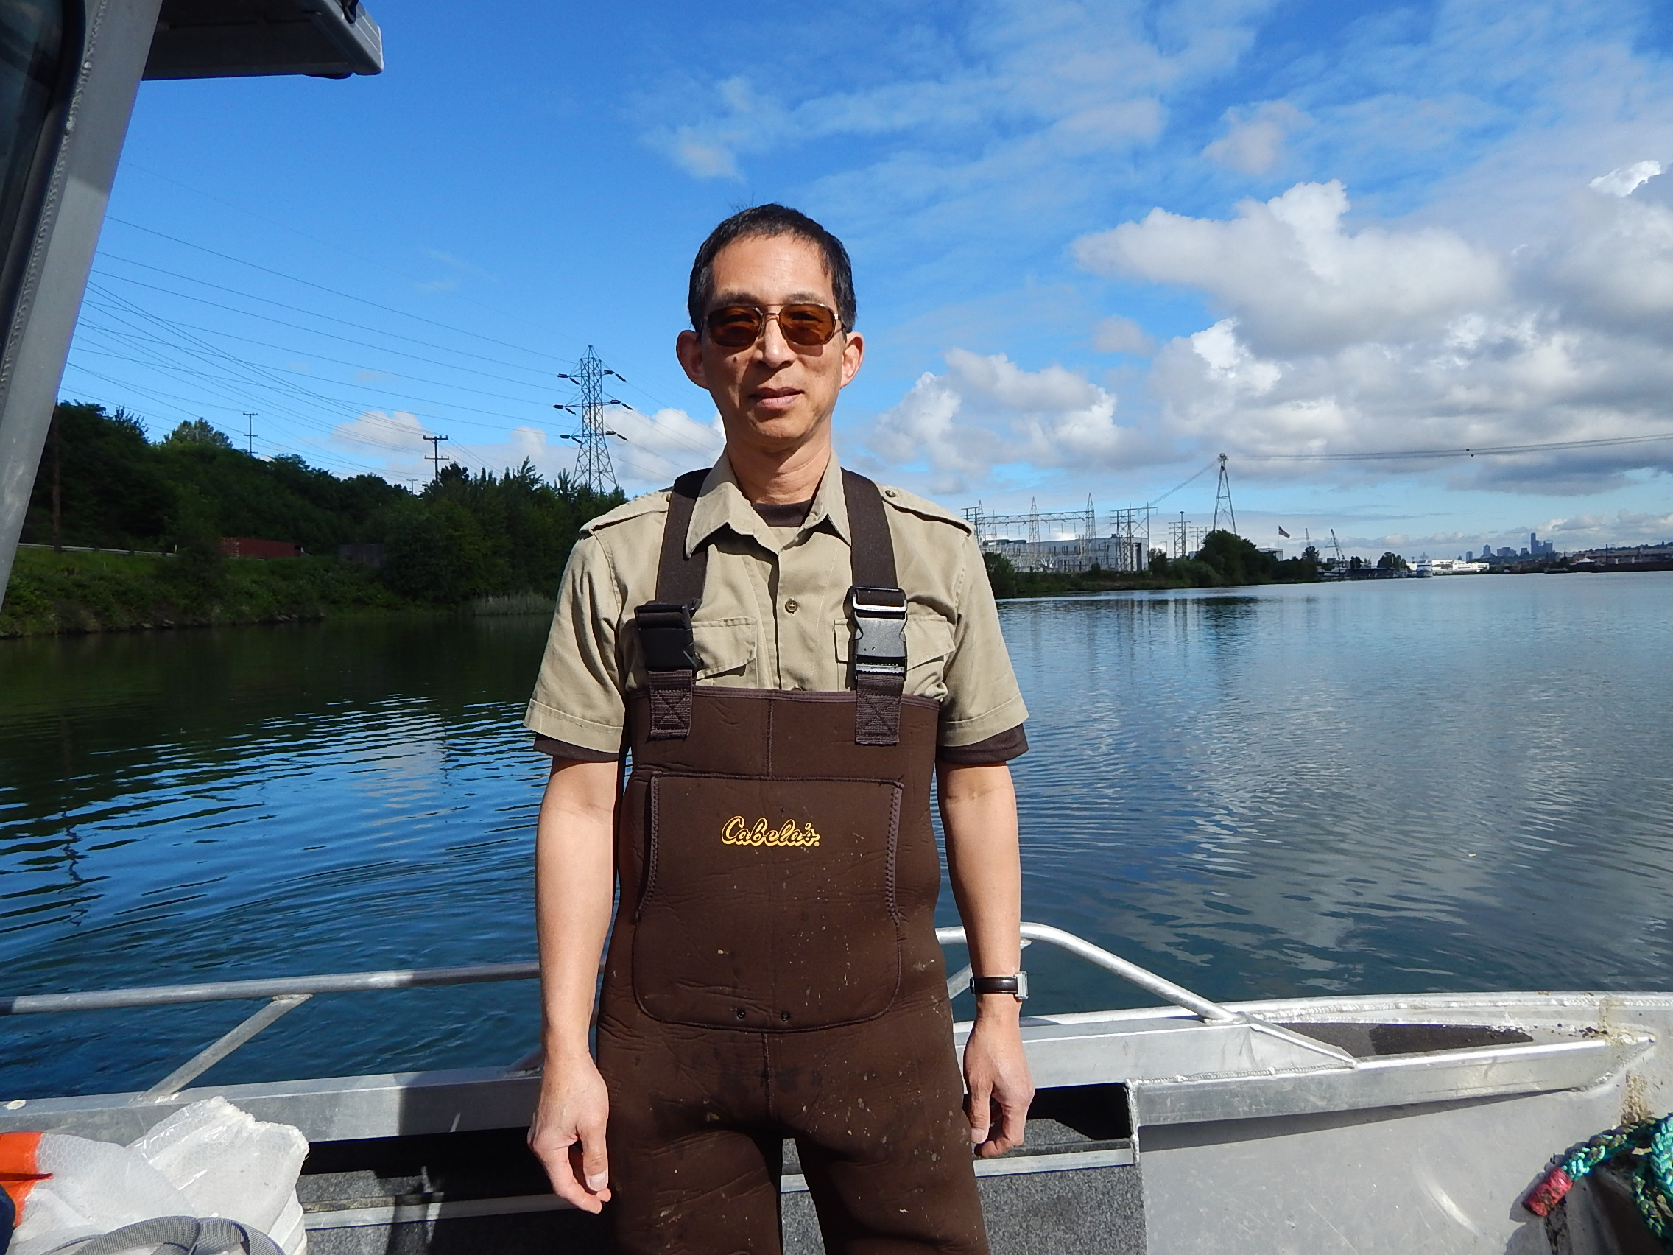
Bottom fishing MA 11,12,13
By Martin F Chen

Slide 2
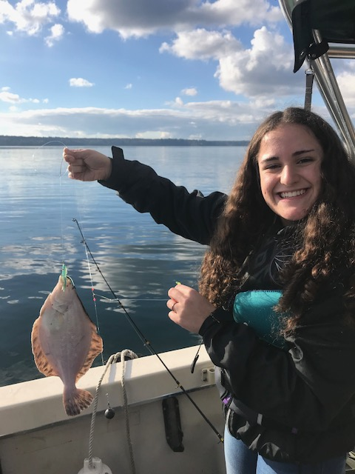
Rock sole
Right eyed flatfish to 23”, usually 10-16”
Small mouth
Irregular blotches on fins.
Prefer gravel bottoms.
Usual catch in cooler months.
Thin body- less meat than you think!

Slide 3
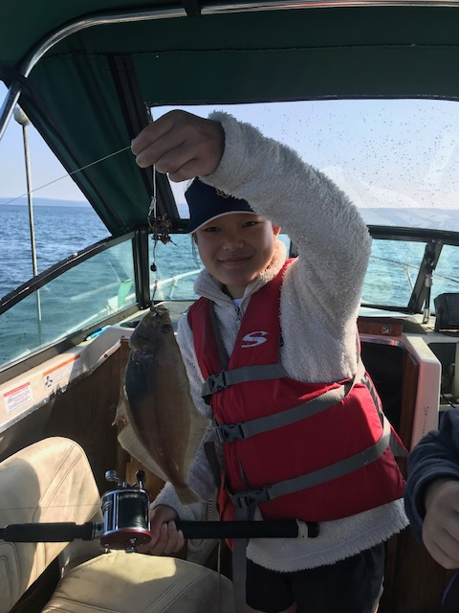
Sand dab
Left eyed flatfish to 16” usually 7-12”
Big mouth, caught jigging for salmon
Fins plain, orange spots on upper side
Mud-sand-gravel bottom
Move shallower in summer 30-60 feet
Deeper and harder to get in winter
Body is thick, makes a better fillet

Slide 4
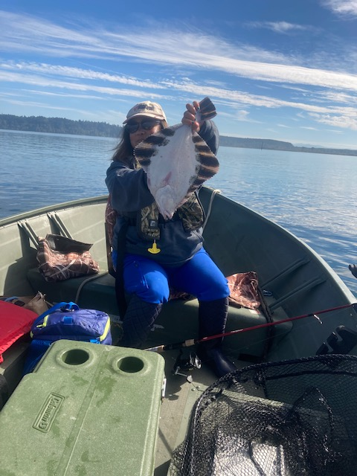
Starry Flounder
Right eyed to 36” and 20 lbs! Usually 12-16”
Fairly big mouth – caught sturgeon fishing
Very rough skin
Alternating black and orange bars on fins
Very shallow (surf) to very deep water
Also enters freshwater
Especially likes mud-gravel deltas
Mouths of rivers
Thick body – great eating

Slide 5
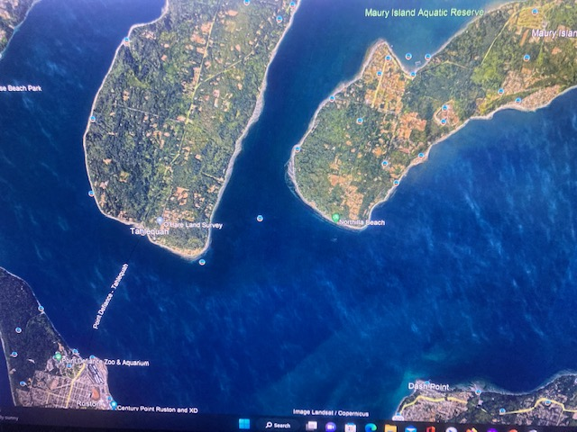
-
Area 11 – Quartermaster Harbor, East Side Maury Island-Sand dabs

Slide 6
Area 12 - Upper Dabob Bay, Triton Cove, Tahuya Delta – Sand Dabs
But current regulations only allow bottom fishing for flatfish in upper Dabob Bay

Slide 7
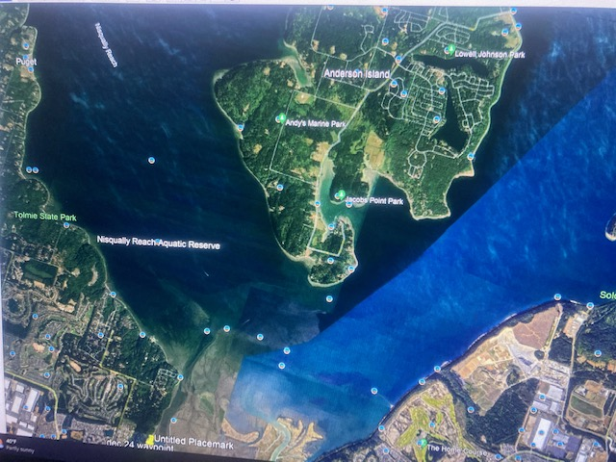
Area 13- Nisqually Reach: Edge Nisqually delta, Thompson Cove, Oro Bay, N end Ketron Island, Green Can off Tolmie – Sand Dabs (summer), Rock Sole, Starry Flounder

Slide 8
NW Area 13
Hit the shelf off the tip of Stretch Island. The famed northeast part of Pickering Passage was known as the “wormy flounder hole”

Slide 9
The gear: 2 dropper rig 1-3 ounces lead, size 6 baitholder hooks (debarbed)

Slide 10
Technique- drifting works best with low wind, weak tide, slack water. Dead end bays are good shelters from wind and tide.
7 foot medium action Uglystick with 12 lb baitcaster outfit (train kids to use revolving spool reels)
Tip hooks with bait: scented corn, clam neck tips, Power Nuggets, herring strip etc. Herring attracts dogfish in the summer.
Drop rig to bottom and bounce the sinker. Bring fish up slow and steady and you may get a double!
Limit of 15 combined bottomfish
Maximum depth of 120 feet
Descender rig must be tied on and ready to use

Slide 11
Boats and weather
Nisqually Delta can be fished with a kayak or even from shore.
The rest of the areas can be fished with an open outboard skiff or bigger.
Avoid wind and strong tide- Use forecasts and terrain.
If your line is angled way off vertical and you can’t feel bottom, you’re not going to connect.

Slide 12
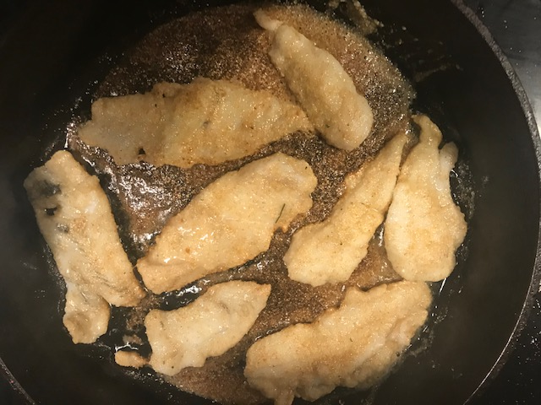
The eating: 4 fillets per fish – a lot of work! No DOH Consumption advisory for Flatfish Areas 11-13 However, Outmigrating Steelhead in Nisqually have PFAS

