Slide 1
SSPSA Fishing Seminar
Squid Fishing, Puget Sound
Cabela’s, 7:30 PM, October 5th, 2017

Slide 2
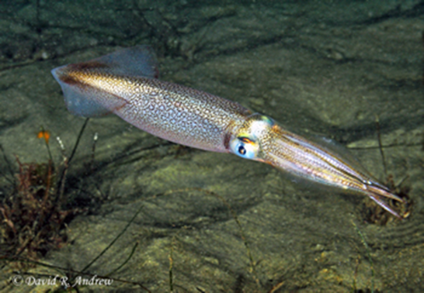
The Quarry
There are four types of squid found in Puget Sound
The most common species of squid found in Washington waters is known as market squid (Loligo opalescens) and measures less than a foot in size. With a long tapered body and triangular tail fins, these fast-moving, ten-armed mollusks are also known as calamari when prepared as food.

Slide 3
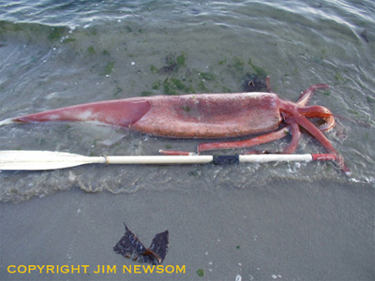
The Quarry
The Onykia robusta, the Robust Clubhook Squid, can grow to a maximum mantle length of 2 meters (making it the third largest squid after the Giant Squid and the Colossal squid). This species appears to follow sockeye salmon into Puget Sound during that fish's annual return from the open ocean during spawning season.

Slide 4
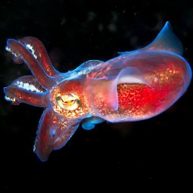
The Quarry
Stubby squid, also called a Bobtail squid, are closely related to the Cuttlefish and are a member of the cephalopods order in the family Sepiolidae, with the scientific name Sepiola atlantica. They have eight arms and two tentacles, and are roughly golfball sized. With the help of Bioluminescent bacteria in it’s skin, Stubby squid can change colors and patterns to match the environment or confuse predators. They can be found at all the most popular dive sites in Puget Sound, plus the Pacific Ocean, the Indian Ocean, and the Cape Peninsula of South Africa. We typically see them on night dives or during times of lower visibility, and in shallow water near eel grass beds.

Slide 5
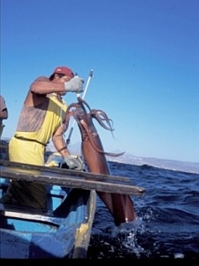
The Quarry
Occasionally a “Humboldt Squid” up to seven feet long and 100 lbs.

Slide 6
The Season
From the Strait of Juan de Fuca to south Puget Sound, recreational squid fishing in Washington state is available to sport anglers year round, although the best time to catch squid is during the fall and winter
A nighttime sport that requires simple, inexpensive fishing tackle, squid fishing-or jigging-typically takes place on the many piers and docks throughout the Puget Sound region.
Squid found along Washington's coast, the Strait of Juan de Fuca and Puget Sound are called Pacific squid, opalescent, or-most commonly-market squid (Loligo opalescens). Adult market squid found in inside waters average about eight inches (mantle plus tentacles).

Slide 7
The squid calendar
During progressive time slots between late May and the following February, adult squid can be found in almost all waters of the Strait of Juan de Fuca and Puget Sound. The map below shows where and when squid generally appear at various public piers.
While reasons for their migration aren’t entirely known, many experts believe the location of squid populations is likely a combination of an ocean-to-South Sound migration of adult squid and resident populations that yield new generations as site conditions become favorable.
Squid feed mainly at night and are attracted to light, which is why public piers are good locations for anglers. Hungry squid lurk in the dark fringes near patches of lighted water and then dart into the bright area in pursuit of food such as young herring and other small fishes

Slide 8
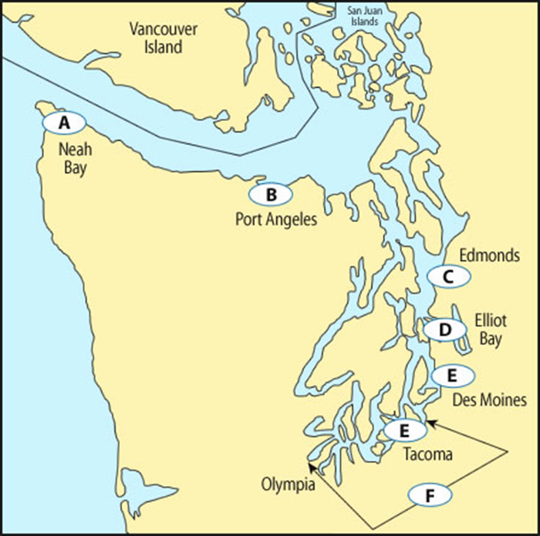
Squid Migration: When and where
A. Squid are usually first seen in Neah Bay in late May
B. Squid present at City Pier and surrounding area from late June to the end of August
C. Squid appear near Edmonds waterfront starting about September
D. Squid in Elliot Bay and surrounding Seattle shoreline
E. Squid appear in Des Moines and Tacoma in late November and December
F. Squid likely throughout South Puget Sound in December and January

Slide 9
Gear
Almost any style of rod and reel will work. Think "light and long" because it's best to have something that is sensitive and telegraphs slight changes.
Successful squidders use anything from six to 20-pound line but the best chances of success come with the lighter line

Slide 10
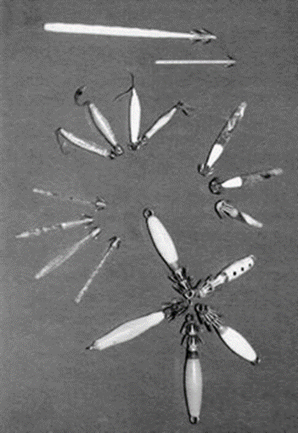
Gear, Lures
The photo on this page gives an idea of the uniqueness of squid lures. It's the "hook" part that is different. Squid lures vary in length and thickness, and color and pattern, but they all have a distinctive upward slanting "ray" or two of sharp prongs

Slide 11
Gear, Lures
Since the idea is to attract the attention of the squid that are watching that lighted area in the water, almost all lures are either luminous or have something embedded in them (metal, etc.) to reflect light.
Most squid jigs are made out of tinted, relatively clear plastic. Common colors are blue, pink, green, red, orange, amber and no-color (clear). Commercial jigs commonly range in size between two and four inches although some are twice as long and pencil thin.
If using an unweighted lure, anglers should buy some one-ounce lead weights to maneuver the lure down to the desired depth.

Slide 12
Gear - Lighting
Squid generally start feeding just after dark and then often tapers off until midnight or later.
Odds of catching a squid are more favorable during high tide on a cloudy or rainy night. These conditions give the nearshore water the depth that squid prefer plus a setting in which the artificial light will be most noticeable.
In many areas, a single lure works best. For example, at Edmonds, most of the successful anglers use a single lure. The tall pole lights at the Edmonds pier shine farther out into the water meaning that you need to cast your lure farther out.
In other places, multiple lures (up to four) are better. By putting lures of different sizes and colors on the line anglers can test which type is attractive to the squid at that site, that night, at that time

Slide 13
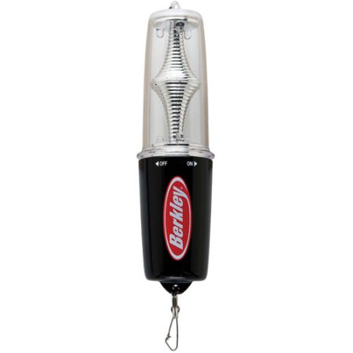
Gear – Lighting - Supplemental
When piers are have no light or low lighting, you can add lighting by using a floating or submersible 12 volt light.

Slide 14
Gear, Lures
Anglers should also experiment with the arrangement of the set of lures. Sometimes putting the same lures in different order on the line makes a difference. A favorite method of setting up with three lures is to space four-inch dropper lines 16 inches apart on the main line. Then add a one-ounce weight to the end of the main line.

Slide 15
Jigging
Single lure: If using a single lure, cast it out some distance from the dock (or boat or bulkhead) and allow it to sink to a depth where the squid may be lurking. Retrieve it with a series of steady jerks or "jigs."
Multiple lures: If using multiple lures, drop them into the lighted area of the water. Lower them down to the chosen depth (which frequently is just off bottom) then slowly raise them up and down in the water column.
Again knowing how challenging squid can be, no one style of lure is a constant winner. The specific environmental conditions dictate what is going to work or isn't.

Slide 16
Depth
Depth is a critical factor in the pursuit of squid. Having jigs working at different depths often spells "luck" or lack of it for side-by-side anglers.
Keep in mind that squid are congregational beings and stay gathered in schools.

Slide 17
How to land a squid
Squid hole up in the darkness near lighted water areas then lunge into the brighter arena when they see something that looks edible. They don't "bite," however. They deftly wrap their tentacles around their intended prey.
The feel: Squid are those ghost-like "streaks" in the water and it's good to keep their fleetness in mind. Squids propel themselves backward by forcibly expelling water through a tiny nozzle that is part of their anatomy. They also can swim backward and forward, using their fins.
When a slight change in the behavior of your gear is felt, jerk upward to set the hooks immediately. Then keep a steady upward motion when reeling or lifting the catch to the surface. The hooks on squid jigs are barbless and most of the time the squid isn't really hooked, only entwined in the prongs so any slack in the line will lose the catch.

Slide 18
Two words of caution
Squid have a defense mechanism - dark ink. They shoot the ink at intruders who come too close. In the water it is an effective defense that creates a cloud behind which the squid makes a quick getaway.
Don't be overly distressed about getting squid ink on your hands and clothes, however. Not surprisingly, the ink is water soluble and washes out if you act quickly before it dries.
A second note of caution is the possibility of bites. It's good to remember that these creatures do have a parrot-like beak. Although squid are not likely to bite at a lure, they can and do bite things like food and perceived enemies who are not alert.

Slide 19
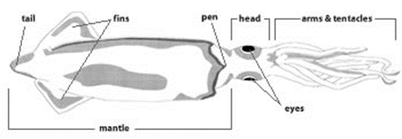
Cleaning Squid
There are two basic ways of cleaning squid depending on whether the recipe calls for cutlets or strips or the whole mantle or rings. The sketches and directions below give these two methods.

Slide 20
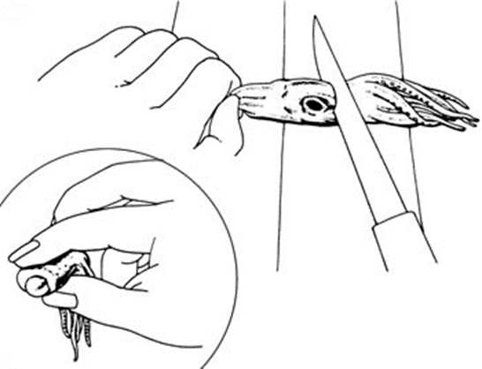
Cleaning Squid - Method A (This method is the faster of the two. Use if recipe calls for cutlets or strips)
Step 1: Slip knife inside mantle and slit lengthwise along underside, or belly. Open mantle and scrape away viscera and pen (transparent backbone).
Step 2: To remove tentacles, cut in front of eyes. Squeeze tentacles near cut end to pop out hard, chitinous beak (see inset). Discard beak, pen, head and viscera. Reserve mantle and tentacles.

Slide 21
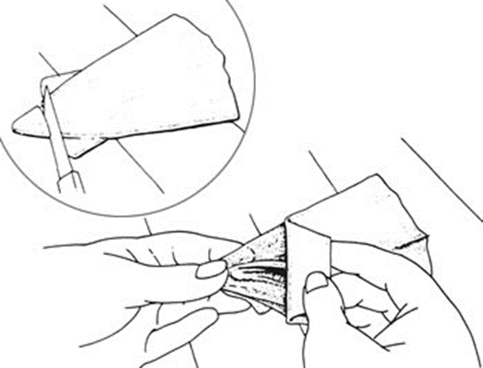
Cleaning Squid - Method A (cont.)
Step 3: Make cut in mantle about 1/4-inch from tail end (see inset). Holding membrane near cut, pull mantle away from membrane. Discard membrane. Rinse mantle with cold water; pat dry with paper towels. Use mantle whole or cut into strips widthwise. Use tentacles in recipe, or fry and serve as an appetizer.

Slide 22
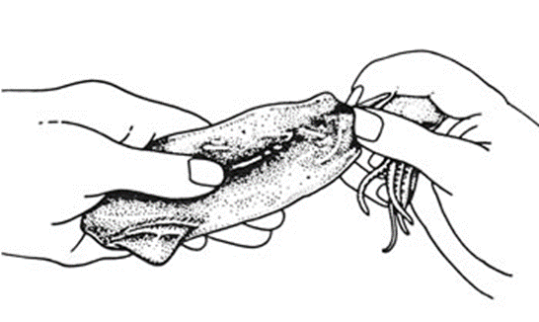
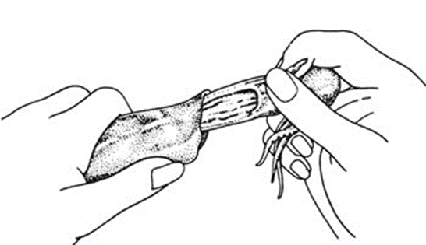
Cleaning Squid - Method B (Use if recipe calls for whole mantles or rings)
Step 1: Holding mantle in one hand, pinch pen (transparent backbone) with index finger and thumb of opposite hand, separating pen from mantle.
Step 2: Gently pull pen out of mantle, easing viscera out along with pen. Cut away tentacles as in Method A, Step 2.

Slide 23
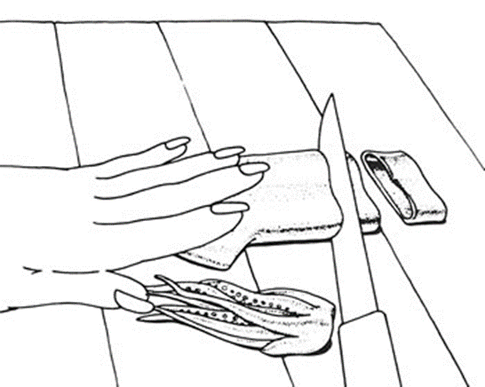
Cleaning Squid - Method B (cont.)
Step 3: (Not illustrated) Scrape membrane to loosen from mantle. Peel away all membrane and discard. Rinse mantle thoroughly with cold water to remove any remaining viscera. Pat dry with paper towels.
Step 4: Use mantle whole or cut into rings. Use tentacles in recipe, or fry and serve as an appetizer.

Slide 24
Rules and Regulations

Slide 25
Recipes
Enjoying the catch
Squid, or calamari, is lower in fat and calories than many other protein sources and is beautifully versatile. It can be used for appetizers, soups, salads or main dishes.
It can be sautéed, simmered, stir-fried or baked. It also can be pickled. It can be used in small pieces, in strips, in rings, as a tube with stuffing or in flat filets. Squid also blends itself into many flavor personalities. There are Scandinavian, Asian, Mexican, French, Russian, Spanish, Italian and, of course, American squid variations.
Squid makes awesome bait for salmon, and all forms of bottom fish.

Slide 26
Recipes
Hints for the chef
Squid belong to the same group of animals as clams, scallops, oysters and abalone.
The flesh is firm, contains very little natural juice and is delicate.
To enjoy the best of this fragile seafood, be careful about cooking times. Three minutes is the maximum time for a sauté and 20 minutes the minimum time for a stew.
The same goes for marinades. Timing is important. Lacking its own juices, squid quickly absorbs marinades and their flavorings. Thirty minutes is probably the maximum soaking time.

Slide 27
Recipes
Calamari
For those who haven't cooked squid before, this favorite recipe for pan-fried squid is an easy way to start.
o Cleaned squid cut into 1-in. rings
o Flour
o 2/3 cup bread crumbs, mixed with
o 1 /3 cup Parmesan cheese
o Milk or egg beaten with 1 Tbs. water
o Your choice of oil (olive, peanut, vegetable, etc.)
Dredge squid rings in flour, dip in milk (or egg mixture), roll in crumb mixture. Allow to rest a few minutes to set crumbs. Fry quickly in oil until golden (about 1 minute on medium heat).

Slide 28
Recipes
Squid Spread
• 3 lbs. whole squid mantles, cleaned
• 1/2 cup sour cream
• 1 /2 cup mayonnaise
• 2 oz. chopped pimiento
• 1 Tbs. lemon juice
• 1 tsp. dried dill weed
• Salt to taste
Cook mantles in boiling, salted water for 20 minutes or until tender. Drain. Chop squid into small pieces. Mix squid, sour cream, mayonnaise, and pimientos. Add lemon juice, dill weed and salt. Serve chilled with crackers or assorted vegetables

Slide 29
Recipes
Stuffed Calamari
The whole mantles can be used as alternates for tube-shaped pastas, such as manicotti. Here is one such Italian-style recipe.
• 2 lbs. cleaned squid mantles (whole)
• 3/4 cup ricotta cheese
• 3/4 cup grated mozzarella cheese
• 2 Tbs. chopped parsley
• 1 tsp. dried oregano
• 1 tsp. dried basil
• 1/4 cup chopped almonds
• 1/2 cup coarse bread crumbs
• 1 cup coarsely chopped mushrooms
• 2 cup marinara sauce (purchased or your favorite recipe)
• 2 Tbs. grated Parmesan cheese
• 1/3 cup grated mozzarella cheese
Combine ricotta, 3/4 c. mozzarella, parsley, oregano, basil, Parmesan and almonds and mix well. Stir in bread crumbs and mushrooms. Stuff squid mantles until plump but not packed. Close opening and secure with toothpick. Pour small amount of marinara sauce into 11x17 inch glass or ceramic baking dish. Arrange squid in single layer in dish. Top with marinara sauce and bake uncovered at 350 F. for 20 minutes. Top with remaining 1/3 c. mozzarella and bake an additional 10 minutes or until squid is tender and filling is bubbly. Serves 4.

Slide 30
Recipes
Squid Oriental
Use squid rings or pieces in favorite stir-fry recipes. They go well with Chinese or Japanese style vegetables cooked in a wok.
Calamari Athena
Here is calamari in Greek attire.
• 3 lbs. cleaned squid, whole or filets
• 2 Tbs. olive oil
• 1 cup chopped onion
• 1 clove garlic, finely chopped
• 2-1/2 cup chopped tomatoes
• 1/2 cup chopped parsley
• 1/2 tsp. salt
• Dash pepper
• 1/2 tsp. basil
• 1/2 tsp. oregano
Cook squid in boiling, salted water about 1 hour or until tender. Drain. Cut into pieces. Sauté onion and garlic in hot oil until brown. Add tomatoes, parsley, seasonings, and squid. Cook until tender. Serve hot over rice. Serves 6.8

Slide 31
South Sound Puget Sound Anglers
Become a member of SSPSA and receive many tips, like this, to improve your angling experience.
Annual dues are $35 per year. Included are SSPSA monthly news letter, subscription to the “Reel News”, entry into the first annual Multi-Species Fishing Contest, access to many seasoned anglers, organized outings plus monthly speakers focusing on topics relevant to the seasons.
General Meeting : Our next meeting will be at the Lacey Community Center, 6729 Pacific Ave SE, Lacey, WA on Thursday, November 2nd. Come and bring a friend. Visitors are always welcome!
www.pugetsoundanglers.org ◊ www.sschapterpsa.com

