Slide 1
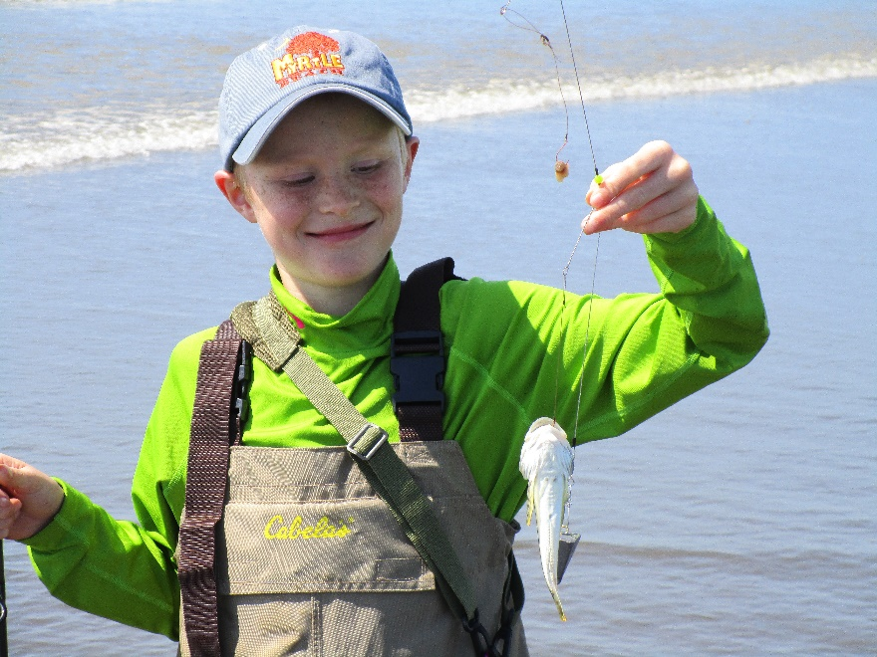
Why fish for surf perch?
Cheap (you probably have the gear you need)
Good exercise
Easy (fun for most ages)
Generous bag limits
12 per day in Washington
15 per day in Oregon
Delicious to eat (mild, white fish)
4/10/2016

Slide 2
When to fish for surf perch?
365 days per year
Surf 6-8 feet or lower (Magic Seaweed phone app)
Wind less than 20 knots
High slack tide ± 1 hour
Low slack tide ± 1 hour
Any other tide (outgoing a little easier)
Late spring (May, June) spawn
4/10/2016

Slide 3
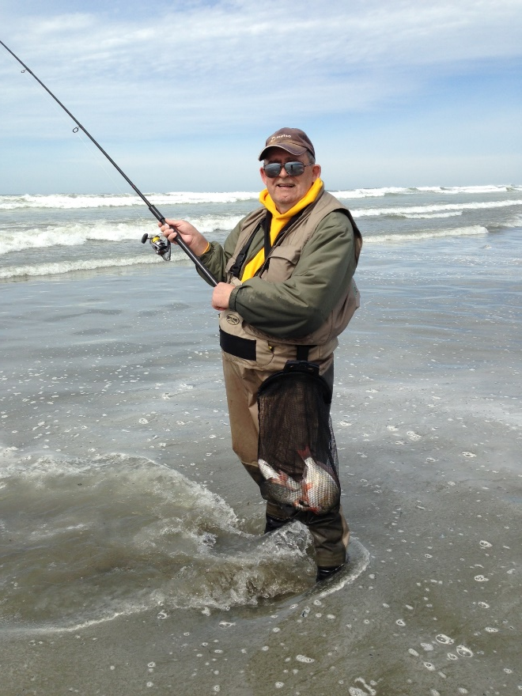
Where to fish for surf perch?
Any NW beach
Bottom contours
Drainage areas
Steeper (more gravel) beaches
Dirty water?
4/10/2016

Slide 4
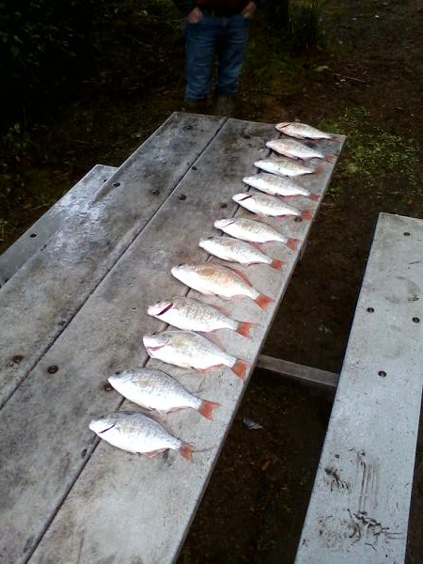
What you need to fish for surf perch?
Chest waders
Spinning rod 8½’ to 14’
± 20# line (braid preferred)
Spreader
Weight
Claw, Pyramid, Pancake, other
1 – 4 ounces
#6 to #2 hook (Gamakatsu #4 baitholder preferred)
Bait (Clam necks, Berkley Saltwater sand worms, Kroger shrimp)
Catch bag (with shoulder strap)
4/10/2016

Slide 5
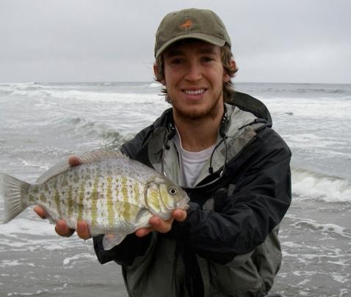
Optional gear to fish for surf perch?
Small tackle bag
Assorted weights (1 – 4 ounces)
Spare spreader
Hooks, swivels, leader
Knife
Pliers
Crab Gauge
Wading Jacket
Gloves
Scent (Ultra Clam or Shrimp)
PFD (Personal Flotation Device)
Cooler with ice
4/10/2016

Slide 6
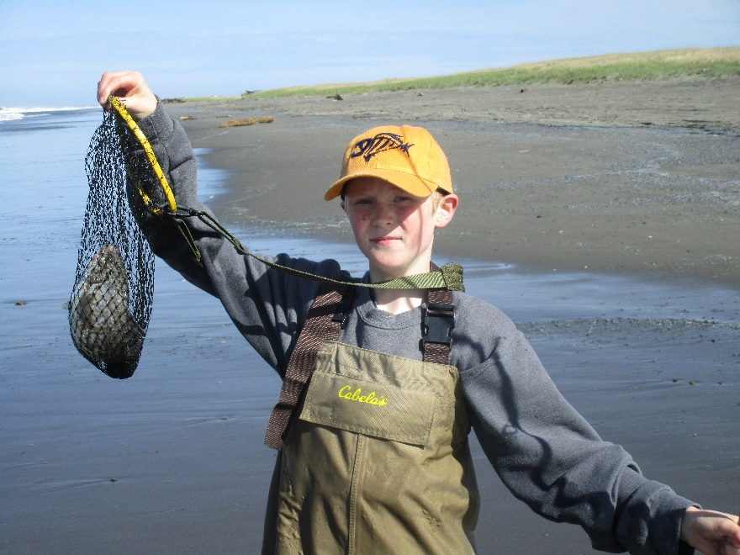
How to fish for surf perch?
Wade out
Cast (as far as you can)
Tighten line
Retreat back onto beach playing out line
5 – 10 minutes
Move
Along beach
Drift with current
50 – 100 yards
Another beach
4/10/2016

