Slide 1
Deep Learning Empowered Computer-assisted Diagnosis on Smartphone Skin Images
Junyan Wu, VoxelCloud
junyanwu@voxelcloud.io
Improving Healthcare with AI
Notes:
Today I am going to introduce our research work
My name is Junyan Wu. I am from Voxelcloud
Robert Dellavalle

Slide 2
Lack of Dermatologist
Diagnostic accuracy for non-specialists(PCP, Nurse) is only 24-70%
For melanoma diagnosis, sensitivity was 0.81 to 1.00 for dermatologists and 0.42 to 1.00 for PCPs.
junyanwu@voxelcloud.io
Notes:
According to JAAD 2017’s research, we have around 10 thousand dermatologist in US, 3.4 dermtologists for 100thouthands people. Around 175 dermatologist increasing each year.
We are sort of lack of certified dermatologists
Because they don’t have enough training in dermatology. Their diagnostic accuracy is far lower than certified dermatologist.
It’s a emerging issue to help especially non-speciallists to improve their diagnostic accuracy.
PCP 资源-> special non-special
Tel-medicine
https://practicaldermatology.com/articles/2019-july/guideposts-for-the-future-of-medical-dermatology

Slide 3
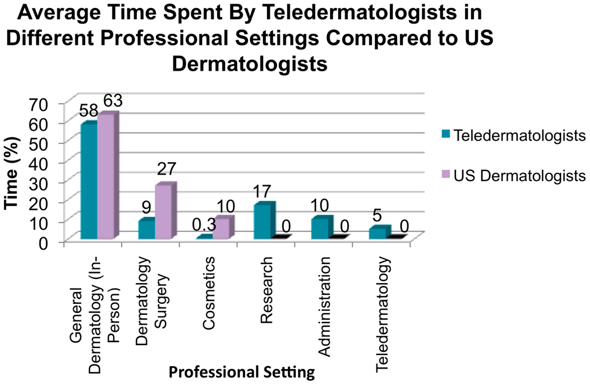
The store-and-forward teledermatology has become more popular, with the number of programs increasing by 48% in U.S. non-governmental programs between 2011 and 2016​.
junyanwu@voxelcloud.io
Notes:
store-and-forward teledermatology has become more popular, with the number of programs increasing by 48% in U.S. non-governmental programs between 2011 and 2016​. More and more people use telmedicine
According to previous research, for general dermatologist, more than half of their time spent on telemedicine platform.
So we start from telemedicine platform, there are so many information we can use to train an AI algorithm for better assisting this process.

Slide 4
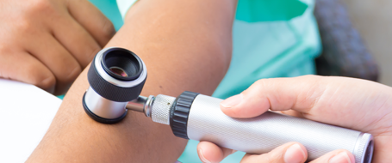
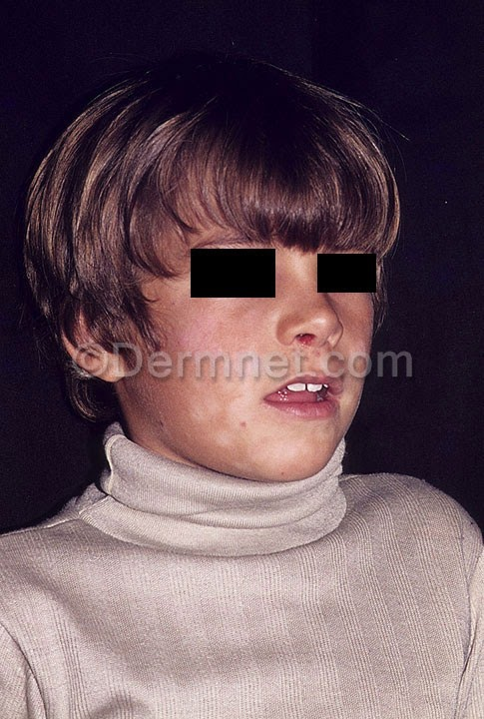
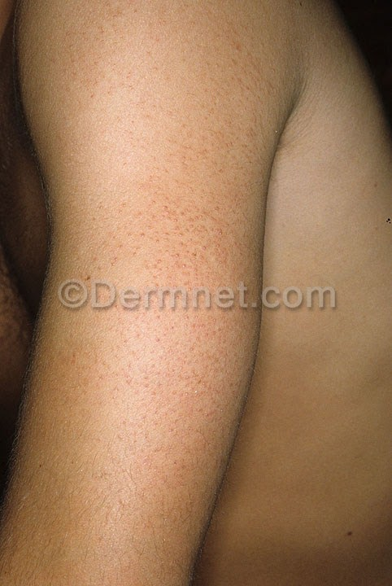
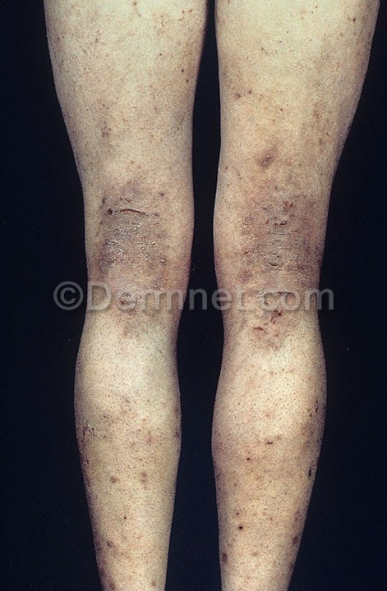
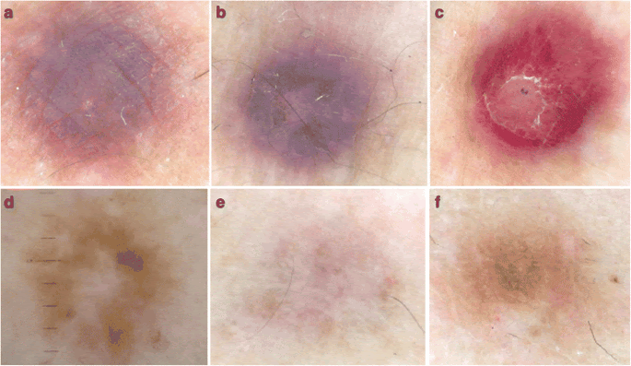
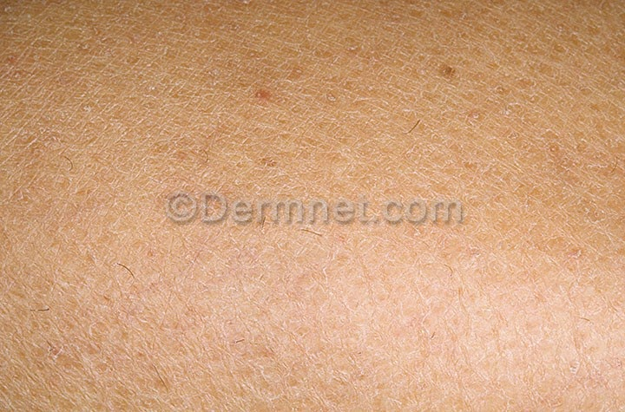
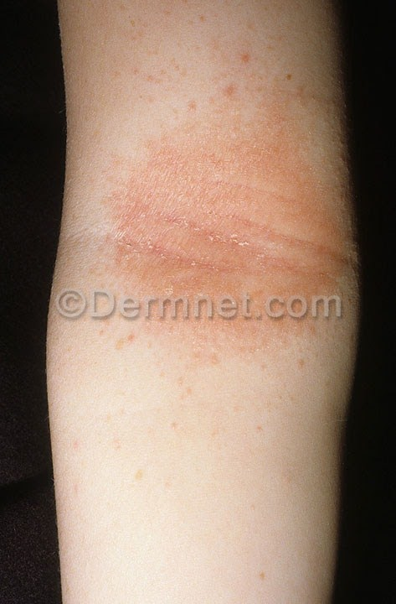
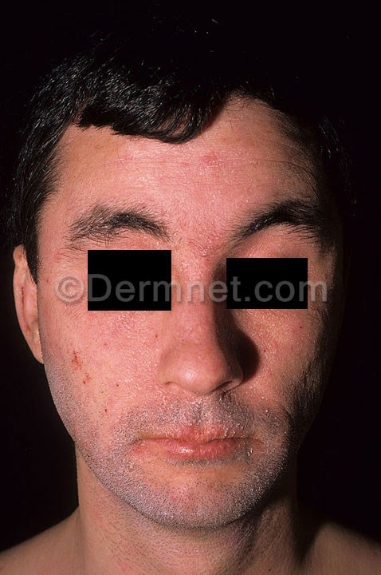
Dermoscopy Images
Clinical Photographs
Unnecessary for many common skin disease
Lack of research on non-cancerous conditions
junyanwu@voxelcloud.io
Notes:
One of the useful information is the skin images.
The use of artificial intelligence tools is a promising method of broadening the availability of dermatology expertise. Recent advances in deep learning have facilitated the development of artificial intelligence tools to assist in diagnosing skin disorders from images.
Many prior works have focused on the visual recognition of skin lesions from dermoscopic images​, which require a dermascope. However, dermascopes are usually inaccessible outside of dermatology clinics and are unnecessary for many common skin diseases.
By contrast, other research have attended to clinical photographs. Many of prior research focus on cancers and reported comparable performance to experts on binary classification tasks (benign. malignant) or on skin lesion conditions​. Though the majority of the papers examined individual skin lesions, dermatologic conditions seen in routine practice more commonly include non-cancerous conditions such as inflammatory dermatoses and pigmentary issues​​. These skin problems have yet to be addressed despite their highprevalence and similarly low diagnostic accuracy by non-specialists​

Slide 5
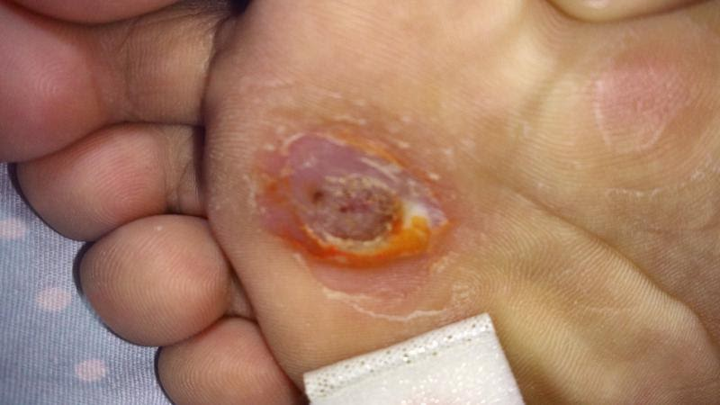
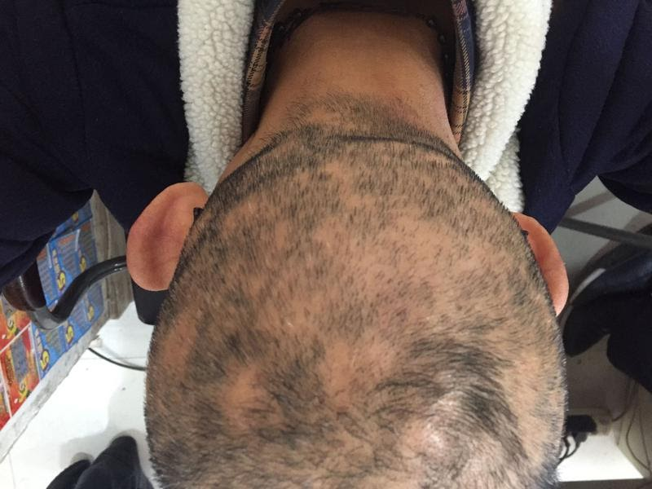
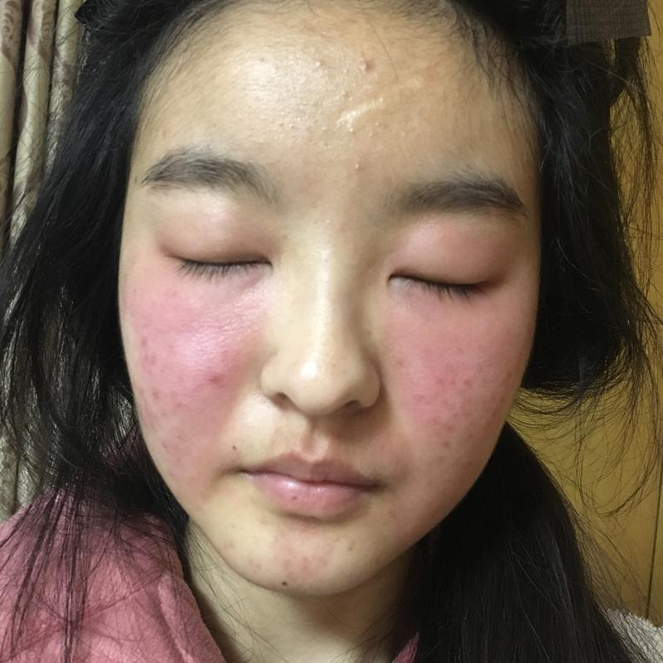
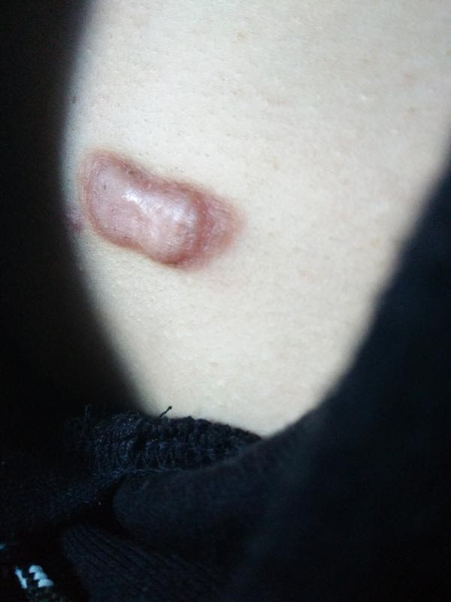
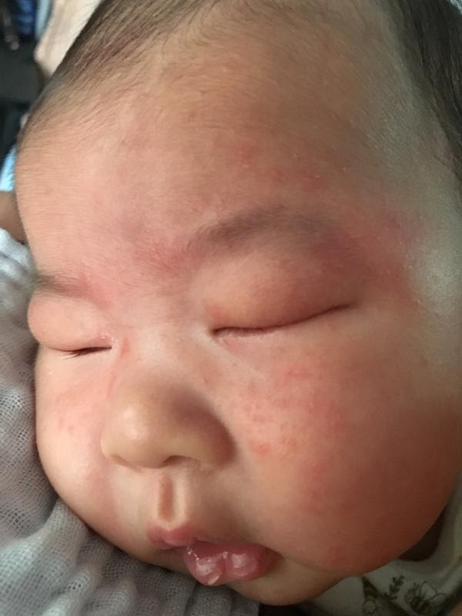
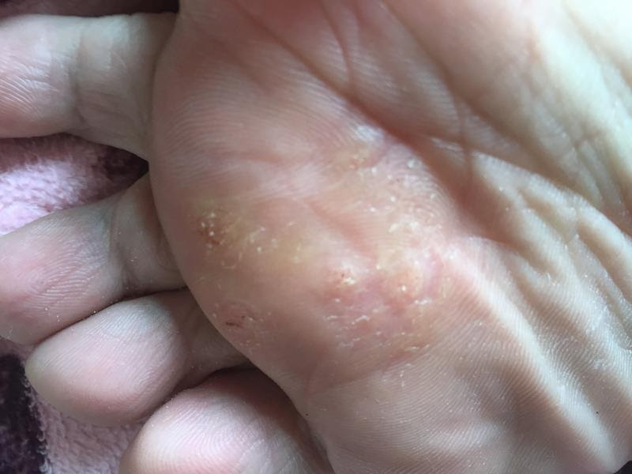
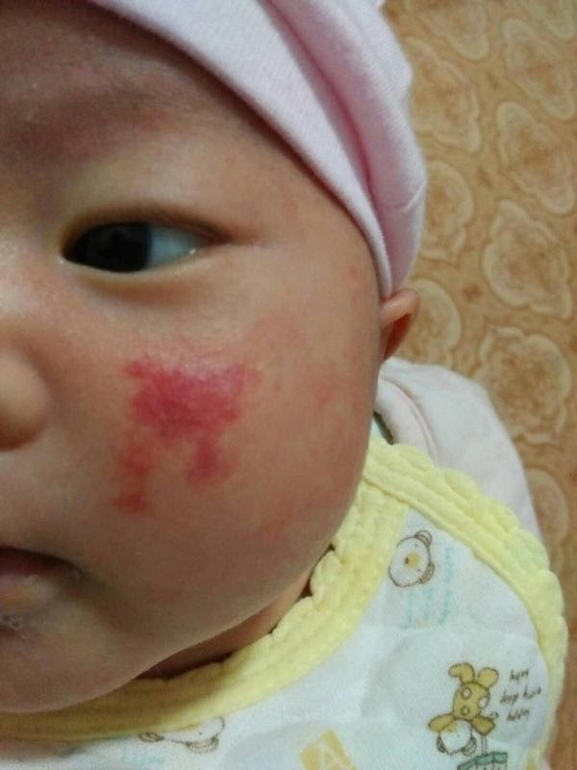
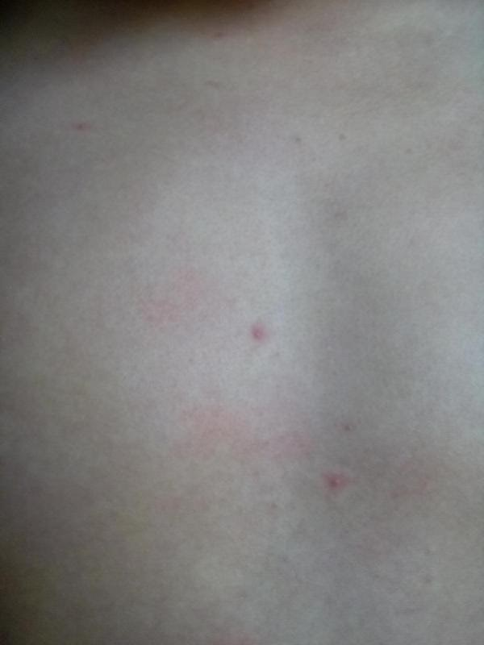
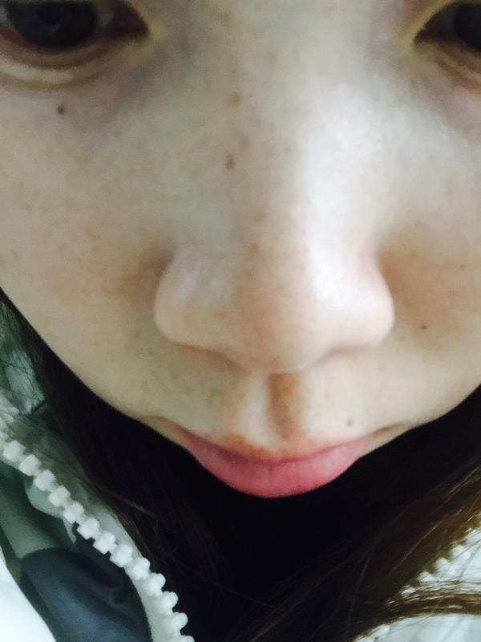
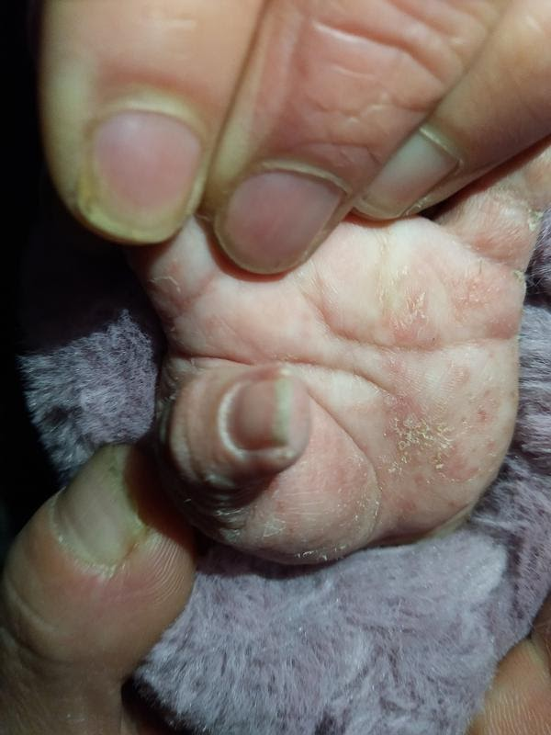
Lack of work focusing on patient taken images.
Lack of work for differential diagnosis
Patient taken Images
junyanwu@voxelcloud.io
Notes:
However, in our research we focus more on patient taken images, which have the highest amount during online consulting. This type of image is missing in previous study.
And also we tackle differential diagnosis issue which is pretty common during physician practices. The previous studies only output one class of skin condition. Doesn’t have any oppinion for similar conditions. Instead, our model will provide a ranked list of conditions with high possibilities.

Slide 6
The most difficult (i.e., low quality smartphone) images:
easy for us to cover other (higher quality) images
User taken images with phone
Physician taken images with phones
Physician taken images with cameras
Dermatoscope on smart phones
Skin imaging devices
Image Quality
Low
High
R&D Difficulty
HIGH
Low
junyanwu@voxelcloud.io
Notes:
According to the imaging quality from low to high, there are patient taken ….
And the lower image quality the higher difficulties for building a Computer vision model.

Slide 7
Skin Data Used to Date to Train our AI
Source: 110K+ annotated patient-taken skin images collected from major Chinese telemedicine platforms
Annotation:
Each image was annotated by at least 2 dermatologists mutual blindly.
Diversity:
1000+ skin conditions
Lesion types
Mild to severe
Various locations, devices, lighting, angles, etc.
Only in mainland China
7
junyanwu@voxelcloud.io

Slide 8
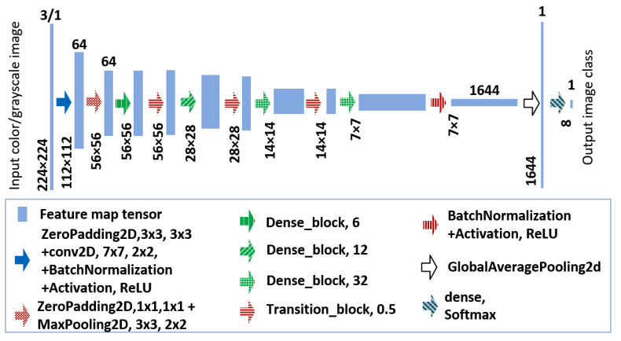
Results
#Dx | top1 accuracy | top3 accuracy | coverage error | label ranking average precision
30 | 0.7708 | 0.9194 | 1.4171 | 0.9392
151 | 0.7311 | 0.8951 | 5.8277 | 0.7468
junyanwu@voxelcloud.io
Notes:
We adopt most successful deep neural network architecture densenet169 which consist 169 layers of convolutional operation(so called artificial neurons)
Coverage error indicates how many top ranked conditions do we need to look at to cover all the true labels.
Label ranking average precision is calculated for each ground truth label, what fraction of higher-ranked labels were true labels.

Slide 9
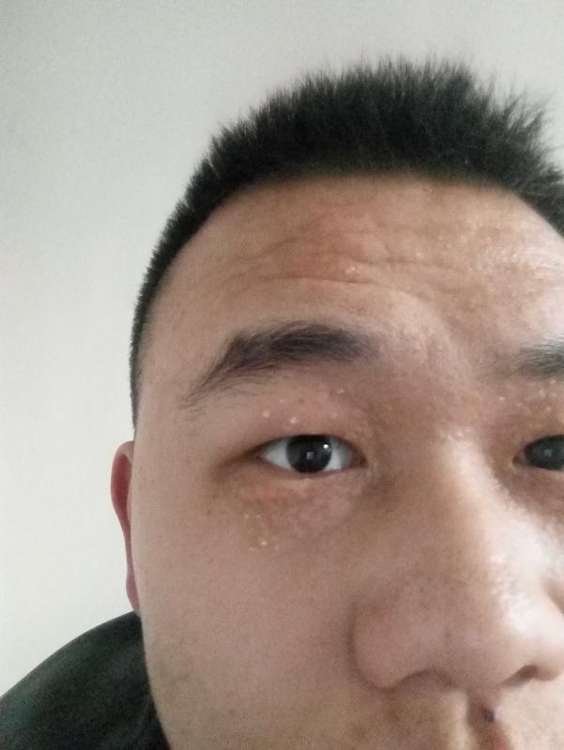
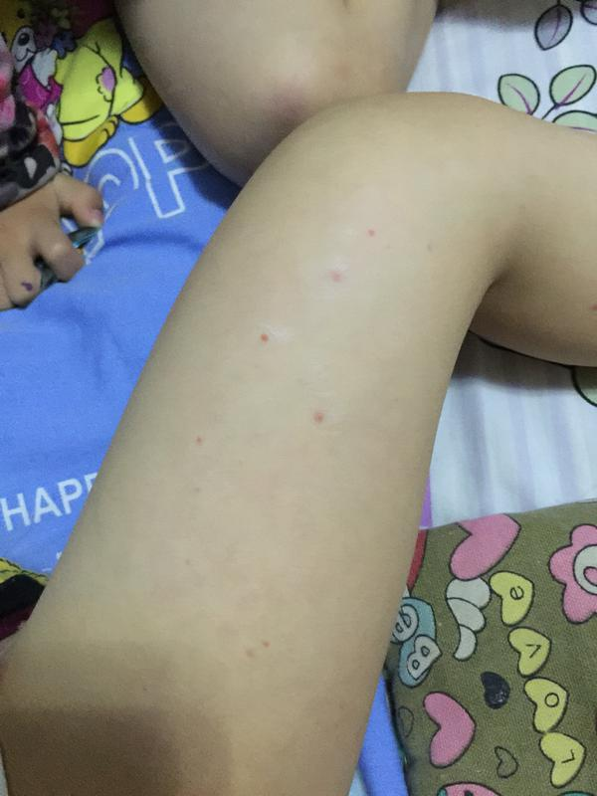
Syringoma
0.926
Milia
0.823
Purpura
0.622
Worm bite dermatitis
0.680
junyanwu@voxelcloud.io
Notes:
To give you a sense of model predictions, here are some examples

Slide 10
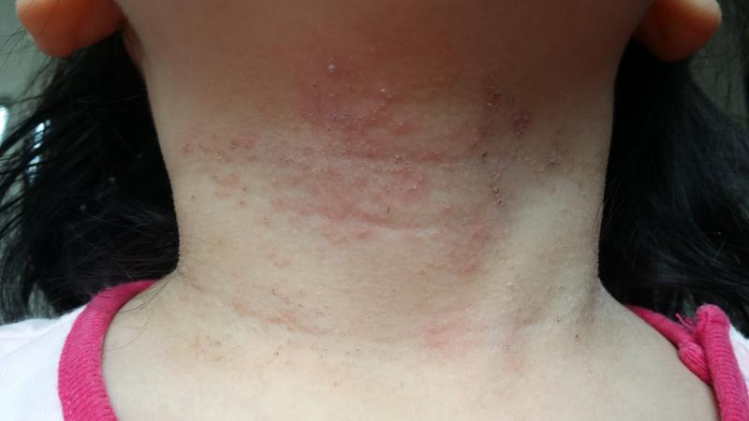
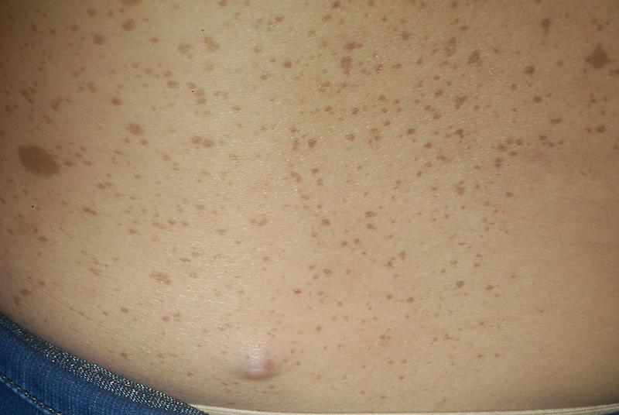
Allergic dermatitis Hypersensitive dermatitis
0.896
Atopic dermatitis
0.797
Heat rash
0.721
Cafe-au-Lait Spots
0.616
Cutaneous fibroma
0.911
Neurofibroma
0.982
junyanwu@voxelcloud.io

Slide 11
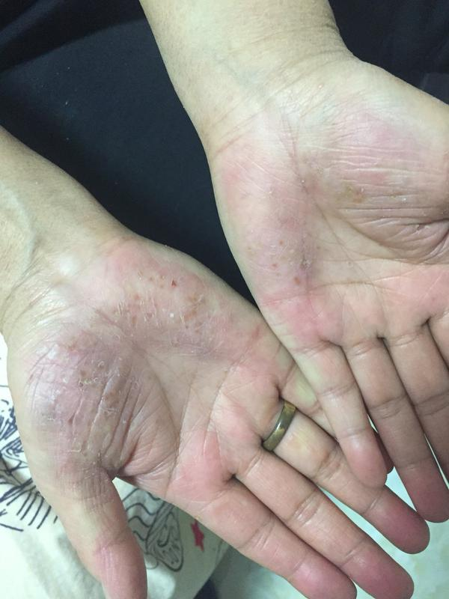
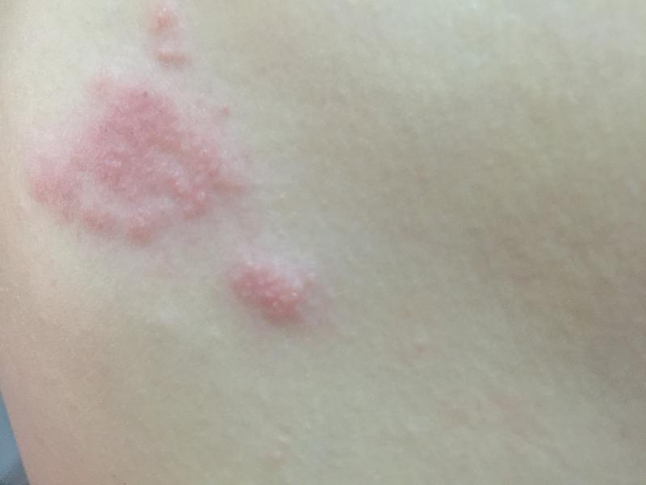
Tinea manuum
0.904
Hand eczema
0.957
Chronic eczema
0.536
Shingles Herpes Zoster
0.997
Herpes simplex
0.742
junyanwu@voxelcloud.io

Slide 12
Performance Comparison
 | image type | #Dx | top1 accuracy | top3 accuracy | top5 accuracy
Google (2019) | clinical images | 26 | 0.71 | 0.93 | NA
Seung et al. (2020) | clinical images | 174 | 0.567 | NA | 0.92
ours | patient images | 151 | 0.731 | 0.895 | 0.939
junyanwu@voxelcloud.io
Notes:
At this level of number of skin conditions, we are pretty much overcome the previous relative work.
And we prove the efficacy of deep learning model to classify the skin conditions on patient taken smartphone skin images.

Slide 13
Thanks!
We are looking for research collaboration
Email to junyanwu@voxelcloud.io
13
junyanwu@voxelcloud.io
Notes:
Well funded，back by sequra and tencent. focusing on skin issue

