Slide 1
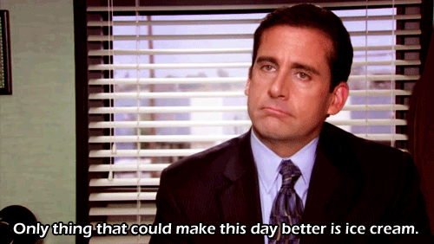
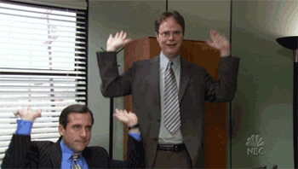
Bears, Beets, Building Better Teams
2019 California FFA State Convention

Slide 2


Slide 3
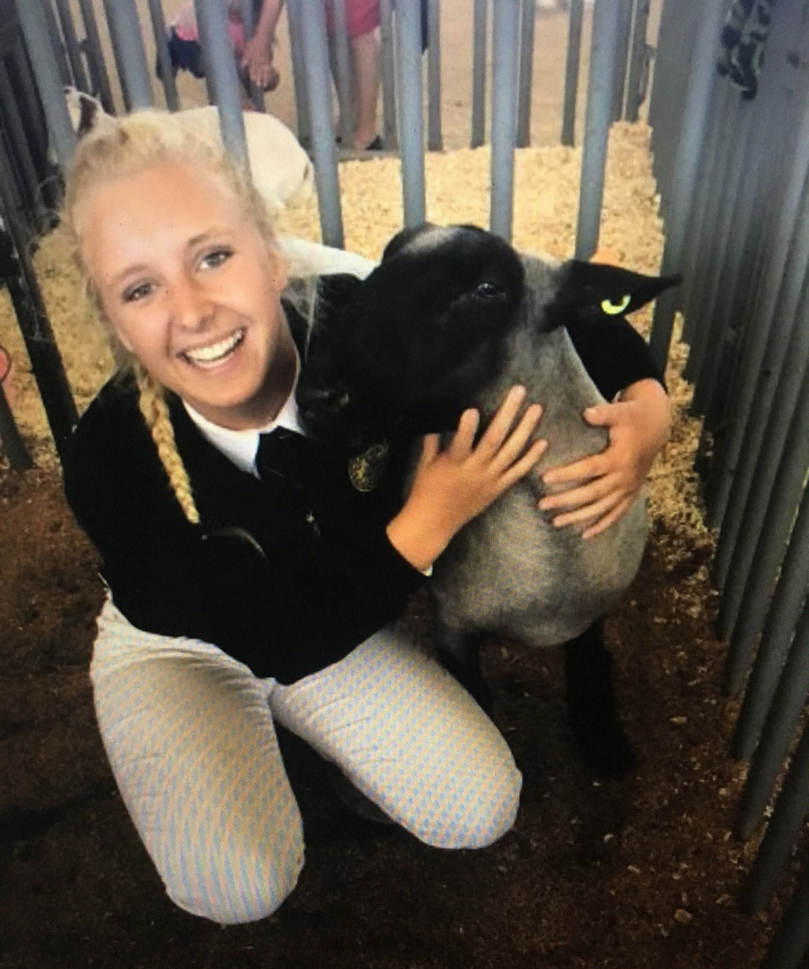
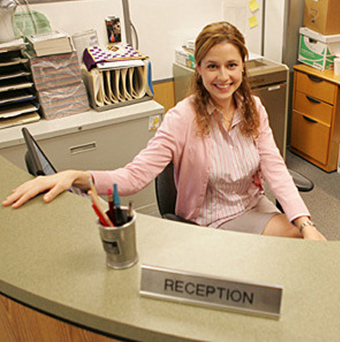
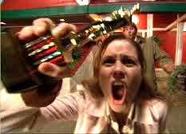
Hailey Baldwin
Alter Ego: Pamela Beesly
First-year Agricultural Science Major
4-Year Escondido FFA member
Favorite Office Character: Dwight Schrute

Slide 4
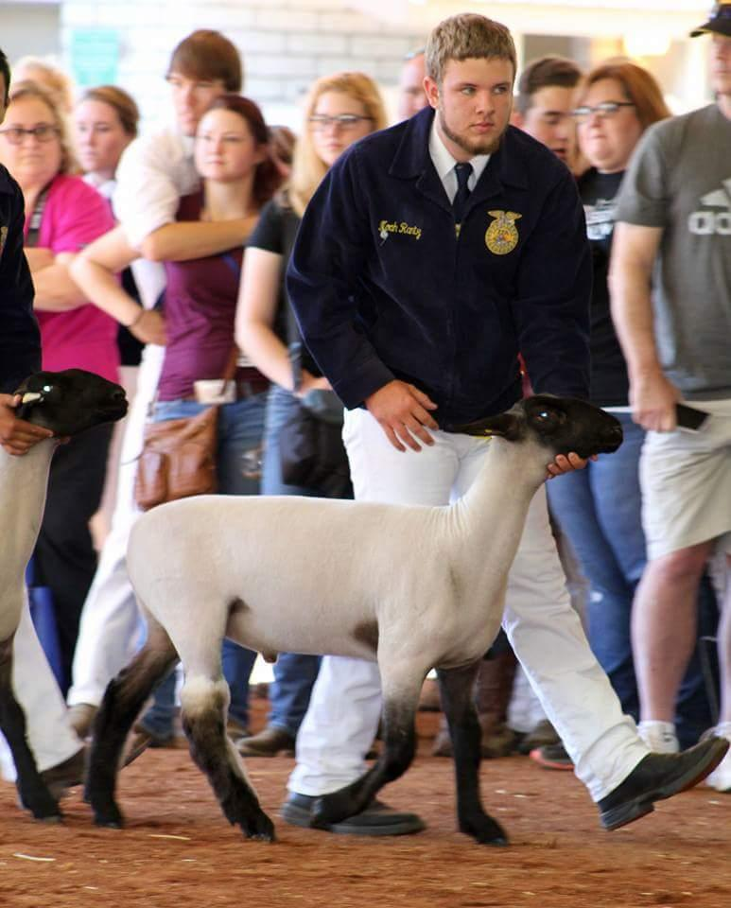
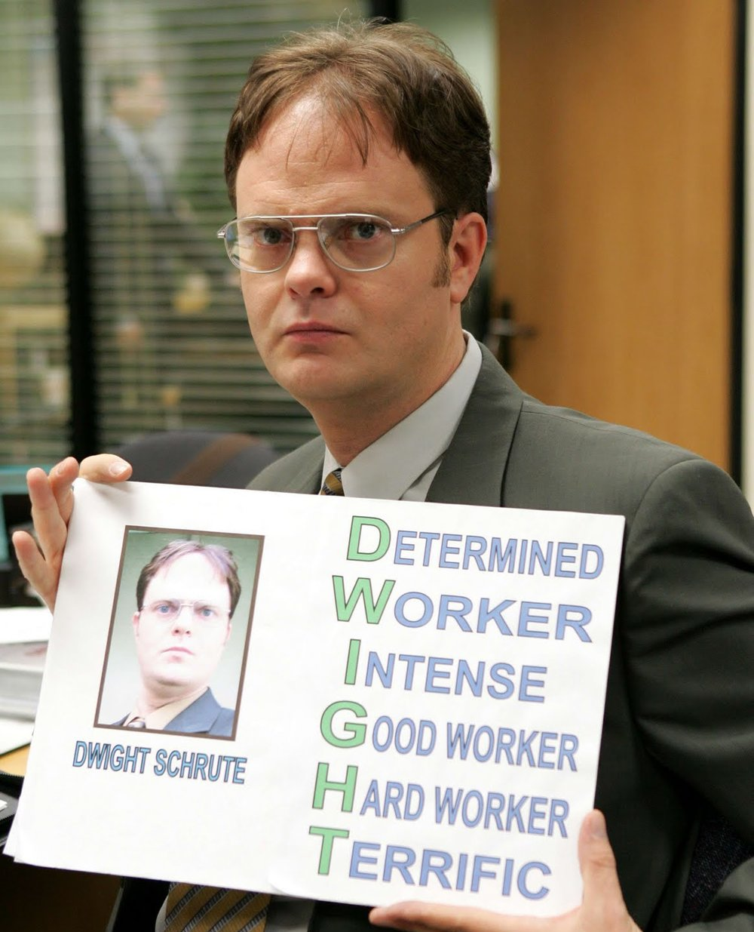
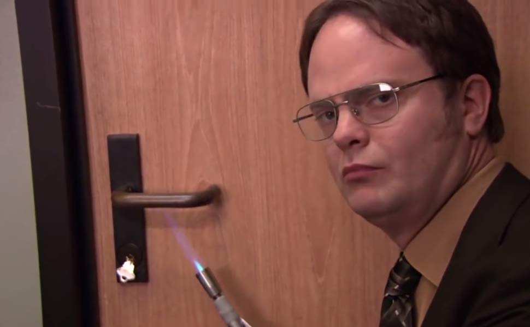
Noah Rantz
Alter Ego: Dwight Schrute
Second-year Agricultural Science Major
4-Year Ceres FFA member
Favorite Office Character: Kevin Malone

Slide 5
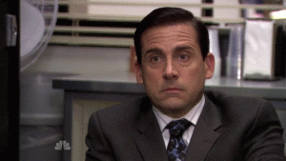
Workshop Expectations
“When we say Dunder, you say Mifflin!”
Before you share, state your name, FFA chapter and favorite Office character
Be respectful of others
Feel free to ask questions
Participate enthusiastically!
Meet people outside of your chapter

Slide 6
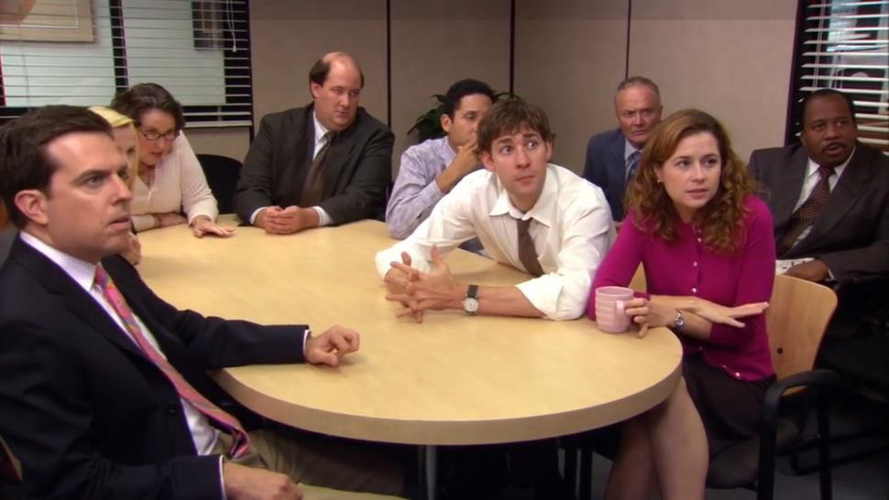
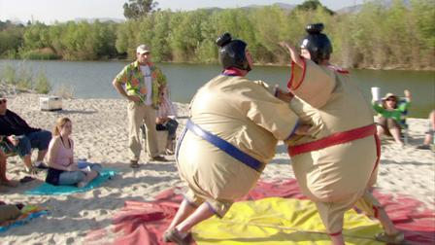
Workshop Objectives
We will learn about collaboration and efficient communication methods to use when we are working within a team.

Slide 7
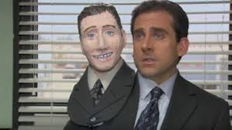
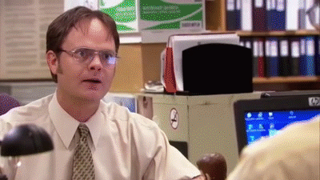
Similarities Game
Break up into teams based off of assigned character card
Find three things everyone in your group has in common (not obvious things)
After you have found three similarities, raise your character faces into the air
Be prepared, as we will have a few groups share out their findings.

Slide 8
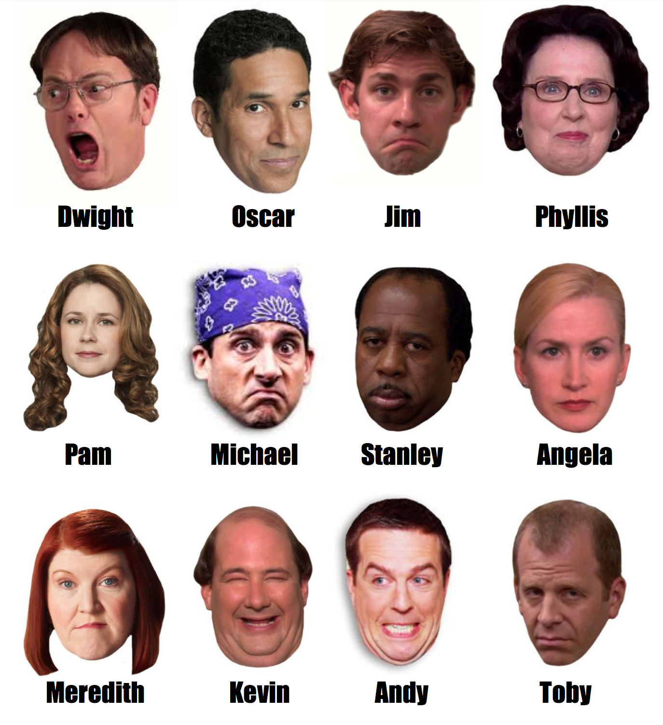
Break Into Character Teams
When we say “I Declare Bankruptcy”, meet your teammates around the room where your characters face is posted!

Slide 9
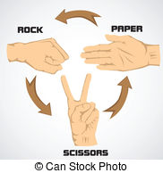
Human Rock, Paper, Scissors
Next, we will have a little competition between all of the groups.
Rock: Roll up in a ball
Paper: Stand up straight with arms out
Scissors: Curl arms above head and stand with legs shoulder-width apart
Teams will get 20 seconds to deliberate on which pose they want to perform and everyone on both teams will strike their pose when we say GO.
The winning team will be deemed Assistant (to the) Regional Manager!

Slide 10
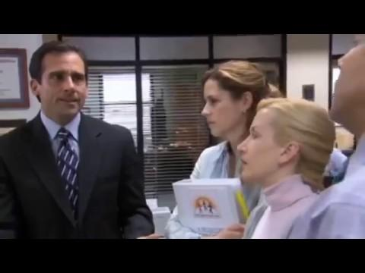

Slide 11
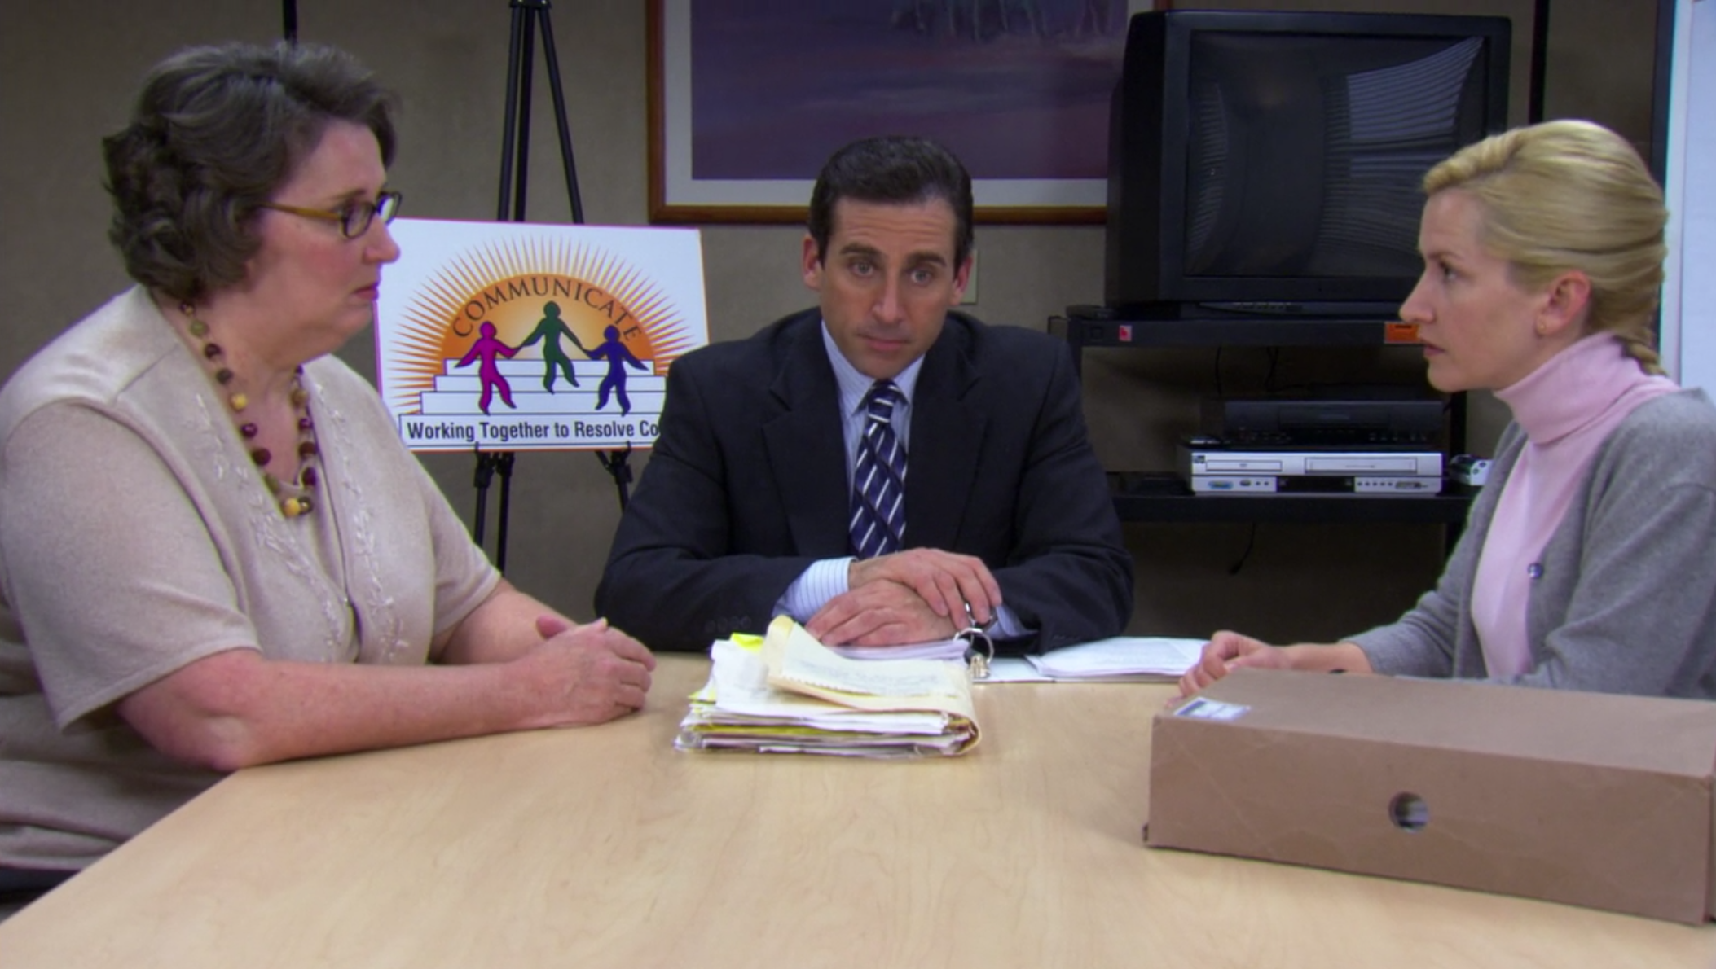
Compromise
Compromise is an invaluable skill in building better teams
We must be considerate of one another in order for compromise to work
Compromises are mutual
Compromise is essential in assuring that everyone is on the same page

Slide 12
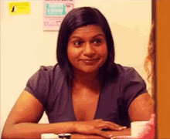
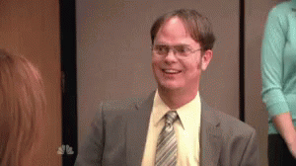
Body Language
7% of any message is conveyed through words, 38% through certain vocal elements, and 55% through nonverbal elements
Important aspects of nonverbal communication are:
Eye Contact
Posture
Engagement

Slide 14
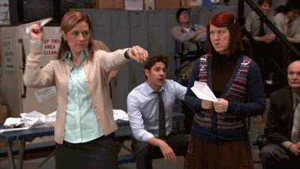
Paper Shapes Activity
Alright Dunder Mifflinites, today we get to work with what we love best, PAPER!
Make sure you have your own piece of paper and close your eyes.
Follow the series of instructions I give you about what to do with your paper.
I will be following the instructions simultaneously.
No cheating, don’t open your eyes until I say so and no talking!
Notes:
Fold sheet of paper in half
Tear off the upper left hand corner
Fold it in half once more and tear off the upper right hand corner of the sheet
Fold it in half again and tear off the lower left hand corner of the sheet of paper
Open your eyes and inspect what you came up with

Slide 15
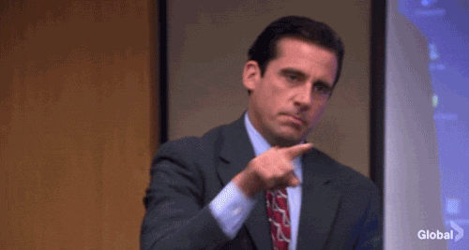
The Importance of Clear Instructions
Unclear initial instructions lead to confusion or disappointment
Delegation is a necessary practice, even among leaders
Repeating back what you heard can provide clarity
Be conscientious of what you have to say: Think before you speak!

Slide 16
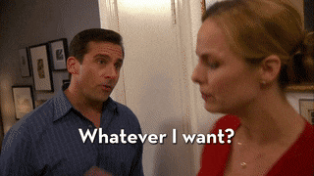
Two-Way Communication
Listen, communication is only effective if you are open-minded and actively listening
Allow for even input and be respectful of one another
Don’t interrupt others
If you’re confused, ask questions
Take different perspectives into account, everyone thinks differently

Slide 17
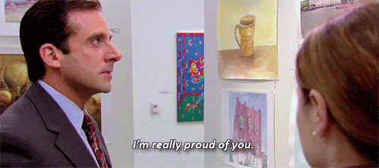
Blind Draw Activity
For this activity, you’ll be playing the part of Pam, or rather the artist within her.
Get back into your teams and appoint an artist
Have the artist turn away while we hand a random item to the rest of their team
The rest of the team will then describe that item to the artist without directly saying what it is
The artist will have 3 minutes to do their best to draw the described item
Only the artist is allowed to see the drawing until it is complete
Following the three minutes, we will reveal our masterpieces and vote on the best drawing.

Slide 18
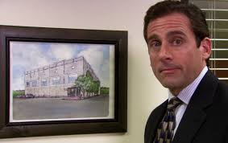
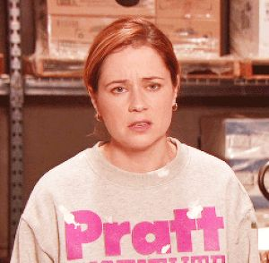
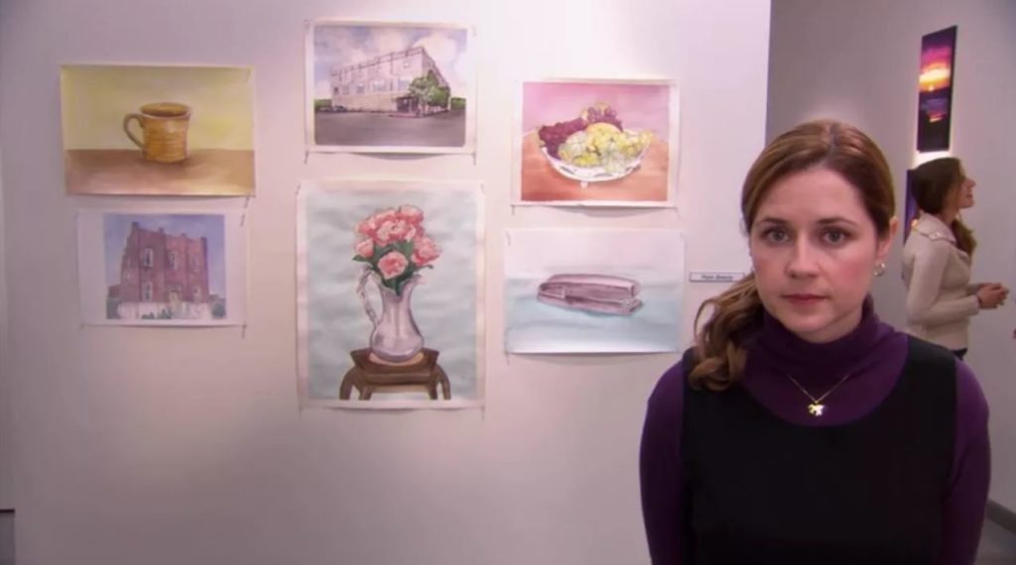
Congrats to all of Michael Scott’s Favorite Artists!

Slide 19
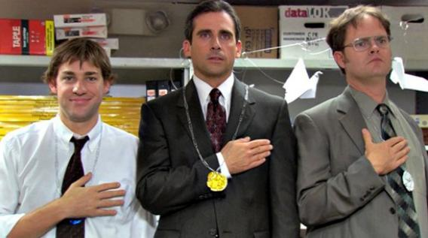
Teamwork
Pay attention to your peers, good ideas may go unheard
Remember, your input ALWAYS matters
Rally behind one another, group morale is important
The strongest teams are often the closest ones, and the closest teams keep everyone on the team up to speed
A good team member will always do their best to contribute their fair share, delegation helps teams do this

Slide 20
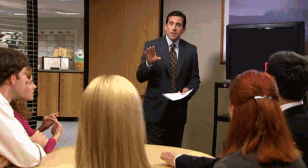
Even Collaboration
To have even collaboration is to ensure that the whole team has equal opportunity to offer input
Good leaders will always allow for even collaboration, so everyone is invested in the success of the team
Those who don’t offer input will inevitably become disinterested
Be involved within a team, what you have to say matters, don’t neglect your own opinions

Slide 21
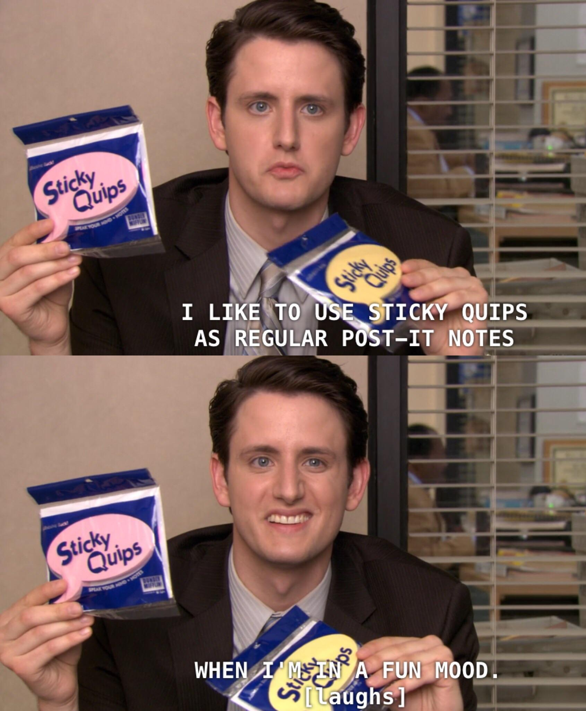
Gallery Discussion
Answer your designated question and paste it under the question when done.
Front of the room: “What do you believe is the most important aspect of communication?”
Middle of the room: “What can go wrong if you improperly utilize communication techniques within a team?”
Back of the room: “How can you apply the things that you learned in this workshop to your everyday life?”

Slide 22
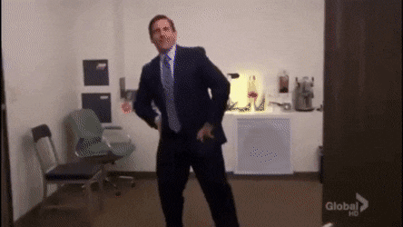
Kahoot Team Quiz
Pop Quiz! Get in your teams! Designate one person to take out their phone, go to kahoot.it and put in the access code we give you.
Notes:
https://create.kahoot.it/share/bears-beets-building-better-teams/c84864fb-41e5-43d2-95b0-7d1f36ff4f2c

